Slide 1
Basics of
Machine Learning
Dmitry Ryabokon, github.com/dryabokon

Slide 2


Lesson 22
PySpark

Slide 3
Installation

Slide 4
Install Pyspark @ Conda
> wget https://repo.anaconda.com/miniconda/Miniconda3-latest-Linux-x86_64.sh
> chmod 777 Miniconda3-latest-Linux-x86_64.sh
> sudo ./Miniconda3-latest-Linux-x86_64.sh
> sudo bash
conda create -n p37 python=3.7
conda activate p37
conda install -c conda-forge pyspark
(p37) root@instance-test-dr:/opt/spark/spark-3.2.0-bin-hadoop2.7/bin# ./pyspark

Slide 5
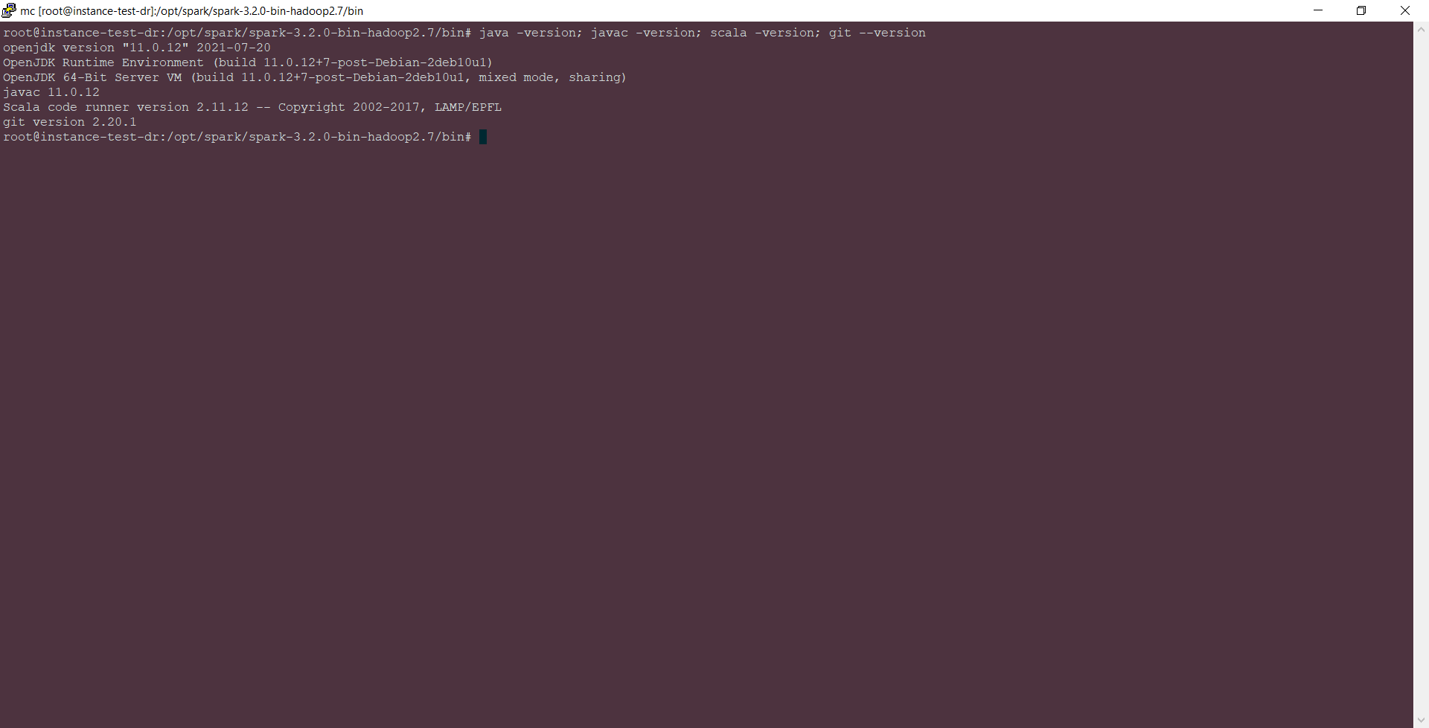
Install Pyspark @ Conda
Spark Ubuntu
https://phoenixnap.com/kb/install-spark-on-ubuntu

Slide 6
Spark Windows PC

Slide 7
Spark Windows PC

Slide 8
RDD vs Dataframe vs Dataset
https://data-flair.training/blogs/apache-spark-rdd-vs-dataframe-vs-dataset/
https://www.analyticsvidhya.com/blog/2020/11/what-is-the-difference-between-rdds-dataframes-and-datasets/

Slide 9
RDD vs Dataframe vs Dataset
RDD
 | RDDs | Dataframes | Datasets
Data Representation | Distributed collection of data elements without any schema. | Distributed collection organized into the named columns | It is an extension of Dataframes with more features like type-safety and object-oriented interface.
Optimization | No in-built optimization engine for RDDs. Developers need to write the optimized code themselves. | It uses a catalyst optimizer for optimization. | It also uses a catalyst optimizer for optimization purposes.
Projection of Schema | Here, we need to define the schema manually. | It will automatically find out the schema of the dataset. | It will also automatically find out the schema of the dataset by using the SQL Engine.
Aggregation Operation | RDD is slower than both Dataframes and Datasets to perform simple operations like grouping the data. | It provides an easy API to perform aggregation operations. It performs aggregation faster than both RDDs and Datasets. | Dataset is faster than RDDs but a bit slower than Dataframes.

Slide 10
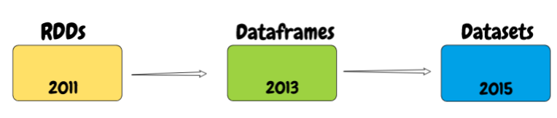
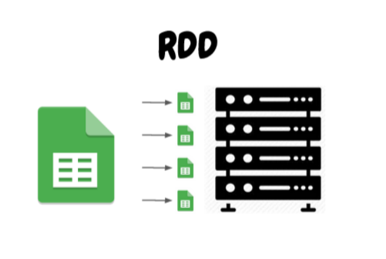
RDD vs Dataframe vs Dataset
RDD
RDDs or Resilient Distributed Datasets is the collection of objects which is capable of fault-tolerant storing the data partitioned across the multiple nodes of the cluster and also allows them to do processing in parallel.
There are 4 ways of creating an RDD:
Parallelizing an existing collection of data
Referencing to the external data file stored
From an existing RDD
from existing DataFrames and DataSets
RDDs usage:
Low-level transformations
Handling unstructured data (media / text streams )

Slide 11
RDD vs Dataframe vs Dataset
RDD: split
>>> RDD_text = sc.textFile(name="file:///C://Users//Anna//source//digits//ML//data//ex_datasets//dataset_wine.csv")
>>> RDD_text.take(3)
['target\talcohol\tmalic_acid\tash\talcalinity_of_ash\tmagnesium\ttotal_phenols\tflavanoids\tnonflavanoid_phenols\tproanthocyanins\tcolor_intensity\thue\tod280/od315_of_diluted_wines\tproline', '0.0\t14.23\t1.71\t2.43\t15.6\t127.0\t2.8\t3.06\t0.28\t2.29\t5.64\t1.04\t3.92\t1065.0', '0.0\t13.2\t1.78\t2.14\t11.2\t100.0\t2.65\t2.76\t0.26\t1.28\t4.38\t1.05\t3.4\t1050.0’]
>>> RDD_text_split = RDD_text.map(lambda line: line.split('\t'))
>>> RDD_text_split.take(3)
[['target', 'alcohol', 'malic_acid', 'ash', 'alcalinity_of_ash', 'magnesium', 'total_phenols', 'flavanoids', 'nonflavanoid_phenols', 'proanthocyanins', 'color_intensity', 'hue', 'od280/od315_of_diluted_wines', 'proline'], ['0.0', '14.23', '1.71', '2.43', '15.6', '127.0', '2.8', '3.06', '0.28', '2.29', '5.64', '1.04', '3.92', '1065.0'], ['0.0', '13.2', '1.78', '2.14', '11.2', '100.0', '2.65', '2.76', '0.26', '1.28', '4.38', '1.05', '3.4', '1050.0']]

Slide 12
RDD vs Dataframe vs Dataset
Dataframes
DF is an immutable distributed collection of data.
Unlike an RDD, data is organized into named columns, similar to a table in a relational database or Python Pandas DataFrames
Usage:
- Rich semantics, high-level abstractions, and domain specific APIs
- High-level expressions, filters, maps, aggregation, averages, sum, SQL queries, columnar access and use of lambda functions on semi-structured data

Slide 13
RDD vs Dataframe vs Dataset
Dataframes
>>> DF_titanic = sqlContext.read.csv("file:///C://Users//Anna//source//digits//ML//data//ex_datasets//dataset_titanic.csv", header=True, sep='\t')
>>> DF_titanic.printSchema()
root
|-- survived: string (nullable = true)
|-- pclass: string (nullable = true)
|-- sex: string (nullable = true)
|-- age: string (nullable = true)
|-- sibsp: string (nullable = true)
|-- parch: string (nullable = true)
|-- fare: string (nullable = true)
|-- embarked: string (nullable = true)
|-- class: string (nullable = true)
|-- who: string (nullable = true)
|-- adult_male: string (nullable = true)
|-- deck: string (nullable = true)
|-- embark_town: string (nullable = true)
|-- alive: string (nullable = true)
|-- alone: string (nullable = true)
>>> DF_titanic.take(3)
[Row(survived='0', pclass='3', sex='male', age='22.0', sibsp='1', parch='0', fare='7.25', embarked='S', class='Third', who='man', adult_male='True', deck=None, embark_town='Southampton', alive='no', alone='False'), Row(survived='1', pclass='1', sex='female', age='38.0', sibsp='1', parch='0', fare='71.2833', embarked='C', class='First', who='woman', adult_male='False', deck='C', embark_town='Cherbourg', alive='yes', alone='False'), Row(survived='1', pclass='3', sex='female', age='26.0', sibsp='0', parch='0', fare='7.925', embarked='S', class='Third', who='woman', adult_male='False', deck=None, embark_town='Southampton', alive='yes', alone='True')]

Slide 14
RDD vs Dataframe vs Dataset
Dataframes
>>> DF_titanic = sqlContext.read.csv("file:///C://Users//Anna//source//digits//ML//data//ex_datasets//dataset_titanic.csv", header=True, sep='\t’)
>>> DF_titanic.show()
+--------+------+------+----+-----+-----+-------+--------+------+-----+----------+----+-----------+-----+-----+
|survived|pclass| sex| age|sibsp|parch| fare|embarked| class| who|adult_male|deck|embark_town|alive|alone|
+--------+------+------+----+-----+-----+-------+--------+------+-----+----------+----+-----------+-----+-----+
| 0| 3| male|22.0| 1| 0| 7.25| S| Third| man| True|null|Southampton| no|False|
| 1| 1|female|38.0| 1| 0|71.2833| C| First|woman| False| C| Cherbourg| yes|False|
| 1| 3|female|26.0| 0| 0| 7.925| S| Third|woman| False|null|Southampton| yes| True|
| 1| 1|female|35.0| 1| 0| 53.1| S| First|woman| False| C|Southampton| yes|False|
| 0| 3| male|35.0| 0| 0| 8.05| S| Third| man| True|null|Southampton| no| True|
| 0| 3| male|null| 0| 0| 8.4583| Q| Third| man| True|null| Queenstown| no| True|
| 0| 1| male|54.0| 0| 0|51.8625| S| First| man| True| E|Southampton| no| True|
| 0| 3| male| 2.0| 3| 1| 21.075| S| Third|child| False|null|Southampton| no|False|
| 1| 3|female|27.0| 0| 2|11.1333| S| Third|woman| False|null|Southampton| yes|False|
| 1| 2|female|14.0| 1| 0|30.0708| C|Second|child| False|null| Cherbourg| yes|False|
| 1| 3|female| 4.0| 1| 1| 16.7| S| Third|child| False| G|Southampton| yes|False|
| 1| 1|female|58.0| 0| 0| 26.55| S| First|woman| False| C|Southampton| yes| True|
| 0| 3| male|20.0| 0| 0| 8.05| S| Third| man| True|null|Southampton| no| True|
| 0| 3| male|39.0| 1| 5| 31.275| S| Third| man| True|null|Southampton| no|False|
| 0| 3|female|14.0| 0| 0| 7.8542| S| Third|child| False|null|Southampton| no| True|
| 1| 2|female|55.0| 0| 0| 16.0| S|Second|woman| False|null|Southampton| yes| True|
| 0| 3| male| 2.0| 4| 1| 29.125| Q| Third|child| False|null| Queenstown| no|False|
| 1| 2| male|null| 0| 0| 13.0| S|Second| man| True|null|Southampton| yes| True|
| 0| 3|female|31.0| 1| 0| 18.0| S| Third|woman| False|null|Southampton| no|False|
| 1| 3|female|null| 0| 0| 7.225| C| Third|woman| False|null| Cherbourg| yes| True|
+--------+------+------+----+-----+-----+-------+--------+------+-----+----------+----+-----------+-----+-----+

Slide 15
RDD vs Dataframe vs Dataset
Datasets
In Spark 2.0, Dataset and DataFrame merge into one unit to reduce the complexity while learning Spark.
DataFrame – is an alias for a collection of generic objects Dataset[Row], where a Row is a generic untyped JVM object.
Dataset, by contrast, is a collection of strongly-typed JVM objects, dictated by a case class you define in Scala or a class in Java

