Slide 1

Basics of
Machine Learning
Assignments
Dmitry Ryabokon, github.com/dryabokon

Slide 2
Scoring
A
90%
B
85%
C
75%
D
65%
E
60%
FX
<60%

Slide 3
Scoring
Assignment 1
Classic
Machine Learning
Assignment 2
Computer Vision and
Deep Learning
Tech Talk
Extra
50%
50%
+30%

Slide 4
Classic Machine Learning
Supervised Learning
Naive Bayesian Classifier
Gaussian Classification Model
Linear Discriminant Functions
Decision strategies
Benchmarking of Supervised Learning Algorithms
Unsupervised Learning

Slide 5
Supervised learning
Description
Assessment criteria
Get train/test data sample from open sources or generate it by yourself. Focus on low-dimension data, preferably 2 dimensions, 2 classes
Visualize the distribution of sample data
Estimate accuracy of data classification for 3-4 classifiers studied over lecture course
Build ROC curves and hit maps
In-house classifier: 40%
Out-of-box classifier: 20%
Data visualization charts: 20%
ROC curve charts: 20%
* Extra: multi class championship 30%

Slide 6
Naive Bayesian Classifier
Description
Assessment criteria
Get train/test data sample from open sources, e.g. GBP/USD index. Use daily change (↑, ↓) as a target.
Visualize the distribution of sample data
Estimate accuracy of data classification
Build ROC curves and calculate AUC
In-house classifier: 40%
Out-of-box classifier: 20%
Data visualization charts: 20%
ROC curve charts: 20%
* Extra: multi class championship 30%

Slide 7
Gaussian Classification Model
Description
Assessment criteria
Get train/test data sample from open sources, e.g. GBP/USD index. Use daily change (↑, ↓) as a target.
Visualize the distribution of sample data
Estimate accuracy of data classification
Build ROC curves and calculate AUC
In-house classifier: 40%
Out-of-box classifier: 20%
Data visualization charts: 20%
ROC curve charts: 20%
* Extra: multi class championship 30%

Slide 8
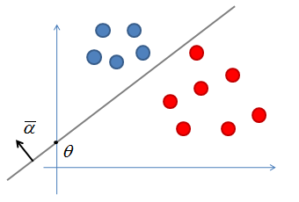
Linear Discrimination with SVM
Description
Assessment criteria
Get train/test data sample from open sources, e.g. GBP/USD index. Use daily change (↑, ↓) as a target.
Visualize the distribution of sample data
Estimate accuracy of data classification
Build ROC curves and calculate AUC
In-house classifier: 40%
Out-of-box classifier: 20%
Data visualization charts: 20%
ROC curve charts: 20%
* Extra: multi class championship 30%

Slide 9
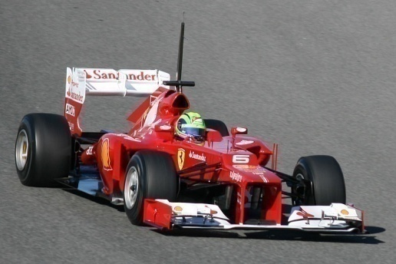
Decision strategies
Description
Assessment criteria
Get bet data from open sources
Visualize the distribution of sample data
Estimate accuracy of random, deterministic (host, visitor, challenger) and Bayesian strategies
Build ROC curves and calculate AUC
Engineer the predictive features and estimate their predictive power
Deterministic strategy: 20%
Random Strategy: 20%
Bayesian Strategy: 40%
ROC curve charts: 20%
* Show predictive features: 30%

Slide 10
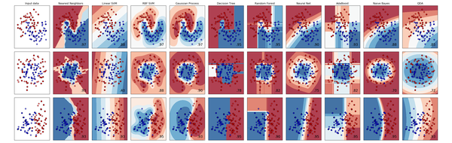
Benchmarking the Supervised Learning Algorithms
Description
Assessment criteria
Get data from open sources
Visualize the distribution of sample data
Estimate accuracy of different classifiers
Build ROC curves and calculate AUC
Engineer the predictive features and estimate their predictive power
Linear discriminant: 20%
Gaussian model: 20%
Other models: 20%
Data visualization charts: 20%
ROC curve charts: 20%
* Extra: multi class championship 30%

Slide 11
Unsupervised learning
Description
Assessment criteria
Get train/test data sample from open sources or generate it by yourself. Focus on low-dimension data, preferably 2 dimensions, 3-5 classes
Visualize the distribution of sample data
Visualize iteration of EM/K-Means algorithms
Estimate the accuracy of classification
In-house unsupervised classifier: 40%
Out-of-box classifier: 20%
Data visualization charts: 20%
Visualize the learning iterations: 20%
* Benchmark results with some clustering algorithms 30%

Slide 12
Deep Learning
Object Detection and tracking
Semantic Segmentation
Stereo Vision
OCR
Use CLIP model for semantic search of images
Benchmark GPT-3 vs ChatGPT vs BLOOM

Slide 13
Object detection
Description
Assessment criteria
Get train/test data sample from open sources or generate it yourself. Try on human faces, human shapes, cars, etc. Any type of object that you can capture with your laptop camera is preferable.
Train the detector and estimate the accuracy against the test set
Run detector in live mode, detect objects in video stream captured by a laptop camera
Build own detector: 40%
Use pre-trained detector: 20%
Precision-recall chart: 20%
Detecting objects in live mode: 20%
* Benchmark results with some alternative detectors 30%

Slide 14
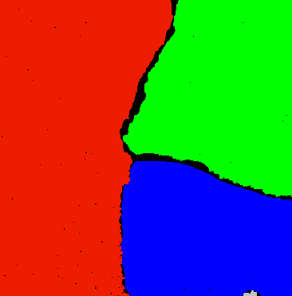
Semantic Segmentation
Description
Assessment criteria
Get train/test data sample from open sources or generate it yourself. Try on human faces, human shapes, cars, etc. Any type of object that you can capture with your laptop camera is preferable.
Train the detector and estimate the accuracy against the test set
Run detector in live mode, detect objects in video stream captured by a laptop camera
Build own detector: 40%
Use pre-trained detector: 20%
ROC chart for 2 classes problem: 20%
Processing images in live mode: 20%
* Benchmark results with some alternative detectors 30%

Slide 15
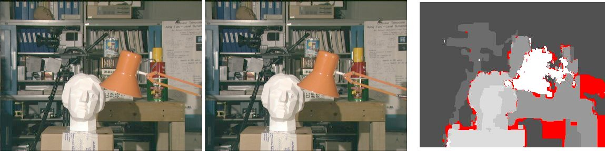
Stereo Vision
Assessment criteria
Assessment criteria
BM approach: 25%
SGBM: 25%
SIFT approach: 25%
Template Matching approach: 25%

Slide 16
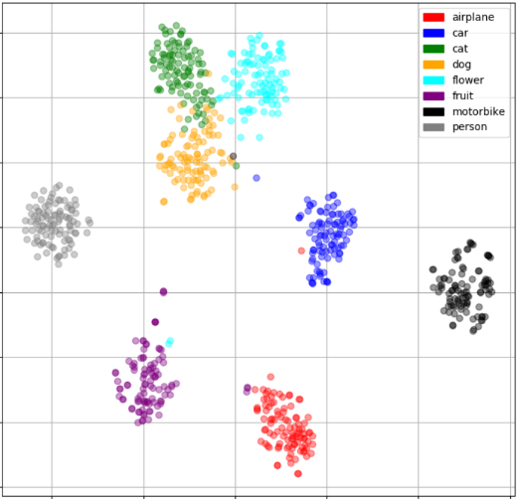
Transfer learning
Description
Assessment criteria
Benchmark accuracy of multiple classifiers (SVM, RF, LM, etc) applied on top of several feature extractors (AlexNet, VGG, ImageNet etc)
Research how accuracy very depending on the depth of the frozen layers, visualize this dependency
Build/visualize confusion matrices
Illustrate most typical classification errors
Build confusion matrices: 60%
Build the accuracy trend: 20%
Illustrate typical errors: 20%

Slide 17
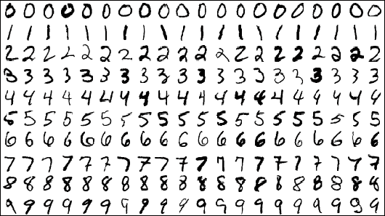
OCR
Assessment criteria
Build confusion matrices: 60%
Build the accuracy trend: 20%
Illustrate typical errors: 20%

