Slide 1
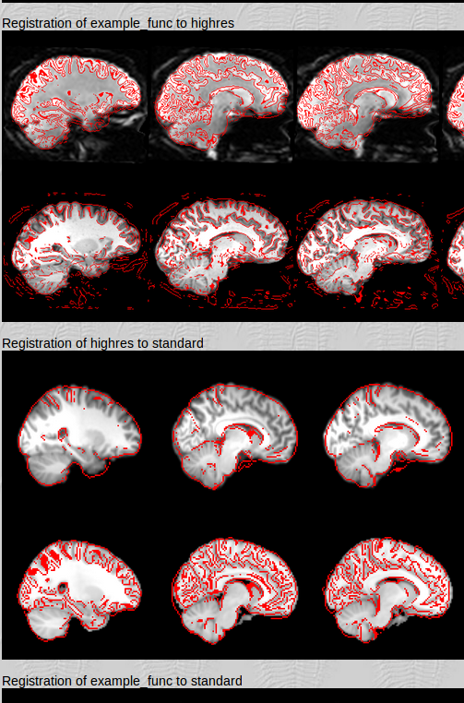
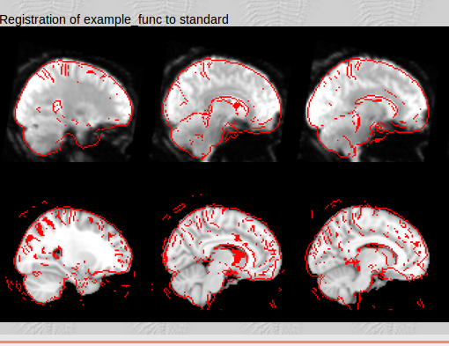
影像對位流程

Slide 2
Question 2: What differences can you see between the linear and linear+non-linear registrations of the structural to standard brain? Name some anatomical structures that are better aligned with the non-linear registration. Why is the non-linear registration much more accurate than the linear?

Slide 3
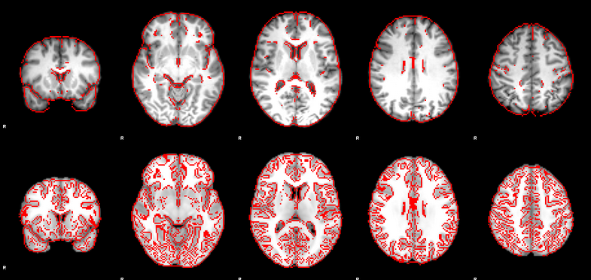
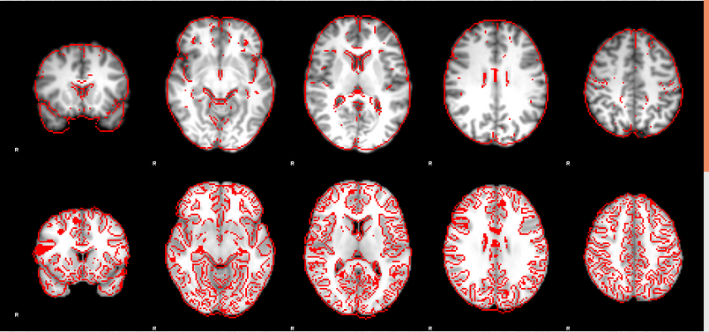
Linear unwarping
Nonlinear unwarping

Slide 4
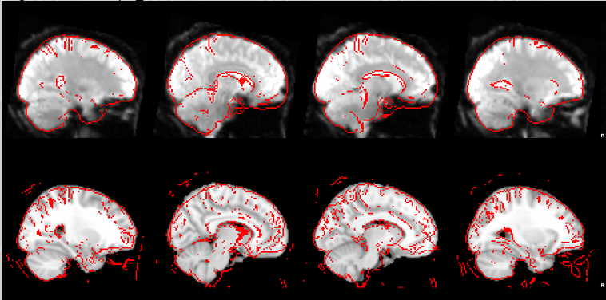
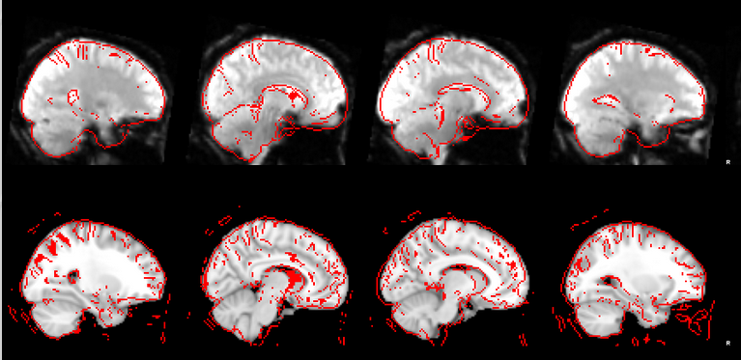
Nonlinear no unwarping
Linear no unwarping

Slide 5
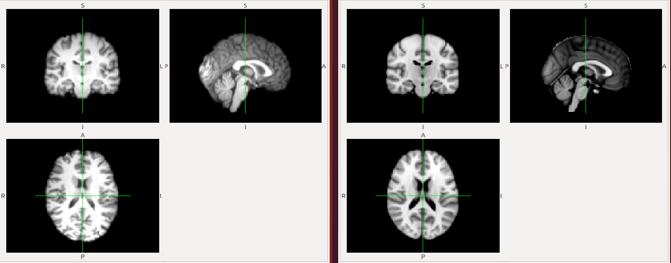
FLIRT
FNIRT

Slide 6
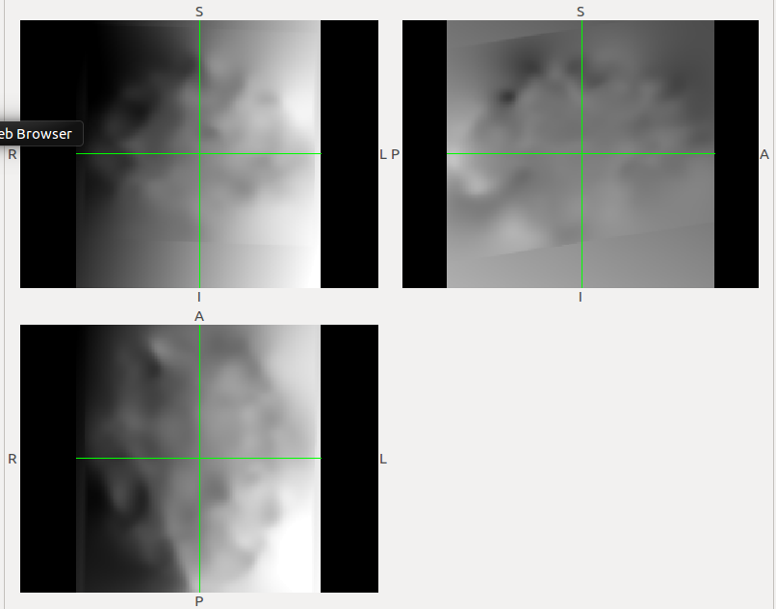
空間反轉換

Slide 7
MASK製作

Slide 8
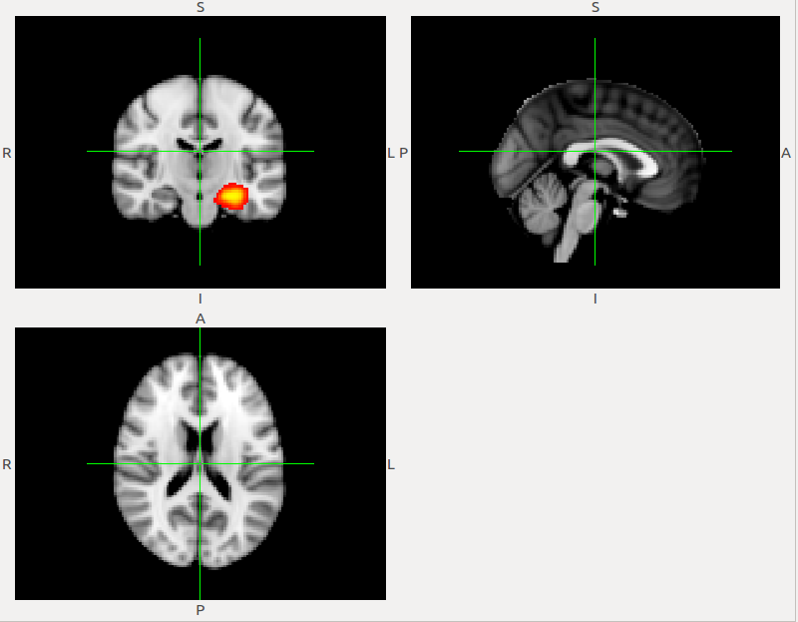
Tools > Toolbars > Atlas Tools
(left hippocampus from the Harvard-Oxford subcortical atlas)

Slide 9
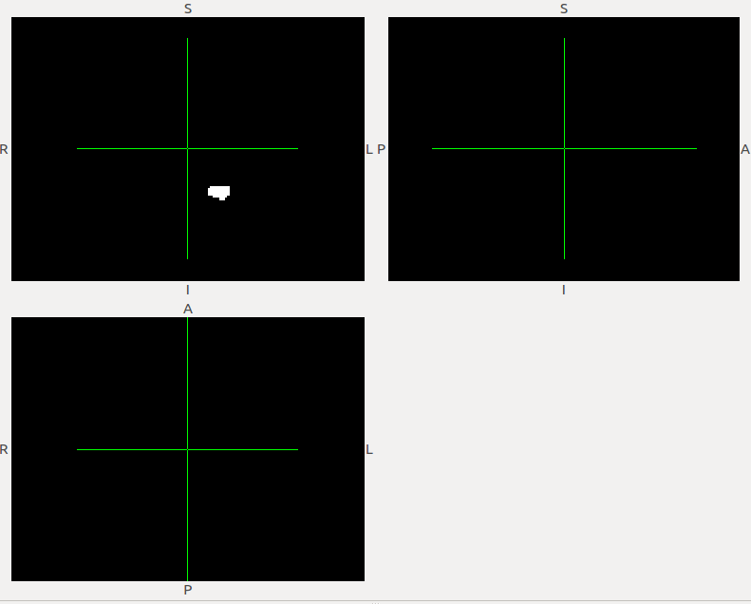
expressed as percentage values (0 to 100)
海馬迴 選0.5mask

Slide 10
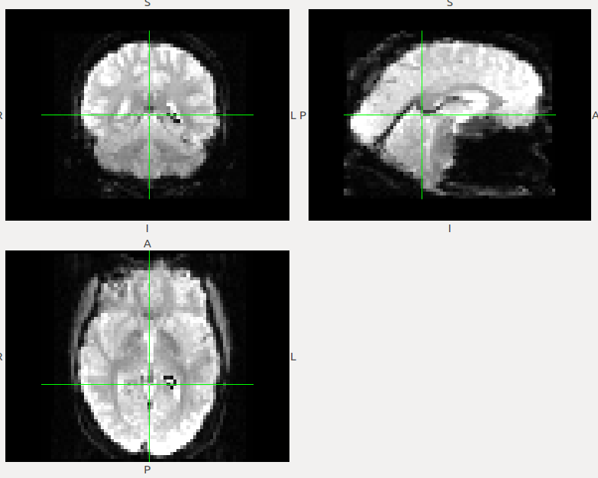
海馬迴遮罩與epi腦影像

Slide 11
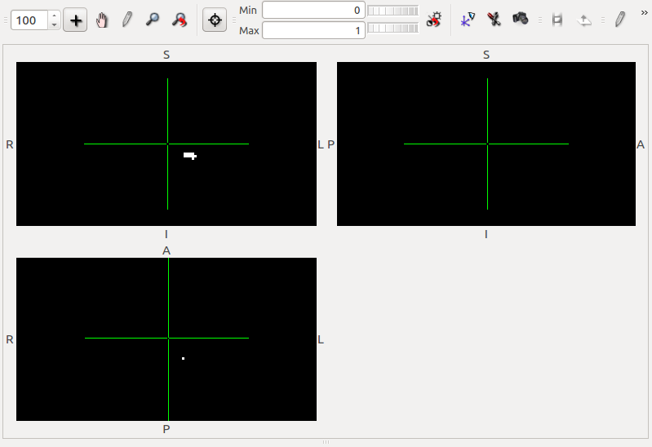
0.9 mask

Slide 12
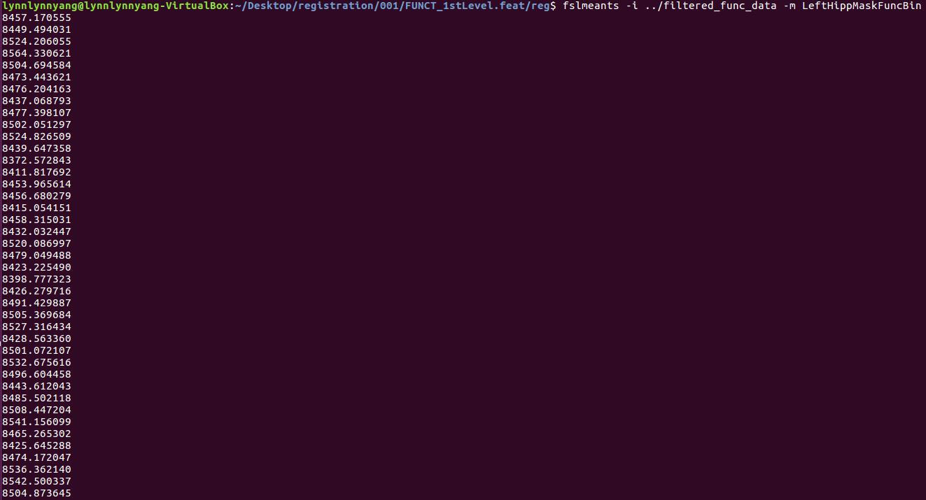
Msak 出的區域的值

