Slide 1

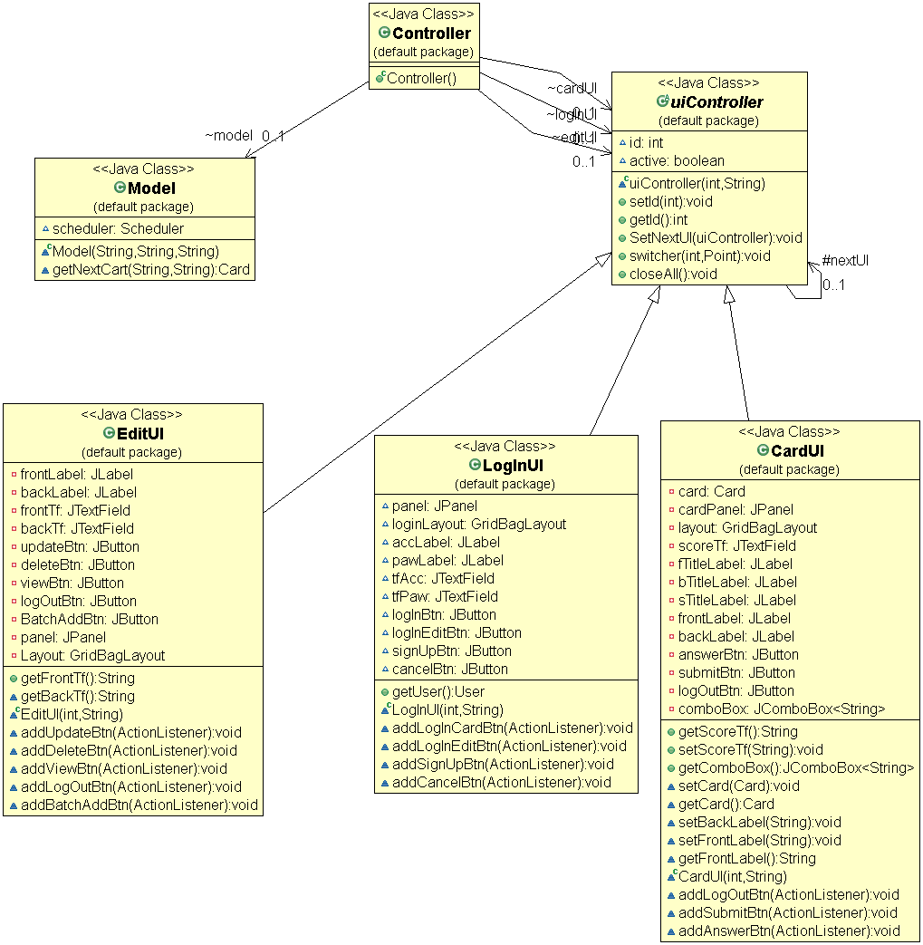
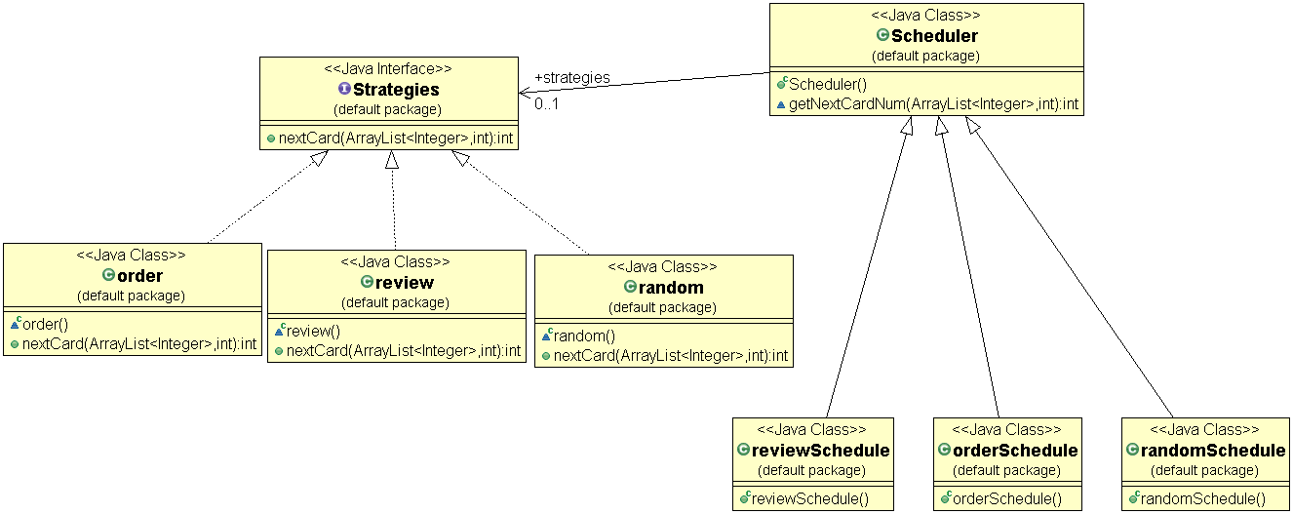
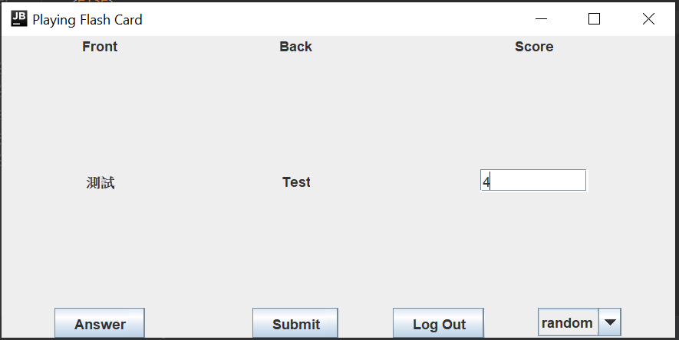
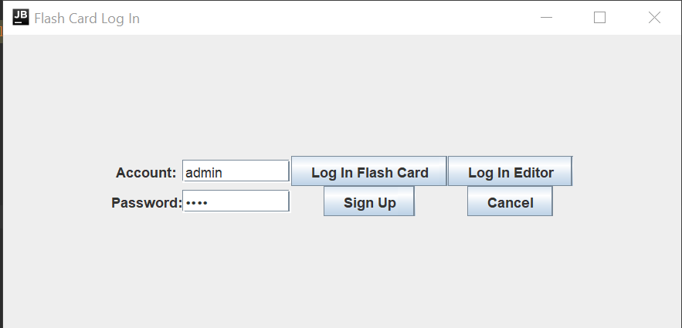
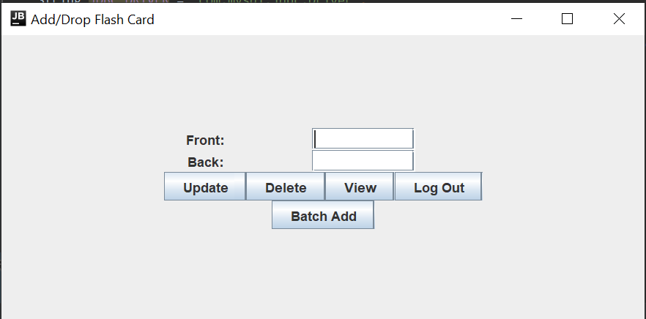
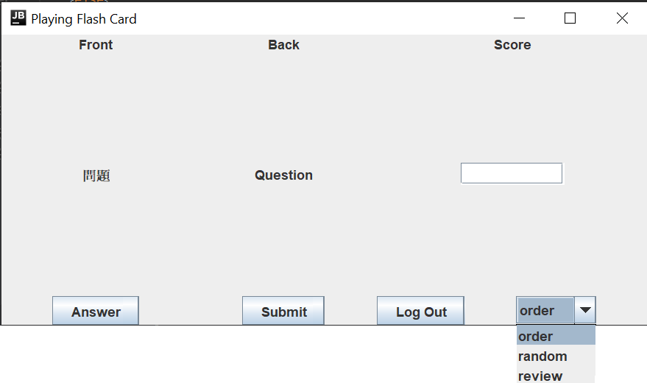
Flashcard 3000
Hua Chuang, Yicun Liu, Ryan Harmon
CS6359.002 Team2
Introduction
Methods (Design Pattern)
One of the most effective ways of remembering information is through the combination of flashcards and a spaced repetition reviewing system. While it is possible to create and review flashcards by hand, they are time-consuming to make, prone to get lost, easy to mix up, and very difficult to systematically review in an efficient manner. In this project, we make a simple Java app that can be used to create, review and manage generic flash cards.
MVC for System
We use MVC pattern decouples these major components allowing for code reuse and parallel development.
Reuse: DBM(database), strategies.
Parallel development: UI design (Log In UI, Card Editor UI and Playing Card UI) and model design (DBM, Strategies)
Strategies for choosing learning mode
Strategies pattern selects one strategy from the pool for use during runtime. This pattern allows the user to change the learning mode arbitrarily.
Chain of Responsibility for control UI
This system use chain of responsibility to switch the UI display.
The pattern can also guarantee the all UI object will be destroyed when the user exits the system.
Strategies
MVC and Chain of Responsibility
Playing the Flash Card!
Features
Why flashcard 3000?
Flashcards are a very effective way to memorize vocabulary words, dates, formulae, or any variety of other facts. In its most basic physical form, a flashcard is simply a small piece of paper with a question written on one side and an answer to be memorized on the other. This system is unwieldy when the number grows large. For this, a computer application can very effectively organize and manage a set of cards, allowing a user to spend more time learning and less time on hassle.
In flashcard system, new flashcards should be shown more frequently to a learner, while older cards should gradually be show less often, until just the point that the learner is about to forget them. This method is much more efficient as less reviews are needed than a monotonic system and has been shown to even increase the rate of learning.[1]
Computer applications make spaced repetition algorithms much easier to manage and totally transparent to a user, who may simply open a flashcard application, review today’s cards and move on.
As flashcards are used in many applications, from students cramming for exams to people who want to learn another language, so it is extremely beneficial to implement a simple computer program which will handle the backend fuss of flashcard management and scheduling, while providing a flexible interface for flashcard creation and review.
Interesting features:
Three Strategies have different learning ways.
Order: learn words from easy to hard.
Random: learn words randomly(more challenge).
Review: review the unfamiliar words.
Useful features:
Everyone has own card set.
Easily to add/drop/delete/update the card.
Batch-add is support in our system.
First Log in UI
Add/Drop UI
Playing UI
Conclusion
References
From this project, we learned most phases of software developing. From having an idea and making a plan, to finishing coding and testing the flashcard application. It’s a precious experience in software design. And the most interesting part must be that we know some vocabulary of Chinese, English, and Spanish when creating the database.
Additionally, we learn lots of Design Patterns. Before this project, we all suffer from how to construct the program. Sometimes, the program is not scalable when it down, so we need to redesign the program. After this project, we learn how to analyst the program and how to choose the pattern. Instead of jumping into the code, we analyst and design first, then build the robust program.
Smolen, Paul; Zhang, Yili; Byrne, John H. (January 25, 2016). "The right time to learn: mechanisms and optimization of spaced learning". Nature Reviews Neuroscience. 17 (2): 77–88. arXiv:1606.08370. Bibcode:2016arXiv160608370S. doi:10.1038/nrn.2015.18. PMC 5126970. PMID 26806627.
https://www.supermemo.com/en/archives1990-2015/english/ol/sm2
Contact
For contact: https://github.com/UTDClassroom/CS6359002-Course_Project-team2
Yicun Liu, yxl170028@utdallas.edu
Hua Chuang, hxc170014@utdallas.edu
Ryan Harmon, rxh107020@utdallas.edu

