Slide 1
JDBC

Slide 2
A JDBC (Java Database Connectivity) program comprises the following steps:
Allocate a Connection object, for connecting to the database.
Allocate a Statement object, under the Connection object created.
Write a SQL query and execute the query, via the Statement and Connection created.
Process the query result.
Close the Statement and Connection object to free up the resources.

Slide 3
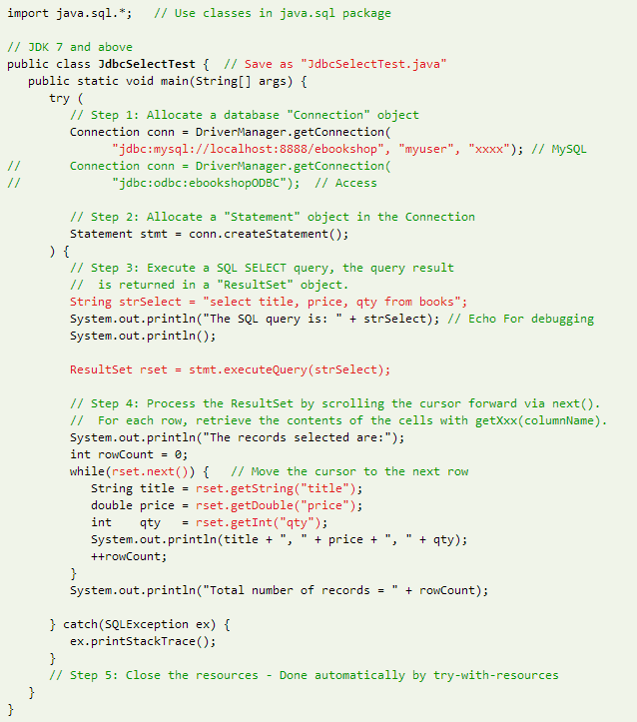

Slide 4
The JDBC operations are carried out through the "Connection", "Statement" and "ResultSet" objects (defined in package java.sql). However, you need not know the details, but merely the public methods defined in the API (Application Program Interface). You also need not re-invent the wheels by creating these classes yourself (which will take you many years?!). "Re-using" software component is a main strength of OOP.
Notice that there is little programming involved in using JDBC programming. You only have to specify the database-URL, write the SQL query, and process the query result. The rest of the codes are kind of "standard JDBC program template". Again, this is because the wheels have been invented.
In Line 7, we allocate a Connection object (called conn) via static method DriverManager.getConnection(database-url, db-user, password). The Java program uses a so-called database-URL to connect to the server:
For MySQL:
// Syntax
Connection conn = DriverManager.getConnection("jdbc:mysql://localhost:{port}/{db-name}", "{db-user}", "{password}");
// Example
Connection conn = DriverManager.getConnection("jdbc:mysql://localhost:8888/ebooksop", "myuser", "xxxx");
The database-url is in the form of "jdbc:mysql://{host}:{port}/{database-name}", with protocol jdbc and sub-protocol mysql. The port specifies the MySQL server's TCP port number; db-user/password is an authorized MySQL user. In our example, "localhost" (with special IP address of 127.0.0.1) is the hostname for local loop-back; "8888" is the server's TCP port number, and ebookshop is the database name.
we allocate a Statement object (called stmt) within the Connection via conn.createStatement().
To execute a SQL SELECT, we invoke method stmt.executeQuery("SELECT ..."). It returns the query result in a ResultSet object (called rset). ResultSet models the returned table, which can be access via a row cursor. The cursor initially positions before the first row in the ResultSet. rset.next() moves the cursor to the first row. You can then use rset.getXxx(columnName) to retrieve the value of a column for that row, where Xxx corresponds to the type of the column, such as int, float, double and String. The rset.next() returns false at the last row, which terminates the while-loop.
You may use rset.getString(columnName) to retrieve all types (int, double, etc).
For maximum portability, ResultSet columns within each row should be read in left-to-right order, and each column should be read only once via the getXxx() methods. Issue getXxx() to a cell more than once may trigger a strange error.
In this example, we use JDK 7's new feature called try-with-resources, which automatically closes all the opened resources in the try-clause, in our case, the Connection and Statement.

Slide 5
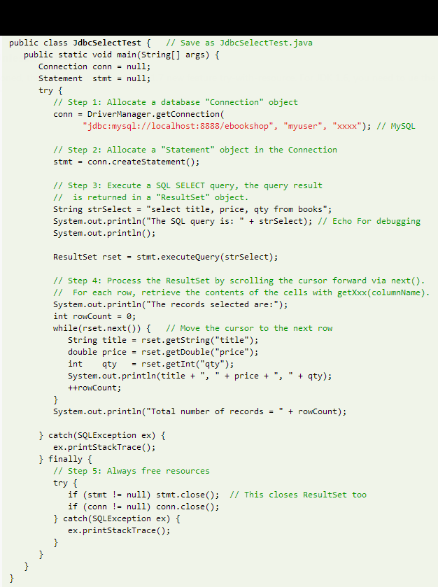

Slide 6
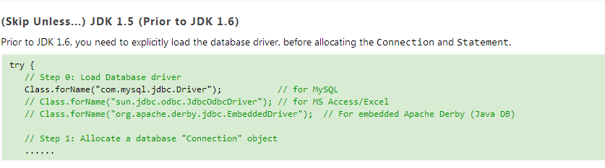

Slide 7
SQL UPDATE
To execute a SQL UPDATE, you have to invoke the method executeUpdate() of the Statement object, which returns an int indicating the number of records affected. Recall that for SELECT, we use executeQuery(), which returns a ResultSet object modeling the returned table.UPDATE|INSERT|DELETE does not return a table, but an int indicating the number of records affected.

Slide 8
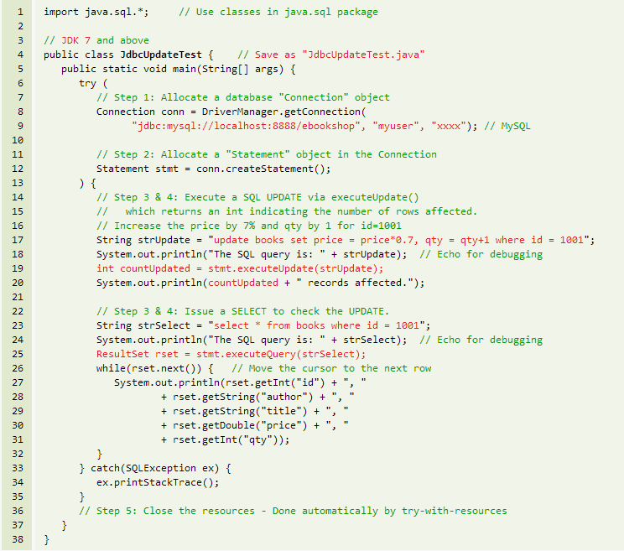
Sql update code

Slide 9
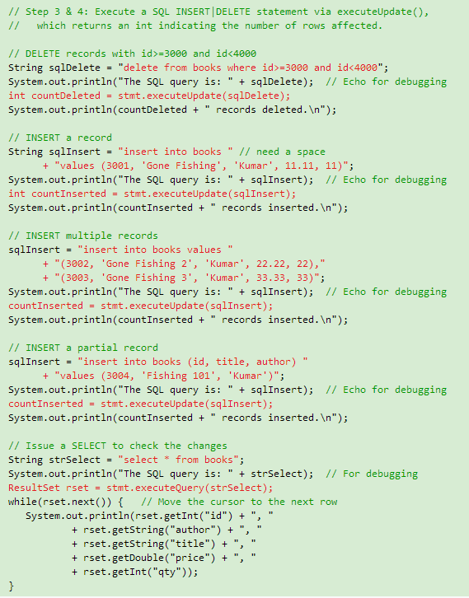
SQL INSERT and DELETE

Slide 10
Atomic Transaction (Commit and Rollback)
An atomic transaction is a group of SQL statements, which either all succeed or none succeeds. This is to prevent partial update to the database. To manage transaction in JDBC, we first disable the default auto-commit (which commits every SQL statement), issue a few SQL statements, and then decide whether to issue a commit() to commit all the changes or rollback() to discard all the changes since the last commit. For example:
Notes:
Transaction: a unit of work, can be several lines of sql query. One thing is that, any part or any step of the work fail, the whole transaction will fail.
ACID transaction

Slide 11
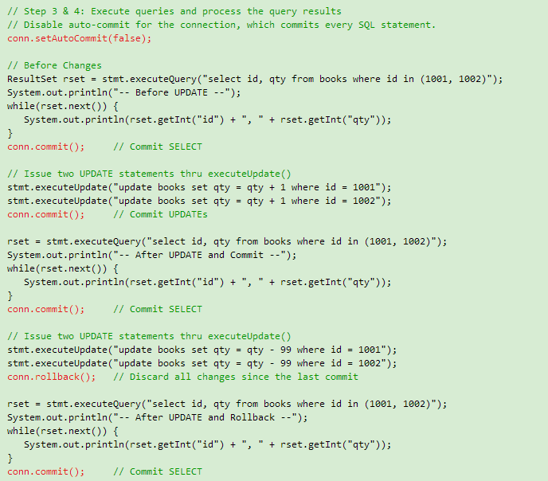
Notes:
为了保证数据库里面信息同步

Slide 12
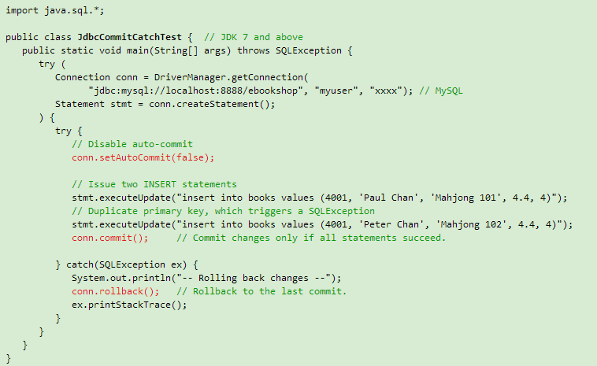
Rolling Back in Catch-Clause
Notes:
Two phase commit

Slide 13
ResultSetMetaData
Each ResultSet object is associated with a header (called meta-data), which contains information about the ResultSet object, such as the number of columns, the name and type of the columns etc. The meta-data is stored in a ResultSetMetaData object. You can use methodrset.getMetaData() to retrieve the associated meta-data object of a ResultSet rset.
ResultSetMetaData is useful in dynamically processing the ResultSet. You could retrieve the number of columns and use rset.getXxx(columnNumber) to retrieve the content of a particular column number in the current row. Note that column number begins at 1 (not 0). For example,

Slide 14
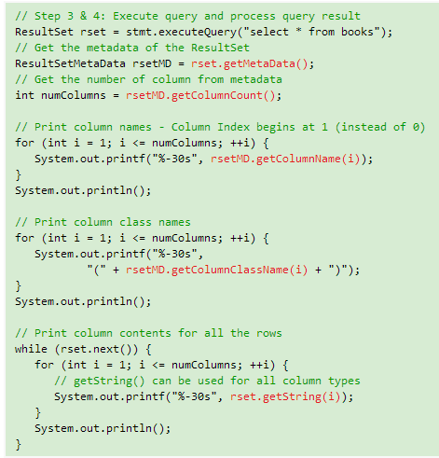

Slide 15
PreparedStatement
JDBC provides a class called PreparedStatement, which allows you to pass parameters into a SQL statement and execute the same SQL statement multiple times. A PreparedStatement is a pre-compiled SQL statement that is more efficient than using Statement over and over. In aPreparedStatement, '?' dentoes a place holder for parameter. A set of setXxx(placeHolderNumber, value) methods can be used to fill in the parameters.

Slide 16
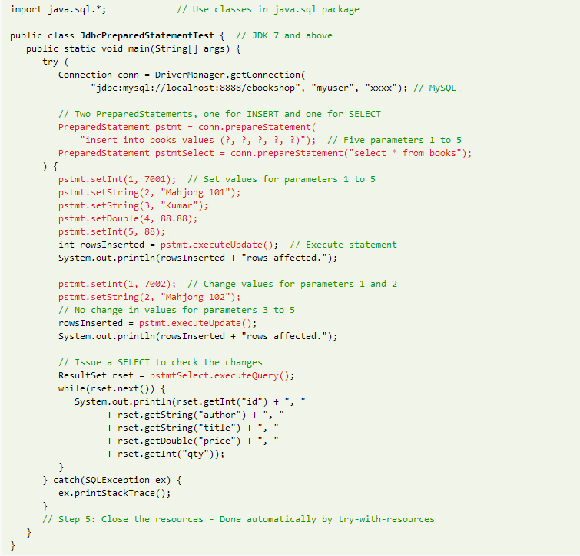
Notes:
More efficient

Slide 17
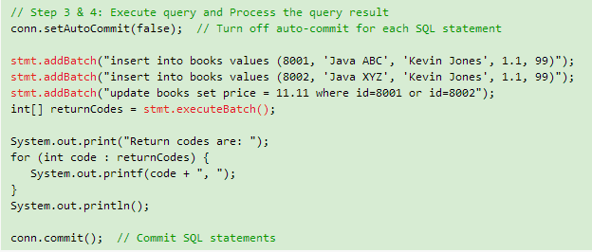
Batch Processing
JDBC 2.0 (available in JDK 1.2) supports batch processing of SQL statements, to improve the performance. Each statement is added to the batch via Statement.addBatch() or PreparedStatement.addBatch(). The entire batch of statements is then sent to the database for execution viaexecuteBatch(), which returns an int array keeping the return codes of each of the statement.

Slide 18
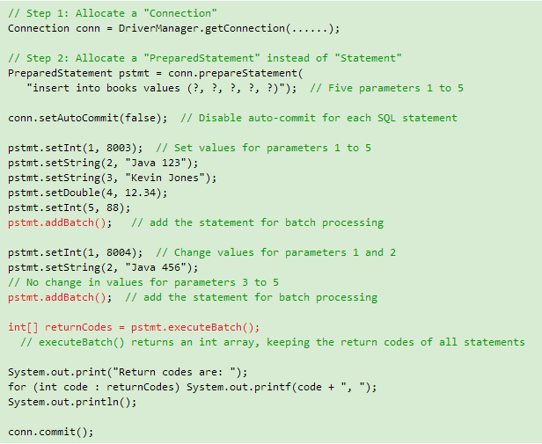
Batch Processing Prepared Statement
Notes:
Three tables, employee, department, project, need a join table. A user table, has a user name and a password
A login page, a register page, use mvc, maven, session, a login servlet, a register servlet
After login, a welcome page, can create employee, delete employee, update employee → employee servlet
Create department → department servlet

