Slide 2
Antra SEP Program
GitHub

Slide 3
GitHub Training Schedule
Register in GitHub.com
Install GitHub (default in eclipse)
Dependency
Plugins

Slide 4
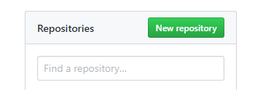
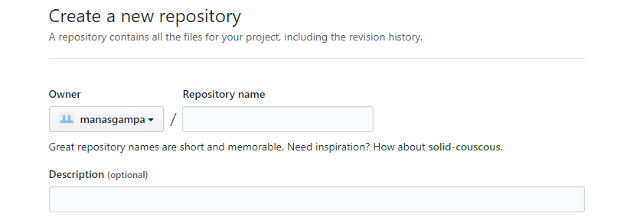
Register in Github.com and create a repository
Register with GitHub with email and password
Create a repository
Give the Repository name(any name)

Slide 5
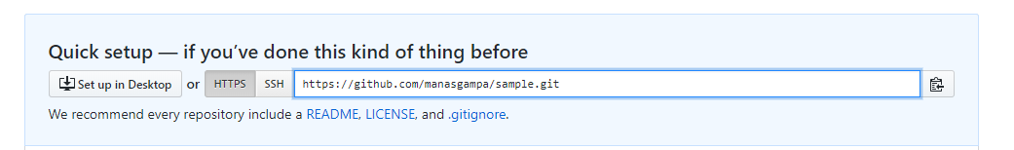
The repository will be created as sown below along with the URL

Slide 6
Install GitHub (default in eclipse)
Eclipse new versions GitHub will be installed by default

Slide 7
To copy the project
Eclipse new versions GitHub will be installed by default

Slide 9
Maven Remote repository
when we declare library does not exist either in local repository nor Maven center repository, the process will stop.
<dependency>
<groupId>org.jvnet.localizer</groupId>
<artifactId>localizer</artifactId>
<version>1.8</version>
</dependency>
The org.jvnet.localizer is now available in Maven center repository.

Slide 10
To tell Maven to get the dependency from Java.net, you need to declared a remote repository in your pom.xml
<repositories>
<repository>
<id>java.net</id>
<url>https://maven.java.net/content/repositories/public/</url>
</repository>
</repositories>

Slide 11
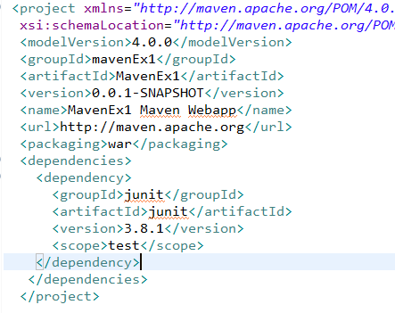
pom.xml

Slide 12
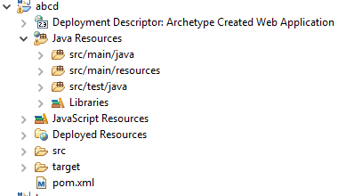
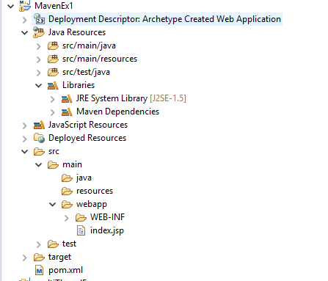
Folder Structure of Maven
jar maven project structure
war maven project structure

Slide 13
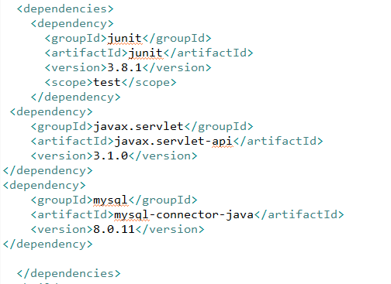
Add Dependencies in Maven

Slide 14
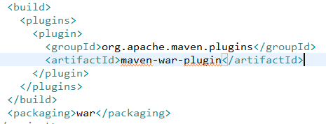

How to add plugins in Maven

Slide 15
Maven Build Lifecycle
validate - validate the project is correct and all necessary information is available
compile - compile the source code of the project
test - test the compiled source code using a suitable unit testing framework. These tests should not require the code be packaged or deployed
package - take the compiled code and package it in its distributable format, such as a JAR.

Slide 16
verify - run any checks on results of integration tests to ensure quality criteria are met
install - install the package into the local repository, for use as a dependency in other projects locally
deploy - done in the build environment, copies the final package to the remote repository for sharing with other developers and projects.

Slide 17
Maven Basic Operations
Clean(mvn clean)
Test(mvn test)
Install(mvn install)

Slide 18
Thanks!

