Slide 2
Antra SEP Program
Maven

Slide 3
Maven Training Schedule
Types of Repositories in Maven
Folder structures
Dependency
Plugins

Slide 4
Types of Repositories in Maven
Maven local repository
Maven Central repository
Remote repository

Slide 5
Maven Local Repository
(plugin jars and other files which are downloaded by The maven local repository is a local folder that is used to store all your project’s dependencies Maven)
when you build a Maven project, all dependency files will be stored in your Maven local repository(.m2 folder).
Unix/Mac OS X – ~/.m2
Windows – C:\Documents and Settings\{your-username}\.m2.

Slide 6
Maven Central Repository
When we build a Maven’s project, Maven will check your pom.xml file, to identify which dependency to download.
First, Maven will get the dependency from your local repository Maven local repository, if not found, then get it from the default Maven central repository to download.
The maven center repository website is http://search.maven.org/

Slide 7
Maven Remote repository
when we declare library does not exist either in local repository nor Maven center repository, the process will stop.
<dependency>
<groupId>org.jvnet.localizer</groupId>
<artifactId>localizer</artifactId>
<version>1.8</version>
</dependency>
The org.jvnet.localizer is now available in Maven center repository.

Slide 8
To tell Maven to get the dependency from Java.net, you need to declared a remote repository in your pom.xml
<repositories>
<repository>
<id>java.net</id>
<url>https://maven.java.net/content/repositories/public/</url>
</repository>
</repositories>

Slide 9
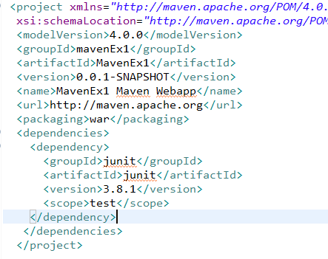
pom.xml

Slide 10
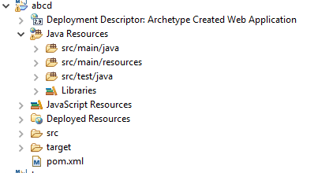
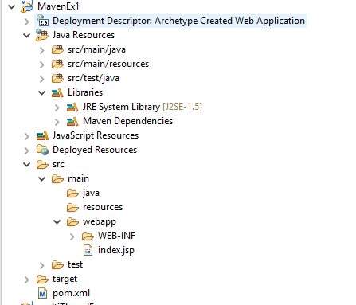
Folder Structure of Maven
jar maven project structure
war maven project structure

Slide 11
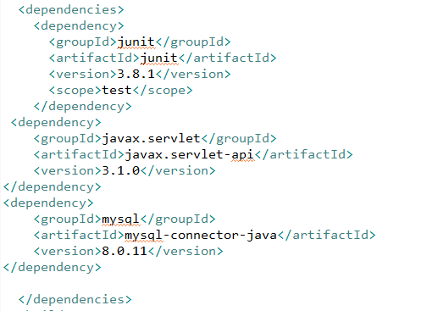
Add Dependencies in Maven

Slide 12
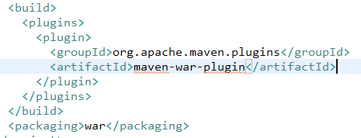

How to add plugins in Maven

Slide 13
Maven Build Lifecycle
validate - validate the project is correct and all necessary information is available
compile - compile the source code of the project
test - test the compiled source code using a suitable unit testing framework. These tests should not require the code be packaged or deployed
package - take the compiled code and package it in its distributable format, such as a JAR.

Slide 14
verify - run any checks on results of integration tests to ensure quality criteria are met
install - install the package into the local repository, for use as a dependency in other projects locally
- done in the build environment, copies the final package to the remotdeploye repository for sharing with other developers and projects.

Slide 15
Maven Basic Operations
Clean(mvn clean)
Test(mvn test)
Install(mvn install)

Slide 16
Thanks!

