Slide 1
ResearchWaste.info: Raising Awareness of Avoidable Waste in Health Research
Pavel Zhelnov, MD
PhD Supervisor: Dr. Andrea Tricco
Committee: Drs. Sharon Straus & David Moher
Patient Partner: Lisa Ridgway, JD
…and at least 56 collaborators, reviewers, peers, instructors, community members…

Slide 2



Positionality & Conflicts of Interest
CIHR’s Strategy for Patient-Oriented Research (SPOR):
“Patients need to be involved in all aspects of research to ensure questions and results are relevant”
Our Vision – SPOR Evidence Alliance:
To promote a Canadian health system that is increasingly informed and continuously improved using up-to-date scientific evidence.
Experience: | MD (2017, St. Pete, Russia), Orthopaedic Surgery (2020), Policy Analyst (2022)
Program: | PhD in Health Systems Research (2023–2027, IHPME)
Emphasis: | Organization & Management, Collab Specialization in Global Health
Funding: | IHPME Funding Package, SPOR Evidence Alliance Grants, SDGs@UofT 2024 Student Award

Slide 3
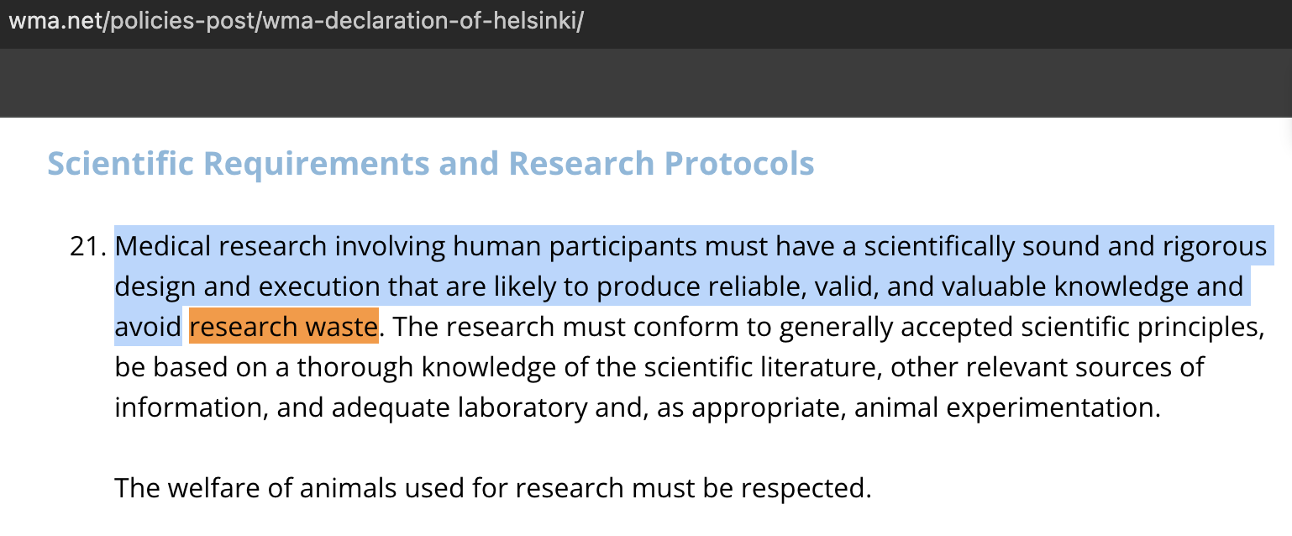
Background – Declaration of Helsinki 2024
____________________________________________________

Slide 4
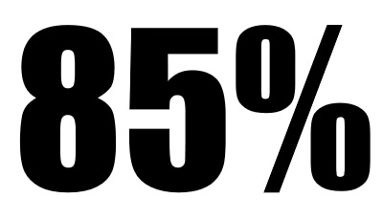
What is (health) research waste? Working definition
Research found unhelpful by other researchers or knowledge users.
A knowledge user is anyone who is “likely to be able to use the knowledge generated through research in order to make informed decisions” (CIHR).
Exclusive of outright misconduct (falsification, fabrication, plagiarism) but taps into “questionable/unacceptable research practices” (p-hacking, “spin”).
A failure on part of “individuals, teams, and organizations involved” in research to implement the “design and execution that are likely to avoid”:
MINUS
framework for research waste
(Rosengaard et al., 2024)
Methodological flaws
Invisibility
Negligible research
Underreporting
Structural barriers
(Glasziou, Chalmers, 2016)

Slide 5
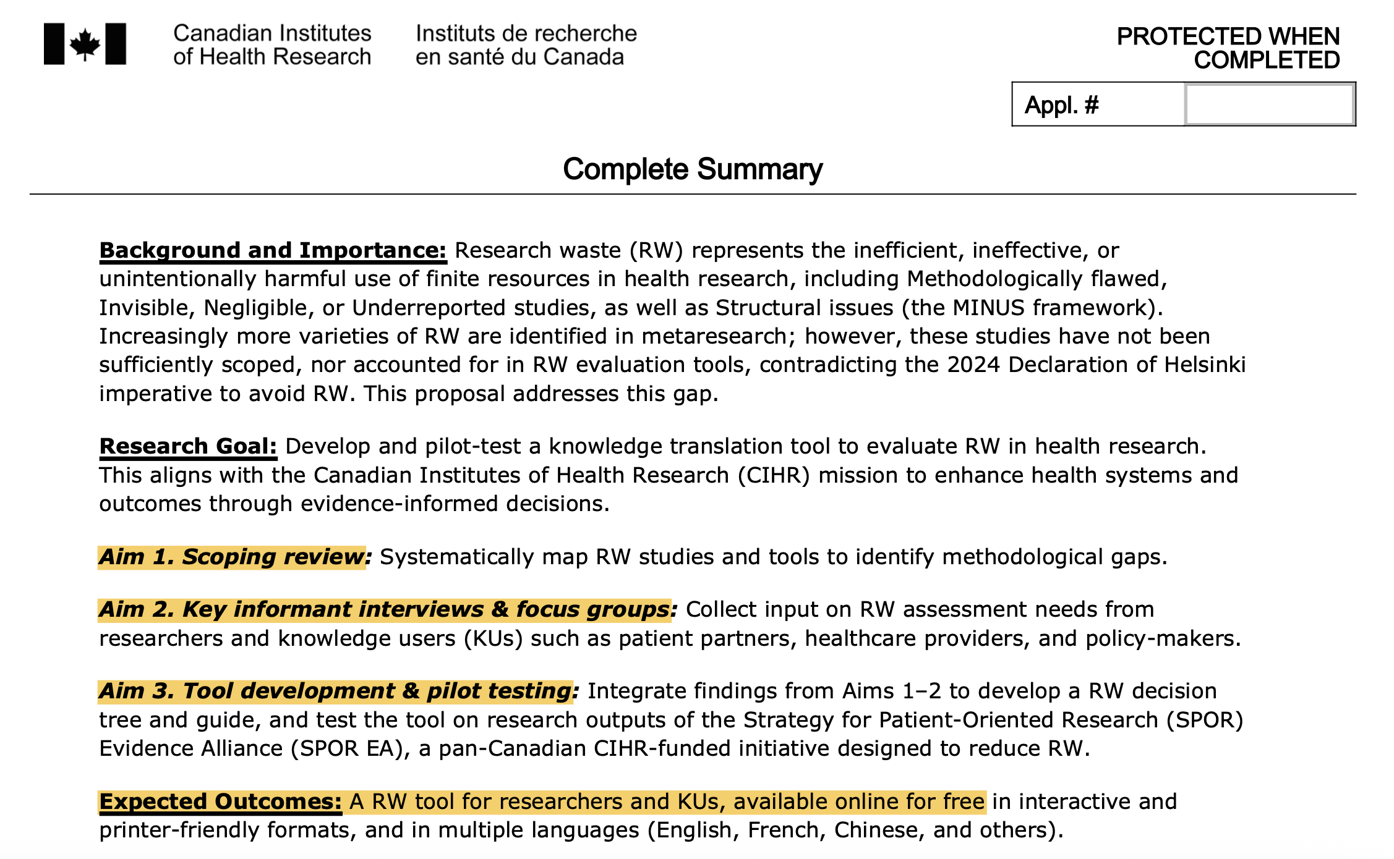
Methods – Thesis design

Slide 6
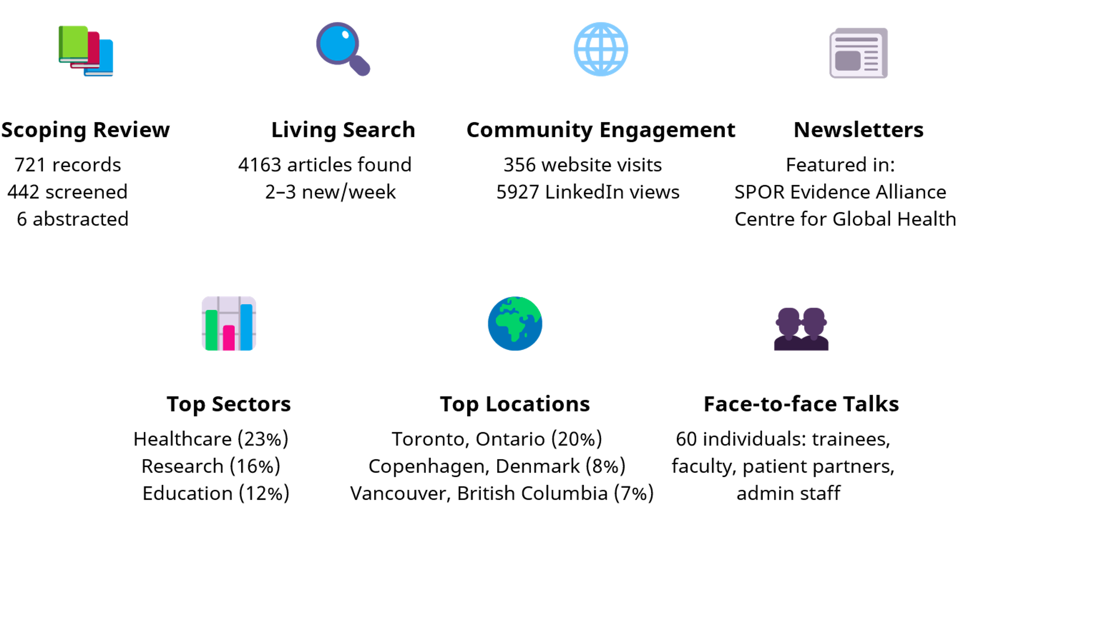
Methods – Knowledge mobilization

Slide 7
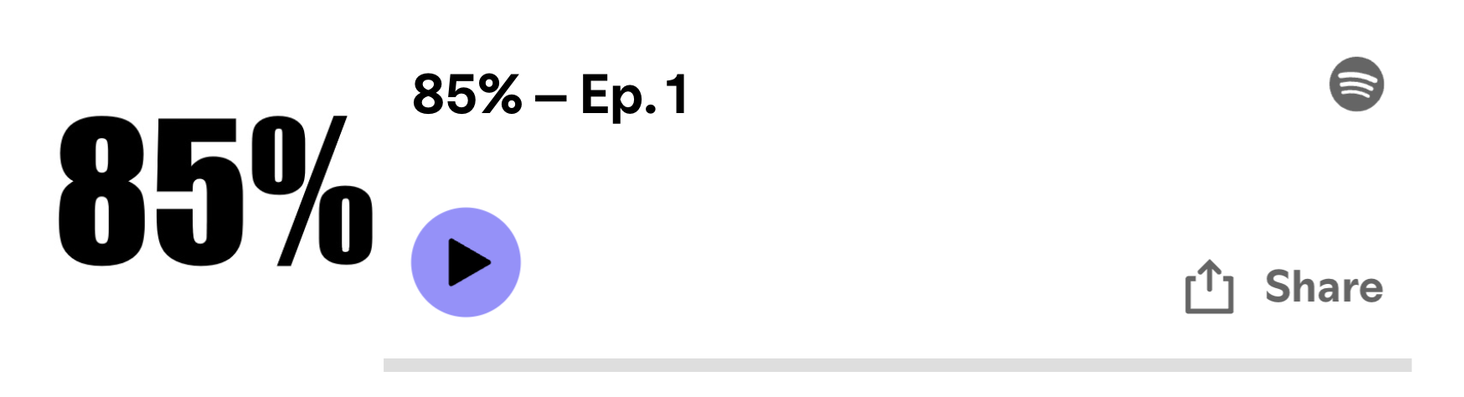
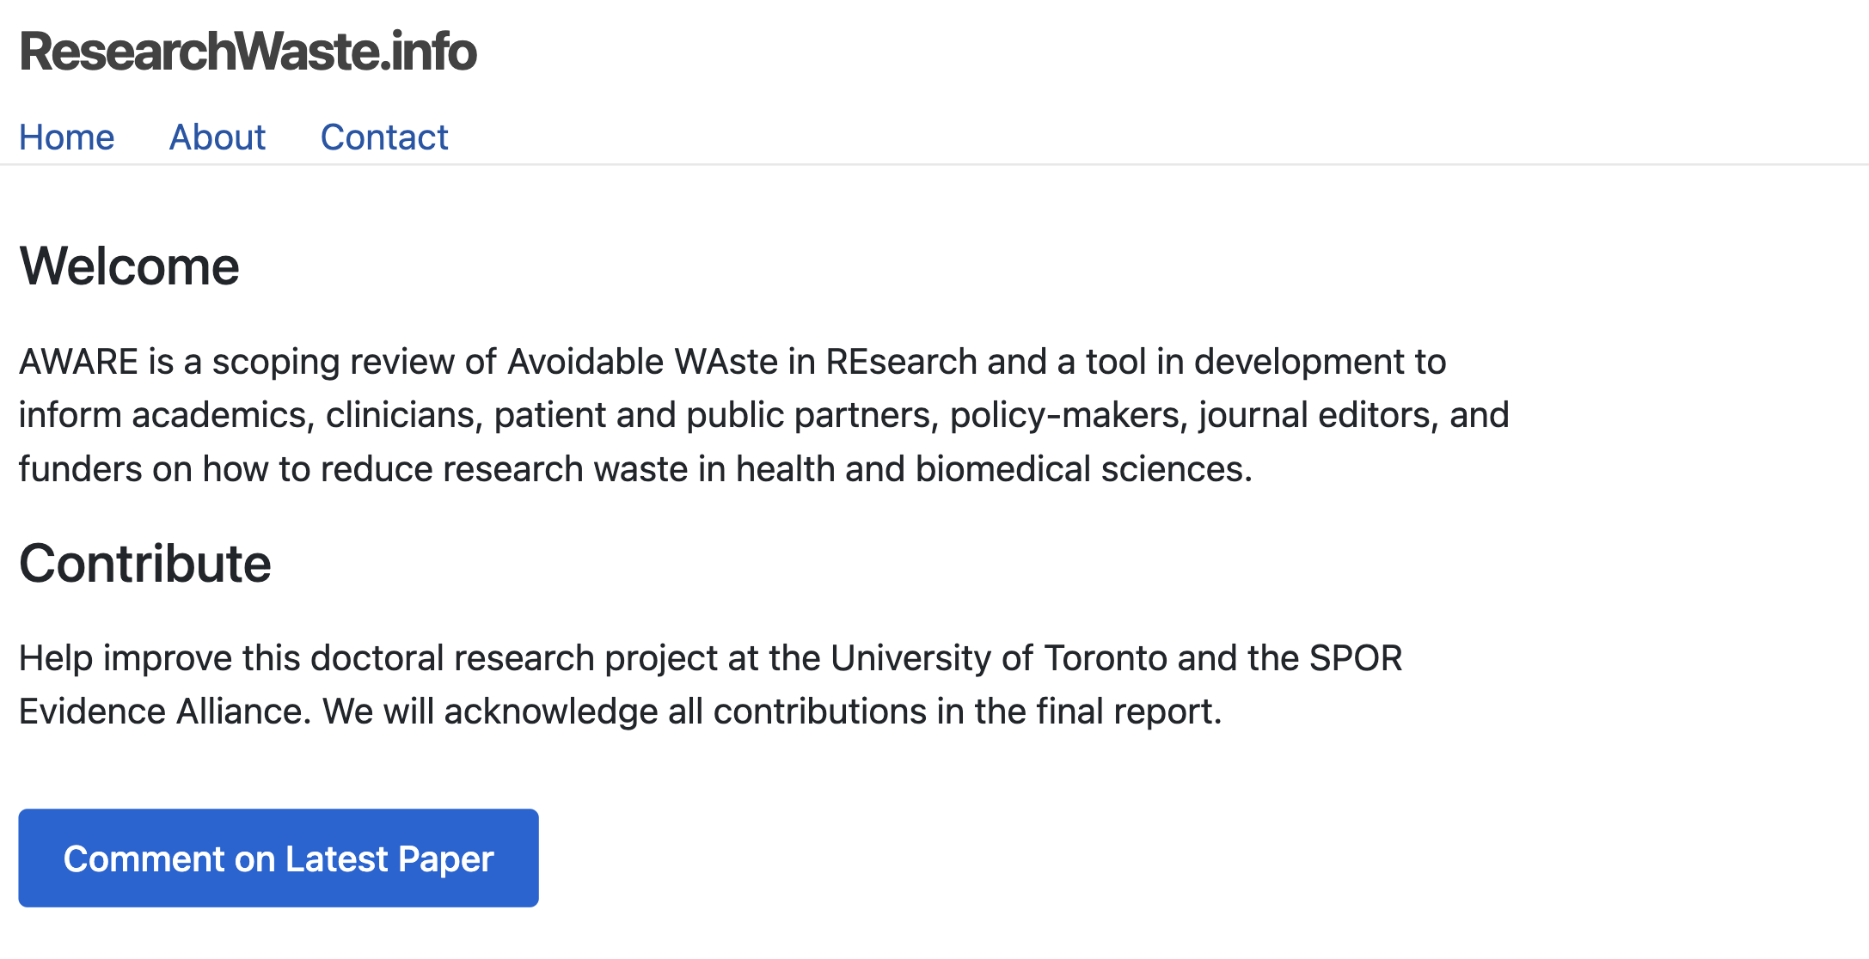

ResearchWaste.info
__________
_______
_______
_________
__________
__________
____________________________
__________
__________

Slide 8
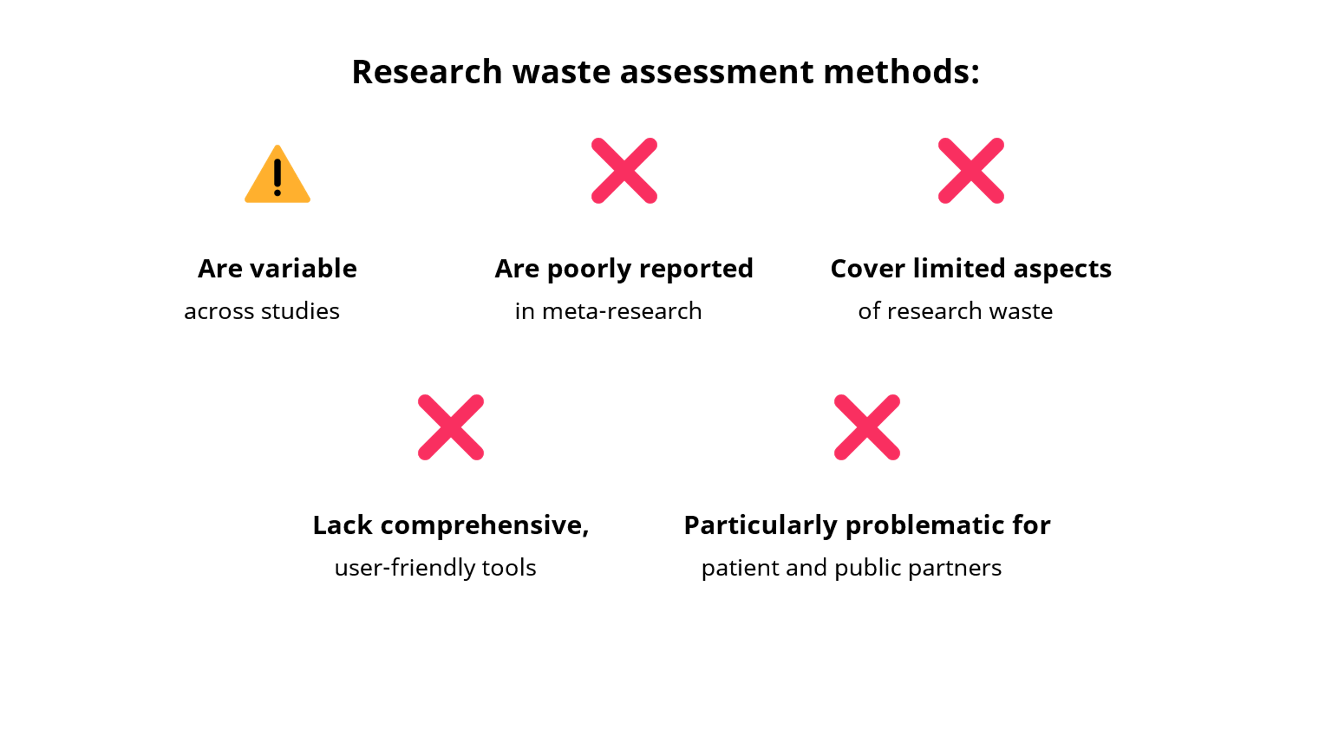
Results – Preliminary findings

Slide 9
Conclusions – Expected impacts
An evidence-informed tool to “run” health research protocols & reports.
Available online for free as an interactive app and a printer-friendly PDF.
Intended for patient partners, the public, academic reviewers (peer, editorial, funding), healthcare professionals, and policy-makers.
Supports decision-makers by informing them about the research waste potential before, during, and after doing the study.
Features:
Aims to incorporate all published research about research waste to date;
Piloted by 10–15 diverse users and on 300+ reports at the SPOR EA;
Developed using reproducible methods – can be updated/customized;
Multiple languages: English, French, Chinese, and others.
Examples of similar tools:
INQUIRE (content): https://doi.org/10.1371/journal.pmed.1002580
Right Review (design): https://whatreviewisrightforyou.knowledgetranslation.net/

Slide 10
Thank You!

Slide 11
Supplemental slides

Slide 12
Methods – Overall goal
The overall project goal is to develop and pilot-test an online interactive tool for evaluating research waste in health research to empower researchers, patients, and other knowledge users (clinicians, trainees, policy-makers, administrators, funders, journal editors, and the public) to make evidence-informed decisions involving health research.
“Evaluation” and “assessment” are used interchangeably because the distinction is applied inconsistently in interdisciplinary practice (e.g., assessment vs. evaluation in education cf. outcome assessment, economic evaluation in health sciences).
“Evidence-informed” is intended to represent a relaxed version of “evidence-based”, meaning reliance on knowledge synthesis of empirical (field) quantitative, qualitative, or mixed-methods research.

Slide 13
Methods – “Scope creep” issues
As a meta-research project, this addresses all four pillars of health research as defined by CIHR, including:
Biomedical research
Clinical research
Health services research
Social, cultural, environmental and population health research
However, as an adopter of patient-oriented research, integrated knowledge translation, and user experience methods, I recognize that an “all size fits all” approach is not likely to enable meaningful use of the tool in practice.
I address this conflict by applying a dialectical critical realist lens that suggests that both general and context-specific insights are important.

Slide 14
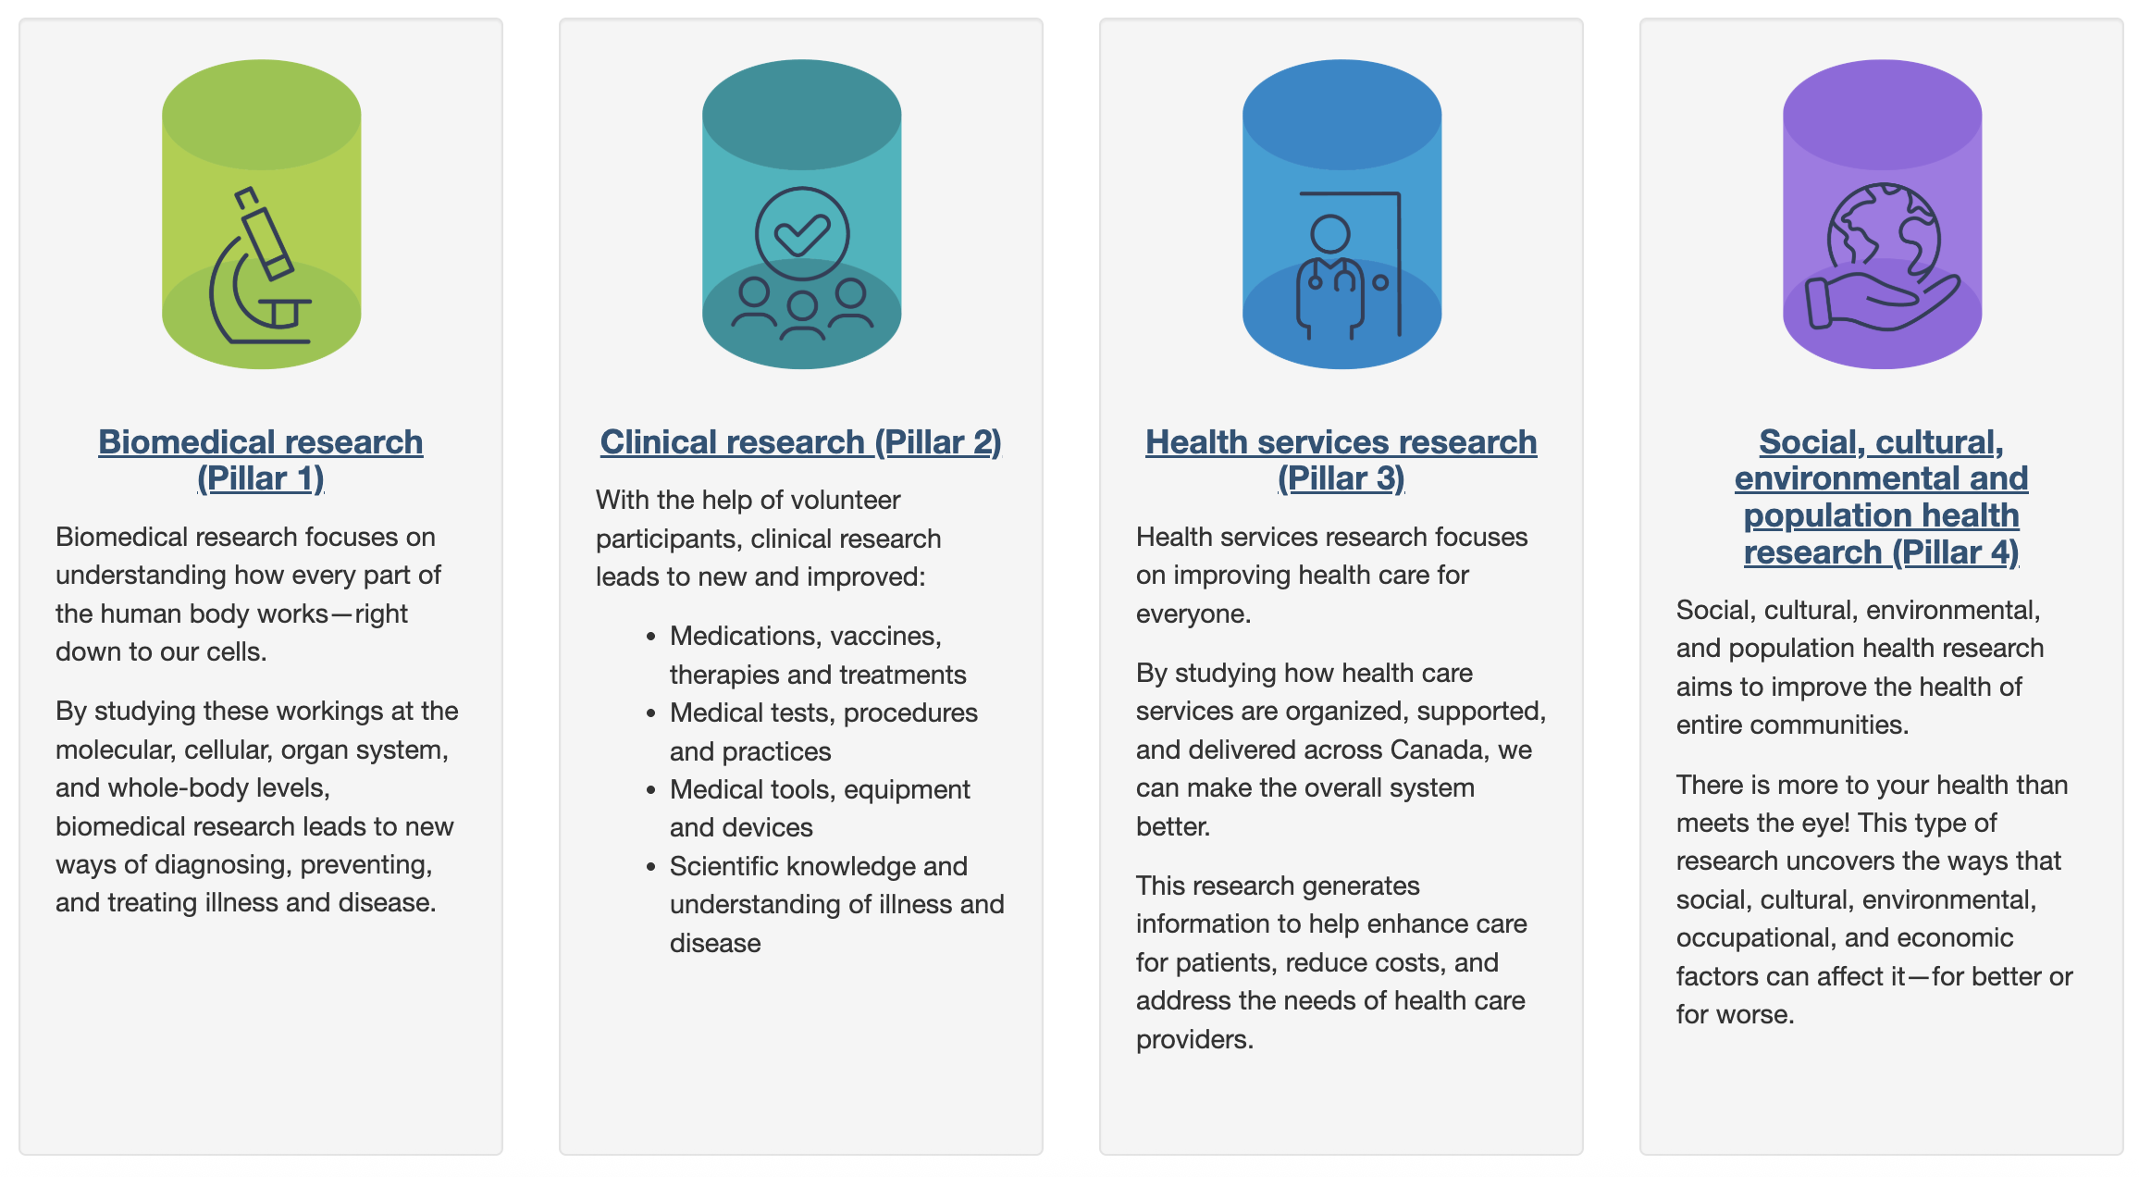
Methods – CIHR Pillars

Slide 15
Methods – Self-evaluation of research waste (MINUS-ES). Slide 1 of 3. Version: 2025-05-05
Methodological: Experienced team, follow conduct guidelines (e.g., JBI Manual for scoping reviews). Inclusive design (mixed methods).
Invisible: Integrated knowledge translation from Day 1, ongoing community updates (website, social media). Intend to register and publish protocol.
Negligible: Rapid scoping review and living search updates at protocol stage, including registers (OSF) and novel technologies (“deep research”). Collaboration with “academic competitors” (Rosengaard, Moher). Open discussion on social media (INQUIRE).
Underreported: Follow relevant reporting guidelines (PRISMA-ScR, COREQ, GRAMMS, FAIR). Check reproducibility whenever possible. Establish channels for public and private feedback.
(continued)

Slide 16
Methods – Self-evaluation of research waste (MINUS-ES). Slide 2 of 3. Version: 2025-05-05
(continued)
Structural: Research conducted at a centre familiar with and embracing intended research methods (Knowledge Translation Program, SPOR EA, University of Toronto), with funding and supports available. High-income country setting. Diverse interdisciplinary team, personal contacts. Internet technologies for global reach-out (machine translation, social media). Funding applications as a way to obtain external feedback. Patient partner collaboration.
Emergent: Periodic AI peer review of protocols and manuscripts to identify additional issues. Existing tools identified (INQUIRE) – iterate and revise thesis design to keep the project relevant.
Summative: (continued)

Slide 17
Methods – Self-evaluation of research waste (MINUS-ES). Slide 3 of 3. Version: 2025-05-05
(continued)
Summative: Generated using Claude 3.7 Sonnet, user prompt.
“This project displays concerning deficiencies despite superficial adherence to methodological rigor. While experienced personnel are involved, the reliance on "mixed methods" suggests potential methodological overreach without clear justification for this approach. The "invisible" components reveal an overly optimistic view of knowledge translation effectiveness---website updates and social media posts often fail to reach key stakeholders and represent checkbox activities rather than meaningful engagement. The "negligible" section is particularly troubling, as it emphasizes technological solutions ("deep research") without defining their validity or reliability. Collaboration with known researchers appears more networking-oriented than scientifically necessary. The reporting guidelines mentioned under "underreported" represent the bare minimum expectation rather than exceptional practice, and the vague promise to "check reproducibility when possible" indicates no concrete reproducibility plan exists. The "structural" advantages listed reveal troubling privilege biases---high-income setting, personal contacts, and technological dependencies that may systematically exclude important perspectives. Machine translation for "global reach-out" demonstrates naivety regarding cross-cultural research validity. Finally, the "emergent" section's reliance on "AI peer review" suggests a dangerous overconfidence in unproven technologies and potential abrogation of human critical thinking. Overall, this project requires substantial redesign to address these fundamental flaws before proceeding.”

