Slide 1
ResearchWaste.info: Raising Awareness of Avoidable Waste in Health Research
Pavel Zhelnov, MD
PhD Supervisor: Dr. Andrea Tricco
Committee: Drs. Sharon Straus & David Moher
Patient Partner: Lisa Ridgway, JD
…and at least 56 collaborators, reviewers,
peers, instructors, community members…
Funding: IHPME Funding Package, SPOR Evidence Alliance Grants,
SDGs@UofT 2024 Student Award

Slide 2
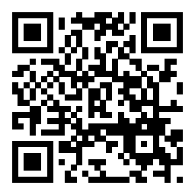
Background – Declaration of Helsinki 2024
Scientific Requirements and Research Protocols
Medical research involving human participants must have a scientifically sound and rigorous design and execution that are likely to produce reliable, valid, and valuable knowledge and avoid research waste*. The research must conform to generally accepted scientific principles, be based on a thorough knowledge of the scientific literature, other relevant sources of information, and adequate laboratory and, as appropriate, animal experimentation. The welfare of animals used for research must be respected.
*Not scientific integrity, discussed in a different item

Slide 3
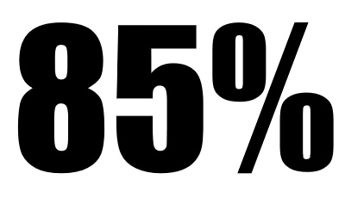
What is (health) research waste? Working definition:
Research found unhelpful by other researchers or knowledge users.
Exclusive of outright misconduct (falsification, fabrication, plagiarism) but taps into “questionable/unacceptable research practices” (p-hacking, “spin”).
A failure on part of “individuals, teams, and organizations involved” in research to implement the “design and execution that are likely to avoid” – MINUS (Rosengaard et al., 2024):
Methodological flaws
Invisibility
Negligible research
Underreporting
Structural barriers
Glasziou, Chalmers, 2016

Slide 4
Methods – Thesis design
Aim 1. Scoping review
Systematically map research waste studies/tools to identify methodological gaps.
Outputs: 2 peer-reviewed open access publications (protocol & report); an online, interactive, and printable evidence and gap map of studies and tools for assessing research waste; 1 plain-language summary; 1 workshop.
Aim 2. Key informant interviews & focus groups
Collect input on research waste assessment needs from researchers, knowledge users, such as patient partners, healthcare providers, policy-makers.
Outputs: 1 peer-reviewed, open access publication; 1 presentation.
Aim 3. Tool development, pilot testing, and evaluation
Integrate findings from Aims 1–2 to develop and test the tool.
Outputs: 1 peer-reviewed, open access publication; source software code; usage guide; webinar and online educational module; 1 presentation.

Slide 5

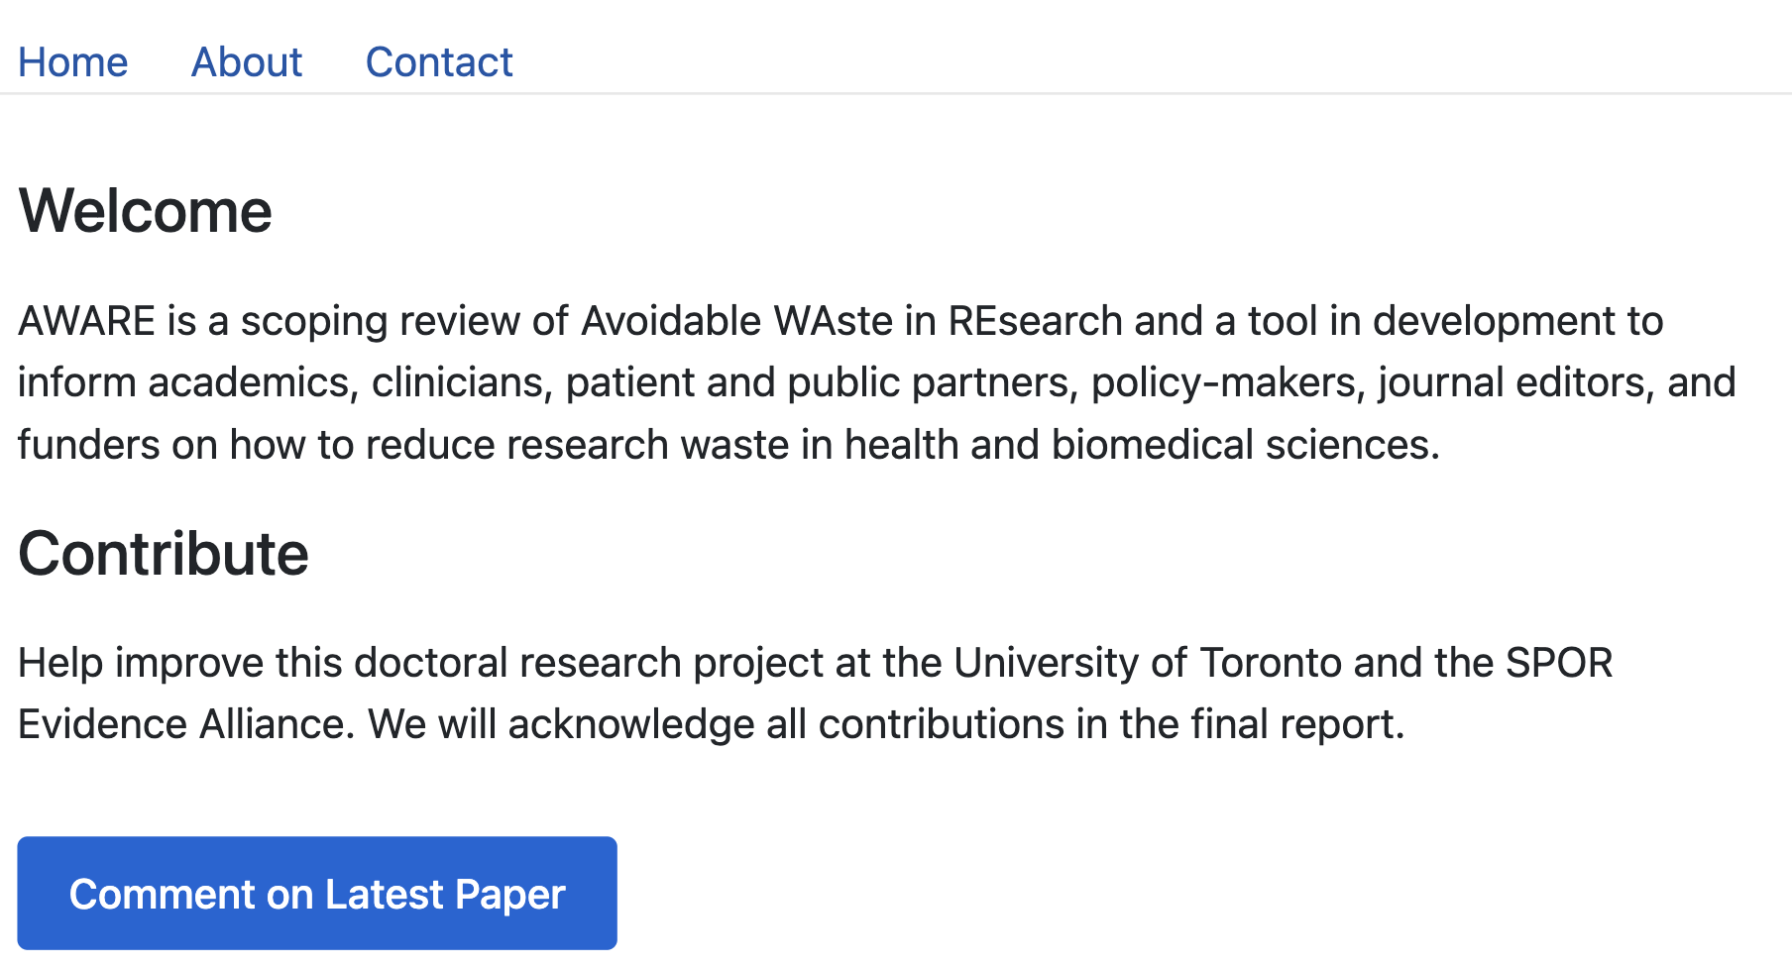
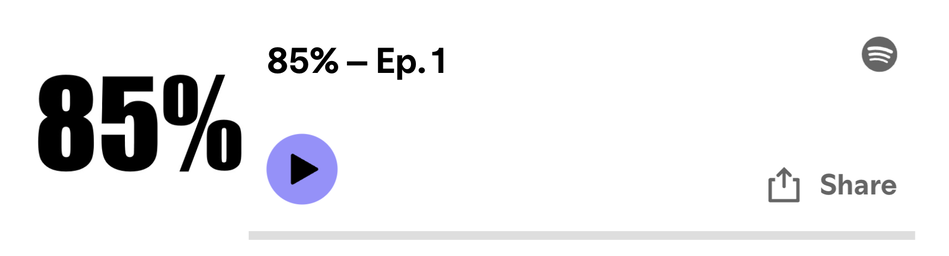
ResearchWaste.info

Slide 6
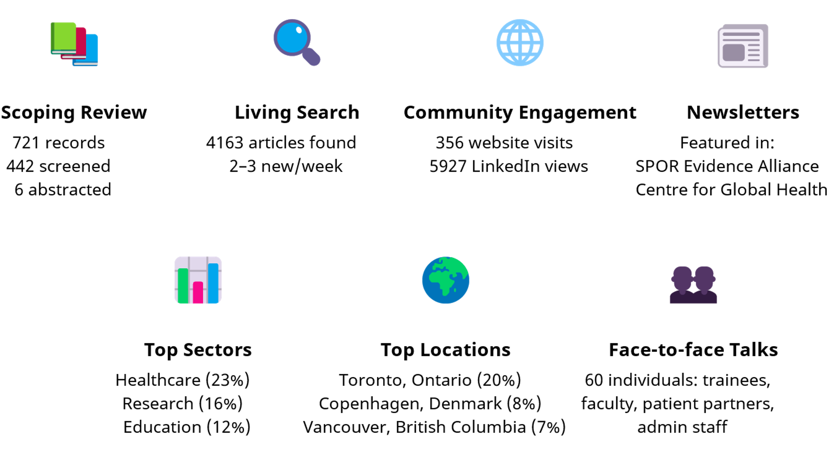
Results – Knowledge mobilization

Slide 7
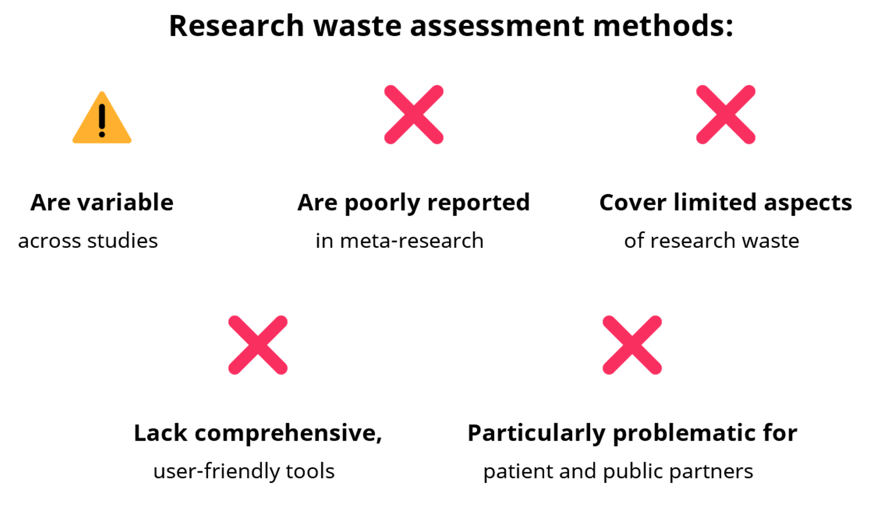
Results – Preliminary findings

Slide 8
Thank you!

