Slide 1
A Clear Text Explanation of the AES Cipher Does a Rijndael By Any Other Name Still Smell As Sweet?
October 9th, 2014 - Houston Perl Mongers
Robert Stone
HostGator.com

Slide 2
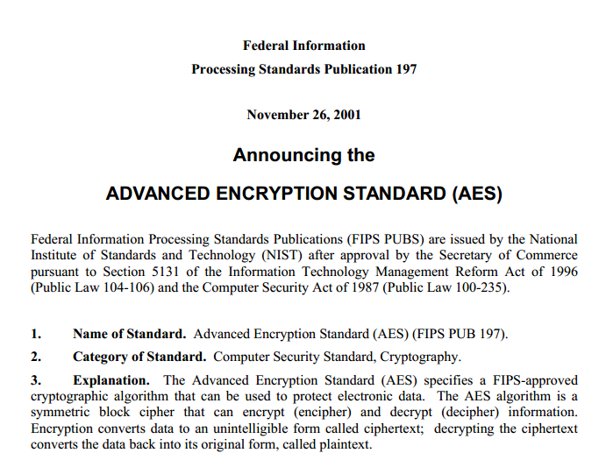
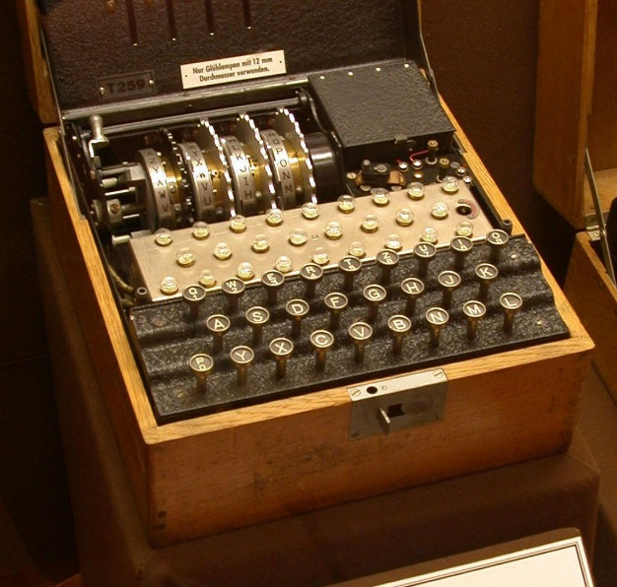

Overview
History
What is AES?
Rijndael vs AES
AES Selection Process Timeline
Algorithm and Implementation
The State
SubBytes
ShiftRows
MixColumns
Multiplication in the Galoios Field modulo an irreducible polynomial
Key Expansion
AddRoundKey
Weaknesses
Side Channel Attacks
Related Key Attack
NIST
Wikipedia
anondesign.deviantart.com

Slide 3
History – What is AES?
Advanced Encryption Standard
Method of Reversibly Encrypting Data
Block Based
Fixed size collection of bits
A Substitution-Permutation Based Cipher
Substitution
Permutation
ABCDEFGHIJKLMNOPQRSTUVWXYZ
EAXMHCRJYOWDTBZUSGKLNVPQIF
Plain Text
PERL MONGERS
UHGD TZBRHGK
Substitution Cipher Text
HUDGT BZHRKG
Permutation Cipher Text

Slide 4
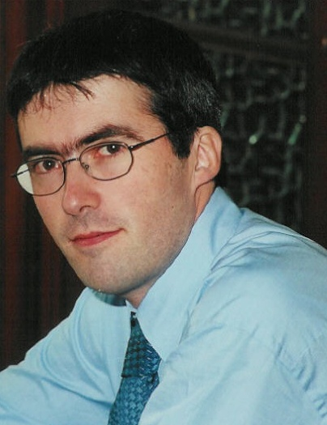

History – Rijndael vs AES
Rijndael created by
Vincent Rijmen
Joan Daemon
AES is a form of Rijndael with one primary restriction
Rijndael allows Block and Keys of 128, 160, 192, 224, or 256 Bits
AES REQUIRES a 128 Bit Block and a 128, 192, or 256 Bit Key
Aside from the Block and Key Size, Rijndael == AES
Wikipedia
RFIDsec 2012
The Daily Dot

Slide 5
History – AES Selection Process Timeline
NIST Announces Call for Algorithms
First AES Candidate Conference
Second AES Candidate Conference
September 1997
August 1998
March 1999
Third AES Candidate Conference
April 2000
NIST Announces Rijndael for AES
October 2000
Federal Information Processing Standard (FIPS) Published
February 2001
DES Stinks!
5 Algorithms
15 Algorithms
Final Discussions

Slide 6
Algorithm - Overview
input_to_state
ExpandKey
AddRoundKey
Encrypt( input, key )
state = input_to_state( input );
key_schedule = ExpandKey( key );
AddRoundKey( state, key_schedule, 0 );
for ( round = 1; round < num_rounds; round++)
SubBytes ( state );
ShiftRows ( state );
MixColumns ( state );
AddRoundKey( state, key_schedule, round );
SubBytes ( state );
ShiftRows ( state );
AddRoundKey( state, key_schedule, num_rounds );
return state_to_output( state );
SubBytes
ShiftRows
MixColumns
AddRoundKey
SubBytes
ShiftRows
AddRoundKey
state_to_output

Slide 7
Algorithm – The State
Internal Representation of a Block
Input is an Array of Bytes
State Composition and Terms
Bit
Byte – 8 Bits
Word – 4 Bytes
Column – 1 Word
Row – 1 Word
2b 7e 15 16 28 ae d2 a6 ab f7 15 88 09 cf 4f 3c
Bit
Byte
2b - 00101011
Word
2b - 00101011
0 - 0
7e - 01111110
15 - 00001111
16 - 00010000
2b | 28 | ab | 09
7e | ae | f7 | cf
15 | d2 | 15 | 4f
16 | a6 | 88 | 3c

Slide 8
Algorithm – The State - Implementation
sub _input_to_state {
my $self = shift;
my $input = shift;
#### Length of Input: ( length $input )
if( length $input != 16 ) {
croak "Invalid Input Length, Must be 128 Bits";
}
my $state;
my $byte_index = 0;
for( my $column_index = 0; $column_index < 4; $column_index++ ) {
for( my $row_index = 0; $row_index < 4; $row_index++ ) {
my $byte = unpack("x" . ( $byte_index++ ) . "a", $input );
#### Row Index : ( $row_index )
#### Column Index : ( $column_index )
#### Byte Index : ( $byte_index )
#### Raw Byte : ( $byte )
#### Byte : ( unpack "H2", $byte )
$state->[$row_index][$column_index] = $byte;
}
}
return $state;
}

Slide 9
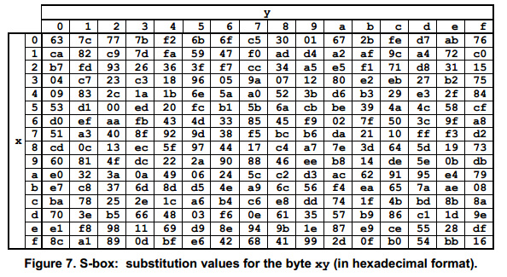
Algorithm – SubBytes
Substitution Step
Uses the S-BOX
Start With a Byte
Break it into XY
Look Up the row on the X Axis
Look Up the column on the Y Axis
Find the Intersection
Replace the Byte in the State with the Indicated Byte
NIST
5
X
X
53
ed
S-BOX
Y
3
Y

Slide 10
Algorithm – SubBytes - Implementation
sub _SubBytes {
my $self = shift;
my $state = shift;
for( my $column_index = 0; $column_index < 4; $column_index++ ) {
for( my $row_index = 0; $row_index < 4; $row_index++ ) {
my $original_byte = $state->[$row_index][$column_index];
my $xy = unpack( "h2", $original_byte );
my $x = substr( $xy, 0, 1 );
my $y = substr( $xy, 1, 1 );
my $substituted_byte = pack( "C", $SBOX[
( hex($y) * 16 ) + hex($x)
]);
#### Row Index : ( $row_index )
#### Column Index : ( $column_index )
#### X Coordinate : ( $x )
#### Y Coordinate : ( $y )
#### Original Byte : ( unpack "H2", $original_byte )
#### Substituted Byte : ( unpack "H2", $substituted_byte )
$state->[$row_index][$column_index] = $substituted_byte;
}
}
return $state;
}
use Readonly;
#<<< Don't Tidy S Box's
Readonly my @SBOX => (
0x63, 0x7c, 0x77, 0x7b, 0xf2, 0x6b, 0x6f, 0xc5, 0x30, 0x01, 0x67, 0x2b, 0xfe, 0xd7, 0xab, 0x76,
0xca, 0x82, 0xc9, 0x7d, 0xfa, 0x59, 0x47, 0xf0, 0xad, 0xd4, 0xa2, 0xaf, 0x9c, 0xa4, 0x72, 0xc0,
0xb7, 0xfd, 0x93, 0x26, 0x36, 0x3f, 0xf7, 0xcc, 0x34, 0xa5, 0xe5, 0xf1, 0x71, 0xd8, 0x31, 0x15,
0x04, 0xc7, 0x23, 0xc3, 0x18, 0x96, 0x05, 0x9a, 0x07, 0x12, 0x80, 0xe2, 0xeb, 0x27, 0xb2, 0x75,
0x09, 0x83, 0x2c, 0x1a, 0x1b, 0x6e, 0x5a, 0xa0, 0x52, 0x3b, 0xd6, 0xb3, 0x29, 0xe3, 0x2f, 0x84,
0x53, 0xd1, 0x00, 0xed, 0x20, 0xfc, 0xb1, 0x5b, 0x6a, 0xcb, 0xbe, 0x39, 0x4a, 0x4c, 0x58, 0xcf,
0xd0, 0xef, 0xaa, 0xfb, 0x43, 0x4d, 0x33, 0x85, 0x45, 0xf9, 0x02, 0x7f, 0x50, 0x3c, 0x9f, 0xa8,
0x51, 0xa3, 0x40, 0x8f, 0x92, 0x9d, 0x38, 0xf5, 0xbc, 0xb6, 0xda, 0x21, 0x10, 0xff, 0xf3, 0xd2,
0xcd, 0x0c, 0x13, 0xec, 0x5f, 0x97, 0x44, 0x17, 0xc4, 0xa7, 0x7e, 0x3d, 0x64, 0x5d, 0x19, 0x73,
0x60, 0x81, 0x4f, 0xdc, 0x22, 0x2a, 0x90, 0x88, 0x46, 0xee, 0xb8, 0x14, 0xde, 0x5e, 0x0b, 0xdb,
0xe0, 0x32, 0x3a, 0x0a, 0x49, 0x06, 0x24, 0x5c, 0xc2, 0xd3, 0xac, 0x62, 0x91, 0x95, 0xe4, 0x79,
0xe7, 0xc8, 0x37, 0x6d, 0x8d, 0xd5, 0x4e, 0xa9, 0x6c, 0x56, 0xf4, 0xea, 0x65, 0x7a, 0xae, 0x08,
0xba, 0x78, 0x25, 0x2e, 0x1c, 0xa6, 0xb4, 0xc6, 0xe8, 0xdd, 0x74, 0x1f, 0x4b, 0xbd, 0x8b, 0x8a,
0x70, 0x3e, 0xb5, 0x66, 0x48, 0x03, 0xf6, 0x0e, 0x61, 0x35, 0x57, 0xb9, 0x86, 0xc1, 0x1d, 0x9e,
0xe1, 0xf8, 0x98, 0x11, 0x69, 0xd9, 0x8e, 0x94, 0x9b, 0x1e, 0x87, 0xe9, 0xce, 0x55, 0x28, 0xdf,
0x8c, 0xa1, 0x89, 0x0d, 0xbf, 0xe6, 0x42, 0x68, 0x41, 0x99, 0x2d, 0x0f, 0xb0, 0x54, 0xbb, 0x16
);
#>>>
Do you see the self correcting bug?
h2 is low nibble first
Look at the dereferencing calculation in $SBOX

Slide 11
Algorithm - ShiftRows
Permutation Step
State is Acted Upon Row by Row
Recall, a row is one word in size which is made up of 4 bytes
Each Row is Left Shifted with Carry
First Row has no shifts
Second Row is Left Shifted 1 Byte
Third Row is Left Shifted 2 Bytes
Fourth Row is Left Shifted 3 Bytes
d4 | e0 | b8 | 1e
27 | bf | b4 | 41
11 | 98 | 5d | 52
ae | f1 | e5 | 30
27 | bf | b4 | 41
11 | 98 | 5d | 52
ae | f1 | e5 | 30
bf | b4 | 41 | 27
98 | 5d | 52 | 11
f1 | e5 | 30 | ae
5d | 52 | 11 | 98
e5 | 30 | ae | f1
d4 | e0 | b8 | 1e
bf | b4 | 41 | 27
d4 | e0 | b8 | 1e
d4 | e0 | b8 | 1e
bf | b4 | 41 | 27
5d | 52 | 11 | 98
d4 | e0 | b8 | 1e
bf | b4 | 41 | 27
5d | 52 | 11 | 98
30 | ae | f1 | e5
30 | ae | f1 | e5

Slide 12
Algorithm – ShiftRows - Implementation
sub _ShiftRows {
my $self = shift;
my $state = shift;
# Row 0 does not shift
for( my $row_index = 1; $row_index < 4; $row_index++ ) {
$self->_shift_row( $state->[$row_index], $row_index );
}
return $state;
}
sub _shift_row {
my $self = shift;
my $row = shift;
my $num_bytes = shift;
for( my $shift_round = 0; $shift_round < $num_bytes; $shift_round++ ) {
push ($row, shift $row);
}
return $row;
}

Slide 13
Algorithm – MixColumns
Finite Field
Limited number of members (Finite)
“Normal” Operations are Redefined
Irreducible Polynomial
Divisors are ONLY one and itself
Modulus Operation Keep us in the Field
State is Acted Upon Column by Column
Recall, a column is one word in size which is made up of 4 bytes
For Each Column
Multiply Columnar Polynomial in GF(2⁸) By
03 x³ + 01 x² + 01 x¹ + 02 mod x⁴ + 1
This is Matrix Multiplication
There is an “Easier” way!
Look up Formula for Column Byte
Perform Operations one part at a time
● - Multiplication in GF(2⁸) mod x⁸ + x⁴ + x³ + x¹ + 1
⊕ - Exclusive OR
d4 | e0 | b8 | 1e
bf | b4 | 41 | 27
5d | 52 | 11 | 98
30 | ae | f1 | e5
S’_{0,c}
S’_{1,c}
S’_{2,c}
S’_{3,c}
02 | 03 | 01 | 01
01 | 02 | 03 | 01
01 | 01 | 02 | 01
03 | 01 | 01 | 01
S_{0,c}
S_{1,c}
S_{2,c}
S_{3,c}
=
Byte | Formula for Byte
S’_{0,c} | ( 0x02 ● S_{0,c} ) ⊕ ( 0x03 ● S_{1,c} ) ⊕ S_{2,c} ⊕ S_{3,c}
S’_{1,c} | S_{0,c} ⊕ ( 0x02 ● S_{1,c} ) ⊕ ( 0x03 ● S_{2,c} ) ⊕ S_{3,c}
S’_{2,c} | S_{0,c} ⊕ S_{1,c} ⊕ ( 0x02 ● S_{2,c} ) ⊕ ( 0x03 ● S_{3,c} )
S’_{3,c} | ( 0x03 ● S_{0,c} ) ⊕ S_{1,c} ⊕ S_{2,c} ⊕ ( 0x02 ● S_{3,c} )

Slide 14
Algorithm – MixColumns – Multiplication in GF(2⁸)
Convert Input Bytes to Polynomial Notation
57
0 | 1 | 0 | 1 | 0 | 1 | 1 | 1
( x⁶ + x⁴ + x² + x¹ + 1 )
x⁷ | x⁶ | x⁵ | x⁴ | x³ | x² | x¹ | x⁰
83
1 | 0 | 0 | 0 | 0 | 0 | 1 | 1
( x⁷ + x¹ + 1 )

Slide 15
Algorithm – MixColumns – Multiplication in GF(2⁸)
Convert Input Bytes to Polynomial Notation
Multiply Polynomials
( x⁶ + x⁴ + x² + x¹ + 1 )
( x⁷ + x¹ + 1 )
x¹³ + x¹¹ + x⁹ + x⁸ + x⁷ +
x⁷ + x⁵ + x³ + x² + x¹ +
x⁶ + x⁴ + x² + x¹ + 1

Slide 16
Algorithm – MixColumns – Multiplication in GF(2⁸)
Convert Input Bytes to Polynomial Notation
Multiply Polynomials
Simplify Resulting Polynomial
Term | Binary Representation of Term
x¹³ | 01000000 00000000
x¹¹ | 00001000 00000000
x⁹ | 00000010 00000000
x⁸ | 00000001 00000000
x⁷ | 00000000 10000000
x⁷ | 00000000 10000000
x⁵ | 00000000 00100000
x³ | 00000000 00001000
x² | 00000000 00000100
x¹ | 00000000 00000010
Term | Binary Representation of Term
x⁶ | 00000000 01000000
x⁴ | 00000000 00010000
x² | 00000000 00000100
x¹ | 00000000 00000010
1 | 00000000 00000001
⊕
x¹³ + x¹¹ + x⁹ + x⁸ + x⁶ + x⁵ + x⁴ + x³ + 1

Slide 17
Algorithm – MixColumns – Multiplication in GF(2⁸)
sub _pmod {
my $self = shift;
my $dividend = shift;
my $divisor = shift;
#### Solving : ( unpack("B*", $dividend )
. " mod " . unpack("B*", $divisor ) )
my $int_dividend = unpack("n", $dividend );
my $int_divisor = unpack("n", $divisor );
my $long_division_result = $int_dividend;
my $aligned_divisor = $int_divisor;
#### Initial Dividend : ( $long_division_result )
#### Initial Divisor : ( $int_divisor )
while( $self->_p_order_compare(
unpack( "B16", pack( "n", $long_division_result) ),
unpack( "B16", pack( "n", $int_divisor ) ),
) >= 0 ) {
#### Dividend : ( unpack("B*", pack("n", $long_division_result ) ) )
#### Divisor : ( unpack("B*", pack("n", $int_divisor ) ) )
my $position_of_msb_in_dividend = 16 –
index( unpack( "B*", pack("n", $long_division_result ) ), "1" );
my $position_of_msb_in_divisor = 16 –
index( unpack( "B*", pack("n", $int_divisor ) ), "1" );
my $num_shifts =
$position_of_msb_in_dividend - $position_of_msb_in_divisor;
#### Position of MSB in Dividend: ( $position_of_msb_in_dividend )
#### Position of MSB in Divisor: ( $position_of_msb_in_divisor )
#### Num Shifts: ( $num_shifts )
$aligned_divisor = $int_divisor << $num_shifts;
#### Aligned Divisor : ( unpack("B*", pack("n", $aligned_divisor ) ) )
$long_division_result ^= $aligned_divisor;
#### Remaining : ( unpack("B*", pack("n", $long_division_result ) ) )
#### Formated Remaining : ( $self->_generate_formatted_expression(
unpack("B*", pack("n", $long_division_result ) ) ) )
}
my $modulus = pack("C", $long_division_result );
#### Resulting Modulus: ( unpack("H*", $modulus ) )
return $modulus;
}
Convert Input Bytes to Polynomial Notation
Multiply Polynomials
Simplify Resulting Polynomial
Modulo Simplified Polynomial the Irreducible Polynomial
x¹³ + x¹¹ + x⁹ + x⁸ + x⁶ + x⁵ + x⁴ + x³ + 1
modulo x⁸ + x⁴ + x³ + x¹ + 1
= x⁷ + x⁶ + 1

Slide 18
Algorithm – MixColumns
Finite Field
Limited number of members (Finite)
“Normal” Operations are Redefined
Irreducible Polynomial
Divisors are ONLY one and itself
Modulus Operation Keep us in the Field
State is Acted Upon Column by Column
Recall, a column is one word in size which is made up of 4 bytes
For Each Column
Multiply Columnar Polynomial in GF(2⁸) By
03 x³ + 01 x² + 01 x¹ + 02 mod x⁴ + 1
This is Matrix Multiplication
There is an “Easier” way!
Look up Formula for Column Byte
Perform Operations one part at a time
● - Multiplication in GF(2⁸) mod x⁸ + x⁴ + x³ + x¹ + 1
⊕ - Exclusive OR
d4 | e0 | b8 | 1e
bf | b4 | 41 | 27
5d | 52 | 11 | 98
30 | ae | f1 | e5
S’_{0,c}
S’_{1,c}
S’_{2,c}
S’_{3,c}
02 | 03 | 01 | 01
01 | 02 | 03 | 01
01 | 01 | 02 | 01
03 | 01 | 01 | 01
S_{0,c}
S_{1,c}
S_{2,c}
S_{3,c}
=
Byte | Formula for Byte
S’_{0,c} | ( 0x02 ● S_{0,c} ) ⊕ ( 0x03 ● S_{1,c} ) ⊕ S_{2,c} ⊕ S_{3,c}
S’_{1,c} | S_{0,c} ⊕ ( 0x02 ● S_{1,c} ) ⊕ ( 0x03 ● S_{2,c} ) ⊕ S_{3,c}
S’_{2,c} | S_{0,c} ⊕ S_{1,c} ⊕ ( 0x02 ● S_{2,c} ) ⊕ ( 0x03 ● S_{3,c} )
S’_{3,c} | ( 0x03 ● S_{0,c} ) ⊕ S_{1,c} ⊕ S_{2,c} ⊕ ( 0x02 ● S_{3,c} )

Slide 19
Algorithm – Key Expansion - Overview
expanded_key = key
ExpandKey( key )
expanded_key = key;
for ( round = 4; round < 44; round++ )
last_word = Last Word in Expanded Key;
if ( round % 4 == 0 )
RotWord( last_word );
SubWord( last_word );
last_word ^ RCONST[ round / 4 ];
prior_word = Four Words Ago in Expanded Key;
expanded_key .= prior_word ^ last_word;
return expanded_key;
last_word
round % 4
prior_word
prior_word ^ last_word
RotWord
SubWord
last_word ^ RCONST
expanded_key

Slide 20
Algorithm – Key Expansion - RotWord
Permutation Step
Very Similar to ShiftRows, however acts on a single word
Recall, a row is one word in size which is made up of 4 bytes
Word is Left Shifted Once with Carry
19 | 3d | e3 | be
3d | e3 | be | 19

Slide 21
Algorithm – Key Expansion – RotWord - Implementation
sub _RotWord {
my $self = shift;
my $word = shift;
my @byte_array;
for( my $byte_index = 0; $byte_index < 4; $byte_index++ ) {
push @byte_array, substr( $word, $byte_index, 1 );
}
push (@byte_array, shift @byte_array);
return join('', @byte_array );
}

Slide 22
Algorithm – Key Expansion - SubWord
Substitution Step
Very Similar to SubBytes, however acts on all the bytes of a word
Uses the S-BOX
For Each Byte in the Word
Look Up the row on the X Axis
Look Up the column on the Y Axis
Find the Intersection
Replace the Byte in the Word with the Indicated Byte
19 | 3d | e3 | be
NIST
d4 | 27 | 11 | ae
d4 | 27 | 11
d4 | 27
d4

Slide 23
Algorithm – Key Expansion - SubWord - Implementation
sub _SubWord {
my $self = shift;
my $word = shift;
my $subbed_word = "";
for( my $byte_index = 0; $byte_index < 4; $byte_index++ ) {
my $original_byte = substr( $word, $byte_index, 1 );
my $xy = unpack( "H2", $original_byte );
my $x = substr( $xy, 0, 1 );
my $y = substr( $xy, 1, 1 );
my $substituted_byte = pack( "C", $SBOX[
hex($y) + ( 16 * hex($x) )
]);
#### Byte Index : ( $byte_index )
#### X Coordinate : ( $x )
#### Y Coordinate : ( $y )
#### Original Byte : ( unpack "H2", $original_byte )
#### Substituted Byte : ( unpack "H2", $substituted_byte )
$subbed_word .= $substituted_byte;
}
return $subbed_word;
}
use Readonly;
#<<< Don't Tidy S Box's
Readonly my @SBOX => (
0x63, 0x7c, 0x77, 0x7b, 0xf2, 0x6b, 0x6f, 0xc5, 0x30, 0x01, 0x67, 0x2b, 0xfe, 0xd7, 0xab, 0x76,
0xca, 0x82, 0xc9, 0x7d, 0xfa, 0x59, 0x47, 0xf0, 0xad, 0xd4, 0xa2, 0xaf, 0x9c, 0xa4, 0x72, 0xc0,
0xb7, 0xfd, 0x93, 0x26, 0x36, 0x3f, 0xf7, 0xcc, 0x34, 0xa5, 0xe5, 0xf1, 0x71, 0xd8, 0x31, 0x15,
0x04, 0xc7, 0x23, 0xc3, 0x18, 0x96, 0x05, 0x9a, 0x07, 0x12, 0x80, 0xe2, 0xeb, 0x27, 0xb2, 0x75,
0x09, 0x83, 0x2c, 0x1a, 0x1b, 0x6e, 0x5a, 0xa0, 0x52, 0x3b, 0xd6, 0xb3, 0x29, 0xe3, 0x2f, 0x84,
0x53, 0xd1, 0x00, 0xed, 0x20, 0xfc, 0xb1, 0x5b, 0x6a, 0xcb, 0xbe, 0x39, 0x4a, 0x4c, 0x58, 0xcf,
0xd0, 0xef, 0xaa, 0xfb, 0x43, 0x4d, 0x33, 0x85, 0x45, 0xf9, 0x02, 0x7f, 0x50, 0x3c, 0x9f, 0xa8,
0x51, 0xa3, 0x40, 0x8f, 0x92, 0x9d, 0x38, 0xf5, 0xbc, 0xb6, 0xda, 0x21, 0x10, 0xff, 0xf3, 0xd2,
0xcd, 0x0c, 0x13, 0xec, 0x5f, 0x97, 0x44, 0x17, 0xc4, 0xa7, 0x7e, 0x3d, 0x64, 0x5d, 0x19, 0x73,
0x60, 0x81, 0x4f, 0xdc, 0x22, 0x2a, 0x90, 0x88, 0x46, 0xee, 0xb8, 0x14, 0xde, 0x5e, 0x0b, 0xdb,
0xe0, 0x32, 0x3a, 0x0a, 0x49, 0x06, 0x24, 0x5c, 0xc2, 0xd3, 0xac, 0x62, 0x91, 0x95, 0xe4, 0x79,
0xe7, 0xc8, 0x37, 0x6d, 0x8d, 0xd5, 0x4e, 0xa9, 0x6c, 0x56, 0xf4, 0xea, 0x65, 0x7a, 0xae, 0x08,
0xba, 0x78, 0x25, 0x2e, 0x1c, 0xa6, 0xb4, 0xc6, 0xe8, 0xdd, 0x74, 0x1f, 0x4b, 0xbd, 0x8b, 0x8a,
0x70, 0x3e, 0xb5, 0x66, 0x48, 0x03, 0xf6, 0x0e, 0x61, 0x35, 0x57, 0xb9, 0x86, 0xc1, 0x1d, 0x9e,
0xe1, 0xf8, 0x98, 0x11, 0x69, 0xd9, 0x8e, 0x94, 0x9b, 0x1e, 0x87, 0xe9, 0xce, 0x55, 0x28, 0xdf,
0x8c, 0xa1, 0x89, 0x0d, 0xbf, 0xe6, 0x42, 0x68, 0x41, 0x99, 0x2d, 0x0f, 0xb0, 0x54, 0xbb, 0x16
);
#>>>
Do you see how this does not suffer from the bug in SubBytes?
H2 is high nibble first
Look at the dereferencing calculation in $SBOX

Slide 24
Algorithm – Key Expansion – XOR with RCONST
i | RCONST(i)
1 | 0x01000000
2 | 0x02000000
3 | 0x04000000
4 | 0x08000000
XOR the resultant word from SubWord with the relevant value from RCONST
RCONST
RCONST(i) = x^{(i-1)} mod x⁸ + x⁴ + x³ + x¹ + 1
i = expansion_round / 4
Rather than doing the calculation we use a Lookup Table
Only the first 10 values are actually needed for AES Key Expansion
expansion_round = 4
i = 4 / 4 = 1
RCONST(1) = 0x01000000
8a | 84 | eb | 01
1 | 0 | 0 | 0 | 1 | 0 | 1 | 0
01 | 00 | 00 | 00
0 | 0 | 0 | 0 | 0 | 0 | 0 | 1
8b | 84 | eb | 01
1 | 0 | 0 | 0 | 1 | 0 | 1 | 1

Slide 25
Algorithm – Key Expansion - XOR with RCONST - Implementation
#<<< Don't Tidy the Round Constansts
Readonly my @RCONST => (
0x8d000000, 0x01000000, 0x02000000, 0x04000000, 0x08000000, 0x10000000, 0x20000000, 0x40000000,
0x80000000, 0x1b000000, 0x36000000, 0x6c000000, 0xd8000000, 0xab000000, 0x4d000000, 0x9a000000,
);
#>>>
--- SNIP ---
my $subbed_word = $self->_SubWord( $rotted_word );
#### Subbed Word : ( unpack("B*", $subbed_word ) . " - " . unpack("H*", $subbed_word ) )
my $int_subbed_word = unpack( "N1", $subbed_word );
$temp = $int_subbed_word ^ $RCONST[$expansion_round / 4];
#### Int Subbed Word : ( unpack("B*", pack( "N", $int_subbed_word ) )
. " - " . unpack("H*", pack( "N", $int_subbed_word ) ) )
#### RCON : ( unpack("B*", pack( "N", $RCONST[$expansion_round] ) )
. " - " . unpack("H*", pack( "N", $RCONST[$expansion_round] ) ) )
#### Xored Result : ( unpack("B*", pack( "N", $temp ) )
. " - " . unpack("H*", pack("N", $temp ) ) )
$temp = pack("N1", $temp );
#### Temp : ( unpack("B*", $temp ) . " - " . unpack("H*", $temp ) )

Slide 26
Algorithm – Key Expansion – XOR with Previous Word
2b | 7e | 15 | 16 | 28 | ae | d2 | a6 | ab | f7 | 15 | 88 | 09 | cf | 4f | 3c
2b | 7e | 15 | 16 | 28 | ae | d2 | a6 | ab | f7 | 15 | 88 | 09 | cf | 4f | 3c | a0 | fa | fe | 17
XOR Step similar to XOR with RCONST
Extract a word 4 word from the end of the key expansion
previous_word =
substr( expanded_key,
(expansion_round * 4) – 16, 4 )
XOR temp with the previous_word
expansion_round % 4 != 0
temp = last_word
expansion_round % 4 == 0
temp = SubWord( RotWord( last_word ) ) ^ RCONST[ expansion_round / 4 ]
previous_word
2b | 7e | 15 | 16
temp
8b | 84 | eb | 01
new word
a0 | fa | fe | 17

Slide 27
Algorithm – Key Expansion - XOR with Previous Word - Implementation
#<<< Don't Tidy the Round Constansts
Readonly my @RCONST => (
0x8d000000, 0x01000000, 0x02000000, 0x04000000, 0x08000000, 0x10000000, 0x20000000, 0x40000000,
0x80000000, 0x1b000000, 0x36000000, 0x6c000000, 0xd8000000, 0xab000000, 0x4d000000, 0x9a000000,
);
#>>>
--- SNIP ---
my $previous_word = substr( $expanded_key, ($expansion_round * 4) - 16, 4 );
my $int_previous_word = unpack( "N1", $previous_word );
my $new_word = $int_previous_word ^ unpack("N1", $temp);
#### Previous Word : ( unpack("B*", $previous_word)
. " - " . unpack("H*", $previous_word ) )
#### Int Previous Word : ( unpack("B*", pack("N", $int_previous_word))
. " - " . unpack("H*", pack("N", $int_previous_word ) ) )
#### New Word : ( unpack("B*", pack("N", $new_word ) )
. " - " . unpack("H*", pack("N", $new_word ) ) )
$expanded_key .= pack("N1", $new_word);
#### Expanded Key : ( unpack("H*", $expanded_key ) )

Slide 28
Algorithm - AddRoundKey
2b | 7e | 15 | 16 | 28 | ae | d2 | a6 | ab | f7 | 15 | 88 | 09 | cf | 4f | 3c
XOR of each column of State with a word from the Key Schedule
Recall, a column is one word in size which is made up of 4 bytes
For Each Column in the State
Extract column of state ( 1 Word )
index_of_state_column identifies which word of Key Schedule to use
XOR column of state with word from Key Schedule
32 | 88 | 31 | e0
43 | 5a | 31 | 37
f6 | 30 | 98 | 07
a8 | 8d | a2 | 34
19 | a0 | 9a
3d | f4 | c6
e3 | e2 | 8d
be | 2b | 2a
19 | a0
3d | f4
e3 | e2
be | 2b
19 | a0 | 9a | e9
3d | f4 | c6 | f8
e3 | e2 | 8d | 48
be | 2b | 2a | 08
19
3d
e3
be
31
31
98
a2
ab
f7
15
88
9a
c6
8d
2a
88
5a
30
8d
e0
37
07
34
28
ae
d2
a6
a0
f4
e2
2b
32
43
f6
a8
09
cf
4f
3c
e9
f8
48
08
2b
7e
15
16
19
3d
e3
be

Slide 29
Algorithm – AddRoundKey - Implementation
sub _AddRoundKey {
my $self = shift;
my $state = shift;
my $key_schedule = shift;
my $round = shift;
my $relevant_key_schedule = substr( $key_schedule,
($round * 16), 16 );
#### Full Key Schedule : ( unpack("H*", $key_schedule ) )
#### Relevant Portion of Key Schedule : ( unpack("H*",
$relevant_key_schedule ) )
for( my $column = 0; $column < 4; $column++ ) {
#### Processing Column : ( $column )
my $key_word = substr( $relevant_key_schedule,
($column * 4 ), 4 );
my $state_column = pack( "C4", (
unpack( "C", $state->[0][$column] ),
unpack( "C", $state->[1][$column] ),
unpack( "C", $state->[2][$column] ),
unpack( "C", $state->[3][$column] ),
) );
#### Key Word : ( unpack("B*", $key_word )
. " - " . unpack("H*", $key_word ) )
#### State Column : ( unpack("B*", $state_column )
. " - " . unpack("H*", $state_column ) )
my $int_key_word = unpack( "N1", $key_word );
my $int_state_column = unpack( "N1", $state_column );
my $xored_column = $int_key_word ^ $int_state_column;
#### Int Key Word : ( unpack("B*", pack( "N", $int_key_word ) )
. " - " . unpack("H*", pack( "N", $int_key_word ) ) )
#### Int State Column : ( unpack("B*", pack( "N", $int_state_column ) )
. " - " . unpack("H*", pack( "N", $int_state_column ) ) )
#### XOR'ed Column : ( unpack("B*", pack( "N", $xored_column ) )
. " - " . unpack("H*", pack( "N", $xored_column ) ) )
$state->[0][$column] = pack("C", unpack( "x0C", pack( "N1", $xored_column ) ) );
$state->[1][$column] = pack("C", unpack( "x1C", pack( "N1", $xored_column ) ) );
$state->[2][$column] = pack("C", unpack( "x2C", pack( "N1", $xored_column ) ) );
$state->[3][$column] = pack("C", unpack( "x3C", pack( "N1", $xored_column ) ) );
#### Value of State Row 0 : ( unpack("H*", $state->[0][$column] ) )
#### Value of State Row 1 : ( unpack("H*", $state->[1][$column] ) )
#### Value of State Row 2 : ( unpack("H*", $state->[2][$column] ) )
#### Value of State Row 3 : ( unpack("H*", $state->[3][$column] ) )
}
return $state;
}

Slide 30
Algorithm - Overview
input_to_state
ExpandKey
AddRoundKey
Encrypt( input, key )
state = input_to_state( input );
key_schedule = ExpandKey( key );
AddRoundKey( state, key_schedule, 0 );
for ( round = 1; round < num_rounds; round++)
SubBytes ( state );
ShiftRows ( state );
MixColumns ( state );
AddRoundKey( state, key_schedule, round );
SubBytes ( state );
ShiftRows ( state );
AddRoundKey( state, key_schedule, num_rounds );
return state_to_output( state );
SubBytes
ShiftRows
MixColumns
AddRoundKey
SubBytes
ShiftRows
AddRoundKey
state_to_output

Slide 31
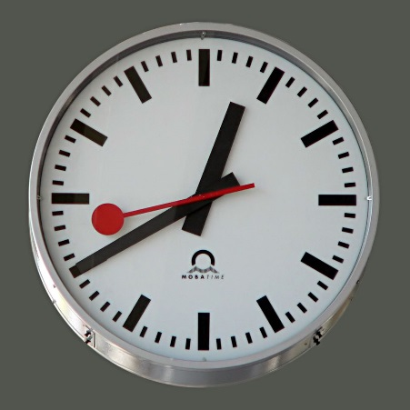
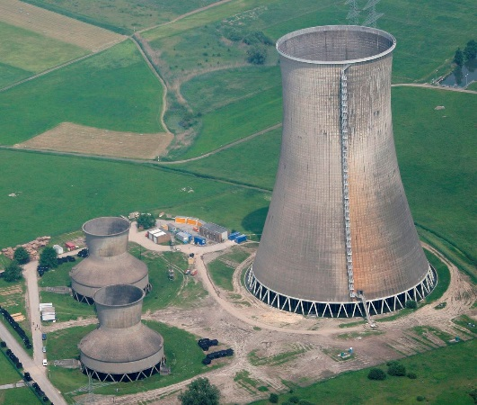
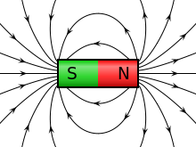
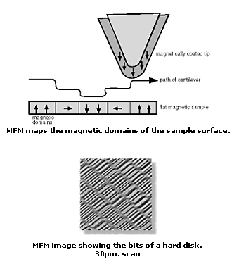
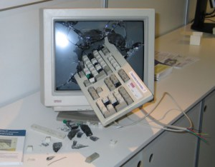
Weaknesses – Side Channel Attacks
What is an “Attack”?
A methodology that gives a solution in less time than brute force would
Characteristics of a Side Channel Attack
Does not attack the algorithm
Targets the system/hardware running the algorithm
What information could the system/hardware leak?
Timing Information
Power Consumption
Electromagnetic Fields
Sound
Responses to Bad Input
Data Remanence
Magnetic Force Microscopy
(List adapted from Wikipedia)
Wikipedia
Wikipedia
Wikipedia
odedran.wordpress.com
Indian Institute Of Science

Slide 32
Weaknesses – Related Key Attack
for ( round = 4; round < 44; round++ )
last_word = Last Word in Expanded Key;
if ( AES-128 && round % 4 == 0 )
RotWord( last_word );
SubWord( last_word );
last_word ^ RCONST[ round / 4 ];
else if ( AES-196 && round % 6 == 4 )
SubWord( last_word );
else if ( AES-256 )
AES Related Key Attack
Exploits “Lack of Diffusion” in Key Schedule during Key Expansion
AES remains strong against all known forms of Related Key Attacks
While they reduce the solution space, it is still well beyond the range of computability.
Why is this significant?
Derivative Ciphers that use AES can never be “provably secure”
AES Bits | Brute Force | Related Key
256 | 2²⁵⁶ | 2^{110.5} ≈ 2¹¹⁹
192 | 2¹⁹² | 2¹⁷⁶
128 | 2¹²⁸ | NOT VULNERABLE

Slide 33
Conclusion – Other Works – References
NIST Specification of AES
http://csrc.nist.gov/publications/fips/fips197/fips-197.pdf
Soon to be released Crypt::Rijndael::PP
https://github.com/drzigman/crypt-rijndael-pp
Paper regarding Related Key Attacks against AES
http://eprint.iacr.org/2009/317.pdf
Another Presentation on AES, this time as an XS Module!
Questions?

