Slide 1
Living Forever Ketogenic Diet and Stronglifts 5x5
March 9th, 2017 – Houston Perl Mongers
Robert Stone
BrainStorm Incubator

Slide 2
Overview
Ketogenic Diet
One Simple Rule
What is Keto? What is it not?
Starter Tips
Stronglifts 5x5
The Program
Exercises

Slide 3
Ketogenic Diet – One Simple Rule
Eat less then 20 Carbs per day
That’s it! On “Lazy Keto” you can eat anything you want, you don’t even have to count calories!

Slide 4
Ketogenic Diet – Keto Is and Is Not
Keto Is Not
A “Diet”
It’s a lifestyle
The “All Bacon” Diet
But, there is a lot of bacon!
You still eat plenty of leafy green vegetables
Keto Is
A sustainable way of reducing your caloric intake
Fats are more filling then carbs
A method to train your body to use fat for energy instead of carbs
Intentionally keeping your body in “Ketosis”

Slide 5
Ketogenic Diet – Starter Tips
Be prepared to cook your own meals
Most prepared food is full of bad stuff anyway and is loaded with hidden carbs
Sugar is a cheap way to make something taste good
Watch out for “Keto Flu” during your first week
Supplement with Potassium and Magnesium
Prepare for “The Woosh”
A sudden lose of water weight when starting Keto
Paradoxically, drink more water to lose more water
Save some money for new clothes

Slide 6
Stronglifts 5x5 – The Program
5 Sets of 5 Reps ( 5x5 )
Three Times a Week
Alternate between Workout A and Workout B
These are “compound exercises” so you get more done with less time in the gym
Workout A | Workout B
Squat 5x5 | Squat 5x5
Bench Press 5x5 | Overhead Press 5x5
Barbell Row 5x5 | Deadlift 1x5

Slide 7
Stronglifts 5x5 – The Program
Starting Weights
Increment by 5 lbs every workout that you complete the 5x5
This is “Linear Gains” once you can no longer achieve linear gains then it’s time for a new program
Exercise | Weight
Squat | 45 lb
Bench Press | 45 lb
Overhead Press | 45 lb
Deadlift | 95 lb
Barbell Row | 65 lb

Slide 8
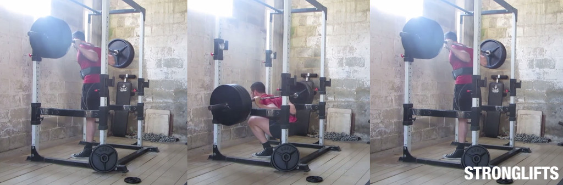
Stronglifts 5x5 – Exercises - Squat
Squat
Feet Forward
Tilted out no more then 30 degrees
Knees Out
Straight Back
Move hips past knees
stronglifts.com

Slide 9
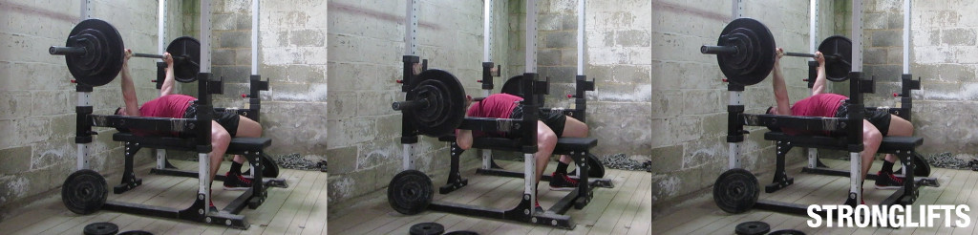
Stronglifts 5x5 – Exercises – Bench Press
Bench Press
Straight Wrists
Back Flat Against Bench
Feet flat on the floor
Lower bar to mid chest
stronglifts.com

Slide 10
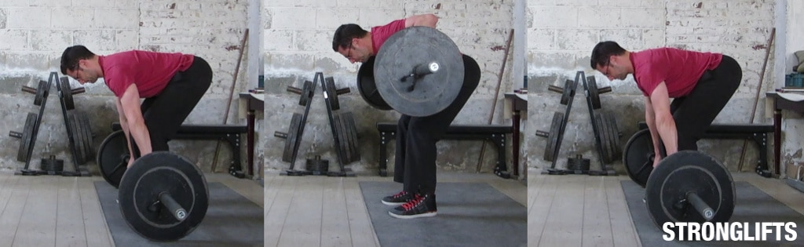
Stronglifts 5x5 – Exercises – Barbell Row
Barbell Row
Feet shoulder width apart
Straight Back
Head neutral
Row up to mid chest
stronglifts.com

Slide 11
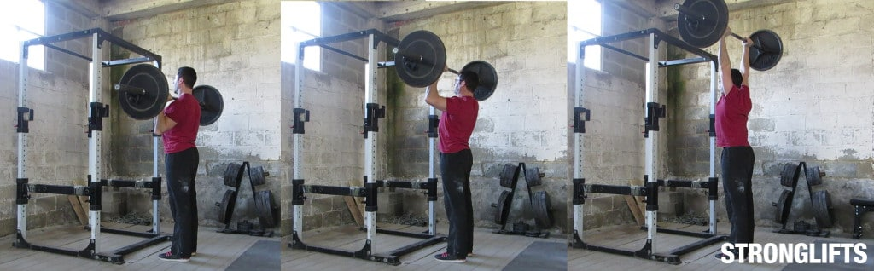
Stronglifts 5x5 – Exercises – Overhead Press
Overhead Press
Elbows under the bar
Hips slightly forward
Head moves under the bar
Lock elbows at apex
stronglifts.com

Slide 12
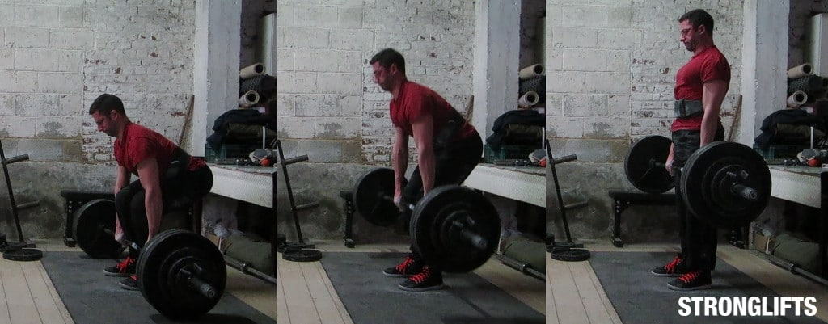
Stronglifts 5x5 – Exercises – Deadlift
Deadlift
“The True Measure of Strength”
Head neutral
Straight Back
Locked elbows
Break with the hips then the knees on the way down
stronglifts.com

