Slide 1
Solving WordBrain A Breadth First Search of a Problem With Great Depth
Feb 11th, 2016 – Houston Perl Mongers
Robert Stone
BrainStorm Incubator

Slide 2

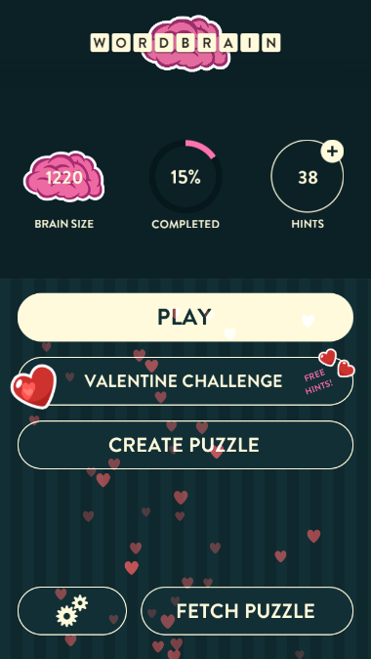

Overview
Search Algorithms
Depth First
Breadth First
About WordBrain
History
WordBrain Popularity
Gameplay
Object of the Game
Rules and How to Play
Caveats
Solving WordBrain
Modeling The Problem
WordBrain::Game->solve
WordBrain::Solver
Running The Solver
Performance
NYTProf
Ideas for Improvement
catcheshire
Thinkstock

Slide 3
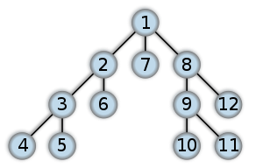
Search Algorithms – Depth First
Depth First Search
Starting at a root node
Identify an unvisited neighboring node connected via an edge
Follow the edge to the neighboring node
Repeat steps 2 – 3 until there are no more unvisited neighboring nodes
Backup to the parent node
Repeat steps 2 – 3 until there are no more unvisited neighboring nodes
Repeated steps 5 – 6 until there are no more unvisited neighboring nodes.
Wikipedia

Slide 4
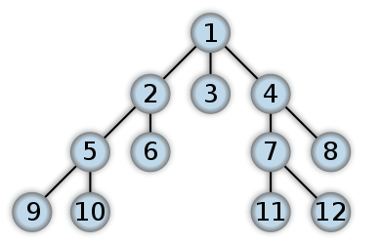
Search Algorithms – Breadth First
Breadth First Search
Starting at a root node
Identify an unvisited neighboring node connected via an edge
Follow the edge to the neighboring node
Backup to the parent node
Repeat steps 2 – 4 until there are no more unvisited neighboring nodes
The first neighboring node explored becomes the new root
Repeat steps 2 – 5 until there are no more unvisited neighboring nodes
Repeated steps 6 – 7, using nodes in the order they were first visited until there are no more unvisited nodes.
Wikipedia

Slide 5
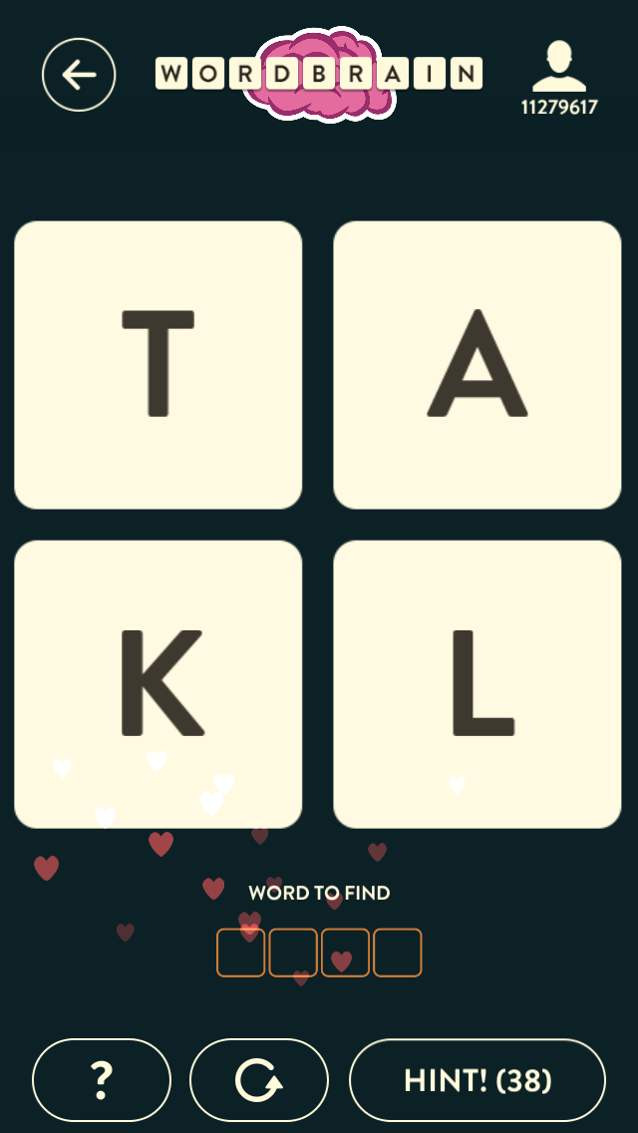
WordBrain – Gameplay
Grid of Letters
2x2 up to 8x8
List of Words to Find
Range in Size and Number of Words to Find
Given
Number of Words to Find
Length of Each Word
Letters from Grid comprise each word
ONLY ONE “RIGHT” SOLUTION
There are multiple solutions, but only one accepted one
No Time Limit
Limited Number of Hints
$$$

Slide 6
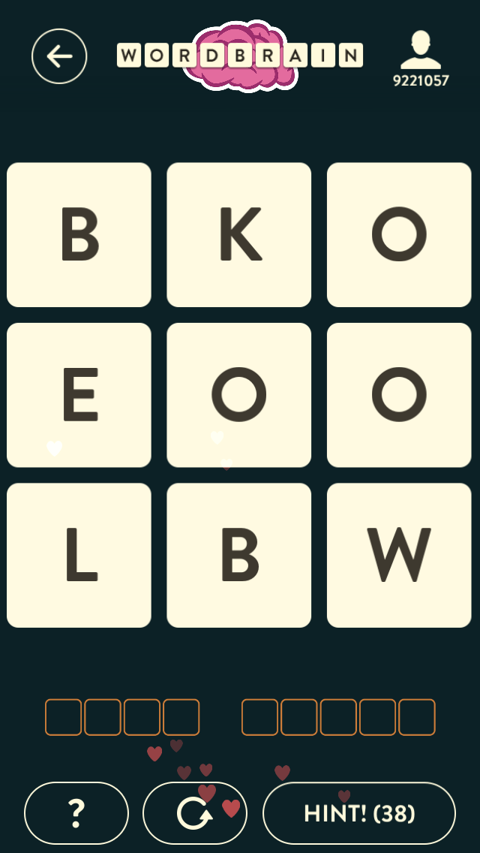
WordBrain – Gameplay
Let’s Play A Quick Game!
Touch Letters For Potential Words
Remember, the letters must touch in one of the eight cardinal directions

Slide 7
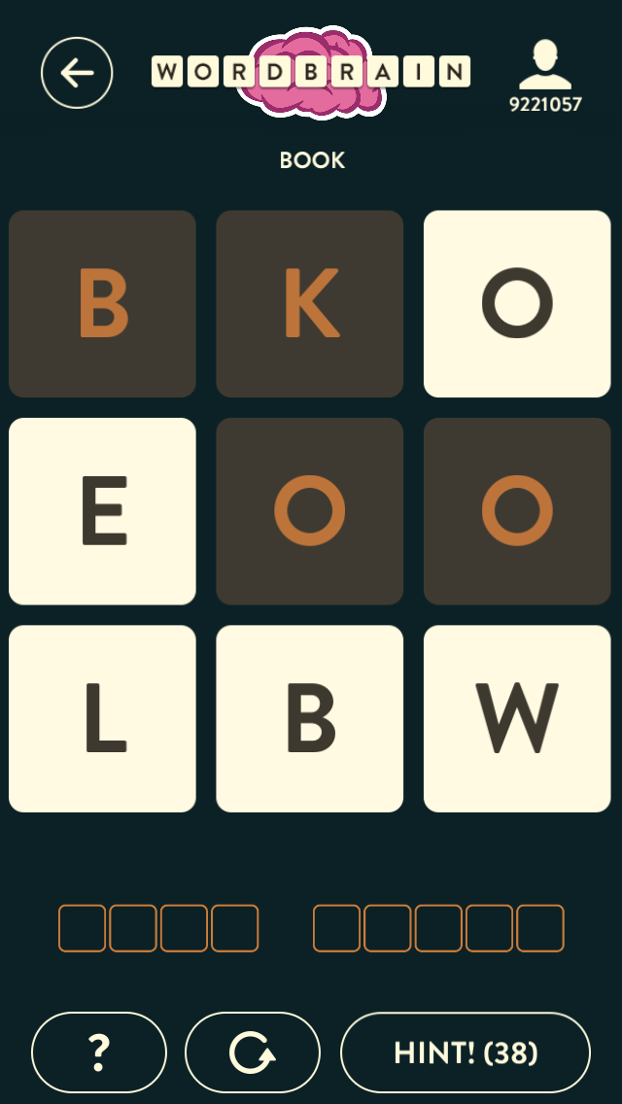
WordBrain – Gameplay
Let’s Play A Quick Game!
Touch Letters For Potential Words
Remember, the letters must touch in one of the eight cardinal directions
If the Selected Word is Correct
Letters Are Removed
Letters Remaining Shift Down

Slide 8
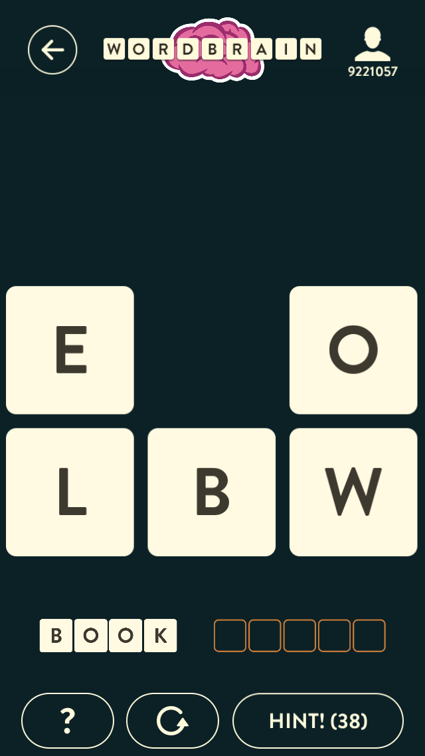
WordBrain – Gameplay
Let’s Play A Quick Game!
Touch Letters For Potential Words
Remember, the letters must touch in one of the eight cardinal directions
If the Selected Word is Correct
Letters Are Removed
Letters Remaining Shift Down
Repeat Selecting Words Until All Needed Words Are Found

Slide 9
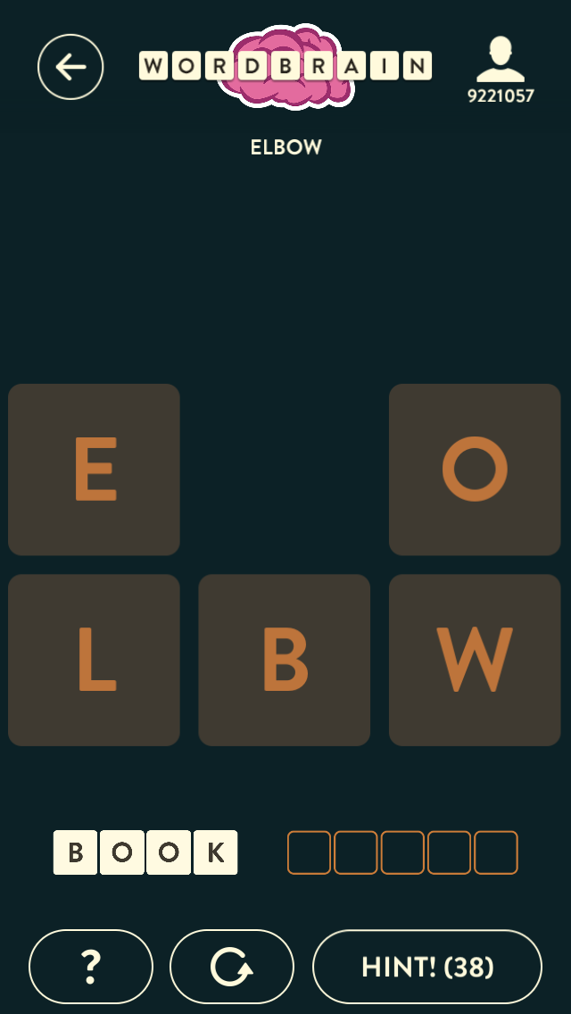
WordBrain – Gameplay
Let’s Play A Quick Game!
Touch Letters For Potential Words
Remember, the letters must touch in one of the eight cardinal directions
If the Selected Word is Correct
Letters Are Removed
Letters Remaining Shift Down
Repeat Selecting Words Until All Needed Words Are Found

Slide 10
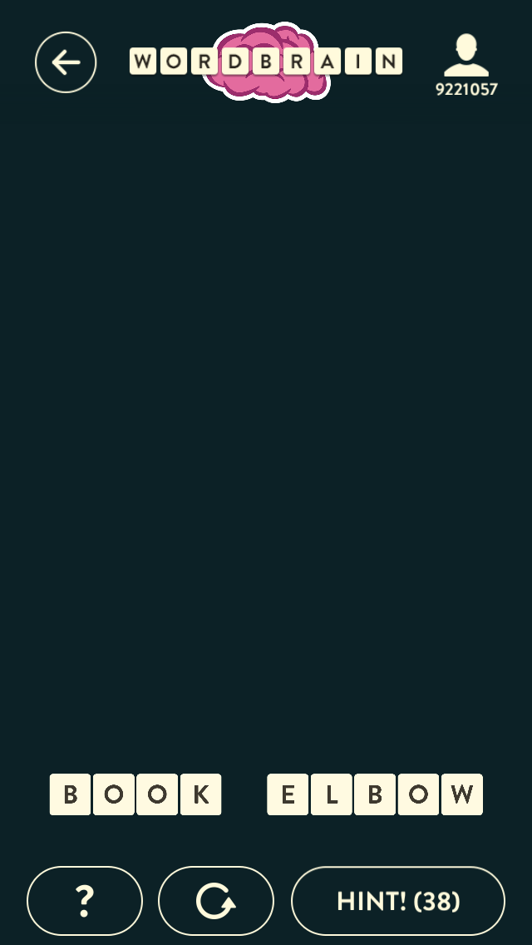
WordBrain – Gameplay
Let’s Play A Quick Game!
Touch Letters For Potential Words
Remember, the letters must touch in one of the eight cardinal directions
If the Selected Word is Correct
Letters Are Removed
Letters Remaining Shift Down
Repeat Selecting Words Until All Needed Words Are Found
Once All Words Are Found, You Win!

Slide 11
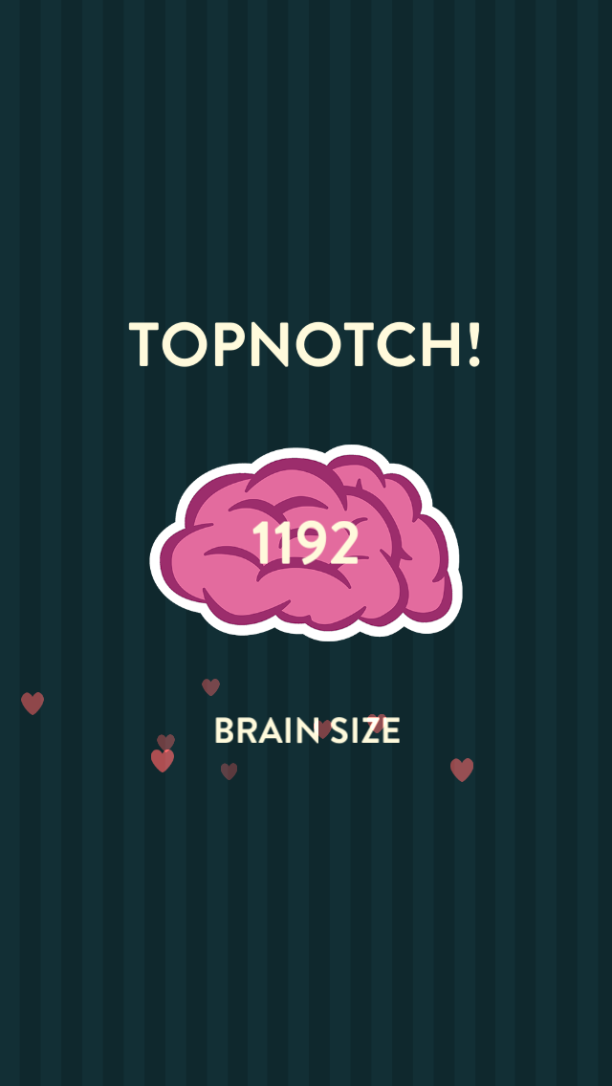
WordBrain – Gameplay
Let’s Play A Quick Game!
Touch Letters For Potential Words
Remember, the letters must touch in one of the eight cardinal directions
If the Selected Word is Correct
Letters Are Removed
Letters Remaining Shift Down
Repeat Selecting Words Until All Needed Words Are Found
Once All Words Are Found, You Win!

Slide 12
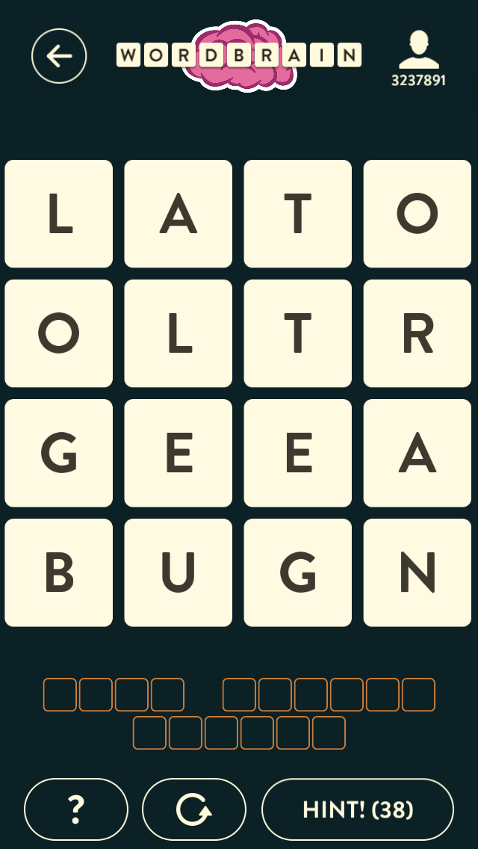
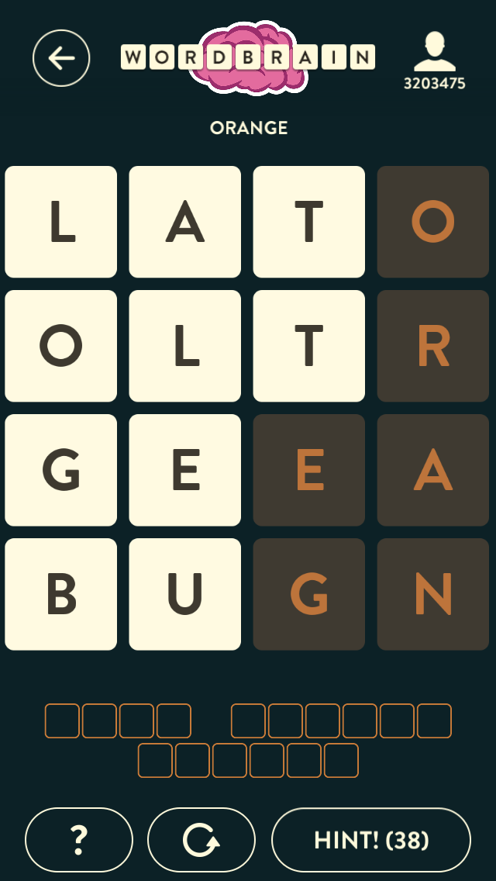
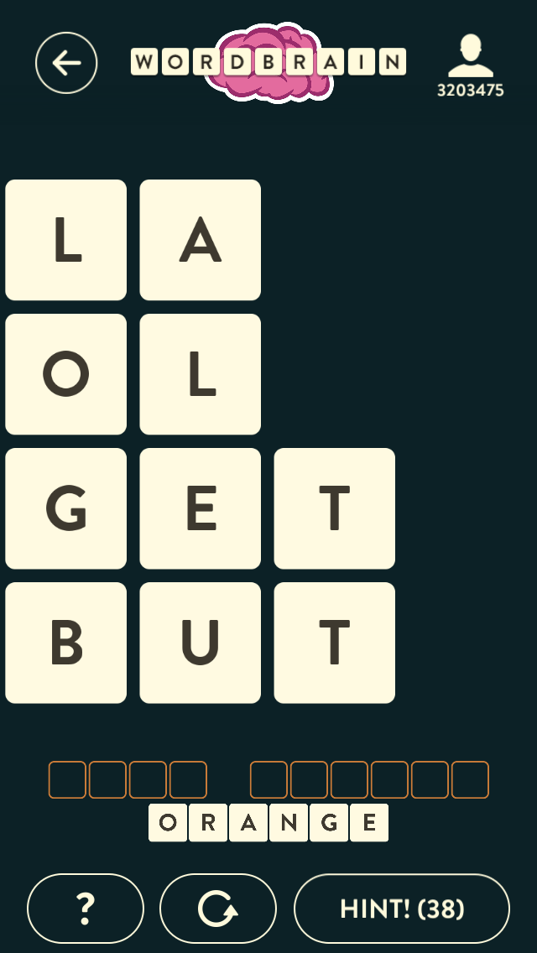
WordBrain – Gameplay
Sounds Easy Right!?!
Caveats
Multiple Solutions But Only One “Accepted” Solution
Words Must Be Selected In Right order using the right letters
Orange
Goat
Bullet

Slide 13
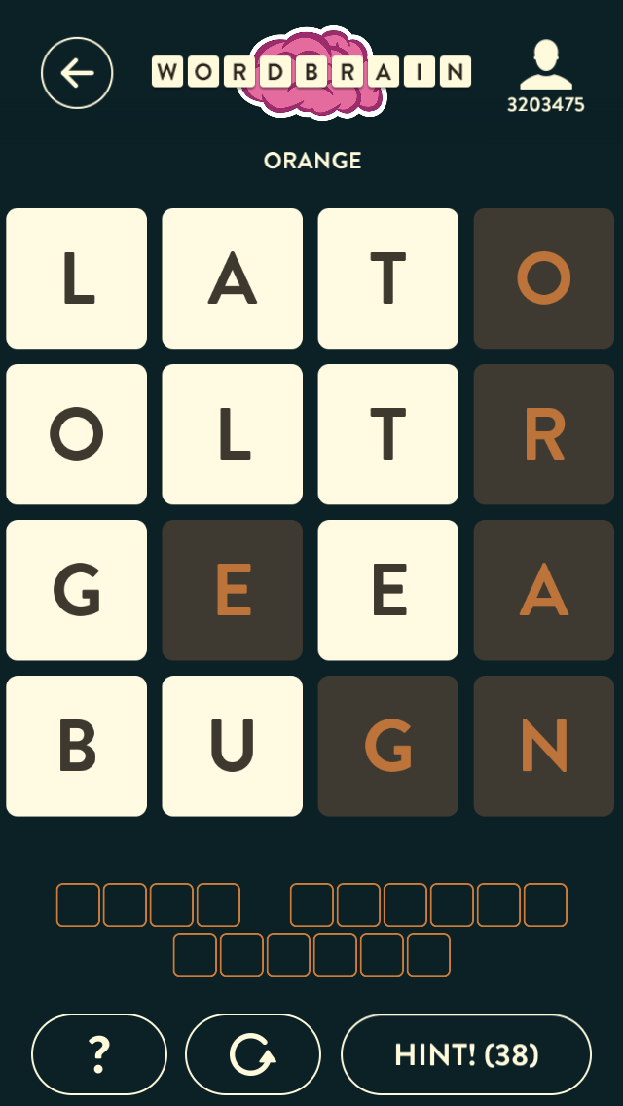
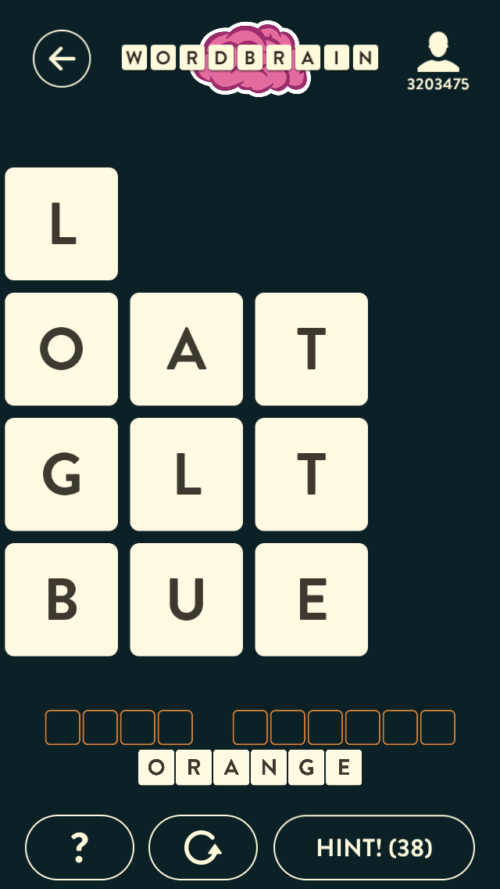
WordBrain – Gameplay
Sounds Easy Right!?!
Caveats
Multiple Solutions But Only One “Accepted” Solution
Words Must Be Selected In Right order using the right letters
Orange
Goat
Bullet

Slide 14
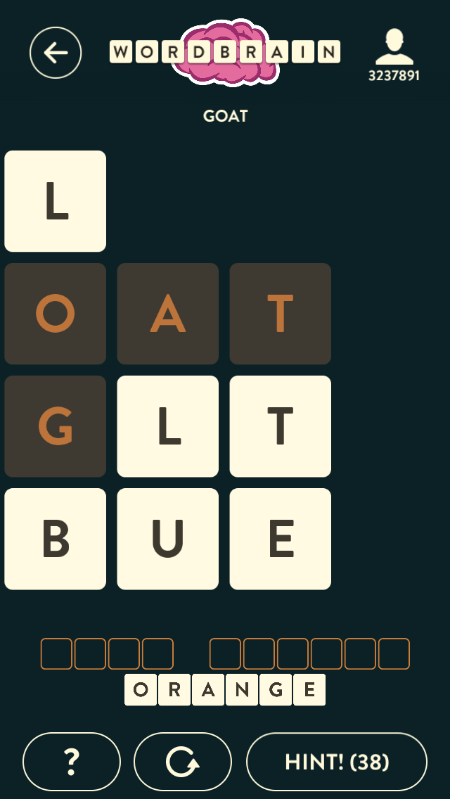
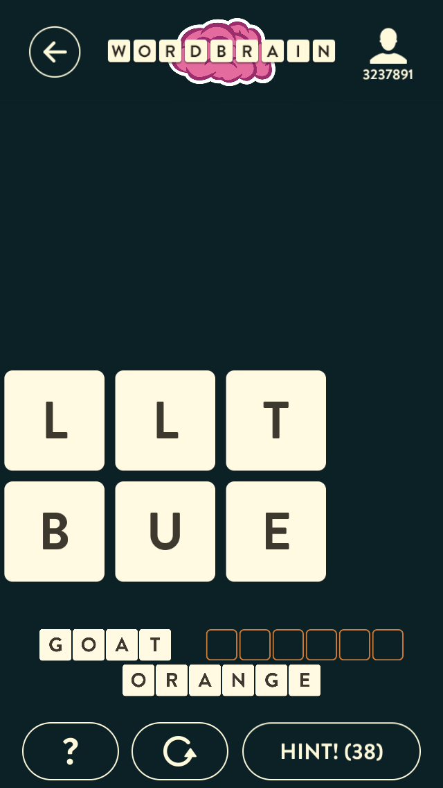
WordBrain – Gameplay
Sounds Easy Right!?!
Caveats
Multiple Solutions But Only One “Accepted” Solution
Words Must Be Selected In Right order using the right letters
Orange
Goat
Bullet

Slide 15
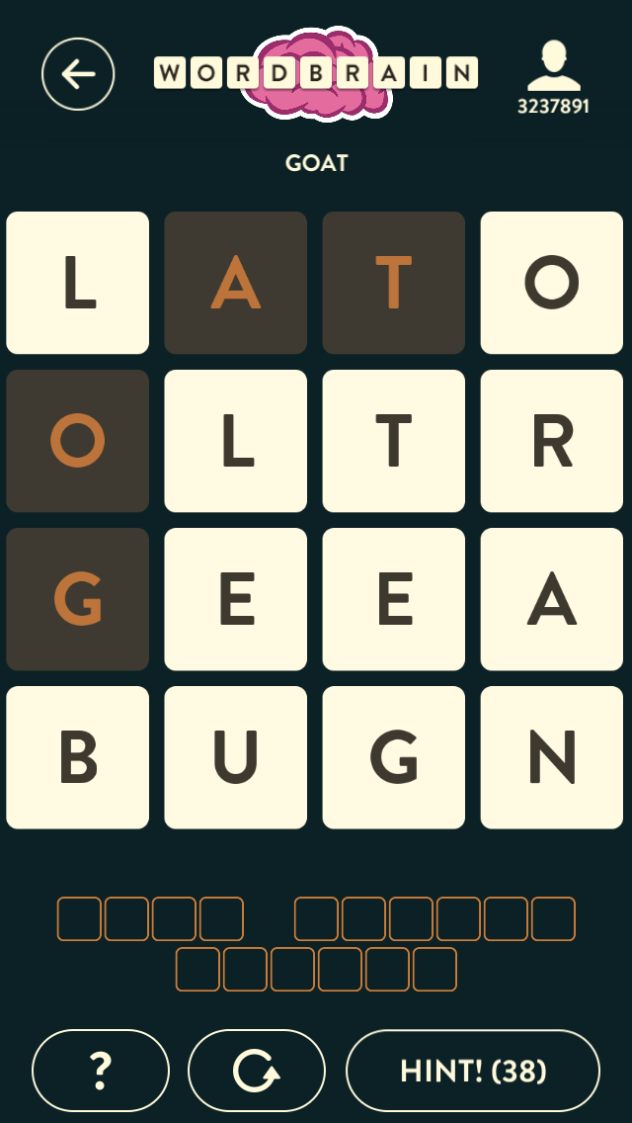
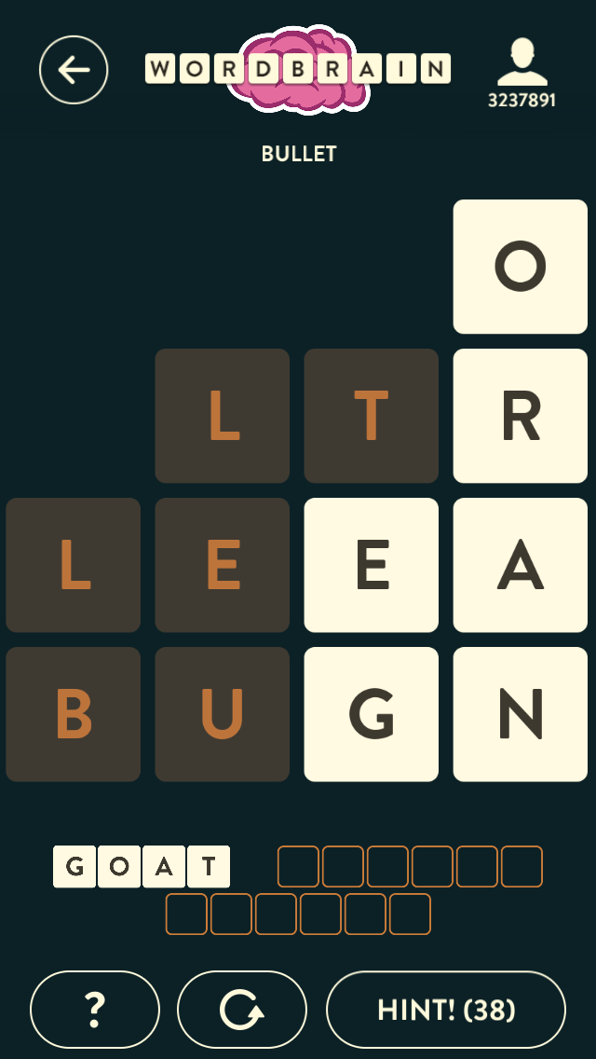
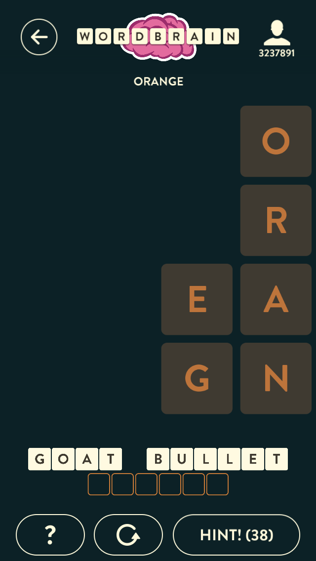
WordBrain – Gameplay

Slide 16
WordBrain – Gameplay
Sounds Easy Right!?!
Caveats
Multiple Solutions But Only One “Accepted” Solution
Words Must Be Selected In Right order using the right letters
Orange
Goat
Bullet
Multiple Ways To Select a Word, But Some Leave the Board Unplayable
Remember, the letters must be touching to be selectable!

Slide 17
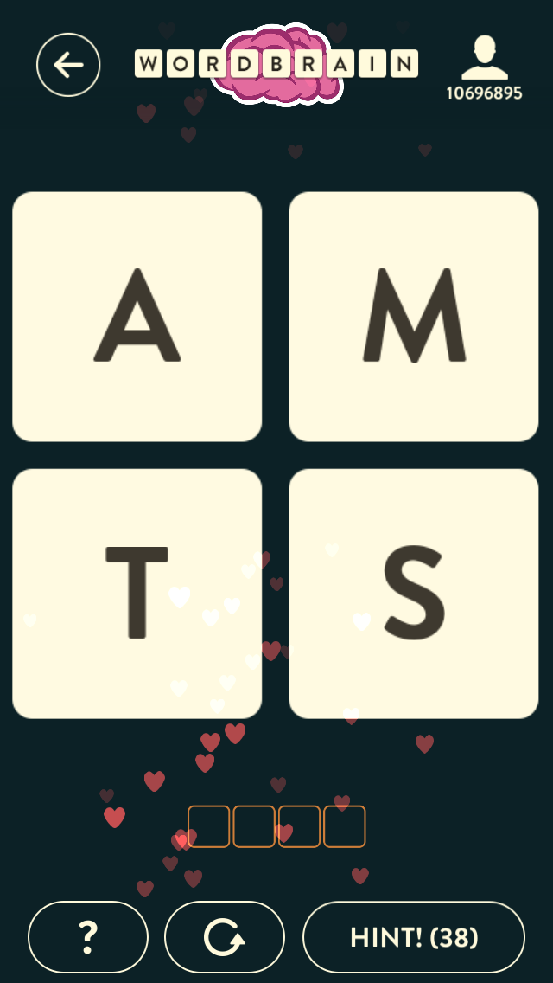
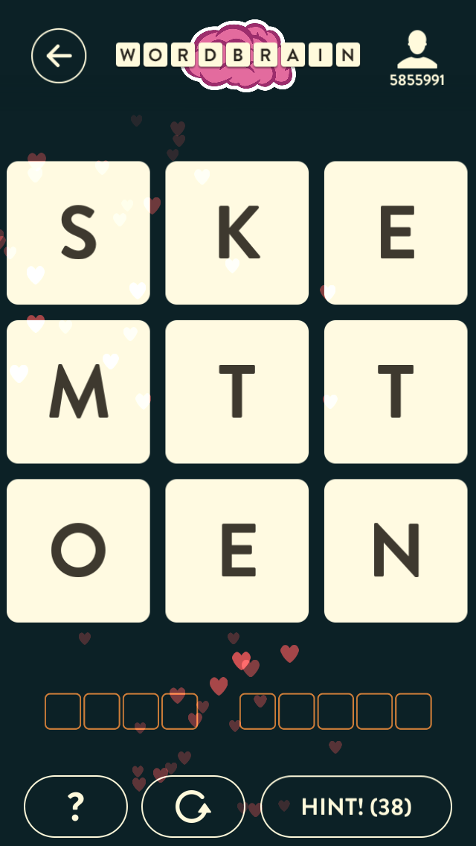
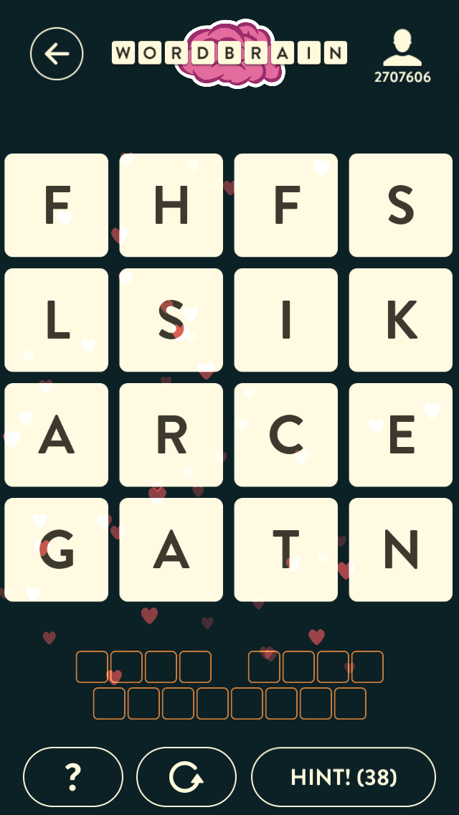
WordBrain – Modeling The Problem

Slide 18



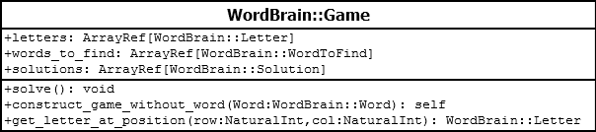

WordBrain – Modeling The Problem
WordBrain::Game
An Entire Game
WordBrain::Letter
A Single Letter
WordBrain::WordToFind
Information We Know About a Word We Must Find
WordBrain::Solution
A Possible Answer
WordBrain::Word
A Possible Answer For One of the Words We Must Find

Slide 19
WordBrain::Game->solve
sub solve {
my $self = shift;
my $max_word_length = 0;
for my $word_to_find (@{ $self->words_to_find }) {
if( $max_word_length < $word_to_find->num_letters ) {
$max_word_length = $word_to_find->num_letters;
}
}
my @solutions;
for my $letter (@{ $self->letters }) {
my $possible_words = find_near_words(
letter => $letter,
game => $self,
max_word_length => $max_word_length,
);
Max Needed Word =
8 Characters
Max Possible Word =
16 Characters!

Slide 20
WordBrain::Game->solve
sub solve {
my $self = shift;
my $max_word_length = 0;
for my $word_to_find (@{ $self->words_to_find }) {
if( $max_word_length < $word_to_find->num_letters ) {
$max_word_length = $word_to_find->num_letters;
}
}
my @solutions;
for my $letter (@{ $self->letters }) {
my $possible_words = find_near_words(
letter => $letter,
game => $self,
max_word_length => $max_word_length,
);
my @actual_words;
for my $possible_word (@{ $possible_words }) {
if( grep {
$_->num_letters == length ( $possible_word->word )
} @{ $self->words_to_find } ) {
if( spellcheck_word( $possible_word ) ) {
push @actual_words, $possible_word;
}
}
}
F
FL
FLA
FLAG
FLAGA
FLAGAR
FLAGARS
FLAGARSH
FLAGARSF
FLAGARSI
FLAGARI
FLAGARIS
FLAGARIH
FLAGARIF
FLAGARIS
…
FLAG
FLAGARSH
FLAGARSF
FLAGARSI
FLAGARIS
FLAGARIH
FLAGARIF
FLAGARIS

Slide 21
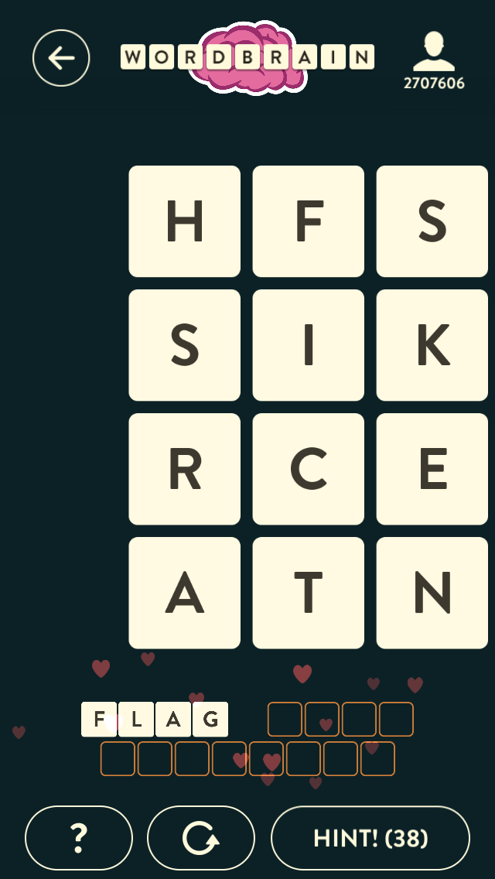
WordBrain::Game->solve
sub solve {
my $self = shift;
# Get Max Word Length
my @solutions;
for my $letter (@{ $self->letters }) {
# Find Near Words
# Check Length of Found Words
# Spell Check Words into @actual_words
for my $word ( @actual_words ) {
if( scalar @{ $self->words_to_find } > 1 ) {
my $updated_game = $self->construct_game_without_word( $word );
my $updated_game_solutions = $updated_game->solve();
for my $updated_game_solution (@{ $updated_game_solutions }) {
push @solutions, WordBrain::Solution->new(
words => [ $word, @{ $updated_game_solution->words } ],
);
}
}
else {
push @solutions, WordBrain::Solution->new(
words => [ $word ],
);
}
}
}
$self->_set_solutions( \@solutions );
}

Slide 22
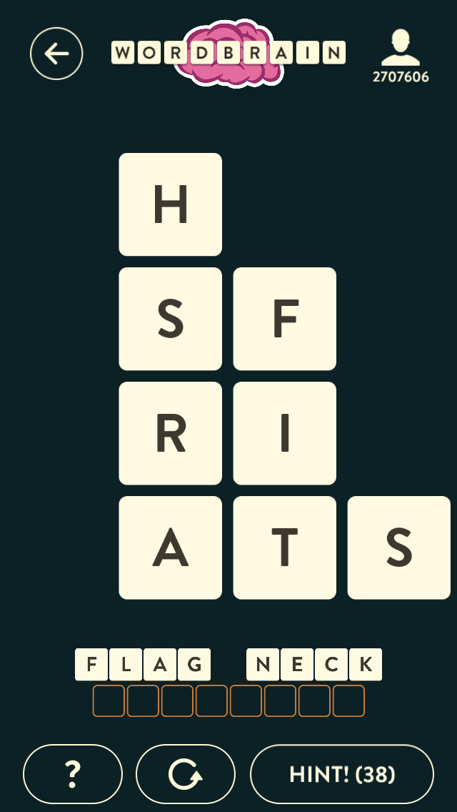
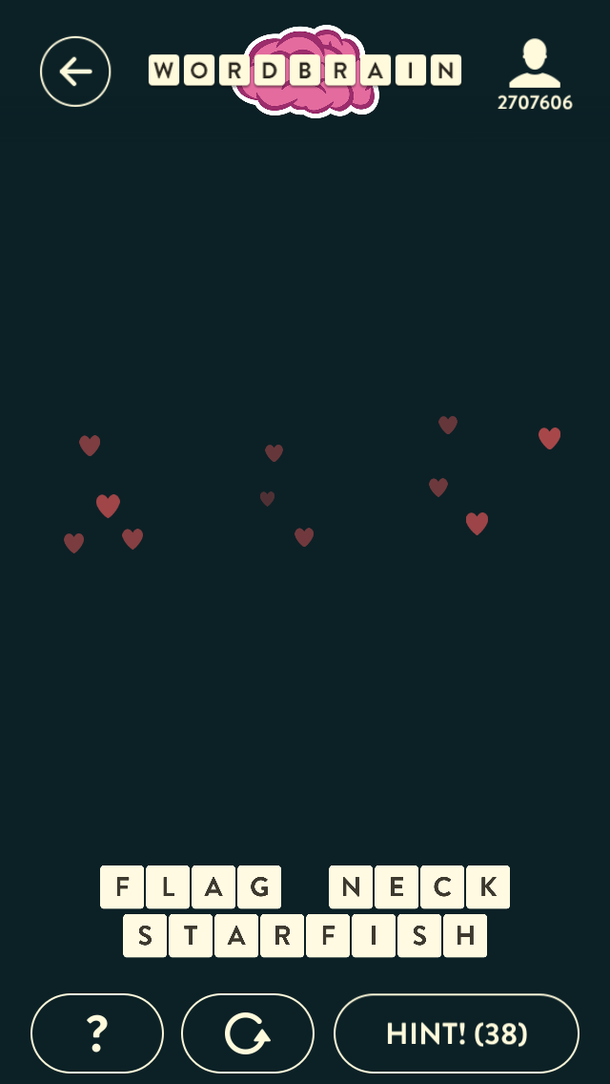
WordBrain::Game->solve

Slide 23
WordBrain::Solver->find_near_letters
# No MooseX::Params::Validate for Performance Reasons
sub find_near_letters {
my %args = @_ == 1 && is_hash_ref( $_[0] ) ? %{ $_[0] } : @_;
my @near_letters;
for my $row_offset ( -1, 0, 1 ) {
for my $col_offset ( -1, 0, 1 ) {
if( $row_offset == 0 && $col_offset == 0 ) {
### Skipping Center Letter
next;
}
my $near_row_number = $args{row_number} + $row_offset;
my $near_col_number = $args{col_number} + $col_offset;
my $letter = $args{game}->get_letter_at_position(
row => $near_row_number,
col => $near_col_number,
);
if( !$letter ) {
next;
}
if( grep { $_ == $letter } @{ $args{used} } ) {
### Skipping Already Used Letter
next;
}
push @near_letters, $letter;
}
}
return \@near_letters;
}
F
-
1
0
1
-
1
S
F
H
X
X
0
X
X
X
1
S
F
R
S
F
I
X

Slide 24
WordBrain::Game->find_near_words
sub solve {
my $self = shift;
my $max_word_length = 0;
for my $word_to_find (@{ $self->words_to_find }) {
if( $max_word_length < $word_to_find->num_letters ) {
$max_word_length = $word_to_find->num_letters;
}
}
my @solutions;
for my $letter (@{ $self->letters }) {
my $possible_words = find_near_words(
letter => $letter,
game => $self,
max_word_length => $max_word_length,
);
...
# No MooseX::Params::Validate for Performance Reasons
sub find_near_words {
my %args = @_ == 1 && is_hash_ref( $_[0] ) ? %{ $_[0] } : @_;
$args{used} //= [ ];
$args{max_word_length} //= scalar @{ $args{game}->letters };
return _find_near_words(
word_root => WordBrain::Word->new( letters => [ $args{letter} ] ),
letter => $args{letter},
game => $args{game},
used => $args{used},
max_word_length => $args{max_word_length},
);
}

Slide 25
WordBrain::Game->find_near_words
# No MooseX::Params::Validate for Performance Reasons
sub _find_near_words {
my %args = @_ == 1 && is_hash_ref( $_[0] ) ? %{ $_[0] } : @_;
push @{ $args{used} }, $args{letter};
if( scalar @{ $args{word_root}->letters } >= $args{max_word_length} ) {
return [ ];
}
my $near_letters = find_near_letters(
used => $args{used},
game => $args{game},
row_number => $args{letter}->row,
col_number => $args{letter}->col,
);
my @words;
for my $near_letter (@{ $near_letters }) {
my $new_word_root = WordBrain::Word->new(
letters => [ @{ $args{word_root}->letters }, $near_letter ]
);
push @words, $new_word_root;
my $near_letter_used = dclone $args{used};
push @words, @{
_find_near_words(
word_root => $new_word_root,
letter => $near_letter,
game => $args{game},
used => $near_letter_used,
max_word_length => $args{max_word_length},
);
};
}
return \@words;
}
F
FL
FLA
FLAG
FLAGA
FLAGAR
FLAGARS
FLAGARSH
FLAGARSF
FLAGARSI
FLAGARI
FLAGARIS
FLAGARIH
FLAGARIF
FLAGARIS
…

Slide 26
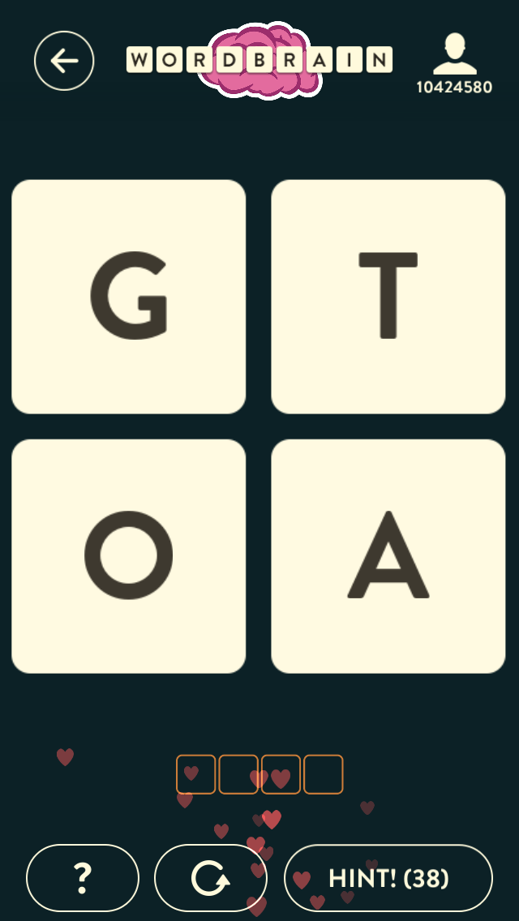
Running the Solver
perl -I lib script/play.pl --playfield="g,t,o,a" --word-to-find=4
======= Game =======
g t
o a
===== Possible Solution =====
Word: goat | g - 0 x 0 | o - 1 x 0 | a - 1 x 1 | t - 0 x 1 |
Word: toga | t - 0 x 1 | o - 1 x 0 | g - 0 x 0 | a - 1 x 1 |
real 0m0.357s
user 0m0.308s
sys 0m0.026s

Slide 27
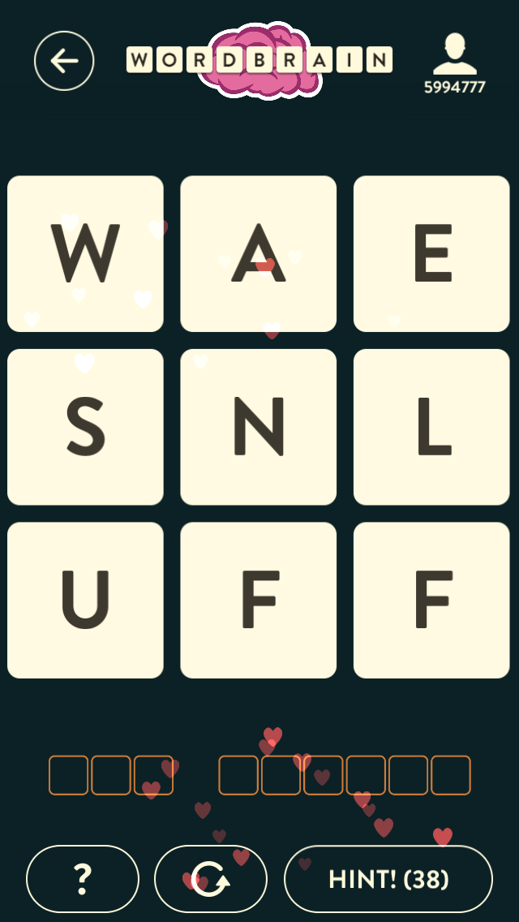
Running the Solver
perl script/play.pl --playfield="w,a,e,s,n,l,u,f,f" \
--word-to-find=3 \
--word-to-find=6
======= Game =======
w a e
s n l
u f f
===== Possible Solution =====
Word: nus | n - 1 x 1 | u - 2 x 0 | s - 1 x 0 |
Word: waffle | w - 2 x 0 | a - 1 x 1 | f - 2 x 1 | f - 2 x 2 | l - 1 x 2 | e - 0 x 2 |
Word: sun | s - 1 x 0 | u - 2 x 0 | n - 1 x 1 |
Word: waffle | w - 2 x 0 | a - 1 x 1 | f - 2 x 1 | f - 2 x 2 | l - 1 x 2 | e - 0 x 2 |
real 0m1.648s
user 0m1.625s
sys 0m0.019s

Slide 28
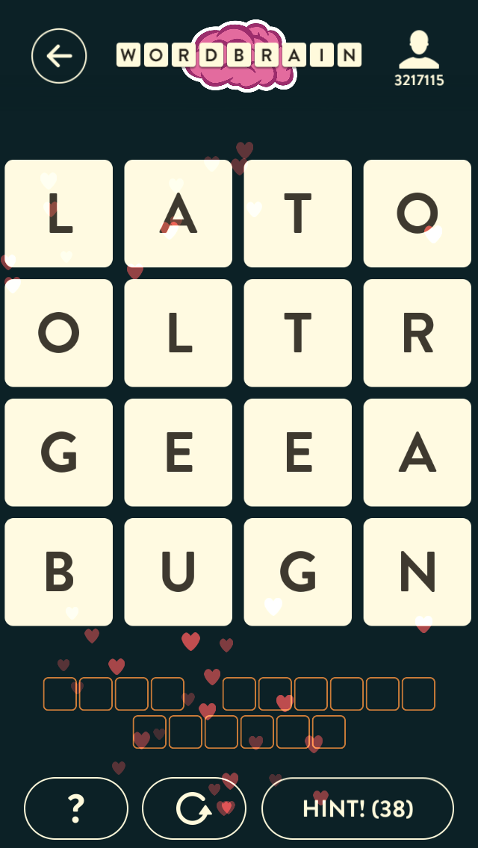
Running the Solver
perl script/play.pl --playfield="l,a,t,o,o,l,t,r,g,e,e,a,b,u,g,n" \
--word-to-find=4 \
--word-to-find=6 \
--word-to-find=6 \
======= Game =======
l a t o
o l t r
g e e a
b u g n
===== Possible Solution =====
Word: rotten | r - 1 x 3 | o - 0 x 3 | t - 0 x 2 | t - 1 x 2 | e - 2 x 2 | n - 3 x 3 |
Word: goal | g - 2 x 0 | o - 1 x 0 | a - 0 x 1 | l - 1 x 1 |
Word: beluga | b - 3 x 0 | e - 2 x 1 | l - 2 x 0 | u - 3 x 1 | g - 3 x 2 | a - 3 x 3 |
Word: goat | g - 2 x 0 | o - 1 x 0 | a - 0 x 1 | t - 0 x 2 |
Word: bullet | b - 3 x 0 | u - 3 x 1 | l - 2 x 0 | l - 1 x 1 | e - 2 x 1 | t - 1 x 2 |
Word: orange | o - 0 x 3 | r - 1 x 3 | a - 2 x 3 | n - 3 x 3 | g - 3 x 2 | e - 2 x 2 |
Word: orange | o - 0 x 3 | r - 1 x 3 | a - 2 x 3 | n - 3 x 3 | g - 3 x 2 | e - 2 x 1 |
Word: bullet | b - 3 x 0 | u - 3 x 1 | l - 2 x 0 | l - 2 x 1 | e - 3 x 2 | t - 2 x 2 |
Word: goal | g - 2 x 0 | o - 1 x 0 | a - 0 x 1 | l - 1 x 1 |
Word: rotten | r - 1 x 3 | o - 0 x 3 | t - 0 x 2 | t - 1 x 2 | e - 2 x 2 | n - 3 x 3 |
Word: beluga | b - 3 x 0 | e - 2 x 1 | l - 2 x 0 | u - 3 x 1 | g - 3 x 2 | a - 3 x 3 |
Word: beluga | b - 3 x 0 | e - 2 x 1 | l - 2 x 0 | u - 3 x 1 | g - 3 x 2 | a - 2 x 3 |
Word: rotten | r - 2 x 3 | o - 1 x 3 | t - 1 x 2 | t - 2 x 2 | e - 3 x 2 | n - 3 x 3 |
Word: orange | o - 0 x 3 | r - 1 x 3 | a - 2 x 3 | n - 3 x 3 | g - 3 x 2 | e - 2 x 1 |
Word: goat | g - 2 x 0 | o - 1 x 0 | a - 1 x 1 | t - 1 x 2 |
Word: bullet | b - 3 x 0 | u - 3 x 1 | l - 2 x 0 | l - 2 x 1 | e - 3 x 2 | t - 2 x 2 |
real 1m24.766s
user 1m24.765s
sys 0m0.026s

Slide 29
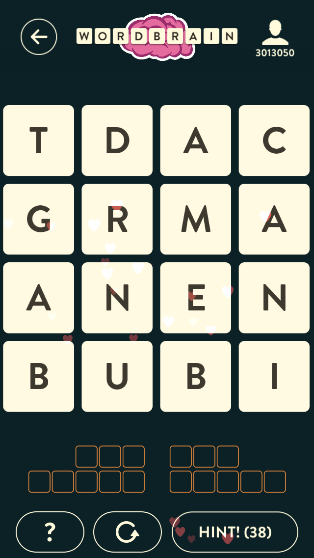
Running the Solver
perl script/play.pl --playfield="t,d,a,c,g,r,m,a,a,n,e,n,b,u,b,i" \
--word-to-find=3 \
--word-to-find=3 \
--word-to-find=5 \
--word-to-find=5 \
======= Game =======
t d a c
g r m a
a n e n
b u b i
Word: bag | b - 3 x 0 | a - 2 x 0 | g - 1 x 0 |
Word: nut | n - 2 x 1 | u - 3 x 1 | t - 3 x 0 |
Word: dream | d - 2 x 1 | r - 3 x 1 | e - 2 x 2 | a - 1 x 3 | m - 1 x 2 |
Word: cabin | c - 1 x 3 | a - 2 x 2 | b - 3 x 2 | i - 3 x 3 | n - 2 x 3 |
===== Possible Solution =====
Word: ban | b - 3 x 0 | a - 2 x 0 | n - 2 x 1 |
Word: cam | c - 0 x 3 | a - 1 x 3 | m - 1 x 2 |
Word: tubed | t - 2 x 0 | u - 3 x 1 | b - 3 x 2 | e - 2 x 2 | d - 1 x 1 |
Word: grain | g - 3 x 0 | r - 3 x 1 | a - 3 x 2 | i - 3 x 3 | n - 2 x 3 |
Word: debug | d - 1 x 1 | e - 2 x 2 | b - 3 x 2 | u - 3 x 1 | g - 3 x 0 |
Word: train | t - 3 x 0 | r - 3 x 1 | a - 3 x 2 | i - 3 x 3 | n - 2 x 3 |
Word: debut | d - 1 x 1 | e - 2 x 2 | b - 3 x 2 | u - 3 x 1 | t - 2 x 0 |
Word: grain | g - 3 x 0 | r - 3 x 1 | a - 3 x 2 | i - 3 x 3 | n - 2 x 3 |
Word: tubed | t - 2 x 0 | u - 3 x 1 | b - 3 x 2 | e - 2 x 2 | d - 1 x 1 |
Word: grain | g - 3 x 0 | r - 3 x 1 | a - 2 x 2 | i - 3 x 3 | n - 2 x 3 |
Word: mac | m - 3 x 2 | a - 3 x 3 | c - 2 x 3 |
Word: cam | c - 2 x 3 | a - 3 x 3 | m - 3 x 2 |
Word: gut | g - 3 x 0 | u - 3 x 1 | t - 2 x 0 |
Word: dream | d - 2 x 1 | r - 3 x 1 | e - 2 x 2 | a - 1 x 3 | m - 1 x 2 |
Word: cabin | c - 1 x 3 | a - 2 x 2 | b - 3 x 2 | i - 3 x 3 | n - 2 x 3 |
Word: debug | d - 1 x 1 | e - 2 x 2 | b - 3 x 2 | u - 3 x 1 | g - 3 x 0 |
Word: train | t - 3 x 0 | r - 3 x 1 | a - 2 x 2 | i - 3 x 3 | n - 2 x 3 |
Word: mac | m - 3 x 2 | a - 3 x 3 | c - 2 x 3 |
Word: cam | c - 2 x 3 | a - 3 x 3 | m - 3 x 2 |
Word: mac | m - 1 x 2 | a - 1 x 3 | c - 0 x 3 |
Word: debug | d - 1 x 1 | e - 2 x 2 | b - 3 x 2 | u - 3 x 1 | g - 3 x 0 |
Word: train | t - 3 x 0 | r - 3 x 1 | a - 3 x 2 | i - 3 x 3 | n - 2 x 3 |
Word: tubed | t - 2 x 0 | u - 3 x 1 | b - 3 x 2 | e - 2 x 2 | d - 1 x 1 |
Word: grain | g - 3 x 0 | r - 3 x 1 | a - 3 x 2 | i - 3 x 3 | n - 2 x 3 |
Word: debut | d - 1 x 1 | e - 2 x 2 | b - 3 x 2 | u - 3 x 1 | t - 2 x 0 |
Word: grain | g - 3 x 0 | r - 3 x 1 | a - 3 x 2 | i - 3 x 3 | n - 2 x 3 |
Word: tug | t - 2 x 0 | u - 3 x 1 | g - 3 x 0 |
Word: dream | d - 2 x 1 | r - 3 x 1 | e - 2 x 2 | a - 1 x 3 | m - 1 x 2 |
Word: cabin | c - 1 x 3 | a - 2 x 2 | b - 3 x 2 | i - 3 x 3 | n - 2 x 3 |
Word: debut | d - 1 x 1 | e - 2 x 2 | b - 3 x 2 | u - 3 x 1 | t - 2 x 0 |
Word: grain | g - 3 x 0 | r - 3 x 1 | a - 2 x 2 | i - 3 x 3 | n - 2 x 3 |
Word: mac | m - 3 x 2 | a - 3 x 3 | c - 2 x 3 |
Word: cam | c - 2 x 3 | a - 3 x 3 | m - 3 x 2 |
Word: dream | d - 1 x 1 | r - 2 x 1 | e - 2 x 2 | a - 1 x 3 | m - 1 x 2 |
Word: cabin | c - 1 x 3 | a - 2 x 2 | b - 3 x 2 | i - 3 x 3 | n - 2 x 3 |
Word: tug | t - 2 x 0 | u - 3 x 1 | g - 3 x 0 |
Word: gut | g - 3 x 0 | u - 3 x 1 | t - 2 x 0 |
Word: gut | g - 3 x 0 | u - 3 x 1 | t - 2 x 0 |
Word: cabin | c - 1 x 3 | a - 2 x 2 | b - 3 x 2 | i - 3 x 3 | n - 2 x 3 |
Word: tug | t - 2 x 0 | u - 3 x 1 | g - 3 x 0 |
Word: cabin | c - 1 x 3 | a - 2 x 2 | b - 3 x 2 | i - 3 x 3 | n - 2 x 3 |
Word: nab | n - 2 x 1 | a - 2 x 0 | b - 3 x 0 |
Word: tug | t - 2 x 0 | u - 3 x 1 | g - 3 x 0 |
Word: dream | d - 2 x 1 | r - 3 x 1 | e - 2 x 2 | a - 1 x 3 | m - 1 x 2 |
Word: cabin | c - 1 x 3 | a - 2 x 2 | b - 3 x 2 | i - 3 x 3 | n - 2 x 3 |
Word: dream | d - 1 x 1 | r - 2 x 1 | e - 2 x 2 | a - 1 x 3 | m - 1 x 2 |
Word: cabin | c - 1 x 3 | a - 2 x 2 | b - 3 x 2 | i - 3 x 3 | n - 2 x 3 |
Word: tug | t - 2 x 0 | u - 3 x 1 | g - 3 x 0 |
Word: gut | g - 3 x 0 | u - 3 x 1 | t - 2 x 0 |
Word: gut | g - 3 x 0 | u - 3 x 1 | t - 2 x 0 |
Word: cabin | c - 1 x 3 | a - 2 x 2 | b - 3 x 2 | i - 3 x 3 | n - 2 x 3 |
Word: tug | t - 2 x 0 | u - 3 x 1 | g - 3 x 0 |
Word: cabin | c - 1 x 3 | a - 2 x 2 | b - 3 x 2 | i - 3 x 3 | n - 2 x 3 |
Word: debut | d - 1 x 1 | e - 2 x 2 | b - 3 x 2 | u - 3 x 1 | t - 2 x 0 |
Word: grain | g - 3 x 0 | r - 3 x 1 | a - 2 x 2 | i - 3 x 3 | n - 2 x 3 |
Word: cam | c - 2 x 3 | a - 3 x 3 | m - 3 x 2 |
Word: mac | m - 3 x 2 | a - 3 x 3 | c - 2 x 3 |
Word: mac | m - 1 x 2 | a - 1 x 3 | c - 0 x 3 |
Word: debug | d - 1 x 1 | e - 2 x 2 | b - 3 x 2 | u - 3 x 1 | g - 3 x 0 |
Word: train | t - 3 x 0 | r - 3 x 1 | a - 3 x 2 | i - 3 x 3 | n - 2 x 3 |
Word: tubed | t - 2 x 0 | u - 3 x 1 | b - 3 x 2 | e - 2 x 2 | d - 1 x 1 |
Word: grain | g - 3 x 0 | r - 3 x 1 | a - 3 x 2 | i - 3 x 3 | n - 2 x 3 |
Word: debut | d - 1 x 1 | e - 2 x 2 | b - 3 x 2 | u - 3 x 1 | t - 2 x 0 |
Word: grain | g - 3 x 0 | r - 3 x 1 | a - 3 x 2 | i - 3 x 3 | n - 2 x 3 |
Word: cam | c - 0 x 3 | a - 1 x 3 | m - 1 x 2 |
Word: debug | d - 1 x 1 | e - 2 x 2 | b - 3 x 2 | u - 3 x 1 | g - 3 x 0 |
Word: train | t - 3 x 0 | r - 3 x 1 | a - 3 x 2 | i - 3 x 3 | n - 2 x 3 |
Word: tubed | t - 2 x 0 | u - 3 x 1 | b - 3 x 2 | e - 2 x 2 | d - 1 x 1 |
Word: grain | g - 3 x 0 | r - 3 x 1 | a - 3 x 2 | i - 3 x 3 | n - 2 x 3 |
Word: debut | d - 1 x 1 | e - 2 x 2 | b - 3 x 2 | u - 3 x 1 | t - 2 x 0 |
Word: grain | g - 3 x 0 | r - 3 x 1 | a - 3 x 2 | i - 3 x 3 | n - 2 x 3 |
Word: gut | g - 3 x 0 | u - 3 x 1 | t - 2 x 0 |
Word: dream | d - 2 x 1 | r - 3 x 1 | e - 2 x 2 | a - 1 x 3 | m - 1 x 2 |
Word: cabin | c - 1 x 3 | a - 2 x 2 | b - 3 x 2 | i - 3 x 3 | n - 2 x 3 |
Word: tubed | t - 2 x 0 | u - 3 x 1 | b - 3 x 2 | e - 2 x 2 | d - 1 x 1 |
Word: grain | g - 3 x 0 | r - 3 x 1 | a - 2 x 2 | i - 3 x 3 | n - 2 x 3 |
Word: cam | c - 2 x 3 | a - 3 x 3 | m - 3 x 2 |
Word: mac | m - 3 x 2 | a - 3 x 3 | c - 2 x 3 |
Word: debug | d - 1 x 1 | e - 2 x 2 | b - 3 x 2 | u - 3 x 1 | g - 3 x 0 |
Word: train | t - 3 x 0 | r - 3 x 1 | a - 2 x 2 | i - 3 x 3 | n - 2 x 3 |
Word: mac | m - 3 x 2 | a - 3 x 3 | c - 2 x 3 |
Word: cam | c - 2 x 3 | a - 3 x 3 | m - 3 x 2 |
Word: cam | c - 0 x 3 | a - 1 x 3 | m - 1 x 2 |
Word: nag | n - 2 x 1 | a - 2 x 0 | g - 1 x 0 |
Word: debut | d - 1 x 1 | e - 2 x 2 | b - 3 x 2 | u - 3 x 1 | t - 2 x 0 |
Word: brain | b - 3 x 0 | r - 3 x 1 | a - 3 x 2 | i - 3 x 3 | n - 2 x 3 |
Word: tubed | t - 2 x 0 | u - 3 x 1 | b - 3 x 2 | e - 2 x 2 | d - 1 x 1 |
Word: brain | b - 3 x 0 | r - 3 x 1 | a - 3 x 2 | i - 3 x 3 | n - 2 x 3 |
Word: nab | n - 2 x 1 | a - 2 x 0 | b - 3 x 0 |
Word: debut | d - 1 x 1 | e - 2 x 2 | b - 3 x 2 | u - 3 x 1 | t - 2 x 0 |
Word: grain | g - 3 x 0 | r - 3 x 1 | a - 3 x 2 | i - 3 x 3 | n - 2 x 3 |
Word: tubed | t - 2 x 0 | u - 3 x 1 | b - 3 x 2 | e - 2 x 2 | d - 1 x 1 |
Word: grain | g - 3 x 0 | r - 3 x 1 | a - 3 x 2 | i - 3 x 3 | n - 2 x 3 |
Word: debug | d - 1 x 1 | e - 2 x 2 | b - 3 x 2 | u - 3 x 1 | g - 3 x 0 |
Word: train | t - 3 x 0 | r - 3 x 1 | a - 3 x 2 | i - 3 x 3 | n - 2 x 3 |
Word: ban | b - 3 x 0 | a - 2 x 0 | n - 2 x 1 |
Word: debut | d - 1 x 1 | e - 2 x 2 | b - 3 x 2 | u - 3 x 1 | t - 2 x 0 |
Word: grain | g - 3 x 0 | r - 3 x 1 | a - 3 x 2 | i - 3 x 3 | n - 2 x 3 |
Word: debug | d - 1 x 1 | e - 2 x 2 | b - 3 x 2 | u - 3 x 1 | g - 3 x 0 |
Word: train | t - 3 x 0 | r - 3 x 1 | a - 3 x 2 | i - 3 x 3 | n - 2 x 3 |
Word: tubed | t - 2 x 0 | u - 3 x 1 | b - 3 x 2 | e - 2 x 2 | d - 1 x 1 |
Word: grain | g - 3 x 0 | r - 3 x 1 | a - 3 x 2 | i - 3 x 3 | n - 2 x 3 |
Word: gnu | g - 1 x 0 | n - 2 x 1 | u - 3 x 1 |
Word: dream | d - 2 x 1 | r - 3 x 1 | e - 2 x 2 | a - 1 x 3 | m - 1 x 2 |
Word: tab | t - 1 x 0 | a - 2 x 0 | b - 3 x 0 |
Word: cabin | c - 1 x 3 | a - 2 x 2 | b - 3 x 2 | i - 3 x 3 | n - 2 x 3 |
Word: bat | b - 3 x 0 | a - 2 x 0 | t - 1 x 0 |
Word: cabin | c - 1 x 3 | a - 2 x 2 | b - 3 x 2 | i - 3 x 3 | n - 2 x 3 |
Word: cabin | c - 1 x 3 | a - 2 x 2 | b - 3 x 2 | i - 3 x 3 | n - 2 x 3 |
Word: tab | t - 1 x 0 | a - 2 x 0 | b - 3 x 0 |
Word: bat | b - 3 x 0 | a - 2 x 0 | t - 1 x 0 |
Word: bat | b - 3 x 0 | a - 2 x 0 | t - 1 x 0 |
Word: dream | d - 2 x 1 | r - 3 x 1 | e - 2 x 2 | a - 1 x 3 | m - 1 x 2 |
Word: cabin | c - 1 x 3 | a - 2 x 2 | b - 3 x 2 | i - 3 x 3 | n - 2 x 3 |
Word: tad | t - 1 x 0 | a - 2 x 0 | d - 2 x 1 |
Word: bream | b - 3 x 0 | r - 3 x 1 | e - 2 x 2 | a - 1 x 3 | m - 1 x 2 |
Word: cabin | c - 1 x 3 | a - 2 x 2 | b - 3 x 2 | i - 3 x 3 | n - 2 x 3 |
Word: tab | t - 1 x 0 | a - 2 x 0 | b - 3 x 0 |
Word: dream | d - 2 x 1 | r - 3 x 1 | e - 2 x 2 | a - 1 x 3 | m - 1 x 2 |
Word: cabin | c - 1 x 3 | a - 2 x 2 | b - 3 x 2 | i - 3 x 3 | n - 2 x 3 |
Word: bream | b - 3 x 0 | r - 3 x 1 | e - 2 x 2 | a - 1 x 3 | m - 1 x 2 |
Word: cabin | c - 1 x 3 | a - 2 x 2 | b - 3 x 2 | i - 3 x 3 | n - 2 x 3 |
Word: tad | t - 2 x 0 | a - 3 x 0 | d - 3 x 1 |
Word: tad | t - 2 x 0 | a - 3 x 0 | d - 3 x 1 |
Word: cabin | c - 1 x 3 | a - 2 x 2 | b - 3 x 2 | i - 3 x 3 | n - 2 x 3
|
Word: rag | r - 1 x 1 | a - 2 x 0 | g - 1 x 0 |
Word: amend | a - 1 x 3 | m - 1 x 2 | e - 2 x 2 | n - 2 x 1 | d - 1 x 1 |
Word: tub | t - 2 x 0 | u - 3 x 1 | b - 3 x 0 |
Word: cabin | c - 1 x 3 | a - 2 x 2 | b - 3 x 2 | i - 3 x 3 | n - 2 x 3 |
Word: but | b - 3 x 0 | u - 3 x 1 | t - 2 x 0 |
Word: cabin | c - 1 x 3 | a - 2 x 2 | b - 3 x 2 | i - 3 x 3 | n - 2 x 3 |
Word: cabin | c - 1 x 3 | a - 2 x 2 | b - 3 x 2 | i - 3 x 3 | n - 2 x 3 |
Word: but | b - 3 x 0 | u - 3 x 1 | t - 2 x 0 |
Word: tub | t - 2 x 0 | u - 3 x 1 | b - 3 x 0 |
Word: tub | t - 2 x 0 | u - 3 x 1 | b - 3 x 0 |
Word: amend | a - 1 x 3 | m - 1 x 2 | e - 2 x 2 | n - 3 x 1 | d - 2 x 1 |
Word: cabin | c - 1 x 3 | a - 2 x 2 | b - 3 x 2 | i - 3 x 3 | n - 2 x 3 |
Word: but | b - 3 x 0 | u - 3 x 1 | t - 2 x 0 |
Word: amend | a - 1 x 3 | m - 1 x 2 | e - 2 x 2 | n - 3 x 1 | d - 2 x 1 |
Word: cabin | c - 1 x 3 | a - 2 x 2 | b - 3 x 2 | i - 3 x 3 | n - 2 x 3 |
Word: inert | i - 3 x 3 | n - 2 x 3 | e - 2 x 2 | r - 1 x 1 | t - 0 x 0 |
Word: adman | a - 2 x 0 | d - 1 x 1 | m - 2 x 2 | a - 1 x 2 | n - 2 x 1 |
Word: bug | b - 3 x 0 | u - 3 x 1 | g - 2 x 0 |
Word: cab | c - 2 x 3 | a - 3 x 3 | b - 3 x 2 |
Word: cab | c - 2 x 3 | a - 3 x 3 | b - 3 x 2 |
Word: bug | b - 3 x 0 | u - 3 x 1 | g - 2 x 0 |
Word: mac | m - 1 x 2 | a - 1 x 3 | c - 0 x 3 |
Word: ban | b - 3 x 0 | a - 2 x 0 | n - 2 x 1 |
Word: tubed | t - 2 x 0 | u - 3 x 1 | b - 3 x 2 | e - 2 x 2 | d - 1 x 1 |
Word: grain | g - 3 x 0 | r - 3 x 1 | a - 3 x 2 | i - 3 x 3 | n - 2 x 3 |
Word: debug | d - 1 x 1 | e - 2 x 2 | b - 3 x 2 | u - 3 x 1 | g - 3 x 0 |
Word: train | t - 3 x 0 | r - 3 x 1 | a - 3 x 2 | i - 3 x 3 | n - 2 x 3 |
Word: debut | d - 1 x 1 | e - 2 x 2 | b - 3 x 2 | u - 3 x 1 | t - 2 x 0 |
Word: grain | g - 3 x 0 | r - 3 x 1 | a - 3 x 2 | i - 3 x 3 | n - 2 x 3 |
Word: nab | n - 2 x 1 | a - 2 x 0 | b - 3 x 0 |
Word: tubed | t - 2 x 0 | u - 3 x 1 | b - 3 x 2 | e - 2 x 2 | d - 1 x 1 |
Word: grain | g - 3 x 0 | r - 3 x 1 | a - 3 x 2 | i - 3 x 3 | n - 2 x 3 |
Word: debug | d - 1 x 1 | e - 2 x 2 | b - 3 x 2 | u - 3 x 1 | g - 3 x 0 |
Word: train | t - 3 x 0 | r - 3 x 1 | a - 3 x 2 | i - 3 x 3 | n - 2 x 3 |
Word: debut | d - 1 x 1 | e - 2 x 2 | b - 3 x 2 | u - 3 x 1 | t - 2 x 0 |
Word: grain | g - 3 x 0 | r - 3 x 1 | a - 3 x 2 | i - 3 x 3 | n - 2 x 3 |
Word: nag | n - 2 x 1 | a - 2 x 0 | g - 1 x 0 |
Word: debut | d - 1 x 1 | e - 2 x 2 | b - 3 x 2 | u - 3 x 1 | t - 2 x 0 |
Word: brain | b - 3 x 0 | r - 3 x 1 | a - 3 x 2 | i - 3 x 3 | n - 2 x 3 |
Word: tubed | t - 2 x 0 | u - 3 x 1 | b - 3 x 2 | e - 2 x 2 | d - 1 x 1 |
Word: brain | b - 3 x 0 | r - 3 x 1 | a - 3 x 2 | i - 3 x 3 | n - 2 x 3 |
Word: bag | b - 3 x 0 | a - 2 x 0 | g - 1 x 0 |
Word: nut | n - 2 x 1 | u - 3 x 1 | t - 3 x 0 |
Word: dream | d - 2 x 1 | r - 3 x 1 | e - 2 x 2 | a - 1 x 3 | m - 1 x 2 |
Word: cabin | c - 1 x 3 | a - 2 x 2 | b - 3 x 2 | i - 3 x 3 | n - 2 x 3 |
Word: dream | d - 0 x 1 | r - 1 x 1 | e - 2 x 2 | a - 1 x 3 | m - 1 x 2 |
Word: cabin | c - 1 x 3 | a - 2 x 2 | b - 3 x 2 | i - 3 x 3 | n - 2 x 3 |
Word: tun | t - 3 x 0 | u - 3 x 1 | n - 2 x 1 |
Word: nut | n - 2 x 1 | u - 3 x 1 | t - 3 x 0 |
Word: tun | t - 3 x 0 | u - 3 x 1 | n - 2 x 1 |
Word: cabin | c - 1 x 3 | a - 2 x 2 | b - 3 x 2 | i - 3 x 3 | n - 2 x 3 |
Word: nut | n - 2 x 1 | u - 3 x 1 | t - 3 x 0 |
Word: cabin | c - 1 x 3 | a - 2 x 2 | b - 3 x 2 | i - 3 x 3 | n - 2 x 3 |
Word: tun | t - 3 x 0 | u - 3 x 1 | n - 2 x 1 |
Word: dream | d - 2 x 1 | r - 3 x 1 | e - 2 x 2 | a - 1 x 3 | m - 1 x 2 |
Word: cabin | c - 1 x 3 | a - 2 x 2 | b - 3 x 2 | i - 3 x 3 | n - 2 x 3 |
Word: art | a - 2 x 0 | r - 1 x 1 | t - 0 x 0 |
Word: amend | a - 1 x 3 | m - 1 x 2 | e - 2 x 2 | n - 2 x 1 | d - 1 x 1 |
Word: cabin | c - 1 x 3 | a - 2 x 2 | b - 3 x 2 | i - 3 x 3 | n - 2 x 3 |
Word: bug | b - 3 x 0 | u - 3 x 1 | g - 2 x 0 |
Word: bug | b - 3 x 0 | u - 3 x 1 | g - 2 x 0 |
Word: cabin | c - 1 x 3 | a - 2 x 2 | b - 3 x 2 | i - 3 x 3 | n - 2 x 3 |
Word: bug | b - 3 x 0 | u - 3 x 1 | g - 2 x 0 |
Word: amend | a - 1 x 3 | m - 1 x 2 | e - 2 x 2 | n - 3 x 1 | d - 2 x 1 |
Word: cabin | c - 1 x 3 | a - 2 x 2 | b - 3 x 2 | i - 3 x 3 | n - 2 x 3 |
Word: bar | b - 3 x 0 | a - 2 x 0 | r - 1 x 1 |
Word: tug | t - 2 x 0 | u - 3 x 1 | g - 3 x 0 |
Word: amend | a - 1 x 3 | m - 1 x 2 | e - 2 x 2 | n - 3 x 1 | d - 2 x 1 |
Word: cabin | c - 1 x 3 | a - 2 x 2 | b - 3 x 2 | i - 3 x 3 | n - 2 x 3 |
Word: gut | g - 3 x 0 | u - 3 x 1 | t - 2 x 0 |
Word: amend | a - 1 x 3 | m - 1 x 2 | e - 2 x 2 | n - 3 x 1 | d - 2 x 1 |
Word: cabin | c - 1 x 3 | a - 2 x 2 | b - 3 x 2 | i - 3 x 3 | n - 2 x 3 |
Word: amend | a - 1 x 3 | m - 1 x 2 | e - 2 x 2 | n - 2 x 1 | d - 1 x 1 |
Word: cabin | c - 1 x 3 | a - 2 x 2 | b - 3 x 2 | i - 3 x 3 | n - 2 x 3 |
Word: tug | t - 2 x 0 | u - 3 x 1 | g - 3 x 0 |
Word: gut | g - 3 x 0 | u - 3 x 1 | t - 2 x 0 |
Word: gut | g - 3 x 0 | u - 3 x 1 | t - 2 x 0 |
Word: cabin | c - 1 x 3 | a - 2 x 2 | b - 3 x 2 | i - 3 x 3 | n - 2 x 3 |
Word: tug | t - 2 x 0 | u - 3 x 1 | g - 3 x 0 |
Word: cabin | c - 1 x 3 | a - 2 x 2 | b - 3 x 2 | i - 3 x 3 | n - 2 x 3 |
Word: gab | g - 1 x 0 | a - 2 x 0 | b - 3 x 0 |
Word: nut | n - 2 x 1 | u - 3 x 1 | t - 3 x 0 |
Word: dream | d - 2 x 1 | r - 3 x 1 | e - 2 x 2 | a - 1 x 3 | m - 1 x 2 |
Word: cabin | c - 1 x 3 | a - 2 x 2 | b - 3 x 2 | i - 3 x 3 | n - 2 x 3 |
Word: dream | d - 0 x 1 | r - 1 x 1 | e - 2 x 2 | a - 1 x 3 | m - 1 x 2 |
Word: nut | n - 2 x 1 | u - 3 x 1 | t - 3 x 0 |
Word: cabin | c - 1 x 3 | a - 2 x 2 | b - 3 x 2 | i - 3 x 3 | n - 2 x 3 |
Word: tun | t - 3 x 0 | u - 3 x 1 | n - 2 x 1 |
Word: cabin | c - 1 x 3 | a - 2 x 2 | b - 3 x 2 | i - 3 x 3 | n - 2 x 3 |
Word: cabin | c - 1 x 3 | a - 2 x 2 | b - 3 x 2 | i - 3 x 3 | n - 2 x 3 |
Word: nut | n - 2 x 1 | u - 3 x 1 | t - 3 x 0 |
Word: tun | t - 3 x 0 | u - 3 x 1 | n - 2 x 1 |
Word: tun | t - 3 x 0 | u - 3 x 1 | n - 2 x 1 |
Word: dream | d - 2 x 1 | r - 3 x 1 | e - 2 x 2 | a - 1 x 3 | m - 1 x 2 |
Word: cabin | c - 1 x 3 | a - 2 x 2 | b - 3 x 2 | i - 3 x 3 | n - 2 x 3 |
Word: dream | d - 0 x 1 | r - 1 x 1 | e - 2 x 2 | a - 1 x 3 | m - 1 x 2 |
Word: nag | n - 2 x 1 | a - 2 x 0 | g - 1 x 0 |
Word: cabin | c - 1 x 3 | a - 2 x 2 | b - 3 x 2 | i - 3 x 3 | n - 2 x 3 |
Word: tub | t - 2 x 0 | u - 3 x 1 | b - 3 x 0 |
Word: but | b - 3 x 0 | u - 3 x 1 | t - 2 x 0 |
Word: but | b - 3 x 0 | u - 3 x 1 | t - 2 x 0 |
Word: cabin | c - 1 x 3 | a - 2 x 2 | b - 3 x 2 | i - 3 x 3 | n - 2 x 3 |
Word: tub | t - 2 x 0 | u - 3 x 1 | b - 3 x 0 |
Word: cabin | c - 1 x 3 | a - 2 x 2 | b - 3 x 2 | i - 3 x 3 | n - 2 x 3 |
Word: gab | g - 1 x 0 | a - 2 x 0 | b - 3 x 0 |
Word: nut | n - 2 x 1 | u - 3 x 1 | t - 3 x 0 |
Word: cabin | c - 1 x 3 | a - 2 x 2 | b - 3 x 2 | i - 3 x 3 | n - 2 x 3 |
Word: tun | t - 3 x 0 | u - 3 x 1 | n - 2 x 1 |
Word: cabin | c - 1 x 3 | a - 2 x 2 | b - 3 x 2 | i - 3 x 3 | n - 2 x 3 |
Word: cabin | c - 1 x 3 | a - 2 x 2 | b - 3 x 2 | i - 3 x 3 | n - 2 x 3 |
Word: tun | t - 3 x 0 | u - 3 x 1 | n - 2 x 1 |
Word: nut | n - 2 x 1 | u - 3 x 1 | t - 3 x 0 |
Word: cabin | c - 1 x 3 | a - 2 x 2 | b - 3 x 2 | i - 3 x 3 | n - 2 x 3 |
Word: ban | b - 3 x 0 | a - 2 x 0 | n - 2 x 1 |
Word: gut | g - 3 x 0 | u - 3 x 1 | t - 2 x 0 |
Word: tug | t - 2 x 0 | u - 3 x 1 | g - 3 x 0 |
Word: nab | n - 2 x 1 | a - 2 x 0 | b - 3 x 0 |
Word: tug | t - 2 x 0 | u - 3 x 1 | g - 3 x 0 |
Word: gut | g - 3 x 0 | u - 3 x 1 | t - 2 x 0 |
Word: gab | g - 1 x 0 | a - 2 x 0 | b - 3 x 0 |
Word: nut | n - 2 x 1 | u - 3 x 1 | t - 3 x 0 |
Word: tun | t - 3 x 0 | u - 3 x 1 | n - 2 x 1 |
Word: gnu | g - 1 x 0 | n - 2 x 1 | u - 3 x 1 |
Word: tab | t - 1 x 0 | a - 2 x 0 | b - 3 x 0 |
Word: bat | b - 3 x 0 | a - 2 x 0 | t - 1 x 0 |
Word: nag | n - 2 x 1 | a - 2 x 0 | g - 1 x 0 |
Word: but | b - 3 x 0 | u - 3 x 1 | t - 2 x 0 |
Word: tub | t - 2 x 0 | u - 3 x 1 | b - 3 x 0 |
Word: bag | b - 3 x 0 | a - 2 x 0 | g - 1 x 0 |
Word: tun | t - 3 x 0 | u - 3 x 1 | n - 2 x 1 |
Word: nut | n - 2 x 1 | u - 3 x 1 | t - 3 x 0 |
Word: bag | b - 3 x 0 | a - 2 x 0 | g - 1 x 0 |
Word: nut | n - 2 x 1 | u - 3 x 1 | t - 3 x 0 |
Word: cabin | c - 1 x 3 | a - 2 x 2 | b - 3 x 2 | i - 3 x 3 | n - 2 x 3 |
Word: tun | t - 3 x 0 | u - 3 x 1 | n - 2 x 1 |
Word: cabin | c - 1 x 3 | a - 2 x 2 | b - 3 x 2 | i - 3 x 3 | n - 2 x 3 |
Word: cabin | c - 1 x 3 | a - 2 x 2 | b - 3 x 2 | i - 3 x 3 | n - 2 x 3 |
Word: nut | n - 2 x 1 | u - 3 x 1 | t - 3 x 0 |
Word: tun | t - 3 x 0 | u - 3 x 1 | n - 2 x 1 |
Word: gnu | g - 1 x 0 | n - 2 x 1 | u - 3 x 1 |
Word: bat | b - 3 x 0 | a - 2 x 0 | t - 1 x 0 |
Word: cabin | c - 1 x 3 | a - 2 x 2 | b - 3 x 2 | i - 3 x 3 | n - 2 x 3 |
Word: cabin | c - 1 x 3 | a - 2 x 2 | b - 3 x 2 | i - 3 x 3 | n - 2 x 3 |
Word: tab | t - 1 x 0 | a - 2 x 0 | b - 3 x 0 |
Word: bat | b - 3 x 0 | a - 2 x 0 | t - 1 x 0 |
Word: tab | t - 1 x 0 | a - 2 x 0 | b - 3 x 0 |
Word: cabin | c - 1 x 3 | a - 2 x 2 | b - 3 x 2 | i - 3 x 3 | n - 2 x 3 |
Word: nab | n - 2 x 1 | a - 2 x 0 | b - 3 x 0 |
Word: gut | g - 3 x 0 | u - 3 x 1 | t - 2 x 0 |
Word: cabin | c - 1 x 3 | a - 2 x 2 | b - 3 x 2 | i - 3 x 3 | n - 2 x 3 |
Word: cabin | c - 1 x 3 | a - 2 x 2 | b - 3 x 2 | i - 3 x 3 | n - 2 x 3 |
Word: tug | t - 2 x 0 | u - 3 x 1 | g - 3 x 0 |
Word: gut | g - 3 x 0 | u - 3 x 1 | t - 2 x 0 |
Word: tug | t - 2 x 0 | u - 3 x 1 | g - 3 x 0 |
Word: cabin | c - 1 x 3 | a - 2 x 2 | b - 3 x 2 | i - 3 x 3 | n - 2 x 3 |
Word: ban | b - 3 x 0 | a - 2 x 0 | n - 2 x 1 |
Word: gut | g - 3 x 0 | u - 3 x 1 | t - 2 x 0 |
Word: cabin | c - 1 x 3 | a - 2 x 2 | b - 3 x 2 | i - 3 x 3 | n - 2 x 3 |
Word: cabin | c - 1 x 3 | a - 2 x 2 | b - 3 x 2 | i - 3 x 3 | n - 2 x 3 |
Word: tug | t - 2 x 0 | u - 3 x 1 | g - 3 x 0 |
Word: gut | g - 3 x 0 | u - 3 x 1 | t - 2 x 0 |
Word: tug | t - 2 x 0 | u - 3 x 1 | g - 3 x 0 |
Word: cabin | c - 1 x 3 | a - 2 x 2 | b - 3 x 2 | i - 3 x 3 | n - 2 x 3 |
Word: nag | n - 2 x 1 | a - 2 x 0 | g - 1 x 0 |
Word: debut | d - 1 x 1 | e - 2 x 2 | b - 3 x 2 | u - 3 x 1 | t - 2 x 0 |
Word: brain | b - 3 x 0 | r - 3 x 1 | a - 2 x 2 | i - 3 x 3 | n - 2 x 3 |
Word: mac | m - 3 x 2 | a - 3 x 3 | c - 2 x 3 |
Word: cam | c - 2 x 3 | a - 3 x 3 | m - 3 x 2 |
Word: tub | t - 2 x 0 | u - 3 x 1 | b - 3 x 0 |
Word: dream | d - 2 x 1 | r - 3 x 1 | e - 2 x 2 | a - 1 x 3 | m - 1 x 2 |
Word: cabin | c - 1 x 3 | a - 2 x 2 | b - 3 x 2 | i - 3 x 3 | n - 2 x 3 |
Word: dream | d - 1 x 1 | r - 2 x 1 | e - 2 x 2 | a - 1 x 3 | m - 1 x 2 |
Word: cabin | c - 1 x 3 | a - 2 x 2 | b - 3 x 2 | i - 3 x 3 | n - 2 x 3 |
Word: but | b - 3 x 0 | u - 3 x 1 | t - 2 x 0 |
Word: tub | t - 2 x 0 | u - 3 x 1 | b - 3 x 0 |
Word: but | b - 3 x 0 | u - 3 x 1 | t - 2 x 0 |
Word: cabin | c - 1 x 3 | a - 2 x 2 | b - 3 x 2 | i - 3 x 3 | n - 2 x 3 |
Word: tub | t - 2 x 0 | u - 3 x 1 | b - 3 x 0 |
Word: cabin | c - 1 x 3 | a - 2 x 2 | b - 3 x 2 | i - 3 x 3 | n - 2 x 3 |
Word: but | b - 3 x 0 | u - 3 x 1 | t - 2 x 0 |
Word: dream | d - 2 x 1 | r - 3 x 1 | e - 2 x 2 | a - 1 x 3 | m - 1 x 2 |
Word: cabin | c - 1 x 3 | a - 2 x 2 | b - 3 x 2 | i - 3 x 3 | n - 2 x 3 |
Word: tubed | t - 2 x 0 | u - 3 x 1 | b - 3 x 2 | e - 2 x 2 | d - 1 x 1 |
Word: brain | b - 3 x 0 | r - 3 x 1 | a - 2 x 2 | i - 3 x 3 | n - 2 x 3 |
Word: cam | c - 2 x 3 | a - 3 x 3 | m - 3 x 2 |
Word: mac | m - 3 x 2 | a - 3 x 3 | c - 2 x 3 |
Word: cam | c - 0 x 3 | a - 1 x 3 | m - 1 x 2 |
Word: tubed | t - 2 x 0 | u - 3 x 1 | b - 3 x 2 | e - 2 x 2 | d - 1 x 1 |
Word: brain | b - 3 x 0 | r - 3 x 1 | a - 3 x 2 | i - 3 x 3 | n - 2 x 3 |
Word: debut | d - 1 x 1 | e - 2 x 2 | b - 3 x 2 | u - 3 x 1 | t - 2 x 0 |
Word: brain | b - 3 x 0 | r - 3 x 1 | a - 3 x 2 | i - 3 x 3 | n - 2 x 3 |
Word: mac | m - 1 x 2 | a - 1 x 3 | c - 0 x 3 |
Word: tubed | t - 2 x 0 | u - 3 x 1 | b - 3 x 2 | e - 2 x 2 | d - 1 x 1 |
Word: brain | b - 3 x 0 | r - 3 x 1 | a - 3 x 2 | i - 3 x 3 | n - 2 x 3 |
Word: debut | d - 1 x 1 | e - 2 x 2 | b - 3 x 2 | u - 3 x 1 | t - 2 x 0 |
Word: brain | b - 3 x 0 | r - 3 x 1 | a - 3 x 2 | i - 3 x 3 | n - 2 x 3 |
Word: gar | g - 1 x 0 | a - 2 x 0 | r - 1 x 1 |
Word: tub | t - 2 x 0 | u - 3 x 1 | b - 3 x 0 |
Word: amend | a - 1 x 3 | m - 1 x 2 | e - 2 x 2 | n - 3 x 1 | d - 2 x 1 |
Word: cabin | c - 1 x 3 | a - 2 x 2 | b - 3 x 2 | i - 3 x 3 | n - 2 x 3 |
Word: but | b - 3 x 0 | u - 3 x 1 | t - 2 x 0 |
Word: amend | a - 1 x 3 | m - 1 x 2 | e - 2 x 2 | n - 3 x 1 | d - 2 x 1 |
Word: cabin | c - 1 x 3 | a - 2 x 2 | b - 3 x 2 | i - 3 x 3 | n - 2 x 3 |
Word: amend | a - 1 x 3 | m - 1 x 2 | e - 2 x 2 | n - 2 x 1 | d - 1 x 1 |
Word: but | b - 3 x 0 | u - 3 x 1 | t - 2 x 0 |
Word: cabin | c - 1 x 3 | a - 2 x 2 | b - 3 x 2 | i - 3 x 3 | n - 2 x 3 |
Word: tub | t - 2 x 0 | u - 3 x 1 | b - 3 x 0 |
Word: cabin | c - 1 x 3 | a - 2 x 2 | b - 3 x 2 | i - 3 x 3 | n - 2 x 3 |
Word: cabin | c - 1 x 3 | a - 2 x 2 | b - 3 x 2 | i - 3 x 3 | n - 2 x 3 |
Word: tub | t - 2 x 0 | u - 3 x 1 | b - 3 x 0 |
Word: but | b - 3 x 0 | u - 3 x 1 | t - 2 x 0 |
real 10m53.063s
user 10m51.906s
sys 0m0.360s

Slide 30
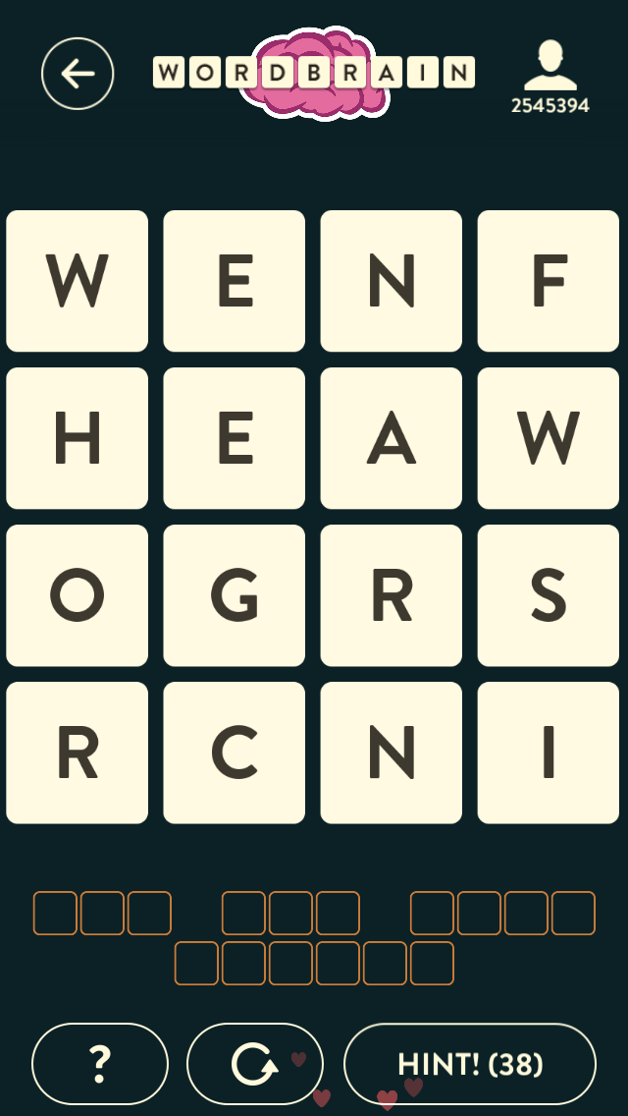

Running the Solver
perl script/play.pl --playfield="w,e,n,f,h,e,a,w,o,g,r,s,r,c,n,i" \
--word-to-find=3 \
--word-to-find=3 \
--word-to-find=4 \
--word-to-find=6 \
======= Game =======
w e n f
h e a w
o g r s
r c n i
Word: saw | s - 2 x 3 | a - 1 x 2 | w - 1 x 3 |
Word: cor | c - 3 x 1 | o - 2 x 0 | r - 3 x 0 |
Word: when | w - 2 x 0 | h - 3 x 0 | e - 2 x 1 | n - 1 x 2 |
Word: fringe | f - 2 x 3 | r - 2 x 2 | i - 3 x 3 | n - 3 x 2 | g - 3 x 1 | e - 2 x 1 |
Word: finger | f - 2 x 3 | i - 3 x 3 | n - 3 x 2 | g - 3 x 1 | e - 2 x 1 | r - 2 x 2 |
Word: fringe | f - 2 x 3 | r - 2 x 2 | i - 3 x 3 | n - 3 x 2 | g - 3 x 1 | e - 2 x 1 |
Word: when | w - 2 x 0 | h - 3 x 0 | e - 3 x 1 | n - 3 x 2 |
Word: finger | f - 2 x 3 | i - 3 x 3 | n - 3 x 2 | g - 3 x 1 | e - 2 x 1 | r - 2 x 2 |
Word: when | w - 2 x 0 | h - 3 x 0 | e - 3 x 1 | n - 3 x 2 |
Word: hen | h - 1 x 0 | e - 0 x 1 | n - 1 x 2 |
Word: fringe | f - 2 x 3 | r - 2 x 2 | i - 3 x 3 | n - 3 x 2 | g - 2 x 1 | e - 1 x 1 |
Word: crow | c - 3 x 1 | r - 3 x 0 | o - 2 x 0 | w - 1 x 0 |
Word: crow | c - 3 x 1 | r - 3 x 0 | o - 2 x 0 | w - 1 x 0 |
Word: finger | f - 2 x 3 | i - 3 x 3 | n - 3 x 2 | g - 3 x 1 | e - 2 x 1 | r - 2 x 2 |
real 27m14.806s
user 27m14.506s
sys 0m0.294s

Slide 31
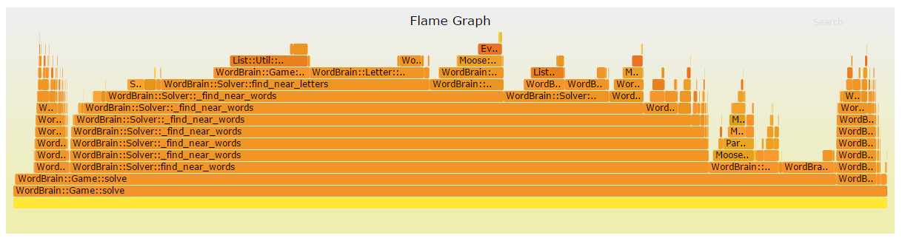
Performance – NYTProf – Flame Graph
There are no major imbalances so there are no low hanging fruit
We see the recursion into _find_near_words nicely here

Slide 32
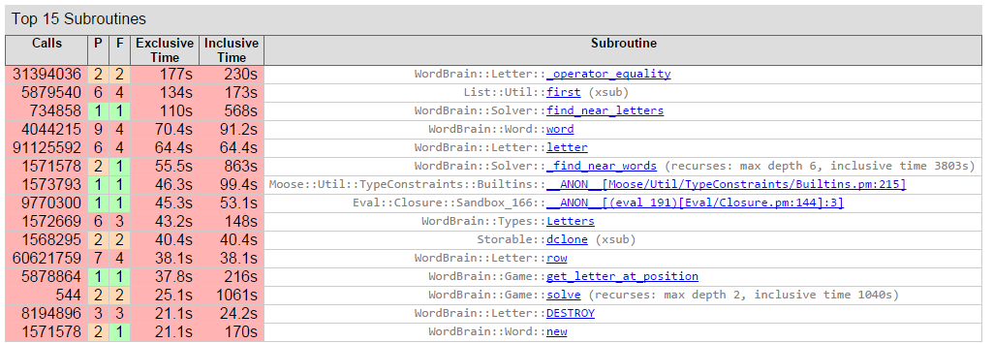
Performance – NYTProf – Top Subroutines
sub _operator_equality {
my ( $a, $b ) = @_;
if( $a->letter eq $b->letter
&& $a->row == $b->row
&& $a->col == $b->col ) {
return 1;
}
return 0;
}
We spend most of our time in:
WordBrain::Letter->_operator_equality
WordBrain::Game->get_letter_at_position’s call to List::Util first
This is List::Util, consider it to already be an optimal implementation
WordBrain::Solver::find_near_letters
Not surprising, it processes 9 letters for each letter provided to it
Again, no low hanging fruit.

Slide 33
Performance – Ideas for Improvement
Implementation
Memoize
Reduce time complexity at the cost of space complexity
However, we’d have to finely control the caches which could prove tricky
Think WordBrain::Game’s construct_game_without_word and find_letter_at_position
Parallel::ForkManager
Spread the work across multiple processors
Expen$iv$ $olution!
Eliminate Moose usage
While Moose may have a startup penalty we can see from NYTProf it’s not really hurting us.
Algorithmic
Terminate Depth First Search once no words start with root word
No word in the English language starts with “stl” no need to keep searching
HUGE POTENTIAL for improvement!
Is this still Depth First Search?
Now share your ideas!

Slide 34

Conclusion
THANK YOU!!!
Any questions?
pixabay

Slide 35
References
Interview with Mag Interactive Founder in Outlier Magazine
http://outliermagazine.co/mag-interactive-daniel-hasselberg/
Stats for WordBrain
https://sensortower.com/ios/us/mag-interactive/app/wordbrain/708600202
Download WordBrain yourself and give it a try!

