Slide 1
DS 102: Data, Inference, and Decisions
Lecture 18
Michael Jordan
University of California, Berkeley

Slide 2
Decisions and Learning
In our lectures on FDR, we talked about making sets of decisions
and in our lectures on online FDR, we talked about making sets of decisions over time
the sets of decisions can be unrelated
We now wish to consider problems in which we make the same decision over and over again, and we want to get better at making that decision
let’s call this a learning problem
learning involves both exploration and exploitation

Slide 3
Exploration and Exploitation
Let’s suppose that we obtain rewards based on our decisions
good decisions mean high rewards, and bad decisions mean low rewards
sometimes we refer to losses instead of rewards, converting between the two with negation
We want to obtain a high rate of reward over time
in doing so we aim to exploit our knowledge as it accrues
But no one is telling us which choice yields highest reward
we have to explore to figure that out

Slide 4
Exploration and Exploitation
Too little exploration means that the learner may not discover which choice yields the highest reward
they stick with a suboptimal choice, and they will not be as happy or successful as they could be over the long run
but too much exploration means forgoing the opportunity to reap immediate rewards in the possibly vain hope of future rewards
So, at any given moment there is a tradeoff---should I exploit what knowledge I currently have, or explore further to improve my knowledge?
Can we devise a formal theory that makes that tradeoff explicit, and actionable?

Slide 5
The Multi-Armed Bandit
We consider a decision-maker who is given options to choose from
we refer to those options as “arms”
please Google “multi-armed bandit” to see a picture of a casino, from whence the language comes
Associated with each arm is a probability distribution over rewards
The decision-maker chooses an arm, and receives a reward sampled from the corresponding reward distribution
This repeats

Slide 6



Multi-Armed Bandits
MABs offer a natural platform to understand exploration / exploitation trade-offs
1
2
3.

Slide 7
The Goal
Generally the goal is to maximize the sum of the rewards over all time steps
Sometimes the rewards are discounted, when rewards in the future are viewed as less valuable than more immediate rewards
A key idea is regret, which is the difference between our total reward and the reward of some kind of oracle who knows more than we do
for example, an oracle who knows in advance which is the optimal arm

Slide 8
Real-World Problems
Drug discovery
A/B testing
Routing in networks
Robot skills
Human-computer interaction

Slide 9
Explore-then-Commit
Explore-then-Commit is a particular algorithm for solving the multi-arm bandit problem
The idea is simple:
pull each arm times (e.g., )
compute the sample average of rewards for each arm
forever afterwards, commit to the arm with the maximal average

Slide 10
Explore-then-Commit
Explore-then-Commit is a particular algorithm for solving the multi-arm bandit problem
The idea is simple:
pull each arm times (e.g., )
compute the sample average of rewards for each arm
forever afterwards, commit to the arm with the maximal average
The problem is that if you commit to a suboptimal arm, your regret grows linearly thereafter ☹
You can increase , but you’ll have more regret before the commit
The optimal choice of depends on the gap between the best arm and the next-best arm, which is unknown

Slide 11
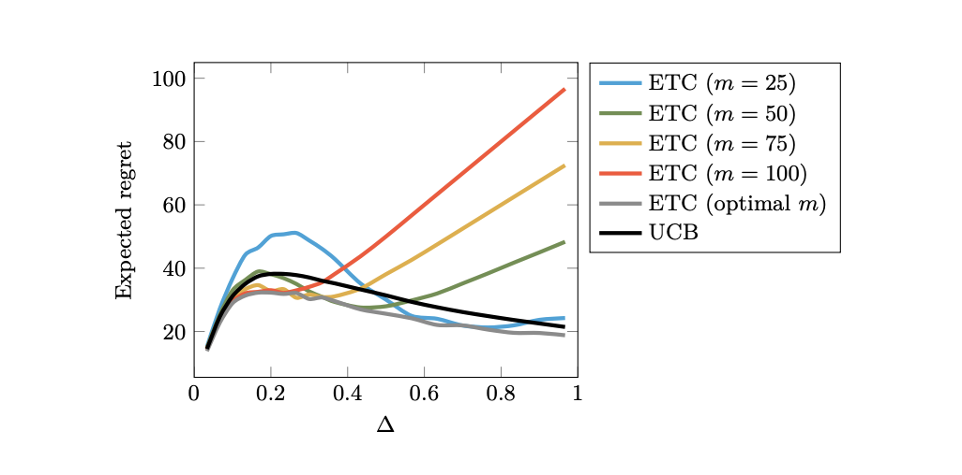
Comparing UCB to Explore-then-Commit

Slide 12
To Jupyter and to the Whiteboard…

Slide 13
Upper Confidence Bound (UCB) Algorithm
Maintain an upper confidence bound on reward values
Pick the arm with the largest upper confidence bound
1
2
3.

Slide 14
Upper Confidence Bound (UCB) Algorithm
Maintain an upper confidence bound on reward values
Pick the arm with the largest upper confidence bound
1
2
3.

Slide 15
Upper Confidence Bound (UCB) Algorithm
Maintain an upper confidence bound on reward values
Pick the arm with the largest upper confidence bound
1
2
3.

Slide 16
Variations on the Basic Multi-Arm Bandit
The environment can be stochastic or adversarial
Contextual bandits blend bandits with regression
There are structured bandits, in which the actions and the rewards have mathematical structure that can be exploited
see the example of path planning on the following page
in such settings, the feedback can be more detailed than simply the reward associated with the selected arm

