Slide 1
DS 102: Data, Inference, and Decisions
Lecture 2
Michael Jordan
University of California, Berkeley

Slide 2
Basics of Decision Making
We’ll start by considering the most simple of decision-making formulations
Let’s suppose that Reality is in one of two states, which we denote as 0 or 1
We don’t observe this state, but we do obtain Data that is drawn from a distribution that depends on whether the state is 0 or 1
We make a Decision based on the Data, which we denote as 0 or 1
We can think of the Decision as our best guess as to the state of Reality or, more generally, as an action we think is best given our guess of the state of Reality

Slide 3
The Basic Two-by-Two Table
Decision
0
1
TN | FP
FN | TP
TN = True Negative
0
FP = False Positive
Reality
FN = False Negative
1
FP = True Positive

Slide 4
The Basic Two-by-Two Table
Decision
0
1
TN | FP
FN | TP
TN = True Negative
0
FP = False Positive
Reality
FN = False Negative
1
FP = True Positive

Slide 5
The Basic Two-by-Two Table
Decision
0
1
TN | FP
FN | TP
TN = True Negative
0
FP = False Positive
Reality
FN = False Negative
1
FP = True Positive
Rough goal: lots of green outcomes, few red outcomes!

Slide 6
Towards a Statistical Framework
Let’s now imagine that we not only make a decision, but we build a decision-making algorithm
We want to evaluate the algorithm not just on one problem, but on a set of related problems
Concretely, we may have a collection of hypothesis-testing problems, where we repeatedly decide whether to accept the null or accept the alternative
Or we may have a set of classification decisions, where we repeatedly classify data points into one of two classes

Slide 7
Towards a Statistical Framework
Decision
0
1
0
Reality
1

Slide 8
Some Row-Wise Rates
Decision
0
1
0
Reality
1
aka, “true positive rate”
sensitivity
or “recall” or “power”

Slide 9
Some Row-Wise Rates
Decision
0
1
0
Reality
1
aka, “true negative rate”
specificity
or “selectivity”

Slide 10
Comments on the Row-Wise Rates
They can be thought of as estimates of conditional probabilities
e.g., sensitivity approximates

Slide 11
Comments on the Row-Wise Rates
They can be thought of as estimates of conditional probabilities
e.g., sensitivity approximates
As such, they are not dependent on the prevalence (i.e., the probabilities of the two states of Reality in the population)

Slide 12
The Bayesian Posterior
The posterior probability of the hypothesis given the data:
where is the prior (the “prevalence”)

Slide 13
Back to Hypothesis Testing
Let’s now consider a column-wise perspective

Slide 14
Let’s Return to our Column-Wise Rates
Decision
0
1
0
Reality
1
false discovery proportion

Slide 15
Comments on the Column-Wise Rates
They can be thought of as estimates of conditional probabilities
They are dependent on the prevalence (i.e., the probabilities of the two states of Reality in the population), via Bayes’ Theorem
as such, they are more Bayesian
this is arguably a good thing
Notation: let denote Reality, and let denote the decision

Slide 16
Bayes’ Theorem

Slide 17
Bayes’ Theorem
This relates a row-wise quantity, , to a column-wise quantity,
And shows that the latter depends on the prevalence:

Slide 18
A Bayesian Calculation

Slide 19
Some Implications
We see that the prevalence has a major effect on the probability of an error
Suppose that and
Then the ratio is 16/1, and if the prevalence was 0.5, the probability of an error would be small
But…. if the prevalence is small, say 1/1000, then the factor is tiny and it kills the 16/1
And so the probability of error goes to one ☹

Slide 20
Type I error rate (per test) = 0.05
Run 10,000 different, independent
A/B tests
9,900 true nulls
495 false discoveries
“false discovery
rate” = 495/575
100 non-nulls
80 true discoveries
Power (per test) = 0.80

Slide 21
Type I error rate (per test) = 0.05
Run 10,000 different, independent
A/B tests
9,900 true nulls
495 false discoveries
“false discovery
rate” = 495/575
100 non-nulls
80 true discoveries
Power (per test) = 0.80
(NB: We’re again not being rigorous at this point; FDR is
actually an expectation of this proportion. We’ll do it right
anon.)

Slide 22
The Goal: Control Errors A Priori
We’ve introduced concepts such as false-positive rates and false-discovery rates as descriptions of performance
We now want to use them as ways to design algorithms
We want to give a priori guarantees that a certain algorithm will have good performance

Slide 23
The Neyman-Pearson Paradigm
The row-focused Neyman-Pearson paradigm turns the problem into a constrained optimization problem

Slide 24
The Neyman-Pearson Paradigm
The row-focused Neyman-Pearson paradigm turns the problem into a constrained optimization problem
The idea is to control the false-positive probability, , to be less than some target value, say 0.05
And to maximize the true-positive probability (the power) subject to that constraint

Slide 25
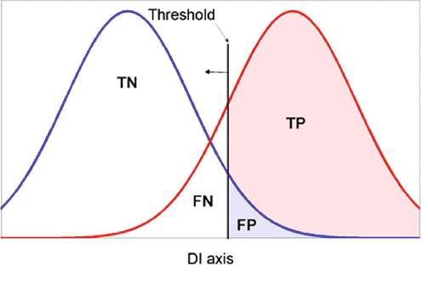
The Neyman-Pearson Paradigm
The row-focused Neyman-Pearson paradigm turns the problem into a constrained optimization problem
The idea is to control the false-positive probability, , to be less than some target value, say 0.05
And to maximize the true-positive probability (the power) subject to that constraint

Slide 26
P-Values
Consider a simple null hypothesis
Consider a statistic, , which has a continuous distribution under the null, and let denote its tail cdf:
Define the P-value as
The P-value has a uniform distribution under the null:

Slide 27
A Generic Decision Rule
Reject if the random variable is equal to 1:
This yields Neyman-Pearson control in the case of a single simple hypothesis (where all the are the same and all the are set equal to some fixed value, say 0.05)

Slide 28
Multiple Hypothesis Testing
Let’s now consider multiple tests, in particular repeated tests of the same hypothesis
The row-focused Neyman-Pearson paradigm provides a priori control over errors made in those cases in which the null hypothesis is true
This isn’t very natural when the hypotheses are “cases” which arise randomly according to their prevalence
It also makes little sense when we’re testing a bag of different hypothesis (cf., A/B testing)

Slide 29
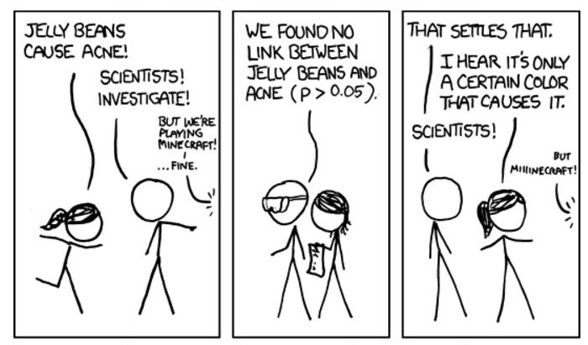
Multiple Decisions: The Statistical Problem

Slide 30
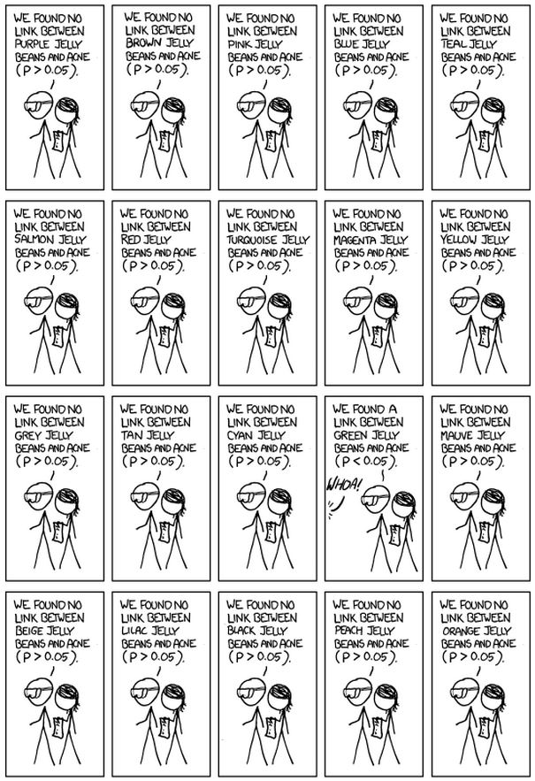

Slide 31
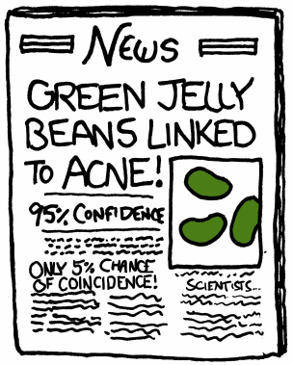

Slide 32
A First Attempt: Bonferroni
Let’s suppose that we’re conducting tests, not just one
Let denote the number of false-positive errors in my tests, and let denote the event of a false positive error on the test
Let’s use a rejection threshold of in the classical paradigm instead of
This controls a certain error rate…

Slide 33
A First Attempt: Bonferroni
We’ve controlled a quantity known as the family-wise error rate (FWER)

Slide 34
Example
P-value
Hypothesis Index
Suppose that we obtain p-values from 25 experiments

Slide 35
Naïve Multiple Decision-Making
P-value
Hypothesis Index
Suppose that we simply reject each test independently if its p-value is smaller than some thresholding

Slide 36
Naïve Multiple Decision-Making
P-value
Hypothesis Index
Suppose that we simply reject each test independently if its p-value is smaller than some thresholding

Slide 37
Naïve Multiple Decision-Making
P-value
Hypothesis Index
An oracle knows the truth: that the blue-shaded bars correspond to nulls (Reality = 0) and the red-shaded bars to alternatives (Reality = 1)

Slide 38
Naïve Multiple Decision-Making
P-value
Hypothesis Index
We see that the decision-maker is avoiding false negatives, but its false discovery proportion is 4/11; pretty bad!

Slide 39
Naïve Multiple Decision-Making
P-value
Hypothesis Index
We see that the decision-maker is avoiding false negatives, but is making a lot of false positives, and its false discovery proportion is 4/11; pretty bad!

Slide 40
Bonferroni
P-value
Hypothesis Index
Bonferroni avoids those false positives, but is making a lot of false negatives, and its false discovery proportion is 1/2; even worse!

Slide 41
Is There Something Else We Can Do?
It’s not clear that any fixed threshold will work, and it’s not how to set such a threshold without knowing the truth
We have to think out of the box: we’ll be developing a procedure that works with sorted p-values, and compares them to a line with a positive slope, not a horizontal line!
P-value
Hypothesis Index

Slide 42
Is There Something Else We Can Do?
It’s not clear that any fixed threshold will work, and it’s not how to set such a threshold without knowing the truth
We have to think out of the box: we’ll be developing a procedure that works with sorted p-values, and compares them to a line with a positive slope, not a horizontal line!
But let’s not get ahead of ourselves
P-value
Hypothesis Index

Slide 43
A Bayesian Calculation

Slide 44
A Bayesian Calculation
We could upper bound with 1, and so the numerator can be controlled; what about the denominator?

Slide 45
A Bayesian Calculation
Using the law of total probability, we have:

Slide 46
A Bayesian Calculation
Using the law of total probability, we have:
so we see that depends on the prior

Slide 47
A Bayesian Calculation
Using the law of total probability, we have:
so we see that depends on the prior
Is this a problem?
i.e., do we have to either decide to be Bayesian and supply the prior, or decide to be frequentist and abandon this approach?
No! Note that it’s easy to estimate directly from the data!

Slide 48
Towards an Algorithm
We will plug in an estimate of into the Bayesian posterior probability
this is called empirical Bayesian
And we will use the empirical Bayesian estimate to set a threshold
Let’s consider

Slide 49
Controlling the FDR
Benjamini & Hochberg (1995) proposed an algorithm that does it

Slide 50
Controlling the FDR
Benjamini & Hochberg (1995) proposed an algorithm that does it
Given tests, obtain p-values , and sort them from smallest to largest, denoting the sorted p-values as

Slide 51
Controlling the FDR
Benjamini & Hochberg (1995) proposed an algorithm that does it
Given tests, obtain p-values , and sort them from smallest to largest, denoting the sorted p-values as
the small ones are the safest to reject

Slide 52
Controlling the FDR
Benjamini & Hochberg (1995) proposed an algorithm that does it
Given tests, obtain p-values , and sort them from smallest to largest, denoting the sorted p-values as
the small ones are the safest to reject
Now, find the largest such that:

Slide 53
Controlling the FDR
Benjamini & Hochberg (1995) proposed an algorithm that does it
Given tests, obtain p-values , and sort them from smallest to largest, denoting the sorted p-values as
the small ones are the safest to reject
Now, find the largest such that:
Reject the null hypothesis (i.e., declare discoveries) for all hypotheses such that

Slide 54
Controlling the FDR
Benjamini & Hochberg (1995) proposed an algorithm that does it
Given tests, obtain p-values , and sort them from smallest to largest, denoting the sorted p-values as
the small ones are the safest to reject
Now, find the largest such that:
Reject the null hypothesis (i.e., declare discoveries) for all hypotheses such that
This controls the FDR!

Slide 55
The Online Problem
Classical statistics, and also the Benjamini & Hochberg algorithm focused on a batch setting in which all data has already been collected
E.g., for Benjamini & Hochberg, you need all of the p-values before you can get started
Is is possible to consider methods that make sequences of decisions, and provide FDR control at any moment in time
Is it conceivable that one can achieve lifetime FDR control?

Slide 56





Many enterprises run thousands of different (independent) A/B tests over time
Decision Rule:
vs.
Color
vs.
Size
Time
vs.
Orientation
vs.
Style
Problem!
vs.
Logo

Slide 57





What we will do instead:
Decision Rule:
vs.
Color
vs.
Size
Time
vs.
Orientation
How do we set each error target to control FDR at any time?
vs.
Style
vs.
Logo

Slide 58
Online FDR control : high-level picture
Error budget for first test
Error budget for second test
Tests use wealth
Remaining error budget
or “alpha-wealth”

Slide 59
Online FDR control : high-level picture
Error budget for first test
Error budget for second test
Tests use wealth
Discoveries earn wealth
Remaining error budget
or “alpha-wealth”

Slide 60
Online FDR control : high-level picture
Error budget for first test
Error budget for second test
Tests use wealth
Discoveries earn wealth
Remaining error budget
or “alpha-wealth”

Slide 61
Online FDR control : high-level picture
Error budget for first test
Error budget for second test
Tests use wealth
Discoveries earn wealth
Error budget is data-dependent
Remaining error budget
or “alpha-wealth”
Infinite process

Slide 62
Online FDR control
classical FDR literature assumes that the data for all hypotheses is collected at once, and only after all the p-values are available, one can decide which of the hypotheses should be proclaimed discoveries
in modern testing we often do not know how many hypotheses we want to test in advance
instead, a possibly infinite sequence of tests (i.e. p-values) arrives sequentially
we have to make decisions online, with no knowledge of future tests, in a way that guarantees FDR control under a pre-specified level at any given time
motivating examples: A/B testing, large-scale clinical trials…

Slide 63
Online vs offline FDR control
classical FDR procedures (like BH) which make all decisions simultaneously are called “offline”
P1
P2
P3
decisions
P4
P5
online FDR procedures make decisions one at a time
P1
P2
P3
P4
P5
decision
decision
decision
decision
decision
time

Slide 64





Example: A/B testing
online FDR algorithms pick significance level adaptively
vs.
Color
vs.
Size
vs.
Orientation
vs.
Style
vs.
Logo

Slide 65
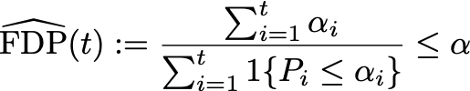
Online FDR algorithm
the first online FDR algorithm was due to Foster and Stine (2008)
a more recent (and simpler) online FDR algorithm is due to Javanmard and Montanari, and is called LORD
its basic idea is to assign in a way that ensures

Slide 66

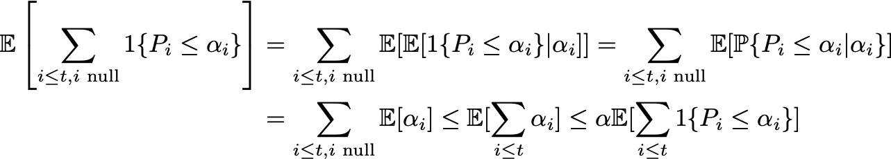
Why ensuring controls FDR:
, and we have
so

Slide 67
Back to Inference
Can we develop general frameworks that allow us to control column-wise quantities like the false-discovery rate (FDR)?
in a similar way as Neyman-Pearson controls the false-positive rate
To be continued…

