Slide 1
DS 102: A Sampler of Game Theory
Lecture 21
Michael Jordan
University of California, Berkeley

Slide 2
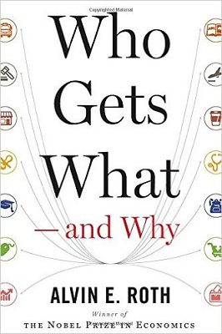
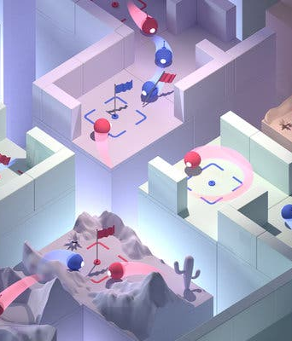
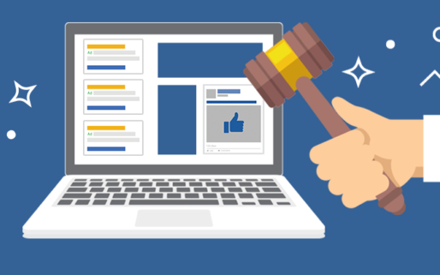
Data, Decisions ... and Economics
Matching Markets
Auctions
Multiplayer games

Slide 3
Two-Way Matching Markets
Bands
Drummers

Slide 4
The Gale-Shapley Deferred Acceptance Algorithm
GS (preference lists of bands and drummers):
INITIALIZE M to empty matching
WHILE (some band b is unmatched and hasn’t proposed to every drummer)
d first drummer on b’s list to whom b has not yet proposed.
IF (d is unmatched and d prefers to be matched with b)
Add (b, d) to matching M
ELSE IF (d prefers b to current matching b’)
Replace (b’, d) with (b, d) in matching M
ELSE
d rejects b
(See Kleinberg and Tardos, 2005 )

Slide 5
Demo of the Gale-Shapley Algorithm
Bands
Drummers

Slide 6
Demo of the Gale-Shapley Algorithm
Bands
Drummers

Slide 7
Demo of the Gale-Shapley Algorithm
Bands
Drummers

Slide 8
Demo of the Gale-Shapley Algorithm
Bands
Drummers

Slide 9
Demo of the Gale-Shapley Algorithm
Bands
Drummers
rejects

Slide 10
Demo of the Gale-Shapley Algorithm
Bands
Drummers

Slide 11
Demo of the Gale-Shapley Algorithm
Bands
Drummers

Slide 12
Demo of the Gale-Shapley Algorithm
Bands
Drummers
rejects

Slide 13
Demo of the Gale-Shapley Algorithm
Bands
Drummers

Slide 14
Demo of the Gale-Shapley Algorithm
Bands
Drummers

Slide 15
The GS Algorithm Finds Stable Matches
Claim: the GS algorithm always outputs a stable matching, regardless of the problem instance.
Proof: there can be at most (number of bands) x (number of drummers) proposals, so the algorithm will terminate.
We must show that there are no unstable pairs (b, d) in the output matching M.
Let (b, d) be a pair not in M.
Case 1. If b never proposed to d, then b prefers its match in M over d, because b proposed in order of its preferences.
Case 2. If b proposed to d, then d prefers its match in M over b because d always improves their match when they switch.
So there cannot be any unstable pairs produced by M.

Slide 16
Optimality and Pessimality of the GS Match
A problem instance can admit multiple stable matches.
Definition: b and d are attainable for each other if there exists a stable matching in which b and d are matched.
Theorem: the matching produced by GS matches each member of the proposing side (bands) with their best attainable partner and matches each member of the passive side (drummers) with their worst attainable partner.

Slide 17
Learning in Matching Markets
What if we don’t know the preferences a priori?
We could consider using a bandit algorithm such as UCB to learn the preferences from experience
So now we will have multiple bandit-based learners interacting with each other in a market

Slide 18
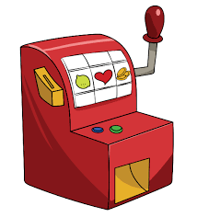





Review of UCB in the Single-Agent Case
Recall that multi-armed bandits provide a natural framework to understand exploration / exploitation trade-offs.
1
2
3
Notes:
arms are actions (what products to buy, or which restaurant to go to)
emphasize stochastic rewards

Slide 19
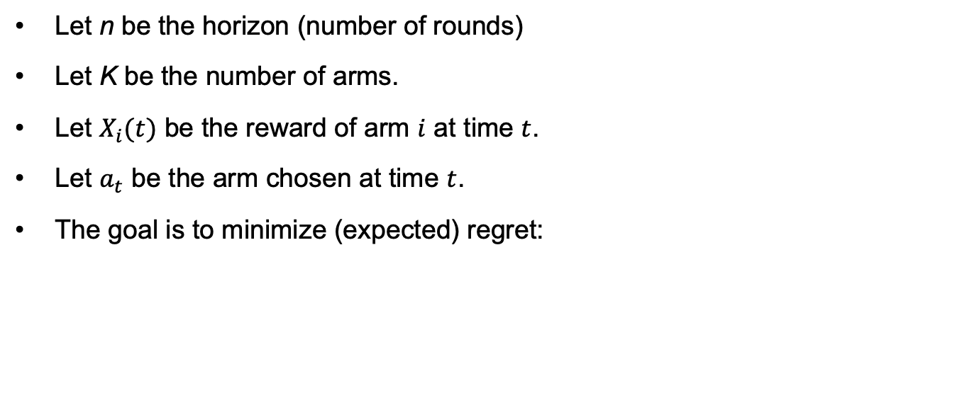
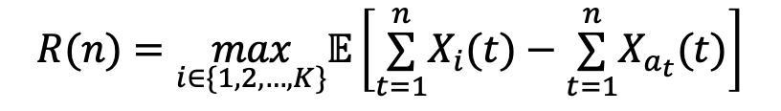
Notation
Let n be the horizon (number of rounds)
Let K be the number of arms.
Let $X_{i}(t)$ be the reward of arm $i$ at time $t$.
Let $a_{t}$ be the arm chosen at time $t$.
The goal is to minimize (expected) regret:
$$R(n)=\max_{i∈\{1,2,…,K\}}𝔼\left[\overset{n}{\underset{t=1}{∑}}X_{i}(t)−\overset{n}{\underset{t=1}{∑}}X_{a_{t}}(t)\right]$$
Total reward of best arm in hindsight
Reward obtained
University of California, Berkeley

Slide 20
UCB Algorithm
Choose the arm with the highest UCB
University of California, Berkeley

Slide 21
UCB Algorithm
Update UCB accordingly
University of California, Berkeley

Slide 22
UCB Algorithm
Now we sample this arm
University of California, Berkeley

Slide 23
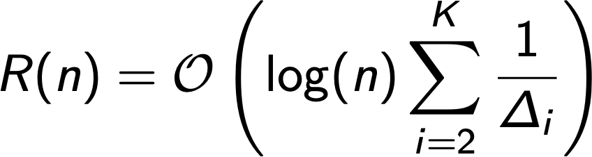

Regret of UCB
Suppose arm 1 has the highest mean reward.
Let $Δ_{i}=μ_{1}−μ_{i}$; this is called the reward gap.
Then, the regret of UCB satisfies
Notes:
horia

Slide 24

Multi-Player Bandits
Let’s add a competing player!
0
1
Bear wins conflict and gets the reward
2
3

Slide 25
Regret in Matching Markets
Suppose that there is some unique stable matching.
Players
Arms
?
1 > 2 > 3
1 > 3 > 2
2 > 3 > 1
3 > 1 > 2
1 > 2 > 3
2 > 1 > 3
Players should always choose their stable match in hindsight
Notes:
assuming perfect info about utilities, then each agent can expect to match to their stable match at every step (assuming unique stable matching). the summation is the actual expected reward

Slide 26
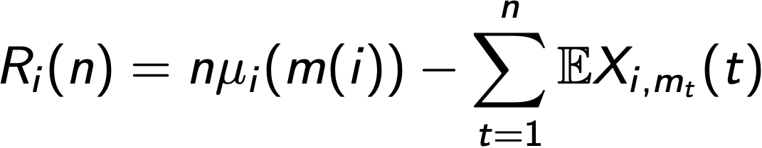
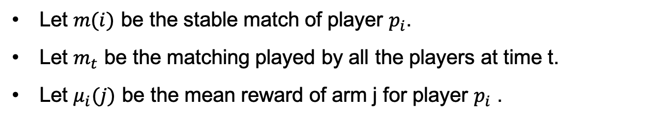
Regret in Matching Markets
Let $m(i)$ be the stable match of player $p_{i}$.
Let $m_{t}$ be the matching played by all the players at time t.
Let $μ_{i}(j)$ be the mean reward of arm j for player $p_{i}$ .
Define the stable regret of agent i up to time n as:
Mean reward of stable match
Reward at time t
Notes:
define m and mu first
assuming perfect info about utilities, then each agent can expect to match to their stable match at every step (assuming unique stable matching). the summation is the actual expected reward

Slide 27
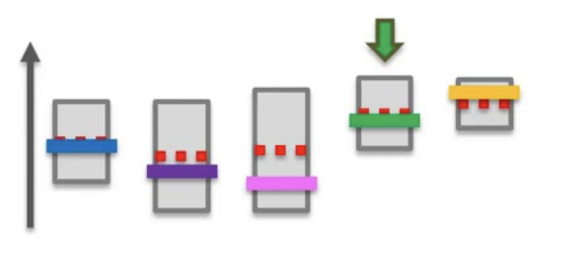
Algorithm: GS-UCB
Involves a Matching Platform that communicates with all Players.
At every round:
Players rank Arms by the UCBs of each Arm’s mean reward for themselves.
Platform runs the Gale-Shapley algorithm to match Players and Arms.
Players receive rewards from matched Arms and update their UCB for the Arm.
UCB
Mean rewards
Arms
University of California, Berkeley

Slide 28
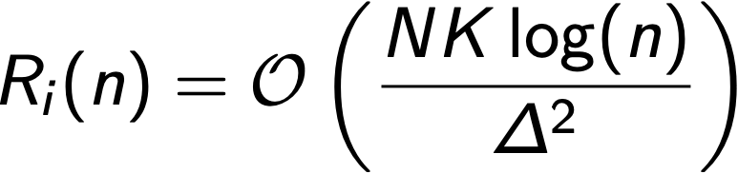
Regret of GS-UCB
Theorem (informal): If there are N players and K arms and GS-UCB is run, the stable (pessimal) regret of player i satisfies
Minimum gap of arms’ rewards for all players.
In other words, if one player has to explore more, another player incurs higher stable regret.
University of California, Berkeley

Slide 29
Summary of Matching Markets and Learning
Many decision problems involve learning and economic thinking
We considered a multi-player bandit problem in the setting of matching markets
notion of Stable Regret
GS-UCB Algorithm
log(n) Player-Pessimal Stable Regret
Many open problems remain!
University of California, Berkeley

Slide 30
Data, Decisions ... and Economics
Matching Markets
Auctions
Multiplayer games

Slide 31
Auctions
Auctions provide a way to match buyers to sellers by setting a price on items that they exchange
We’ll consider two kinds of auctions: sealed-bid auctions and Vickrey auctions
In both cases we’ll focus on the simple setting in which there are n buyers and one seller, who’s attempting to sell a single item
University of California, Berkeley

Slide 32
A Classical Sealed-Bid Auction
In a sealed-bid auction, each buyer submits an amount to an auctioneer, without knowing what the other buyers submit
The winner is the buyer who has bid the highest value
In a first-price auction, they pay the price that they bid and obtain the item
Imagine that each buyer has an internal valuation of the item
Should they simply submit that valuation as their bid?
University of California, Berkeley

Slide 33
An Example
Suppose that you’re considering buying a company
You know that you can increase the value of the company by a factor of 1.5 (given your experience, connections, etc)
Suppose that your valuation of the company is uncertain, but it lies uniformly between $2M and $12M, with a mean of $7M
What should you offer?
University of California, Berkeley

Slide 34
An Example (Cont)
Suppose that the actual current value of the company is $8M and suppose that you bid $10M
your expertise will bring the value up to $12M, and you gain $2M
but if the actual current value of the company is $4M, your expertise will bring it up to $6M, and you lose $4M
What’s the most you can offer and expect to break even on average?
this would give an idea of the largest amount you can reasonably bid
A possible answer: on average the company is worth $7M, which can be raised to $10.5M, so a bid of up to $10.5 seems reasonable
but this is faulty economic thinking
University of California, Berkeley

Slide 35
An Example (Cont)
If you win based on your bid of $10.5M, you have learned that in fact the value of the company is not $11M or $12M; otherwise the seller would not have sold it to you
And, based on that knowledge, the true value is somewhere between $2M and $10.5M, or $6.25 on average
Even if you improve the company by 1.5X, that’s only $9.375M, so you will lose money on average
If you bid $8M, and win the range is now ($2M, $8M), or $6M on average, and so you again lose
A bit of calculation will reveal that if you bid $6M, you will break even on average
University of California, Berkeley

Slide 36
An Example (Cont)
The way to think about this is that a bid of $6M means that you’re not likely to have any regret if you’re the winner
More generally, the way to approach this kind of decision-making process is to assume that your bid will be accepted, and work out whether you’ll have regret
so, compute the maximum value that gives you no regret if you win
If you lose, you may feel some pain, but at least you haven’t lost any money
The problem with this approach to auctions is that it’s hard for buyers to think about---buyers aren’t just bidding their valuation
they should bid a bit less than their valuation
University of California, Berkeley

Slide 37
Second-Price Auctions
In a second-price auction, also known as a Vickrey auction, again the highest bidder wins, but she only pays the amount that was bid by the second-highest bidder
Example: suppose that there are four buyers, and their bids are {$5, $7, $2, $9}
in this case the fourth buyer is the winner, and she pays $7
Theorem: In a Vickrey auction, the right thing to do is to bid your valuation
University of California, Berkeley

Slide 38
Proof Sketch
Suppose that your valuation of an item is v, and the maximum valuation of all of the other bidders is m
Example: suppose that there are bids: {$5, $7, $2, $9}
focusing on the first bidder, m = $9 is the maximum over the other bids
Case 1: v < m
bidding more than v is a bad idea, because you might win, and pay more than m, which is more than your valuation, so you lose
bidding less than v doesn’t have any effect
Case 2: v > m
bidding more than v doesn’t have any effect
bidding less than v is a bad idea, because you might lose, and you would have lost the value v – m associated with winning
University of California, Berkeley

Slide 39
Game Theory
The topics that we’ve been discussing, matching markets and auctions, belong to the branch of game theory known as mechanism design
What is game theory?
It’s the analysis and design of behavior in strategic interactions
“Strategy” can have many aspects, including competition, cooperation, exchange of information, learning, bluffing, etc
University of California, Berkeley

Slide 40
Game Theory
Generally we have some number of players, each of whom choose an action, and an outcome results as a joint function of all of the actions
The actions may be simultaneous or sequential
The actions may involve a single decision or a sequence of decisions
There can be randomness in the choice of actions and in the final outcome
University of California, Berkeley

Slide 41
Game Theory
P2
0
1
0
8
5
P1
1
6
2
A game is a zero-sum game when P1 receives the outcome given in the table and P2 receives the negative of that outcome
Key idea of a best response: for each player, what is the best response given a choice made by the other player?
Here that yields dominant strategies, and a value of 5
University of California, Berkeley

Slide 42
Non-Zero-Sum Games
P2
0
1
0
(-1,-1)
(-10,0)
P1
1
(0,-10)
(-8,-8)
Considering a pair of actions (X,Y), if X is P1’s best response to Y, and Y is P2’s best response to X, then (X,Y) is called a Nash equilibrium
University of California, Berkeley

Slide 43
Non-Zero-Sum Games
P2
0
1
0
(-1,-1)
(-10,0)
0: silent
P1
1: confess
1
(0,-10)
(-8,-8)
This is the famous Prisoner’s Dilemma game
The best response to 0 is a 1, and the best response to a 1 is a 1, so (1,1) is a Nash equilibrium (sadly)
University of California, Berkeley

Slide 44
Fun Examples (from Dixit & Nalebuff)
Capital One’s business model
Junior associates in a law firm
Bureaucratic delays
University of California, Berkeley

