Slide 1
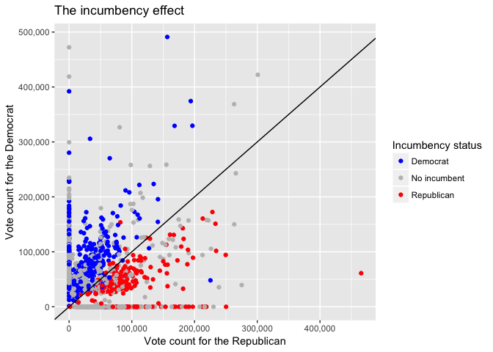
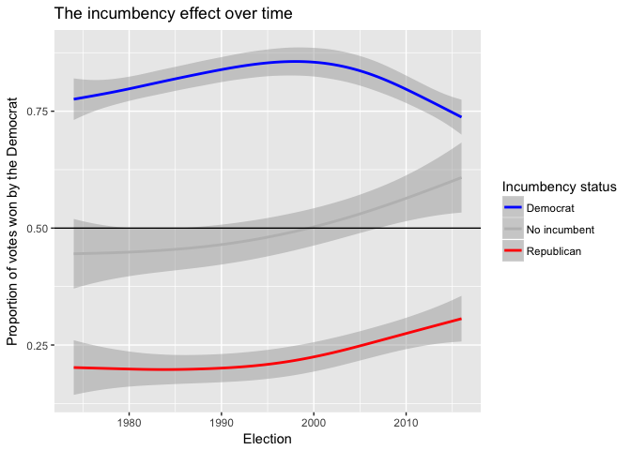
Forecasting California Legislative Elections
EJ Arce, Jonathan Matz
Introduction
What determines state elections?
How to model for state elections
We hope you find this template useful! This one is set up to yield a 24x36 horizontal poster.
We’ve put in the headings we usually see in these posters, you can copy and paste and change to your hearts content! We suggest you use keep black text against a light background so that it is easy to read. Background color can be changed in format-background-drop down menu.
The boxes around the text will automatically fit the text you type, and if you click on the text, you can use the little handles that appear to stretch or squeeze the text boxes to whatever size you want. If you need just a little more room for your type, go to format-line spacing and reduce it to 90 or even 85%.
The dotted lines through the center of the piece will not print, they are for alignment. You can move them around by clicking and holding them, and a little box will tell you where they are on the page. Use them to get your pictures or text boxes aligned together.
Data
Upper and lower districts’ voting totals for democratic and republican candidates running for a legislative seat
District voting totals for democratic and republican candidates running for gubernatorial, US senate, and presidential offices
Quarterly average real personal income (national level)
Presidential approval ratings (national level)
2018 Election results forecast
Bibliography
Xxxxxxxxxxxxxxxxxxxxxxxxxxxxxxxxxxxxxxxxxxxxxxxxxxxxxxxxxxxxxxxxxxxxxxxxxxxxxxxxxxxxxxxxxxx
Xxxxxxxxxxxxxxxxxxxxxxxxxxxxxxxxxxxxxxxxxxxxxxxxxxxxxxxxxxxxxxxxxxxxxxxxxxxxxxxxxxxxxxxxxxxx
Xxxxxxxxxxxxxxxxxxxxxxxxxxxxxxxxxxxxxxxxxxxxxxxxxxxxxxxxxxxxxxxxxxxxxxxxxxxxxxxxxxxxxxxxxxxxxxxxxxxxxxxxxxxxxxxxxxxxxxx
Xxxxxxxxxxxxxxxxxxxxxxxxxxxxxxxxxxxxxxxxxxxxxxxxxxxxxxxxxxxxxxxxxxxxxxxxxxxxxxxxxxx

