Slide 1
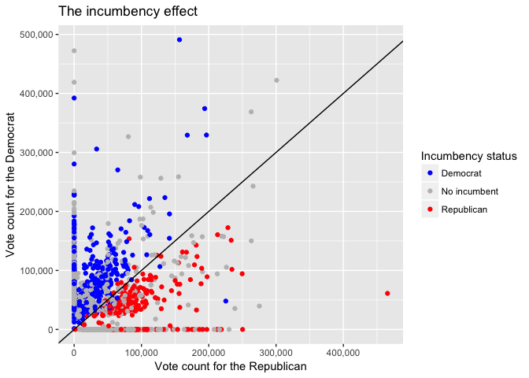
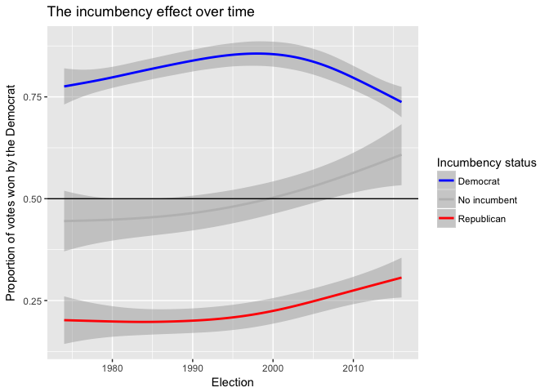
Forecasting California Legislative Elections
EJ Arce, Jonathan Matz
Introduction
What determines state elections?
California State Legislature
Senate: 40 Seats (4 year term)
House/Assembly: 80 Seats (2 year term)
State Partisanship
48 out of 80 assembly districts and 25 out of 40 senate districts have elected Democrats more times than Republicans since 1974
How to model for state elections
Big Picture
Many of these ‘factors’ can be used as covariates in a Mixed Effects Model to predict the probability of a democratic candidate winning an upcoming election.
Data
(collected from 1974 to present)
Upper and lower house districts’ voting totals awarded to democratic and republican candidates for the following seats:
Legislature
US President
California governor
US Senate
Quarterly average real personal income (national level)
Presidential approval ratings (national level)
Incumbency status of legislative candidates
Midterm penalty
2018 Election Results Forecast
Bibliography
Xxxxxxxxxxxxxxxxxxxxxxxxxxxxxxxxxxxxxxxxxxxxxxxxxxxxxxxxxxxxxxxxxxxxxxxxxxxxxxxxxxxxxxxxxxx
Xxxxxxxxxxxxxxxxxxxxxxxxxxxxxxxxxxxxxxxxxxxxxxxxxxxxxxxxxxxxxxxxxxxxxxxxxxxxxxxxxxxxxxxxxxxx
Xxxxxxxxxxxxxxxxxxxxxxxxxxxxxxxxxxxxxxxxxxxxxxxxxxxxxxxxxxxxxxxxxxxxxxxxxxxxxxxxxxxxxxxxxxxxxxxxxxxxxxxxxxxxxxxxxxxxxxx
Xxxxxxxxxxxxxxxxxxxxxxxxxxxxxxxxxxxxxxxxxxxxxxxxxxxxxxxxxxxxxxxxxxxxxxxxxxxxxxxxxxx

