Slide 1
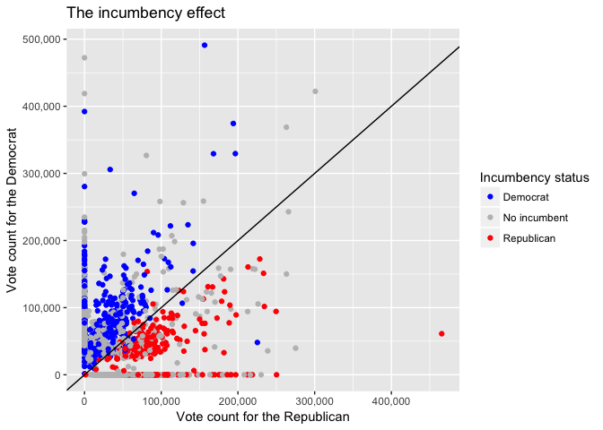
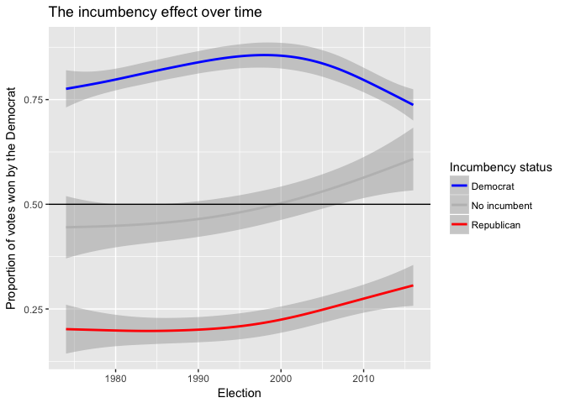
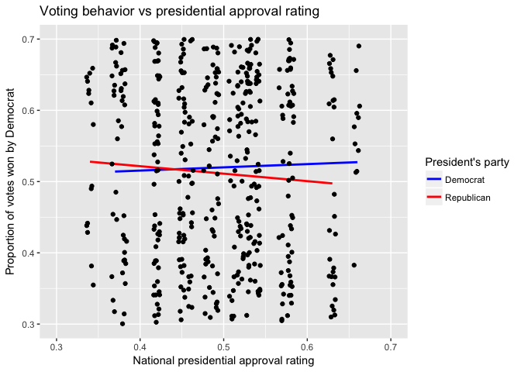
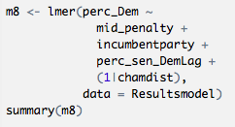
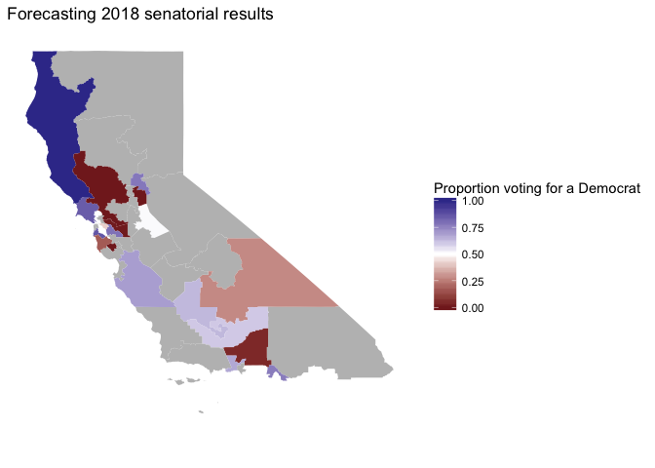
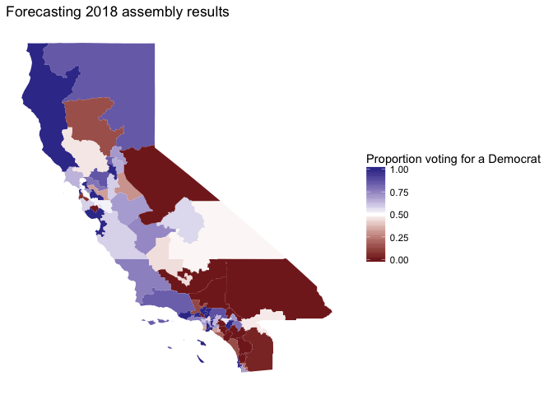
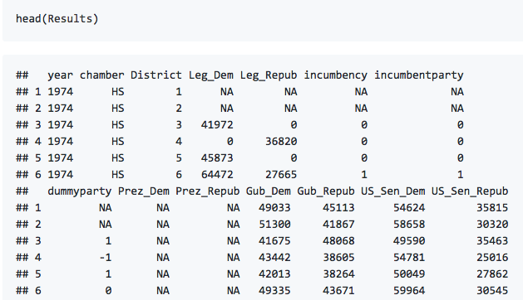
Forecasting California Legislative Elections
EJ Arce, Jonathan Matz
Objective
g
What determines state elections?
The goal of this project was to create a mixed effects model using data from previous elections to predict the outcome of the 2018 California state legislative elections.
How to model for state elections
Incumbency
Heavily increases chances of re-election (Figure 1)
Democrats have seen increased success in elections with no incumbent (Figure 2)
Voting behavior and Presidential Approval Rating (Figure 3)
Figure 1
Introduction
A Mixture of Fixed and Random Effects
Intercepts vary by chamber-district
Fixed slopes for the variables:
Midterm penalty
Incumbency
Proportion of votes for Democratic US Senate candidate from the previous election
Why?
Accounts for random differences between districts and their voting tendencies
Each predictor was statistically significant and led to lower RSS errors
Useful for simulating future elections
California State Legislature
Senate: 40 Seats (4 year term)
House/Assembly: 80 Seats (2 year term)
State Partisanship
48 out of 80 assembly districts and 25 out of 40 senate districts have elected Democrats more times than Republicans since 1974
Data (1974 to present)
Upper and lower house districts’ voting totals awarded to democratic and republican candidates for the following seats:
Legislature
US President
California governor
US Senate
Quarterly average real personal income (national level)
Presidential approval ratings (national level)
Incumbency status of legislative candidates
Midterm penalty
Figure 2
Figure 3
2018 Election Results Forecast
Vote Expectations
18 seats will flip parties
Republicans net gain of 4 seats
Gain 5 in the Assembly
Lose 1 in the Senate
References
Karner, Carl. California State Legislative Forecast Data.
Klarner, Carl. Presidential Approval Data from Gallup.com.
Statewide Election Results 2010-2016. California Secretary of State.
Table 2.1. Personal Income and Its Disposition. US Bureau of Economic Analysis.

