Slide 1
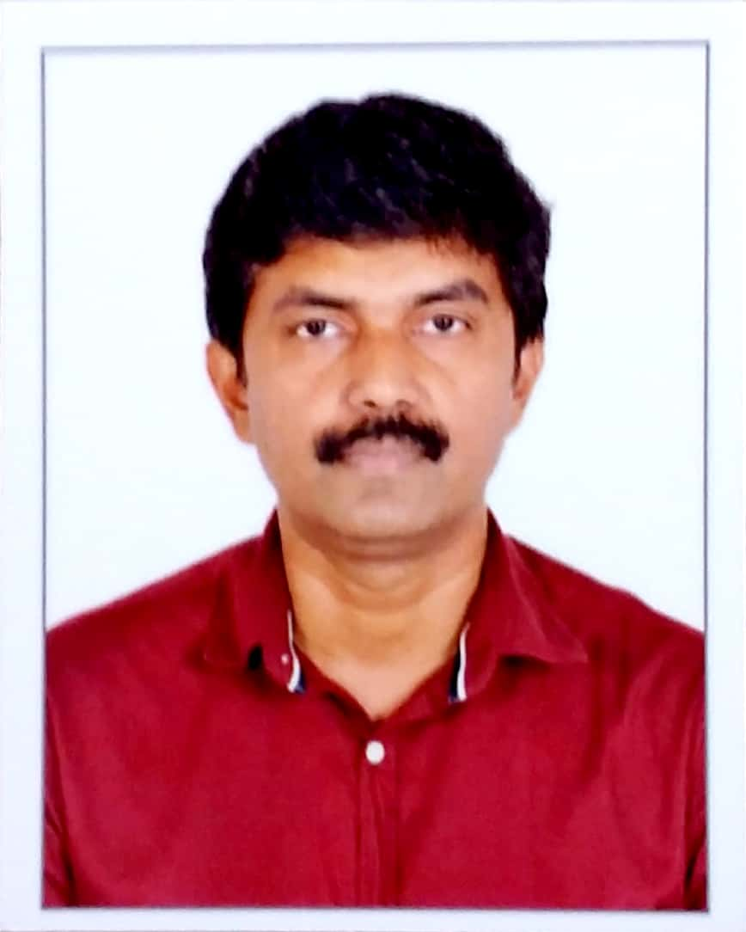
Biju K. Sasidharan – Data Scientist
Experience:
15 years of experience in IT with 4+ years into Statistical Data Analytics and Machine Learning
Academics/Certifications
Post Graduate in Computer Applications
Cloudera Certified Developer
Key Skills:
Python, R, H2O.ai, Tensorflow, SQL, Hadoop
Data Scientist with Post Graduation in Computer Application using Python & R for Machine learning, Big data analytics, AI, Predictive analysis and Data exploration within the Telecom, Banking and Automotive space. Focus on Predictive modelling, NLP and Deep learning.
Professional Summary
Experienced working with Fortune 50 companies as well with Start-ups.
Expertise in all phases of Data Science.
Knowledgeable in Quality standards and Lean software development.
Experienced working in Overseas sectors.
Relevant Experience
4+ years of experience in Statistical Data Analysis and Predictive Modeling
Churn prediction for wireline sector of topmost US telecom giant.
Agent retention model based on conversation data using NLP techniques.
Predictive modeling and Insights generation for reconciliation unit in Banking sector.
Assistance in R&D initiatives of in-house 'Data Science Work Bench' tool.
Consulting Role for Start-Ups
Experienced Consultant for start-ups (Identify use cases, Feasibility study, Data analytics, Delivery and implementation).
Skill Summary
Strong in Data analysis and Python coding.
Expertise in predictive modeling and identifying hidden insights from data.
Certified Developer for Hadoop by Cloudera.

