Slide 1
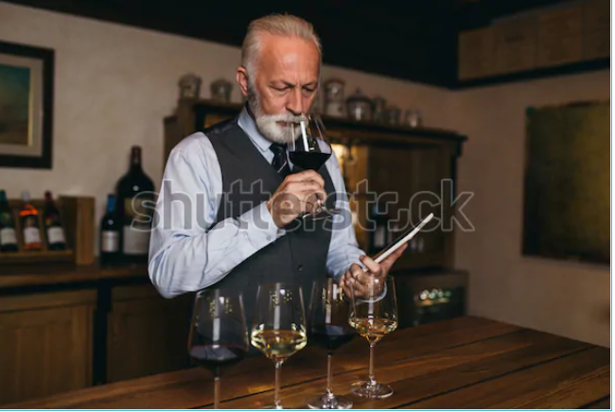
Smart Sommelier
Team 1:
Amir, Gerald and Sin

Slide 2
Agenda
    Business Case
    Data
    ML Model
    What next

Slide 3
Business Case
Food with good paired wine in enjoyed twice.
People usually do not have a good knowledge of pairing wine with their food.
Hiring a smellier in a restaurant is expensive
An application on the pad taking the orders can suggest paring wine for the meals ordered

Slide 4
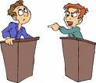

Data
We had challenges gathering the needed data
Wine folly provides an image of food ingredients and the paired wine
We had to manually prepare the required data for the labels
The data is of 20,000 rows and over 250 columns

Slide 5
ML Model
    Requires all Company business functions to develop, maintain and annually test business continuity and disaster recovery plans
    The DRP must be tested, at a minimum, annually or upon any major changes to information systems or processes

Slide 6
What is next
    Provide an understanding of how response teams work together
    Tests their ability to make decisions
    Evaluates the timing of recovery events

Slide 7
Refferences
What was effective?
What was not effective?
What needs to be improved?
Determine next meeting date to discuss corrective actions

