Slide 1

DS Pergola - Architecture
Prabhakar

Slide 2
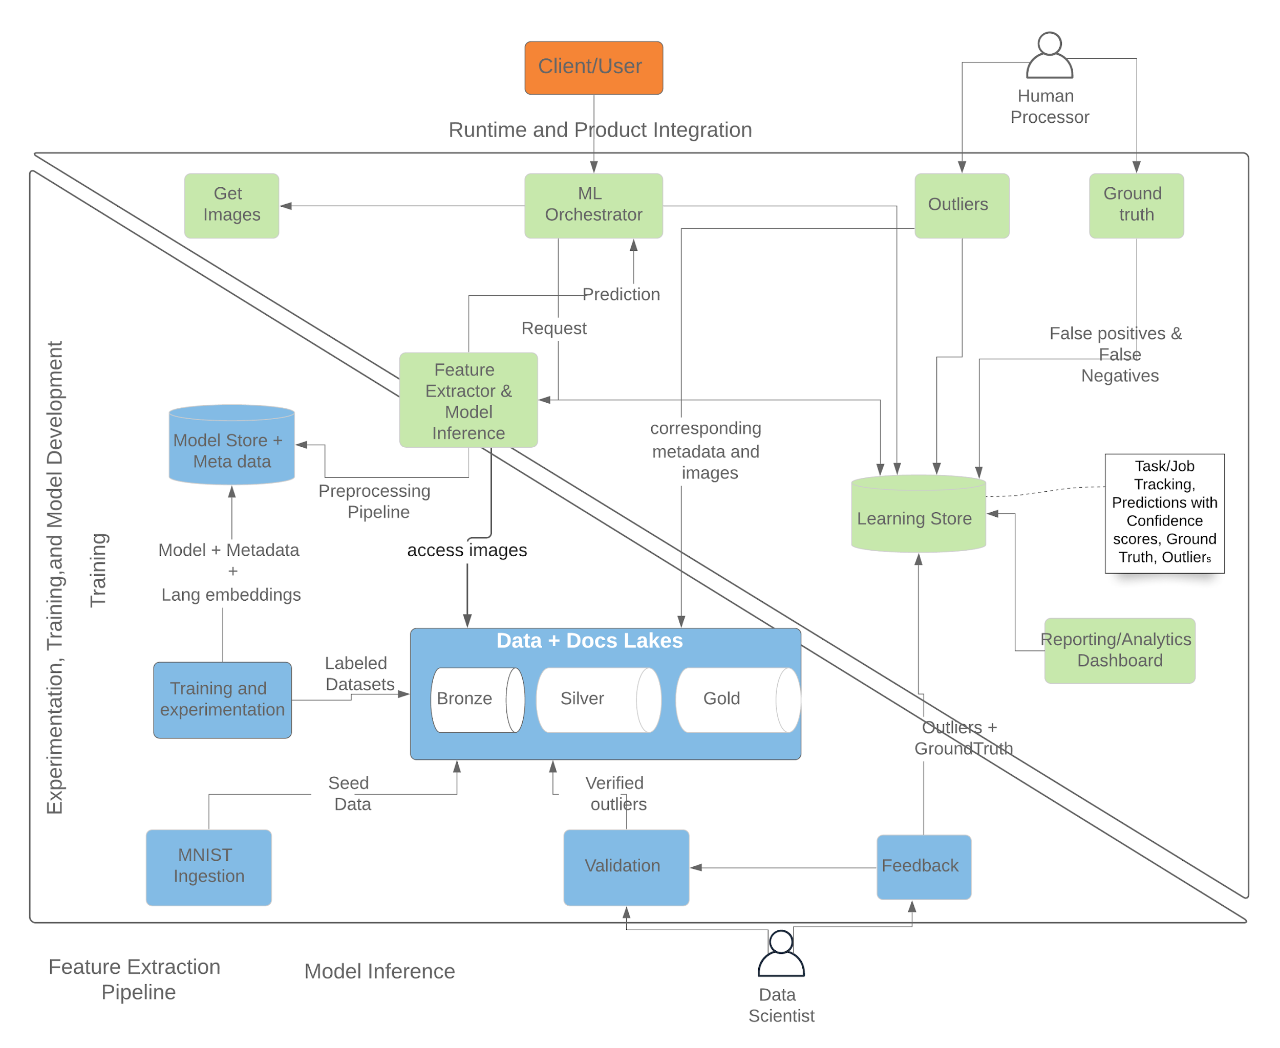
Architecture

Slide 3





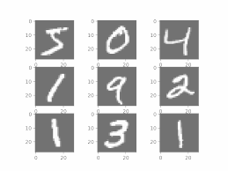


High Level Design
Data Sources
Data Acquisition
Data Lake
Training Pipeline
Learning Store
Inference Pipeline
AI/ML Model Trainer
Microservices
Features
AWS S3
Task Tracking Store
Gold Store
ML Orchestrator
Feature Extractor
Preprocessed Data
Feature Extractor
AWS S3
Model Store
MNIST acquisition Process
Silver Store
Model Deployment
Model Inference
Data Preprocessor
Raw Data
Google Scraper & Online content acquisition process
AWS S3
Bronze Store
Online content
Notes:
IBM Kernal and Zeppelin sit on top of Spark Processing layer

Slide 4





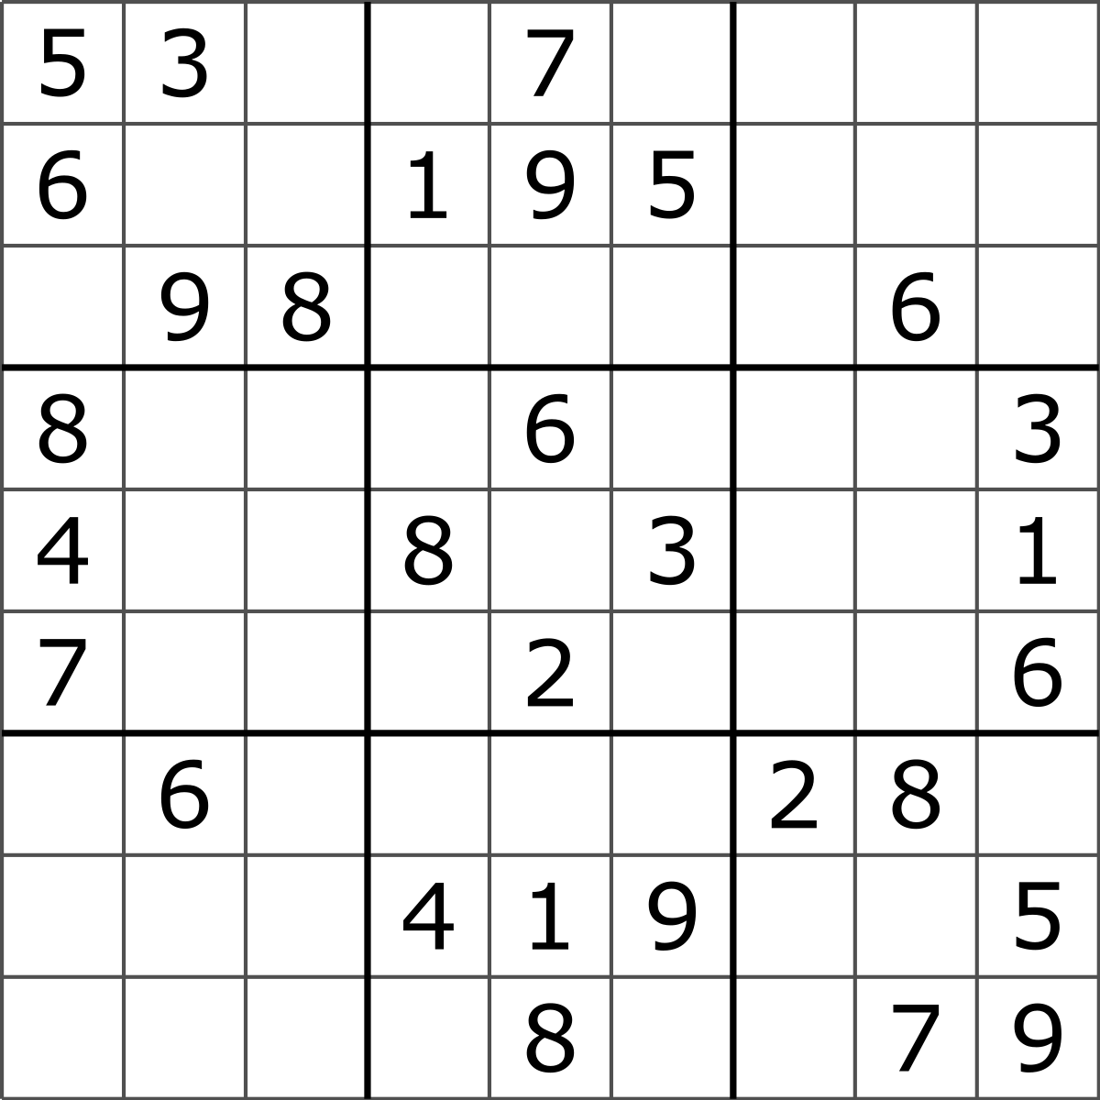

High Level Design
Data Sources
Data Acquisition
Data Lake
Training Pipeline
Learning Store
Inference Pipeline
AI/ML Model Trainer
Model Store
Model Inference Layer
reload_model
Features
- reload_model()
- test_parameters()
- predict()
GCP
Gold Store
Feature Extractor
MNIST acquisition Process
Preprocessed Data
Task Tracking Store
GCP
predict
Silver Store
Web/UI Layer
Google Scraper & Online content acquisition process
Data Preprocessor
User Data with Ground Truth
Raw Data
GCP
Bronze Store
Online content
Human Processor
Notes:
IBM Kernal and Zeppelin sit on top of Spark Processing layer

