Slide 1
Foreigners, Migrants - OECD and UN data
ID, Last Name, First Name

Slide 2
R Markdown Options
R Notebook: options
isoslides_presentation:
widescreen: yes
smaller: yes
pdf_documents: tinytex
word_document:
reference_doc: ref-doc-style.docx
powerpoint_presentation:
reference_doc: ref-ppt-style.pptx

Slide 3
Abstract
In this note, we study immigrants using OECD data and migrants using UN data. We also combine these two sets of data to provide examples to use public data.

Slide 4
OECD data
OECD data top
OECD data https://data.oecd.org/
Browse by Topics (Choose from 12 topics) or Country (Choose from 37 countries)
Topics:
Society
Demography
Inequality
Migration
Population by Region
Social protection

Slide 5
Topic: Society - Migration
Permanent immigrant inflows
Permanent immigrant inflows cover regulated movements of foreigners considered to be settling in the country from the perspective of the destination country. They cover regulated movements of foreigners as well as free movement migration. The data presented are the result of a standardisation process that allows for cross-country comparisons. This indicator is measured by numbers of permanent inflows.
Stocks of foreign-born population in OECD countries
Foreign-born population
Foreign population
Native-born employment
Foreign-born employment
Native-born unemployment
Foreign-born unemployment
Native-born participation rates
Foreign-born participation rates

Slide 6
Permanent immigrant inflows
Permanent immigrant inflows Total, Number, 2022 Link
Definition of Permanent immigrant inflows
Permanent immigrant inflows cover regulated movements of foreigners considered to be settling in the country from the perspective of the destination country. They cover regulated movements of foreigners as well as free movement migration. The data presented are the result of a standardisation process that allows for cross-country comparisons. This indicator is measured by numbers of permanent inflows.
Citation: OECD (2024), Permanent immigrant inflows (indicator). doi: 10.1787/304546b6-en (Accessed on 27 January 2024)

Slide 7
OECD: Permanent immigrant inflows
Data Information
Data Site: https://data.oecd.org/migration/permanent-immigrant-inflows.htm
Definition of Permanent immigrant inflows: Permanent immigrant inflows cover regulated movements of foreigners considered to be settling in the country from the perspective of the destination country. They cover regulated movements of foreigners as well as free movement migration. The data presented are the result of a standardisation process that allows for cross-country comparisons. This indicator is measured by numbers of permanent inflows.
Citation: OECD (2024), Permanent immigrant inflows (indicator). doi: 10.1787/304546b6-en (Accessed on 28 January 2024)
Categories: Total, Work, Free movements, Family, Family accompanying workers, Humanitarian, Other

Slide 8
Read the downloaded full data of ‘Permanent Immigrant Inflows’.
df_inflows <- read_csv("data/DP_LIVE_28012024004117279.csv")
## Rows: 3597 Columns: 8 ## ── Column specification ──────────────────────────────────────────────────────── ## Delimiter: "," ## chr (5): LOCATION, INDICATOR, SUBJECT, MEASURE, FREQUENCY ## dbl (2): TIME, Value ## lgl (1): Flag Codes ## ## ℹ Use `spec()` to retrieve the full column specification for this data. ## ℹ Specify the column types or set `show_col_types = FALSE` to quiet this message.

Slide 9
df_inflows |> slice_head(n = 10)
## # A tibble: 10 × 8 ## LOCATION INDICATOR SUBJECT MEASURE FREQUENCY TIME Value `Flag Codes` ## <chr> <chr> <chr> <chr> <chr> <dbl> <dbl> <lgl> ## 1 AUS IMMIGINFLOW FAM NBR A 2003 40105 NA ## 2 AUS IMMIGINFLOW FAM NBR A 2004 42187 NA ## 3 AUS IMMIGINFLOW FAM NBR A 2005 43747 NA ## 4 AUS IMMIGINFLOW FAM NBR A 2006 45943 NA ## 5 AUS IMMIGINFLOW FAM NBR A 2007 48769 NA ## 6 AUS IMMIGINFLOW FAM NBR A 2008 49870 NA ## 7 AUS IMMIGINFLOW FAM NBR A 2009 56366 NA ## 8 AUS IMMIGINFLOW FAM NBR A 2010 60254 NA ## 9 AUS IMMIGINFLOW FAM NBR A 2011 54543 NA ## 10 AUS IMMIGINFLOW FAM NBR A 2012 58604 NA

Slide 10
Categorial Variables
df_inflows |> select(-Value, -LOCATION, -TIME) |> lapply(unique)
## $INDICATOR ## [1] "IMMIGINFLOW" ## ## $SUBJECT ## [1] "FAM" "FAMWORKR" "FREEMOVS" "HUMNTRN" "OTH" "WORK" "TOT" ## ## $MEASURE ## [1] "NBR" ## ## $FREQUENCY ## [1] "A" ## ## $`Flag Codes` ## [1] NA

Slide 11
Add country names using the countrycode package and delete INDICATOR, MEASURE, FREQUENCY, Flag Codes.
df_in <- df_inflows |> mutate(country = countrycode(LOCATION, "iso3c", "country.name"), .before = LOCATION) |> select(country, iso3c = LOCATION, category = SUBJECT, year = TIME, value = Value) df_in |> head()
## # A tibble: 6 × 5 ## country iso3c category year value ## <chr> <chr> <chr> <dbl> <dbl> ## 1 Australia AUS FAM 2003 40105 ## 2 Australia AUS FAM 2004 42187 ## 3 Australia AUS FAM 2005 43747 ## 4 Australia AUS FAM 2006 45943 ## 5 Australia AUS FAM 2007 48769 ## 6 Australia AUS FAM 2008 49870

Slide 12
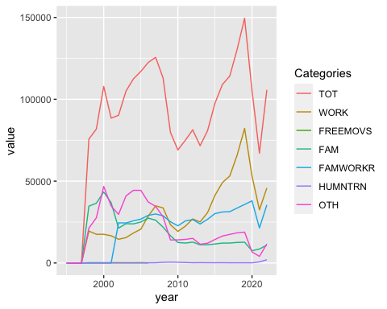

Slide 13
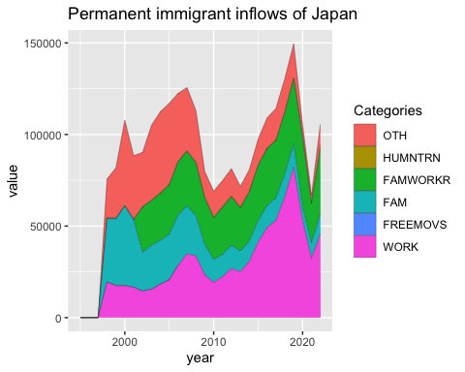

Slide 14
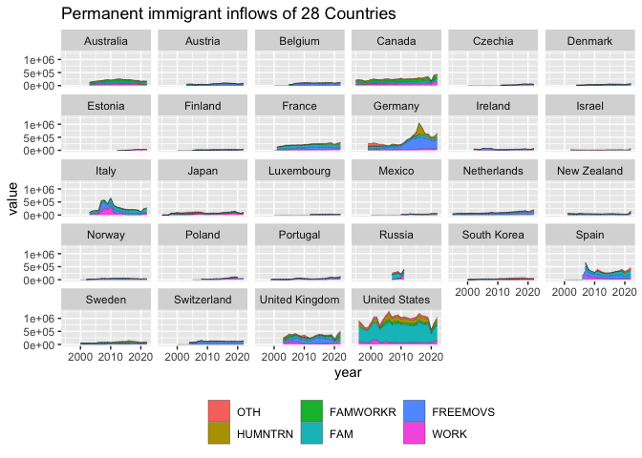

Slide 15
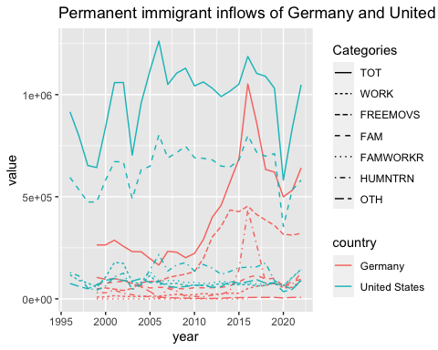

Slide 16
