Slide 1
Hack-The-Planet
Holiday Hackathon
2021

Slide 2

GitHub Archive Integrations With Astra

Slide 3




Hack-The-Planet Team
George Cross
Geni Gomez
James Colvin
Steven Matison

Slide 4


Slide 5

Use Case
What projects are our peers working on in Github?
Who contributed to the repo apache/cassandra?
Who contributes to the repo stargate/stargate?
As a business DataStax employs countless resources who are interacting with GitHub on business, personal, and community projects. Within our team of DA’s we asked ourselves: “How could we know what our peers were working on?”
For this Holiday Hackathon we are going to try and solve this business challenge.

Slide 6


Open-source developers all over the world are working on millions of projects: writing code & documentation, fixing & submitting bugs, and so forth. GH Archive is a project to record the public GitHub timeline, archive it, and make it easily accessible for further analysis.
https://www.gharchive.org/

Slide 7
Technologies Used

Slide 8
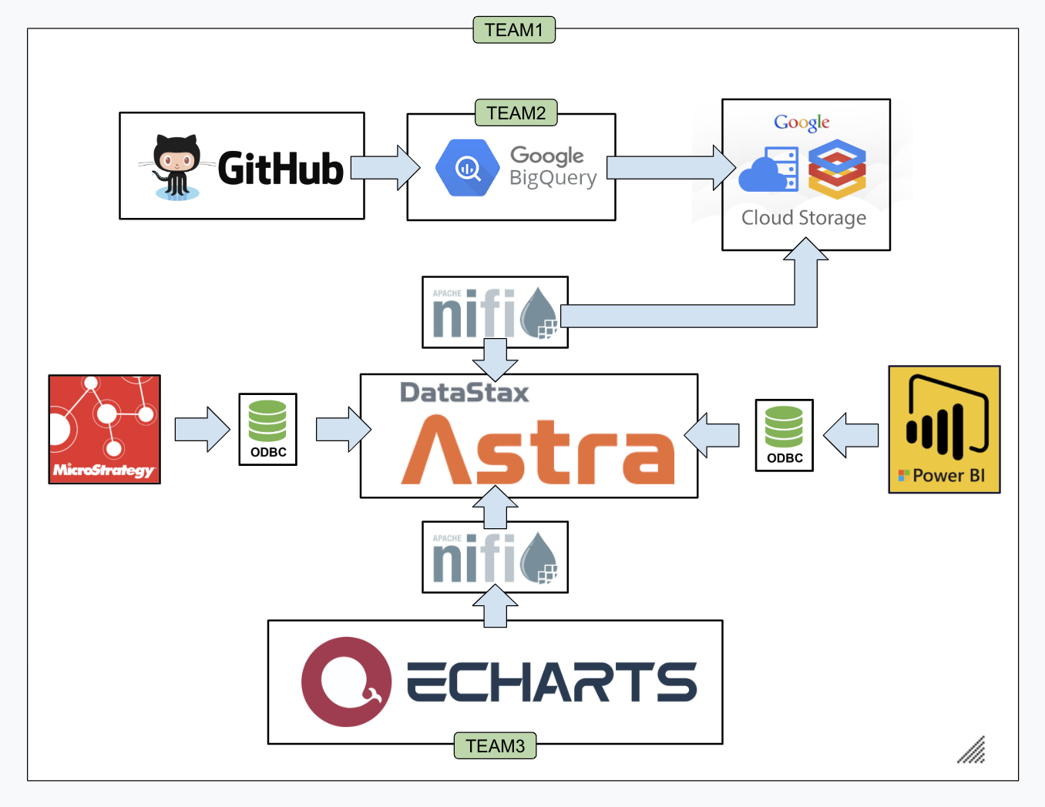

Slide 9
DataStax Astra
DataStax Astra is at the heart of our hackathon providing the persistent data store behind all raw data inspection, data modeling, prototyping, and final visualizations.

Slide 10
StarGate
StarGate provides API Gateway to Astra with functionality to ingest JSON and CSV data with Document API and REST API.

Slide 11
GCP: BigQuery & Cloud Storage
Google GCP provides access to Public Data Set for GitHuB Archive. BigQuery is used to build refined queries against the GitHub Archive dataset and GCS is used to store the results.

Slide 12
Apache NiFi
Wrapping the heart of our project (astra) NiFi is used to automate the data pipeline from GCS to Astra. Additionally NiFi is used to provide a constantly authorized endpoint for eChart visualizations.

Slide 13
BI Tools Microstrategy & PowerBI
BI Tools were used to create external access to Astra for Data Modeling and BI Tool based visualizations.

Slide 14
Apache eCharts
A current incubating project at apache.org, eCharts is used to integrate with Astra to provide robust charts, graphs, and powerful data visualizations without drivers, access, and authorization concerns.

Slide 15
eChart Visualizations

Slide 16
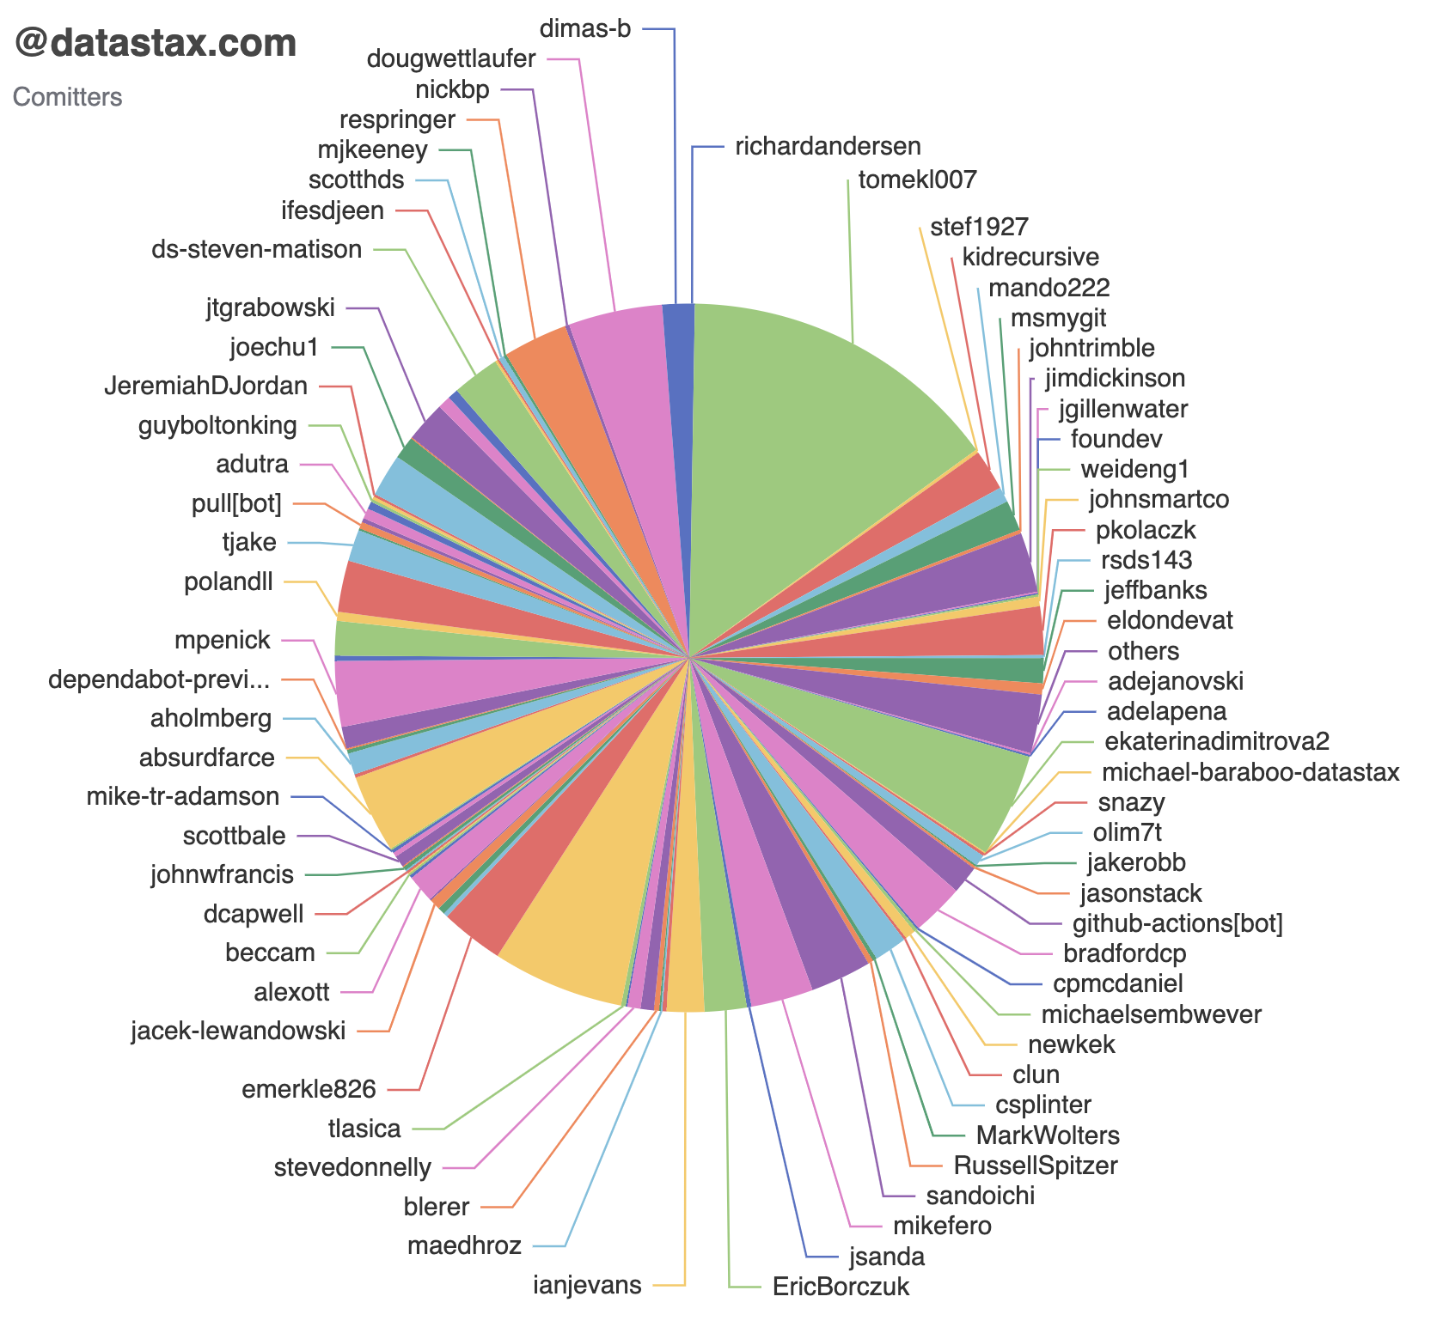
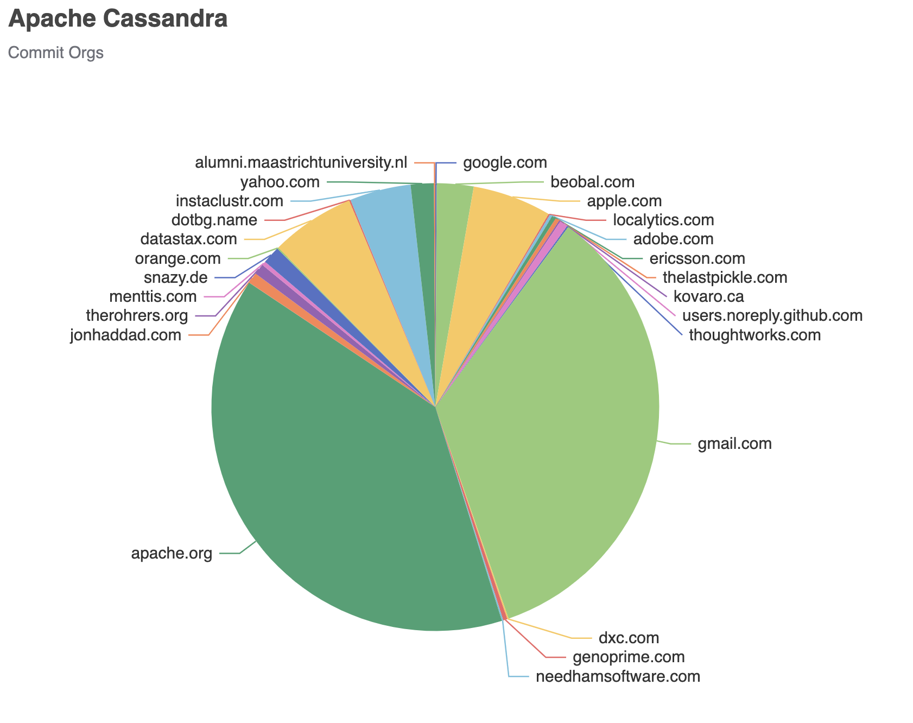
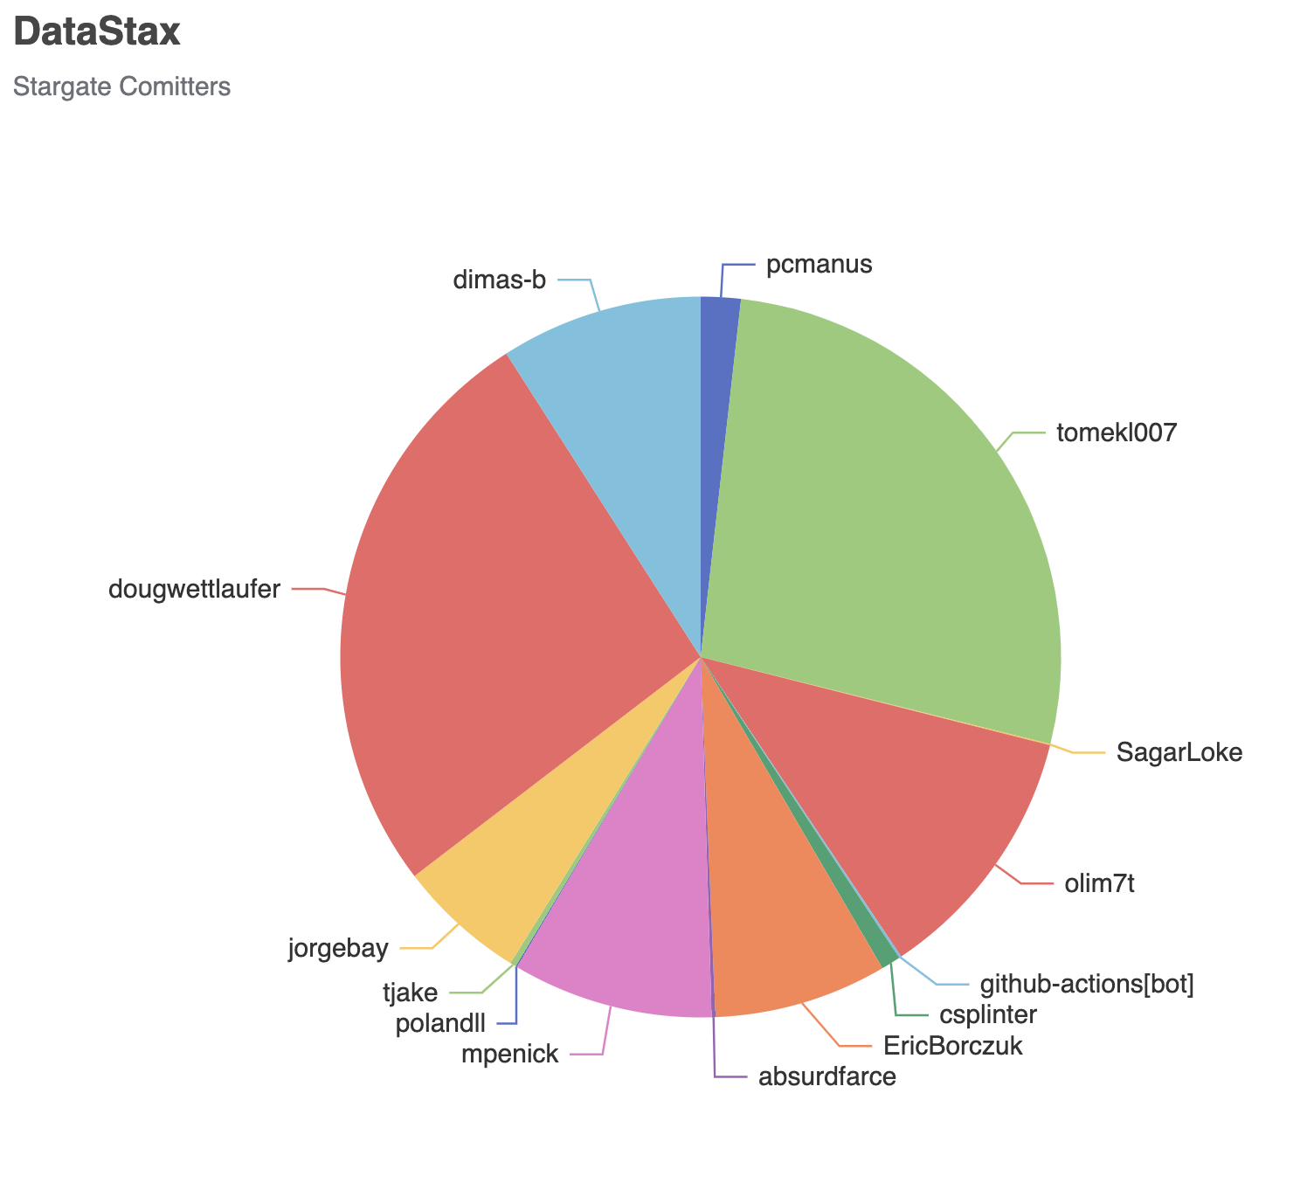

Slide 17
Live eCharts Visualization URLs
Chart 1:
http://makeopensourcegreatagain.com/gharchive_graph1_csv.html
Chart 2:
http://makeopensourcegreatagain.com/gharchive_graph2_csv.html
Chart 3:
http://makeopensourcegreatagain.com/gharchive_graph3_csv.html

Slide 18
BI Tool Visualizations

Slide 19
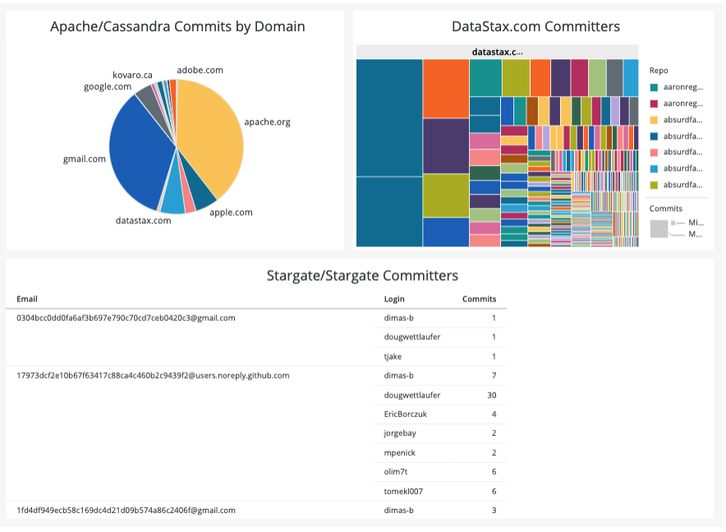



Slide 20
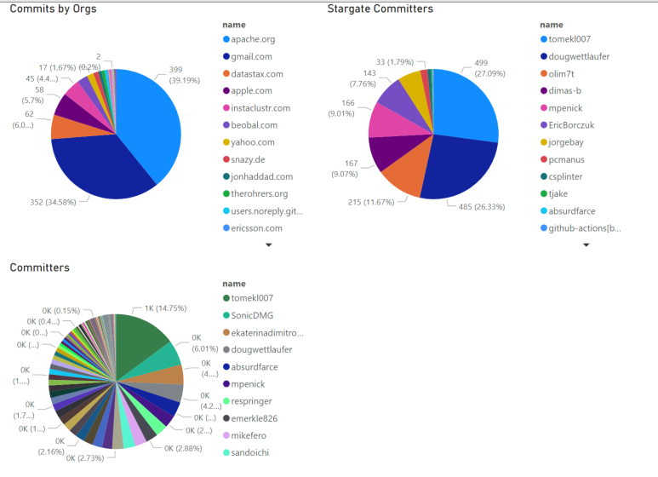

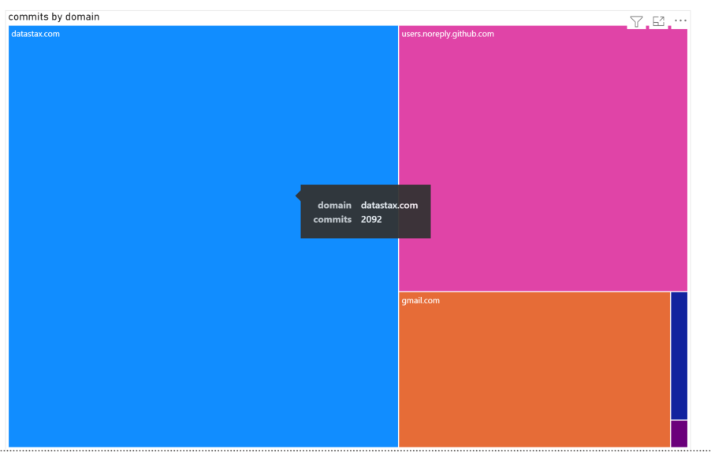

Slide 21
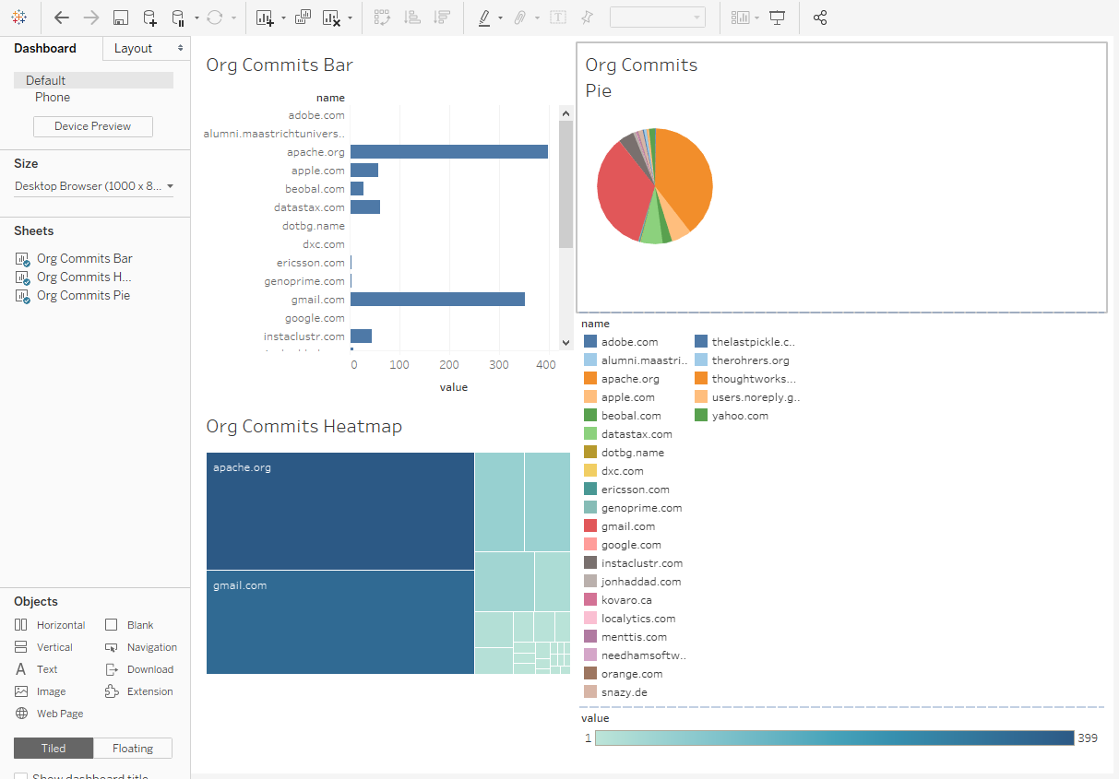


Slide 22
How did we do this?

Slide 23
Team Approach
During this Hackathon our team worked independently on the following areas:
Team 1 - Infrastructure & Automation
Team 2 - Data Modeling & Aggregations
Team 3 - Visualization
At the Infrastructure & Automation level we provided a fully automated raw data ingestion platform based on Apache NiFi. The data pipeline is pulling data from a GCS bucket in csv or json formats and executing the appropriate Stargate API endpoints to insert JSON (document api - no schema) or CSV (rest api - inferred schema).
On the Data Modeling & Aggregation side we viewed raw data using BigQuery, both ODBC & JDBC Drivers (raw ingested data), and Astra Studio. These tools helped us inspect the raw data to formulate final normalized tables and schemas we needed to support automated data pipeline for the final chart aggregations.
On the Visualization side we leveraged an incubating project at apache.org called eCharts which is accepting of the JSON output of our normalized data sources. Additionally, BI Tool Teams created similar visualizations to prove equal BI Tool capability.

Slide 24
BigQuery Queries
// master raw dataset
SELECT repo.name AS repo, actor.login AS login, actor.avatar_url AS avatar
,JSON_EXTRACT_SCALAR(payload, '$.commits[0].author.email') AS email
,LEFT(JSON_EXTRACT_SCALAR(payload, '$.commits[0].author.email'),INSTR(JSON_EXTRACT_SCALAR(payload, '$.commits[0].author.email'),'@')-1) AS author
,RIGHT(JSON_EXTRACT_SCALAR(payload, '$.commits[0].author.email'),LENGTH(JSON_EXTRACT_SCALAR(payload, '$.commits[0].author.email')) - INSTR(JSON_EXTRACT_SCALAR(payload, '$.commits[0].author.email'),'@')) AS domain
FROM `githubarchive.month.202*`
WHERE type = 'PushEvent' AND (repo.name IN('apache/cassandra','stargate/stargate') OR JSON_VALUE(payload,'$.commits[0].author.email') LIKE '%@datastax.com');
// graph 1
SELECT domain AS name, sum(commits) AS value FROM `gharchive-301514.dset_gharchive.gharchive_master` WHERE repo = 'apache/cassandra' GROUP BY name ORDER BY value desc;
// graph 2
select case when rowid < 100 then name else 'others' end name, sum(value) value FROM (SELECT row_number() over (order by value desc) rowid, name, value FROM (SELECT login AS name, sum(commits) AS value FROM `gharchive-301514.dset_gharchive.gharchive_master` WHERE domain = 'datastax.com' GROUP BY name )) group by name;
// graph 3
SELECT login AS name, sum(commits) AS value FROM `gharchive-301514.dset_gharchive.gharchive_master` WHERE repo = 'stargate/stargate' GROUP BY name ORDER BY value desc;

Slide 25
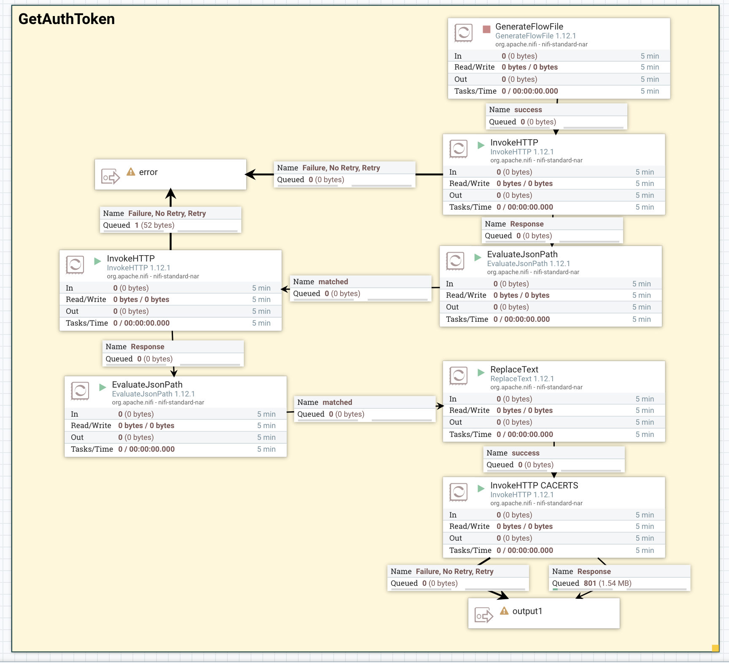
Apache NiFi Always On Auth Token

Slide 26
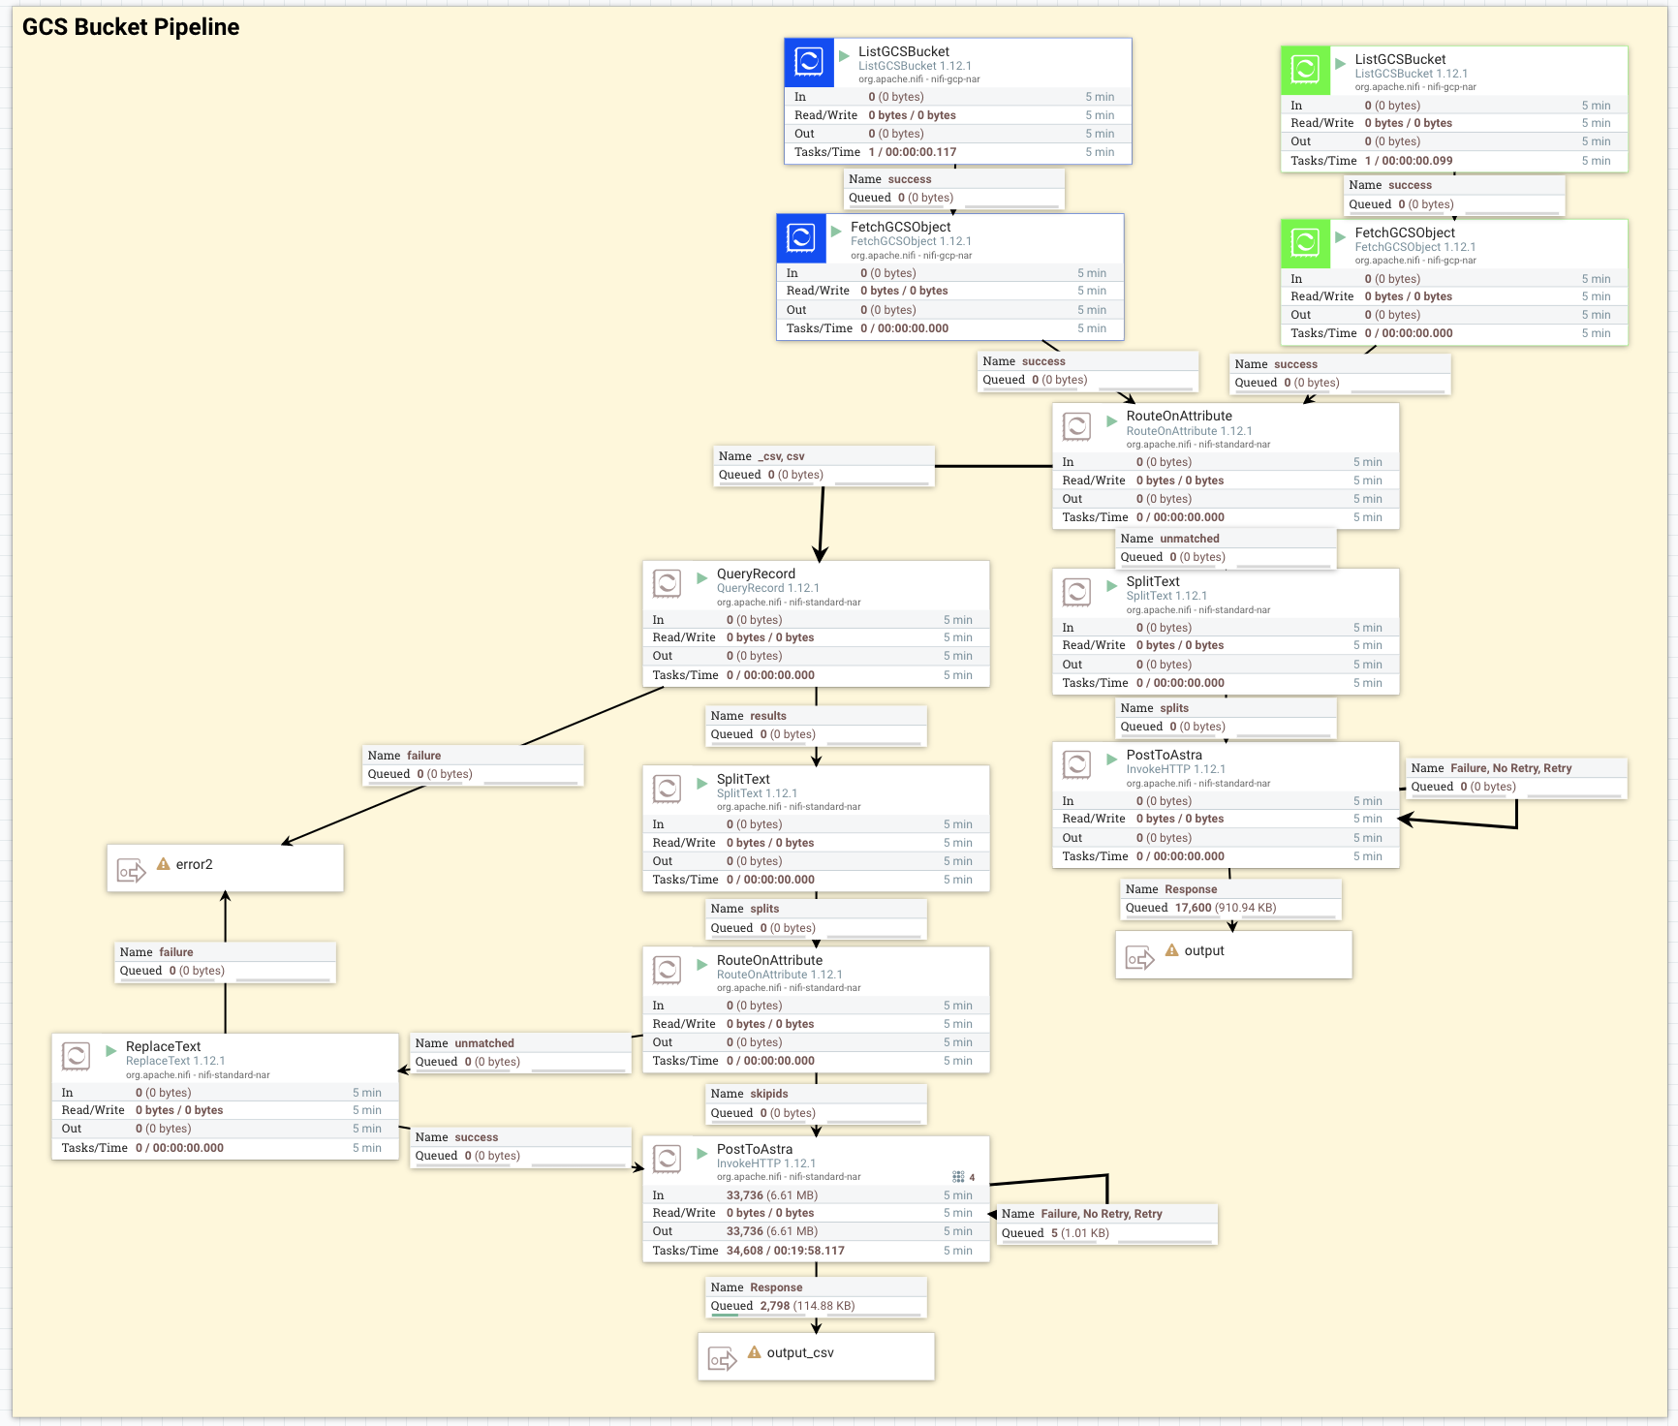
Apache NiFi GCS Bucket Pipeline

Slide 27
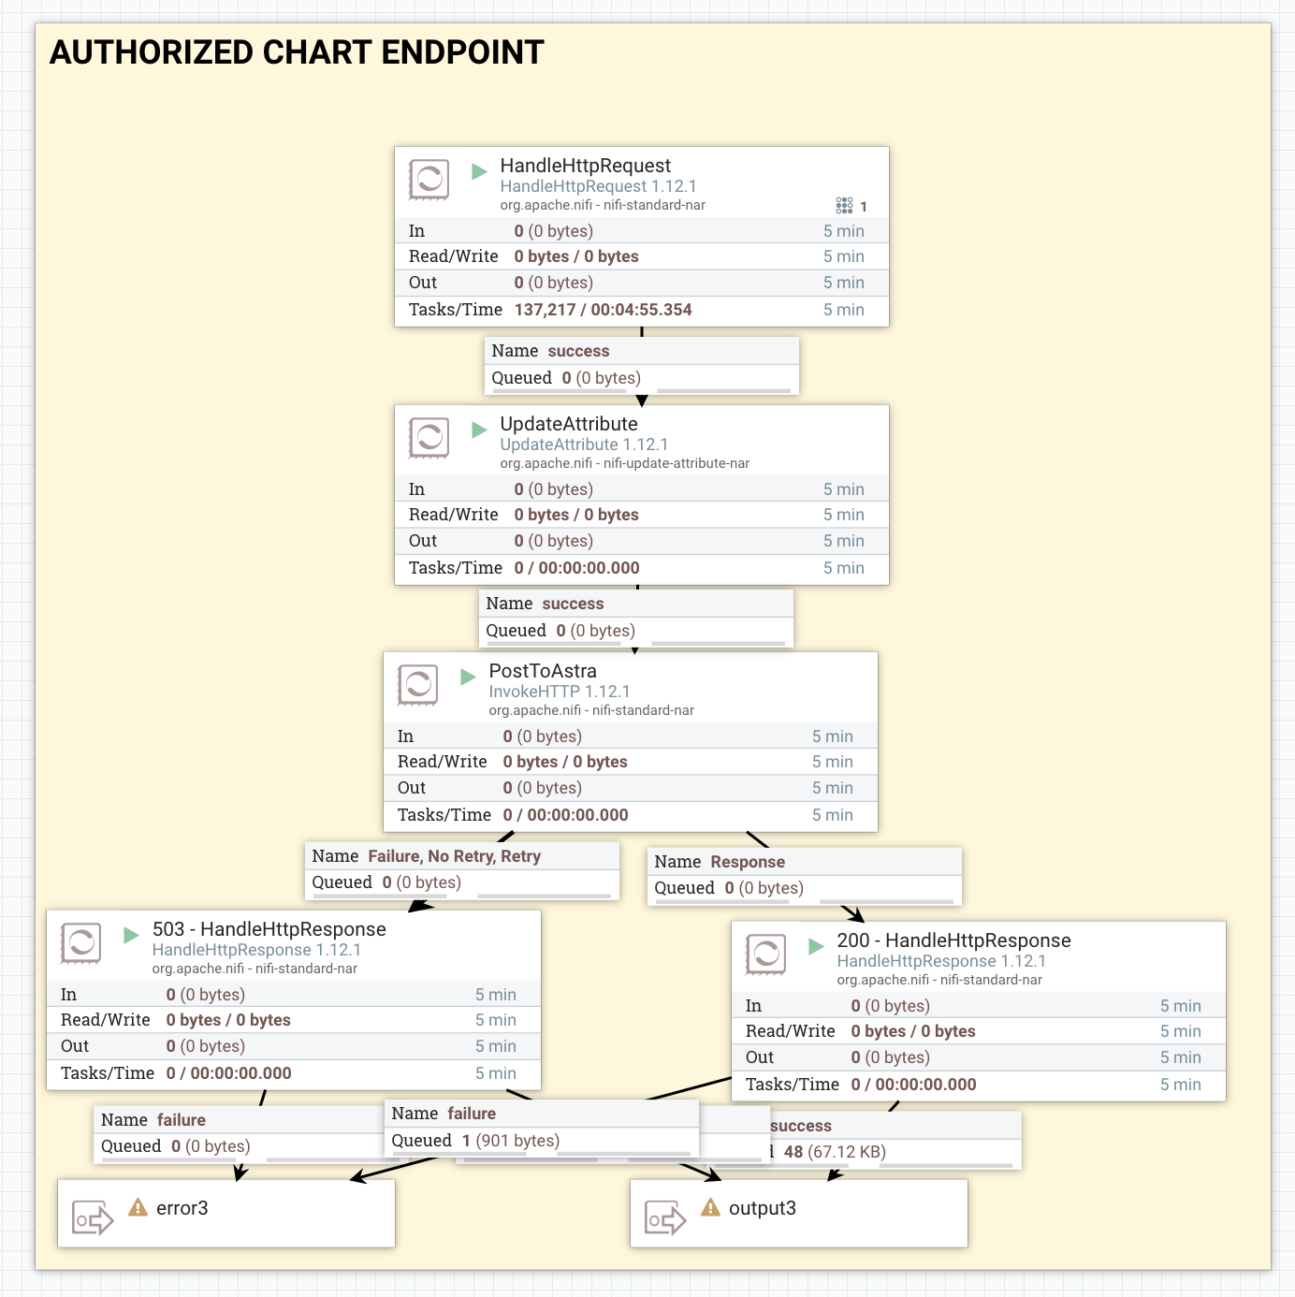
Apache NiFi eCharts EndPoint

Slide 28
Apache eCharts Sample Code & Data Graph 1
<script type="text/javascript">
var myChart = echarts.init(document.getElementById('main'));
$.get('http://192.241.141.13:8081/gharchive_graph1_csv').done(function (data) {
myChart.setOption({
title: {
text: 'Apache Cassandra',
subtext: 'Commit Orgs'
},
tooltip: {},
series: [
{
name: 'org domain',
type: 'pie',
radius: '55%',
center: ['40%', '50%'],
data: data.rows,
emphasis: {
itemStyle: {
shadowBlur: 10,
shadowOffsetX: 0,
shadowColor: 'rgba(0, 0, 0, 0.5)'
}
}
}
]
});
});
</script>
{
"count": 25,
"rows": [
{
"name": "google.com",
"value": 1
},
{
"name": "beobal.com",
"value": 27
},
...[result set trimmed for presentation]
]
}

Slide 29
Apache eCharts Sample Code & Data Graph 2
<script type="text/javascript">
var myChart = echarts.init(document.getElementById('main'));
$.get('http://192.241.141.13:8081/gharchive_graph21_csv').done(function (data) {
myChart.setOption({
title: {
text: '@datastax.com',
subtext: 'Comitters'
},
tooltip: {},
series: [
{
name: 'github user',
type: 'pie',
radius: '55%',
center: ['40%', '50%'],
data: data.rows,
emphasis: {
itemStyle: {
shadowBlur: 10,
shadowOffsetX: 0,
shadowColor: 'rgba(0, 0, 0, 0.5)'
}
}
}
]
});
});
</script>
{
"count": 100,
"pageState": "B2RpbWFzLWIA8H///5sA",
"rows": [
{
"name": "richardandersen",
"value": 18
},
{
"name": "tomekl007",
"value": 1050
},
...[result set trimmed for presentation]
]
}

Slide 30
Apache eCharts Sample Code & Data Graph 3
<script type="text/javascript">
var myChart = echarts.init(document.getElementById('main'));
$.get('http://192.241.141.13:8081/gharchive_graph3_csv').done(function (data) {
myChart.setOption({
title: {
text: 'DataStax',
subtext: 'Stargate Comitters'
},
tooltip: {},
series: [
{
name: 'github user',
type: 'pie',
radius: '55%',
center: ['40%', '50%'],
data: data.rows,
emphasis: {
itemStyle: {
shadowBlur: 10,
shadowOffsetX: 0,
shadowColor: 'rgba(0, 0, 0, 0.5)'
}
}
}
]
});
});
</script>
{
"count": 14,
"rows": [
{
"name": "pcmanus",
"value": 33
},
{
"name": "tomekl007",
"value": 499
},
...[result set trimmed for presentation]
]
}

Slide 31
Next Steps?

Slide 32
Build a front end application capable of deeper drill down into data sets with live query-able interactive visualizations.
Track all commits to Apache Cassandra by engaging DataStax resources with personal, gmail, or apache.org accounts.
Expand visualizations and datasets for:
Forks
Issues
PRs
Create weekly contests for:
Top Committers
Most Repos Touched
Most Lines of Code

Slide 33
“Mess with the best, die like the rest...”
Dade “Zero Cool” “Crash Override” Murphy
Hackers (The Movie)

Slide 34

Thank You!

