Slide 1

Diwali Sales Data Analysis
Author: Victor Banerjee
Ph: +919836547801
Email: banerjeevictor06@gmail.com

Slide 2

Outline
Executive Summary
Introduction
Methodology
Conclusion
Recommendation
Appendix

Slide 3
Executive Summary
Analysing the Gender Wise Sales Distribution
Understanding how Marital Status impact Sales Performance
Understanding Sales Performance among age categories
Finding out Top 5 Performing States
Understanding Top 5 product Categories
Understanding the relation between Customer’s Occupation and Purchase Power

Slide 4
Introduction
We are given a dataset on Diwali Sales of a Retail Store. The dataset has information about count of sales and total sale amount across different product category and across various customer segment.
We want to analyze the dataset to answer following questions:
Gender Impact on Sales
Marital Status Impact
Age Impact
Occupation Impact
State Wise Performance
Product Category Wise Performance

Slide 5

Methodology

Slide 6
Methodology
Data Collection:
Data is provided by the client as a csv file
Link: https://drive.google.com/file/d/1BPotfWkpOV5kr72UPZpsCcf3w_bxyaCN/view?usp=sharing
Data Wrangling
Filtering the data
Dealing with missing values
Dealing With Outliers
Data Analysis & Visualization using:
Pandas
Matplotlib
Seaborn

Slide 7
Data Collection
Data is provided by the client as a csv file
Link: https://drive.google.com/file/d/1BPotfWkpOV5kr72UPZpsCcf3w_bxyaCN/view?usp=sharing
Data is then loaded as DataFrame using Pandas Library
Data In Client Google Drive
Downloading Data In Local Drive
Pandas Library
Export it back to CSV
Data Cleaning

Slide 8
Data Wrangling
In the data set, there are duplicate entries. We filtered them out to get unique row entries.
There are two columns which did not have any data. They are dropped.
There are null values corresponding to many features. It is dropped depending on importance and percentage of null values and some places it is filled with mode, given that the features are object data type.
A new column is created for marriage status where ‘Married’ = 1 and ‘Unmarried’ = 0
‘Orders’ and ‘Amount’ columns has outliers which are filtered out using IQR
Filtering Duplicate Entries
Dropping Columns with no data
Filling Null Values
Detecting & Removing Outliers

Slide 9

Data Visualization

Slide 10
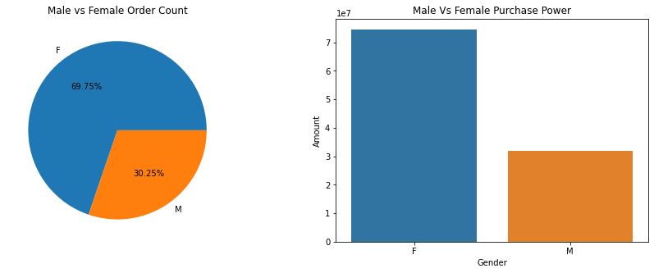
Sales Distribution Across Gender
Conclusion:
Female orders more and also they have more purchase power

Slide 11
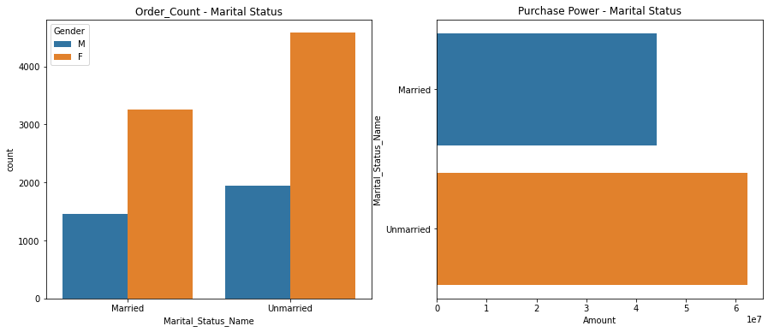
Sales Distribution Across Marriage Status
Conclusion:
Unmarried female makes more order, then married female and then unmarried male.

Slide 12
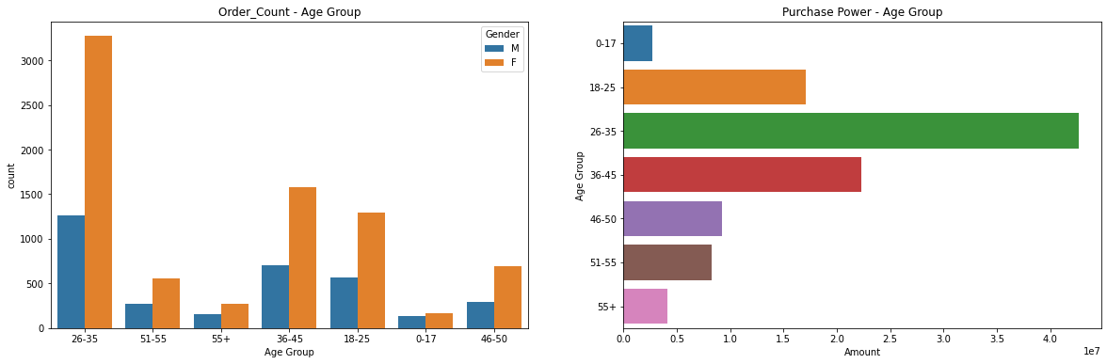
Sales Distribution Across Age Group
Conclusion:
Maximum number of orders comes from the age group 26-35

Slide 13
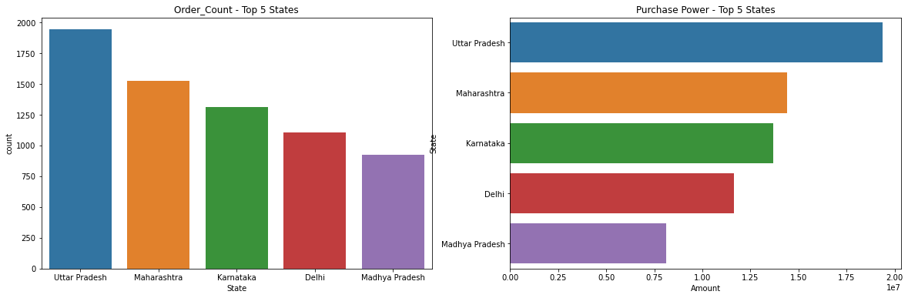
Top 5 Performing State
Conclusion:
The top performing states are: Uttar Pradesh, Maharashtra, Karnataka

Slide 14
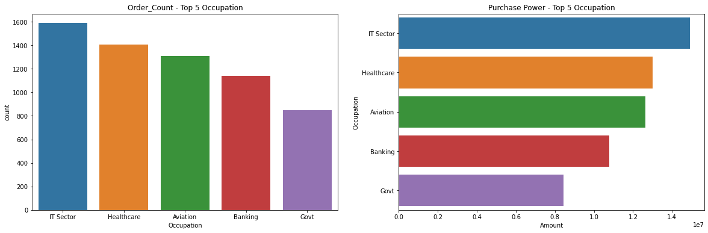
Impact of Occupation On Sales
Conclusion:
People placing larger quantity of orders are from IT Sector, Healthcare and Aviation

Slide 15
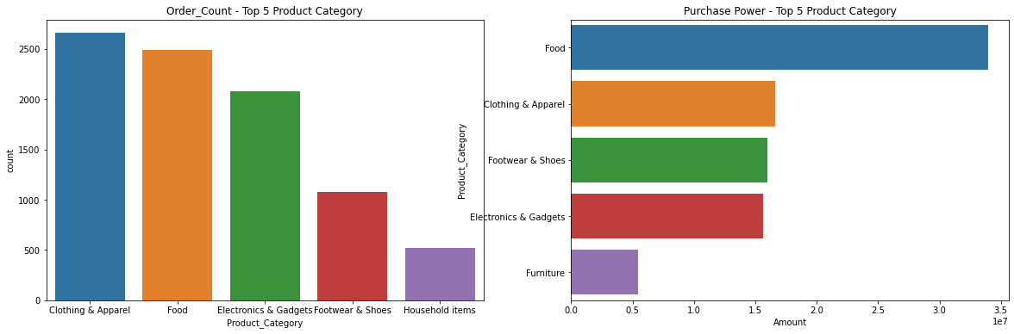
Top Performing Product Categories
Conclusion:
Top performing product categories are: Food, Clothing & Aparel, Footwear

Slide 16
Conclusion
Female orders more and also they have more purchase power
Unmarried female makes more order, then married female and then unmarried male
Maximum number of orders comes from the age group 26-35
The top performing states are: Uttar Pradesh, Maharashtra, Karnataka
People placing larger quantity of orders are from IT Sector, Healthcare and Aviation
Top performing product categories are: Food, Clothing & Apparel, Footwear

Slide 17
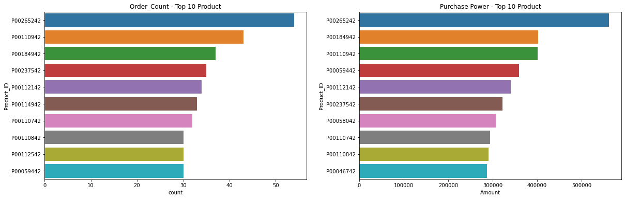
Appendix
Product Wise Performance

Slide 18
Final Suggestion
Relevant campaigns and discounts should be run to attract female customers
More Stocks should be maintained for product categories like Food, Clothing and Foot ware
People from IT, healthcare and aviation should be targeted more with community promotions

Slide 19

Thank You
Victor Banerjee

