Slide 1
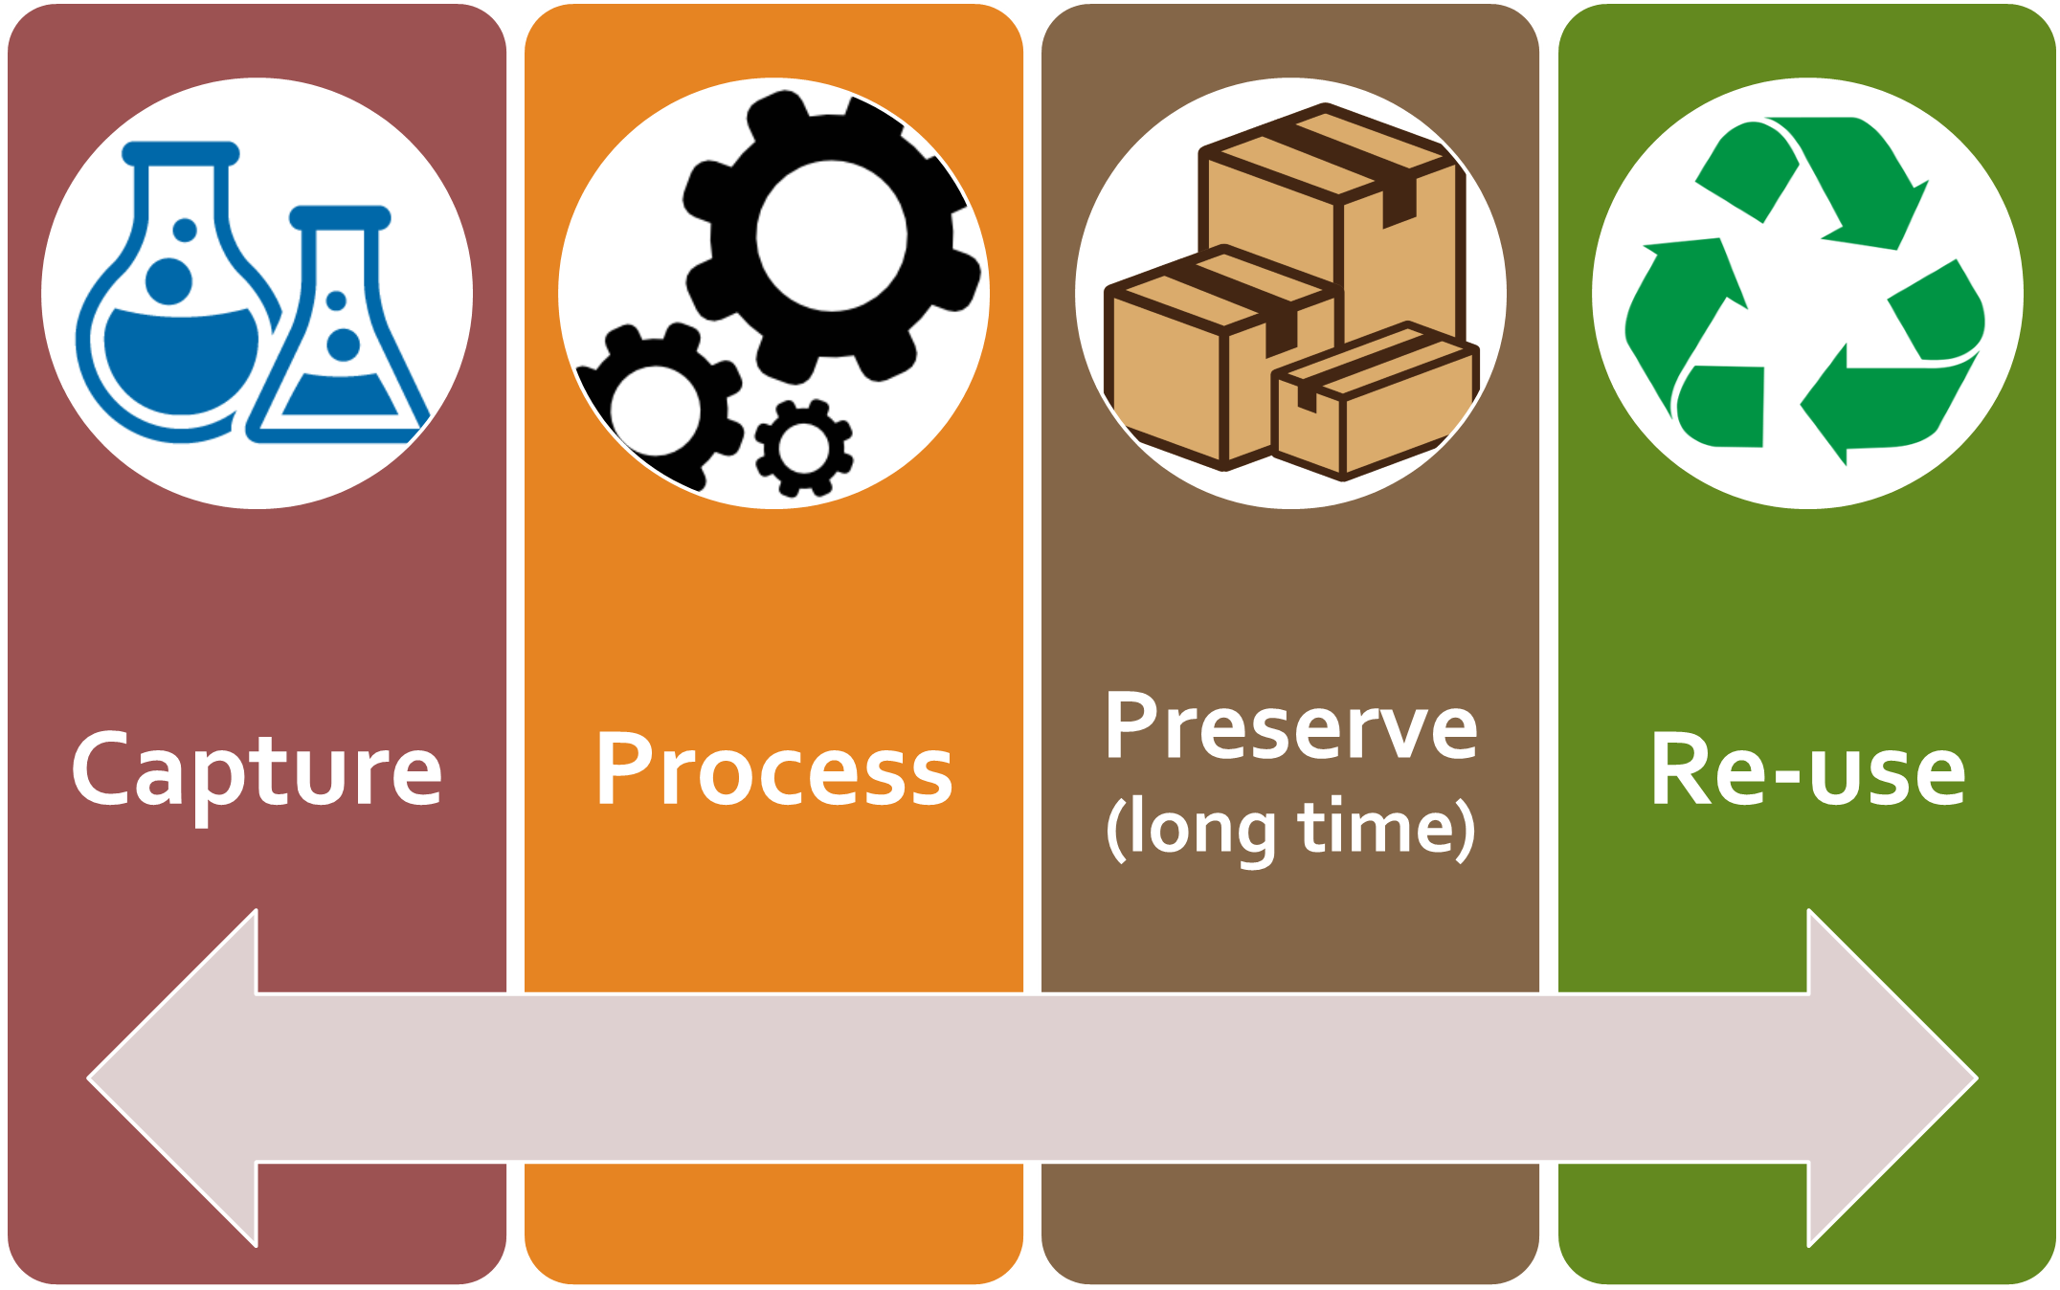
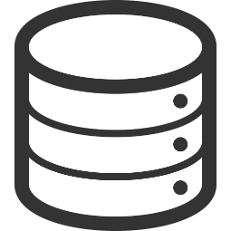

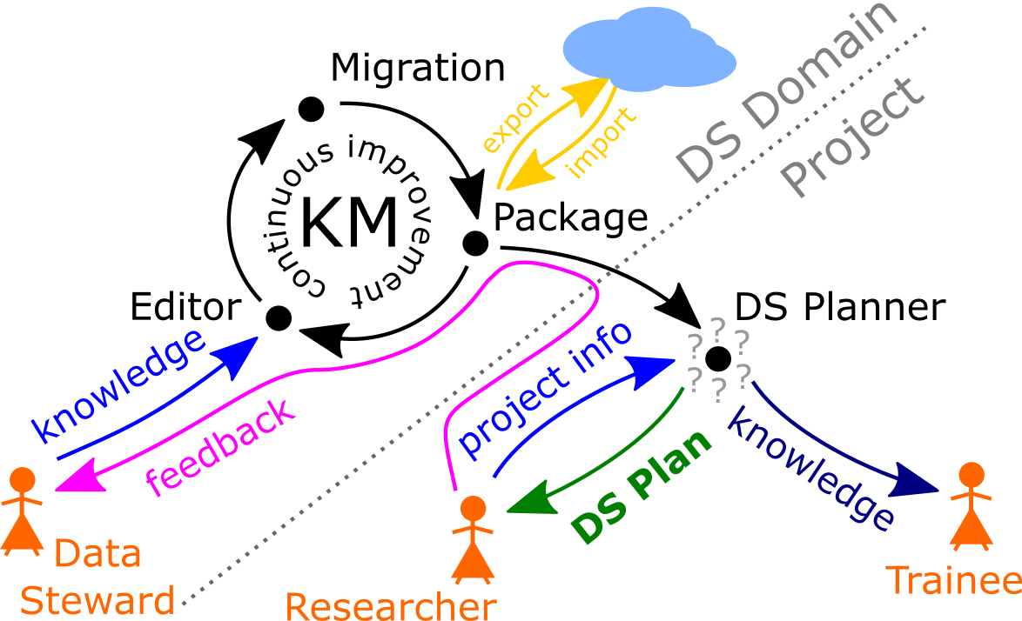
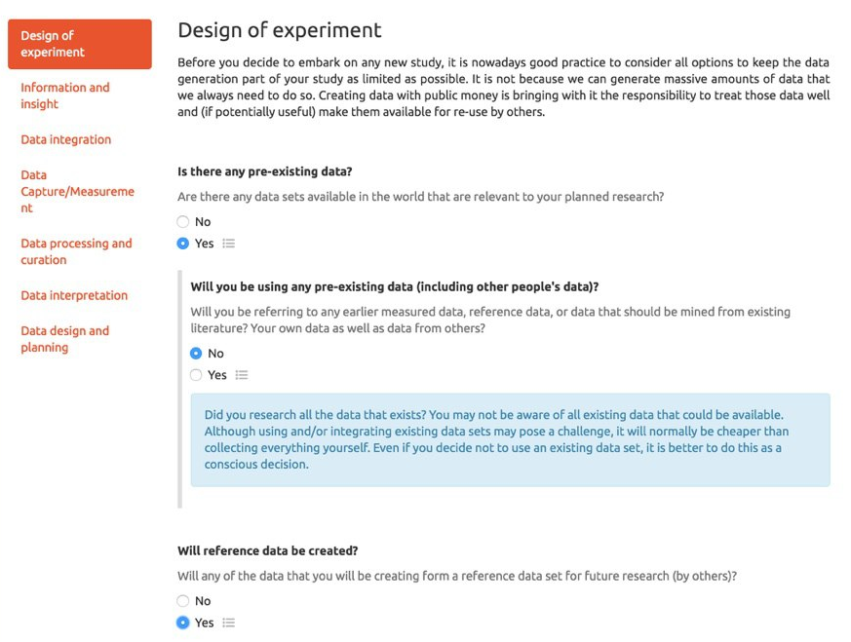
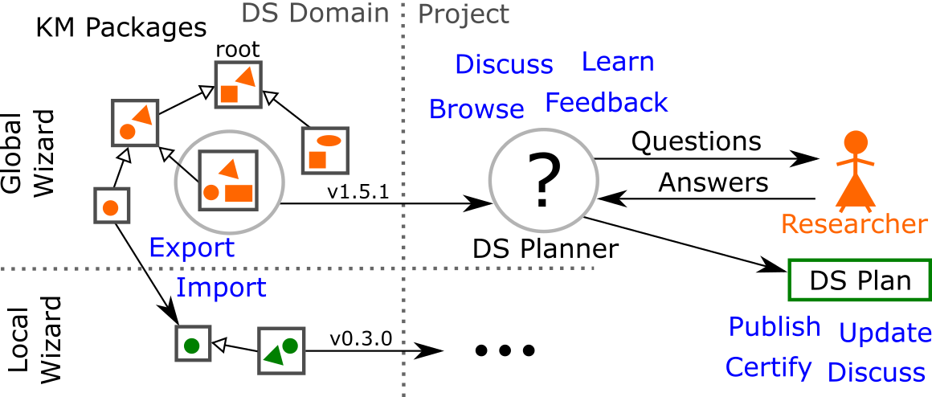
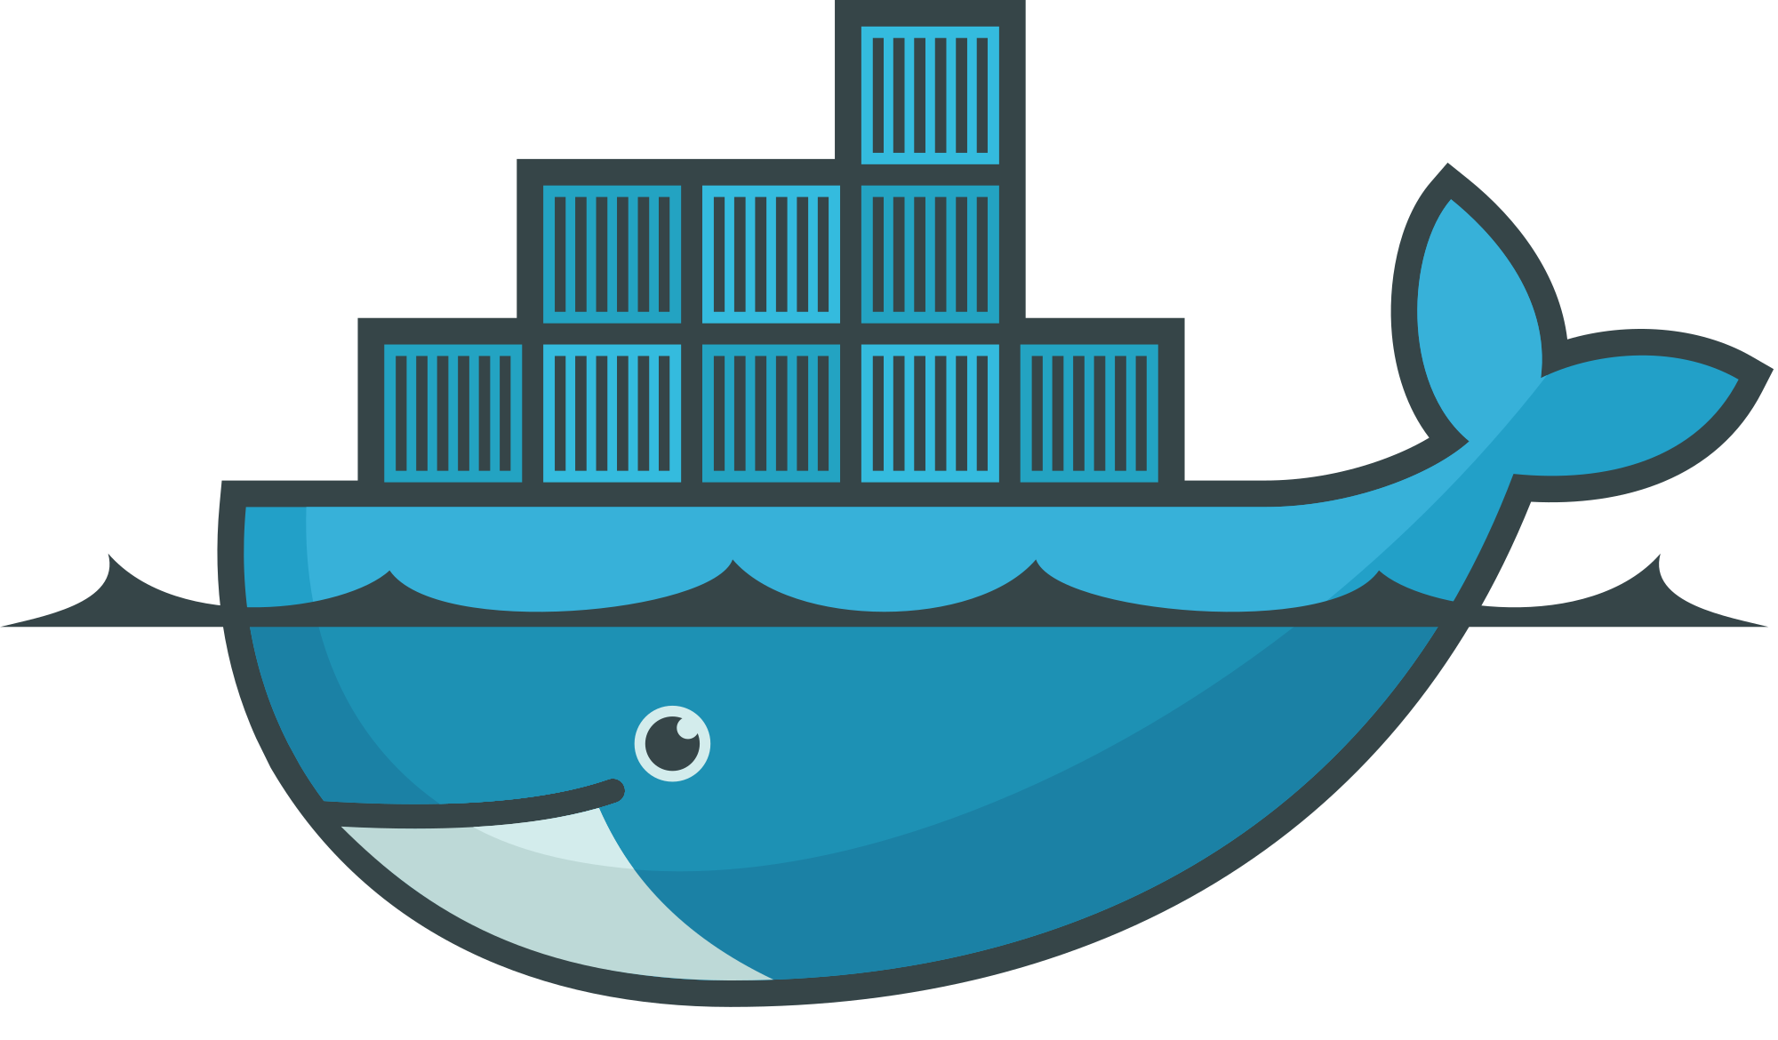
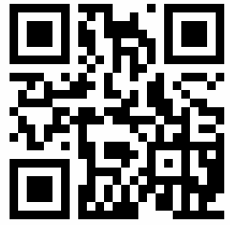


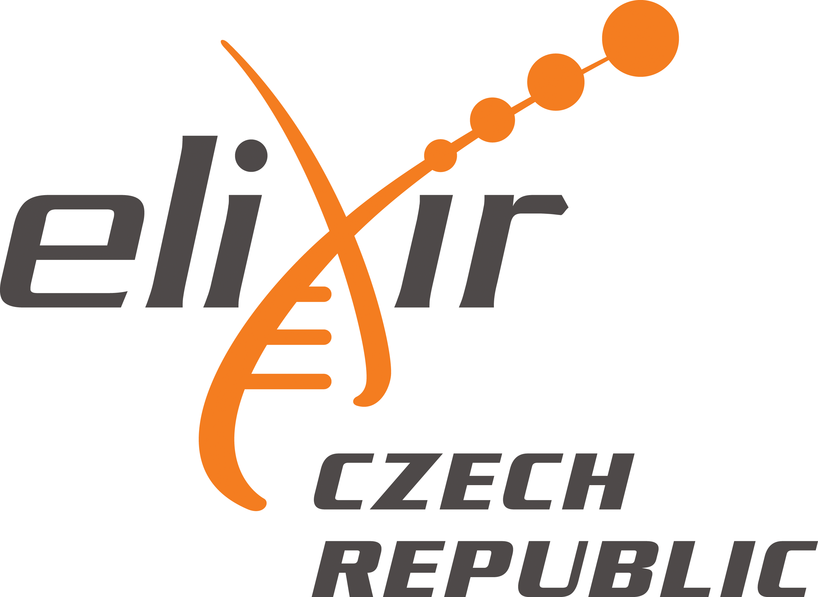


Data Stewardship Wizard
https://dsw.fairdata.solutions
Rob Hooft, Robert Pergl, Marek Suchánek, Celia van Gelder
Data Stewardship Plans
To support efficient, simple and smart work with data within research projects, an elaborate DM/DS Plan is desirable. Adopting FAIR Data principles is essential not just to satisfy requirements of funders, but to benefit your own research project as well.
Data Stewardship
Data Management Plans (DMPs) are a key element of good data management.
DMPs are important and required (e.g. H2020 projects).
DS Wizard – The Roadmap
We are working on a new „generation“ of Data Stewardship Wizard as a Docker-based modular portal solution that is hosted by ELIXIR CZ, but can be also deployed locally within your organization. The system includes:
interactive tool for creating the plan by answering relevant questions for your project,
knowledge models registry, editor, and migration tool,
organisation and user management (administration).
The Wizard is being developed as part of an 18-month ELIXIR Implementation Study of the ELIXIR Training Platform, which also includes doing an inventory of training materials and needs in the ELIXIR nodes, and setting up DM/DS trainings.
Interactive DS Planner
Researcher or trainee can go through the questions and fill in their answers via DS Planner tool in the form of interactive questionnaire. There can be thousands of questions in the knowledge model (KM), but the user won‘t be overwhelmed – only questions important for the specific case will be shown based on previous answers.
For researchers, output will be a project FAIR DS Plan. A trainee will learn what considerations should be made and what is data stewardship about. The last (but vital) part is a feedback system that allows continuous improvement of the KM.
User-friendly knowledge model editor
All the knowledge about data stewardship (DS Domain) is contained in the knowledge model. Data Stewards can use our editor to customize (add, edit, delete) the knowledge: chapters, questions, answers, follow up questions, references, and experts. You can simply build your own knowledge model on top of another one as a customization.
Smart migrations of the knowledge model
You can rely on consistency and up-to-date state of your customized knowledge model thanks to the migration tool: it handles all various versions in the hierarchy of models that need to be merged together. It works automatically in the background, however, you have full control of the migration.
Come, try, and stay tuned with us!
Register and try to use our DS Planner for you real or imaginary project.
Get into the role of Data Steward and customize the knowledge model with your specific organisational, geographical, legal or other expertise.
In the future, you will be able to run your own instance of DSW if needed (via Docker).
github.com/DataStewardshipWizard
rob.hooft@dtls.nl robert.pergl@fit.cvut.cz marek.suchanek@fit.cvut.cz
DSW Working Group
info@dsw.fairdata.solutions
https://dsw.fairdata.solutions

