Slide 1
PGM Week5
NER with Custom CRF
Team 5
2021313549 Sungsoo Chung
2021313129 TJ Park
2022310668 DG Kim
2025313590 IM Hwang
Notes:
Name and Student ID please

Slide 2
CONTENTS
Baseline Analysis
Methodology
Experiments
Result Analysis

Slide 3
1
Baseline Analysis
Three Representative Error Cases in Baseline
1) “1995 World Cup”: (B-MISC, I-MISC, I-MISC) → (O, B-MISC, I-MISC)
digit “1995” misclassified as O, shifting entity boundary
2) “CHINA” (B-PER) -> (B-LOC), “LUCKY” in headline: (O) → (B-ORG)
all-caps word falsely detected due to isupper() signal
3) “Champions ’ League”: (B-MISC, I-MISC, I-MISC) → (O, O, O)
common-noun-like multi-word entity entirely missed

Slide 4
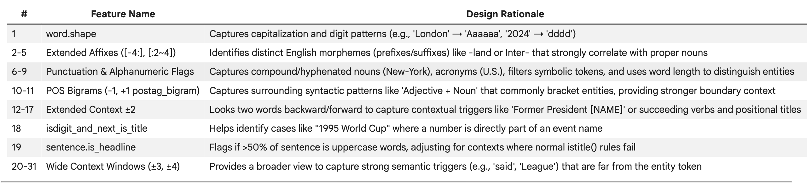
2
Methodology
Proposed Features

Slide 5
2
Methodology
Proposed Features
Context Window Expansion: wider context helps model see surrounding tokens, e.g., “1995 World Cup”, or “Champions ’ League”
Sentence-level Uppercase Ratio: detects headline sentences where isupper() is no longer a reliable entity signal, reducing false positives like “LUCKY” → B-ORG

Slide 6
3
Experiments
Tuning Context Window c
Models | Metric: F1-score
 | LOC | MISC | ORG | PER | Overall
Ours (c=1) | 0.8416 | 0.7660 | 0.7442 | 0.8561 | 0.8083
Ours (c=2) | 0.8461 | 0.7763 | 0.7555 | 0.8743 | 0.8199
Ours (c=3) | 0.8494 | 0.7743 | 0.7609 | 0.8719 | 0.8217
Ours (c=4) | 0.8496 | 0.7635 | 0.7708 | 0.8711 | 0.8232
Ours (c=5) | 0.8529 | 0.7690 | 0.7666 | 0.8707 | 0.8232
Ours (c=6) | 0.8474 | 0.7635 | 0.7625 | 0.8684 | 0.8192
c: Context Window

Slide 7
3
Experiments
Overall Performance Table
Models | Metric | LOC | MISC | ORG | PER | Overall
Baseline | Precision | 0.8428 | 0.7917 | 0.7282 | 0.8258 | 0.7986
 | Recall | 0.8034 | 0.7365 | 0.6887 | 0.8472 | 0.7739
 | F1-score | 0.8226 | 0.7631 | 0.7079 | 0.8364 | 0.7861
Ours (c=4) | Precision | 0.8491 | 0.7960 | 0.8079 | 0.8526 | 0.8326
 | Recall | 0.8501 | 0.7336 | 0.7369 | 0.8905 | 0.8139
 | F1-score | 0.8496 | 0.7635 | 0.7708 | 0.8711 | 0.8232
Ours (c=5) | Precision | 0.8576 | 0.7979 | 0.7933 | 0.8569 | 0.8322
 | Recall | 0.8483 | 0.7422 | 0.7417 | 0.8850 | 0.8143
 | F1-score | 0.8529 | 0.7690 | 0.7666 | 0.8707 | 0.8232

Slide 8
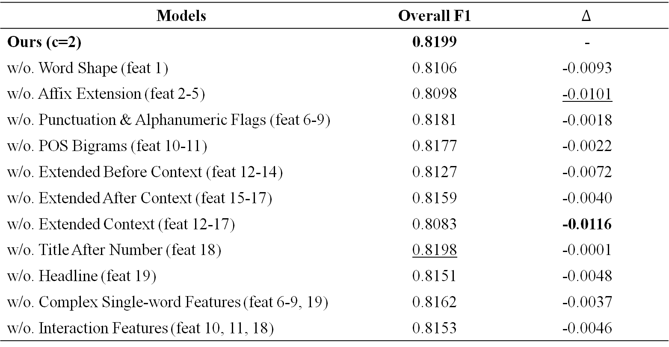
3
Experiments
Ablation Study
Models | Overall F1 | $$Δ$$
Ours (c=2) | 0.8199 | -
w/o. Word Shape (feat 1) | 0.8106 | -0.0093
w/o. Affix Extension (feat 2-5) | 0.8098 | -0.0101
w/o. Punctuation & Alphanumeric Flags (feat 6-9) | 0.8181 | -0.0018
w/o. POS Bigrams (feat 10-11) | 0.8177 | -0.0022
w/o. Extended Before Context (feat 12-14) | 0.8127 | -0.0072
w/o. Extended After Context (feat 15-17) | 0.8159 | -0.0040
w/o. Extended Context (feat 12-17) | 0.8083 | -0.0116
w/o. Title After Number (feat 18) | 0.8198 | -0.0001
w/o. Headline (feat 19) | 0.8151 | -0.0048
w/o. Complex Single-word Features (feat 6-9, 19) | 0.8162 | -0.0037
w/o. Interaction Features (feat 10, 11, 18) | 0.8153 | -0.0046

Slide 9
4
Result Analysis
Interesting Error Cases
Headline feature is sometimes working and sometimes not. It correctly fixes “LUCKY” (O) examples, but fails on “CHINA” (B-PER -> B-LOC). Moreover, it make new error “JAPAN” (B-PER -> B-LOC) in same sentence, which was originally correct.

Slide 10
4
Result Analysis
Lessons learned & Connection to Chapter 4
In a CRF, the final prediction is a balancing act between Node Factors (or emission weights) and Edge Factors (or transition weights).
When analyzing our transition matrix heatmap, we noticed that transitions to the 'Outside' or 'O' label do not have overwhelmingly high edge weights. Applying the concept of Compatibility from Chapter 4, this makes perfect sense.

