Slide 1
PGM Week5
NER with Custom CRF
Team 5
2021313549 Sungsoo Chung
2021####29 TJ Park
2022####68 DG Kim
2025####90 IM Hwang
Notes:
Name and Student ID please

Slide 2
CONTENTS
Baseline Analysis
Methodology
Experiments
Result Analysis

Slide 3
1
Baseline Analysis
DD
DD
DD
dd

Slide 4
2
Methodology
DD
DD
DD
dd

Slide 5
3
Experiments
Overall Performance Table
Models | Metric | LOC | MISC | ORG | PER | Overall
Baseline | Precision | 0.8428 | 0.7917 | 0.7282 | 0.8258 | 0.7986
 | Recall | 0.8034 | 0.7365 | 0.6887 | 0.8472 | 0.7739
 | F1-score | 0.8226 | 0.7631 | 0.7079 | 0.8364 | 0.7861
Ours (c=4) | Precision | 0.8491 | 0.7960 | 0.8079 | 0.8526 | 0.8326
 | Recall | 0.8501 | 0.7336 | 0.7369 | 0.8905 | 0.8139
 | F1-score | 0.8496 | 0.7635 | 0.7708 | 0.8711 | 0.8232
Ours (c=5) | Precision | 0.8576 | 0.7979 | 0.7933 | 0.8569 | 0.8322
 | Recall | 0.8483 | 0.7422 | 0.7417 | 0.8850 | 0.8143
 | F1-score | 0.8529 | 0.7690 | 0.7666 | 0.8707 | 0.8232

Slide 6
3
Experiments
Tuning Context Window c
Models | Metric: F1-score
 | LOC | MISC | ORG | PER | Overall
Ours (c=1) | 0.8416 | 0.7660 | 0.7442 | 0.8561 | 0.8083
Ours (c=2) | 0.8461 | 0.7763 | 0.7555 | 0.8743 | 0.8199
Ours (c=3) | 0.8494 | 0.7743 | 0.7609 | 0.8719 | 0.8217
Ours (c=4) | 0.8496 | 0.7635 | 0.7708 | 0.8711 | 0.8232
Ours (c=5) | 0.8529 | 0.7690 | 0.7666 | 0.8707 | 0.8232
Ours (c=6) | 0.8474 | 0.7635 | 0.7625 | 0.8684 | 0.8192

Slide 7
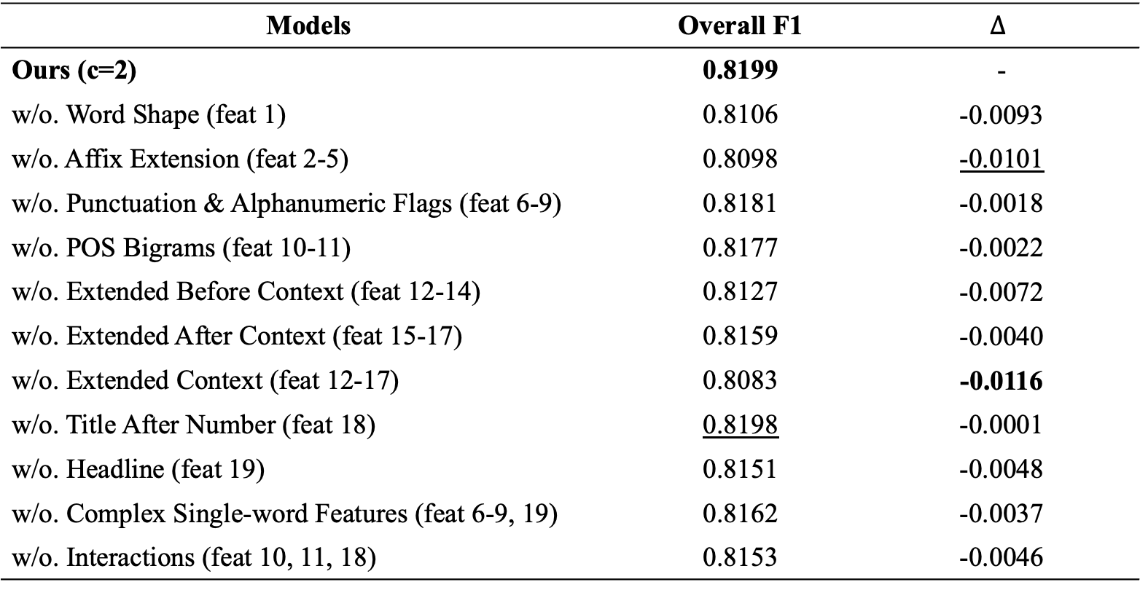
3
Experiments
Ablation Study
Models | Overall F1 | $$Δ$$
Ours (c=2) | 0.8199 | -
w/o. Word Shape (feat 1) | 0.8106 | -0.0093
w/o. Affix Extension (feat 2-5) | 0.8098 | -0.0101
w/o. Punctuation & Alphanumeric Flags (feat 6-9) | 0.8181 | -0.0018
w/o. POS Bigrams (feat 10-11) | 0.8177 | -0.0022
w/o. Extended Before Context (feat 12-14) | 0.8127 | -0.0072
w/o. Extended After Context (feat 15-17) | 0.8159 | -0.0040
w/o. Extended Context (feat 12-17) | 0.8083 | -0.0116
w/o. Title After Number (feat 18) | 0.8198 | -0.0001
w/o. Headline (feat 19) | 0.8151 | -0.0048
w/o. Complex Single-word Features (feat 6-9, 19) | 0.8162 | -0.0037
w/o. Interactions (feat 10, 11, 18) | 0.8153 | -0.0046

Slide 8
4
Result Analysis
DD
DD
DD
dd

