Slide 1
Modernizing Models of Care for Psychology
DIYA SHAH | SHREYA RAGADE
CARLA ALLAN, PhD

Slide 2
AVERAGE TIME SPENT WAITING TO RECEIVE CARE
3 – 18 Months
AVERAGE TIME SPENT IN TRADITIONAL THERAPY
2.2 sessions
NUMBER OF PEOPLE IN THE US WAITING FOR CARE
1.2 Million

Slide 3
Be Our Guest Program
Weekly Modules Created by Phoenix Children’s Hospital
Lemmy Forum created for those in the program to share
their
progress/tips/advice
Survey results compared • to comment sentiment
analysis'
Survey given to those in the program
Comments analyzed for sentiment
Results of the survey analyzed
SSI
END

Slide 4
Overview
1 | Fediverse | Survey | 5
2 | Lemmy | Data Collection | 6
3 | Postgres | Data Analysis | 7
4 | Sentiment Analysis | Data Display | 8

Slide 5
Welcome to the FEDIVERSE
YEAR: 2008
THE BENEFITS
WHY?
• PeerTube
°YouTube
• Lemmy
o Reddit
• Mastodon
° Twitter
• Pixelfed
° Instagram
• Decentralized and distributed across distinct service providers
• Operate using Open Source Standards
• Separated from big corporations
• Owned by those who create the instance
• Allows users to have control over their data and privacy

Slide 6



Made up of different instances (websites) each with their own sub-communities
Created 2019 by Dessalines, a GitHub User
Users can post on these instances, reply to posts, up-vote, down-vote,
etc
No advertising, data tracking, or controlling by big
corporations

Slide 7


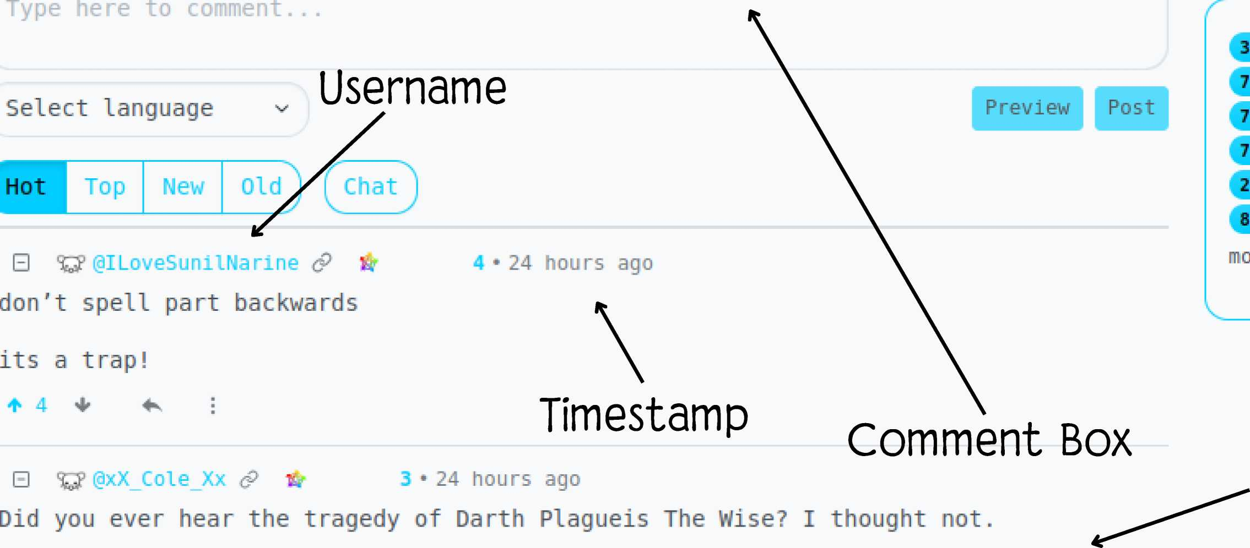

Trying Sadness
^ @MMCPPhoenix (m) (T) to Weekly Modules * ^3 seconds ago P 8 £r (q © ! ~
'\
Weekly Modules
!modules
D
^ Joined
I
Trial module for parent forum
Name of community
Create a post
BJc?©0H-S-"
< > X_{t} K[ A 0
j
"s
3 users / day 7 users / week 7 users / month 7 users / 6 months
2 subscribers 1 Post
S Comments
mods: ^ (§MMC PPhoenix
Content
It's not a story the Jedi would tell you, It's a Sith legend. Dartlh Plagueis was a Dark Lord of the Sith, so powerful and so wise he could use the Force to influence

Slide 8

POSTGRES
Use: Postgres' terminal-based PSQL
PSQL enables users to type in queries interactively and see the results through the terminal
Gathered all of the comments from a particular community into a Comma Seperated Value (CSV) file

Slide 9
P
R
O
G
R
A
M
sentiment = Sentiment I ntensityAnalyzerO
## read in the csv file given the path
df=pd.read_csv("/home/ds/expo rts/myManF reshBeatBand1,csv")
# grab the column with the comments specif ic_column=df [ ''title'¹ ]
# get the length of that column - 1 so that you can iterate through that row numofcolumns=(len(specific_column)}-1
# set the output file
f = open('op2.csv‘, 'w')
# iterate through all of the rows in that column for 1 in specific_column:
# get the polarity scores for that sentence/phrase sentiment_dict = sentiment.polarity_scores(i)
# get the compound score for the phrase and multiply it by LOG to get a number between -100 and 100 sent_l = sentiment_dict|‘compound'|⁺100
#
writer = csv.writerff)
# write that out into the csv file with the delimeter as the @ sign writer.writerow( [i+"@" +str(int(sent_l))+"V"])

Slide 10





TEXTBLOB
SCIKIT-LEARN
BERT
VADER
Sentiment Analysis

Slide 11

The Survey

Slide 12
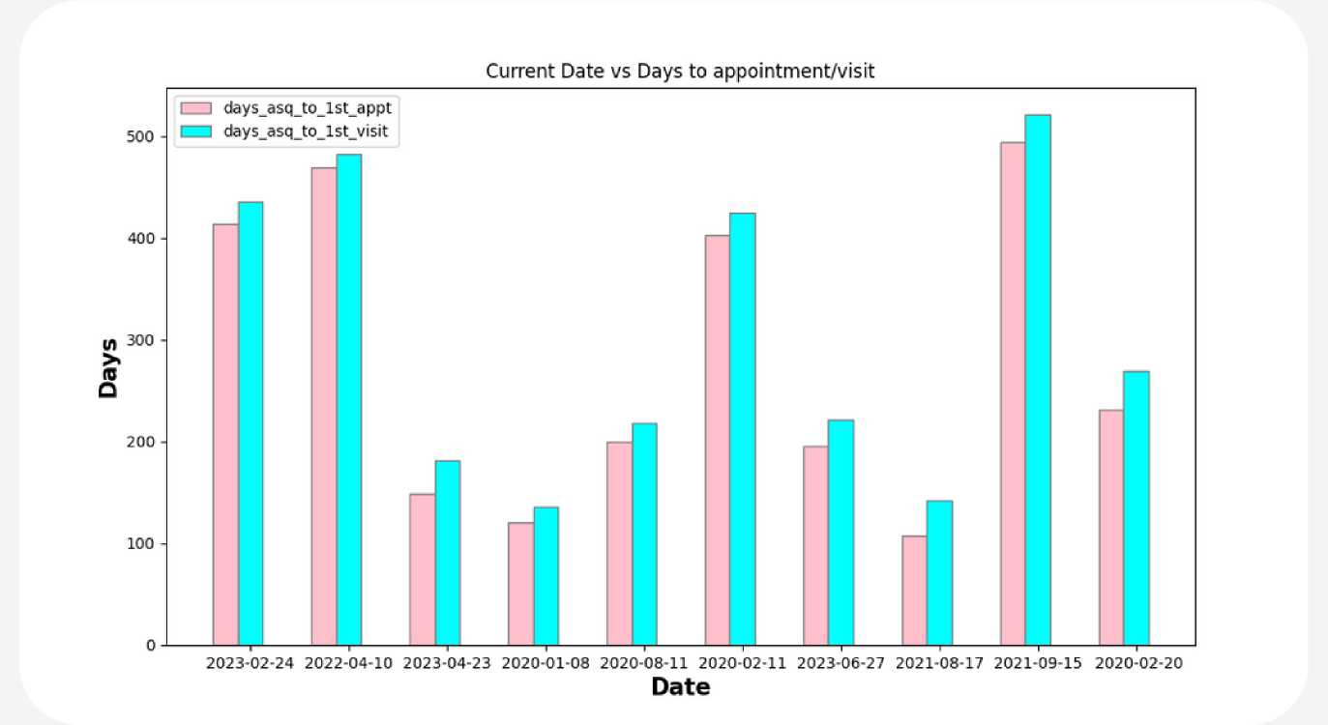
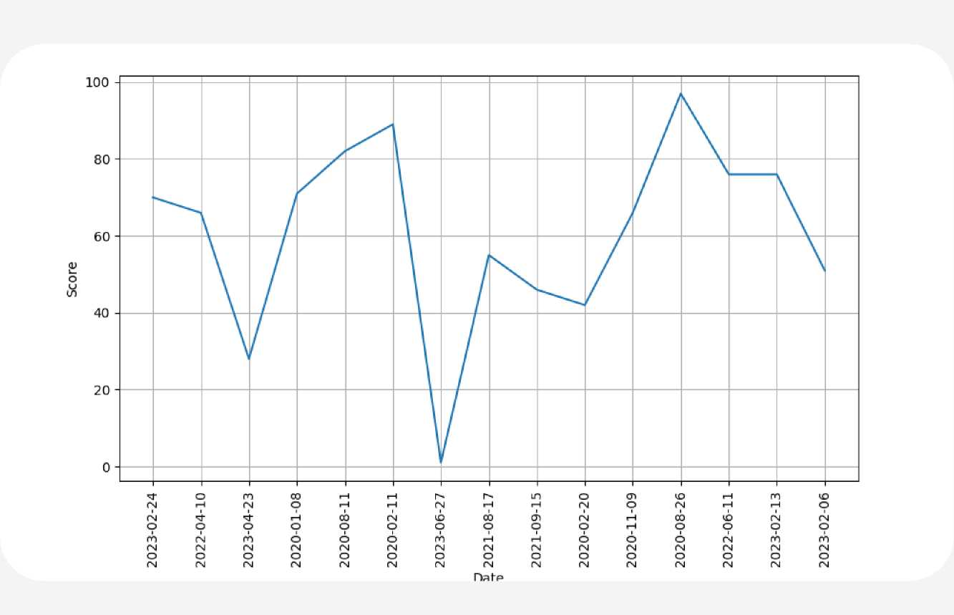
Display

Slide 13
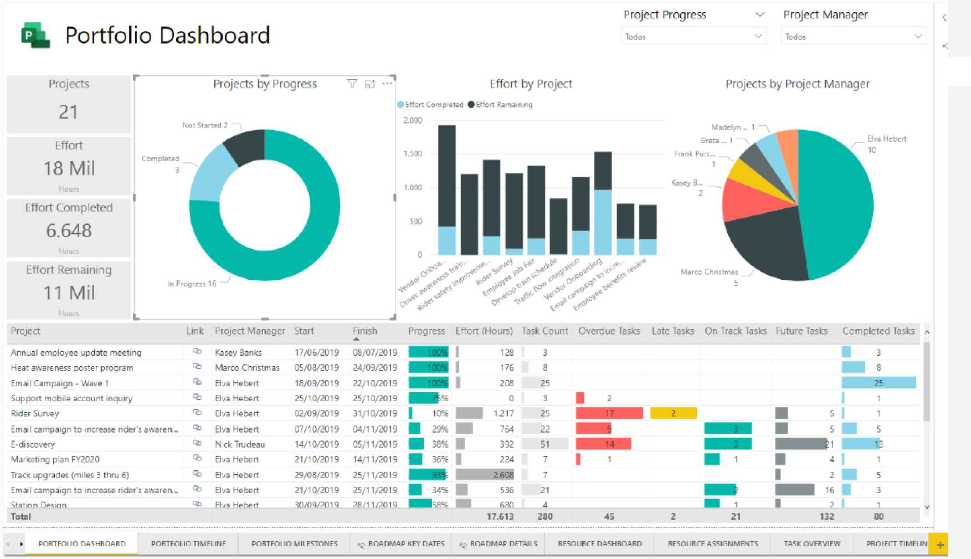
Next Steps
• Data Visualization:
o Power BI o Graphic View
• Documentation
• Automate Lemmy Sentiment Analysis
• RSS Feed
FilTros

