Slide 1
AUREX · BCCL’S SECURE AI WORKSPACE
Reading data
A working method for getting from a spreadsheet you did not build
to a number you would defend in front of your MD.
DISHANT SINGLA
₹110 Cr
1 Bn+
200 M
120 M
ad business on the
platform I built
ad impressions
a month
monthly active
users
Ola customer
profiles built
Notes:
TAKEAWAY — By the end of two hours you will open an unfamiliar file and produce a number you would defend.
SAY
- Do not read the title. Open cold, with the room's own problem: 'Somebody has sent you a spreadsheet you did not build. It is 4pm. They want your read by tomorrow.'
- Hands up: who has had that in the last month? Wait for the hands. That is your mandate for the next two hours.
- Say what this is NOT: not an Excel class, not statistics, no formulas to memorise.
- It is a sequence. Same sequence every time, any file, any department.
- Logistics in one breath: two hours, two hands-on blocks, laptops open, practice file link in the chat now.
ASK THE ROOM
"Type in the chat: the last file somebody sent you that you did not build."
~3m · NEXT: Who is running this

Slide 2
WHO IS RUNNING THIS SESSION
I have spent ten years building
the systems these numbers come out of.
AT SCALE
₹110 Cr
ad revenue running on the platform
1 Bn+
Ola, Koo, Khatabook, Wealthy, HT Media. Customer data platforms, identity resolution, recommendation systems, ad targeting. Most recently the central data platform at HT Digital Streams, sitting under a ₹110 crore a year ad business.
ad impressions a month
200 M
monthly active users
120 M
Every trap in this session is one I have shipped, been burned by, or caught in review. That is the only reason it is in here.
Ola customer profiles built
₹2.5 Cr
a year in retired tooling
60%
duplicate IDs eliminated
02
Notes:
TAKEAWAY — Credibility, fast. Every trap in this deck was paid for, not read in a book.
SAY
- Ninety seconds maximum. This slide buys you permission, it is not the show.
- The line that matters: 'Every trap in this session is one I have shipped, been burned by, or caught in review.'
- Do not walk the stat panel item by item. Point at it once and move.
- If the room is senior, name the ₹110 Cr and stop. If the room is analysts, name the identity-resolution work instead.
~2m · NEXT: Why a company pays for this

Slide 3
Five frameworks, one file, and the cards to run them again
Everything in this session is designed to be reusable on Monday
01
02
03
04
05
THE SEVEN-STEP READ
THE EIGHT LENSES
THE CHART SELECTOR
THE SIX DISTORTIONS
THE FIVE-CHECK GATE
The sequence for any unfamiliar file
Every question a dataset can answer
Say the comparison, get the chart
Where confident numbers go wrong
What to verify before you send
YOU ALSO LEAVE WITH
The practice file
Eight prompts
The gate card
3,079 rows of real-shaped ad bookings, traps included
One per lens, written to force checkable output
Five checks, one page, stick it on your monitor
04
Notes:
TAKEAWAY — Five cards. Everything today hangs off one of them, and you take all five home.
SAY
- This is the map. Point at each card for five seconds, no more — you are orienting, not teaching.
- Stress the promise: reusable on Monday, on any file, in any department.
- The bottom strip is what they physically leave with: the file, the eight prompts, the gate card.
- Tell them now that every prompt in this deck is copy-paste and will be shared. It stops people transcribing slides instead of listening.
~2m · NEXT: The practice file

Slide 4
One file. Every framework runs on it.
ad-sales-data.csv · three years of advertising bookings, 2022 to 2024
3,079
14
8
2,490
₹44.8 Cr
rows
columns
cities
confirmed bookings
net revenue
WHAT IS IN IT
Dates
booked and published
Cities
8 Indian metros
Editions
4 publications
Ad types
Display, Digital, Classified, and two more
Categories
10 advertiser sectors
Reps
30 salespeople
Money
rate, discount, gross, net
Status
confirmed, cancelled, pending
TAKEAWAY
It carries four planted data-quality faults. Finding them is Step 2.
05
Notes:
TAKEAWAY — One file runs every framework, and it has four faults planted in it on purpose.
SAY
- Get the file open on their machines now, while you talk. Do not move on until laptops are up.
- Read the shape out loud: 3,079 rows, 14 columns, three years, 2,490 confirmed.
- Note the gap: 3,079 rows but 2,490 confirmed. That gap is a decision somebody has to make, and it is Step 1 of the Seven-Step Read.
- End on the fault line: four planted data-quality faults. Do not tell them what they are. Finding them is Step 2.
ASK THE ROOM
"Anyone already spotted something odd in the file? Hold it — do not say it yet."
~4m · NEXT: Module 1 divider

Slide 5
MODULE 1 · THE SEVEN-STEP READ
MODULE 1 OF 5
01
The Seven-Step Read
Analysts do not start with the numbers. They start with the decision,
then the shape of the file, and only then the arithmetic.
STEPS 1 TO 7 · 25 MINUTES
06
Notes:
TAKEAWAY — Analysts do not start with numbers. They start with the decision.
SAY
- Divider. Ten seconds. Read the line under the title and move.
- One framing sentence: 'Everything that goes wrong in Module 4 goes wrong because somebody skipped Module 1.'
~1m · NEXT: The seven steps on one page

Slide 6
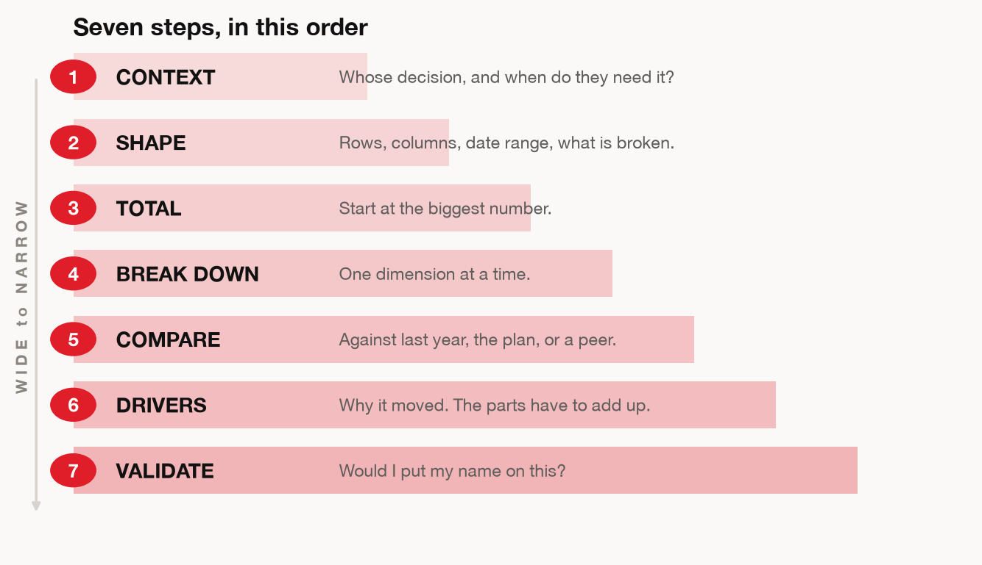
THE FRAMEWORK
MODULE 1 · THE SEVEN-STEP READ
TAKEAWAY
Most people start at step 3. That is how you answer a question nobody asked.
07
Notes:
TAKEAWAY — Seven steps, in order. The order is the whole point.
SAY
- Let them photograph it. Say so out loud, then genuinely pause five seconds.
- Walk the arc, not the boxes: the first three steps are about the file, the next three are about the finding, the last one is about whether you send it.
- Say the thing that reframes it: most people start at step 3. That is why they get a correct answer to a question nobody had.
- Flag that Steps 1 and 2 get their own slides next, and the rest are covered inside the Eight Lenses.
~3m · NEXT: Step 1 — Context

Slide 7
MODULE 1 · THE SEVEN-STEP READ
Step 1 — CONTEXT: three questions before the file opens
Most weak analysis is a correct answer to a question nobody had.
1
Who decides, and when?
If you cannot name the person and the date, you are producing trivia.
2
Which answer would change the decision?
If every possible finding leads to the same action, do not run the analysis.
3
What is the smallest version you could answer today?
One metric, one dimension, one period. Widen later if it earns it.
TAKEAWAY
The analysis has not started yet. These three answers make the rest of it worth doing.
08
Notes:
TAKEAWAY — Three questions before the file is even open. If you cannot answer them, do not start.
SAY
- Question 1 — 'Who decides, and when?' Say it hard: if you cannot name the person and the date, you are producing trivia.
- Question 2 — 'Which answer would change the decision?' If every possible finding leads to the same action, cancel the analysis. That is a legitimate output.
- Question 3 — 'What is the smallest version you could answer today?' One metric, one dimension, one period.
- Personal example: give a real one from your own work where you skipped Q2 and burned a week.
ASK THE ROOM
"Take the file on your desk right now. Who decides, and by when? Type the name."
~4m · NEXT: What that sounds like in practice

Slide 8
MODULE 1 · THE SEVEN-STEP READ
What Step 1 sounds like in practice
Same file, same tool, two different opening moves
WITHOUT A FRAME
WITH A FRAME
“Analyse this file.”
“Which two cities should lose
headcount next quarter?”
Revenue rose 4.3%
8 cities represented
3,079 rows
Q3 shows a dip
Average deal ₹1.8 lakh
One table
Revenue per rep, by city
Two cities named
A caveat about deal mix
All of it true. None of it usable.
One question, and the file has a job.
09
Notes:
TAKEAWAY — Same file, same tool. The only difference is the opening question — and it changes everything.
SAY
- Read the left column verbatim, in a flat voice. Every line is true. Let the room feel how useless it is.
- Land it: 'All of it true. None of it usable.' Pause.
- Now the right: one question, and the file suddenly has a job. One table, two cities named, a caveat attached.
- The point is not that the right side is longer. It is that the right side ends in a decision.
- Do not soften this. Most of the room opens files the left-hand way and knows it.
ASK THE ROOM
"Be honest — which side is your normal Monday?"
~4m · NEXT: Your own Aurex data

Slide 9
MODULE 1 · THE SEVEN-STEP READ
What 153 of your colleagues actually typed into Aurex
1,488 sessions to 27 August 2026. 367 of them opened on a spreadsheet. This is not a hypothetical.
46%
46%
41%
16%
named no question,
comparison or decision
in the opening message
ended after one turn.
The first answer became
the final answer
spent turns on colour,
font, axis labels and
chart size
ever challenged or
verified a number
Two and a half times more effort went into how the chart looked
than into whether the number was right.
ACTUAL OPENING MESSAGES, VERBATIM
"create a dashboard for analysis" "Analyse the file" "prepare excel dynamic dashboard"
"make a dashboard in which this excel is underlying data" "PLEASE ANALYSIS BOTH FINANCIALS"
10
Notes:
TAKEAWAY — This is not a hypothetical. It is your own usage, and it says the room checks the chart more than the number.
SAY
- This is the slide that turns the session from advice into evidence. Slow down for it.
- Set it up honestly: 'I pulled every Aurex session up to 27 August. 1,488 sessions, 402 people. 367 of them opened on a spreadsheet. This is us.'
- 46% named no question — that is the left-hand column of the previous slide, measured.
- 46% ended after one turn — the first answer became the final answer. Nobody pushed back.
- Then the pairing, and let it sit: 41% spent turns on colour, font and axis labels. 16% ever questioned a number.
- Read the verbatim openers off the panel. They are real messages from people in this building. Read them without mockery — the point is that they are completely normal, and that is exactly the problem.
- Close: 'Nobody here is bad at this. The sequence just was not there. That is all today is.'
ASK THE ROOM
"Nobody has to answer out loud — but which of those four numbers is you?"
~5m · NEXT: Step 2 — Shape

Slide 10
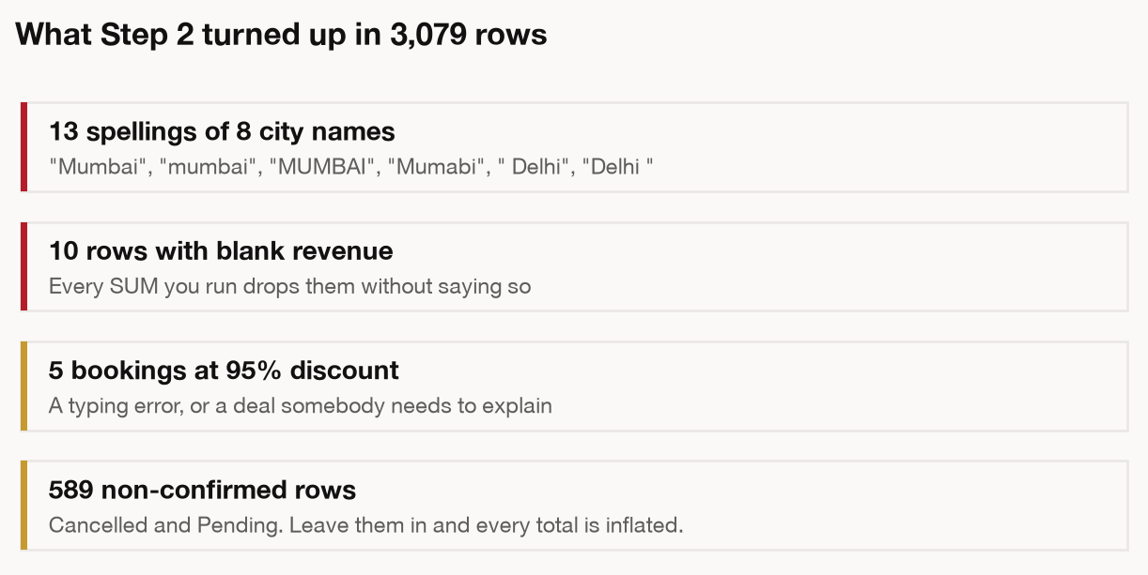
STEP 2 — SHAPE: WHAT DID THE FILE ACTUALLY ARRIVE AS
MODULE 1 · THE SEVEN-STEP READ
TAKEAWAY
Answer “what is one row?” first. Every number you produce inherits that answer.
11
Notes:
TAKEAWAY — Before any arithmetic: what did this file actually arrive as?
SAY
- Anchor on one question and repeat it three times today: what is one row?
- Walk the checks on screen quickly — row count, column types, date range, blanks, duplicates, categories.
- Give them the two-minute rule: you are not analysing yet, you are establishing what you are holding.
- Tie it to the practice file: 3,079 rows arrive, 2,490 are confirmed. Which number goes in your headline, and can you say why?
ASK THE ROOM
"Open the file and answer one thing: what does one row represent?"
~4m · NEXT: War story — identity resolution

Slide 11
MODULE 1 · THE SEVEN-STEP READ
Spend the first two minutes
on what the file is.
Somebody filtered it, named the columns and decided what to leave out before it reached you. Those decisions are now your assumptions, whether you look at them or not.
13
Notes:
TAKEAWAY — Someone made decisions about this file before it reached you. They are now your assumptions.
SAY
- Statement slide. Say the headline, then stop talking. Silence does the work.
- Then one sentence: somebody filtered it, named the columns, decided what to leave out.
- The sting: those decisions are your assumptions now, whether you look at them or not.
- Do not add anything. Move.
~1m · NEXT: Module 2 — The Eight Lenses

Slide 12
MODULE 2 · THE EIGHT LENSES
MODULE 2 OF 5
02
The Eight Lenses
Almost every question you will be handed is one of these eight.
Naming the lens tells you the cut, the chart, and the trap to check.
LENSES 1 TO 8 · 40 MINUTES
14
Notes:
TAKEAWAY — Almost every question you will be handed is one of eight. Naming the lens does the rest.
SAY
- Divider. Set the size of the promise: eight lenses, forty minutes, and it covers nearly everything anyone will ask you.
- The mechanic that matters: naming the lens tells you the cut, the chart, AND the trap to check. Three decisions from one word.
- Tell them the shape of the next forty minutes: each lens gets a card with a ready-made prompt they can paste and share immediately.
~1m · NEXT: All eight on one page

Slide 13
MODULE 2 · THE EIGHT LENSES
The Eight Lenses, on one page
Photograph this. Naming the lens gives you the cut, the chart and the trap — three decisions from one word.
LENS
THE QUESTION
THE CUT
THE TRAP IT HIDES
1 Comparison
How does this stack up against that?
Total by dimension, sorted
Counts where rates belong
2 Ranking
Who is on top, who is at the bottom?
Sort both ends, not just the top
A top-10 list with no bottom
3 Trend
What changed, and when exactly?
Index to a common base
Two scales on one chart
4 Composition
What makes up the whole?
Share of total, by period
Mix shift read as performance
5 Distribution
What does a typical one look like?
Histogram, plus the median
The mean quoted as typical
6 Correlation
Do these move together?
Scatter, then a coefficient
Correlation stated as cause
7 Outliers
What looks wrong?
Flag against the median
Concentration read as a trend
8 Decomposition
Why did the number move?
Bridge that sums to the total
A residual nobody names
15
Notes:
TAKEAWAY — The reference artefact. Photograph this one slide and you have the module.
SAY
- Say 'photograph this' and then actually wait. Five full seconds. Phones up.
- Do not read the table. Read down the trap column only — that is the column nobody has seen before.
- Point out the pattern: every lens has a signature failure, and they are all failures of framing, not arithmetic.
- Promise the structure: eight cards, same four parts each — question, today's file, the trap, and the prompt.
ASK THE ROOM
"Scan the trap column. Which one have you personally shipped?"
~4m · NEXT: Lens 1 — Comparison

Slide 14
LENS 1 OF 8
MODULE 2 · THE EIGHT LENSES
1
COMPARISON
THE QUESTION IT ANSWERS
ON TODAY’S FILE
THE TRAP IT HIDES
How does this one stack up against that one?
Which city bills the most ad revenue?
Mumbai is biggest at everything. Biggest is not best.
A number with nothing beside it is not a finding. The comparison makes it one.
Top city bills 2.1× the bottom. The multiple is the finding, not the two totals.
Catch it: divide by something. Per rep, per order, per rupee. Then re-rank.
THE PROMPT · PASTE THIS INTO AUREX
DROP IT IN THE CHAT — LET THE ROOM RUN IT WITH YOU
Filter ad-sales-data.csv to status = Confirmed. Tell me how many rows you dropped, and why.
The city column has spelling variants. Show me the mapping BEFORE you apply it.
Total net_amount by city, sorted high to low.
Give me the gap between top and bottom as a multiple, not as two numbers.
Horizontal bar chart: sorted, one accent colour, values on bars, title = the finding as a sentence.
16
Notes:
TAKEAWAY — A number means nothing until you name what it is being compared to.
SAY
- RHYTHM for every lens card — question, file, trap, then paste the prompt. Ninety seconds.
- This is the lens the other seven are built on. Say that.
- The trap is the good bit: Mumbai is biggest at everything, because Mumbai is biggest. Biggest is not best.
- The fix is one word — divide. Per rep, per order, per rupee of discount. Then the ranking changes and you have a finding.
- Note the prompt makes it show the city-name mapping BEFORE applying it. That is the habit: make the tool show its working.
- Then: 'Prompt is on the slide. I am dropping it in the chat now — run it while I talk.'
- Paste it into the chat for real. This is the interactive beat of the module; do not skip it to save time.
ASK THE ROOM
"Before you run it — guess which city wins on revenue per rep, not total revenue."
~2m · NEXT: the chart it produces

Slide 15
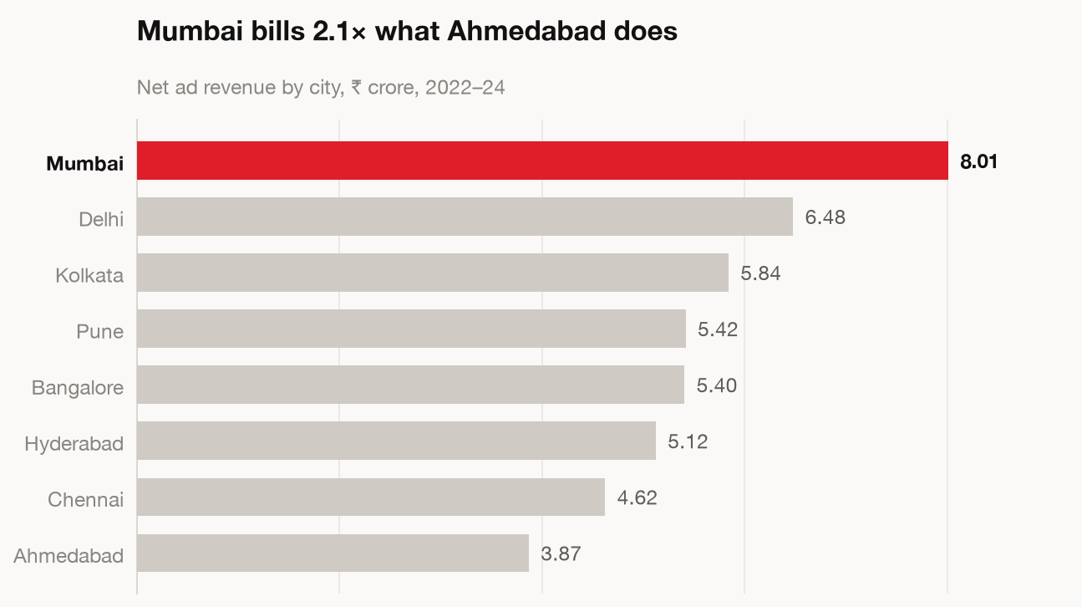
LENS 1 · COMPARISON
MODULE 2 · THE EIGHT LENSES
TAKEAWAY
Sorted, one colour, numbers on the bars. You will use this shape more than any other.
17
Notes:
TAKEAWAY — This bar chart shape will carry more of your work than any other.
SAY
- Point at the three things that make it work: sorted, one colour on the point, values on the bars.
- No legend, no gridlines, no chart junk. The title carries the finding.
- Say it plainly: if you learn one chart today, learn this one.
- Compare to what they would normally get — an unsorted rainbow column chart with a legend.
~1m · NEXT: the prompt, in full

Slide 16
MODULE 2 · THE EIGHT LENSES
The prompt behind Lens 1
The same prompt from the Lens 1 card, pulled apart. Every line defends against one specific failure.
Using the code interpreter on ad-sales-data.csv:
Filter to status = Confirmed and drop rows
where net_amount is blank. Tell me how many
rows you dropped.
The city column has spelling variants. Show me
the mapping you intend to apply before you
apply it.
Then total net_amount by city, sorted high
to low. Give me the gap between top and
bottom as a multiple, not just two numbers.
Return a horizontal bar chart, sorted, one
accent colour, values on the bars, titled with
the finding as a sentence.
WHAT COMES BACK
A sorted bar chart, titled with the finding
A cleaning log: 13 city strings collapsed to 8
The row count it dropped, stated up front
The gap as “2.1×”, not as two raw numbers
TAKEAWAY
You are not asking for an answer. You are asking for an answer you can check.
18
Notes:
TAKEAWAY — The wording of the prompt is the lesson. It forces checkable output.
SAY
- This is the teaching slide for prompt construction. The other lenses get the short version; this one gets pulled apart.
- Walk the four demands in the prompt and name what each one defends against:
- 1. 'Tell me how many rows you dropped' — defends against silent filtering.
- 2. 'Show me the mapping before you apply it' — defends against invented cleaning.
- 3. 'The gap as a multiple' — defends against two numbers with no comparison.
- 4. 'Title with the finding as a sentence' — defends against a chart nobody can read.
- The meta-point: you are not asking for an answer. You are asking for an answer you can check.
- 'Paste this, do not type it' is on the slide for a reason — typing introduces variation and they lose the constraint.
ASK THE ROOM
"Which of those four constraints would have saved you on a recent piece of work?"
~4m · NEXT: Lens 2 — Ranking

Slide 17
LENS 2 OF 8
MODULE 2 · THE EIGHT LENSES
2
RANKING
THE QUESTION IT ANSWERS
ON TODAY’S FILE
THE TRAP IT HIDES
Who is on top, and who is at the bottom?
Which reps carry the business, and which coast?
A top-10 flatters. The bottom holds the recoverable money.
Comparison with the order made explicit. The order is your argument.
30 reps. What matters is the gap between rank 5 and rank 25.
Catch it: print both ends, with the order count beside every name.
THE PROMPT · PASTE THIS INTO AUREX
DROP IT IN THE CHAT — LET THE ROOM RUN IT WITH YOU
Rank all 30 reps by total net_amount on confirmed bookings only.
Show me the top 5 AND the bottom 5 in one table, with order count beside each name.
Flag any rep with fewer than 10 orders. I do not want a rank built on three deals.
State the gap between rank 5 and rank 25 as a multiple, and say what it would take to close it.
19
Notes:
TAKEAWAY — A top-10 list flatters everybody. The bottom is where the money you can recover actually sits.
SAY
- RHYTHM for every lens card — question, file, trap, then paste the prompt. Ninety seconds.
- Ranking is Comparison with the order made explicit — say the link, it keeps the eight from feeling like a list of eight unrelated things.
- The trap: top-10 lists get made because they are pleasant. Nobody makes a bottom-10 because nobody wants to present it.
- But the recoverable money is at the bottom. Rank 25 moving to rank 15 is worth more than rank 1 moving to rank 1.
- The prompt forces the order count beside every name — a rank built on three deals is noise, not performance.
- Then: 'Prompt is on the slide. I am dropping it in the chat now — run it while I talk.'
- Paste it into the chat for real. This is the interactive beat of the module; do not skip it to save time.
ASK THE ROOM
"In your team's last ranking, did anyone show the bottom?"
~2m · NEXT: the chart

Slide 18
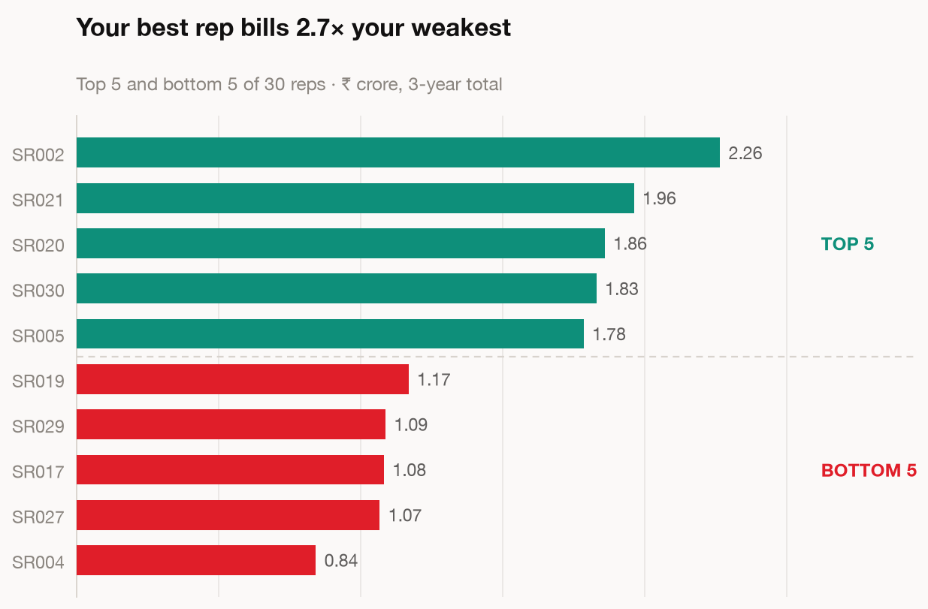
LENS 2 · RANKING
MODULE 2 · THE EIGHT LENSES
TAKEAWAY
Show both ends. A top-5 alone hides the gap you can actually act on.
20
Notes:
TAKEAWAY — Show both ends, or you have hidden the actionable half.
SAY
- Point at the gap between the two ends — that distance is the management conversation.
- A top-5 on its own would have hidden all of it.
- One line and move: 'Same data, twice the decision.'
~1m · NEXT: Lens 3 — Trend

Slide 19
LENS 3 OF 8
MODULE 2 · THE EIGHT LENSES
3
TREND
THE QUESTION IT ANSWERS
ON TODAY’S FILE
THE TRAP IT HIDES
What changed over time, and when exactly?
Is digital really growing, or does it just feel that way?
Raw lines let the biggest series bury every other story.
“When exactly” is the whole lens. A direction with no date is not actionable.
Indexed to 2022 = 100 the shape is visible. In raw rupees it is not.
Catch it: index every series to a common base before you plot anything.
THE PROMPT · PASTE THIS INTO AUREX
DROP IT IN THE CHAT — LET THE ROOM RUN IT WITH YOU
Monthly net_amount by ad_type, 2022 to 2024, confirmed bookings only.
Index every series to its own first month = 100, so I compare shapes and not sizes.
Name the month each series changed direction. Do not just tell me it is growing.
Exclude any part-finished month at the end, and tell me explicitly if you excluded one.
21
Notes:
TAKEAWAY — A direction with no date attached is not actionable.
SAY
- RHYTHM for every lens card — question, file, trap, then paste the prompt. Ninety seconds.
- Push on 'and when exactly'. 'Digital is growing' is not a finding. 'Digital turned in March 2023' is.
- The trap is a scale problem: when one series is forty times another, the raw plot shows you the big line and nothing else.
- Indexing to a common base is the whole fix, and it takes one line in the prompt.
- Note the last line of the prompt — exclude the part-finished month. That is Distortion 3 arriving early; flag it and say you will come back to it.
- Then: 'Prompt is on the slide. I am dropping it in the chat now — run it while I talk.'
- Paste it into the chat for real. This is the interactive beat of the module; do not skip it to save time.
ASK THE ROOM
"Anyone reported a monthly number this year that included a half-finished month?"
~2m · NEXT: the indexed chart

Slide 20
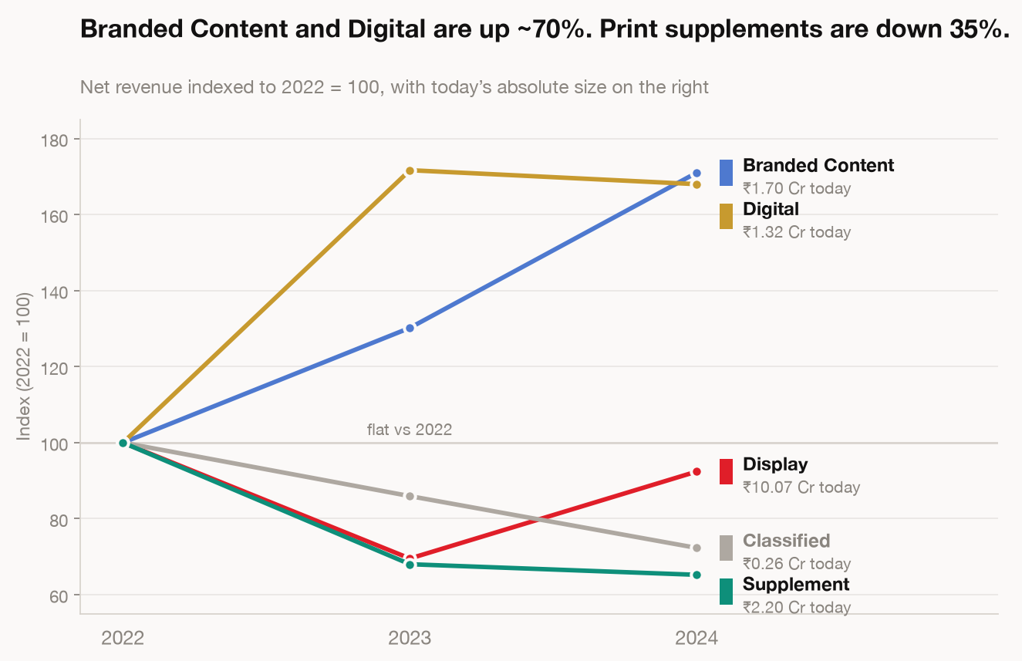
LENS 3 · TREND
MODULE 2 · THE EIGHT LENSES
TAKEAWAY
Indexed to 2022 = 100. Plot raw values and you see the big line and nothing else.
22
Notes:
TAKEAWAY — Indexed to 2022 = 100. Now every series is visible.
SAY
- Say the counterfactual: plotted raw, this chart is one big line and four flat ones at the bottom.
- Indexing does not change the data. It changes what you can see.
- Caution to add out loud: indexed charts hide absolute size. Always show the base values somewhere.
~1m · NEXT: Lens 4 — Composition

Slide 21
LENS 4 OF 8
MODULE 2 · THE EIGHT LENSES
4
COMPOSITION
THE QUESTION IT ANSWERS
ON TODAY’S FILE
THE TRAP IT HIDES
What makes up the total, and is the mix moving?
Print is shrinking. By how much, and into what?
Volume can rise while revenue stalls. That is mix.
A trend question in different clothes. Always ask for composition by period.
Share of total by year says where the money went. A single-year pie does not.
Catch it: plot share and absolute together. If they disagree, mix is the story.
THE PROMPT · PASTE THIS INTO AUREX
DROP IT IN THE CHAT — LET THE ROOM RUN IT WITH YOU
Share of net_amount by ad_type for each year: 2022, 2023, 2024. Confirmed only.
Give me share % and absolute rupees in the same table, side by side.
Tell me which category gained share while losing rupees, or the reverse. That is the finding.
100% stacked column by year. Label only the categories that moved more than 2 points.
23
Notes:
TAKEAWAY — Volume can rise while revenue stalls. That is mix moving, and it is not performance.
SAY
- RHYTHM for every lens card — question, file, trap, then paste the prompt. Ninety seconds.
- Composition is a trend question in different clothes — always ask for it BY PERIOD, never as a single pie.
- The trap is the most commercially expensive one in the deck: pages sold went up, money did not, and somebody gets congratulated.
- Say the diagnosis out loud: more of what sold was the cheap thing.
- The prompt asks for share % and absolute rupees in the same table. When those two disagree, you have found the story.
- Then: 'Prompt is on the slide. I am dropping it in the chat now — run it while I talk.'
- Paste it into the chat for real. This is the interactive beat of the module; do not skip it to save time.
ASK THE ROOM
"Where in your patch could volume be up and value flat right now?"
~2m · NEXT: the chart

Slide 22
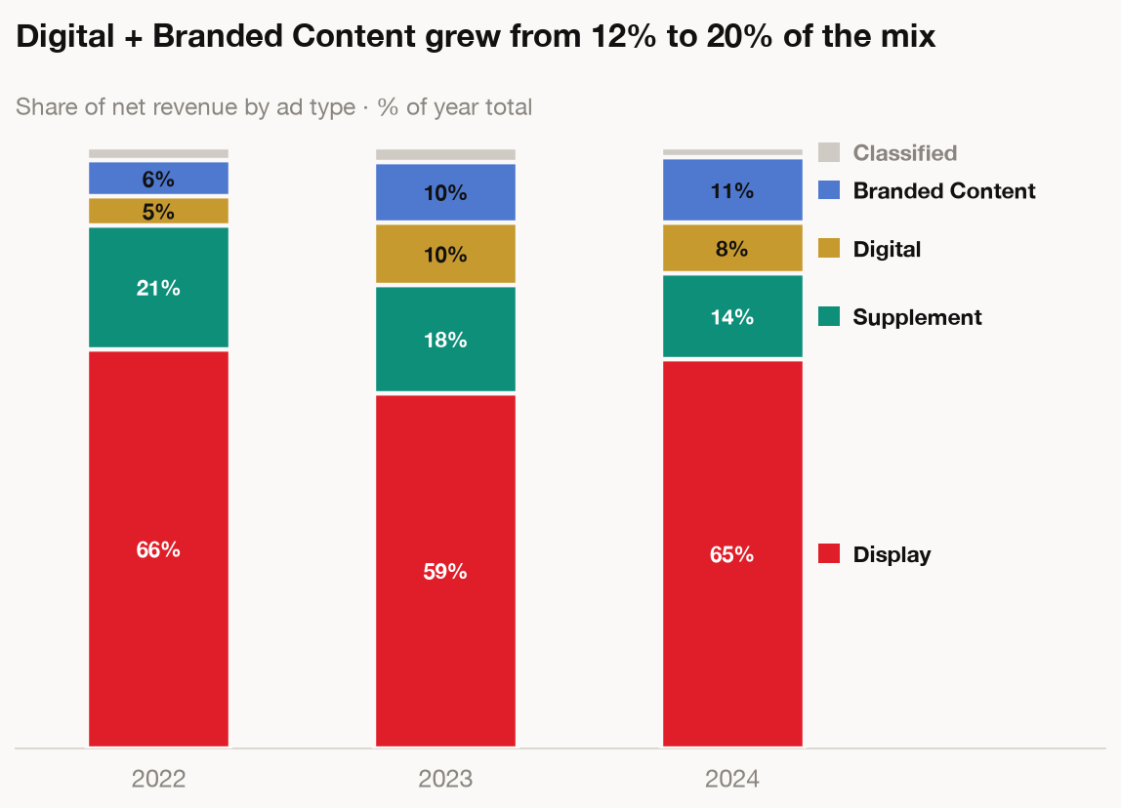
LENS 4 · COMPOSITION
MODULE 2 · THE EIGHT LENSES
TAKEAWAY
More of what sold was the cheap thing, so pages went up and money did not.
24
Notes:
TAKEAWAY — Mix shift lives here, and it is the finding most often missed.
SAY
- Trace the shrinking band with your finger, then the growing one.
- Say the sentence on the slide slowly: more of what sold was the cheap thing, so pages went up and money did not.
- That is a sentence they can take into a review meeting tomorrow.
~1m · NEXT: Lens 5 — Distribution

Slide 23
LENS 5 OF 8
MODULE 2 · THE EIGHT LENSES
5
DISTRIBUTION
THE QUESTION IT ANSWERS
ON TODAY’S FILE
THE TRAP IT HIDES
What does a typical one actually look like?
What is a normal deal size here?
A handful of whales drag the average away from reality.
“Typical” is a claim about the middle. Most people answer it with the average.
Mean ₹1.80L, median ₹0.79L. The honest answer to “normal” is the smaller one.
Catch it: ask for both, plus the ratio. Above 1.3× the mean is misleading you.
THE PROMPT · PASTE THIS INTO AUREX
DROP IT IN THE CHAT — LET THE ROOM RUN IT WITH YOU
Distribution of net_amount across confirmed bookings.
Give me mean, median, p25, p75, p90 — and the mean-to-median ratio as a number.
Histogram with the median drawn as a line on the chart, not just quoted in the caption.
If that ratio is above 1.3, tell me in one sentence which figure I should quote, and why.
25
Notes:
TAKEAWAY — Quote the mean as 'typical' on this file and you overstate by 2.3×.
SAY
- RHYTHM for every lens card — question, file, trap, then paste the prompt. Ninety seconds.
- Do the numbers as a live moment: mean ₹1.80 lakh, median ₹0.79 lakh. Ask the room which one is 'a normal deal'.
- Someone will say the mean. That is the point — the mean is the default and the default is wrong here.
- Explain why in one line: a handful of whales drag the average away from reality.
- Give them the rule of thumb they can carry: mean-to-median above 1.3 and you must not say 'typical' about the mean.
- The prompt asks for the ratio explicitly, so the tool tells you which figure to quote.
- Then: 'Prompt is on the slide. I am dropping it in the chat now — run it while I talk.'
- Paste it into the chat for real. This is the interactive beat of the module; do not skip it to save time.
ASK THE ROOM
"Say the honest sentence out loud: what IS a normal deal on this file?"
~2m · NEXT: the histogram

Slide 24
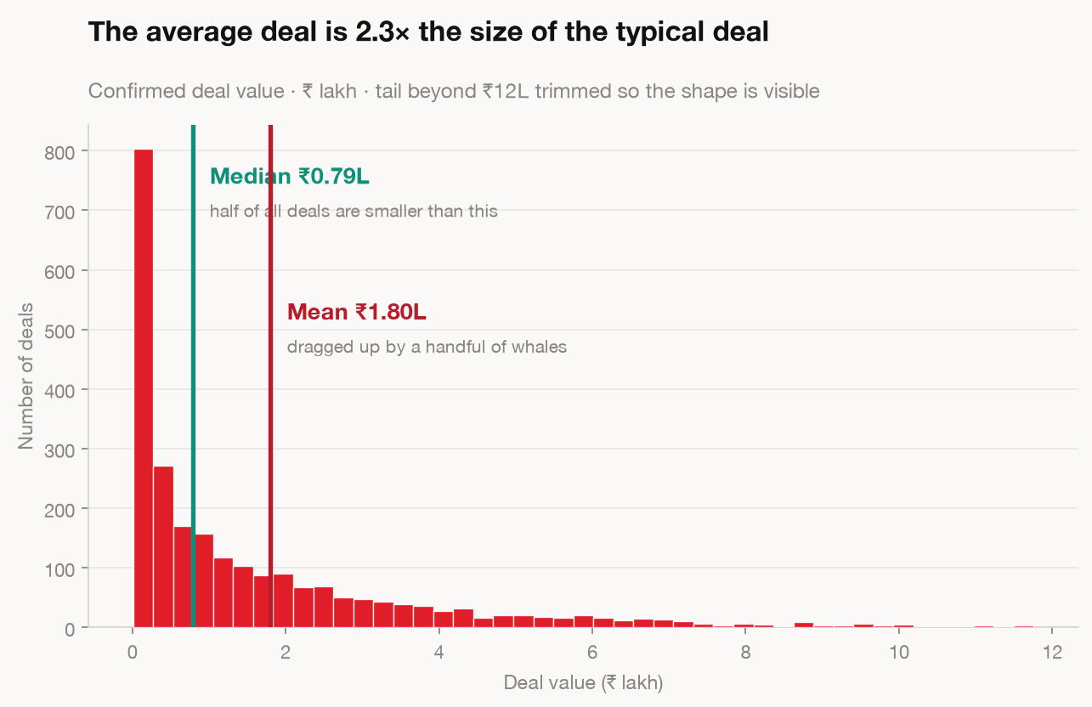
LENS 5 · DISTRIBUTION
MODULE 2 · THE EIGHT LENSES
TAKEAWAY
Mean ₹1.80L, median ₹0.79L. Call the mean “typical” and you overstate by 2.3×.
26
Notes:
TAKEAWAY — The gap between mean and median is the whole finding.
SAY
- Point at the long right tail. That tail is what pulls the mean up.
- Median line on the chart, not just in the caption — that is a deliberate choice, say so.
- Close with the consequence: call the mean 'typical' in a meeting and you have overstated by 2.3×. Somebody will plan against that.
~1m · NEXT: Lens 6 — Correlation

Slide 25
LENS 6 OF 8
MODULE 2 · THE EIGHT LENSES
6
CORRELATION
THE QUESTION IT ANSWERS
ON TODAY’S FILE
THE TRAP IT HIDES
Do these two things move together?
Do bigger discounts actually win bigger deals?
Two things moving together is not one causing the other.
Often the useful answer is no — and a clean no ends the argument.
r = −0.05. Nothing there. That result is worth more than a weak yes.
Catch it: name the third thing — season, campaign, pricing.
THE PROMPT · PASTE THIS INTO AUREX
DROP IT IN THE CHAT — LET THE ROOM RUN IT WITH YOU
Scatter discount_pct against net_amount for confirmed bookings.
Give me the correlation coefficient, and say plainly whether that is strong, weak or nothing.
Do NOT describe this as one thing causing the other. I will ask for that separately.
List three other factors that could be driving both, given this is ad sales data.
27
Notes:
TAKEAWAY — A clean 'no relationship' is a real result, and it settles arguments that have run for months.
SAY
- RHYTHM for every lens card — question, file, trap, then paste the prompt. Ninety seconds.
- This is where the room usually expects a finding and gets none. Use that.
- r = −0.05. There is nothing there. Bigger discounts do not win bigger deals on this file.
- Say why that matters commercially: somebody has been arguing for deeper discounts on instinct. This ends it.
- The trap and the discipline: two things moving together is not one causing the other. Name the third thing.
- Note the prompt explicitly forbids causal language. That constraint is doing real work.
- Then: 'Prompt is on the slide. I am dropping it in the chat now — run it while I talk.'
- Paste it into the chat for real. This is the interactive beat of the module; do not skip it to save time.
ASK THE ROOM
"What is the discount argument in your team, and what would settle it?"
~2m · NEXT: the scatter

Slide 26
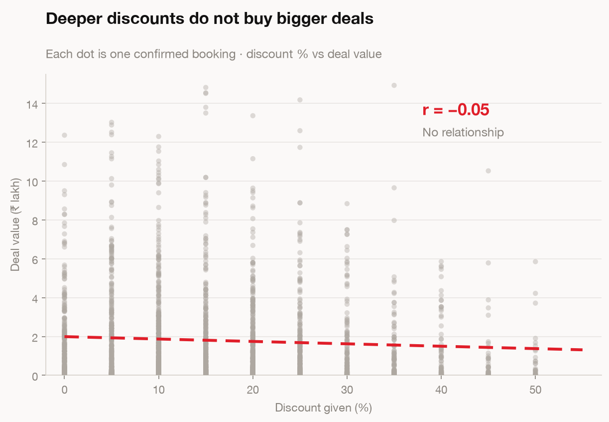
LENS 6 · CORRELATION
MODULE 2 · THE EIGHT LENSES
TAKEAWAY
r = −0.05, so there is nothing here. Still a result — and it settles the argument.
28
Notes:
TAKEAWAY — Nothing there. Say so, and stop looking.
SAY
- Show the cloud. No pattern. Resist the urge to squint for one.
- The professional move is reporting the null result and moving on.
- One warning: r near zero rules out a straight-line relationship, not every relationship. Say that if the room is technical.
~1m · NEXT: Lens 7 — Outliers

Slide 27
LENS 7 OF 8
MODULE 2 · THE EIGHT LENSES
7
OUTLIERS
THE QUESTION IT ANSWERS
ON TODAY’S FILE
THE TRAP IT HIDES
What looks wrong, and is it real or a data error?
Are a handful of deals carrying the whole year?
A few large deals can manufacture a trend.
One is a story, the other is a bug. Decide which before you present either.
80 deals out of 2,490 carry 22% of revenue. That is concentration, not growth.
Catch it: re-run the headline with the top 1% removed. If it vanishes, say so.
THE PROMPT · PASTE THIS INTO AUREX
DROP IT IN THE CHAT — LET THE ROOM RUN IT WITH YOU
Flag every booking above 3× the median net_amount. How many, and what % of revenue are they?
Show them in a table with client, city, rep and date, so I can eyeball them for data errors.
Then re-run the revenue growth headline with those rows excluded. Show me both numbers.
Tell me straight whether my headline survives without them.
29
Notes:
TAKEAWAY — 80 deals out of 2,490 carry 22% of revenue. Lose two and your trend disappears.
SAY
- RHYTHM for every lens card — question, file, trap, then paste the prompt. Ninety seconds.
- Open with the fork: something looks wrong. Is it a story or is it a bug? Two completely different next actions.
- Then the concentration number. 80 deals, 3% of rows, 22% of the money.
- The consequence is what lands: a segment gets called a growth engine, one client churns, and the growth engine goes with it. That was on slide 3.
- The test in the prompt is the reusable habit: re-run your headline with the top 1% removed. If it vanishes, you must say so.
- REAL EXAMPLE if you want one: a colleague here asked this month how to verify field-team GPS check-ins, suspecting depots were geo-tagged wrong. That is this lens — is the odd value real, or is it a data error?
- Then: 'Prompt is on the slide. I am dropping it in the chat now — run it while I talk.'
- Paste it into the chat for real. This is the interactive beat of the module; do not skip it to save time.
ASK THE ROOM
"Does your headline survive without your top two accounts?"
~2m · NEXT: the chart

Slide 28
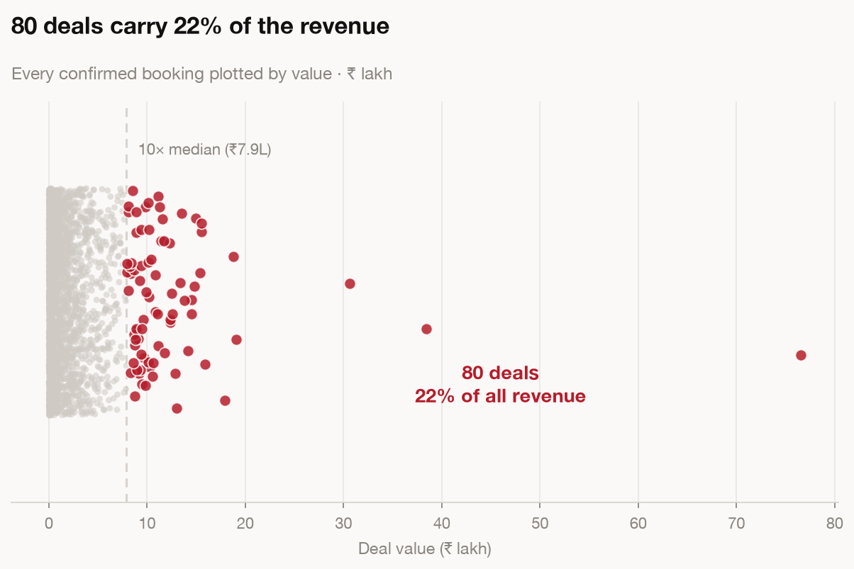
LENS 7 · OUTLIERS
MODULE 2 · THE EIGHT LENSES
TAKEAWAY
80 deals out of 2,490 carry 22% of revenue. Lose two and your trend goes away.
30
Notes:
TAKEAWAY — Concentration read as a trend is the most common way a growth story turns out to be one client.
SAY
- Point at the handful on the right. Name what percentage of revenue they are.
- Say the sentence: lose two of them and the trend you were describing goes away.
- Then the ask: that caveat goes in the email, not in your head.
~1m · NEXT: Lens 8 — Decomposition

Slide 29
LENS 8 OF 8
MODULE 2 · THE EIGHT LENSES
8
DECOMPOSITION
THE QUESTION IT ANSWERS
ON TODAY’S FILE
THE TRAP IT HIDES
Why did the number move?
Revenue grew 21%. More deals, or bigger ones?
“It went up” is not a driver. The parts must sum.
The only lens that answers why. It is also the one that reliably gets skipped.
About 20% from more orders, 80% from bigger ones. Two very different actions.
Catch it: demand the residual. Not near zero means not finished.
THE PROMPT · PASTE THIS INTO AUREX
DROP IT IN THE CHAT — LET THE ROOM RUN IT WITH YOU
Net revenue moved from ₹12.81 Cr in 2023 to ₹15.54 Cr in 2024. Split that change, with code.
volume effect = (orders24 − orders23) × avg23 size effect = (avg24 − avg23) × orders24
The two must sum to the total change. Print the reconciliation and print the residual.
If the residual is not about zero, stop and tell me what is unexplained.
Label every driver OBSERVED or INFERRED.
31
Notes:
TAKEAWAY — 'It went up' is not a driver. If the parts do not sum, you do not have an answer.
SAY
- RHYTHM for every lens card — question, file, trap, then paste the prompt. Ninety seconds.
- This is the lens that gets you invited back into the room. Say that explicitly.
- Revenue grew 21%. More deals or bigger deals? Two completely different management responses.
- The answer on this file: roughly 20% from more orders, 80% from bigger ones. So the action is about pricing, not headcount.
- The discipline is the residual. Parts must sum to the whole. An unexplained residual means you do not understand the movement yet.
- This is the one lens where the full prompt gets its own slide next — flag that.
- Then: 'Prompt is on the slide. I am dropping it in the chat now — run it while I talk.'
- Paste it into the chat for real. This is the interactive beat of the module; do not skip it to save time.
ASK THE ROOM
"Last time revenue moved in your patch — was it volume or price? Do you actually know?"
~2m · NEXT: the bridge

Slide 30
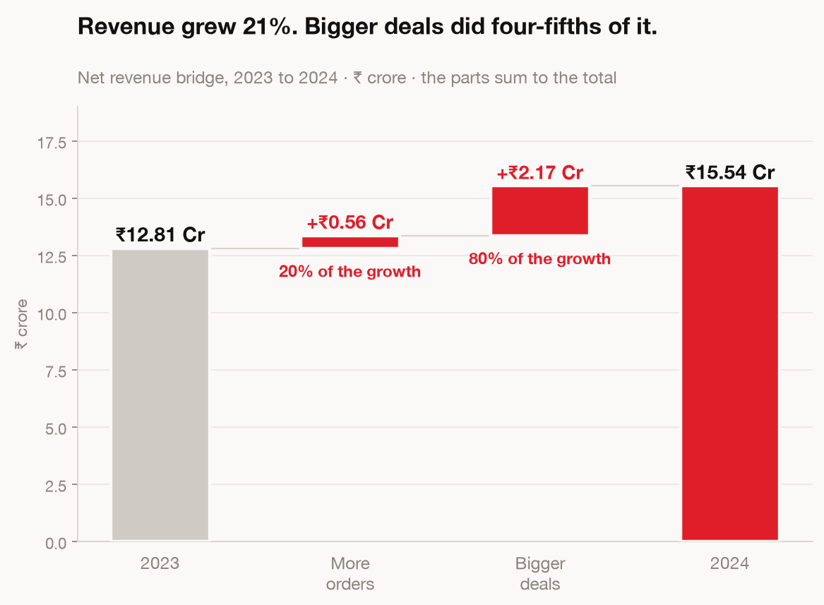
LENS 8 · DECOMPOSITION
MODULE 2 · THE EIGHT LENSES
TAKEAWAY
The parts must sum to the whole. An unexplained residual means you are not finished.
32
Notes:
TAKEAWAY — The parts have to sum to the whole. That is the check.
SAY
- Walk the bridge left to right, naming each bar.
- Land on the residual: if that bar is not near zero, the analysis is not finished.
- Say the professional standard: you print the residual even when it is zero, because printing it is how anyone knows you checked.
~1m · NEXT: the full decomposition prompt

Slide 31
MODULE 2 · THE EIGHT LENSES
The prompt behind Lens 8
The same prompt from the Lens 8 card. This one makes the tool prove its own arithmetic.
Net revenue moved from ₹12.81 Cr in 2023 to
₹15.54 Cr in 2024. Find out why, with code.
1 Confirm the total change, absolute and %.
2 Split it into two effects:
volume = (orders24 − orders23) × avg23
deal size = (avg24 − avg23) × orders24
3 The two must sum to the total change.
Print the reconciliation and the residual.
If the residual is not about zero, stop and
tell me what is unexplained.
4 Label every driver OBSERVED or INFERRED.
WHAT COMES BACK
A bridge where the parts tie to the total
20% from more orders, 80% from bigger ones
The residual, printed, at about zero
An honest label on anything it assumed
TAKEAWAY
Make the tool print its own reconciliation. A residual nobody names is not an answer.
33
Notes:
TAKEAWAY — A prompt that makes the tool prove its own arithmetic.
SAY
- Second teaching slide on prompt construction. Contrast it with slide 17: that one enforced honesty about cleaning, this one enforces honesty about maths.
- The killer line is 'If the residual is not about zero, stop and tell me what is unexplained.' You are giving the tool permission to fail loudly.
- 'Label every driver OBSERVED or INFERRED' — two words that change how a room treats a claim. Come back to this in Module 4.
- Point at the right-hand column: this is what checkable output looks like. Not prettier, just verifiable.
ASK THE ROOM
"Add one constraint to this prompt for your own work. What would it be?"
~3m · NEXT: War story — contextual targeting

Slide 32
MODULE 2 · THE EIGHT LENSES
WAR STORY · HT DIGITAL STREAMS · CONTEXTUAL TARGETING
The lift was real. The first number we ran was not.
+25%
CTR and conversion against vanilla targeting, on a like-for-like cut
We moved from broad targeting to in-page semantics with brand-safety controls. The early read looked enormous, because the two groups were not comparable. Different placements, different weeks, different mix.
Once it was cut properly against a like-for-like baseline, the gain held up. Smaller than the first number, and defensible in front of a client.
TAKEAWAY
A number means nothing until you name what it is being compared to.
34
Notes:
TAKEAWAY — The lift was real. The first number we ran was not.
SAY
- Tell it plainly: we moved from broad targeting to in-page semantics. The early read looked enormous.
- Why it was wrong: the two groups were not comparable. Different placements, different weeks, different mix.
- The honest ending is the point — cut like-for-like, the gain held up. Smaller, and defensible in front of a client.
- Say the uncomfortable part out loud: the bigger number would have been easier to present and would have blown up later.
- Land the closing line: Lens 1 is the whole discipline. A number means nothing until you name what it is compared to.
~3m · NEXT: Statement slide

Slide 33
MODULE 2 · THE EIGHT LENSES
Most people stop at
“revenue went up.”
Lenses 6 to 8 are the ones that get skipped, and the ones that get you invited back into the room.
35
Notes:
TAKEAWAY — Lenses 6, 7 and 8 are the ones that get skipped and the ones that get you invited back.
SAY
- Statement slide. Say the headline, pause, say the line underneath, move.
- If you want one extra beat: most people stop at 'revenue went up' because that is where the work stops being easy.
~1m · NEXT: Hands-on block 1

Slide 34
MODULE 2 · THE EIGHT LENSES
HANDS-ON · 12 MIN
Open ad-sales-data.csv in Aurex.
Pick any two lenses and run them properly.
Write down which trap you checked for.
Post in chat: “The one thing that surprised you most”
TAKEAWAY
Naming the trap you checked for is the habit. A finding is worth less than the check.
36
Notes:
TAKEAWAY — Twelve minutes of them doing it, not you talking. Protect this block.
SAY
- Read the three instructions and then stop talking. Genuinely stop.
- Set a visible timer. Twelve minutes.
- Repeat the third instruction, because it is the one that gets skipped: write down WHICH TRAP you checked for.
- Walk the room, or watch the chat. Look for people who picked two lenses that are really the same lens.
- At two minutes remaining, say so.
- Bring it back with the chat prompt: the one thing that surprised you most. Read out three. Do not comment on all of them — pick the one that sets up Module 3.
ASK THE ROOM
"Post in the chat: the one thing that surprised you most."
~12m · NEXT: Module 3 — The Chart Selector

Slide 35
MODULE 3 · THE CHART SELECTOR
MODULE 3 OF 5
03
The Chart Selector
Nine comparisons, nine answers. Name the comparison out loud
and the chart stops being a matter of taste.
15 MINUTES
37
Notes:
TAKEAWAY — Say the comparison out loud and the chart stops being a matter of taste.
SAY
- Divider. Fifteen minutes, and it is the fastest win in the session.
- The framing: chart choice feels like design. It is not. It is a lookup.
- Set the mechanic: name the comparison in words first, then take the chart the selector gives you. No debate.
~1m · NEXT: the selector

Slide 36
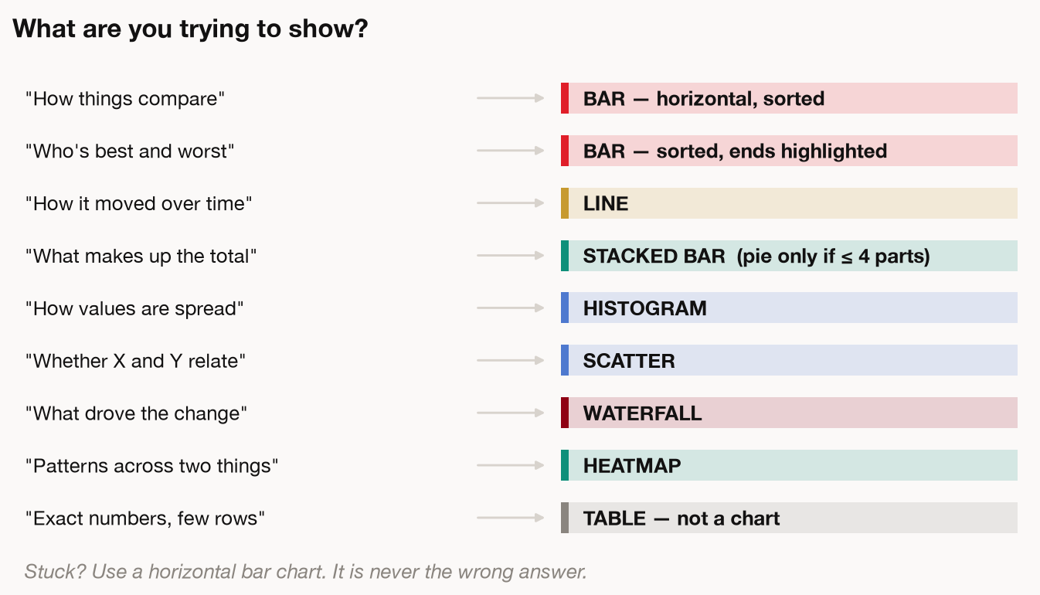
THE SELECTOR
MODULE 3 · THE CHART SELECTOR
TAKEAWAY
Finish “I am comparing ___ across ___” and the chart has already been chosen.
38
Notes:
TAKEAWAY — Nine comparisons, nine answers. Photograph it.
SAY
- Say 'photograph this' and wait. This is the second artefact of the day.
- Do not read all nine. Pick three the room will use tomorrow and do those.
- Make the point about pie charts explicitly if it is on there — people want to be told.
- The habit to install: before you choose a chart, finish the sentence 'I am comparing ___ across ___.'
ASK THE ROOM
"Finish this out loud for your current piece of work: I am comparing ___ across ___."
~4m · NEXT: the same numbers, twice

Slide 37
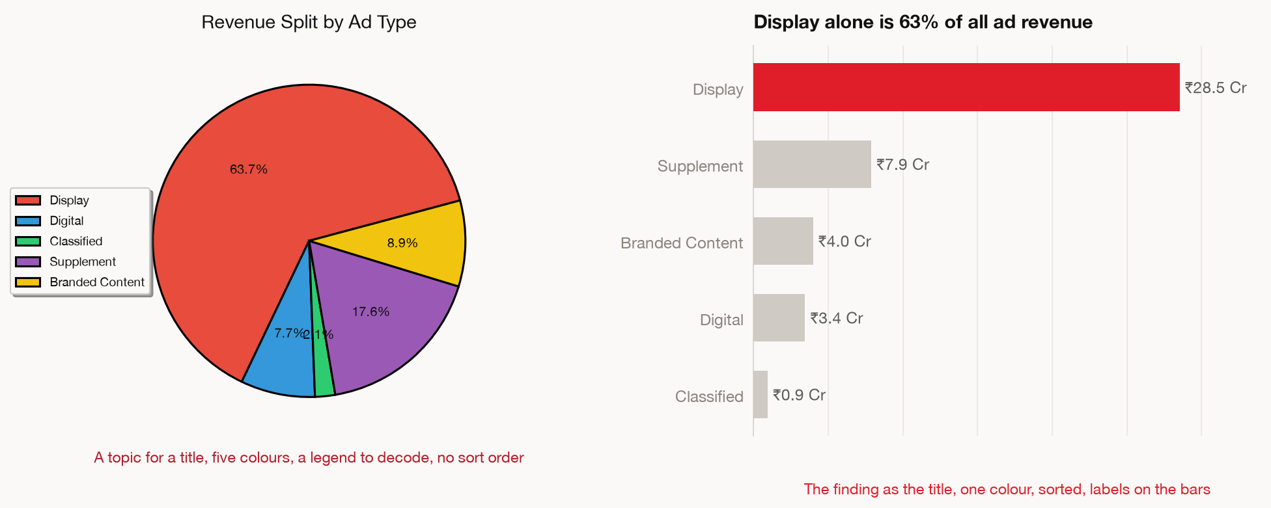
THE SAME NUMBERS, TWICE
MODULE 3 · THE CHART SELECTOR
TAKEAWAY
Nobody makes the bad chart on purpose. It is the default, and the default is never finished.
39
Notes:
TAKEAWAY — Identical numbers. Two charts. Only one of them says anything.
SAY
- Do not explain first. Show it and ask what is different. Let them find it.
- Then name the three changes: sorted, one colour, values on the bars.
- The honest bit: nobody made the bad chart on purpose. It is the default output.
- So the rule is: the default is never finished.
ASK THE ROOM
"What is different? Shout it out."
~3m · NEXT: the three rules

Slide 38
MODULE 3 · THE CHART SELECTOR
Three rules that fix almost every chart
Then point at anything still on the chart and ask what it proves. If it does not support the title, take it off.
1
Put the finding in the title
“Display is 63% of revenue”, never “Revenue by Ad Type”.
2
One colour carries the point
Everything else goes grey. Colour is an argument, not decoration.
3
Label the bars, delete the furniture
Legend, gridlines, border, markers. All of it competes with the data.
TAKEAWAY
A title that names the finding does the reader's work. A title that names the axes does not.
40
Notes:
TAKEAWAY — Three rules fix almost every chart you will ever make.
SAY
- Rule 1 is the one that changes careers: put the finding in the title. 'Display is 63% of revenue', never 'Revenue by Ad Type'.
- Say why: a descriptive title makes the reader do the work. Half of them will do it wrong.
- Rule 2 — colour is an argument, not decoration. One colour carries the point, everything else goes grey.
- Rule 3 — label the bars, delete the furniture. Legend, gridlines, border, markers. All of it competes with the data.
- The closing test on the slide is the real takeaway: point at anything still on the chart and ask what it proves. If it does not support the title, take it off.
ASK THE ROOM
"Open your last chart. Is the title a finding, or a label?"
~5m · NEXT: Module 4 — The Six Distortions

Slide 39
MODULE 4 · THE SIX DISTORTIONS
MODULE 4 OF 5
04
The Six Distortions
No formulas. Six ways a technically correct number
ends up telling a room the wrong thing.
20 MINUTES
41
Notes:
TAKEAWAY — Six ways a technically correct number tells a room the wrong thing.
SAY
- Divider. Stress the framing hard: no formulas, no statistics. These are all failures of framing.
- Say it: every number in this module is arithmetically correct. That is what makes them dangerous.
- Twenty minutes.
~1m · NEXT: Distortion 1 — counts where rates belong

Slide 40
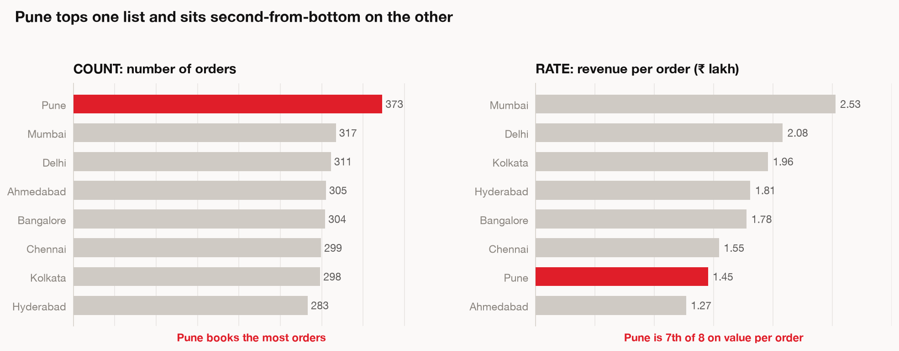
DISTORTION 1 — COUNTS WHERE RATES BELONG
MODULE 4 · THE SIX DISTORTIONS
TAKEAWAY
Counts tell you who is biggest. Rates tell you who is good. Only one is a decision.
42
Notes:
TAKEAWAY — Counts reward whoever is biggest. Rates tell you who is actually good.
SAY
- Walk the chart: on counts one answer wins, on rates a different one does. Same data.
- This is Lens 1's trap arriving as its own distortion — say the callback, it makes the deck feel like one thing.
- Real example if useful: circulation targets. AOP 28,141 against actual 27,060 is a shortfall of 1,081 — but per person it is 353, 184 and 544. The three are completely different conversations. Only the per-person view tells you where to act.
~3m · NEXT: Statement — always ask per what

Slide 41
MODULE 4 · THE SIX DISTORTIONS
Always ask “per what?”
Counts reward whoever is biggest. Divide by something and you find out who is actually good at it. Per order, per rep, per rupee spent, per head.
43
Notes:
TAKEAWAY — Always ask 'per what?'
SAY
- Statement slide. Say the four words. Pause.
- Then the list, slowly, because this is the bit they will actually reuse: per order, per rep, per rupee spent, per head.
- One line: counts reward whoever is biggest. Divide by something and you find out who is good at it.
- Move.
~1m · NEXT: Distortion 2 — the mean

Slide 42
DISTORTION 2 — THE MEAN QUOTED AS TYPICAL
MODULE 4 · THE SIX DISTORTIONS
TAKEAWAY
The mean here is 2.3× the median. Say “average” in a meeting and you overstate by that much.
44
Notes:
TAKEAWAY — The mean quoted as typical. The most common distortion in this building.
SAY
- Point at the skew on the chart.
- Callback to Lens 5 — same problem, now named as a distortion in its own right.
- Do not re-teach it. They have seen it. This slide is reinforcement, not new material.
~2m · NEXT: Mean, median and the gap

Slide 43
MODULE 4 · THE SIX DISTORTIONS
Mean, median, and the gap between them
Read the gap before you quote either
WHAT IT IS
WHEN TO USE IT
Mean
Add everything up, divide by the count
Values cluster together with no long tail
Median
Line them up, take the one in the middle
A few large values are pulling the average
The gap
₹1.80L mean against ₹0.79L median
At 2.3× apart, quoting the mean overstates
TAKEAWAY
Check the ratio before you quote either. More than 1.3× apart, the mean is not “typical”.
45
Notes:
TAKEAWAY — Read the gap before you quote either number.
SAY
- Table slide. Walk the three rows.
- Mean: when values cluster with no long tail. Median: when a few large values are pulling the average.
- The third row is the actual takeaway — ₹1.80L against ₹0.79L, 2.3× apart, and at that gap quoting the mean overstates.
- Give the portable rule again: check the ratio before you open your mouth. Above 1.3, use the median or say both.
ASK THE ROOM
"What is the mean-to-median ratio on the number you report most often? Do you know?"
~3m · NEXT: Distortion 3 — calendar

Slide 44
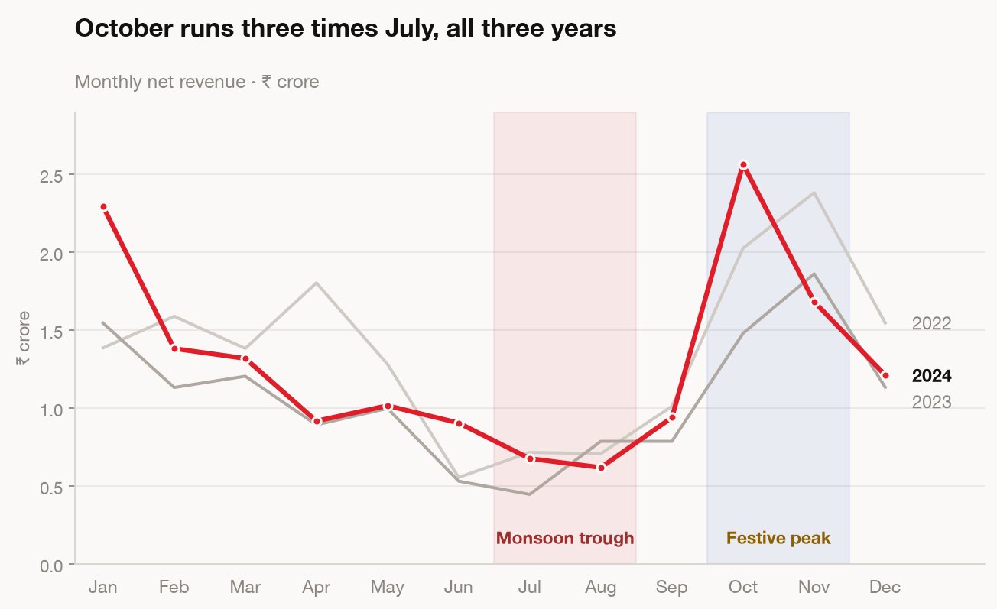
DISTORTION 3 — CALENDAR READ AS PERFORMANCE
MODULE 4 · THE SIX DISTORTIONS
TAKEAWAY
This file swings threefold across the year. A month-on-month number here is mostly calendar.
46
Notes:
TAKEAWAY — Calendar read as performance. Seasonality wearing a performance costume.
SAY
- Point at the swing. This file moves threefold between July and October, and none of that is performance.
- Say the trap: somebody reports a month-on-month drop and a team gets a hard conversation about a number that was the calendar.
- Real one from your own data: a colleague asked for 'category-wise revenue for YTD July'26 vs last year YTD July'25.' That is exactly right — same window, both years. Praise that pattern, it is the fix.
~2m · NEXT: Which growth comparison to use

Slide 45
MODULE 4 · THE SIX DISTORTIONS
Which growth comparison to use
This file swings threefold between July and October, so a month-on-month number here is mostly calendar.
1
Year on year
This January against last January. Cancels seasonality. Your default.
2
Month on month
Fast signal, very noisy. Never multiply it by 12 to get an annual rate.
3
A part-finished month
Exclude it, or put the day count right next to the number.
TAKEAWAY
Year on year is your default. Never annualise a monthly number by multiplying it by twelve.
47
Notes:
TAKEAWAY — Year on year is your default. Month on month is a signal, not a number you report.
SAY
- Rule 1 — year on year cancels seasonality. Make it the default and say why.
- Rule 2 — month on month is fast and very noisy. Then the hard prohibition: never multiply it by 12 to get an annual rate. Say that twice.
- Rule 3 — a part-finished month. Exclude it, or put the day count right next to the number. Never silently include it.
- This is the most immediately reusable slide in Module 4. Tell them so.
ASK THE ROOM
"Has anyone here annualised a monthly number this quarter?"
~4m · NEXT: Distortion 4 — tiny samples

Slide 46
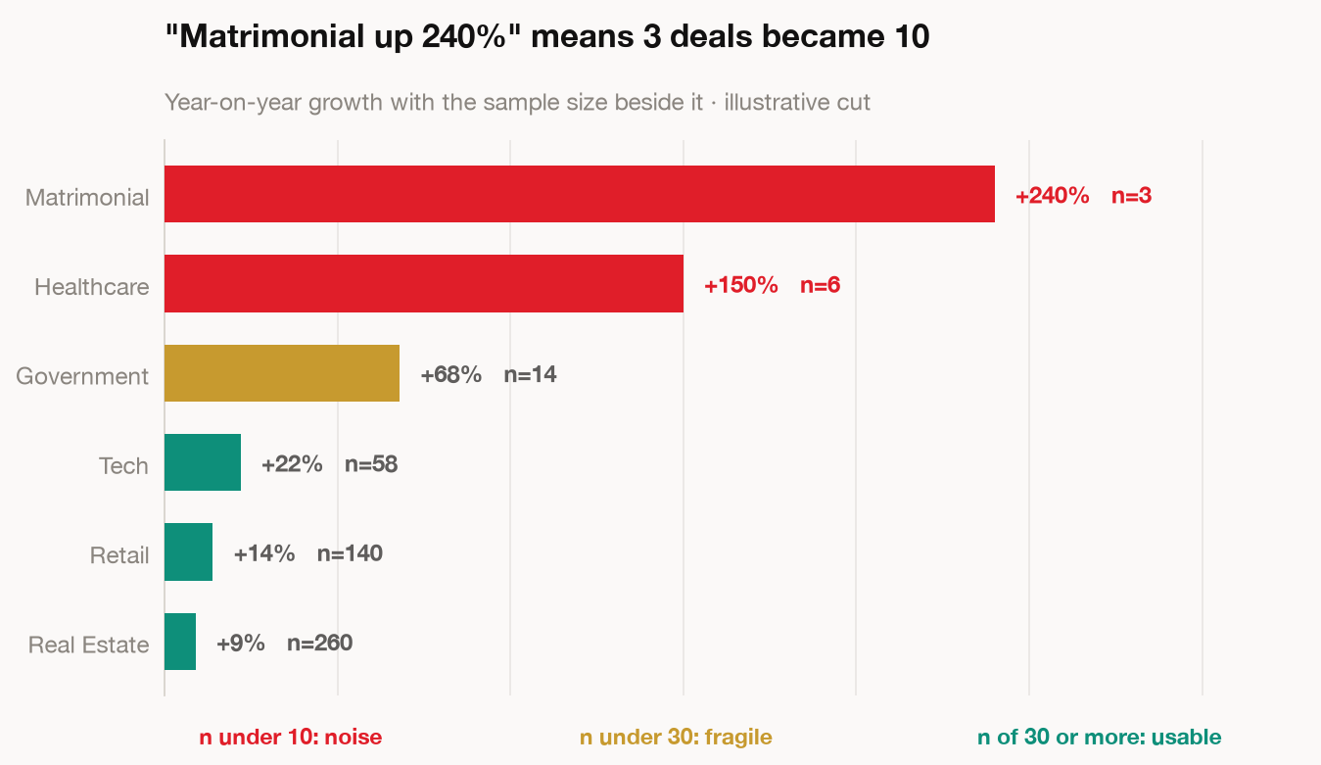
DISTORTION 4 — PERCENTAGES ON TINY SAMPLES
MODULE 4 · THE SIX DISTORTIONS
TAKEAWAY
Always print the denominator beside the percentage. Under 30 observations, quote the count.
48
Notes:
TAKEAWAY — A percentage on a tiny sample is a headline waiting to embarrass you.
SAY
- Walk the chart. '100% growth' on two orders becoming four.
- The rule to give them: always show the denominator next to the percentage. Always.
- '67% of respondents' means nothing until you know it was three people out of four.
- Quick habit: if n is under 30, quote the count, not the percentage.
~3m · NEXT: Distortion 5 — correlation as cause

Slide 47
MODULE 4 · THE SIX DISTORTIONS
Distortion 5 — correlation reported as cause
Two series moving together is the beginning of the work, not the end
Ice cream sales and drowning deaths rise together.
Summer drives both.
SO WHEN YOU FIND A RELATIONSHIP
Ask what else changed in the same window
Campaigns, pricing, seasonality, a tracking change.
Say out loud whether you observed it or inferred it
Two words. It changes how the room treats the claim.
Go looking for the third thing driving both
That is usually where the actual explanation is.
49
Notes:
TAKEAWAY — Two series moving together is the beginning of the work, not the end.
SAY
- Ice cream and drowning. Get the laugh, then immediately make it serious.
- Summer drives both. There is always a third thing, and finding it is the job.
- Walk the three moves: what else changed in that window; say whether you observed it or inferred it; go looking for the third thing.
- OBSERVED or INFERRED — two words, and they change how the room treats the claim. Callback to slide 32.
- Callback to Lens 6 so the deck holds together.
ASK THE ROOM
"Say your last causal claim out loud. Observed, or inferred?"
~4m · NEXT: War story — platform consolidation

Slide 48
MODULE 4 · THE SIX DISTORTIONS
WAR STORY · HT DIGITAL STREAMS · PLATFORM CONSOLIDATION
Three tools, three versions of the same metric.
₹2.5 Cr
a year in run-rate savings once the duplicate stack was retired
Mixpanel, Redshift and Elasticsearch each held a version of the truth, and teams quoted whichever one they had access to. Meetings were spent reconciling numbers rather than deciding anything.
Consolidating onto one modelled layer with agreed definitions took most of six months. The reporting improvement was almost a side effect.
TAKEAWAY
The undefined metric is the cheapest distortion to fix, and the one nobody owns.
50
Notes:
TAKEAWAY — Distortion 6 is the undefined metric. Cheapest to fix, and nobody owns it.
SAY
- Three tools, three versions of the same metric. Teams quoted whichever one they had access to.
- The detail that lands: meetings were spent reconciling numbers instead of deciding anything. Everyone here has sat in that meeting.
- Six months to consolidate. ₹2.5 Cr a year in retired tooling. The reporting improvement was almost a side effect.
- REAL BCCL PARALLEL — a colleague this month: 'the report is not correct, exclude the not-to-consider line items.' And another: 'why is rate coming as Rs 90? it should be taxable amount divided by qty divided by 1000, times damage qty, times 110%.' Both are the same thing: the metric was never defined in writing.
- Close with the action, and make it small enough to actually do: write your top three metrics down, in one sentence each, and get someone to disagree with you.
ASK THE ROOM
"Name a metric your team defines two different ways."
~4m · NEXT: Module 5 — The Five-Check Gate

Slide 49
MODULE 5 · THE FIVE-CHECK GATE
MODULE 5 OF 5
05
The Five-Check Gate
Aurex will run your code perfectly and still answer
the wrong question. This is the gate before you send.
15 MINUTES
51
Notes:
TAKEAWAY — The tool will run your code perfectly and still answer the wrong question.
SAY
- Divider. This is the module that keeps them out of trouble, so give it weight.
- The framing sentence is on the slide and it is the best line in the deck — read it as written.
- Fifteen minutes.
~1m · NEXT: Where accuracy actually falls over

Slide 50
MODULE 5 · THE FIVE-CHECK GATE
A groupby on the wrong column runs perfectly
Nothing in the output tells you the column was wrong
You get a clean table, a tidy chart and a confident summary. The failure mode moved from arithmetic to aim.
MEASURED ACCURACY ON REAL SPREADSHEETS
Looking things up
Filtering rows
Adding things up
89%
71%
54%
Counting
Sorting
Medians
42%
38%
20%
TAKEAWAY
Lookups come back right. Anything needing arithmetic across rows, check yourself.
52
Notes:
TAKEAWAY — The failure mode moved from arithmetic to aim. Nothing in the output tells you the aim was wrong.
SAY
- Open with the sentence: a groupby on the wrong column runs perfectly. Clean table, tidy chart, confident summary.
- Then the numbers. Do not read all six — read the shape: lookups 89%, and it falls off a cliff from there. Medians 20%.
- The rule to leave them with: lookups come back right. Anything that needs arithmetic across rows, check it yourself.
- Be fair and say it: this is not an argument against the tool. It is an argument for the gate on the next slide.
~3m · NEXT: The Five-Check Gate

Slide 51
MODULE 5 · THE FIVE-CHECK GATE
The Five-Check Gate
94% of working spreadsheets already carry a human error. The bar here is checkability, not perfection.
1
Row accounting
Ask how many rows it used, then compare that to how many are in the file.
2
Spot-verify the headline
Pick the number that matters most and check that one against the source.
3
Ask it a second way
Different phrasing, same question. Two answers means you have none.
4
Open what it made you
Look at the axis. Read the labels. Generated files look finished early.
5
Sign it
Would you put your name on this? You are about to.
53
Notes:
TAKEAWAY — Five checks, one page. The bar is checkability, not perfection.
SAY
- Lead with the 94% stat — most working spreadsheets already carry a human error. This is not about being perfect.
- Check 1, row accounting — ask how many rows it used, compare to the file.
- REAL EXAMPLE, use it here, it is the best one you have: a colleague wrote this month — 'How are you getting an overdue list of 637 vendors, however I am getting 652? Please recheck.' They caught a 15-row gap by counting. That is Check 1, done by someone in this building, and it worked.
- Check 2, spot-verify the headline. One number, the one that matters, against the source.
- Check 3, ask it a second way. Different phrasing, same question. Two answers means you have none.
- Check 4, open what it made you. Generated files look finished early. Look at the axis, read the labels.
- Check 5, sign it. 'Would you put your name on this? You are about to.' Say that and stop.
- Remind them: only 16% of the sessions I pulled ever challenged a number. These five checks put you in that 16%.
ASK THE ROOM
"Which of the five do you skip most? Be honest."
~6m · NEXT: Hands-on block 2

Slide 52
MODULE 5 · THE FIVE-CHECK GATE
HANDS-ON · 10 MIN
Take the finding you produced earlier.
Run all five checks against it.
Rewrite it as one sentence your manager could act on.
Post in chat: “Your one sentence”
TAKEAWAY
The shape: what is true, by how much, what to do, and the caveat that stays attached.
54
Notes:
TAKEAWAY — Ten minutes. They run the gate on their own finding and write one sentence.
SAY
- Read the three steps, set a timer, stop talking.
- The third step is the real exercise: rewrite it as one sentence your manager could act on.
- Coach the sentence shape if they stall: [what is true] + [by how much] + [what to do] + [the caveat].
- Warn them at two minutes.
- Collect four or five from the chat. Read them out. Improve one live — that is the most valuable ninety seconds of the session.
ASK THE ROOM
"Post in the chat: your one sentence."
~10m · NEXT: The five cards

Slide 53
The five cards you are leaving with
Each one works on any file, in any tool, in any department
01
THE SEVEN-STEP READ
Context · Shape · Total · Break down · Compare · Drivers · Validate
02
THE EIGHT LENSES
Comparison · Ranking · Trend · Composition · Distribution · Correlation · Outliers · Decomposition
03
THE CHART SELECTOR
Name the comparison, take the chart it gives you
04
THE SIX DISTORTIONS
Rates · Mean · Calendar · Sample size · Cause · Definitions
05
THE FIVE-CHECK GATE
Rows · Headline · Second phrasing · Open the file · Sign it
55
Notes:
TAKEAWAY — Five cards. This is what they physically leave with.
SAY
- Recap slide. Walk down it at pace — you are refreshing, not teaching.
- For each card, say the one-line version and nothing more.
- Then the promise: all five go out as a one-page PDF, plus the eight prompts, plus the practice file.
- Say when they will arrive, and then actually send them.
~3m · NEXT: Close

Slide 54
Somebody sends you a spreadsheet you did not build,
about a part of the business you half-know,
and wants your read on it by tomorrow morning.
You now have a sequence for that.
Dishant Singla · Base42 Systems · run on Aurex, inside BCCL
56
Notes:
TAKEAWAY — You now have a sequence for the thing that used to be a bad evening.
SAY
- Return to the opening image, deliberately. Same words as slide 1.
- Pause after 'by tomorrow morning.'
- Then: 'You now have a sequence for that.' Let it sit.
- Do not add a summary. Do not add a thank-you slide. This is the end.
- Take questions after this slide, not before it.
- Send the pack within the hour, while the session is still live in their heads.
~2m + Q&A

