Slide 1
Midterm Presentation on PEMFC
David Sun
2026年7月31号10点

Slide 2
Fundamentals

Slide 3
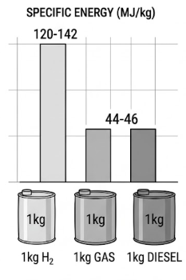
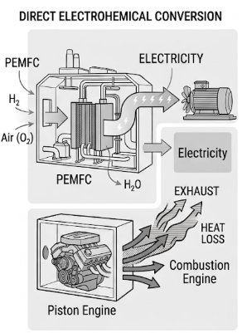
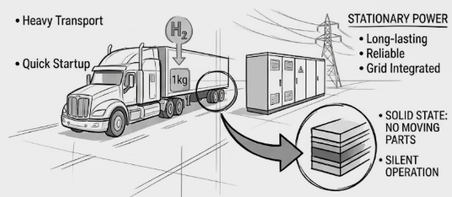
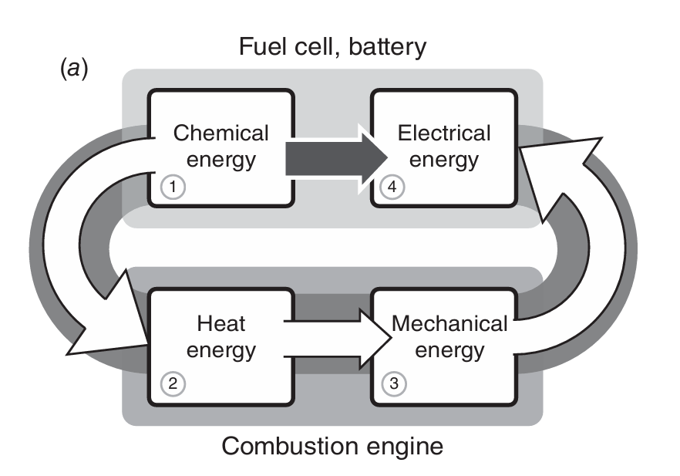
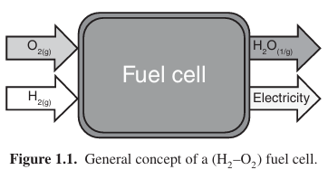
Introduction
Hydrogen Fuel & Efficiency: Hydrogen offers a specific energy by mass nearly three times higher than gasoline, utilizing fuel cells to continuously convert chemical energy directly into electricity with far greater efficiency than combustion engines.
PEMFC Advantages: Proton Exchange Membrane Fuel Cells (PEMFCs) are the most widely used type due to their low operating temperatures, high power density, rapid startup, and highly reliable, silent solid-state operation with no moving parts.
Notes:
Decarbonization efforts of the global energy infrastructure has sparked extensive research into hydrogen as an energy carrier. With a high specific energy by mass nearly three times higher than gasoline and diesel, hydrogen is well suited for heavy-duty transportation and stationary power generation.
In order to capture this energy, we use fuel cells, which behaves similar to a factory since it generates electricity chemically, but never dies or needs to be recharged as long as there is a continuous fuel supply. It generates power by harnessing the flow of electrons as they move from high-energy reactant bonds to low-energy product bonds. Since fuel cells converts chem energy directly to electricity, they are far more efficient than combustion engines. Proton Exchange Membrane Fuel Cells, PEMFCs are the most widely used type of fuel cell. They are characterized by their low operating temperature, high power density, and quick startup time. They are also solid state and mechanically ideal due to no moving parts leading to high reliability, long lasting life and silent power generation

Slide 4
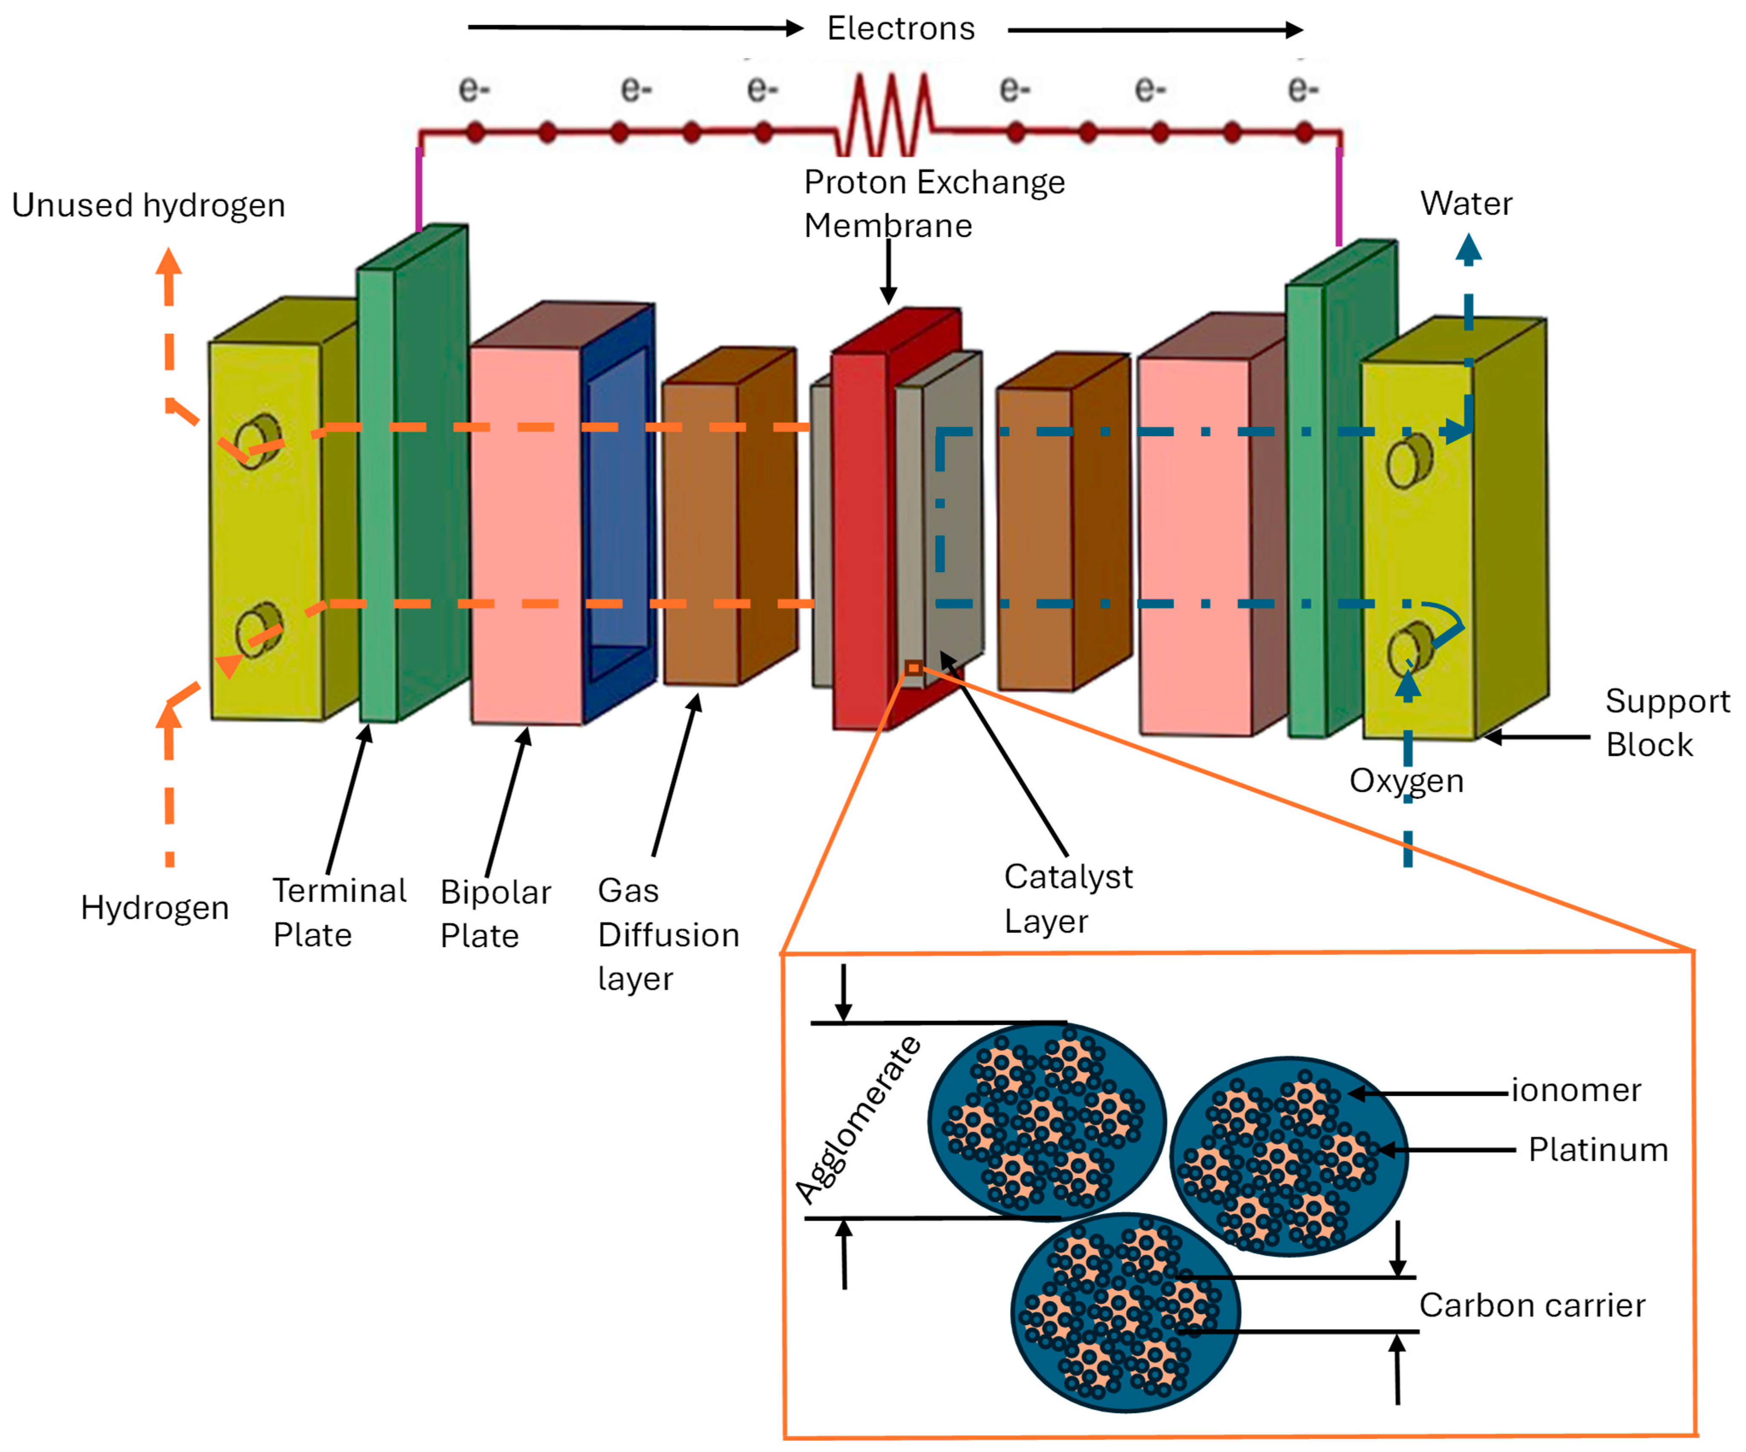



Reactant’s Pathway
Notes:
Let’s go over hydrogen’s journey through the PEMFC,
First, Hydrogen gas is pumped into the macroscopic flow fields within the metal or graphite bipolar plates on the anode side. Here, transport operates on a millimeter scale, so it is dominated by fluid flow and convection, flow field within the bipolar plates ensures the gas is evenly distributed across the active area of the fuel cell.
As the gas is pushed out of the flow field, it enters the GDL, made of highly porous carbon fiber paper. Because the structure and porosity here operate on a micrometer/nanometer scale, the transport mechanism switches from convection to diffusion, governed by Darcy’s Law, where gas flow is caused by pressure gradient through the porous medium. Also, the gas flow velocity drops to near zero due to viscous friction against solid carbon fibers. This causes hydrogen to spread out uniformly.
Next, the hydrogen passes through the MPL, a thin layer of fine carbon black and hydrophobic Teflon (PTFE) applied to the inner surface of the GDL. This ensures the incoming hydrogen maintains a clear, direct pathway into the catalyst layer.
Finally, the hydrogen reaches an active platinum site consisting of platinum nanoparticles supported on carbon, mixed with Nafion ionomer. This triggers the Hydrogen Oxidation Reaction (HOR). The molecule is split into two protons and two electrons. The MEA acts as an electrical insulator, so the protons travel straight through the Nafion electrolyte to the cathode. The electrons are blocked and forced to travel backward through the carbon support, MPL, GDL, bipolar plate, and into an external circuit to power a load (like an electric motor) before looping back to the cathode.
For the cathode side, oxygen from the air follows a similar initial path. However, a major differentiator is that the cathode produces liquid water as a byproduct. Thus, the cathode GDL and MPL must allow oxygen gas to diffuse inward while pushing liquid water outward so the pores don’t get blocked.
Once oxygen gas arrives at the active platinum sites on the cathode, it must converge simultaneously with the protons that crossed the Proton Ex Mem, and the electrons arriving from the external wire at a point called the Triple Phase Boundary.
This is where Oxygen Reduction Reaction (ORR) occurs. The diatomic oxygen molecules split and combine with the protons and electrons to form pure liquid water and heat.
Combining the two half-reactions gives the overall cell operation and the theoretical maximum voltage.
Water Management (Electro-Osmotic Drag) When protons travel through the proton exchange membrane from anode to cathode, each proton physically drags several water molecules along with it. This is known as electro-osmotic drag. Because of this drag, the anode tends to dry out, with excess moisture at the cathode side—resulting in more than what’s chemically generated by the Oxygen RR alone.
To prevent severe flooding at the cathode, liquid water must be actively swept out using exhaust mechanisms, such as air compressors blasting air parallel across the cathode flow channels.

Slide 5
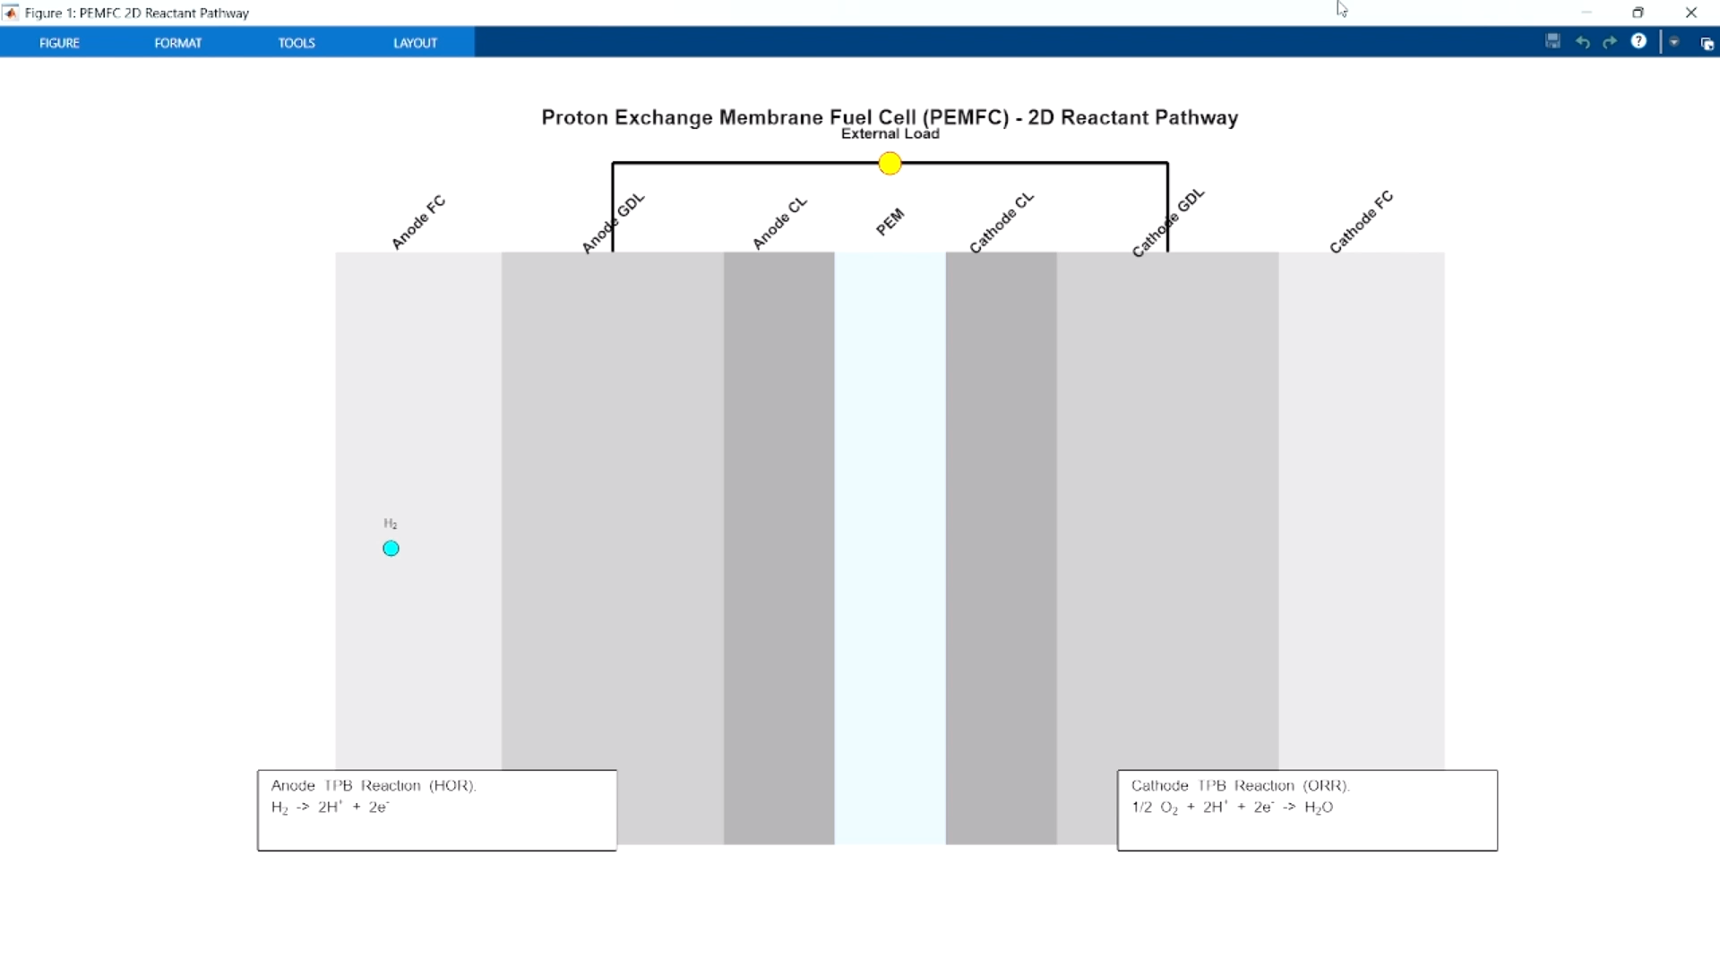

Slide 6
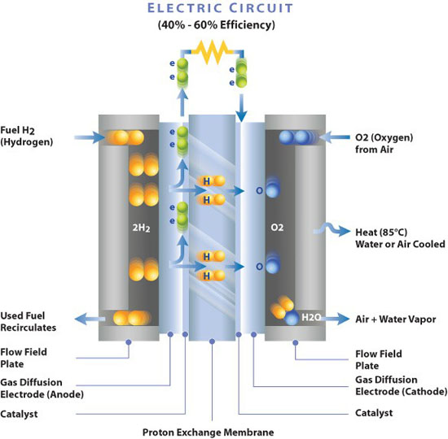
Membrane Electrode Assembly (MEA)
The MEA is the central structure of the PEMFC, consisting of one PEM, catalyst layer, and GDL on both sides.
PEM transports protons and water while physically blocking reactant gases and electrons to prevent short circuits
Nafion
  Hydrophobic Backbone: Teflon-like (PTFE) structure that repels water and withstands oxidative/reductive environments
  Hydrophilic Side Chains: Terminate in sulfonic acid groups that attract water and allows ionic conductivity
Notes:
The MEA is the central structure of the PEMFC, consisting of one PEM, catalyst layer, and GDL on either sides. The PEM is the most important layer in FC, it must transport protons and water, while turning away reactant gases and electrons to prevent short-circuiting. The industry standard for this is a perfluorosulfonic acid (PFSA) ionomers called Nafion. Nafion has a hydrophobic fluorocarbon backbone and hydrophilic sulfonic acid side chains. It’s Teflon-like structure repels water and provides structural support in the fuel cell’s oxidative and reductive environments. Attached to the backbone are side chains ending in hydrophilic sulfonic acid groups.
PREP
Let’s look at a simulation: currently the membrane is dry. The grey line is the PTFE backbone and red dots are the sulfonic acid sites. The green protons are initially attracted to the acid groups, so there is no conductivity currently. When the membrane is hydrated, the sulfonic acid groups dissociate and creates highly acidic aqueous domains where protons migrate to.
Once the protons are free, their transport across the membrane is mainly dominated by two types, the one we see here is the Grotthuss mechanism/proton hopping along this network of water molecules extending through the membrane.
The other is vehicular transport where protons attaches itself to water molecules to form form hydronium h3o+ ions which then diffuses through the aqueous phase of the membrane and is the root cause of the electro-osmotic drag previously mentioned.
“attached to this backbone are perfluorovinyl ether side chains terminated by hydrophilic sulfonic acid groups. When the membrane becomes hydrated ”

Slide 7
Polarization Curve

Slide 8
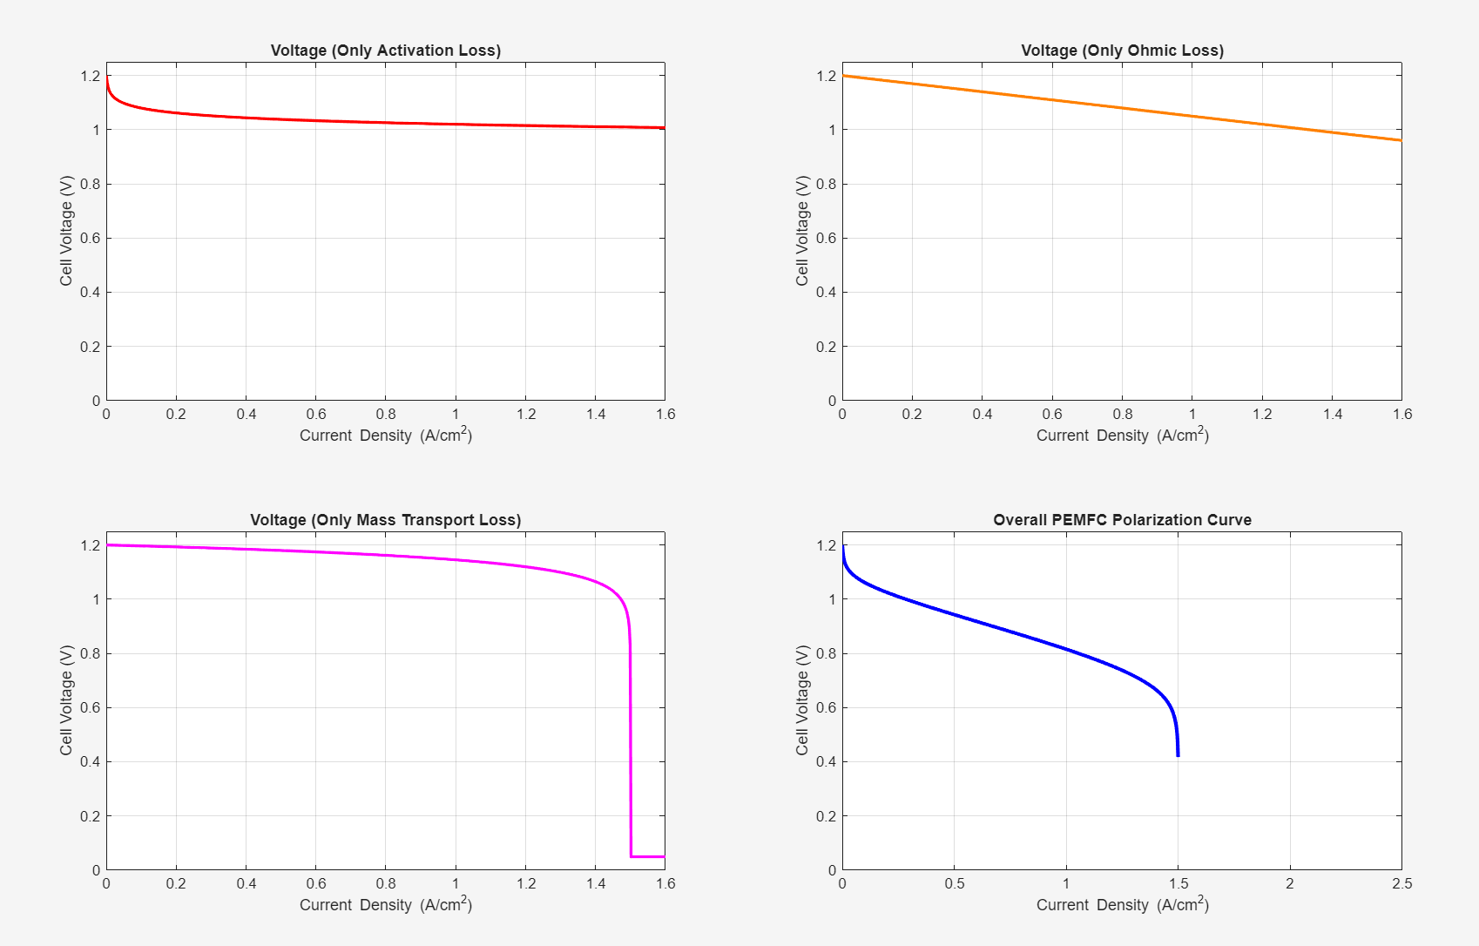




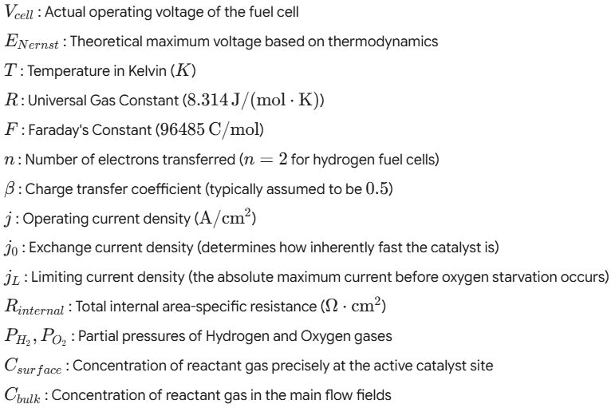
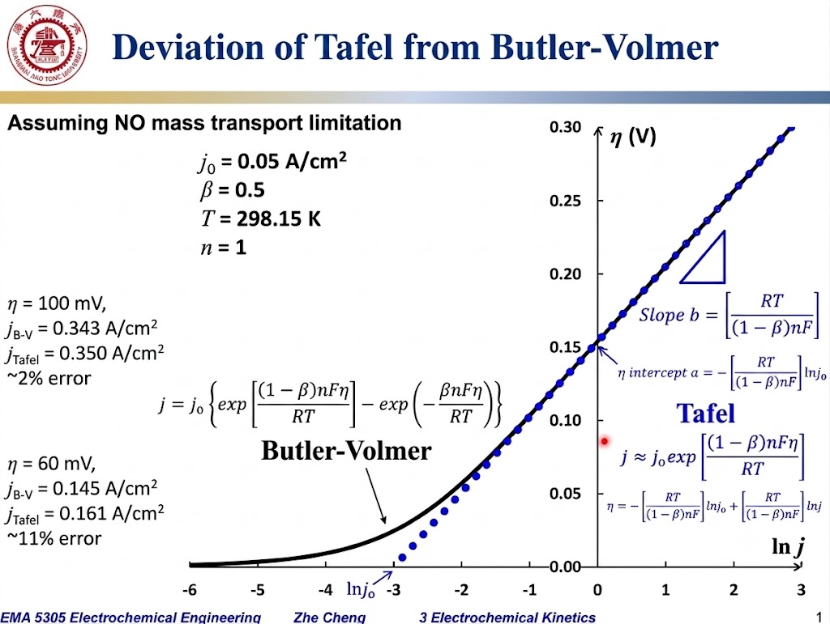

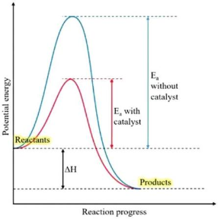
Notes:
First, we have the master equation that dictates the entire curve by subtracts the three primary losses from the theoretical max voltage
The Nernst equation is the the theoretical maximum voltage a PEMFC can produce at zero current, under standard ambient conditions producing liquid water, typically 1.229V. But real world testing always falls below 1V due to reactant crossover.
The first type of loss is activation loss arising from the energy barrier needed to initiate the electrochemical reaction. In PEMFC, we are only concerned about the bottleneck, the oxygen reduction reaction at the cathode. This loss can be seen at the initial, low-current region of the polarization curve.
2a shows the full BV equation with mass transport limits since in a real fuel cell at high currents, the conc. Of oxygen at the catalyst surface drops below the conc. Available in the bulk gas channels.
2b is the std. BV eq. without mass transport. This is used at low to moderate currents where the gas reaches the catalyst perfectly so the fraction cancels to 1
2c shows the Tafel Equation which is used at large overpotentials over 100mV, reducing the second half of the BV equation (anodic polarization) to close to 0.
The graph on the bottom right demonstrates that at high overpotentials, the curves will overlap and it is safe to use Tafel simplification at above 100mV.
Next, we have Ohmic polarization caused by the internal electrical and ionic resistance of the fuel cell. The most significant contributor is the ionic resistance of protons traveling through the solid Nafion membrane. On the graph, we can see the straight, linear downward slope in the midle of the polarization curve. Since protons rely on the Grotthuss mechanism to travel, this resistance is dependent on a balanced hydration level in the PEM.
Next we have mass transport loss at the last part of the graph shown by the sharp voltage crash at high current densities when the consumption of oxygen at the catalyst sites is faster than the physical rate of gas diffusion. Although bulk diffusion through the GDL is important, the bottleneck is in the local transport resistance where oxygen molecules cannot diffuse through the Nafion ionomer coating the platinum nanoparticles fast enough. Further losses caused by water flooding due to electro-osmotic drag may cause flash floods to fill the GDL pores, physically blocking oxygen gas from reaching the TPB.

Slide 9
Lit. Review & Current R&D

Slide 10
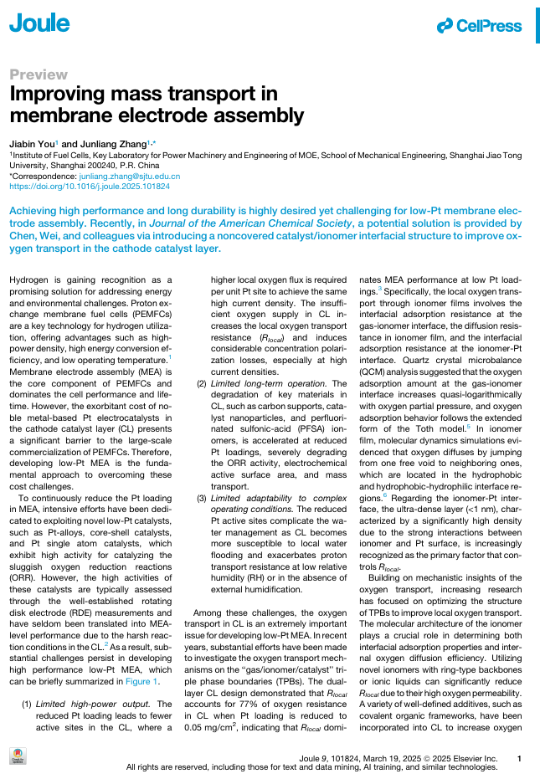
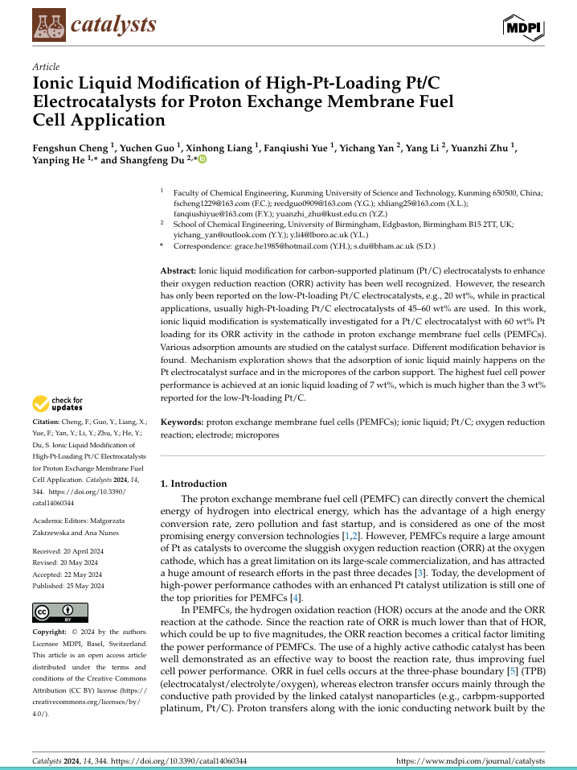
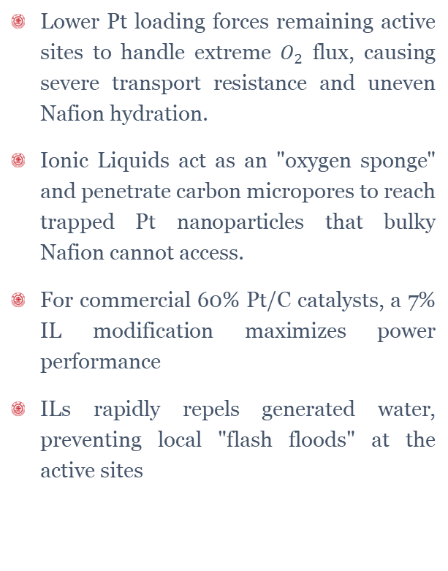
Article Review
Lower Pt loading forces remaining active sites to handle extreme $O_{2}$ flux, causing severe transport resistance and uneven Nafion hydration.
Ionic Liquids act as an "oxygen sponge" and penetrate carbon micropores to reach trapped Pt nanoparticles that bulky Nafion cannot access.
For commercial 60% Pt/C catalysts, a 7% IL modification maximizes power performance
ILs rapidly repels generated water, preventing local "flash floods" at the active sites
Notes:
the scarcity of platinum and its high cost has led to various academic articles exploring ultra-low platinum loading in the cathode CL. The 2025 article from Zhang discusses about the consequences of such.
First, Less platinum means the remaining active sites on the CL have to work harder to generate the same power (due to higher oxygen flux). This worsens the already existing issue of mass transport limitations and creates severe local oxygen transport resistance. any blockage within the catalyst pores and ionomer films creates higher magnitudes of resistance than standard plat loading.
Fewer Pt sites increases stress on remaining materials (carbon supports, the catalyst, and Nafion ionomer), leading to less durability. First, the carbon support may corrode/oxidize into CO2 gas. The pt may dissolve into acid or agglomerate into clusters. Less active sites changes water management including how water is produced, distributed, and taken away, increasing the risk of local flooding
The 2024 article from cheng talks about ionic liquid modification for carbon-support platinum catalyst to enhance their Oxygen reduction reaction in practical applications with high pt-loading of 45-60 wt% weight percentage. Ionic liquids are liquid salts that do not evaporate, able to sustain high temperatures, and has excellent gas solubility for oxygen. They are placed into the catalyst ink to act as a “oxygen sponge” that pulls O2 out of gas phase and directs it to platinum sites, raising the limiting current density and pushing mass transport polarization region to the right. They are also hydrophobic, so they expel the water from the catalyst surface which prevents flash floods at catalyst sites. The study concludes that 7% IL optimizes the fuel cell performance in high platinum loading scenarios.
Mass Transport Resistance: Slowed gas diffusion of oxygen through the gas diffusion layer (GDL) and cathode catalyst layer (CCL).
Flooding: Excess liquid water blocks microspores and coats catalyst sites, choking reactant access.
Dehydration: High local temperatures or low humidity dry out the ionomer, dropping proton conductivity

Slide 11
Experimentation

Slide 12
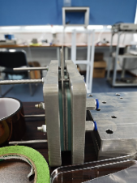
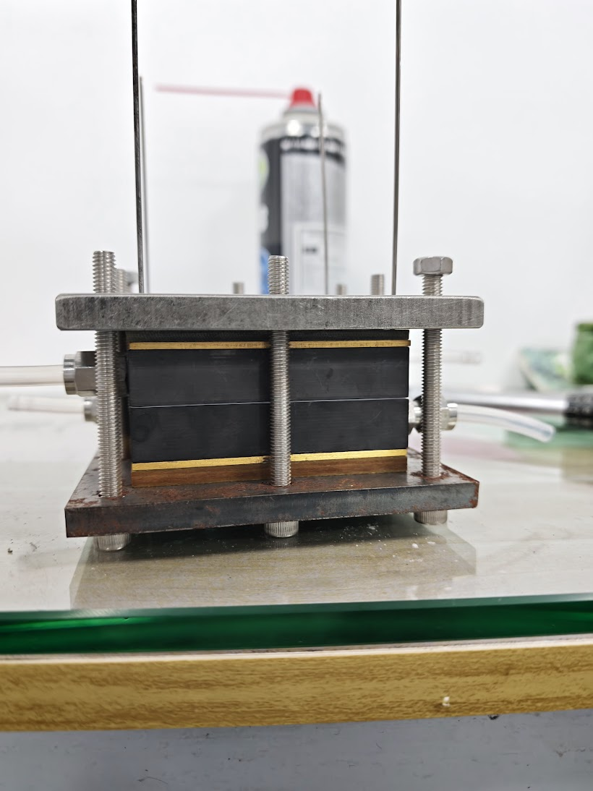
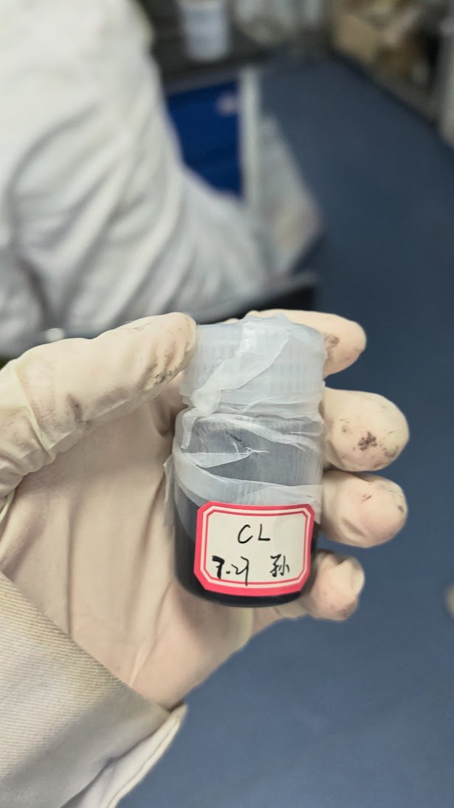
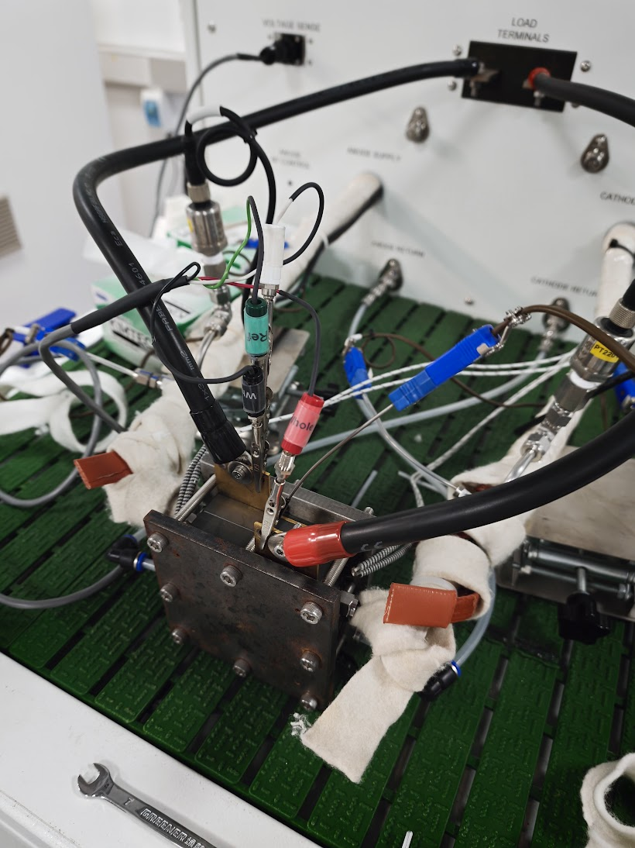
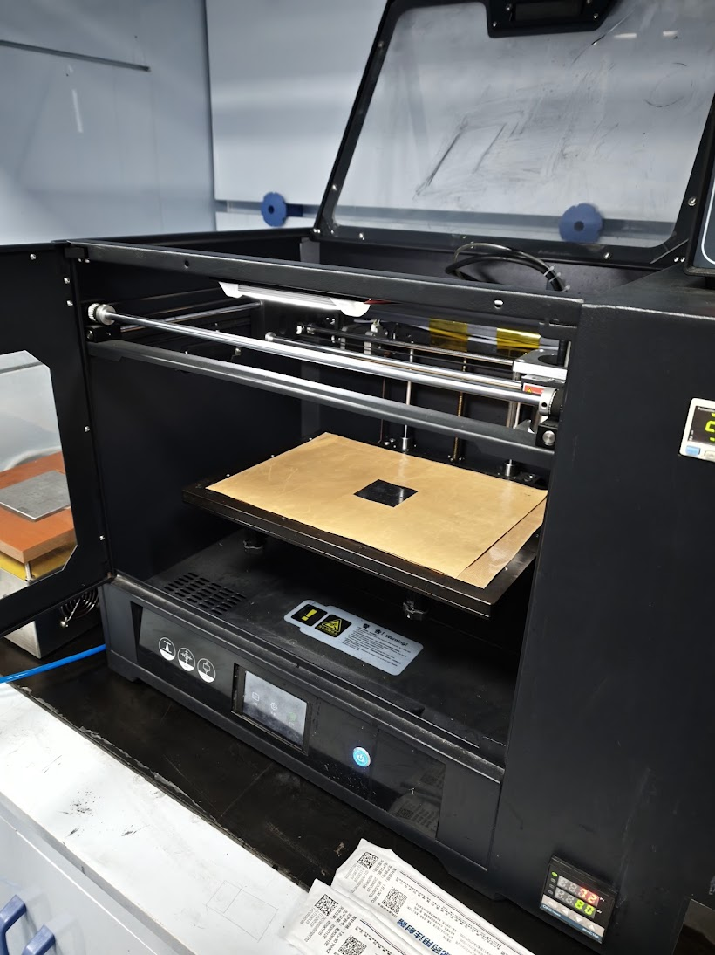
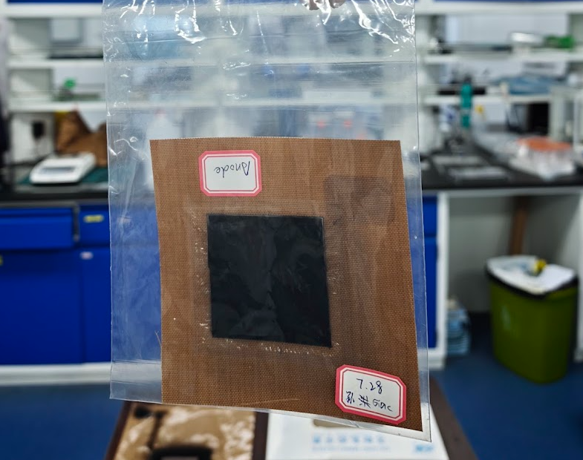
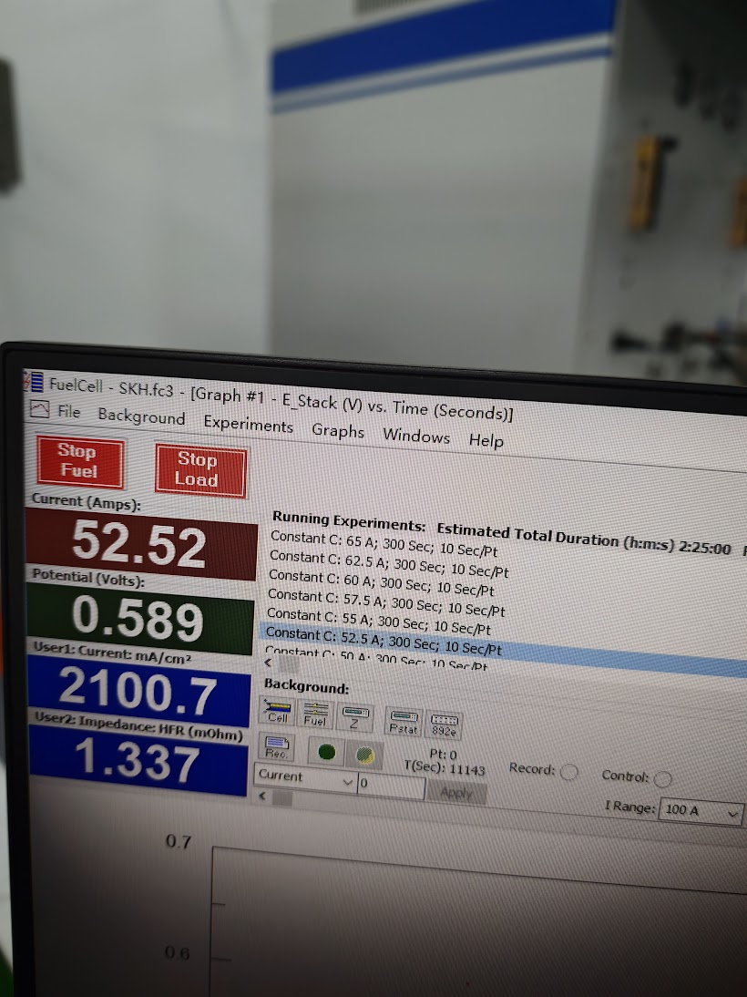
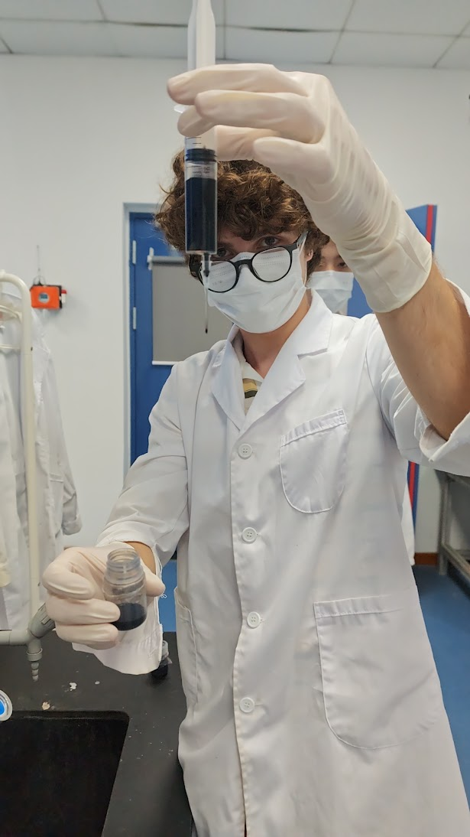
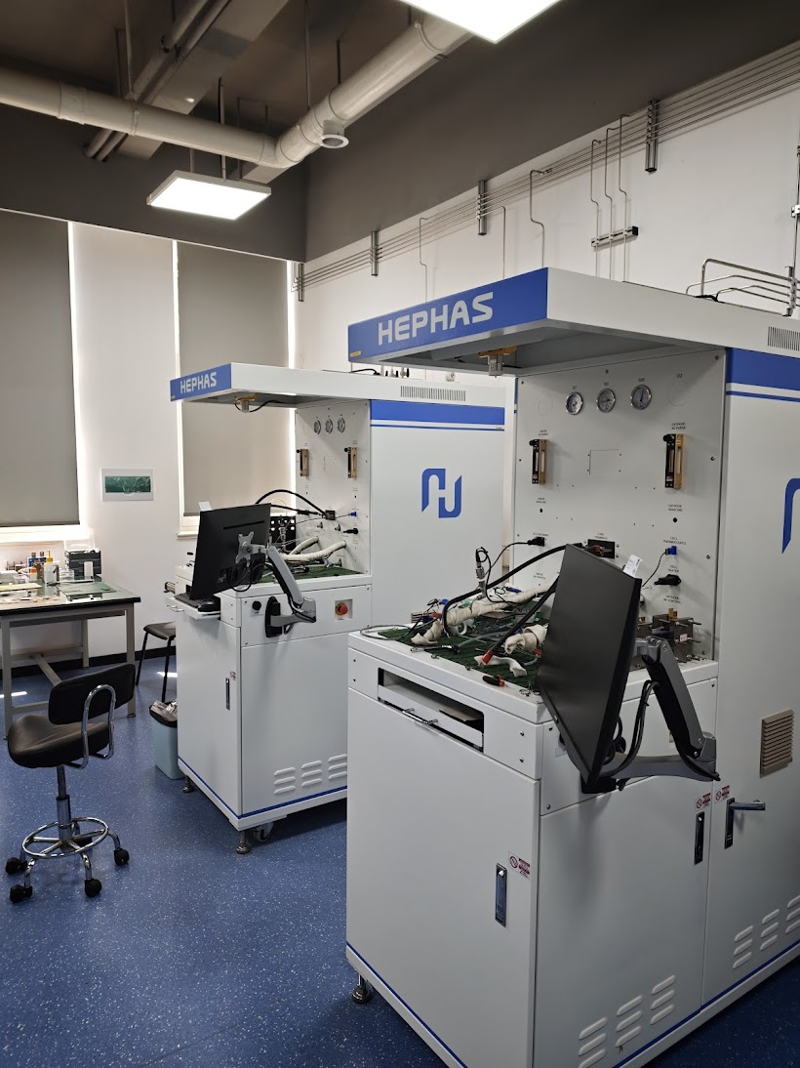
Notes:
Pt/C catalyst 10E50E (0.0479g)
Pure water H2O
Isopropanol
Nafion solution 20 wt%
Miling beads to improve dispersion
Ink sealed with parafilm
ccm

