Slide 1
l-Diversity for Top-Down Greedy
Extending the k-anonymity toolbox so that equivalence classes also hide the sensitive value
Lara Schwabe, Livia Zylja
SPAI 2026, Exercise 1.2 (Anonymisation)
Notes:
Short intro: who we are, we did task 1.2 with Top-Down Greedy on cahousing.

Slide 2
k-anonymity alone still leaks ocean proximity
cahousing, original TDG, k = 10 (largest homogeneous ECs)
Original TDG on cahousing
longitude | latitude | income | house value | size | ocean_proximity
-119 | 36 | 0 ~ 3.53 | 14,000 ~ 74,999 | 74 | 2 (all 74)
-121 | 38 | 0 ~ 3.53 | 75,000 ~ 135,999 | 66 | 2 (all 66)
-119 | 36 | 0 ~ 3.53 | 14,000 ~ 74,999 | 64 | 2 (all 64)
-118 | 33.8 | 3.53 ~ 7.07 | 197,000 ~ 257,999 | 50 | 1 (all 50)
85%
of districts in homogeneous ECs at k = 2
49%
of districts in homogeneous ECs at k = 10
Rows 1 and 3 differ in housing age. Everyone in the class has the same value (homogeneity attack). Age column left out.
13
homogeneous ECs left even at k = 100
Schwabe, Zylja | SPAI 2026, Exercise 1.2
2
Notes:
Example from cahousing, original TDG with k = 10. The table is 10-anonymous, but if I know where a district is and roughly its income and house value, I know its ocean proximity for sure. The reason is that ocean proximity basically follows from longitude and latitude.

Slide 3
Top-Down Greedy (as in the toolbox)
• Start with the whole table as one partition
• Pick two records u, v that are far apart
  – distance = NCP of their common generalisation
  – 3-round heuristic instead of all pairs
• Every record goes to the closer seed
• Side with < k records: move nearest records or merge again
• Recurse until partitions have < 2k records
• Generalise each partition (LCA in the hierarchy)
partition P
|P| >= 2k
records closer to u
records closer to v
Only the QIs are used for the split.
The sensitive attribute plays no role.
Schwabe, Zylja | SPAI 2026, Exercise 1.2
3
Notes:
Quick recap of how TDG works, because our change is inside the split step. Important: the split only looks at QI distance (NCP), the sensitive attribute is ignored completely.

Slide 4
Our change: check every split and repair it
1
2
3
4
Split as before
Check both halves
Repair the bad half
Still invalid or worse NCP?
seeds u, v, closer seed
>= k records and l-diverse?
move nearest records with
missing SA values over,
other half must stay valid
then keep P as one EC
Supported l-diversity types
Usage
• distinct: at least l different values
• entropy: H(SA) >= log(l)
• recursive (c, l): r1 < c (rl + ... + rm)
python anonymize.py
--method=topdown_ldiv --k=10
--l=2 --dataset=cahousing
Schwabe, Zylja | SPAI 2026, Exercise 1.2
4
Notes:
This is the main contribution. A split is only kept if both halves are k-anonymous AND l-diverse. If one half fails, we do not throw the split away directly but take records from the other half that bring in the missing occupations. Without l (l = 0) the original code path is used.

Slide 5
Experimental setup
• cahousing, 20,640 districts
• 5 QIs: longitude, latitude, housing_median_age, median_income, median_house_value
• SA: ocean_proximity, 3 values (4,953 / 9,136 / 6,551)
  – same column is the classification target
  – only l = 2, 3 possible, entropy l = 3 impossible
• Metrics: NCP, DM, CAVG, #ECs
• Privacy: homogeneous ECs, majority share
• KNN, SVM, RF predict ocean_proximity (80/20, weighted F1)
B
k = 2 ... 100
TDG vs. distinct l = 2, l = 3, entropy l = 2
C
k = 2, 10 and l = 2, 3
reject vs. retry (10x) vs. repair
R
recursive (c = 2, l = 2, 3)
at k = 10
Schwabe, Zylja | SPAI 2026, Exercise 1.2
5
Notes:
cahousing is the dataset from the toolbox. ocean_proximity has only three values and is also the class the toolbox predicts, so l can only be 2 or 3. We also compare three ways of handling bad splits.

Slide 6
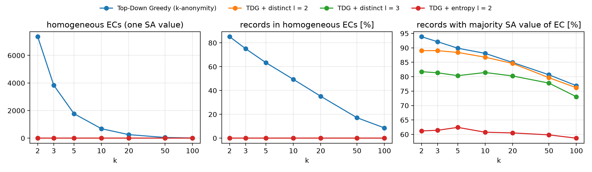
No homogeneous ECs, but distinct l is weak here
TDG + l: 0 homogeneous ECs in every run. But majority guess still right for 87% (distinct l = 2), 81% (l = 3), 61% (entropy l = 2) at k = 10. Without QIs: 44%.
Schwabe, Zylja | SPAI 2026, Exercise 1.2
6
Notes:
Left and middle: the original TDG has a lot of homogeneous ECs, ours has none. Right: how often you are right if you guess the most frequent value of the EC. Distinct l = 2 still 87% at k = 10, because the ECs are very skewed, e.g. 393 vs. 2 districts. Only entropy l brings it close to the 44% you get without any QI.

Slide 7
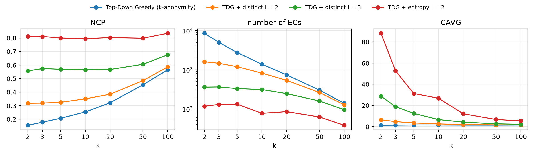
Information loss
• distinct l = 2: NCP 0.16 -> 0.32 (k = 2), 0.25 -> 0.35 (k = 10); same NCP as plain TDG at k = 20 (0.32), which still leaks
• distinct l = 3 about 0.57, entropy l = 2 about 0.80, recursive (c = 2, l = 3): one single EC
Schwabe, Zylja | SPAI 2026, Exercise 1.2
7
Notes:
Distinct l = 2 doubles the NCP at k = 2, but the gap closes with larger k. And compared at the same NCP it is better than just raising k: TDG at k = 20 has a similar NCP and still 7,255 districts in homogeneous ECs.

Slide 8
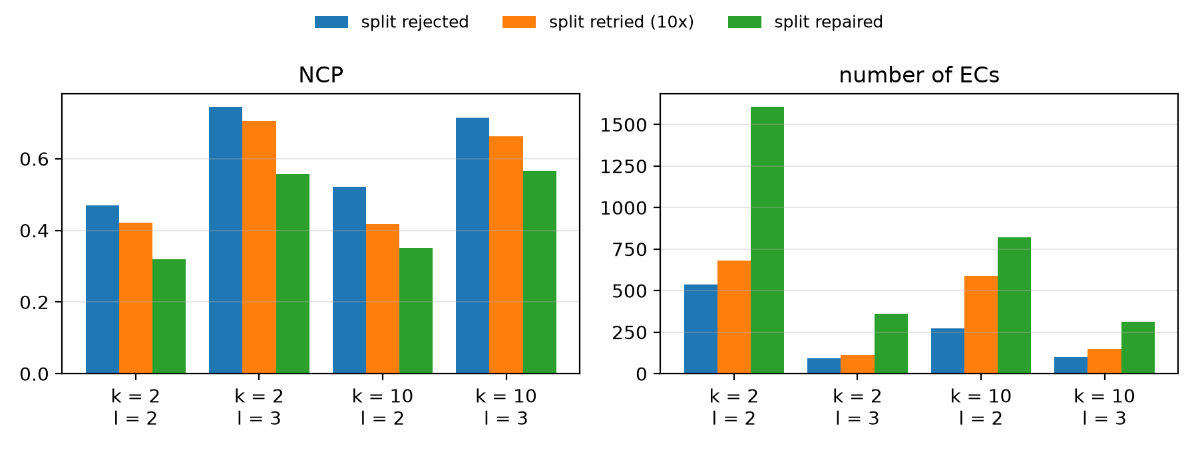
Repairing splits beats rejecting or retrying
NCP at k = 2, l = 2
reject 0.469
retry 0.421
repair 0.319
NCP at k = 10, l = 3
reject 0.714
retry 0.663
repair 0.566
Schwabe, Zylja | SPAI 2026, Exercise 1.2
8
Notes:
Retry was our first idea: try up to 10 new random splits. It helps a bit, but a new random split has the same problem because the SA is ignored. The repair moves a few records with the missing values and gives the lowest NCP in all four settings.

Slide 9
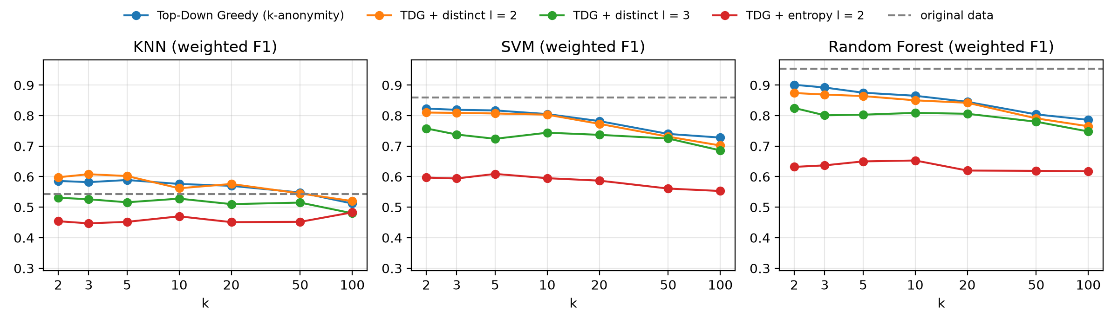
Classification: privacy and prediction collide
Weighted F1 (KNN / SVM / RF) at k = 10: original 0.54 / 0.86 / 0.95, TDG 0.58 / 0.81 / 0.86, l = 2 0.56 / 0.80 / 0.85, l = 3 0.53 / 0.74 / 0.81, entropy 0.47 / 0.59 / 0.65
Schwabe, Zylja | SPAI 2026, Exercise 1.2
9
Notes:
Dashed line is the original data. ocean_proximity is the SA and the class at the same time, so l-diversity mixes classes inside every EC. l = 2 costs little, l = 3 and entropy cost a lot. KNN is weak even on the original data because the toolbox does not scale its features. We also found two bugs in the toolbox evaluation on cahousing (decimal numbers became 0, rows matched by position).

Slide 10
Conclusion
What we found
Limitations / next steps
• TDG + l-diversity: 0 violations in all runs
• repairing splits gives the lowest NCP
• better than raising k at the same information loss
• distinct l = 2 only removes certainty, majority guess still mostly right
• entropy l protects, but costs a lot of utility
• only 3 SA values, SA = target
• greedy repair, not optimal
• skewness / similarity attacks -> t-closeness
• whole table must already be l-diverse
Schwabe, Zylja | SPAI 2026, Exercise 1.2
10
Notes:
Main messages: it works, repair is the best strategy, but on cahousing distinct l-diversity alone is weak and strong l-diversity destroys the prediction of the same column.

Slide 11
Thank you! Questions?
Code: algorithms/top_down_greedy, compare_topdown.py, demo_topdown.py

