Slide 1
l-Diversity for Top-Down Greedy
Extending the existing k-anonymity implementation with distinct l-diversity
Lara Schwabe, Livia Zylja
SPAI 2026, Exercise 1.2 (Anonymisation)
Notes:
Short intro: who we are, we did task 1.2 with Top-Down Greedy on cahousing.

Slide 2
Why l-diversity?
• k-anonymity requires at least k records to share the same quasi-identifiers.
• But all records in an equivalence class may still share the same sensitive value.
• This can reveal sensitive information even though the data is k-anonymous.
Our goal:
enforce both |EC| ≥ k and
at least l distinct sensitive values
Sensitive attribute:
ocean_proximity
Dataset:
cahousing
Evaluate the privacy–utility trade-off using information loss and classification performance.
Schwabe, Zylja | SPAI 2026, Exercise 1.2
2
Notes:
Example from cahousing, original TDG with k = 10. The table is 10-anonymous, but if I know where a district is and roughly its income and house value, I know its ocean proximity for sure. The reason is that ocean proximity basically follows from longitude and latitude.

Slide 3
Top-Down Greedy (baseline)
• Start with the full dataset as one partition.
• Choose two distant seed records using NCP-based distance.
• Assign each record to its closer seed.
• Balance partitions if one side contains fewer than k records.
• Recurse until no further valid split is possible.
• Generalize each final partition.
partition P
|P| ≥ 2k
records closer to u
records closer to v
Only QIs drive the split.
The sensitive attribute is ignored.
Schwabe, Zylja | SPAI 2026, Exercise 1.2
3
Notes:
Quick recap of how TDG works, because our change is inside the split step. Important: the split only looks at QI distance (NCP), the sensitive attribute is ignored completely.

Slide 4
Our change: validate and retry candidate splits
1
2
3
4
Split
Balance
Validate
Retry / stop
Generate a normal TDG candidate split.
Apply the original k-anonymity balancing step.
Both children must satisfy k and distinct l-diversity.
Try up to 10 candidates; otherwise keep the parent partition.
Initial attempt
reject the first invalid split → one giant EC (NCP = 1.000)
Final implementation
retry up to 10 candidate splits → much lower information loss
• Sensitive attribute index is recalculated after the framework reorders columns.
• random.seed(42) makes the anonymization results reproducible.
Schwabe, Zylja | SPAI 2026, Exercise 1.2
4
Notes:
This is the main contribution. A split is only kept if both halves are k-anonymous AND l-diverse. If one half fails, we do not throw the split away directly but take records from the other half that bring in the missing occupations. Without l (l = 0) the original code path is used.

Slide 5
Experimental setup
• cahousing: 20,640 records
• 5 QIs: longitude, latitude, housing_median_age, median_income, median_house_value
• Sensitive attribute / classification target: ocean_proximity (3 values)
• Configurations: k = 2, 5, 10; l = 2, 3 where applicable
• Same predefined train/validation split for every configuration.
• Generalized numeric ranges are represented by their midpoint for classification.
Information loss
NCP • CAVG • DM
Classification utility
Random Forest • weighted F1
Privacy validation
EC size • min. l - violation counts
Schwabe, Zylja | SPAI 2026, Exercise 1.2
5
Notes:
cahousing is the dataset from the toolbox. ocean_proximity has only three values and is also the class the toolbox predicts, so l can only be 2 or 3. We also compare three ways of handling bad splits.

Slide 6
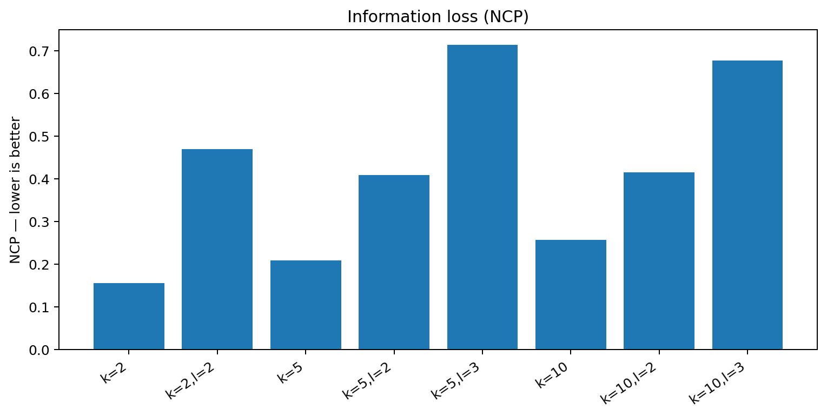
Privacy is satisfied — but stronger l increases information loss
0
k-anonymity violations
in every run
0
l-diversity violations
in every l-diverse run
k=5:
NCP 0.208 → 0.408 → 0.713
as l increases
l has a stronger utility cost than increasing k alone.
Schwabe, Zylja | SPAI 2026, Exercise 1.2
6
Notes:
Left and middle: the original TDG has a lot of homogeneous ECs, ours has none. Right: how often you are right if you guess the most frequent value of the EC. Distinct l = 2 still 87% at k = 10, because the ECs are very skewed, e.g. 393 vs. 2 districts. Only entropy l brings it close to the 44% you get without any QI.

Slide 7
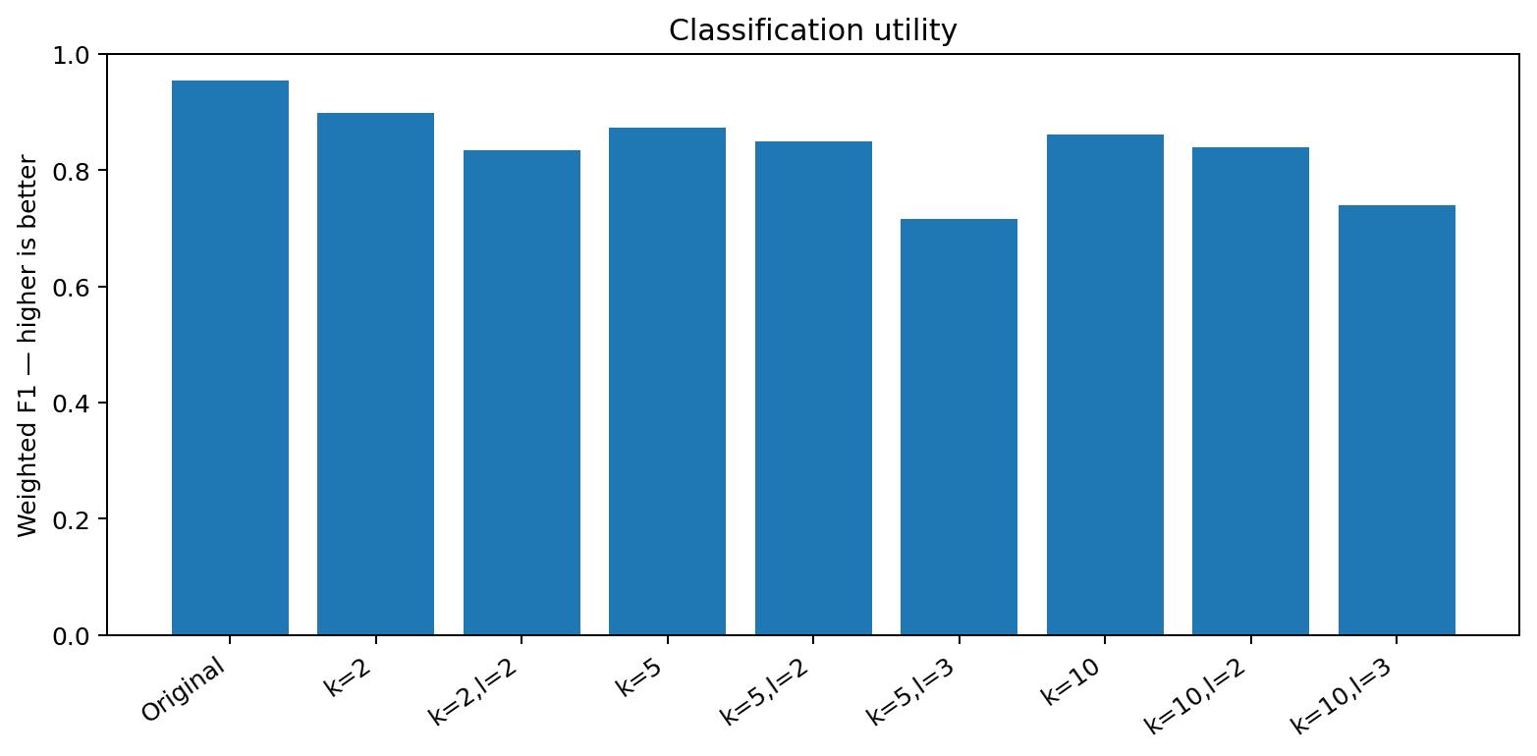
Classification utility decreases as privacy strengthens
Original data
F1 = 0.954
TDG k=5
F1 = 0.874
TDG k=5,l=3
F1 = 0.716
Distinct l=3 has the largest classification penalty.
Schwabe, Zylja | SPAI 2026, Exercise 1.2
7
Notes:
Distinct l = 2 doubles the NCP at k = 2, but the gap closes with larger k. And compared at the same NCP it is better than just raising k: TDG at k = 20 has a similar NCP and still 7,255 districts in homogeneous ECs.

Slide 8
Conclusion
• The TDG extension successfully enforces distinct l-diversity on top of k-anonymity.
• Retrying alternative candidate splits is much more useful than rejecting the first invalid split.
• Increasing k causes moderate information loss; increasing l has a substantially stronger effect.
• The strongest privacy settings also produce the largest drop in Random Forest performance.
• The k/l effect is not perfectly monotonic because TDG is heuristic and depends on the resulting partition structure.
Main takeaway
Stronger diversity guarantees improve privacy, but at a measurable cost in data utility.
Schwabe, Zylja | SPAI 2026, Exercise 1.2
8
Notes:
Retry was our first idea: try up to 10 new random splits. It helps a bit, but a new random split has the same problem because the SA is ignored. The repair moves a few records with the missing values and gives the lowest NCP in all four settings.

Slide 9
Thank you! Questions?

