Slide 1
HOUSE PRICE PREDICTION
INDRANUJ GANGAN(MS BME)

Slide 2
BOSTON HOUSING DATASET
NUMBER OF FEATURES: 13 →
CRIM: per capita crime rate by town
ZN: proportion of residential land zoned for lots over 25,000 sq.ft.
INDUS: proportion of non-retail business acres per town
CHAS: Charles River dummy variable (= 1 if tract bounds river; 0 otherwise)
NOX: nitric oxides concentration (parts per 10 million)
RM: average number of rooms per dwelling
AGE: proportion of owner-occupied units built prior to 1940
DIS: weighted distances to five Boston employment centres
RAD: index of accessibility to radial highways
TAX: full-value property-tax rate per $10,000
PTRATIO: pupil-teacher ratio by town
B: 1000(Bk - 0.63)^2 where Bk is the proportion of blacks by town
LSTAT: % lower status of the population
LABEL: 1 → MEDV: Median value of owner-occupied homes in $1000's

Slide 3
RANDOM FOREST REGRESSION ALGORITHM
Random forest Regression is a Supervised Learning algorithm which uses ensemble learning method for regression.
Random forest is a bagging technique
It operates by constructing a multitude of decision trees at training time and outputting mean prediction (regression) of the individual trees.
A random forest is a meta-estimator (i.e. it combines the result of multiple predictions) which aggregates many decision trees

Slide 4

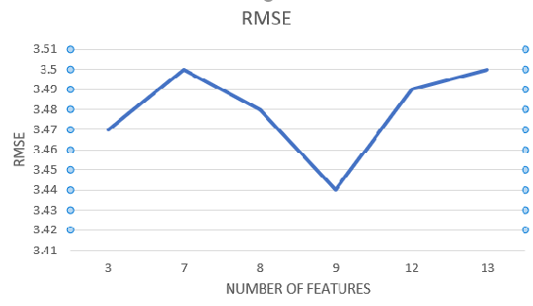
ROOT MEAN SQUARED ERROR
TOP 9 FEATURES
LSTAT
DIS
NOX
RM
CRIM
AGE
PTRATIO
B
TAX

Slide 5
APP DEMO
https://housing-pred.herokuapp.com/

