Slide 1
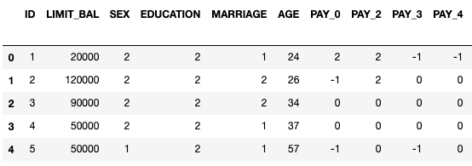
Default of Credit Card Clients
Default of credit card clients data set stored in UCI Center for Machine Learning and Intelligent System ‘Machine Learning Repository’.
Data set consists of 24 attributes and 30,000 instances.
The first ‘six’ attributes include clients’ balance limit and other statistics such as age, sex, marriage, age and education.

Slide 2
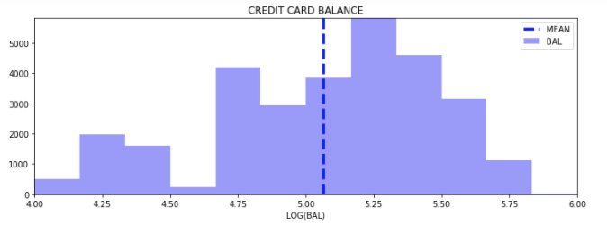
DATA VISUALIZATION :
BALANCE LIMIT
Default of credit card clients data set stored in UCI Center for Machine Learning and Intelligent System ‘Machine Learning Repository’.
Data set consists of
=> 24 attributes and
=> 30,000 instances
The first ‘six’ attributes include clients’ balance limit and other statistics such as age, sex, marriage, age and education.
Hist shows balance distribution plotted on log10 scale, average balance more than 100K.

Slide 3
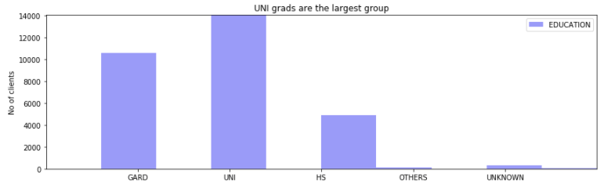
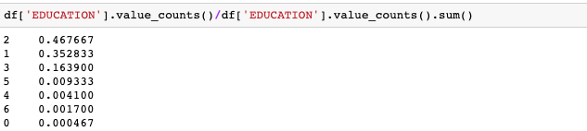
CLIENTS’ EDUCATION:
EDUCATION => GARD : UNI : HS : OTHERS = 35 : 47 : 16 : 1

Slide 4
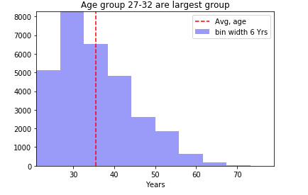
CLIENTS’ AGE:
Age group:
Largest group of customer
In terms of age:
27-32 Years
Next largest group:
33-38 Years

Slide 5
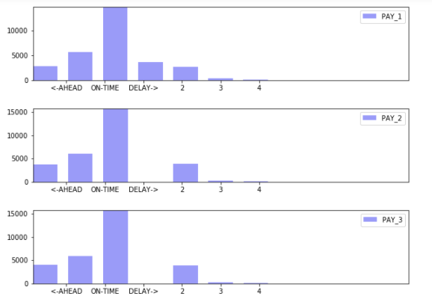
CUSTOMERS CONSECUTIVE PAY RECORDS (APRIL-JUNE, 2005) :

Slide 6
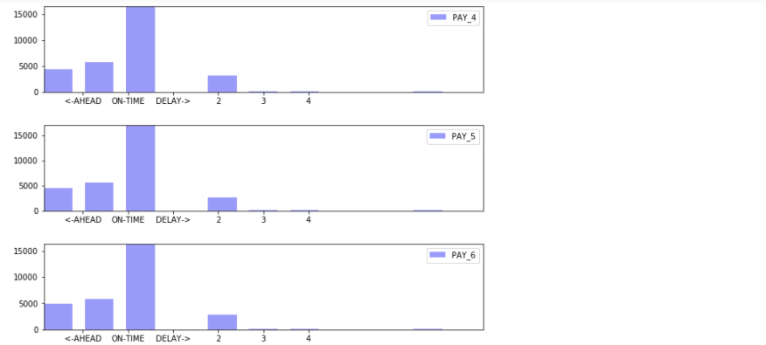
CUSTOMERS CONSECUTIVE PAY RECORDS (JULY-SEPT., 2005) :

Slide 7
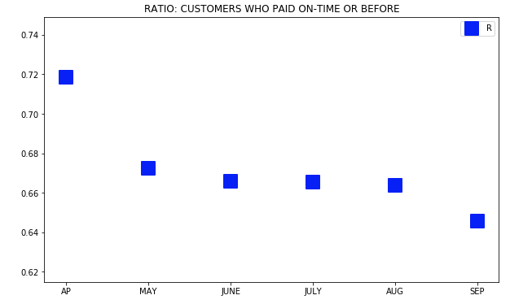
SIX CONSECUTIVE PAY RECORDS (APRIL-SEP, 2005) :
As we see roughly 72% client made the first payments on time. It drops down to less than 68% in the next pay cycle. Trend shows further drop down in terms of number of customer who made payments on time or before the time with small fluctuations towards the end of pay cycles.

Slide 8
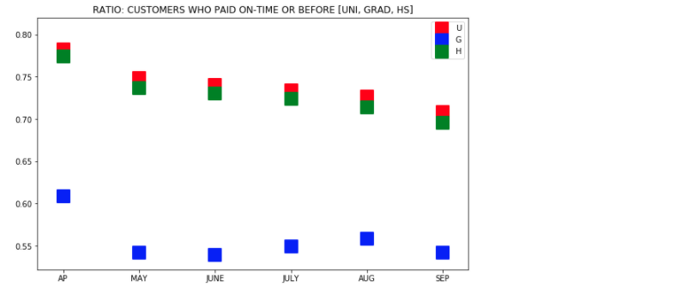
CUSTOMER PAY RECORDS IN TERMS OF EDUCATION :
We found that in terms of pay records university and HS students show similar trends as well as grad student, however grad student make a consistent difference from the other two groups.

Slide 9
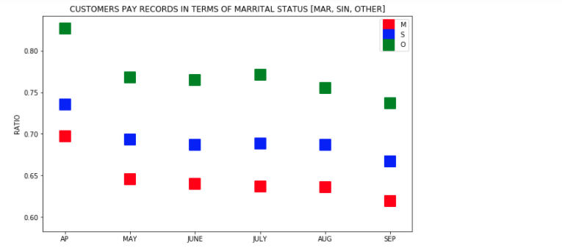
CUSTOMER PAY RECORDS IN TERMS OF MARRITAL STATUS :
It shows comparing to Married or Single, the other group pay records are better, however this group represents only 1% of the client.

Slide 10
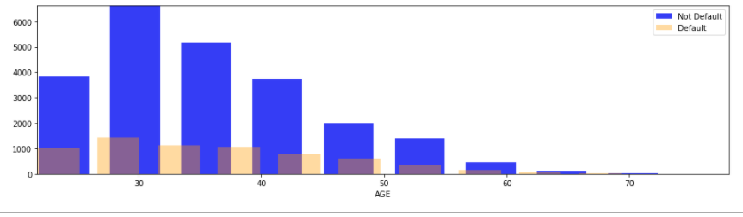
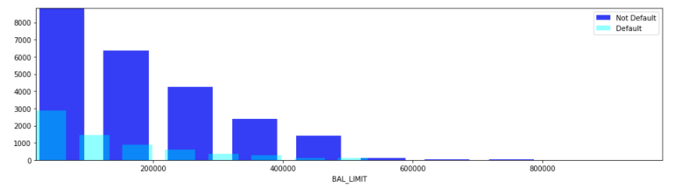
CLASSIFICATION ( PAY status, default or not default in terms of AGE group)
CLIENTS BALANCE ( Group: default, Not default )

Slide 11
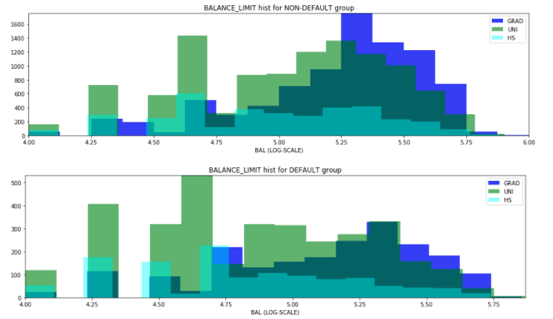
CLASSIFICATION ( PAY status, default or Not default in terms of EDUCATION)

Slide 12
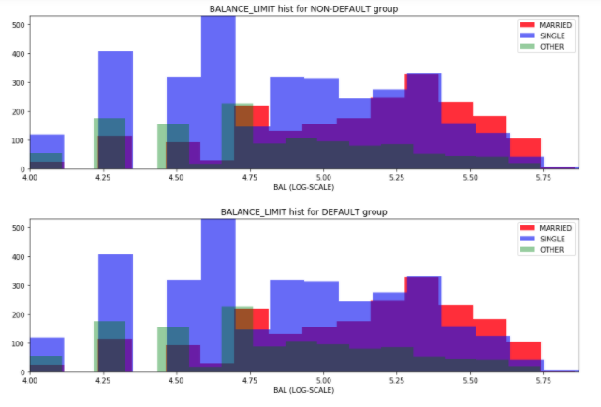
CLASSIFICATION ( PAY status, default or Not default in terms of MARRIAGE )

Slide 13
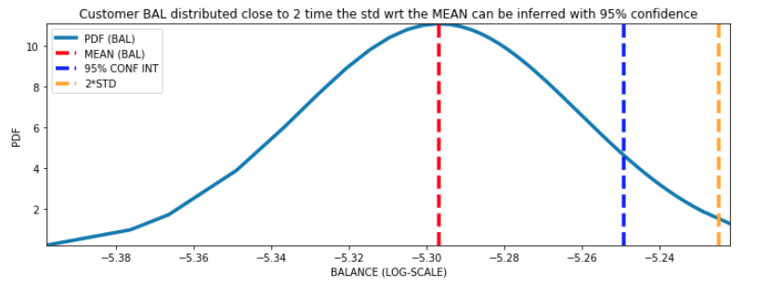
ANALYSIS : Probability Distribution Function (PDF) of Customer BALANCE (log10 scale)
Overall customers balance distributed close to 2*STD WRT the MEAN balance can be inferred with 95% CONFIDENCE.

Slide 14
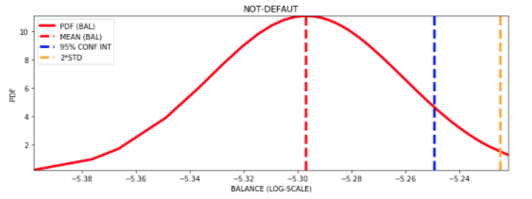
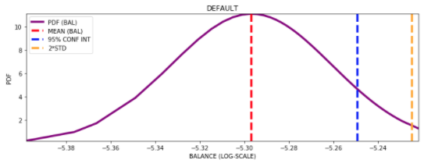
This TREND remains consistent even if we group customers in terms of
o Default, Not Default
o Education
o Marriage or
o Age group
95% CONFIDENCE INTERVALE : Default,
Not Default Group

Slide 15
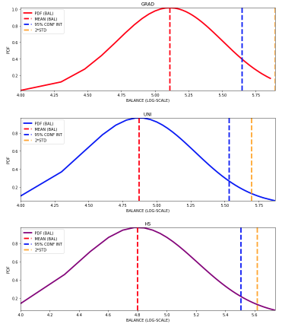
o Education
95% CONFIDENCE INTERVALE : GRAD,
UNI STU
HS STU
Group

Slide 16
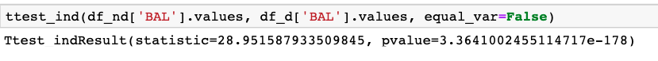
HYPOTHESIS TEST:
Now we would do a HYPOTHESIS with a claim that
“THE ABOVE TWO GROUPS (default, not default) ARE STATISTICALLY IDENTIAL”
With T test we found the p-value is < 0.05, so the null hypothesis is rejected, i.e.; the two groups are statistically different.
We did similar tests in terms of other attributes such as education, marital status or age group and found that null hypothesis is rejected.

Slide 17
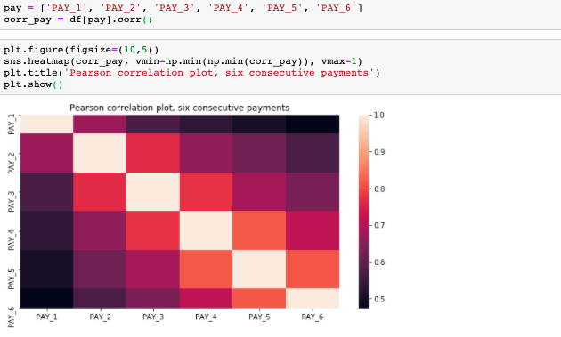
FEATURE CORRELATION :
Pearson correlation among the time-based payment features

Slide 18
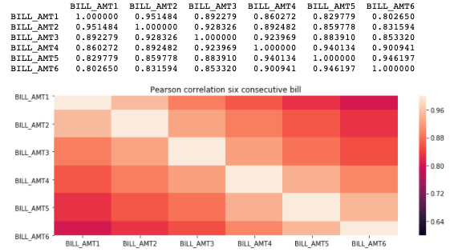
Pearson correlation bill amount

Slide 19
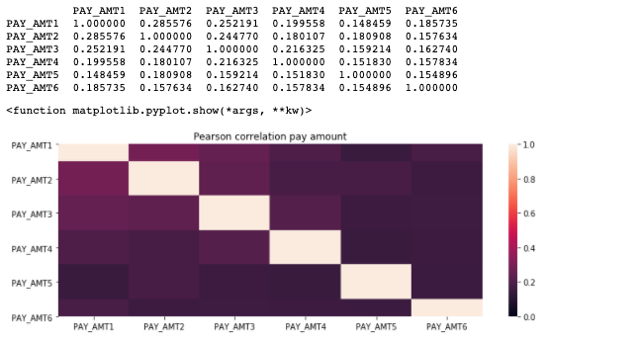
Pearson correlation pay amount

Slide 20
LAON DEFAULT PREDICTION :
Now we will apply various Machine Learning Algorithms to predict whether clients will be a default or not default in the next month.

