Slide 1

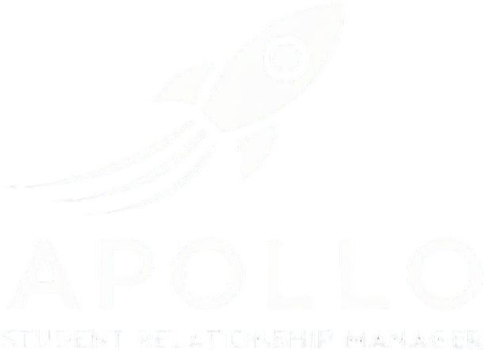

Data Security Overview
Smart. Simple. Seamless. AND SECURE.
The Future of Student Relationship Management.
Flight Controls: How ApolloSRM Secures PII
Multi-tenant SIS on AWS; prod/stage/dev isolated by account and VPC.
Private subnets for app/data tiers; least-privilege Security Groups and NACLs.
ALB/CloudFront at the edge; AWS WAF and Shield in front.
TLS 1.2+ on all endpoints with HSTS.
ApolloSRM Shield: Cloud-Native PII Defense
PII encrypted at rest with AES-256 (SSE-KMS); in transit with TLS 1.2+.
KMS key rotation and strict key policies.
Secrets in AWS Secrets Manager/Parameter Store; no secrets in code/images.
S3 Block Public Access; object lock for critical logs/backups.
Federated SSO with MFA for admins; no long-lived access keys.
Least-privilege IAM roles; application RBAC with audit trails.
Secure SDLC: code review, SAST/DAST, dependency and image scanning.
OWASP Top 10 controls: validation, output encoding, CSRF, CSP, rate limiting.
Ground Control to Data Integrity: ApolloSRM Security
Centralized logging with immutable S3 retention.
24×7 alerting with runbooks and on-call escalation.
Backups: daily encrypted snapshots; RDS point-in-time recovery; Multi-AZ.
Targets: RTO ≤ 4h, RPO ≤ 15m; 30–90-day retention with vault lock.
Privacy/compliance: FERPA-ready, SOC 2-aligned; GDPR/CCPA via DPA/SCCs.
Data minimization; tenant-level deletion on request/termination.
Subprocessors disclosed; payment cards handled only by PCI processor.
Incident response: triage → containment → eradication → recovery → post-mortem.
Customer notification without undue delay; within 72h if reportable..
Ready for Launch?
Take one small step for your institution and one giant leap for student success with ApolloSRM. Let's ignite your institutional potential together!

