Slide 1


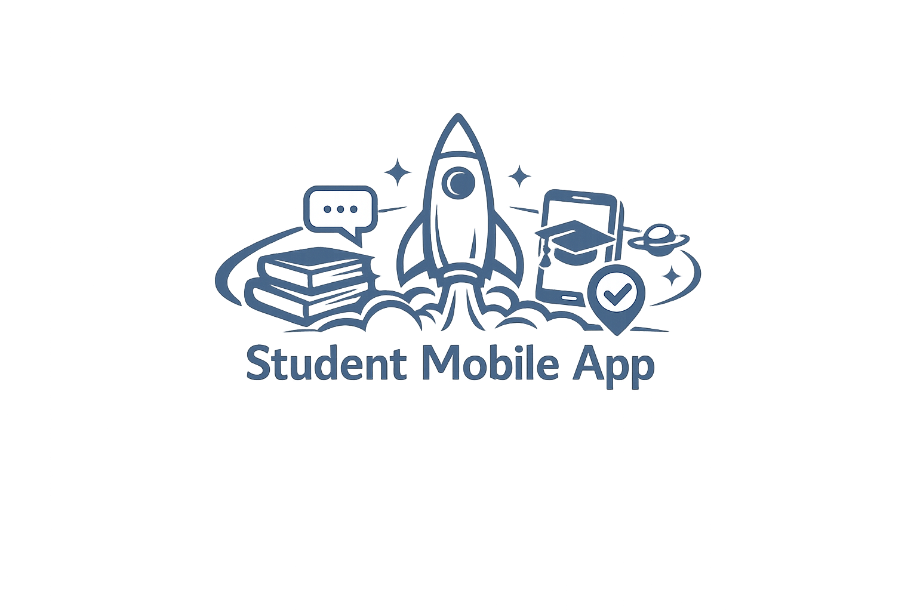

ApolloSRM MOBILE
Student Mission Control. Smart. Simple. Seamless.
The Future of Student Self-Service.
Student Mission Control in Every Pocket
Give students a single mobile home for schedule, communication, payments, attendance, and coursework. Less chaos, fewer lines at the front desk, cleaner data for staff.
What the Mobile App Delivers in Orbit
Schedule + Alerts: Live schedule with real-time changes, rooms, and push alerts.
Chat + Messaging: 1:1 and group chat with instructors and classmates.
Account + Holds: Balance, payment history, and key holds in one place.
In-App Payments: Pay tuition and fees securely (cards handled by a PCI processor).
Verified Attendance: Check in/out with timestamped verification (QR, location, device options).
Class Materials: Syllabi, files, links, and announcements organized by class.
Nudges + To-Dos: Personalized reminders so students stop forgetting paperwork.
Why Mobile + Verified Attendance Is Mission-Critical
Higher attendance compliance with timestamped proof, not guesswork.
Fewer front-office interruptions because students self-serve schedule, chat, and payments.
Faster collections with in-app payments and automated nudges.
Cleaner data for staff dashboards, audits, and funding reviews.
Ready for Launch?
Give every student mission control on day one with ApolloSRM Mobile.
Visit www.apollosrm.com to schedule a quick demo.
ApolloSRM-guiding your institution from launchpad to orbit, and beyond.

