Slide 1
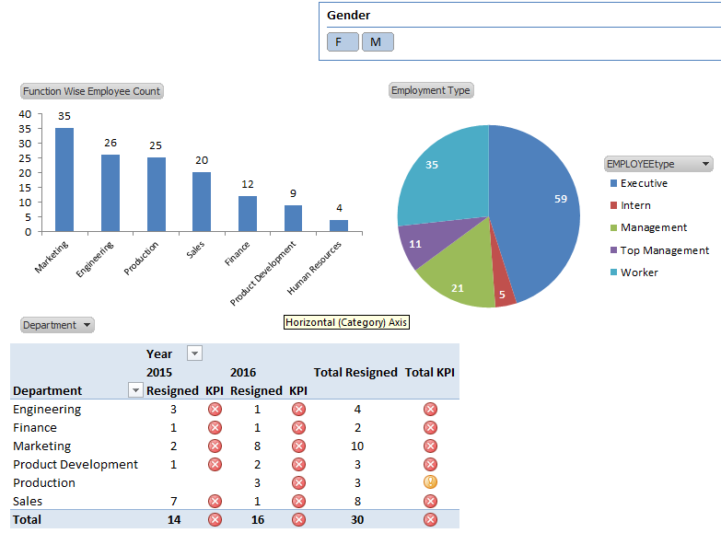
HR ANALYTICS
Department Wise Employee Count
Employment Type Wise Employee Count
<Gender Filter/Slicer for req. no. 1 & 2>
Year wise churn rate
Department wise year on year increase in manpower cost (salary+bonus+ovretime+commission)
Pie chart showing components of manpower cost (salary, bonus, overtime, commission)
<Year Filter/Slicer for req. no. 3, 4, & 5)
6. List of employees who are most likely to leave the copany

Slide 2
Requirements
Prepare data for Analysis (Use manual scripts or ETL Package)
Prepare Mining Model
Prepare Dashboard as per screen shot required (Add manpower cost component as well)
Run scripts/ETL job on fresh data
Display dashboard as per new data
<Max. time for steps 3&4 is 5 minutes>

