Slide 1


EASWARI ENGINEERING COLLEGE
Smart Classroom & Attendance Analytics Portal (Computer Vision)
Under the Guidance of Presented By
Ms. D S K Harshitha Sabarinathan . D (310624243149) Technical Trainer, AIADS

Slide 2
AGENDA
Scope of Review — Smart Classroom & Attendance Portal
Requirements (Functional & Non-Functional)
Detailed System Architecture
Use Case & ER Diagrams
Module Description & Tech Stack
UI Design, Frontend & Backend Build
Database & API Integration
AI Vision Engine (Face ID + Behavior Detection)
Progress, Screenshots & Challenges
Agenda
Review 1 & 2 | Smart Classroom & Attendance Analytics Portal

Slide 3
01
REQUIREMENTS
Functional & Non-Functional Requirements
Functional Requirements
Non-Functional Requirements
Secure login for Admin & Teacher roles
Manage classrooms & students (CRUD)
Mark attendance: present / absent / late
Log behavior: studying, sleeping, speaking, phone use, hand raise, distracted
Live AI camera: face-based presence & behavior detection
Attendance % & behavior summary per class
Security: JWT auth, bcrypt password hashing
Protected REST routes (Bearer token)
Usability: simple sidebar-based UI
Performance: camera status polled every 1.5 s
Reliability: embedded MongoDB fallback + seed data
Modularity: separate frontend, backend & AI engine
Requirements
Review 1 & 2 | Smart Classroom & Attendance Analytics Portal

Slide 4
02
ARCHITECTURE
System Architecture (Detailed)
CLIENT TIER
APPLICATION TIER
DATA TIER
React 18 + Vite, React Router,
Axios, plain CSS
⇄
Node.js + Express.js
REST API, JWT Auth, Vision proxy
⇄
MongoDB + Mongoose
5 collections & schemas
The React client (:5173) calls Express REST endpoints (:5000) with a JWT; Express reads and writes MongoDB and proxies camera control to the Python AI engine (:5001).
AI Engine (Python / Flask): MTCNN + FaceNet identifies students and YOLOv8 detects behavior; results are synced to Express through /api/attendance/manual and /api/behavior/manual.
Architecture
Review 1 & 2 | Smart Classroom & Attendance Analytics Portal

Slide 5
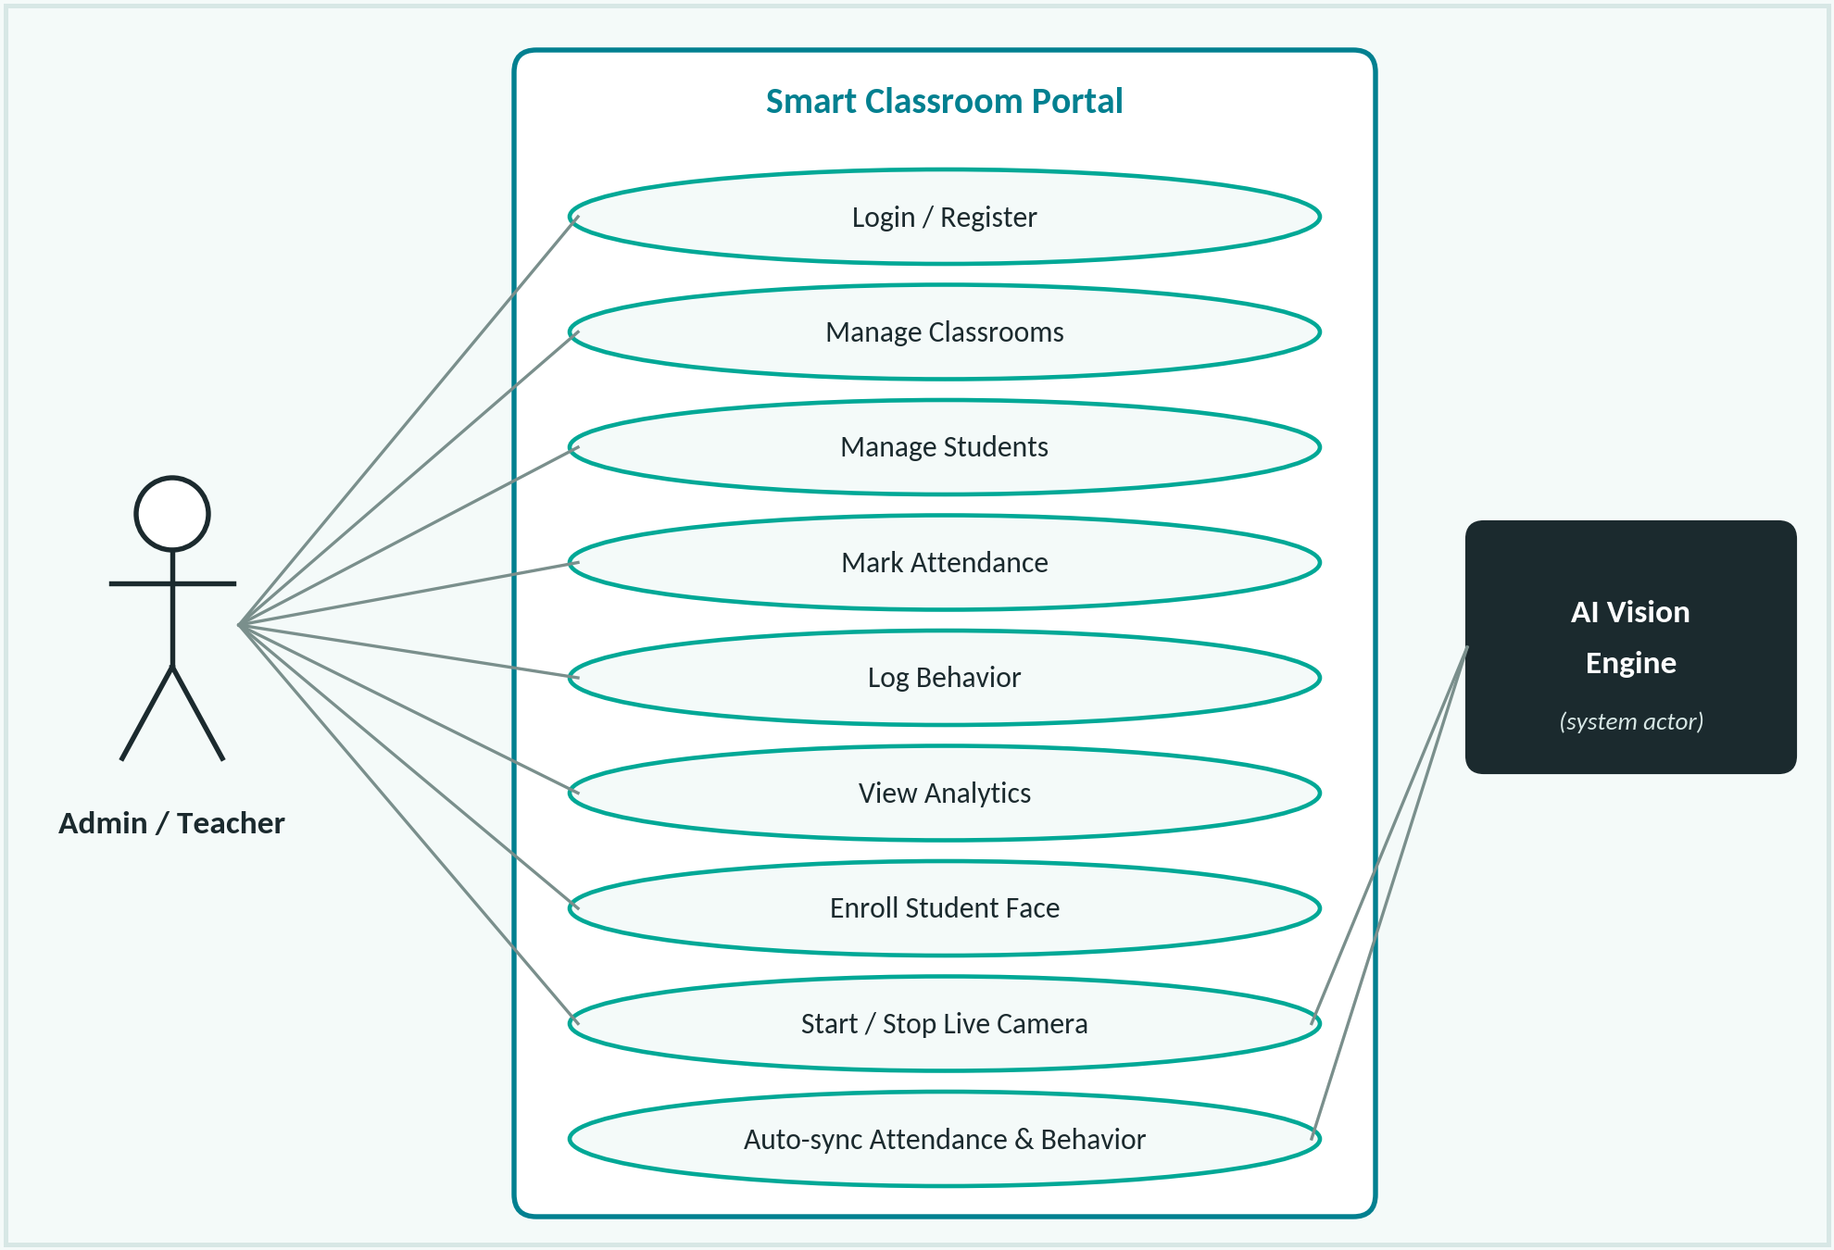
03
USE CASE
Use Case Diagram
Actors & Relationships
Admin / Teacher: manage data, mark attendance & behavior
AI Vision Engine: system actor that auto-syncs results
«include»: JWT login required for every use case
«extend»: live camera pre-fills attendance & behavior
Analytics: attendance % and behavior summary per class
Use Case
Review 1 & 2 | Smart Classroom & Attendance Analytics Portal

Slide 6
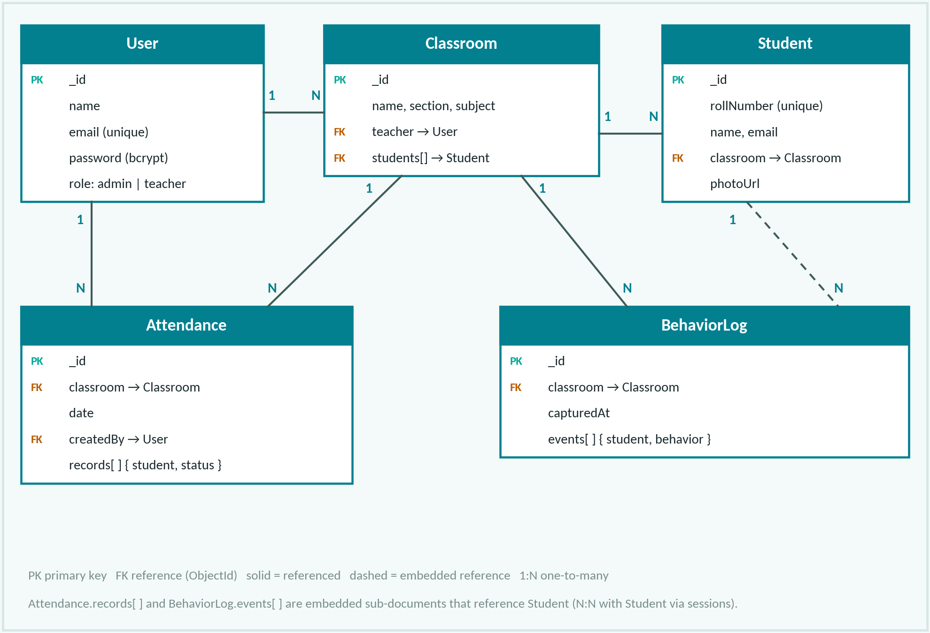
04
ER DIAGRAM
ER Diagram / Database Design
Design Notes
5 collections: User, Classroom, Student, Attendance, BehaviorLog
Primary key: MongoDB ObjectId (_id)
Foreign keys stored as ObjectId references
Records / events embedded in each session document
Unique: Student.rollNumber, User.email
Indexed on (classroom, date) and (classroom, capturedAt)
ER Diagram
Review 1 & 2 | Smart Classroom & Attendance Analytics Portal

Slide 7
05
MODULES
Module Description
Module | Description | Key Functions
User Management | Registration, login & role handling | Register, Login, JWT /me
Classroom & Student | Manage classes and enrolled students | Create, Edit, Delete, Filter
Attendance Module | Session-wise present / absent / late marking | Mark, History, Attendance %
Behavior Module | Per-session behavior logs & class summary | Log, Summary counts
AI Vision Module | Face identity + YOLOv8 behavior detection | Enroll, Live stream, Auto-sync
Modules
Review 1 & 2 | Smart Classroom & Attendance Analytics Portal

Slide 8
06
TECH STACK
Technology Stack
MongoDB
Express.js
React.js
Node.js
NoSQL Database
Backend Framework
Frontend Library
Runtime Environment
Supporting Tools
Mongoose (ODM) with mongodb-memory-server fallback
JWT & bcryptjs (auth / security)
Vite, React Router, Axios (frontend tooling)
Python: Flask, OpenCV, PyTorch
YOLOv8 (Ultralytics) + FaceNet (facenet-pytorch)
Git & GitHub, VS Code, npm
Tech Stack
Review 1 & 2 | Smart Classroom & Attendance Analytics Portal

Slide 9
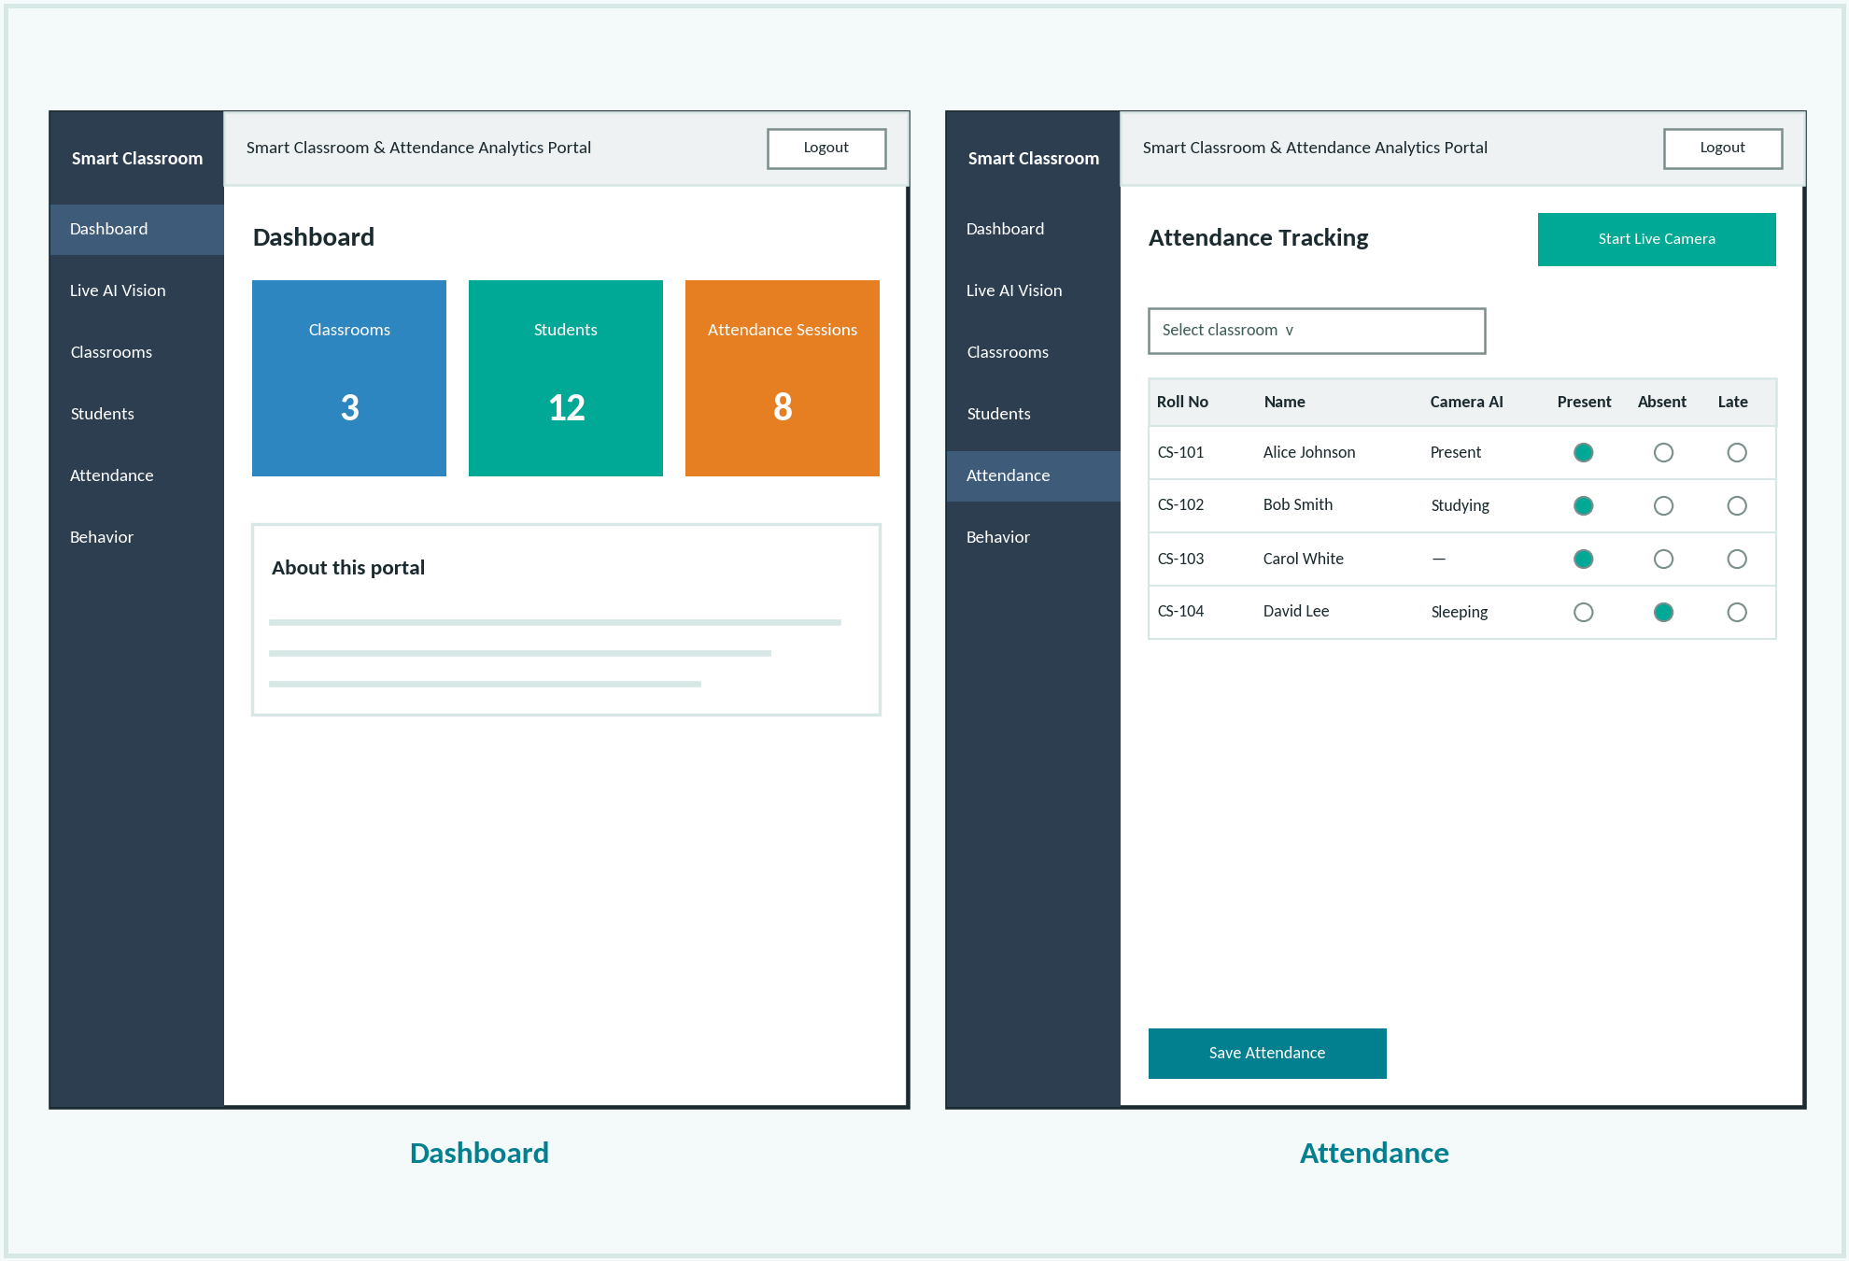
07
UI DESIGN
UI Design / Wireframes
Key Screens
Login: Sign In / Register tabs with demo access
Dashboard: classroom, student & session counts
Live AI Vision: camera feed & detections
Classrooms & Students: add / edit / delete
Attendance & Behavior: mark, log & summarize
Plain CSS, sidebar + top-navbar layout
UI Design
Review 1 & 2 | Smart Classroom & Attendance Analytics Portal

Slide 10
08
FRONTEND
Frontend Development
Built with React 18 + Vite using functional components & hooks
Pages: Login, Dashboard, Live AI Vision, Classrooms, Students, Attendance, Behavior
Shared layout: Sidebar and Navbar components
Auth state kept in App + localStorage; session cleared on a 401 response
React Router v6 routing; Axios instance with JWT request interceptor
Plain CSS styling (no UI library); Live AI page polls camera status every 1.5 s
Completed pages: Login, Dashboard, Classrooms, Students, Attendance, Behavior and Live AI Vision.
Frontend
Review 1 & 2 | Smart Classroom & Attendance Analytics Portal

Slide 11
09
BACKEND
Backend Development
Node.js + Express.js server with modular routes: auth, students, classrooms, attendance, behavior, vision
MVC pattern: routes → controllers → Mongoose models
protect middleware verifies the JWT Bearer token; adminOnly guard available
Centralized notFound & errorHandler middleware
Config via .env (PORT, MONGO_URI, JWT_SECRET, CLIENT_ORIGIN); CORS + morgan logging
/api/vision routes proxy camera control to the Flask AI server (:5001)
GET /api/health for status; demo admin, teacher, classroom & students are seeded on an empty database.
Backend
Review 1 & 2 | Smart Classroom & Attendance Analytics Portal

Slide 12
10
DATABASE
Database Integration
MongoDB (local, port 27017) accessed through Mongoose
Falls back to an embedded mongodb-memory-server when no database is reachable
Attendance & BehaviorLog embed per-student records / events; other links use ObjectId refs
Indexes on (classroom, date) and (classroom, capturedAt); unique rollNumber & email
Passwords hashed with bcrypt in a pre-save hook
Seed script loads demo users, a classroom and students on first run
Collections: Users, Classrooms, Students, Attendance, BehaviorLogs.
Database
Review 1 & 2 | Smart Classroom & Attendance Analytics Portal

Slide 13
11
API
API Development
Method | Endpoint | Description
POST | /api/auth/login | Authenticate & issue JWT
POST | /api/auth/register | Create an Admin / Teacher user
GET | /api/students?classroom= | List students of a classroom
POST | /api/attendance/manual | Save attendance for a session
GET | /api/attendance/analytics/:classroomId | Per-student attendance %
POST | /api/behavior/manual | Save behavior log for a session
GET | /api/behavior/summary/:classroomId | Per-student behavior counts
POST | /api/vision/start | stop | sync_now | Control the AI camera engine
API
Review 1 & 2 | Smart Classroom & Attendance Analytics Portal

Slide 14
12
STATUS
Module-wise Implementation Status
User Authentication
100%
Classroom & Student Management
100%
Attendance Module
90%
Behavior Module
85%
Live AI Vision Integration
70%
Dashboard Analytics
40%
Status
Review 1 & 2 | Smart Classroom & Attendance Analytics Portal

Slide 15
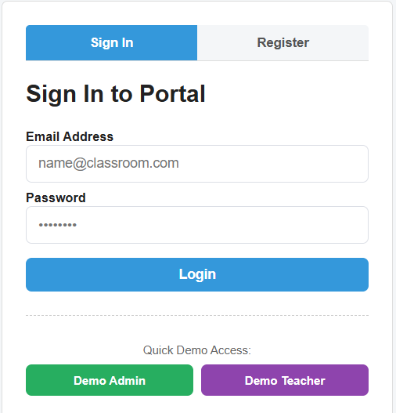
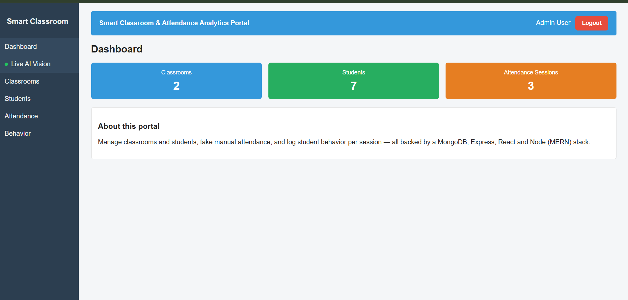
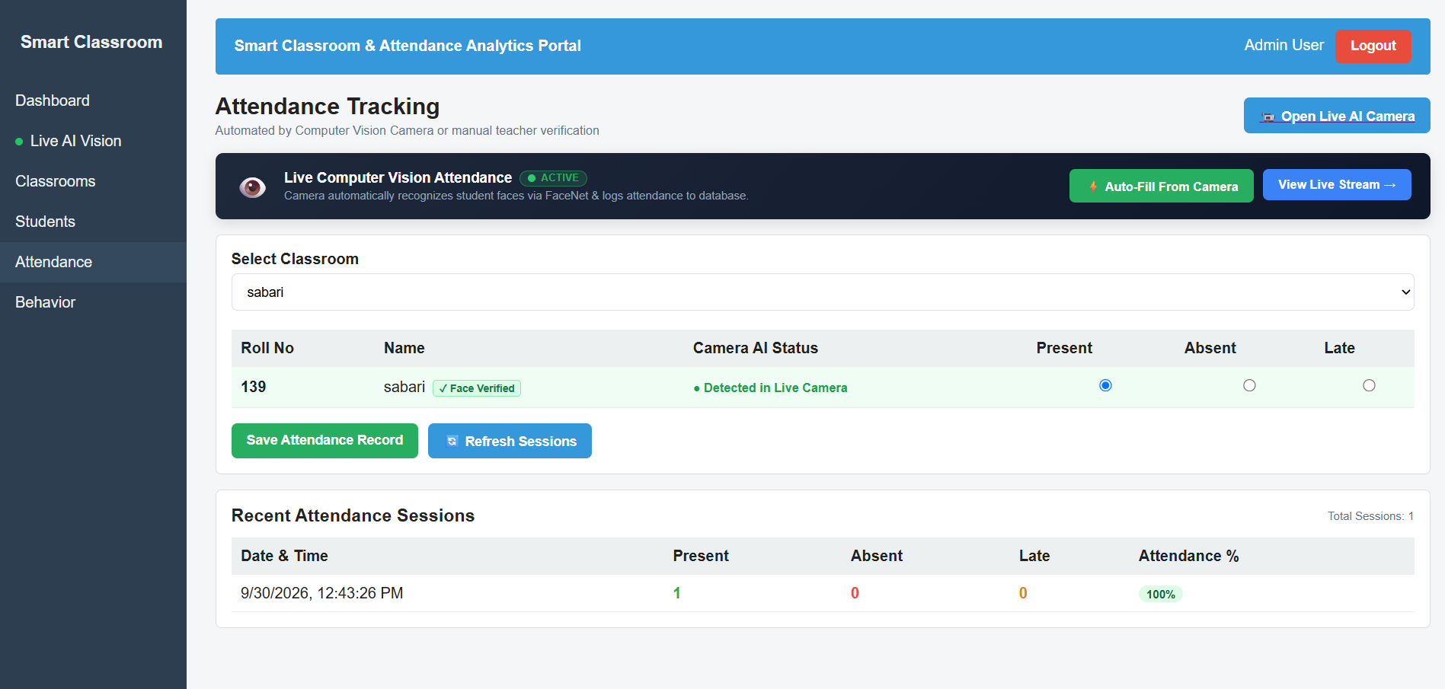
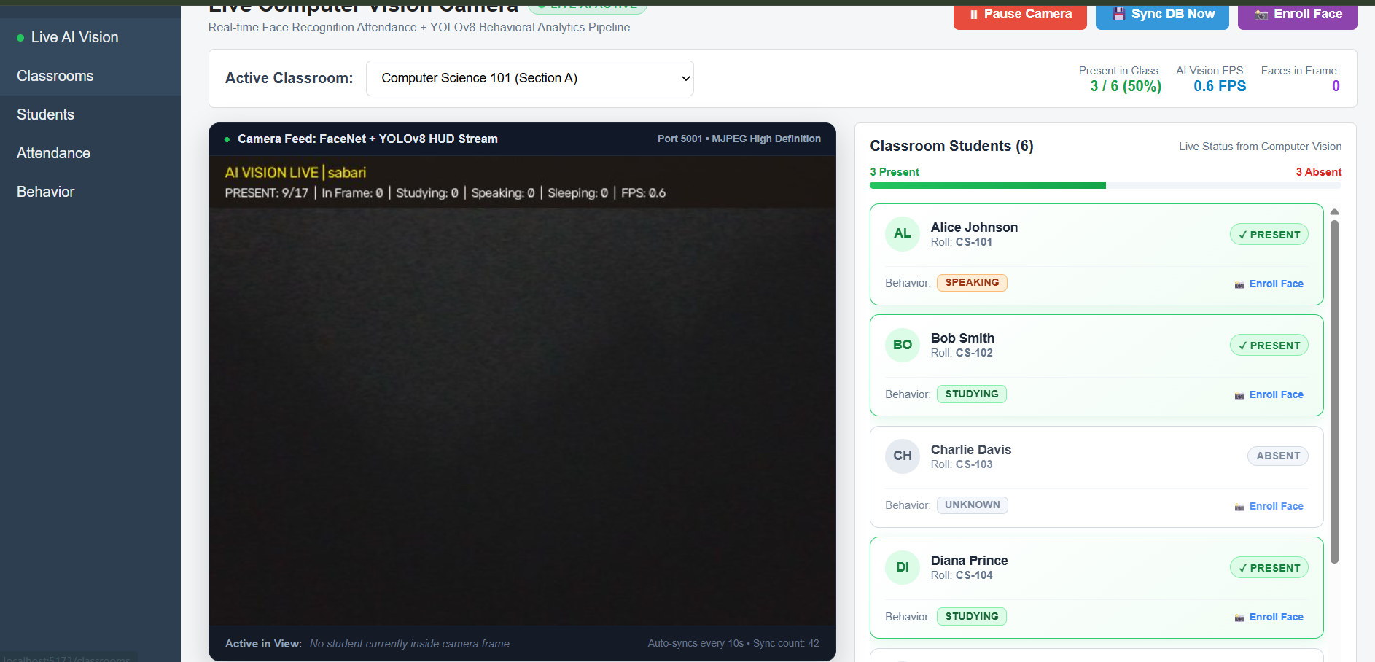
13
SCREENSHOTS
Screenshots
Login page: Sign In / Register with demo access
Dashboard: classroom, student and session counts
Attendance page: face-verified, camera auto-fill
Live AI Vision: FaceNet + YOLOv8 camera feed
Screenshots
Review 1 & 2 | Smart Classroom & Attendance Analytics Portal

Slide 16
14
CHALLENGES
Challenges Faced & Solutions
Challenge | Solution Adopted
Connecting a Python AI engine to the MERN stack | Flask vision server + Express /api/vision proxy; engine syncs via REST with JWT
Cross-origin calls between :5173, :5000 and :5001 | CORS middleware in Express; API base URL derived from the browser hostname
Expired or invalid JWT sessions | Axios 401 interceptor clears the token and logs the user out
Running without a local MongoDB install | Embedded mongodb-memory-server fallback with automatic seed data
Limited labeled classroom data for behavior model | SCB dataset + ICFD face samples; needs more data & epochs to improve accuracy
Challenges
Review 1 & 2 | Smart Classroom & Attendance Analytics Portal

Slide 17
15
NEXT STEPS
Remaining Work & Plan
Add attendance & behavior charts to the Dashboard
Add date-range filters, search & pagination for large student lists
Retrain the YOLOv8 behavior model on the full SCB dataset for higher accuracy
Add password reset & role management UI (enforce admin-only actions)
Integration & user-acceptance testing with real classroom video
Deploy (frontend, backend, MongoDB Atlas) and prepare final documentation & demo
Next Steps
Review 1 & 2 | Smart Classroom & Attendance Analytics Portal

Slide 18
16
REFERENCES
References
# | Reference
1 | MongoDB, Mongoose, Express, React, Node.js — official documentation
2 | Ultralytics YOLOv8 documentation; SCB-Dataset (Student Classroom Behavior)
3 | FaceNet (Schroff et al., 2015); facenet-pytorch (MTCNN + InceptionResnetV1, VGGFace2)
4 | Indian Classroom Face Dataset (ICFD) samples used for face enrollment & validation
References
Review 1 & 2 | Smart Classroom & Attendance Analytics Portal

Slide 19
THANK YOU

