Slide 1
DSC 530 Project Topic : Exploratory Data Analysis on bestsellers data Student Name : Abhishek Srivastava

Slide 2
AGENDA
Exploratory Data Analysis (EDA) is a crucial first step in understanding and gaining insights from datasets. When applied to bestsellers data, EDA can reveal fascinating trends in the publishing industry, reader preferences, and market dynamics. Using Python's powerful data analysis libraries such as pandas, matplotlib, and seaborn, we can dive deep into bestseller data to uncover patterns in book sales, author popularity, pricing strategies, and genre preferences over time.
This analysis typically involves:
1. Loading and cleaning the dataset
2. Examining basic statistics and distributions of key variables
3. Visualizing relationships between different features
4. Identifying trends and patterns in bestseller characteristics
5. Exploring correlations between factors like price, ratings, and sales
By conducting EDA on bestsellers data, we can gain valuable insights into what makes a book successful, how reader preferences evolve, and potentially predict future trends in the publishing industry. This process not only helps in understanding the current market but also provides a foundation for more advanced analyses and predictive modeling.

Slide 3
Variables
Amazon Best-Selling Books Dataset
Overview:
- Source: Amazon Top 50 Best-Selling Books (2009-2019)
- Total Variables: 7
Key Variables for Analysis:
1. Name: Book title
2. Author: Writer of the book
3. User Rating: Reader satisfaction score
4. Reviews: Number of reader reviews
5. Price: Cost of the book
Insights:
- Analyzes trends in book performance and relationships between pricing, ratings, and genre.

Slide 4
Description of variables
Variable Descriptions
- Name: The title of the best-selling book (Object datatype)
- User Rating: User-provided rating (Float datatype)
- Reviews: Total number of user reviews (Integer datatype)
- Price: Cost of the book (Integer datatype)
- Year: The year the book became a best-seller (Integer datatype)
- Genre: Category of the book (Object datatype)

Slide 5
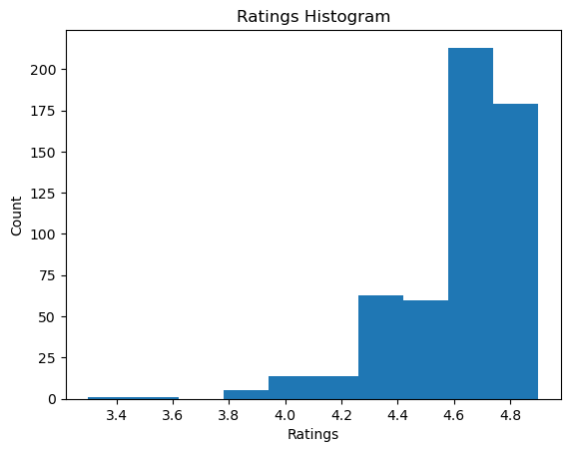
Histograms - ratings

Slide 6
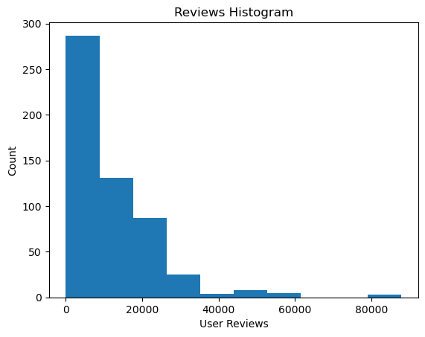
Histograms - reviews

Slide 7
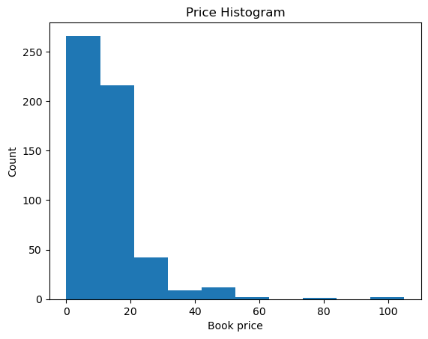
Histograms - price

Slide 8
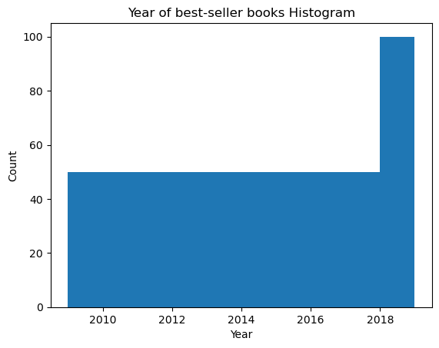
Histograms -year

Slide 9
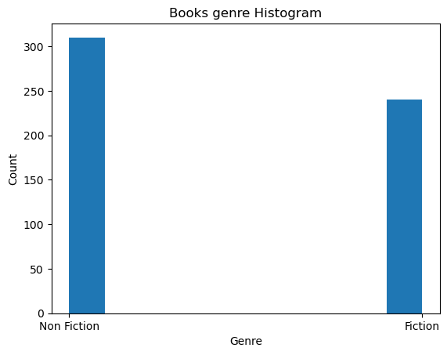
Histograms - genre

Slide 10
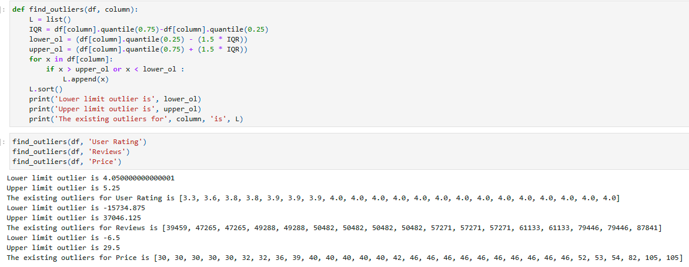
Find Outliers

Slide 11
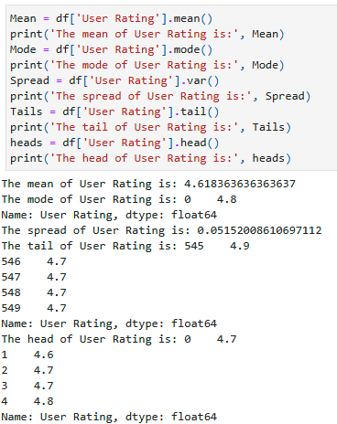
Analyze Descriptive characteristics User ratings

Slide 12
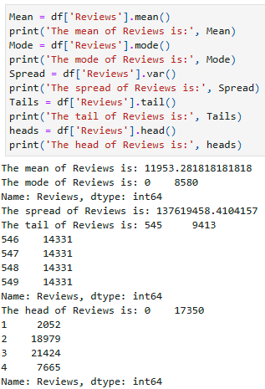
Analyze Descriptive characteristics Reviews

Slide 13
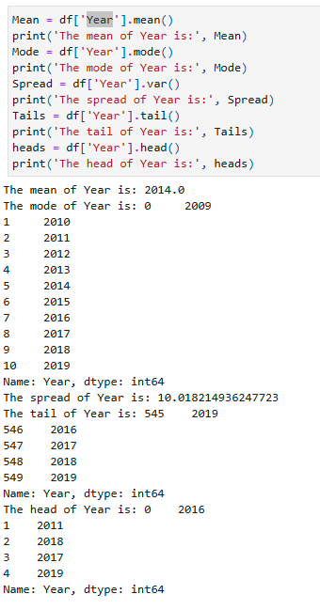
Analyze Descriptive characteristics Year

Slide 14
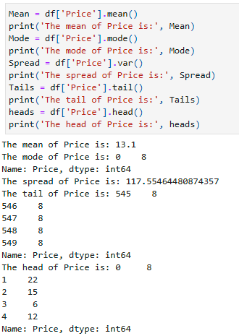
Analyze Descriptive characteristics Price

Slide 15
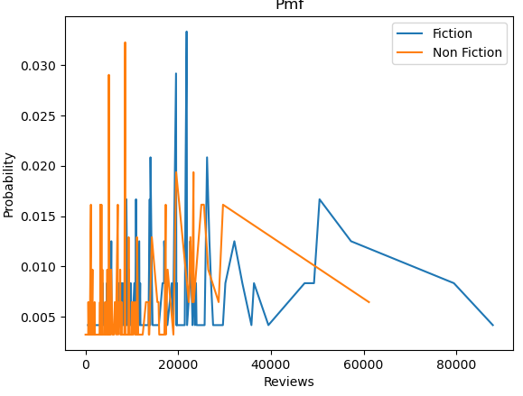
Plotting Probability Mass Function(PMF)
Key Findings:
- Fiction Books:
- Highest probability of reviews: 20,000 - 30,000
- Peak at approximately 25,000 reviews
- Non-Fiction Books:
- Highest probability of reviews: Around 10,000
Comparison:
- Fiction books show slightly higher probability of reviews than non-fiction
Visualization:
- Plot shows Probability Mass Functions of 'Reviews' by genre
- X-axis: Number of reviews
- Y-axis: Probability
- Each line represents a different genre
Insight:
Reveals distribution patterns of reviews across genres, indicating potential differences in reader engagement between fiction and non-fiction books.

Slide 16
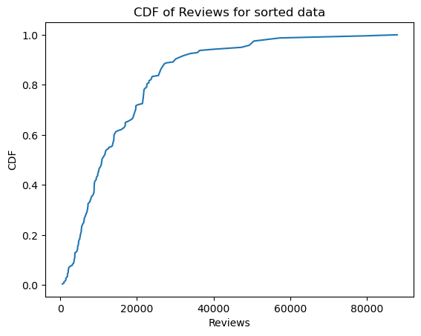
Plotting Cumulative Distribution Function(CDF)

Slide 17
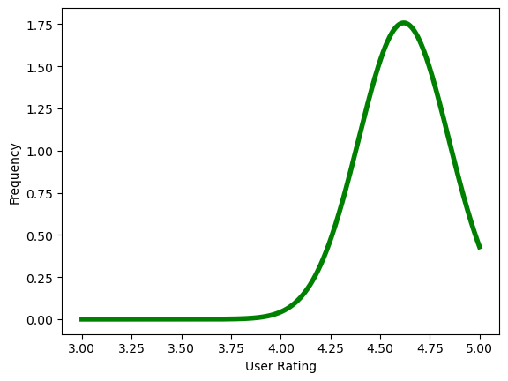
Normal or Gaussian Distribution
The distribution of user rating is almost a bell-shaped curve, so this follows gaussian distribution.

Slide 18
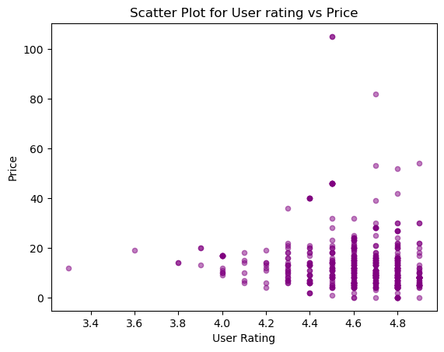
Scatter plots

Slide 19
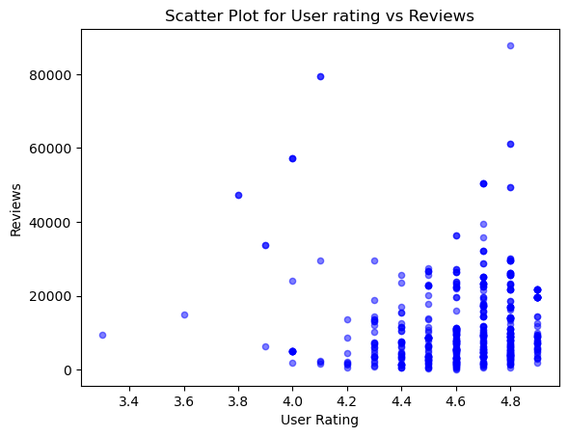
Scatter plots
Key Insights from Scatter Plot Analysis
1. Price vs Reviews:
- Most reviews concentrate on lower-priced books
- Significant cluster below $40
2. User Ratings vs Reviews:
- Highly-rated books tend to receive more reviews
- No strong correlation observed
3. User Ratings vs Price:
- No strong correlation evident
Conclusion:
- Visual analysis reveals complex relationships between variables
- Price, ratings, and review count interact in nuanced ways
- Further statistical analysis recommended to quantify relationships

Slide 20

Correlation
Pearson's correlation coefficient always falls within the range of -1 to 1, inclusive. A positive correlation (indicated by a positive value) suggests that as one variable increases, the other tends to increase as well. Conversely, a negative correlation (indicated by a negative value) implies that as one variable increases, the other tends to decrease. In this case, the correlation value between rating and price is negative. This indicates a weak inverse relationship, meaning that as one variable increases, the other tends to decrease slightly, but the relationship is not strong. There is no perfect correlation observed here, as a perfect correlation would be exactly -1 or 1. This weak negative correlation further supports the conclusion that there isn't a strong relationship between a book's rating and its price.

Slide 21

SpearmanCorr
The Spearman's correlation coefficient shows a slightly lower value compared to Pearson's correlation in this case. This difference is noteworthy because Spearman's correlation is often considered more robust when dealing with non-linear relationships or data that doesn't follow a normal distribution. Pearson's correlation can be sensitive to outliers and skewed distributions, potentially leading to misleading results in either direction. In contrast, Spearman's rank correlation is less affected by these factors, as it focuses on the ranked order of the data rather than the actual values. Given these characteristics, the Spearman's correlation might provide a more reliable measure of the relationship between the variables in this dataset, especially if the data contains outliers or is not normally distributed.

Slide 22
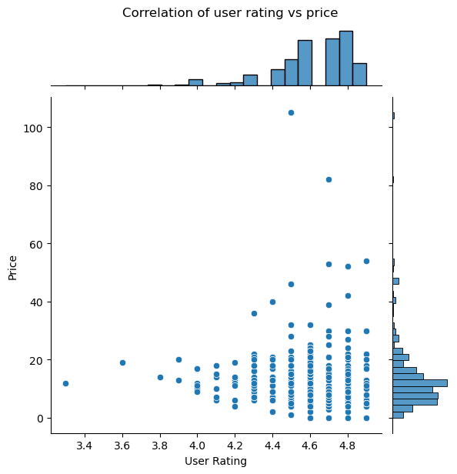
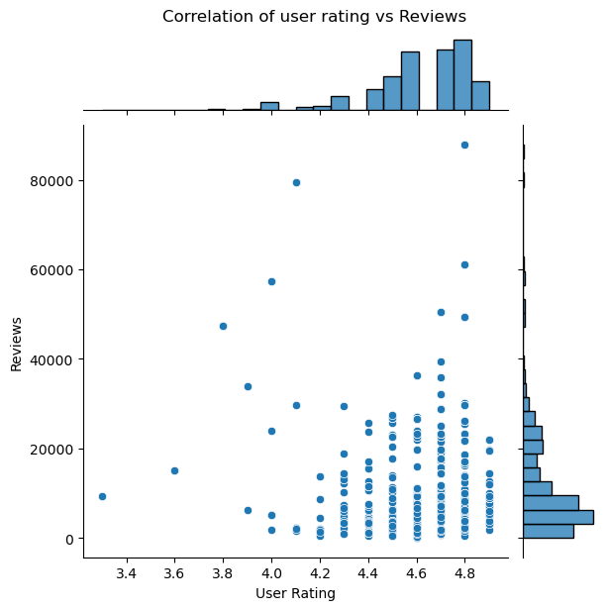
Plotting Correlations
By looking at the plot the relation in both the cases is very weak.

Slide 23
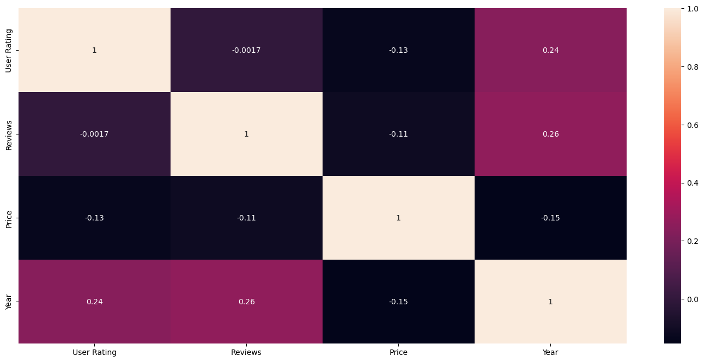
Heatmap

Slide 24

Hypothesis testing
Hypothesis Test: User Rating vs Price
Test Used: Paired t-test
Result:
p-value = 1.0274904064983002e-58
1. Extremely Low p-value:
- Far below conventional significance level (0.05)
2. Strong Statistical Significance:
- Reject null hypothesis
- Significant difference between User Rating and Price
3. Relationship Implication:
- Strong evidence of a relationship between User Rating and Price
- Nature of relationship not specified by this test
4. Practical Significance:
- Consider effect size and business context
- Statistical significance ≠ Practical importance
Next Steps:
- Investigate nature and direction of relationship
- Consider additional analyses (e.g., correlation, regression)

Slide 25
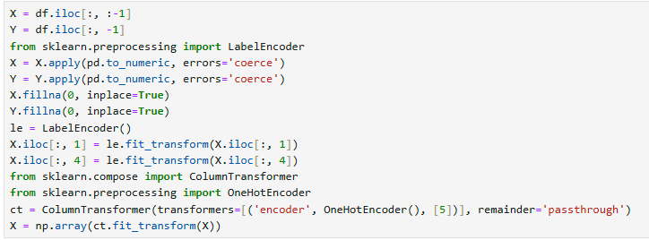
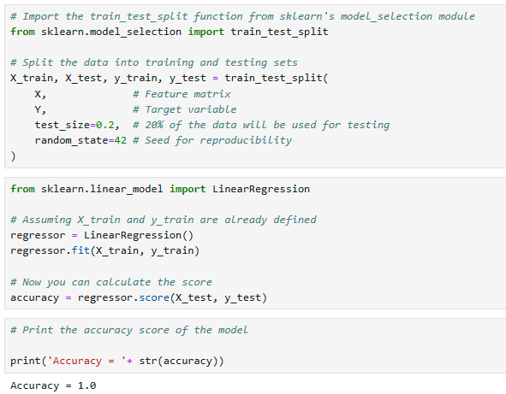
Multiple linear regression
Multiple Regression Analysis
Key Points:
1. Purpose:
- Comprehensive examination of relationships between variables
2. Model Performance:
- Measured by accuracy score (0 to 1)
- 1.0 = Perfect fit (explains all variability)
3. Interpretation:
- Perfect accuracy (1.0) is rare in real-world scenarios
- High accuracy may suggest overfitting
4. Best Practice:
- Interpret accuracy cautiously
- Use multiple performance metrics
- Ensure model reliability and generalizability
Conclusion:
Balance high accuracy with model robustness for reliable insights

