Slide 1
Rockbuster Stealth
Samira Stragiotti

Slide 2
Key Questions and Objectives
The Rockbuster Stealth Management Board has asked a series of business questions and they expect data-driven answers that they can use for their 2020 company strategy. Here are the main questions they’d like to answer:
Which movies contributed the most/least to revenue gain?
What was the average rental duration for all videos?
Which countries are Rockbuster customers based in?
Where are customers with a high lifetime value based?
Do sales figures vary between geographic regions?

Slide 3
Data Overview
 | AVG | MIN | MAX
Rental duration | 5 days | 3 days | 7 days
Rental rate | $2.98 | $0.99 | $4.99
Film length | 115.272 min | 46 min | 185 min
Replacement cost | $19.984 | $9.99 | $29.99
Total films | 1000

Slide 4
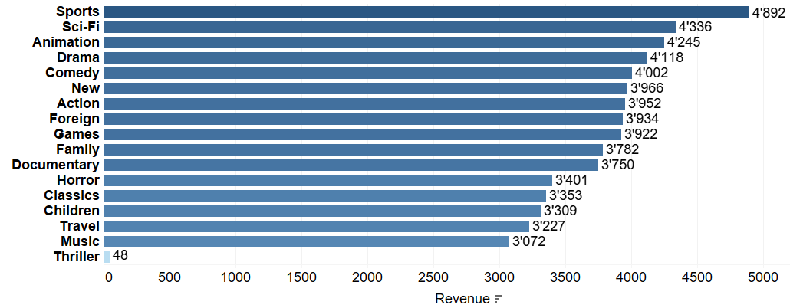
Revenue per category
Sports, Sci-Fi and Animation are the top 3 categories.
Travel, Music and especially Thriller are the 3 categories with the lowest revenue.

Slide 5

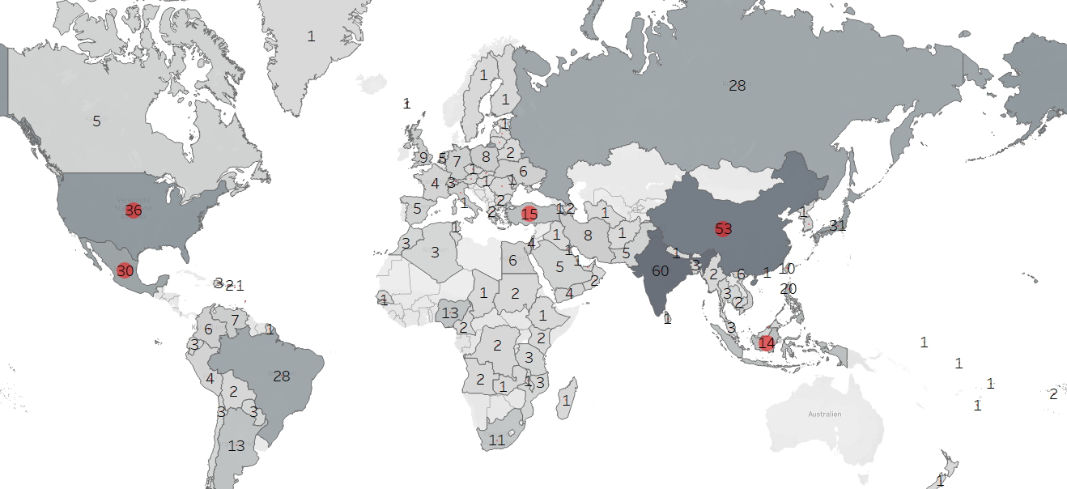
Which countries are Rockbuster customers based in?
There are also countries with no customers at all, for example the whole continent of Australia.
The top 5 countries with the most customers are India (60), China (53), United States (35), Japan (31) and Mexico (30).
= top 5 customers with a high lifetime value based
5

Slide 6

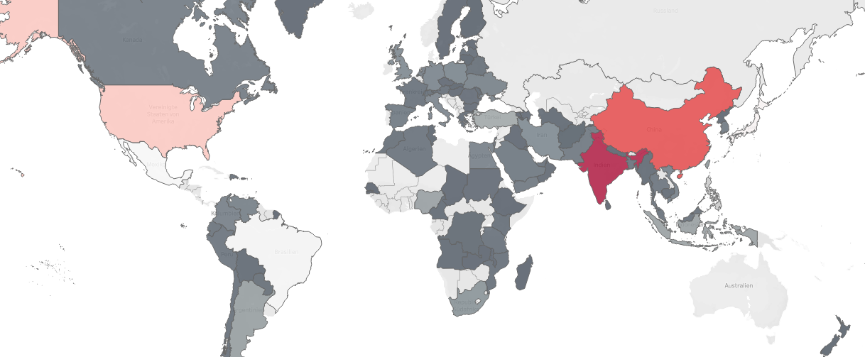
Do sales figures vary between geographic regions?
There is clearly a strong correlation between the countries and their revenues.
For example, we see that revenues are highest in India and China.

Slide 7
Summary
1 - Which movies contributed the most/least t revenue gain?
Sports, Sci-Fi and Animation are the top 3 categories. Travel, Music and especially Thriller are the 3 categories with the lowest revenue.
2 - What was the average rental duration for
all videos?
5 days
3 - Which countries are Rockbuster customers based in?
The top 5 countries with the most customers are India (60), China (53), United States (36), Japan (31) and Mexico (30).
4 - Where are customers with a high lifetime value based?
The top 5 customers with a high lifetime value are based in the United States, Mexico, Turkey, China and Indonesia.
5 - Do sales figures vary between geographic regions?
There is clearly a strong correlation between the countries and their revenues.

Slide 8
Next steps
Since the categories Sports, Sci-Fi and Animation are the 3 most important categories it is recommended to focus mainly on them and less on Travel, Music and especially Thriller because those are the 3 categories with the lowest revenues.
Focus on countries with the most customers such as India, China, the United States, Japan and Mexico, and also Turkey and Indonesia, as the top 5 customers with a high lifetime value are based there.
Based on the sales figures, it also makes sense to invest further in China, India and the United States.

Slide 9
Questions?
example@example.com
Tableau Link

