Slide 1


PKM Educational Trust ®
R. R. Institute of Technology
Affiliated to VTU Belgaum and Approved by AICTE, New Delhi ,Recognized by Govt. of Karnataka
Accredited by NAAC with ‘A+’
Raja Reddy Layout, Chikkabanavara, Bengaluru – 560090
Technical Seminar
on
Evaluation and technological solutions for a dynamic, unified cloud programming development environment
Presented by
DIPU KUMAR SAH
(1RI20CS062)
Guide:
Prof. Niranjan R Chougala
Professor
Dept. of CSE, RRIT

Slide 2
CONTENTS
INTRODUCTION
OBJECTIVE
LITERATURE REVIEW
PROBLEM STATEMENT
METHODOLOGY
RESULT
CONCLUSION
REFERENCES

Slide 3
introduction
Collaborative Nature and Academic Impact:
Facilitates seamless code sharing between teachers and students, ensuring consistency and enhancing student efficiency through task-specific templates.
Simplified Learning Experience:
Eliminates setup complexities, offering shared configurations and templates for a standardized learning experience, allowing students to focus on coding principles.
Industry Relevance and Collaborative Efficiency:
Aligns with industry demands for efficient, collaborative, and standardized coding practices, streamlining projects with shared configurations and templates.

Slide 4
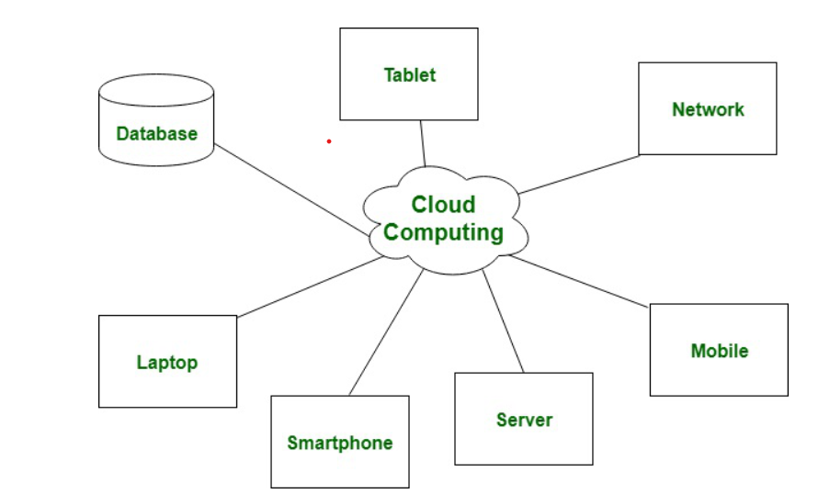
Fig: - cloud environment

Slide 5
OBJECTIVE
Enable Seamless Code Sharing:
Teachers can effortlessly share code and project settings within Cloud Programming Environments, fostering collaboration and active engagement between educators and students.
Streamline Project Initiation with Templates:
Showcase the simplicity of template creation for coding projects, ensuring a standardized and efficient approach to project initiation, saving time and promoting consistency.
Industry-Friendly Features for Easy Transition:
Highlight features tailored for industry use, demonstrating how Cloud Programming Environments prepare students for professional coding practices, ensuring a smooth transition from academia to the industry.

Slide 6
LITERATURE REVIEW
YEAR | AUTHOR | TITLE | PROBLEM | METHODOLOGY | OUTCOME
2023 | Prakrati Kaloni, Jageshwar Ray, Gotte Ranjith Kumar , Shravan Kumar , Anita Gehlot, Meera Sharma | Environment Management and Protection Integrated With Cloud Computing And Artificial Intelligence | The escalating impacts of advanced living standards on the environment pose significant challenges to sustainability and conservation. Environmental degradation due to human activities necessitates urgent intervention to mitigate the adverse effects and protect the planet. | Using an observational approach, the study explores the impacts on environmental sustainability, emphasizing the potential of AI and cloud computing in finding solutions. | The research underscores the significant role of AI and cloud computing in addressing environmental challenges, providing a viable path for sustainable resource management and a healthier environment.
2022 | Yue Jia | Modern Art Design Knowledge Teaching System Based on Cloud Computing Environment | Challenges in adapting traditional education to modern concepts drive the need for innovative teaching solutions. | Utilizing cloud computing and .NET, the study constructs a Modern Art Design Knowledge Teaching System, emphasizing security and rights management. | Results indicate substantial satisfaction, highlighting the system's potential, with identified areas for improvement providing valuable insights for future development.
2022 | Prabir Bhattacharya; Minzhe Guo; Lixin Tao; Bin Wu; Kai Qian; E. Kent Palmer | A Cloud-based Cyberlearning Environment for Introductory Computing Programming Education | Meeting the demands of cyber-education requires effective solutions. | This paper proposes a cloud-based cyberlearning environment designed for interactive and personalized learning in introductory programming courses. | The ongoing work aims to foster collaborative and personalized learning experiences in computer science by leveraging the potential of cloud computing, contributing to more engaging introductory programming education.

Slide 7
LITERATURE REVIEW
YEAR | AUTHOR | TITLE | PROBLEM | METHODOLOGY | OUTCOME
2022 | Xiaoxue Duan | Data Mining Algorithm Based on Cloud Computing in Course Teaching Service Platform | Traditional course teaching systems face optimization challenges, prompting exploration of cloud computing's vast potential when combined with data mining algorithms. | The study establishes an application framework for cloud mining in a network teaching platform, develops tools, and conducts performance tests, achieving response speeds below 0.3 seconds. | Experimental results demonstrate normal performance, validating the effectiveness of the course teaching service platform based on data cloud mining. The article concludes with insights into applying data mining cloud technology to an English grammar-guided learning platform.
2022 | Xinjun Li, Libin Zheng, Bingnan Liu, Yan Zhen, Wenbin Chen, Ganghong Zhang | A CloudBased Development Platform for Distribution Power Internet of Things | Developing efficient software for distribution power IoT poses challenges. | This paper proposes a cloud-based platform for software and hardware application and simulation in power IoT. It integrates development, simulation, and release, managing the entire application development cycle. | The implemented cloud platform streamlines user and authority management, development environments, simulation setups, and release processes. It proves effective in swiftly deploying and maintaining software and hardware in the power field.

Slide 8
PROBLEM STATEMENT
Currently, cloud integrated development system are more towards storage and portability. To make this system useful for teaching friendly like sharing code and creating templates and also better way of participation.
EXISTING SYSTEM
Limited Collaborative Capabilities
Outdated Development Practices
Inefficient Monitoring and Control for Educators
Inadequate Configuration Sharing
Absence of Template Creation Features
Limited Use of Containerization

Slide 9
PORPOSED SYSTEM
Cloud-Centric Development
Enhanced Teacher Monitoring
Comprehensive Sharing Mechanisms
Template Creation by Teachers
Containerization Implementation
Centralized Access
Increased Portability

Slide 10
METHODOLOGY
VPS Setup:
Utilize a Virtual Private Server (VPS) like Ubuntu to securely host applications. Employ HAProxy for efficient HTTP request handling.
HAProxy Load Balancer:
Implement HAProxy as a high-performance load balancer and reverse proxy, ensuring optimal application delivery and server availability.
Docker Containerization:
Leverage Docker for open-source containerization, enabling easy packaging, deployment, and management of applications. Use docker file and docker-compose for efficient container configuration and management.
NodeJS Web Server:
Build web applications using NodeJS, a JavaScript-based runtime environment. Employ a user-friendly web interface for secure student access to virtual environments.

Slide 11
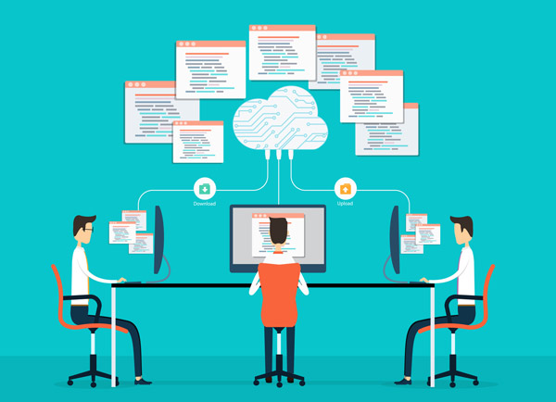
Fig: - student working on cloud programming development environment

Slide 12
RESULT
Enhanced Collaboration Through Cloud-Centric Approach:
The implementation of the Cloud Programming Development Environment has markedly improved collaborative efforts among developers. The cloud-centric approach allows real-time collaboration, enabling multiple users to seamlessly work on shared projects concurrently.
Consistent and Reproducible Development Environments with Docker:
Docker containerization has played a pivotal role in ensuring consistent and reproducible development environments. This integration has mitigated compatibility issues and streamlined coding efforts within the development team.
Efficient Runtime Environment with NodeJS Integration:
The incorporation of NodeJS has proven instrumental in providing a fast and efficient runtime environment, contributing to the expeditious development of applications. Educators benefit from enhanced monitoring capabilities, centralized access to student progress, and features like template creation for coding exercises.

Slide 13
CONCLUSION
Innovative Shift in Software Development:
The Cloud Programming Development Environment has transformed traditional software development by seamlessly integrating VPS, Docker, and NodeJS. This innovation addresses collaboration, efficiency, and scalability challenges, marking a new era of collaborative and efficient development.
Revolutionizing Collaboration Globally:
Adopting a cloud-centric paradigm, the environment redefines collaborative coding, enabling real-time teamwork and contributions globally. Docker ensures reproducible development environments, while NodeJS accelerates coding efficiency.
Educational Advancements and Resource Optimization:
Educators benefit from advanced monitoring and centralized access. Features like template creation and seamless code sharing foster collaboration. Integration of Docker and VPS reduces operational costs and empowers agile development for scalable applications.

Slide 14
REFERENCES
Yue Jia “ Modern Art Design Knowledge Teaching System Based on Cloud Computing Environment
Prakrati Kaloni, Jageshwar Ray, Gotte Ranjith Kumar , Shravan Kumar , Anita Gehlot, Meera Sharma “ Environment Management And Protection Integrated With Cloud Computing And Artificial Intelligence “
Xiaoxue Duan “ Data Mining Algorithm Based on Cloud Computing in Course Teaching Service Platform ”
Xinjun Li, Libin Zheng, Bingnan Liu, Yan Zhen, Wenbin Chen, Ganghong Zhang “ A Cloud-Based Development Platform for Distribution Power Internet of Things ”
Mónika Rajcsányi Molnár. Anetta Bacsa Bán. (2022). Towards Digitalisation Student Experiences in Online Education at a Higher Education Institution,
Elod Gogh, Reka Racsko, Attila Kovari (2023). Experience of SelfEfficacy Learning among Vocational Secondary School Students,
Kinary, Jangla. (2018). Accelerating Development Velocity Using Docker: Docker Across Microservices

Slide 15
THANK YOU

