Slide 1
About:-
Delivery Methods
Instructor-Led
Live Online
Onsite
Course Overview
The hands-on training course explores Basics and Application of docker. The course consist docker basic, docker Container and docker images. The training is meant to make engineers capable of extending the docker devops ecosystem.
Course Duration
5-Days
20% Lecture/80% Lab
Target Audience
Devops engineers
Course Objective
At the end of course you should gain an understanding of the docker in large scale production environment and ability to do
Docker ecosystem Management
Extend docker devops
Prerequisite
Basic English + Logical Reasoning
Prepared By:
dwaipayan.saha@synectiks.com

Slide 2
Introduction to Docker
What is Docker?
Docker vs. Virtual Machine
History, Status, Run Platforms
Hello World
Images and Containers
Volume Mounting, Port Publishing, Linking
Dcoker File & Docker Compose
Dcoker Volume
Dcoker Networking
Building a 2 tyre appln
Around Docker, Docker Use Cases
Hands-On Workshop.

Slide 3
What is Docker?
Docker is an open-source project that automates the deployment of applications inside software containers, by providing an additional layer of abstraction and automation of operating system–level virtualization on Linux.
[Source: en.wikipedia.org]

Slide 4
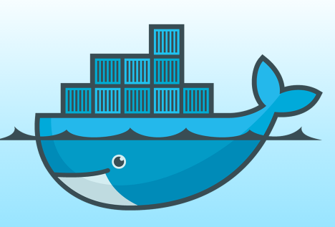
What is the meaning?
Docker: Name
docker [naut.]: der Dockarbeiter, der Hafenarbeiter
Source: leo.org
Provide a uniformed wrapper around a software package: «Build, Ship and Run Any App, Anywhere» [www.docker.com]
Similar to shipping containers: The container is always the same, regardless of the contents and thus fits on all trucks, cranes, ships, ...
Docker - Name
[www.docker.com]

Slide 5
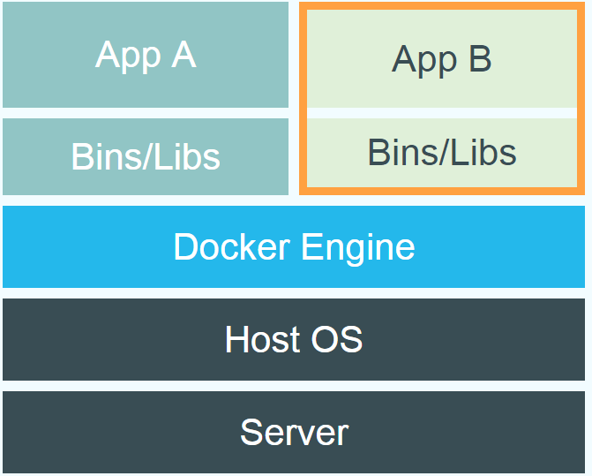
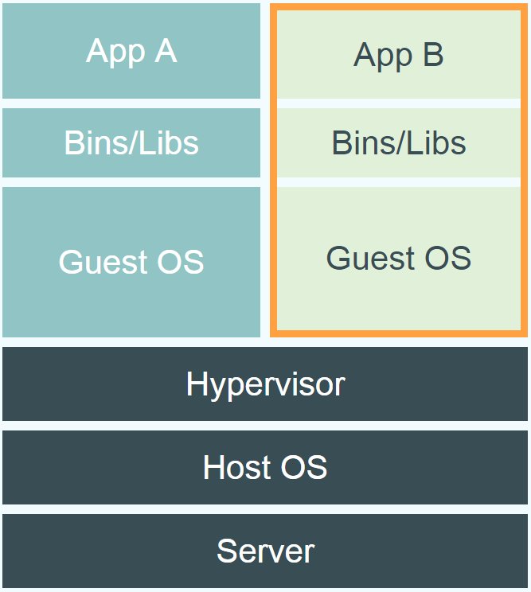
Comparison Between Docker & VM’s.
Docker vs. Virtual Machine
Source: https://www.docker.com/whatisdocker/

Slide 6
Explanation:-
Virtual Machines:-
Each virtualized application includes not only the application - which may be only 10s of MB - and the necessary binaries and libraries, but also an entire guest operating system - which may weigh 10s of GB.
Docker:-
The Docker Engine container comprises just the application and its dependencies. It runs as an isolated process in userspace on the host operating system, sharing the kernel with other containers. Thus, it enjoys the resource isolation and allocation benefits of VMs but is much more portable and efficient.
Docker provides base images that contain OS installations we can start from: The OS is not more than an application running on the Kernel...

Slide 7
Terminology - Image
Persisted snapshot that can be run
images: List all local images
run: Create a container from an image and execute a command in it
tag: Tag an image
pull: Download image from repository
rmi: Delete a local image
This will also remove intermediate images if no longer used

Slide 8
Terminology - Container
Runnable instance of an image
ps: List all running containers
ps –a: List all containers (incl. stopped)
top: Display processes of a container
start: Start a stopped container
stop: Stop a running container
pause: Pause all processes within a container
rm: Delete a container
commit: Create an image from a container

Slide 9
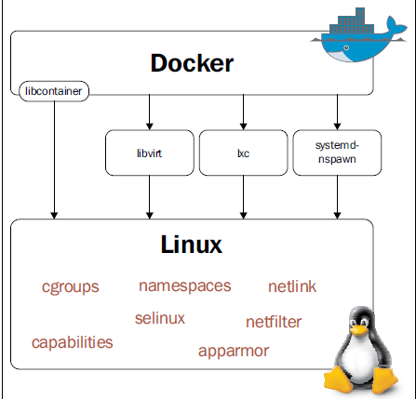
Architecture

Slide 10
INSTALL - SETUP
Prerequisite:-
64 bit , > Kernel 3.8 ,
Storage backend - VFS, DeviceMapper, AUFS, Btrfs, and OverlayFS.
Support for cgroups & namespaces in kernel
Checklist –
$ uname -i
x86_64
$ uname -r
3.18.7-200.fc21.x86_64
(Optional):-
$ grep device-mapper /proc/devices
253 device-mapper
$ grep -i namespaces /boot/config-3.18.7-200.fc21.x86_64 CONFIG_NAMESPACES=y
$ grep -i cgroups /boot/config-3.18.7-200.fc21.x86_64
CONFIG_CGROUPS=y

Slide 11
INSTALL - SETUP
Install on centos 7 –
Install Docker using yum:
$ yum -y install docker
How it works...
The preceding command will install Docker and all the packages required by it.
The default Docker daemon configuration file is located at /etc/sysconfig/docker, which is used while starting the daemon.
To start the service:
$ systemctl start docker
To verify the installation:
$ docker info
To update the package:
$ yum -y update docker
To enable the service start at boot time:
$ systemctl enable docker
To stop the service:
$ systemctl stop docker

Slide 12
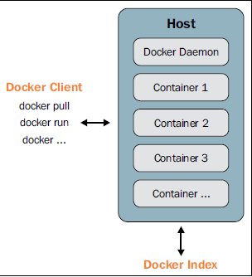
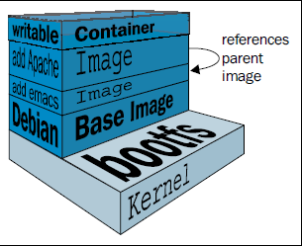
PULL & RUN
Docker pull HelloWorld //pull an image fro docker.io
Docker images // list images
Docker run –id –name HelloWorld bash //create container with pulled images
Docker ps //list containers
Docker ps –a –q //list all exited containers
How they work ?

Slide 13
Basic Commands
$ docker version //check version
docker search TERM // list search in registry
$ docker search ubuntu or ubuntu:latest. -> Docker Daemon Searches for image name <ubuntu:latest> form dockerhub.com public repo.
$ docker pull NAME[:TAG] // pull a image
Eg:- docker pull ubuntu:latest
docker pull centos:centos7
$ docker images -> Shows list of images pulled.
$ docker run [ OPTIONS ] IMAGE[:TAG] [COMMAND] [ARG...] //start a docker
Eg:-docker run -i -t --name=myubuntu ubuntu:latest /bin/bash
The -i option starts the container in the interactive mode
The -t option allocates a pseudo-tty and attaches it to the standard input
Under the hood, Docker:
Will merge all the layers that make that image using UnionFS.
Allocates a unique ID to a container, which is referred to as Container ID.
Allocates a filesystem and mounts a read/write layer for the container. Any changes on this layer will be temporary and will be discarded if they are not committed.
Allocates a network/bridge interface.
Assigns an IP address to the container.
Executes the process specified by the user.
Also, with the default Docker configuration, it creates a directory with the container's ID inside /var/lib/docker/containers, which has the container's specific information such as hostname, configuration details, logs, and /etc/hosts.

Slide 14
Pull an Image and Instantiate a Container.
Let’s pull an image by the name ubuntu.
root@microbox:/home/Saha# docker pull ubuntu:latest
latest: Pulling from library/ubuntu
6b683210e931: Pull complete
2710139890b6: Pull complete
73f656ee3a66: Pull complete
0153a4475206: Pull complete
ec00daa05fe6: Pull complete
2ebb207dc43f: Pull complete
Digest: sha256:8e6b67faf44a036a18b9a3987e826fe3accbd1742e219145a461a3210a9d8142

Slide 15
Instantiate a Container from a base image
/home/Saha# docker images
REPOSITORY TAG IMAGE ID CREATED VIRTUAL SIZE
ubuntu latest 2ebb207dc43f 5 min ago 119.2 MB
Now here we will instantiate an Container out of the base image ubuntu.
/home/Saha# docker run -i -t ubuntu:latest /bin/bash
root@3ed9cf9adf51:/# (bydefault docker attach you as root user inside container)
• -it is shorthand for -i -t.
• -i tells Docker to connect us to the container's stdin.
• -t tells Docker that we want a pseudo-terminal or attach to our terminal or tty.
root@3ed9cf9adf51:/# exit
• Our container is now in a stopped state.

Slide 16
Restart an exited container and attach it again to your terminal
After you exited out of an Container, if you run docker ps it won’t show any running container ,Now to restart a particular ….
/home/Saha# docker ps –a (this cmd shows all exited container’s)
CONTAINER ID IMAGE COMMAND CREATED STATUS PORTS NAMES
3ed9cf9adf51 ubuntu:latest "/bin/bash" 17 minutes ago Exited (0) 5 minutes ago tender_hopper
/home/Saha# docker restart 3ed9cf9adf51
3ed9cf9adf51
root@microbox:/home/Saha# docker ps
CONTAINER ID IMAGE COMMAND CREATED STATUS PORTS NAMES
3ed9cf9adf51 ubuntu:latest "/bin/bash" 18 minutes ago Up 4 seconds tender_hopper
root@microbox:/home/Saha# docker attach 3ed9cf9adf51
root@3ed9cf9adf51:/# (Now you are again attached to your previous Container).
Note:-you can initiate as many container as you like by running docker run -i –t cmd, but every time you run this cmd a new container will get initiated.

Slide 17
Image vs. Container
Base Image
ubuntu:latest
Container
cid1
run
cmd → new state
New Image
iid1
Container
cid1
commit
Container
cid2
run
Container
cid3
Container
cid4
17

Slide 18
Running a container in the background
Containers can be started in the background, with the -d flag (daemon mode):
/home/Saha # docker run –i -d ubuntu:latest
50d13f1d4096ad0bc60
• We don't see the output of the container.
• But don't worry: Docker collects that output and logs it!
• Docker gives us the ID of the container.
/home/Saha # docker ps
CONTAINER ID IMAGE COMMAND CREATED STATUS PORTS NAMES
50d13f1d4096 ubuntu:latest "/bin/bash" 6 seconds ago Up 5 seconds jovial_swanson
Now to attach to the container run docker attach <container Id or name>
To stop a container running in the background run:
docker stop <container name or Id> ie docker stop 50d13f1d4096

Slide 19
View the logs of a container
Docker always loggs the container output. Let's see that now.
/home/Saha# docker logs 068
Fri Feb 20 00:39:52 UTC 2015
Fri Feb 20 00:39:53 UTC 2015 ...
• I specified a prefix of the full container ID.
• You can, of course, specify the full ID. • The logs command will output the entire logs of the container.
Note:- you can only get logs of running Container’s . So be sure your Container is running.

Slide 20
Stopping our containers
There are two ways we can terminate our detached container. • Killing it using the docker kill command.
• Stopping it using the docker stop command.
The first one stops the container immediately, by using the KILL signal.
The second one is more graceful. It sends a TERM signal, and after 10 seconds, if the container has not stopped, it sends KILL.
Note: the KILL signal cannot be intercepted, and will forcibly terminate the container
/home/Saha# docker stop c8fb7df8ffad (container Id).
• Docker sends the TERM signal;
• the container doesn't react to this signal (it's a simple Shell script with no special signal handling);
• 10 seconds later, since the container is still running, Docker sends the KILL signal;
• this terminates the container

Slide 21
Restarting a container
When a container has exited, it is in stopped state.
It can then be restarted with the start command.
/home/Saha# docker ps -a
CONTAINER ID IMAGE COMMAND CREATED STATUS PORTS NAMES
8c96d561ee67 ubuntu:latest "/bin/bash" 16 minutes ago Exited (0) 8 seconds ago drunk_gates
/home/Saha# docker start drunk_gates
drunk_gates
/home/Saha# docker ps
CONTAINER ID IMAGE COMMAND CREATED STATUS PORTS NAMES
8c96d561ee67 ubuntu:latest "/bin/bash" 16 minutes ago Up 3 seconds drunk_gates
The container will be restarted using the same options you launched it with. You can re-attach to it if you want to interact with it:
/home/Saha# docker attach <container ID>
Use docker ps -a to identify the container ID of a previous

Slide 22
Building Images With A Dockerfile
We will build a container image automatically, with a Dockerfile. At the end of this lesson, you will be able to:
• Write a Dockerfile.
• Build an image from a Dockerfile.
Dockerfile overview
• A Dockerfile is a build recipe for a Docker image.
• It contains a series of instructions telling Docker how an image is constructed.
• The docker build command builds an image from a Dockerfile.
Writing our first Dockerfile
Our Dockerfile must be in a new, empty directory.
Create a directory to hold our Dockerfile.
$ mkdir myimage
Create a Dockerfile inside this directory.
$ cd myimage
$ vim Dockerfile Of course, you can use any other editor of your choice.
FROM ubuntu
RUN apt-get update
RUN apt-get install figlet
• FROM indicates the base image for our build. • Each RUN line will be executed by Docker during the build. • Our RUN commands must be non-interactive. (No input can be provided to Docker during the build.) • In many cases, we will add the -y flag to apt-get.

Slide 23
Continue…
Build it!
Save our file, then execute: $ docker build -t myimage .
• -t indicates the tag to apply to the image.
• . indicates the location of the build context. (We will talk more about the build context later; but to keep things simple: this is the directory where our Dockerfile is located.)
What happens when we build the image?
$ docker build -t myimage .
Sending build context to Docker daemon 2.048 kB
Sending build context to Docker daemon Step 0 :
FROM ubuntu ---> e54ca5efa2e9
Step 1 : RUN apt-get update ---> Running in 840cb3533193 ---> 7257c37726a1 Removing intermediate container 840cb3533193
Step 2 : RUN apt-get install figlet ---> Running in 2b44df762a2f ---> f9e8f1642759 Removing intermediate container 2b44df762a2f Successfully built f9e8f1642759 • The output of the RUN commands has been omitted.
---------------------------------------------------------------------------------------------------
• Let's explain what this output means
. A container (840cb3533193) is created from the base image.
• The RUN command is executed in this container.
• The container is committed into an image (7257c37726a1).
• The build container (840cb3533193) is removed.
• The output of this step will be the base image for the next one.

Slide 24
Running our Image
The resulting image is not different from the one produced manually.
/home/Saha# docker images
REPOSITORY TAG IMAGE ID CREATED VIRTUAL SIZE
myimage latest 6882a3324b3a 2 minutes ago 193.2 MB
/home/Saha# docker run -i -t myimage
root@91f3c974c9a1:/# figlet hello
| |__ ___| | | ___
| '_ \ / _ \ | |/ _ \
| | | | __/ | | (_) |
|_| |_|\___|_|_|\___/
• Sweet is the taste of success. Yes finally we did it . We created our own Image and ran it.

Slide 25
Adding CMD to our Dockerfile
"
• CMD defines a default command to run when none is given.
• It can appear at any point in the file.
• Each CMD will replace and override the previous one.
For Eg:-
/home/Saha# vim Dockerfile
FROM ubuntu
RUN apt-get update
RUN apt-get install figlet
CMD echo “Hello World”
Let's build it:
/home/Saha# docker build –t myimage .
... Successfully built 042dff3b4a8d
And run it:
/home/Saha# docker run myimage
Hello World

Slide 26
Adding ENTRYPOINT to our Dockerfile
• ENTRYPOINT defines a base command (and its parameters) for the container.
• The command line arguments are appended to those parameters.
• Like CMD, ENTRYPOINT can appear anywhere, and replaces the previous value.
• ENTRYPOINT will define the base command for our container.
• CMD will define the default parameter(s) for this command.
For Eg:
/home/Saha# vim Dockerfile
FROM ubuntu
MAINTAINER dwaipayan.saha@synectiks.com
RUN apt-get update
RUN apt-get install figlet
CMD echo “Hello World”
ENTRYPOINT echo
For example, if you have installed a specific application inside an image and you will use this image to only run that application, you can state it with ENTRYPOINT and whenever a container is created from that image, your application will be the target.

Slide 27
Copying Files During The Build
So far, we have installed things in our container images by downloading packages by specifying in Dockerfile as
/home/Saha# vim Dockerfile
FROM ubuntu
MAINTAINER dwaipayan.saha@synectiks.com
RUN apt-get update
RUN apt-get install figlet
CMD echo “Hello World”
ENTRYPOINT echo
We can also copy files from the build context to the container that we are building.
Note:- the build context is the directory containing the Dockerfile.
Note:- The MAINTAINER instruction tells you who wrote the Dockerfile.
Here we will learn a new Dockerfile keyword: COPY.

Slide 28
Continue….
We want to build a container that compiles a basic "Hello world" program in C.
Let's create a new directory, and put this file in there. Then we will write the Dockerfile
/home/Saha# mkdir CProgramFiles
/home/Saha# cd CProgramFiles/
home/Saha/CProgramFiles# vim helloworld.c
#include<stdio.h>
int main()
{
printf("Hello World!");
printf("Welcome Saha");
}
home/Saha/CProgramFiles# which cc
/usr/bin/cc
/home/Saha/CProgramFiles# cc helloworld.c //compile’s C program

Slide 29
Now write the dockerfile and build it
On Debian and Ubuntu, the package build-essential will get us a compiler. When installing it, don't forget to specify the -y flag, otherwise the build will fail (since the build cannot be interactive). Then we will use COPY to place the source file into the container.
Note:- Create hello.c and Dockerfile in the same direcotry.
/home/Saha/CProgramFiles# vim Dockerfile
FROM ubuntu
MAINTAINER dwaipayan.saha@synectiks.com
RUN apt-get update
RUN apt-get install -y build-essential
COPY helloworld.c /
RUN make helloworld
CMD /helloworld
• Run docker build -t helloworld . in this directory.
Run docker images // to list all the newly created images.
• Run docker run hello, you should see Hello, world!. Success!

Slide 30
Advanced Dockerfiles
So far we have seen simple Dockerfiles to illustrate how Docker build container images.
Again I fell to highlight some of the usage of Dockerfile.
• Dockerfile instructions are executed in order.
• Each instruction creates a new layer in the image.
• Instructions are cached. If no changes are detected then the instruction is skipped and the cached layer used.
• The FROM instruction MUST be the first non-comment instruction.
• Lines starting with # are treated as comments.
• You can only have one CMD and one ENTRYPOINT instruction in a Dockerfile.

Slide 31
Continue…
It is possible to execute multiple commands in a single step
For Eg:-
/home/Saha/CProgramFiles# vim Dockerfile
FROM ubuntu
MAINTAINER dwaipayan.saha@synectiks.com
RUN apt-get update && apt-get install -y wget && apt-get clean
COPY helloworld.c /
RUN make hello
CMD /hello
It is also possible to break a command onto multiple lines:
For Eg:-
/home/Saha/CProgramFiles# vim Dockerfile
FROM ubuntu
MAINTAINER dwaipayan.saha@synectiks.com
RUN apt-get update \
&& apt-get install -y wget \
&& apt-get clean
COPY helloworld.c /
RUN make hello
CMD /hello

Slide 32
Using EXPOSE command
So far we have seen some basic attributes in Dockerfile.
Here, what we are building is an image that will run the nginx proxy server for us.
/home/Saha# vim Dcokerfile
FROM ubuntu
MAINTAINER dwaipayan.saha@synectiks.com
RUN apt-get update && apt-get install -y nginx
ENTRYPOINT ["/usr/sbin/nginx","-g","daemon off;"]
EXPOSE 80
Looking at the set of instructions and it should be pretty clear. After the standard FROM and MAINTAINER instructions, we are executing a couple of RUN instructions. A RUN instruction is used to execute any commands. In this case we are running a package update and then installing nginx. The ENTRYPOINT is then running the nginx executable and we are using the EXPOSE command here to inform what port the container will be listening on.

Slide 33
Continue……
Now build the image out of the Dockerfile.
/home/Saha# docker build -t nginx .
Sending build context to Docker daemon 32.26 kB
Step 1 : FROM ubuntu
---> 2ebb207dc43f
Step 2 : MAINTAINER dwaipayan.saha@synectiks.com
---> Running in 7387b3ededb5
---> 66014ffa1564
Removing intermediate container 7387b3ededb5
Step 3 : RUN apt-get update && apt-get install -y nginx …..
/home/Saha# docker images
REPOSITORY TAG IMAGE ID CREATED VIRTUAL SIZE
nginx latest 37ff7f8ff69a 6 seconds ago 214.2 MB
Now run the docker image.
/home/Saha# docker run -d -P --name webserver1 nginx:latest
/home/Saha# docker ps
CONTAINER ID IMAGE COMMAND CREATED STATUS PORTS NAMES
bb515542a455 nginx:latest "/usr/sbin/nginx -g '" 2 minutes ago Up 2 minutes 0.0.0.0:32768->80/tcp webserver1
Here what we can observe is that that NGINX is running by making an HTTP request to port 32768.

Slide 34
Continue….
We can also verify that NGINX is running by making an HTTP request to port 32768 (reported in the output from the preceding command as the port on the Docker host that is mapped to port 80 in the container); the default NGINX welcome page appears.
You can test weather nginx is running by using curl (which is a common linux command line url) or open your browser and type your host ip.
/home/Saha# curl http://localhost:32768
<!DOCTYPE html>
<html>
<head>
<title>Welcome to nginx!</title>
<style>
body {
width: 35em;
margin: 0 auto;
font-family: Tahoma, Verdana, Arial, sans-serif;
}
</style>
</head>
<body>
<h1>Welcome to nginx!</h1>
<p>If you see this page, the nginx web server is successfully installed and
working. Further configuration is required.</p>
Or
Open browser and type http://<your Ip>:32768 .

Slide 35
Continue….
Note:-• All ports are private by default.
• The Dockerfile doesn't control if a port is publicly available.
• When you docker run -p ..., that port becomes public. (Even if it was not declared with EXPOSE.)
• When you docker run -P ... (without port number), all ports declared with EXPOSE become public.
A public port is reachable from other containers and from outside the host.
A private port is not reachable from outside.
Remember if we use the -P command, then the EXPOSE port will be used by default. However, you can always change the host port via the -p parameter as needed.
Now, how about adding your own web pages into the nginx server instead of the default page.
So, let’s say that you were in the images folder still and have the Dockerfile present over there. Create an index.html file over there with just some simple text like <h1>Hello Docker</h1>
The updated Dockerfile is shown below:

Slide 36
Continue….
/home/Saha# vim index.html
<html>
<head>
<body bgcolor="orange">
<center><h1><font color=white size=8>Welcome To Synectiks!</font>
</h1>
</center>
</body>
</head>
</html>
/home/Saha# vim Dockerfile
FROM ubuntu
MAINTAINER dwaipayan.saha@synectiks.com
RUN apt-get update && apt-get install -y nginx
COPY index.html /usr/share/nginx/html/
ENTRYPOINT ["/usr/sbin/nginx","-g","daemon off;"]
EXPOSE 80
Notice a new command COPY. This will copy the files/folders from the source to the destination in the container. On building and running this container, you will see your default page not nginx default page.

Slide 37
A Brief Intro on Docker Compose File
Compose is a tool for defining and running multi-container Docker applications. With Compose, you use a Compose file to configure your application’s services. Then, using a single command, you create and start all the services from your configuration.
Docker Compose File is a .yml extension file, inside which we define our multi container image’s.
A typical Docker Compose File look’s like this.
vim docker-compose.yml
db:
image: mysql
environment:
- MYSQL_ROOT_PASSWORD=password
app:
image: journal
environment:
- DB_USER=root
- DB_PASSWORD=password
- DB_HOST=localhost
ports:
- "8080:8080"
links:
- db:localhost

Slide 38
Continue….
1.) Before downloading & installing Docker Compose please check your Docker version in order to download the latest DockerCompose tool.
/home/Saha# docker –version
Docker version 1.9.1, build a34a1d5
2.) Installing Docker Compose in Centos 7
/home/Saha# yum install -y python-pip
/home/Saha# pip install docker-compose
/home/Saha# yum upgrade python*
3.) To Check Docker Compose Version
/home/Saha# docker-compose -v
docker-compose version: 1.3.0
CPython version: 2.7.10
OpenSSL version: OpenSSL 1.0.2d 9 Jul 2015

Slide 39
Continue….
Running a Container with Docker Compose
The public Docker registry, https://hub.docker.com/, includes a simple Hello World image. Now that we have Docker Compose installed, let's test it with this really simple example.
1.) First, create a directory for our YAML file
/home/Saha# mkdir hello-world
/home/Saha# cd hello-world
/home/Saha/hello-world# vim docker-compose.yml (you can even use nano editor)
Put the following contents into the file, save the file, and exit the text editor.
my-test:
image: hello-world
The first line will be used as part of the container name.
The second line specifies which image to use to create the container.
The image will be downloaded from the official Docker Hub repository.

Slide 40
Continue…
While still in the ~/hello-world directory, execute the following command to create the container:
home/Saha/hello-world# docker-compose up
Creating helloworld_my-test_1...
Attaching to helloworld_my-test_1
my-test_1 |
my-test_1 | Hello from Docker.
my-test_1 | This message shows that your installation appears to be working correctly.
my-test_1 | …….
The output then explains what Docker is doing:
The Docker client contacted the Docker daemon.
The Docker daemon pulled the "hello-world" image from the Docker Hub.
The Docker daemon created a new container from that image which runs the executable that produces the output you are currently reading.
The Docker daemon streamed that output to the Docker client, which sent it to your terminal.
Note:- If the process doesn't exit on its own, press CTRL-C.

Slide 41
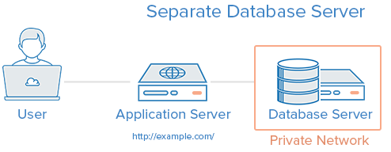
-:Linking Containers:-
So far we have been working with single container. Now here we shall take a look at how to link Docker Containers. By linking containers, we provide a secure channel via which Docker containers can communicate to each other.
Think of a sample web application. You might have a Web Server and a Database Server.
When we talk about linking Docker Containers, what we are talking about here is the following:
We can launch one Docker container that will be running the Database Server.
We will launch the second Docker container (Web Server) with a link flag to the container launched in Step 1. This way, it will be able to talk to the Database Server via the link name.

Slide 42
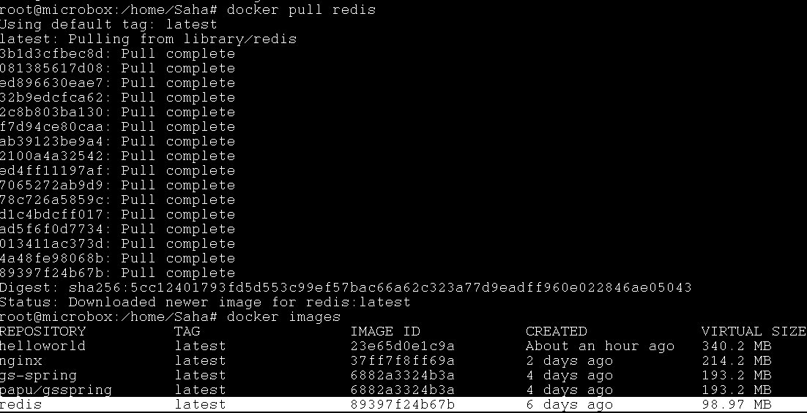
Linking Containers Continue……
We can achieve this task using Docker Compose also, but here at this point we will see how to link two different containers using link-flag.
1.) Let us begin first by launching the popular NoSQL Data Structure Server Redis. Like other software, Redis too has its official Docker image available in the Docker Hub.
First, let us pull down the Redis image via the following

Slide 43
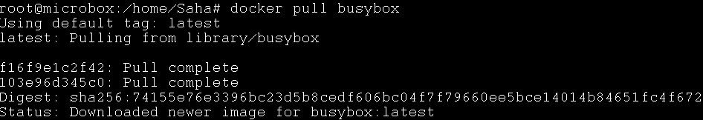
Linking Containers Continue……
Next, let us launch a Redis container (named myredis) in detached mode as follows:
We can check that myredis container has started via the following command:
Notice that it has started on port 6379.
Now, let us pull another image busybox as shown below:

Slide 44
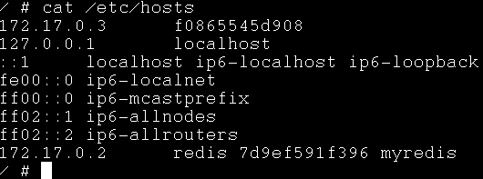
Linking Containers Continue……
Now, let us run the busybox container as shown below:
Notice the - - link flag. The value provided to the - - link flag is sourcecontainername(myredis):containeraliasname(redis).
The above launch of container (myredisclient1) will lead you to the shell prompt.
Now let’s explore /etc/hosts file inside myredisclient1 container.

Slide 45


Linking Containers Continue……
Notice an entry at the end, where the container myredis has got associated with the redis name.
Now, if you do a ping by the host name i.e. alias name (redis) — it will work: Remember you should be in the cli of the myredis container.
Exit the myredis container and come back to the normal prompt. Type exit.
Let us launch a container based on the redis image but this time instead of the default command that will launch the redis server, we will simply go into the shell so that all the redis client tools are ready for us.
Next thing is to launch the redis client (redis-cli) and connect to our redis server (running in another container and to which we have linked) as shown

Slide 46
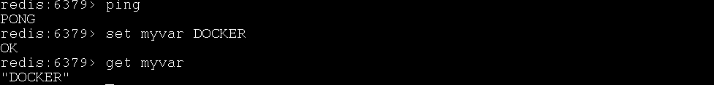
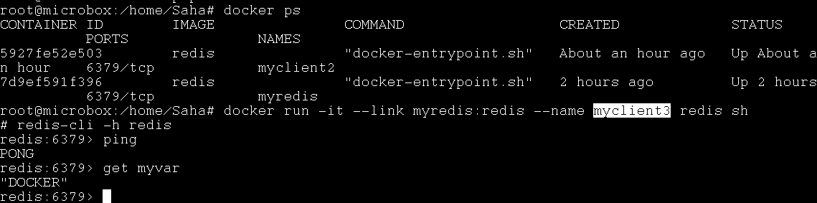
Linking Containers Continue……
Now let us execute some standard redis cmd’s.
Everything looks fine. Let us exit this container and launch another client (myclient3) that wants to connect to the same Redis Server that is still running in the first container(mycontainer2)that we launched and to which we added a string key / value pair.

Slide 47
-:Docker Volume:-
Docker Volumes essentially tells how to manage data within your Docker containers.
Containers are Ephemeral or Temporary storage, ie data is available only during container life time and once a container is removed, data is gone. What about scenarios where you want the applications running inside the container to write to some files/data and then ensure that the data is still present.
For e.g. let’s say that you are running an application that is generating data and it creates files or writes to a database and so on. Now, even if the container is removed and in the future you launch another container, you would like that data to still be there.
Here we will try to separate out the container lifecycle from the data stored inside it.
As per the official documentation, there are 2 ways in which you can manage data in Docker:
Data volumes
Data volume containers

Slide 48

-:Docker Volume:-
A data volume is a specially designed directory in the container.
It is initialized when the container is created. By default, it is not deleted when the container is stopped. It is not even garbage collected when there is no container referencing the volume.
The data volumes are independently updated. Data volumes can be shared across containers too. They could be mounted in read-only mode too.
Mounting a Data volume
Let us begin with mounting a data volume in one of our containers. We will be working with the busybox image to keep things simple.
First Creates a new volume that containers can consume and store data in.

Slide 49
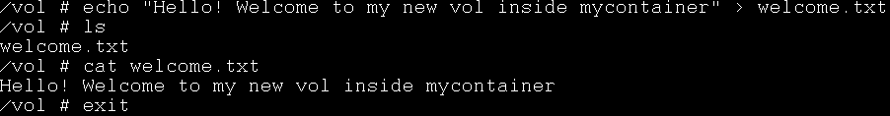
-:Docker Volume:-
Let us launch a container as given below:
Here –v /data tells to mount a volume(/data) for our container by mycontainer1.
Let us a do a cd inside the data volume and create a file named file1.txt
Now, let us exit the container by typing exit and going back to pwd prompt.
Now, if we do a docker ps -a , we should see our container (mycontainer) currently in the exited state as shown below:

Slide 50
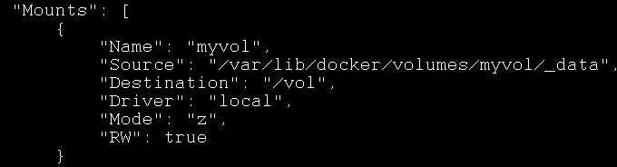
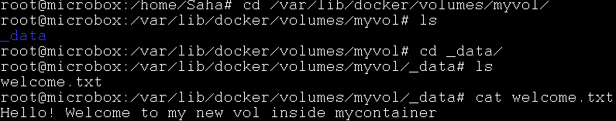
-:Docker Volume:-
Now, let us inspect the container and see what Docker did when we started this container.
This will give out a JSON output and you should look for Volumes attribute in the output.
Now if we go inside /var/lib/docker/volume/myvol, we should see our file created inside our container /vol to be mounted on /myvol.

Slide 51

-:Docker Volume:-
If we remove our container and again check the mount point we should be able to see the file, which is now persistence.
As we can see our container mycontainer has been removed completely. Now if we check our mount point the file and data inside it should be persistently available.

Slide 52
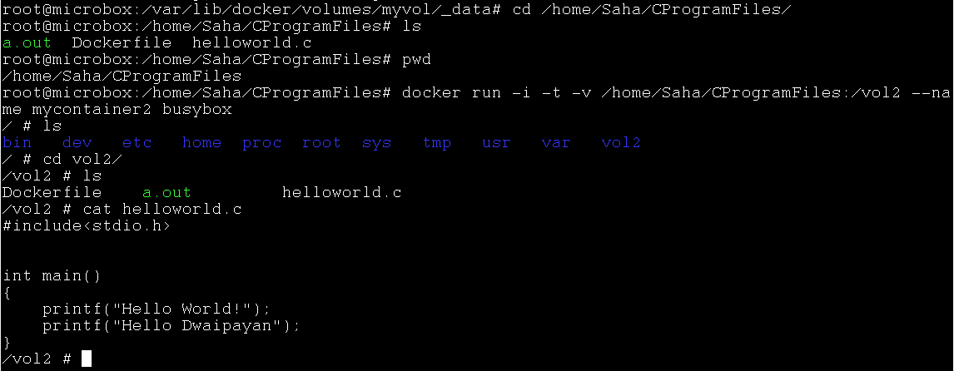
-:Docker Volume:-
Mounting a Host Directory as a Data volume:
Now that we have seen how to mount a volume in the container, the next step is to look at the same process of mounting a volume but this time we will mount an existing host folder in the Docker containner.
Please follow this steps:

Slide 53
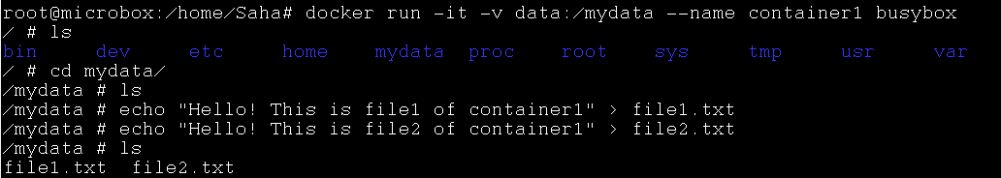
-:Docker Volume:-
Data volume containers
We now come to the next part i.e. creating a Data volume container. This is very useful if you want to share data between containers or you want to use the data from non-persistent containers. The process is really two step:
You first create a Data volume container
Create another container and mount the volume from the container created in Step 1.
Let us see that in action:
We will first create a volume in host machine & then create a container (container1) and mount a volume inside of that:

Slide 54

-:Docker Volume:-
Now press Ctrl+P+Q to come back to the host machine prompt without exiting the container.
Now, if we do a docker ps, we should see our running container:
Now, if we execute a command on the running container1 i.e. see the contents of our /data volume, you can see that the two files are present.
Now, let us launch another container (container2) but it will mount the data volume from container1 as given below:

Slide 55
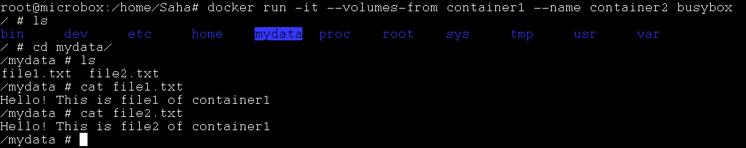
-:Docker Volume:-
Notice above that we have launched it in interactive mode and have used a new parameters — volumes-from <containername> that we have specified. This tells container2 to mount the volumes that container1mounted.
Now, if we do a ls, we can see that the data folder is present and if we do a ls inside of that, we can see our two files: file1.txt and file2.txt
------------------------------That is all for Docker Volumes---------------------------------

Slide 56
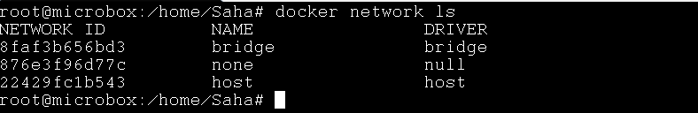
-:Docker Container Networking:-
Objective:-
In this section we will look at an overview of Docker’s default networking behavior and how to create our own user-defined networks.
We will also explore about those resources required to create networks on a single host or across a cluster of hosts.
================================================When we install Docker for the first time, it creates three networks automatically.
These three networks are built into Docker. When you run a container, you can use the - -net flag to specify which networks your container should connect to(bridge,none,host).

Slide 57
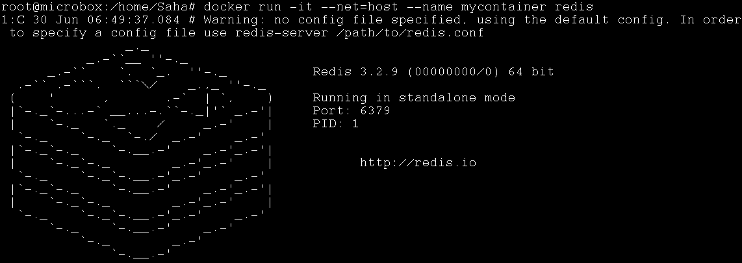
-:Docker Container Networking:-
Let’s run a container(mycontainer) based on redis image which we have earlier pulled by explicitly specifying network as host.
If we don’t specify any network name, then Docker daemon connects the container to bridge network by default.
Note:-
The host network adds a container on the host’s network stack, if you run a container that runs a web server on port 80 using host networking, the web server is available on port 80 of the host machine.

Slide 58
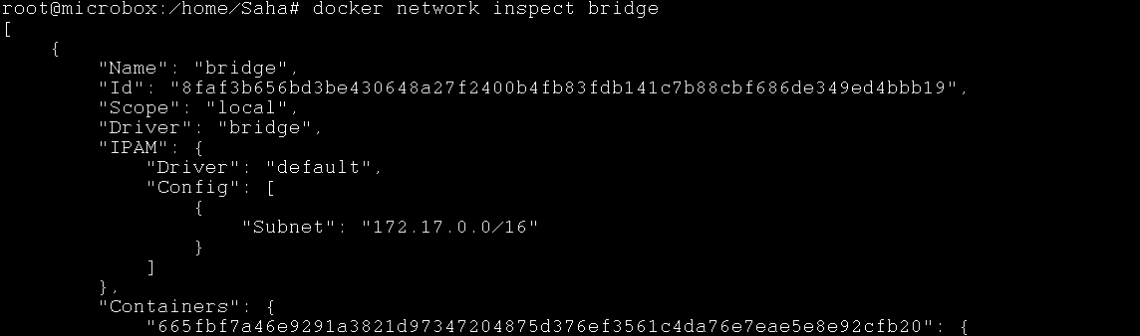
-:Docker Container Networking:-
bridge network:
The default bridge network is present on all Docker hosts. If you do not specify a different network, new containers are automatically connected to the default bridge network.
Note: The docker network inspect command returns information about a network

Slide 59

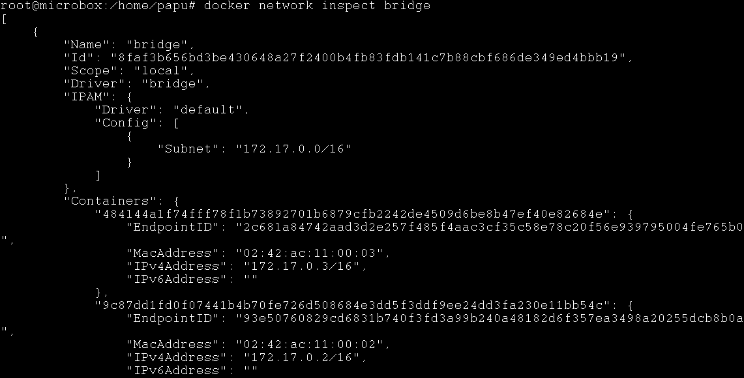
-:Docker Container Networking:-
Let us run 2 busybox container’s in detached mode on default network ie bridge network.
Now let’s inspect the bridge network.

Slide 60
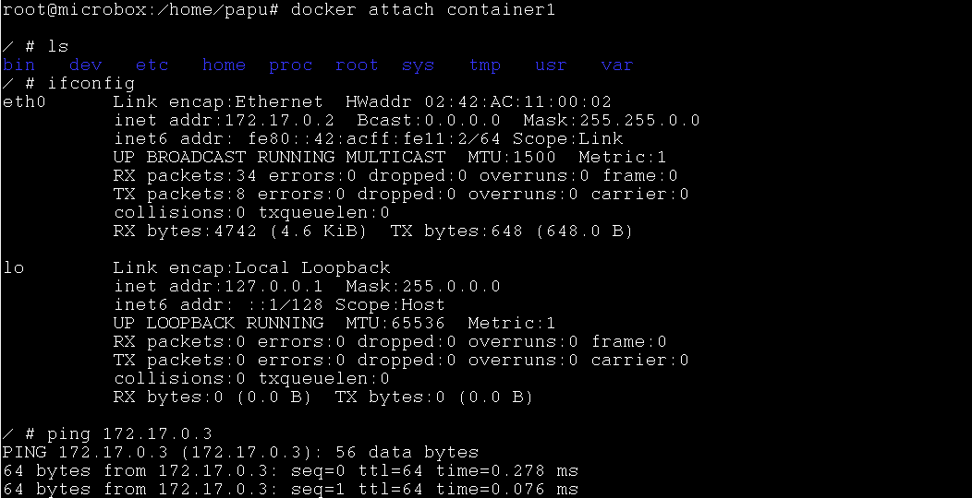
-:Docker Container Networking:-
What we see is both the busybox containers(container1 and container2) are connected to the default network.
The Ip addr of container1 is 172.17.0.2 and container2 is 172.17.0.3(which means both are in the same network). Which means both the containers can communicate with each other by IP address.

Slide 61
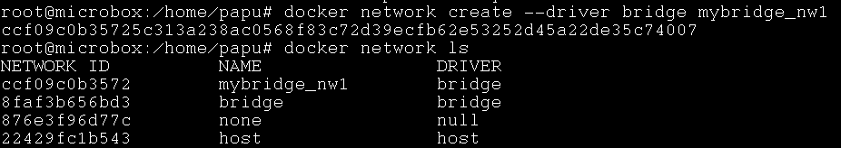
-:Docker Container Networking:-
User-defined bridge networks:
User-defined bridge networks are similar to the default bridge network, but we can add some new features to it, such as to control which containers can communicate with each other, and also to enable automatic DNS resolution of container names to IP addresses.
The following examples create some bridge networks and perform some experiments on containers on these networks.
Let’s run a container3 based on busybox image but on our recently created user-defined bridge network.

Slide 62
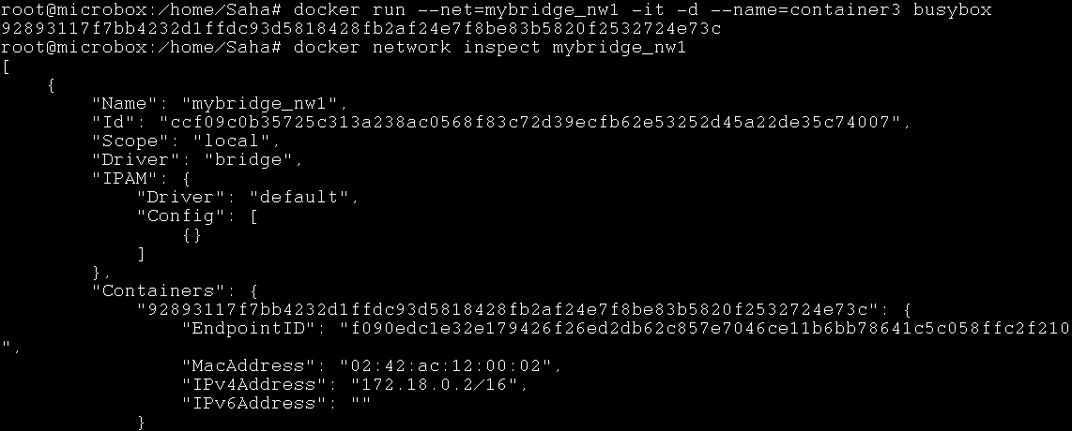
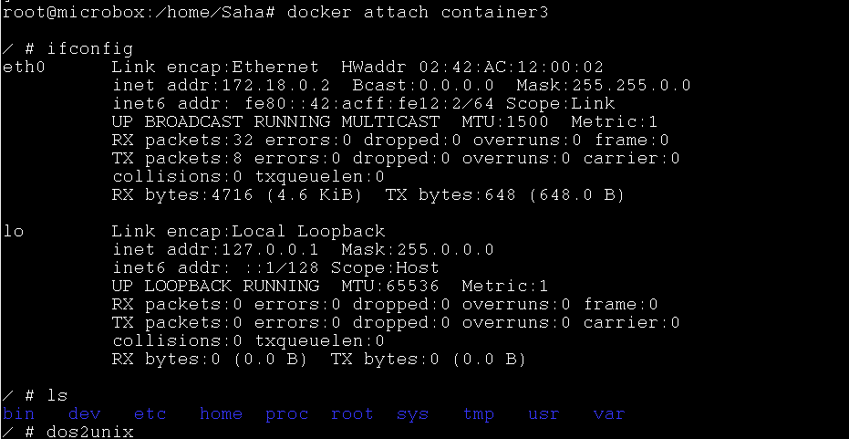
-:Docker Container Networking:-

Slide 63
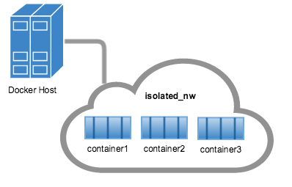
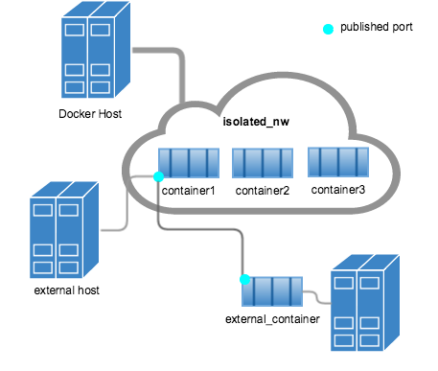
-:Docker Container Networking:-
The container3 we launched into our user-defined bridge network must reside on the same Docker host. Each container in the network can immediately communicate with other containers in the network. Though, the network itself isolates the containers from external networks.
Within a user-defined bridge network, linking is not supported. But we can expose and publish container ports on containers in this network. This is useful if you want to make a portion of the bridge network available to an outside network.

Slide 64
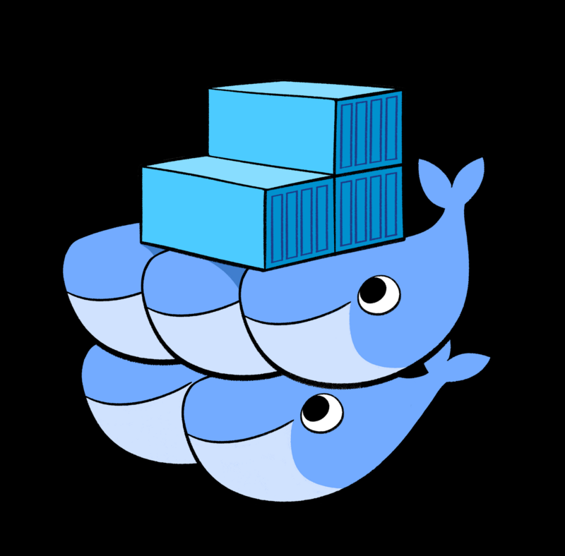
-:Docker Swarm:-
Objective:-
In this section we will look at what is Docker Swarm? And what is Container Orchestration ?
We will be looking towards Building →Shipping → Running container’s at scale primarily using Docker Swarm.
Containers have quickly taken a large role in the cloud computing industry for their lightweight characteristics and ability to efficiently share underlying resources.
Docker containers were created for fast and reliable deployment of self-contained application components on any underlying infrastructure.

Slide 65
-: Docker Swarm :-
Why do we want a Container Orchestration System?
Let’s imagine that we want to deploy and run an applications typically multi-tier architecture, which means that many containers will be associated for that application & each container has dependencies with the other which need to be managed properly.
If those container’s are running in a distributed mode, there are multiple features that we need from a management angle to make sure that those container’s are running in a cluster & is up, running, healthy and more.
Some of these necessary features include:
Health Checks on the Containers
Launching a fixed set of Containers for a particular Docker image
Scaling the number of Containers up and down depending on the load
Performing rolling update of software across containers
and more…

Slide 66
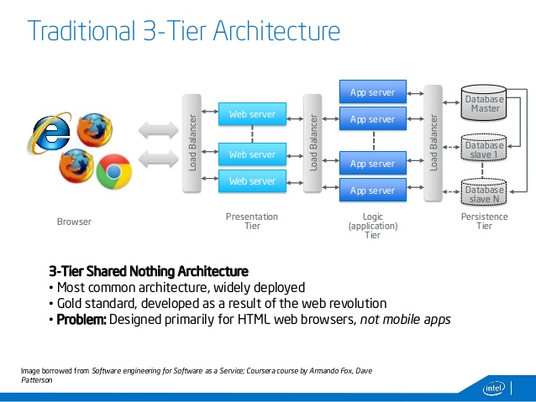
Build & Run 3 tire Application in docker
Objective:-
Here we will see how to build and run a typical 3 tire application in docker.
Note:-Knowledge of Micro Services & Spring Boot is not mandatory.
This Diagram shows here a typical 3 tire architecture.

Slide 67
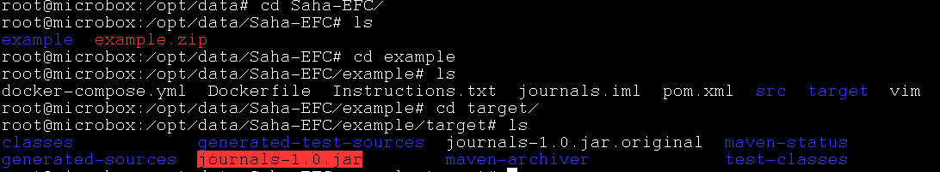
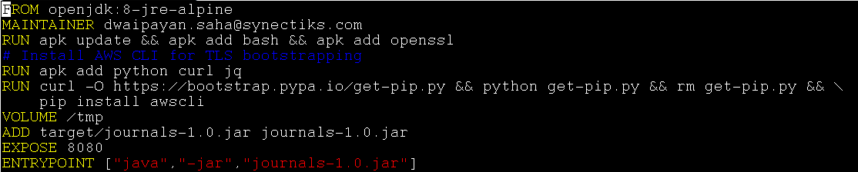
Build & Run 3 tire Application in docker
I have created a 3 tire application using spring boot and also created a .jar file out of the entire Application.
I have written a Dockerfile

Slide 68
-:continue…..
FROM openjdk:8-jre-alpine
The From directive defines the base image to use to start the build process.
If a FROM image is not found on the host, docker will try to find it (and download) from the docker image index.
RUN apk update && apk add bash && apk add openssl
The RUN command is the central executing directive for Dockerfiles. It takes a command as its argument and runs it to form the image.
RUN apk add python curl jq
RUN curl -O https://bootstrap.pypa.io/get-pip.py && python get-pip.py && rm get-pip.py && pip install awscli
The RUN command is the central executing directive for Dockerfiles. It takes a command as its argument and runs it to form the image. Her we are directing the Dockerfile to execute apk tool to install python curl and jq software on a running system.
Note:- jq is json parser(to read json format files).
Then we are downloading and installing pip for awscli(AWS Command Line Interface).

Slide 69
-:Continue…….
VOLUME /tmp
The VOLUME command is used to enable access from your container to a directory on the host machine /tmp (i.e. mounting it).
ADD target/journals-1.0.jar journals-1.0.jar
The ADD command gets two arguments: a source(target) and a destination. It basically copies the files(journal-1.0.jar) from the source on the host into the container's own filesystem at the set destination.
EXPOSE 8080
The EXPOSE command is used to associate a specified port to enable networking between the running process inside the container and the outside world (i.e. the host).
ENTRYPOINT ["java","-jar","journals-1.0.jar"]
The ENTRYPOINT argument sets the concrete default application that is used every time a container is created using the image. For example, if you have installed a specific application inside an image and you will use this image to only run that application, you can state it with ENTRYPOINT and whenever a container is created from that image, your application will be the target.

Slide 70
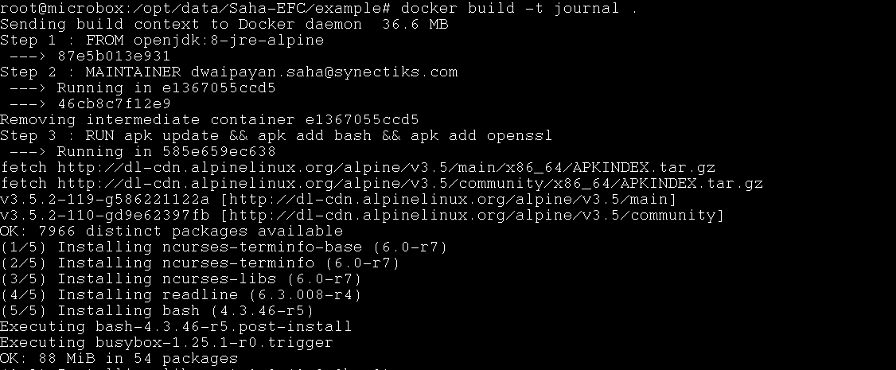
-:Continue…….
Now let’s build the docker file by specifying the name journal.
After the image is built we need to tag that image to push it to dockerhub.
For more info on dockerhub visit https://hub.docker.com

Slide 71
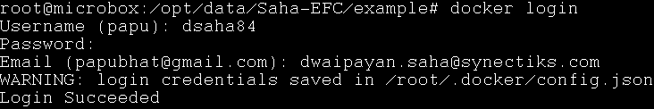
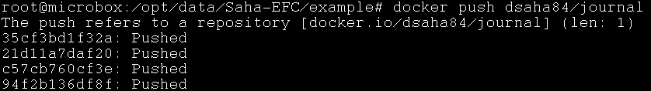
-:Continue…….
Let’s tag our journal image.
Now let’s push the tagged image to my docker hub PUBLIC REPOSITORY.
Before that I need to login to my docker hub account from host cli.
Now let’s push the tagged image.

Slide 72
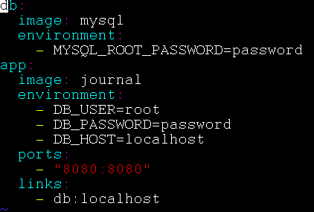
-:Continue…….
Now at the end let’s create a docker-compose.yml file, where we are going to add 2 container image journal and mysql.
Note:- As discussed earlier docker-compose file is a .yml extension file, inside which we define our multi container image’s.
Now let’s run the docker-compose file to run our entire application as images.

Slide 73
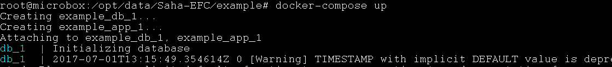
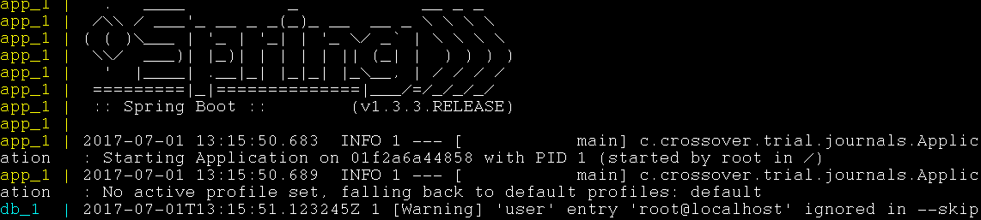
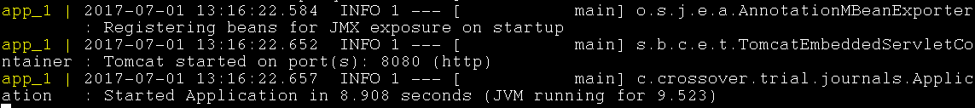
-:Continue…….

Slide 74
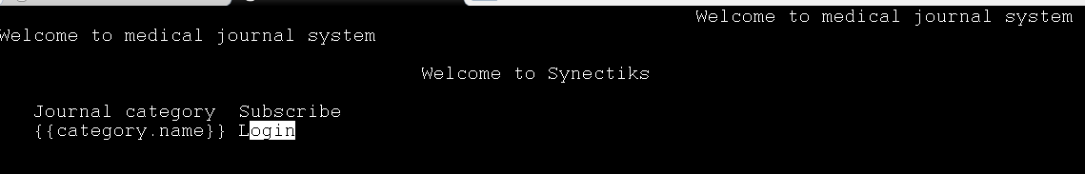
-:Continue…….
You can now open any browser and test your Application running locally.
Here I am using elinks to test this application.
----------------------That’s It for Docker, Thanks-------------------------

