Slide 1
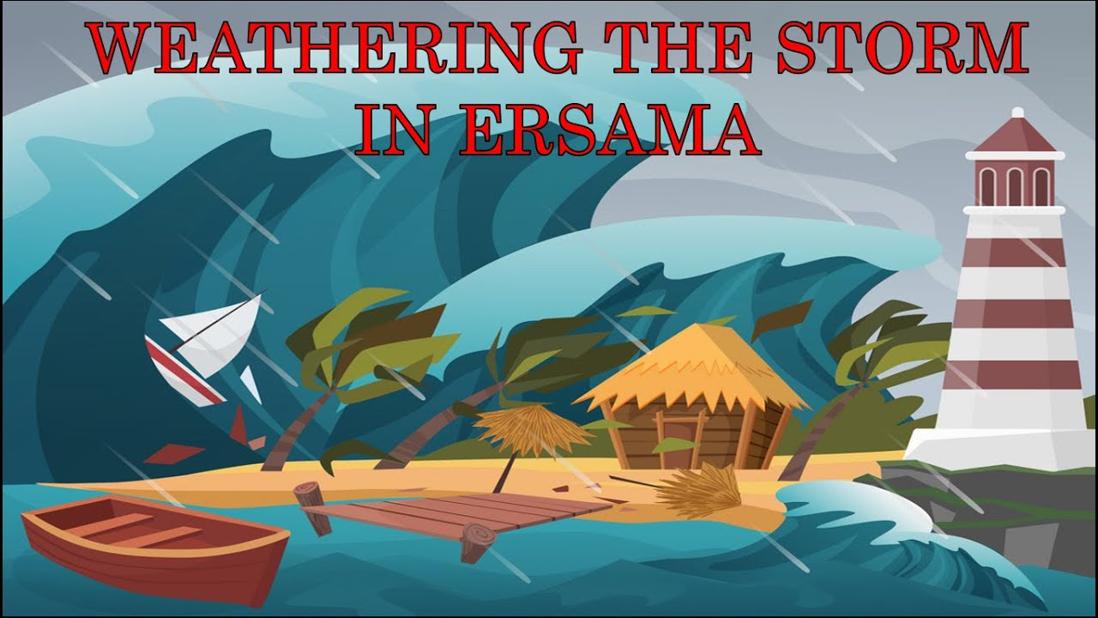
PRESENTATION BY-VAIBHAV SAHU
-9TH I2
-91153

Slide 2
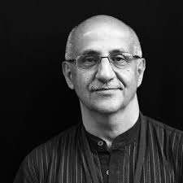
ABOUT THE AUTHOR
Harsh Mander is a great humanitarian and social activist who has dedicated his life to working for the survivors, victims of natural calamities, hunger, mass violence, communal riots, bonded labour and other social injustices.
He has held a number of posts in various organizations and presently the Director of the Center for Equity Studies. Being an ardent writer, he has written a number of books depicting the social problems in India. "

Slide 3

The story gives an account of the storm that hit the coastal town of Ersama in Odisha state in the year 1999.
A young boy Prashant faced the fury of the storm and reached his village. The details of how he worked hard to help the villagers overcome the devastation caused by the storm inspire us to have courage and a positive approach towards life.

Slide 4
Prashant was a young boy of nineteen years of age. He belonged to Kalikuda, a village in the coastal state of Odisha. He had lost his mother seven years ago.
On 27 October 1999, when he was visiting a friend in Ersama, a super cyclone hit the area. There was large scale devastation. The gushy winds and rains continued for two days. They remained on the rooftop of the house and survived on the tender coconuts from the coconut trees that had fallen on the roof.
As the rain stopped, Prashant left for his home as he feared the worst for his family. He took a stick to help him find the road. At times, he had to swim through the flood waters. On the way he met two friends and their uncle and the group moved together. They came across dead bodies of human beings and animals which floated with the current. As they crossed villages, not even a single house could be seen.

Slide 5
 Prashant’s house was shattered too and he saw the belongings hanging on the branches of the trees. He wept as he felt that he had lost his beloved. He went to the Red cross shelter in search of his family. There Prashant met his maternal grandmother. She was elated to see him alive as they had not expected that he would have survived the storm. Prashant saw a crowd of 2500 people at the shelter. Many had lost their families in the disaster. They were grief stricken as the catastrophe had snatched everything. For the last 2 days they had survived on coconuts but they were running out of stock.

Slide 6
Prashant took control of the situation. He formed a group with some elders and young people. They forced the merchant to give them the stock of rice and were successful. After 4 days the crowd ate a meal. Then the group of volunteers cleaned the shelter and tended to the injured people. Prashant engaged the widows to work in the NGO named
“Food for Work”. He engaged the children by arranging sports matches for them. The volunteers managed to set up foster families comprising of the widows, orphaned children and lone men who would form a family and support each other. Like this Prashant overcame his grief and learnt to smile even in the face of adversities.

Slide 7

 In the weathering the storm in Erasma by Harsh Mander, the theme of the story is evoked when the storm takes place and due to which people are in a lot of suffering. It states that the community members should mobilize in order to prevent themselves from suffering apart from the aid provided by the government. However, in this story, a 19 year old young man initiates to help the community members and makes them stand on their feet. The theme of leadership by this young man is praised in this story.

Slide 8

The message in this poem is conveyed that the community members should help themselves when a calamity strikes. In order to get the aid, they should not be completely dependent upon the government. Also, the important message conveyed in this chapter is that a youth plays a vital role in his/her contribution to society.

Slide 9

Prashant- a young boy who is 19 years old
Devastated by the superstorm in Orissa
Takes up leadership role and starts organising the people
Helps people return to their normal lives
A saviour of orphans and widows
Ready to work hard to help people
Role model for the youth of our country

Slide 10
A superstorm happens in Ersama in Orissa state in 1999. Prashant, a 19 year old boy sees nearly 2500 people in a pitiable condition in a storm shelter.
He mobilised the people to help themselves and arranges food and accommodation for them.
He involved in rehabilitation work for the community.
Since the article talks about the efforts of the people to overcome the destruction caused by the storm, the title is appropriate.

Slide 11


