Slide 1
Logical Agents
Lesson 10

Slide 2
Outline
Knowledge-based agents
Wumpus world
Logic in general — models and entailments
Propositional (Boolean) logic
Equivalence, validity, satisfiability
Inference rules and theorem proving
Forward chaining
Backward chaining
Resolution

Slide 3
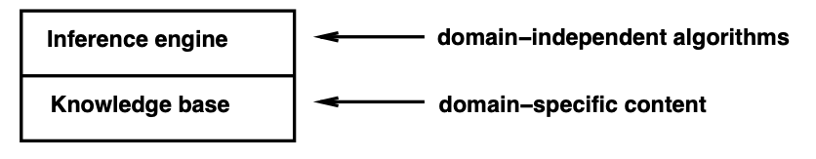
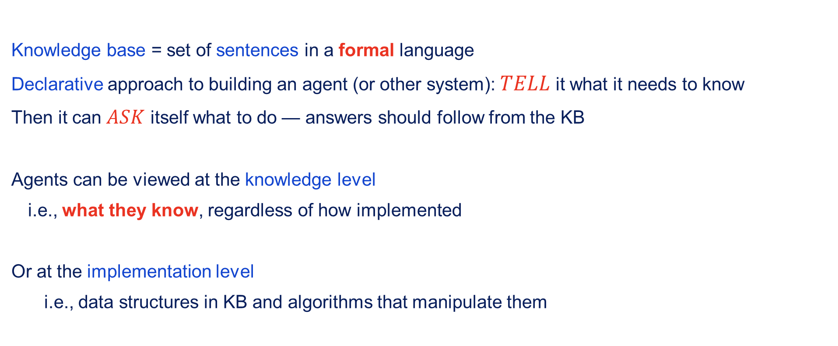
Knowledge bases
Knowledge base = set of sentences in a formal language
Declarative approach to building an agent (or other system): $TELL$ it what it needs to know
Then it can $ASK$ itself what to do — answers should follow from the KB
Agents can be viewed at the knowledge level
i.e., what they know, regardless of how implemented
Or at the implementation level
i.e., data structures in KB and algorithms that manipulate them

Slide 4
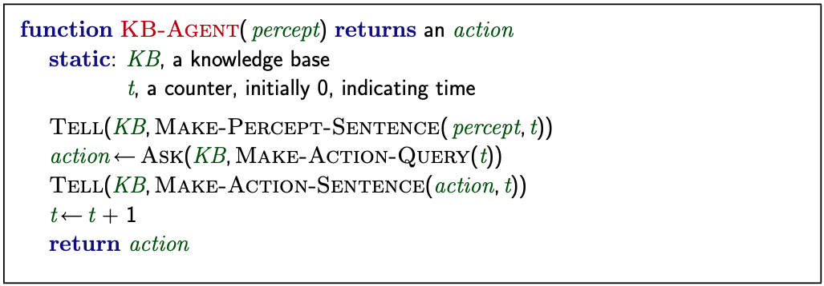
A simple knowledge-based agent
The agent must be able to:
Represent states, actions, etc.
Incorporate new percepts
Update internal representations of the world
Deduce hidden properties of the world
Deduce appropriate actions

Slide 5
Wumpus World PEAS description
Performance measure
Gold + 1000, death -1000
-1 per step, -10 for using the arrow
Environment
Squares adjacent to wumpus are smelly
Squares adjacent to pit are breezy
Glitter iff gold is in the same square
Shooting kills wumpus if you are facing it.
Shooting uses up the only arrow
Grabbing picks up the gold if in game square
Releasing drops the gold in same square
Actuators Left turn, Right turn, Forward, Grab, Release, Shoot
Sensors Breeze, Glitter, Smell

Slide 6
Wumpus world characterisation
Observable? No, only local perception
Deterministic? Yes, outcomes exactly specified
Episodic? No, sequential at the level of actions
Static? Yes, Wumpus and pits do not move
Discrete? Yes.
Single-agent? Yes, Wumpus is essentially a natural feature.

Slide 7
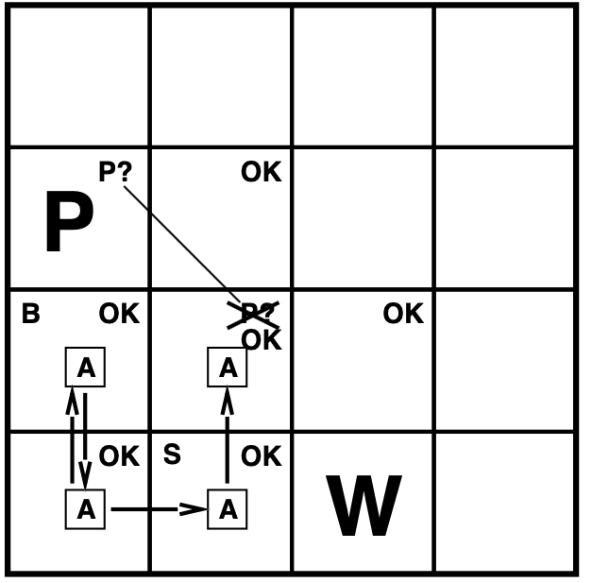
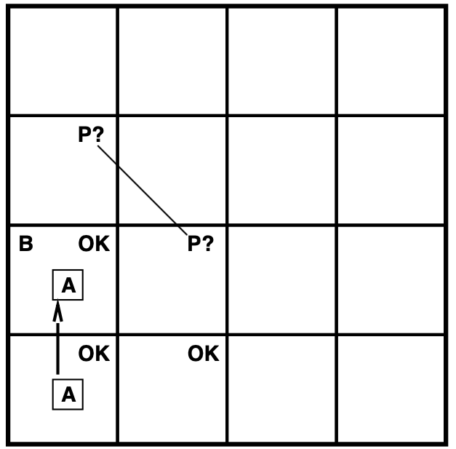
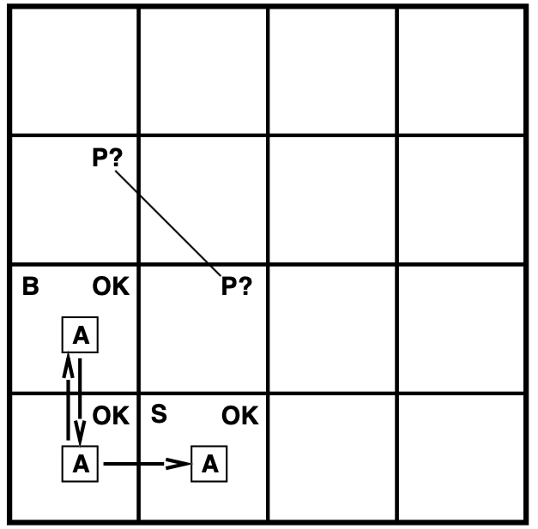
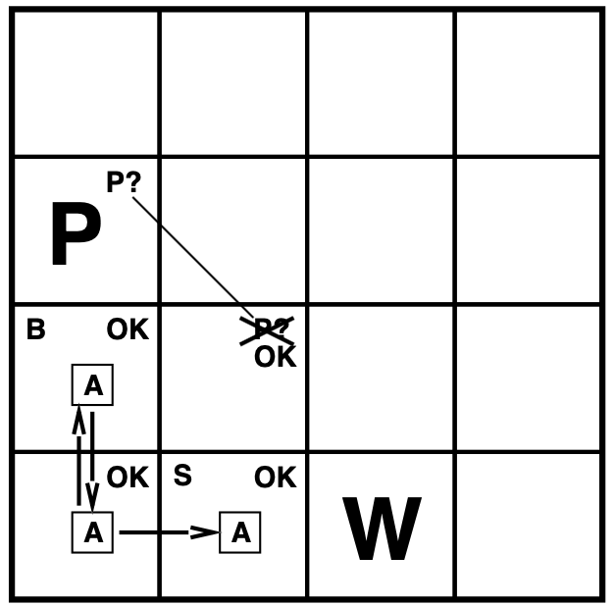

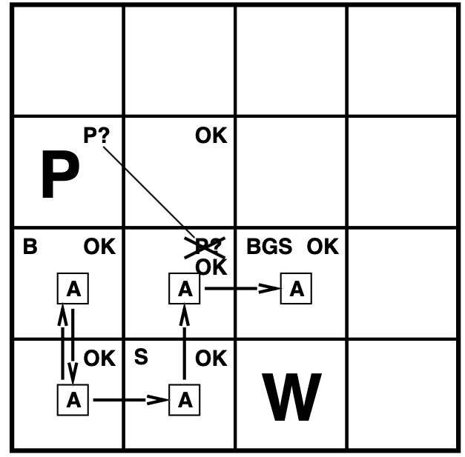
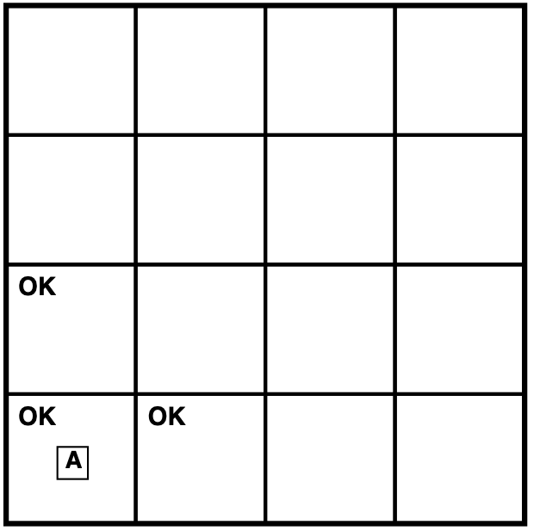
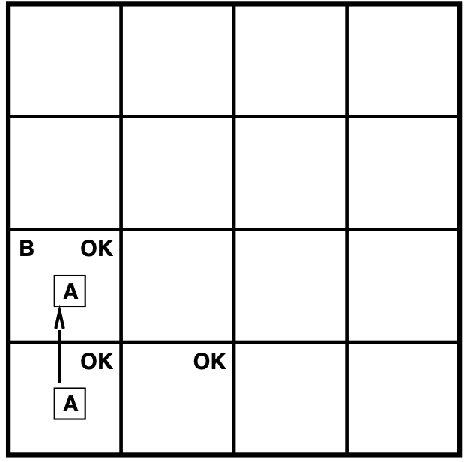
Exploring a wumpus world

Slide 8
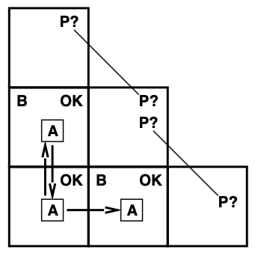
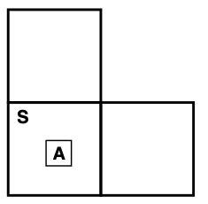
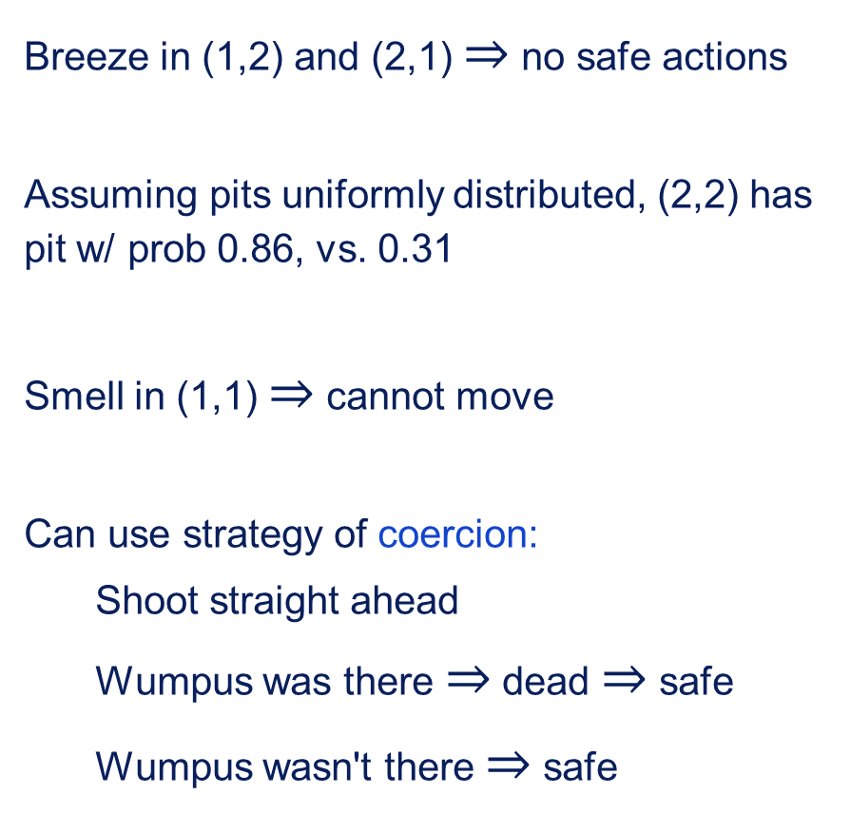
Other tight spots
Breeze in (1,2) and (2,1) $⇒$ no safe actions
Assuming pits uniformly distributed, (2,2) has pit w/ prob 0.86, vs. 0.31
Smell in (1,1) $⇒$ cannot move
Can use strategy of coercion:
Shoot straight ahead
Wumpus was there $⇒$ dead $⇒$ safe
Wumpus wasn't there $⇒$ safe

Slide 9
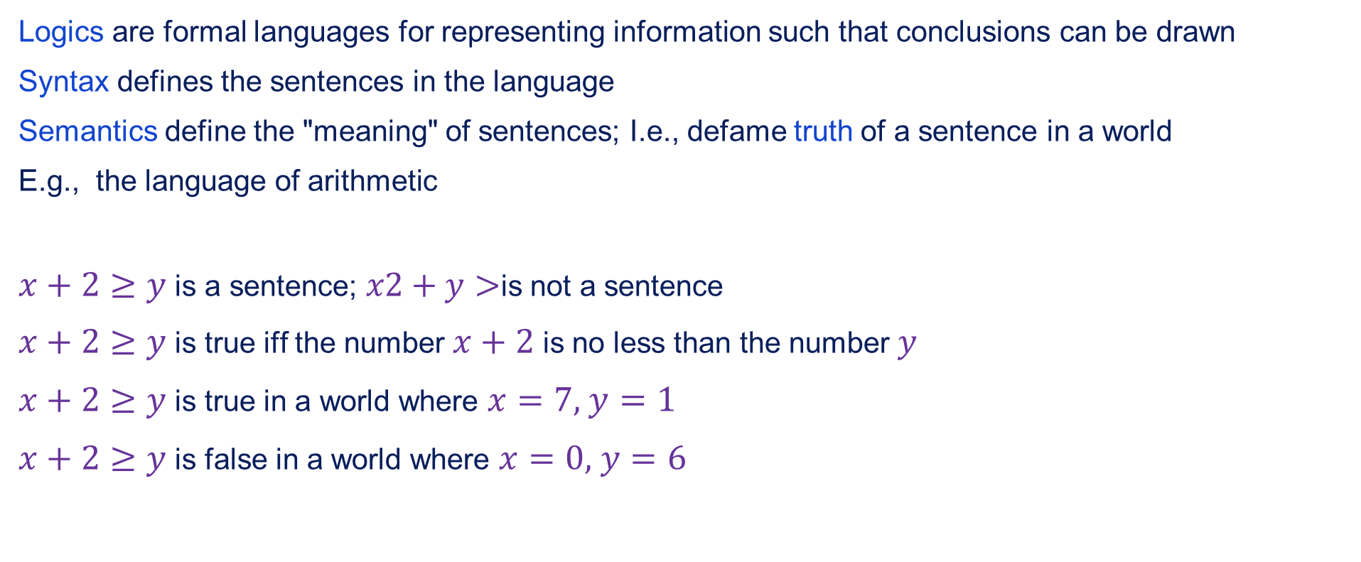
Logic in general
Logics are formal languages for representing information such that conclusions can be drawn
Syntax defines the sentences in the language
Semantics define the "meaning" of sentences; I.e., defame truth of a sentence in a world
E.g., the language of arithmetic
$x+2≥y$ is a sentence; $x2+y>$is not a sentence
$x+2≥y$ is true iff the number $x+2$ is no less than the number $y$
$x+2≥y$ is true in a world where $x=7,$ $y=1$
$x+2≥y$ is false in a world where $x=0,$ $y=6$

Slide 10
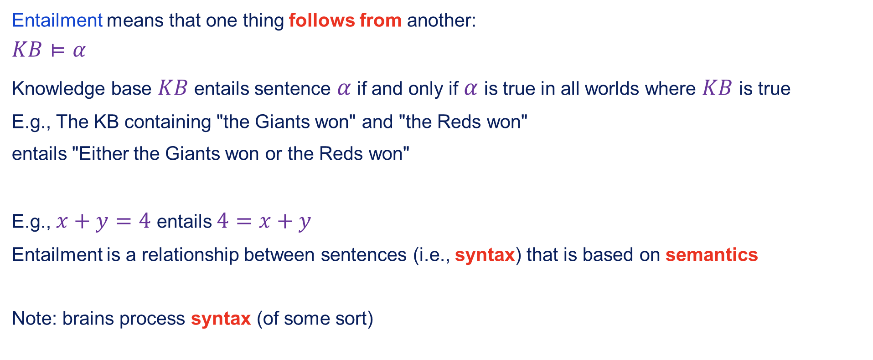
Entailment
Entailment means that one thing follows from another:
$$KB⊨α$$
Knowledge base $KB$ entails sentence $α$ if and only if $α$ is true in all worlds where $KB$ is true
E.g., The KB containing "the Giants won" and "the Reds won"
entails "Either the Giants won or the Reds won"
E.g., $x+y=4$ entails $4=x+y$
Entailment is a relationship between sentences (i.e., syntax) that is based on semantics
Note: brains process syntax (of some sort)

Slide 11
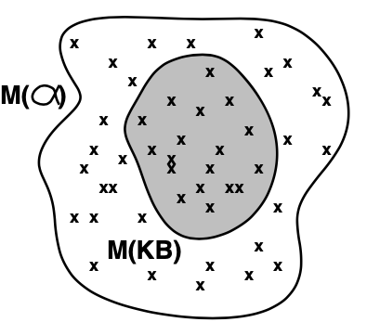

Models
Logicians typically think in terms of models, which are formulary structured worlds with respect to which truth evaluated
We $m$ is a model of a sentence $α$ if $α$ is true in $m$
$M(a)$ is the set of all models of $α$
Then $KB⊨α$ if and only if $M(KB)⊆M(α)$
E.g., $KB$ = Giants won and Reds won
$α$ = Giants won

Slide 12
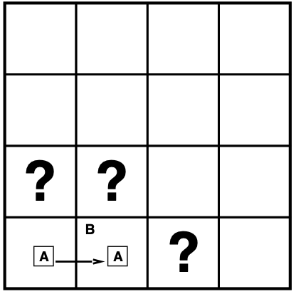

Entailment in the wumpus world
Situation after detecting nothing in [1,1],
moving right, breeze in [2,1]
Consider possible models for ?s
3 Boolean choices $⇒$ 8 possible models

Slide 13
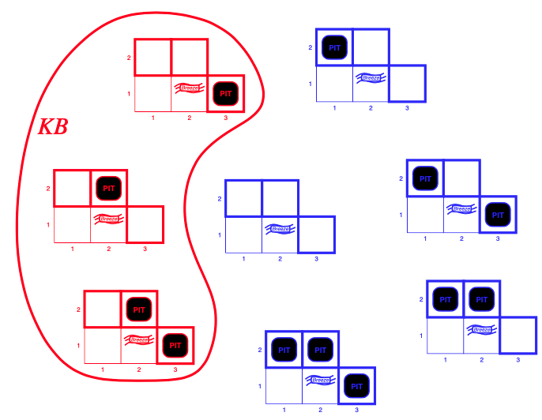
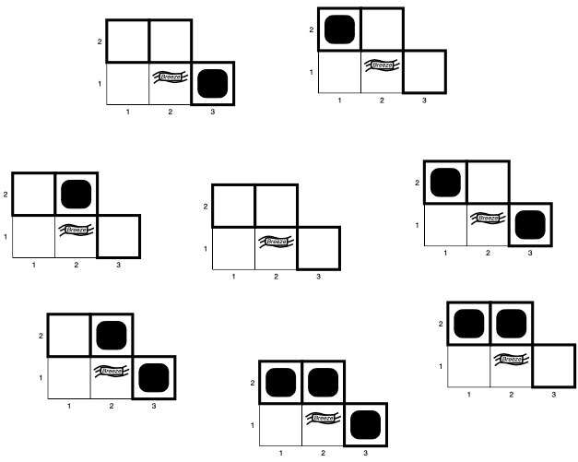

Wumpus models
$KB$ = rumpus-world rules + observations
$a_{1}$ = "[1,2] is safe", $KB⊨α_{1}$, proved by model checking

Slide 14
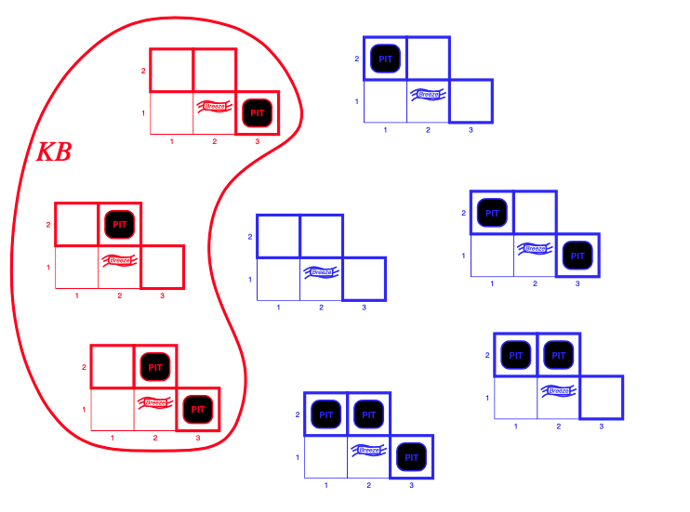
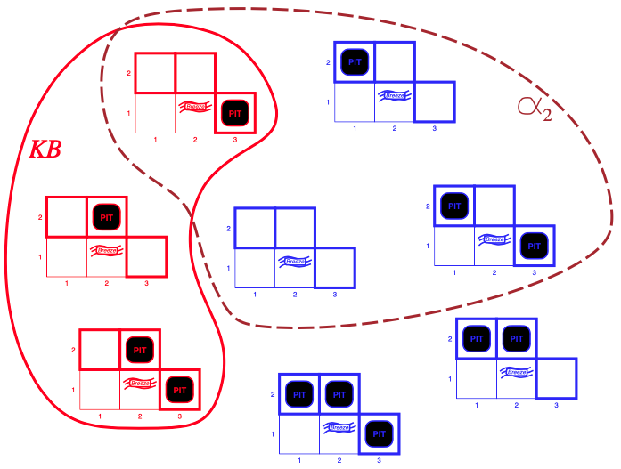
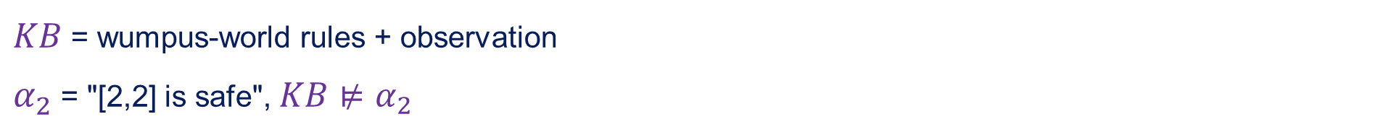
Wumpus models
$KB$ = wumpus-world rules + observation
$α_{2}$ = "[2,2] is safe", $KB⊭α_{2}$

Slide 15
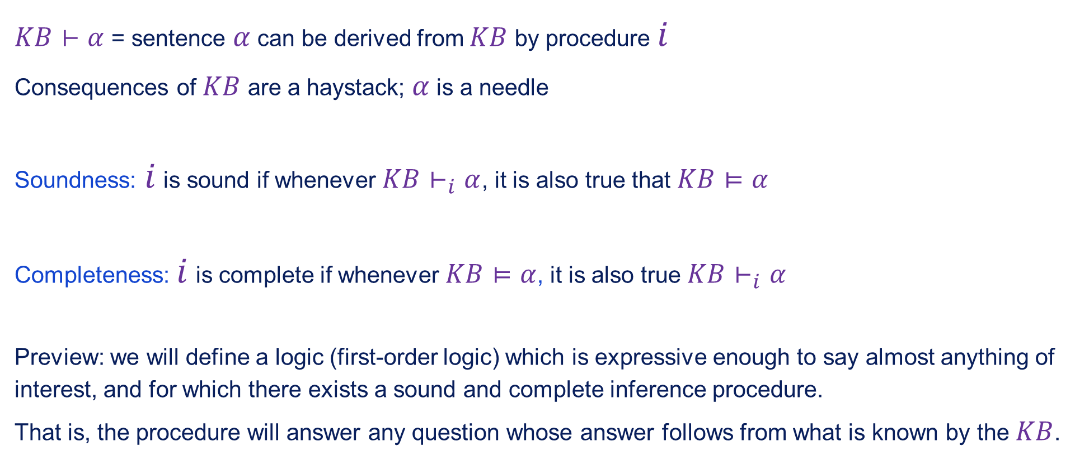
Inference
$KB⊢α$ = sentence $α$ can be derived from $KB$ by procedure $i$
Consequences of $KB$ are a haystack; $α$ is a needle
Soundness: $i$ is sound if whenever $KB⊢_{i}α$, it is also true that $KB⊨α$
Completeness: $i$ is complete if whenever $KB⊨α$, it is also true $KB⊢_{i}α$
Preview: we will define a logic (first-order logic) which is expressive enough to say almost anything of interest, and for which there exists a sound and complete inference procedure.
That is, the procedure will answer any question whose answer follows from what is known by the $KB$.

Slide 16
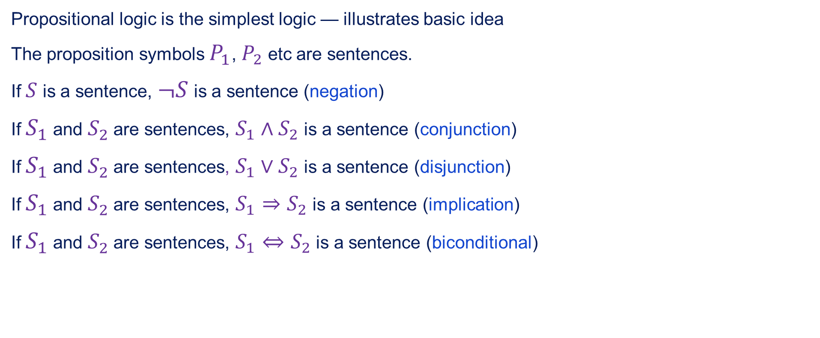
Propositional logic: Syntax
Propositional logic is the simplest logic — illustrates basic idea
The proposition symbols $P_{1}$, $P_{2}$ etc are sentences.
If $S$ is a sentence, $¬S$ is a sentence (negation)
If $S_{1}$ and $S_{2}$ are sentences, $S_{1}∧S_{2}$ is a sentence (conjunction)
If $S_{1}$ and $S_{2}$ are sentences, $S_{1}∨S_{2}$ is a sentence (disjunction)
If $S_{1}$ and $S_{2}$ are sentences, $S_{1}⇒S_{2}$ is a sentence (implication)
If $S_{1}$ and $S_{2}$ are sentences, $S_{1}⇔S_{2}$ is a sentence (biconditional)

Slide 17

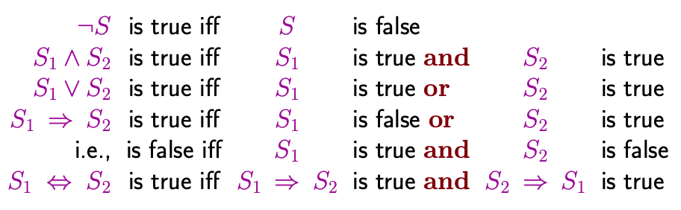
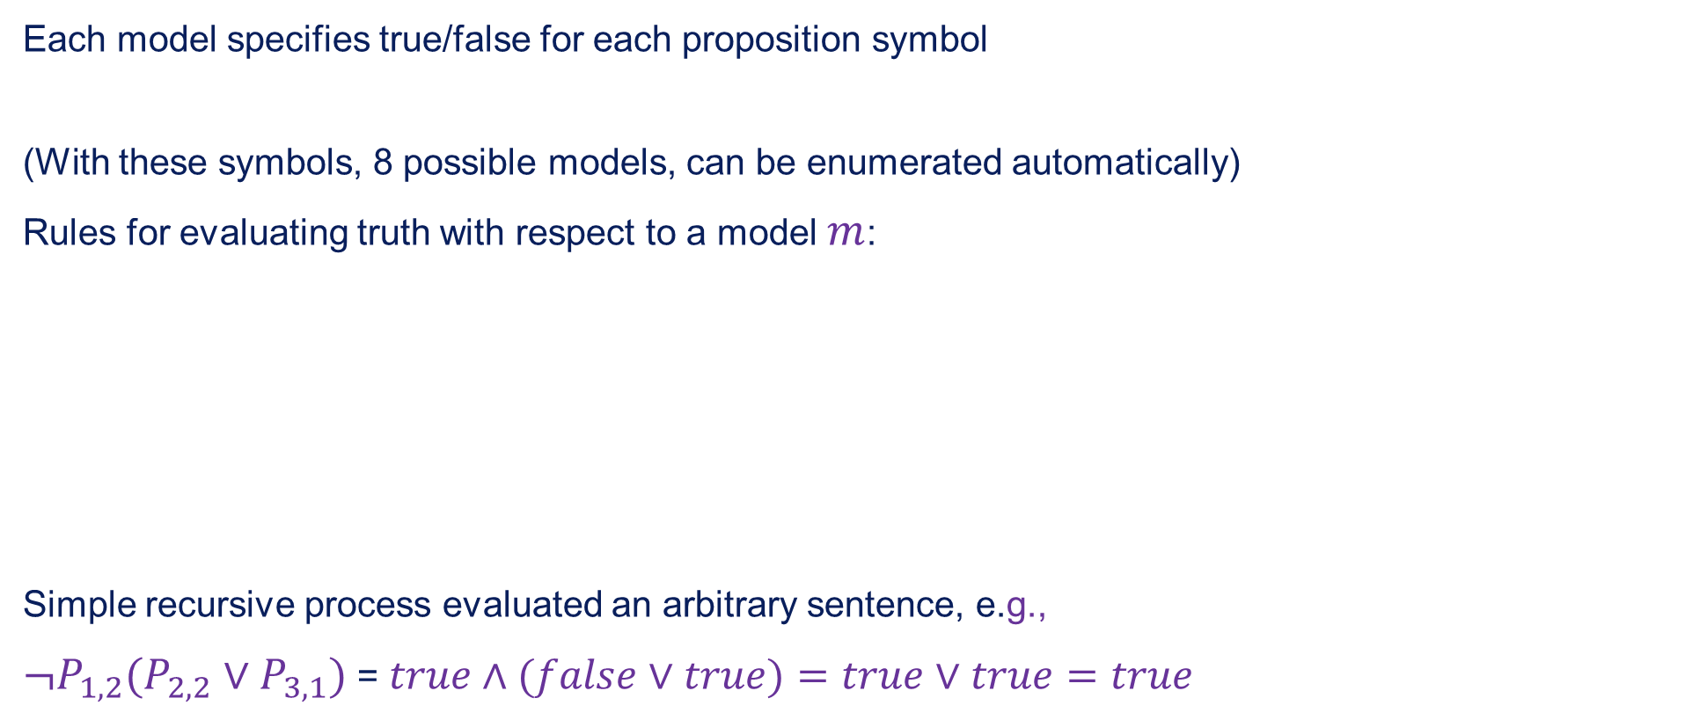
Propositional logic: Semantics
Each model specifies true/false for each proposition symbol
(With these symbols, 8 possible models, can be enumerated automatically)
Rules for evaluating truth with respect to a model $m$:
Simple recursive process evaluated an arbitrary sentence, e.g.,
$¬P_{1,2}(P_{2,2}∨P_{3,1})$ = $true∧(false∨true)=true∨true=true$

Slide 18
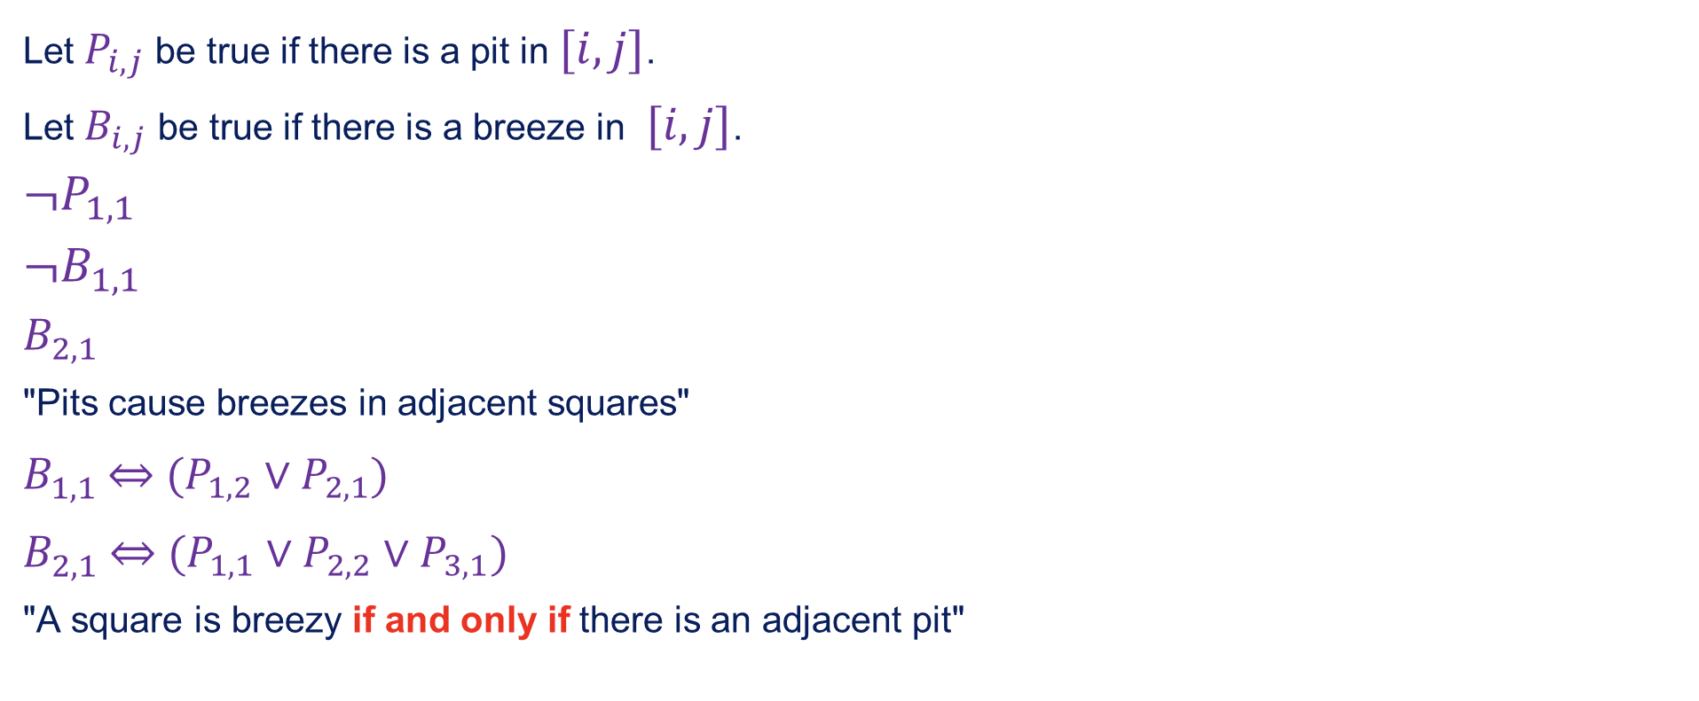
Wumpus world sentences
Let $P_{i,j}$ be true if there is a pit in $[i,j]$.
Let $B_{i,j}$ be true if there is a breeze in $[i,j]$.
$$¬P_{1,1}$$
$$¬B_{1,1}$$
$$B_{2,1}$$
"Pits cause breezes in adjacent squares"
$B_{1,1}$ $⇔$ $(P_{1,2}∨P_{2,1})$
$B_{2,1}$ $⇔$ $(P_{1,1}∨P_{2,2}∨P_{3,1})$
"A square is breezy if and only if there is an adjacent pit"

Slide 19
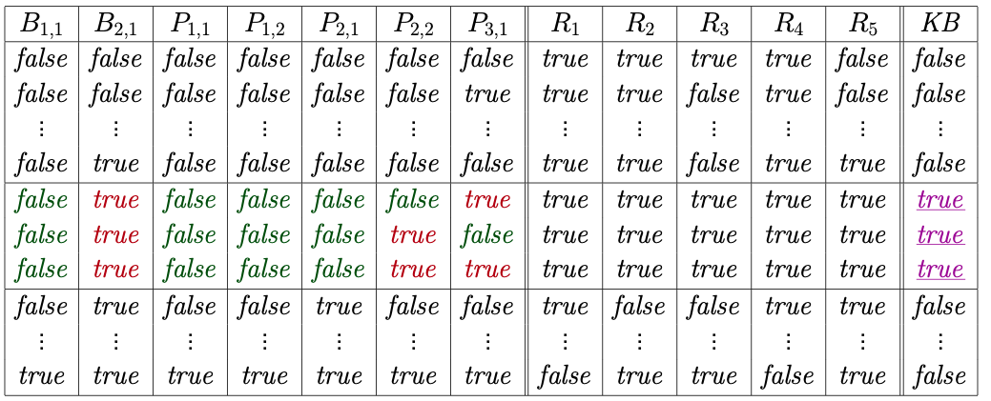
Truth tables for inference
Enumerate rows (different assignments to symbols), if KB is true in row, check that $α$ is too

Slide 20
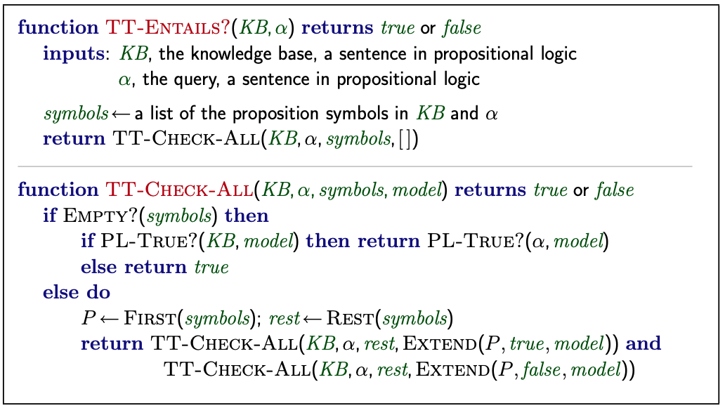

Inference by enumeration
Depth-first enumeration of all models is sound and complete
$O(2^{n})$ is $n$ symbols; problem is co-NP-complete

Slide 21
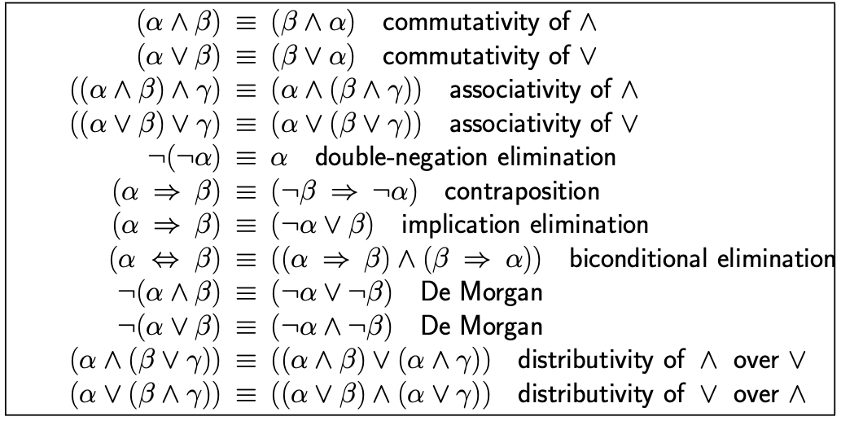

Logical equivalence
Two sentences are logically equivalent iff true in same models: $α≡β$ if and only if $α⊨β$ and $β⊨α$

Slide 22
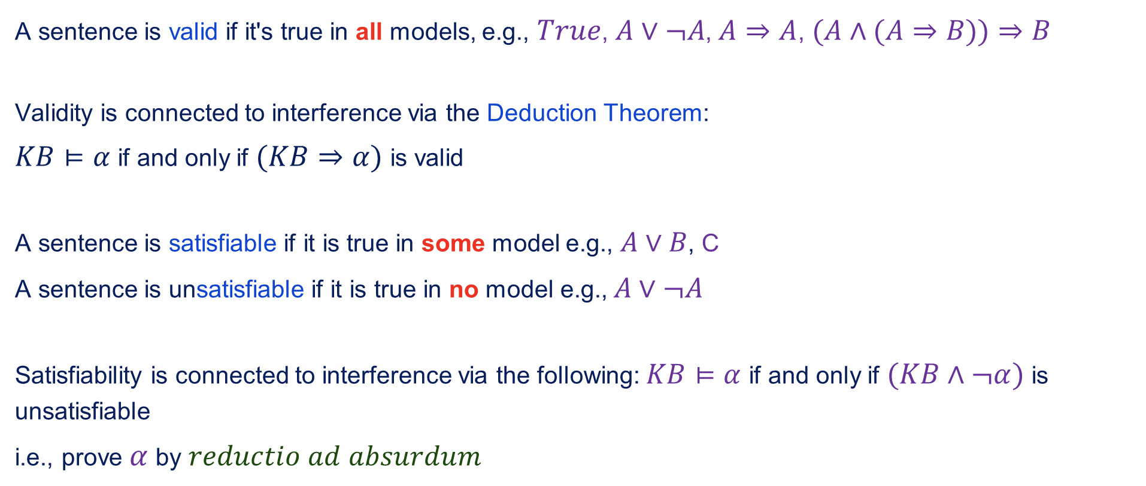
Validity and satisfiability
A sentence is valid if it's true in all models, e.g., $True$, $A∨¬A$, $A⇒A$, $(A∧(A⇒B))⇒B$
Validity is connected to interference via the Deduction Theorem:
$KB⊨α$ if and only if $(KB⇒α)$ is valid
A sentence is satisfiable if it is true in some model e.g., $A∨B$, C
A sentence is unsatisfiable if it is true in no model e.g., $A∨¬A$
Satisfiability is connected to interference via the following: $KB⊨α$ if and only if $(KB∧¬α)$ is unsatisfiable
i.e., prove $α$ by $reductio$ $ad$ $absurdum$

Slide 23
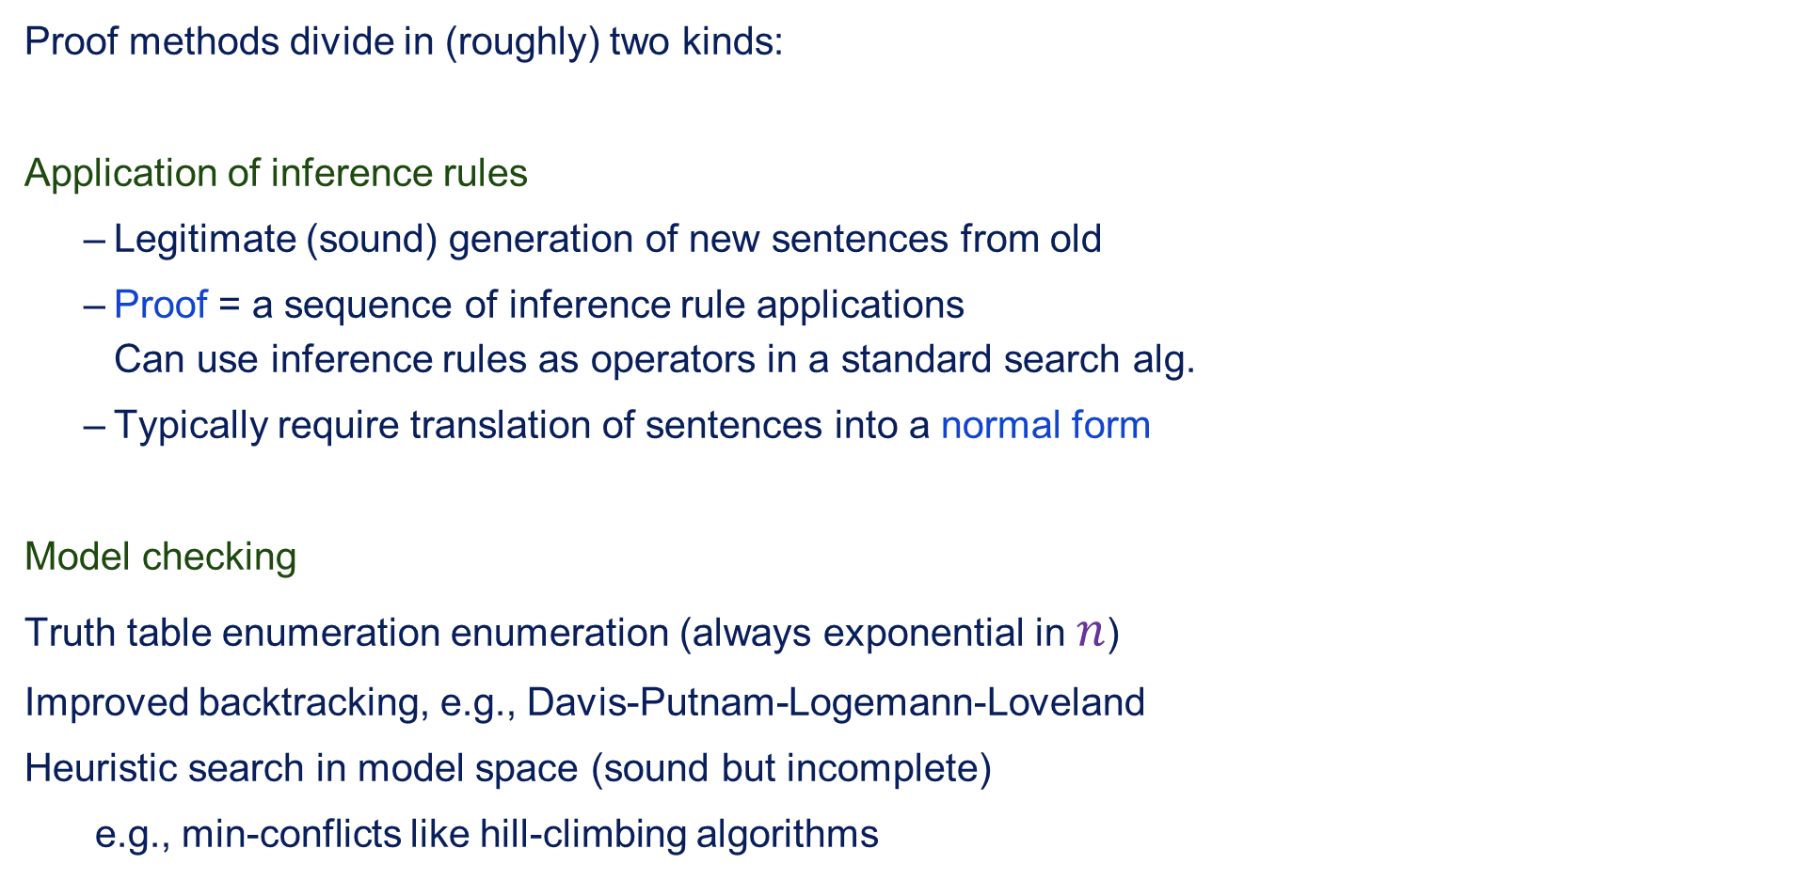
Proof methods
Proof methods divide in (roughly) two kinds:
Application of inference rules
Legitimate (sound) generation of new sentences from old
Proof = a sequence of inference rule applications Can use inference rules as operators in a standard search alg.
Typically require translation of sentences into a normal form
Model checking
Truth table enumeration enumeration (always exponential in $n$)
Improved backtracking, e.g., Davis-Putnam-Logemann-Loveland
Heuristic search in model space (sound but incomplete)
e.g., min-conflicts like hill-climbing algorithms

Slide 24

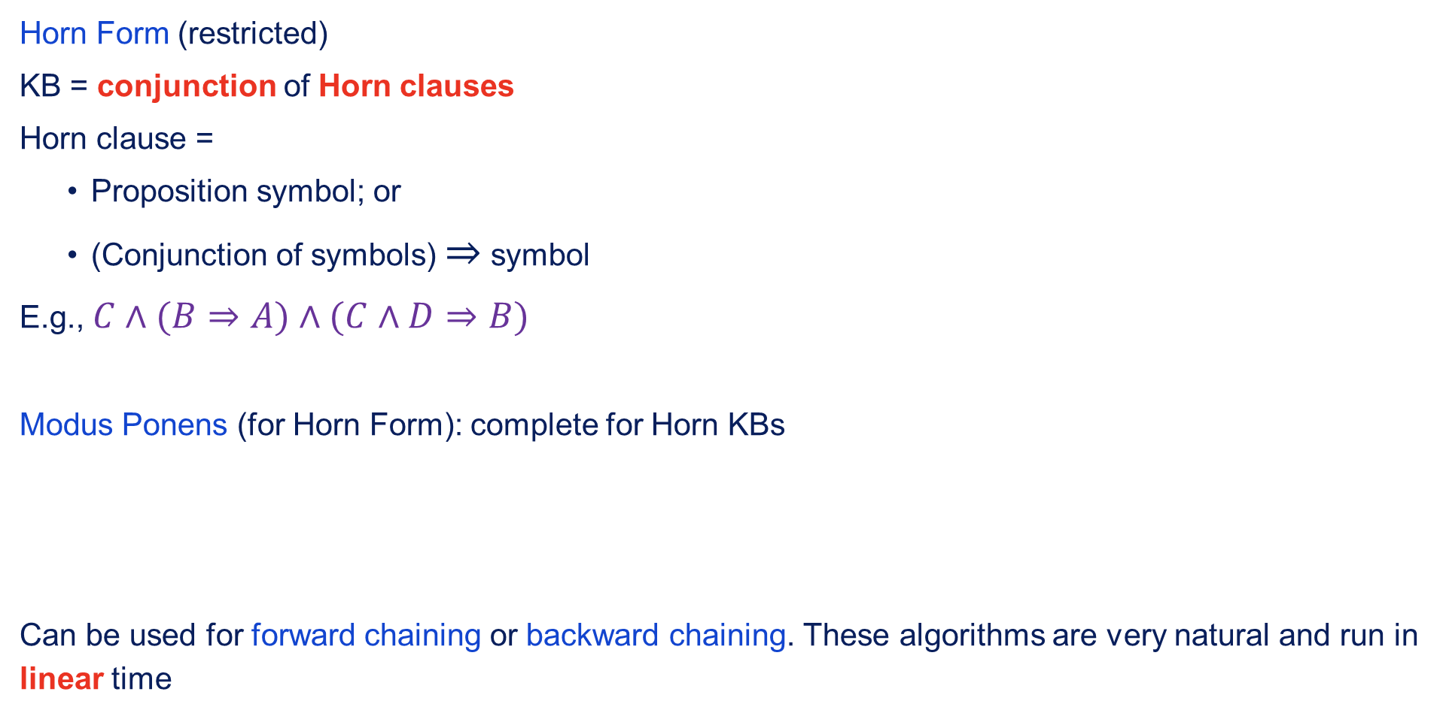
Forward and backward chaining
Horn Form (restricted)
KB = conjunction of Horn clauses
Horn clause =
Proposition symbol; or
(Conjunction of symbols) $⇒$ symbol
E.g., $C∧(B⇒A)∧(C∧D⇒B)$
Modus Ponens (for Horn Form): complete for Horn KBs
Can be used for forward chaining or backward chaining. These algorithms are very natural and run in linear time

Slide 25
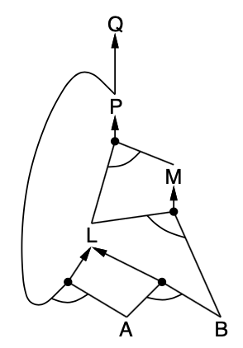

Forward chaining
Idea: fire any rule whose premises are satisfied in the $KB$,
add it's conclusion to the $KB$ until query is found.
$$P⇒Q$$
$$L∧M⇒P$$
$$B∧L⇒M$$
$$A∧P⇒L$$
$$A∧P⇒L$$
$$A$$
$$B$$

Slide 26
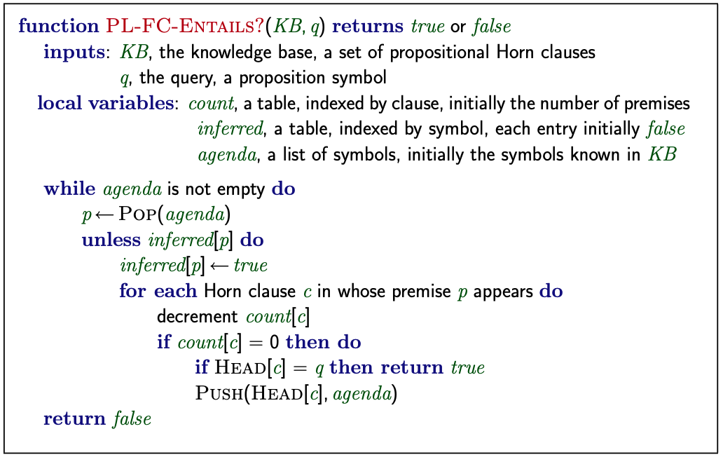
Forward chaining algorithm

Slide 27
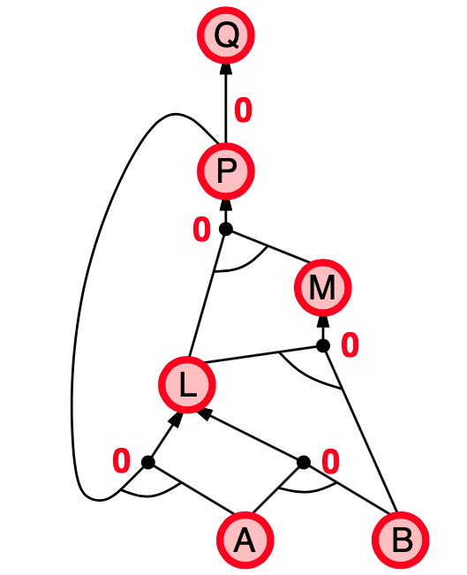
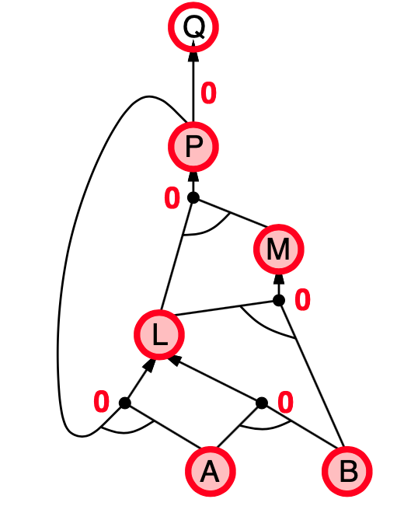
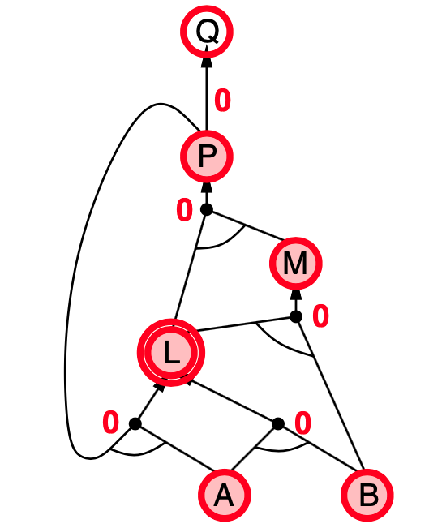
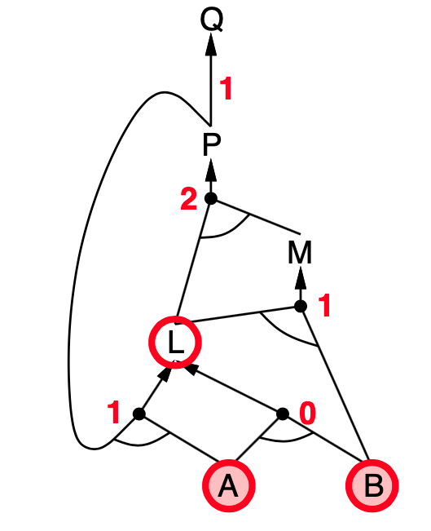
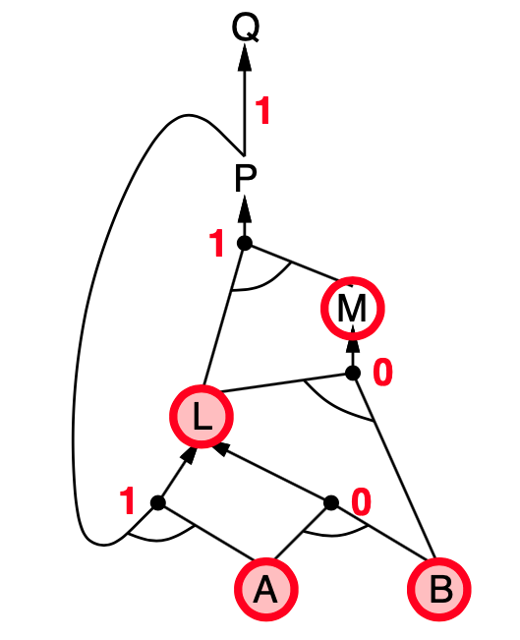
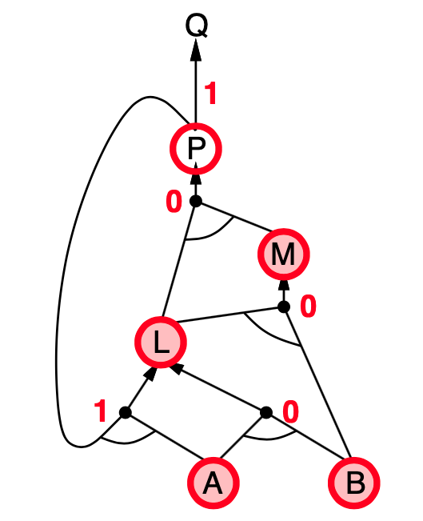
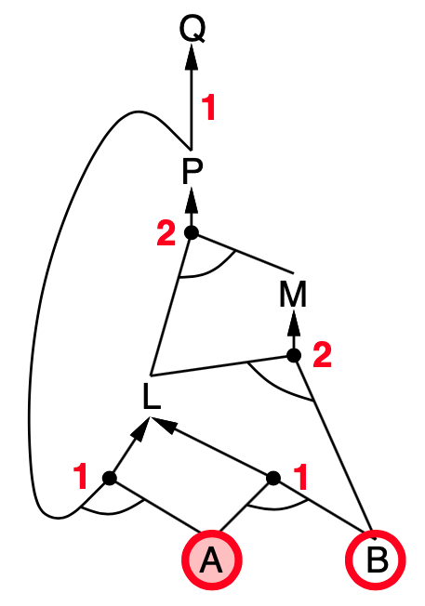
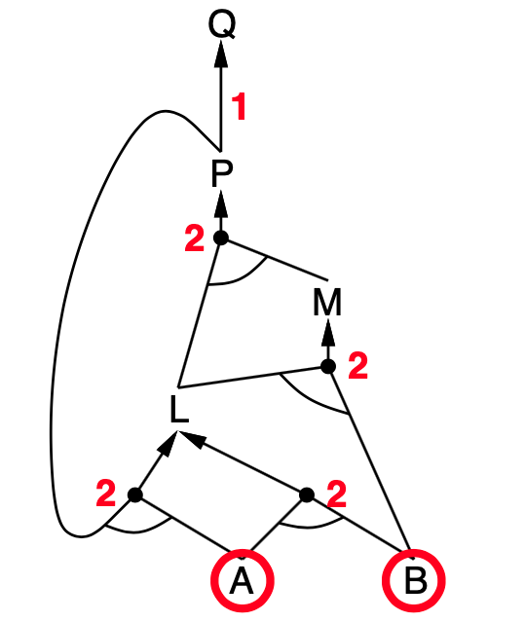
Forward chaining example

Slide 28
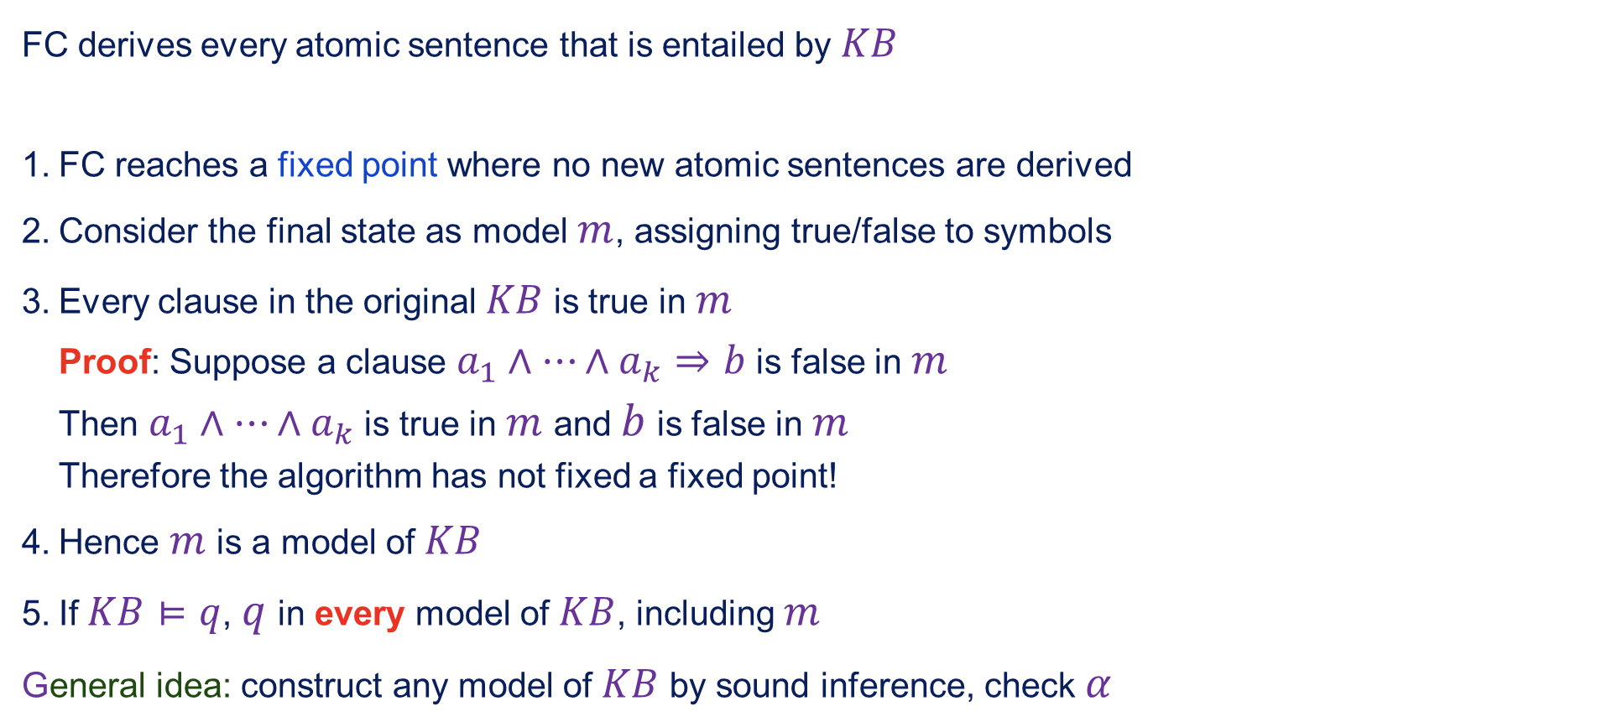
Proof of completeness
FC derives every atomic sentence that is entailed by $KB$
FC reaches a fixed point where no new atomic sentences are derived
Consider the final state as model $m$, assigning true/false to symbols
Every clause in the original $KB$ is true in $m$ Proof: Suppose a clause $a_{1}∧…∧a_{k}⇒b$ is false in $m$ Then $a_{1}∧…∧a_{k}$ is true in $m$ and $b$ is false in $m$ Therefore the algorithm has not fixed a fixed point!
Hence $m$ is a model of $KB$
If $KB⊨q$, $q$ in every model of $KB$, including $m$
General idea: construct any model of $KB$ by sound inference, check $α$

Slide 29

Backward chaining
Idea: work backwards form the query $q$:
To prove $q$ is known already, or prove by BC all premises of some rule concluding $q$
Avoid loops: check if new subgoal is already on the goal stack
Avoid repeated work: check if new subgoal
Has already been proven true, or
Has already failed

Slide 30











Backward chaining example

Slide 31
Forward vs. Backward chaining
FC is data-driven, cf. automatic, unconscious processing, e.g., object recognition, routine decisions
May do lots of work the is irrelevant to the goal
BC is goal-driven, appropriate for problem-solving
e.g., Where are my keys? How do I get into a PhD program?
Complexity of BC can be much less than linear in size of KB

Slide 32



Resolution
Conjunctive Normal Form (CNF—universal):
Resolution inference rule (for CNF): complete for propositional logic

Slide 33


Conversion to CNF
$$B_{1,1}⇔(P_{1,2}∨P_{2,1})$$

Slide 34


Resolution algorithm
Proof by contradiction, i.e., show $KB∧¬α$ unsatisfiable

Slide 35


Resolution example
$$KB=(B_{1,1}⇔(P_{1,2}∨P_{2,1}))∨¬B_{1,1}α=¬P_{1,2}$$

Slide 36
Summary
Logical agents apply interference to a knowledge base to derive new information and make decisions
Basic concepts of logic:
Syntax: formal structure of sentences
Semantics: truth of sentences wrt models
Entailment: necessary truth of one sentence given another
Inference: deriving sentences from other sentences
Soundness: derivations produce only entailed sentences
Completeness: derivations can produce all entailed sentences

Slide 37
Summary contd.
Wumpus world requires the ability to represent partial and negated information, reason by cases, etc.
Forward, backward chaining are linear-time, compete for Horn clauses
Resolution is complete for propositional logic
Propositional logic lacks expressive power

