Slide 1
Brief Introduction to Prolog
Lesson 11: Basic material

Slide 2
What‟s Prolog?
Prolog is a language that is useful for doing symbolic and logic-based computation.
It‟s declarative: very different from imperative style programming like Java, C++, Python,...
A program is partly like a database but much more powerful since we can also have general rules to infer new facts!
A Prolog interpreter can follow these facts/rules and answer queries by sophisticated search.
Ready for a quick ride? Buckle up!

Slide 3
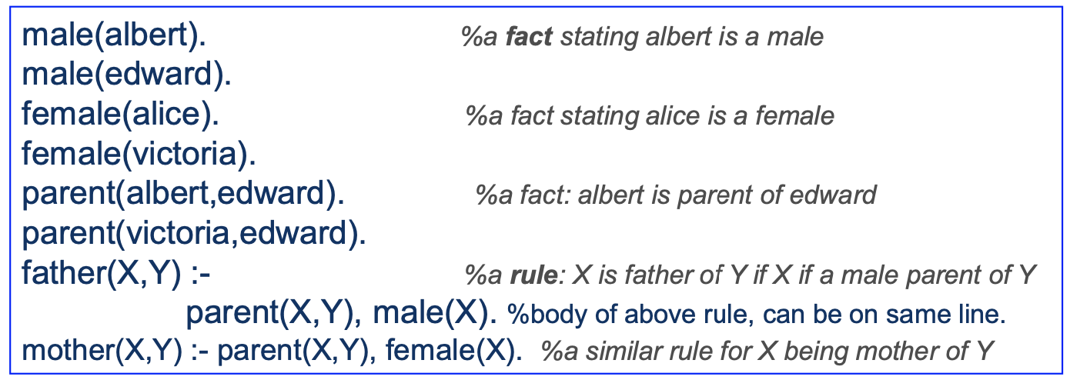
What's Prolog? Let's do a test drive!
Here is a simple Prolog program saved in a file named family.pl
A fact/rule (statement) ends with “.” and white space ignored
read :- after rule head as “if”. Read comma in body as “and”
Comment a line with % or use /* */ for multi-line comments
Ok, how do we run this program? What does it do?

Slide 4
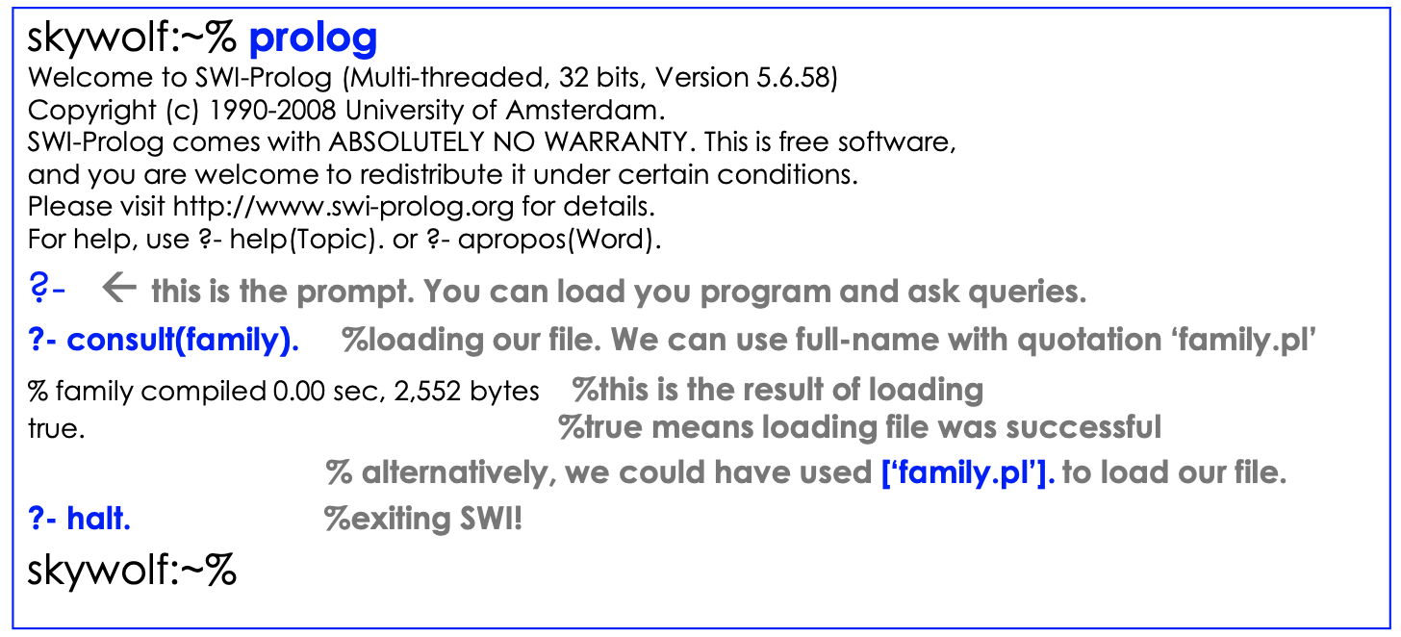
Running Prolog
There are many Prolog interpreters.
SWI is the one we use on CDF. Type prolog in command line:

Slide 5
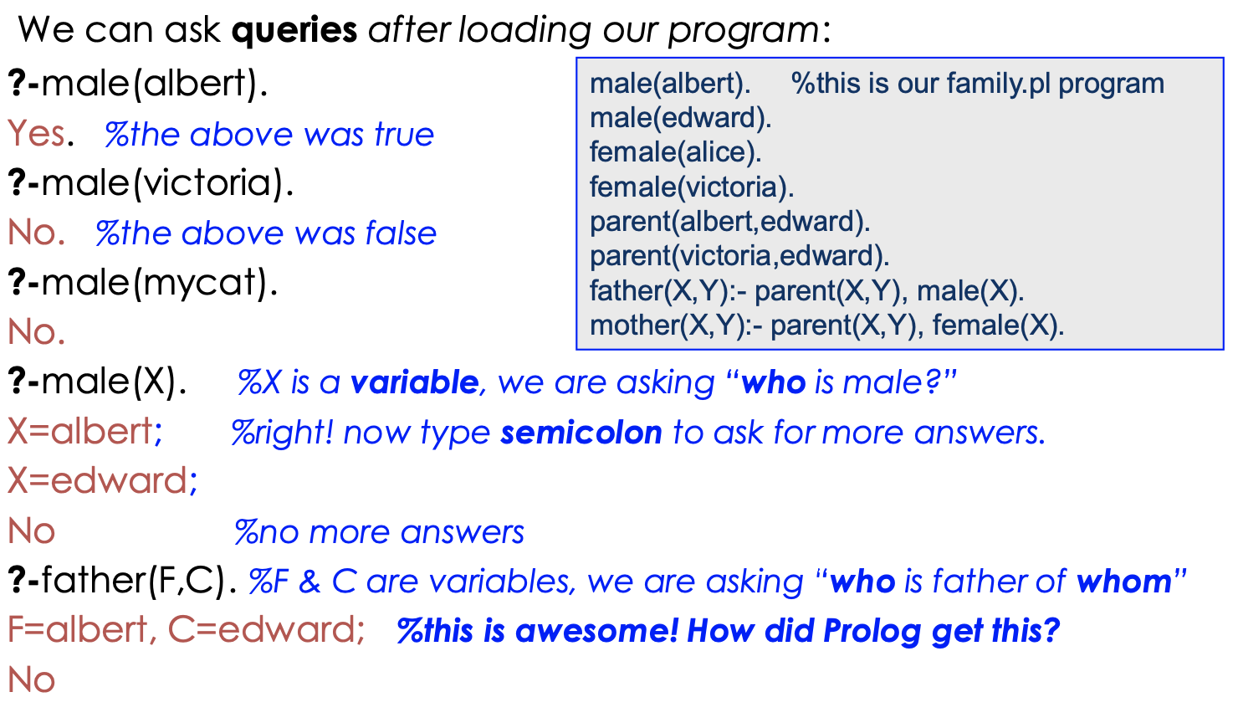
But what can we do with our program?

Slide 6
What to learn?
Your first impression? It‟s very different from Java, Python, and C!
We first need to learn the Prolog Syntax, similar to learning any other language!
To learn how to write programs and ask queries, we also need to understand how a Prolog interpreter operates to find answers to our queries.
Finally, you will need to learn how to write more efficient programs, how to use Negation as Failure, and how to control the Prolog search mechanism using cut.

Slide 7
Syntax of Prolog
Terms
Predicates
Facts and Rules
Programs
Queries

Slide 8
Syntax of Prolog: Terms
Constants:
  Identifiers
    sequences of letters, digits, or underscore “_” that start with lower case letters.
    mary, anna, x25, x_25, alpha_beta
Numbers
  1.001, 2, 3.03
Strings enclosed in single quotes
  'Mary', '1.01, 'string
Variables
  Sequence of letters digits or underscore that start with an upper case letter or the underscore.
    _x, Anna, Successor_State,

Slide 9
Syntax of Prolog: Terms
Constants:
Variables
Structures (like function applications)
  <identifier>(Term1, ..., Termk)
    date(1, may, 1983)
    point(X, Y, Z)
  Note that the definition is recursive. So each term can itself be a structure
    date(+(0,1), may, +(1900,-(183,100)))
  Structures can be represented as a tree

Slide 10
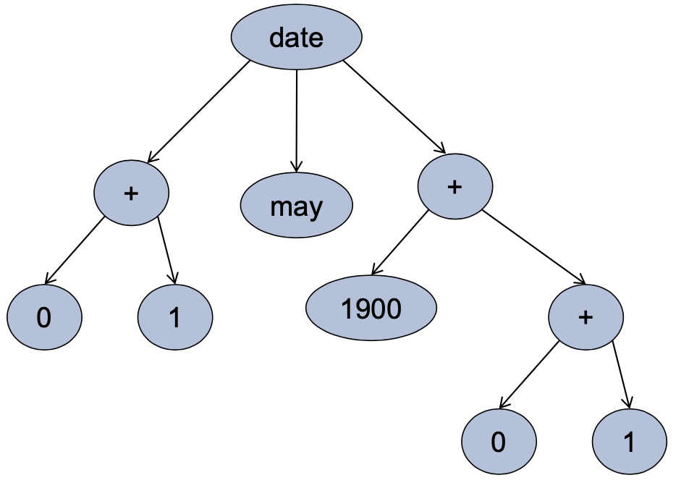
Syntax of Prolog: Terms
Structures as trees
  date(+(0,1), may, +(1900,-(183,100)))

Slide 11
Syntax of Prolog: Terms
Structures
  Rather than represent the arithmetic term
  +(1900,-(183,100))
  in this format (prefix form) Prolog will represent it in more standard infix form
  1900 + (183 – 100)
  Note that since Prolog is a symbolic language it will treat this arithmetic expression as a symbol. That is, it will not evaluate this expression to 1983.
  To force the evaluation we use “is” X is 1900 + (183 – 100).

Slide 12
Syntax of Prolog: Lists as special terms
Lists are a very useful data structure in Prolog.
Lists are structured terms represented in a special way.
  [a,b,c,d]
    This is actually the structured term
    [a | [c | [b | [d | []]]]]
    Where [] is a special constant the empty list.
    Each list is thus of the form [<head> | <rest_of_list>]
    <head> an element of the list (not necessarily a list itself).
    <rest_of_list> is a list (a sub-list).
    also, [a,b,c,d]=[a|[b,c,d]] =[a,b|[c,d]] = [a,b,c|[d]]
    List elements can be any term! For example the list [a, f(a), 2, 3+5, point(X,1.5,Z)] contains 5 elements.
  As we will see, this structure has important implications when it comes to matching variables against lists!

Slide 13
Syntax of Prolog: Predicates
Predicates are syntactically identical to structured terms
<identifier>(Term1, ..., Termk)
  elephant(mary)
  taller_than(john, fred)

Slide 14
Syntax of Prolog: Facts and Rules
A prolog program consists of a collection of facts and rules.
A fact is a predicate terminated by a period “.”
<identifier>(Term1, ..., Termk).
Facts make assertions:
  elephant(mary). Mary is an elephant.
  taller_than(john, fred). John is taller than Fred.
  parent(). Everyone is a parent!
    Note that X is a variable. X can take on any term as its value so this fact asserts that for every value of X, “parent” is true.

Slide 15
Syntax of Prolog: Facts and Rules
Ruleps redicateH :- predicate1, ..., predicatek.
First predicate is RULE HEAD. Terminated by a period.
Rules encode ways of deriving or computing a new fact.
  animal(X) :- elephant(X).
    We can show that X is an animal if we can show that it is an elephant.
  taller_than(X,Y) :- height(X,H1), height(Y,H2), H1 > H2.
    We can show that X is taller than Y if we can show that H1 is the height of X, and H2 is the height of Y, and H1 is greater than H2.
  taller_than(X,Jane) :- height(X,H1), H1 > 165
    We can show that X is taller than Jane if we can show that H1 is the height of X and that H1 is greater than 165
  father(X,Y) :- parent(X,Y), male(X).
    We can show that X is a father of Y if we can show that X is a parent of Y and that X is male.

Slide 16
Operation Of Prolog
A query is a sequence of predicates
  predicate1, predicate2, ..., predicatek
Prolog tries to prove that this sequence of predicates is true using the facts and rules in the Prolog Program.
In proving the sequence it performs the computation you want.

Slide 17
Example
elephant(fred).
elephant(mary).
elephant(joe).
animal(fred) :- elephant(fred).
animal(mary) :- elephant(mary).
animal(joe) :- elephant(joe).
QUERY
animal(fred), animal(mary), animal(joe)

Slide 18
Operation
Starting with the first predicate P1 of the query
Prolog examines the program from TOP to BOTTOM.
It finds the first RULE HEAD or FACT that matches P1
Then it replaces P1 with the RULE BODY.
If P1 matched a FACT, we can think of FACTs as having empty bodies (so P1 is simply removed).
The result is a new query.
E.g.
P1 :- Q1, Q2, Q3
QUERY = P1, P2, P3 P1 matches with rule
New QUERY = Q1, Q2, Q3, P2, P3

Slide 19
Example
elephant(fred).
elephant(mary).
elephant(joe).
animal(fred) :- elephant(fred).
animal(mary) :- elephant(mary).
animal(joe) :- elephant(joe).
QUERY
animal(fred), animal(mary), animal(joe)
elephant(fred), animal(mary), animal(joe)
animal(mary),animal(joe)
elephant(mary), animal(joe)
animal(joe)
elephant(joe)
EMPTY QUERY

Slide 20
Operation
If this process reduces the query to the empty query, Prolog returns “yes”.
However, during this process each predicate in the query might match more than one fact or rule head
  Prolog always choose the first match it finds. Then if the resulting query reduction did not succeed (i.e., we hit a predicate in the query that does not match any rule head of fact), Prolog backtracks and tries a new match.

Slide 21
Example
ant_eater(fred).
animal(fred) :- elephant(fred).
animal(fred) :- ant_eater(fred).
QUERY
animal(fred)
elephant(fred).
FAIL BACKTRACK.
ant_eater(fred).
EMPTY QUERY

Slide 22
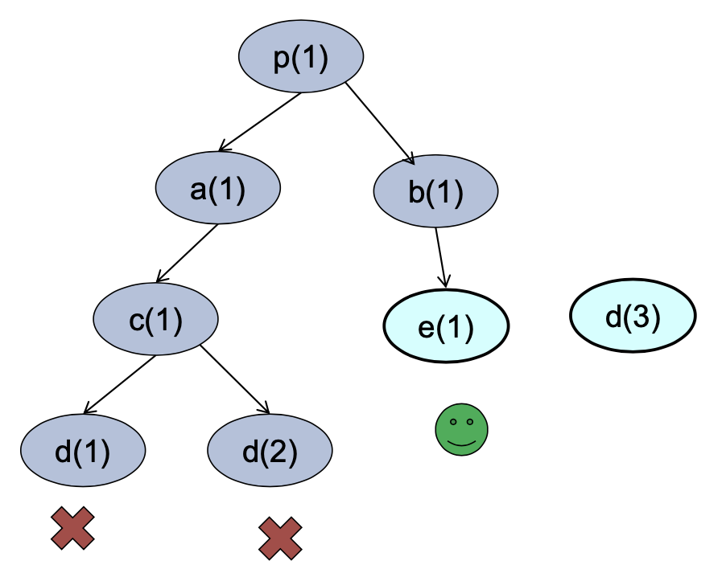
Operation
Backtracking can occur at every stage as the query is processed.
p(1) :- a(1).
p(1) :- b(1).
a(1) :- c(1).
c(1) :- d(1).
c(1) :- d(2).
b(1) :- e(1).
e(1).
d(3).
Query: p(1)

Slide 23
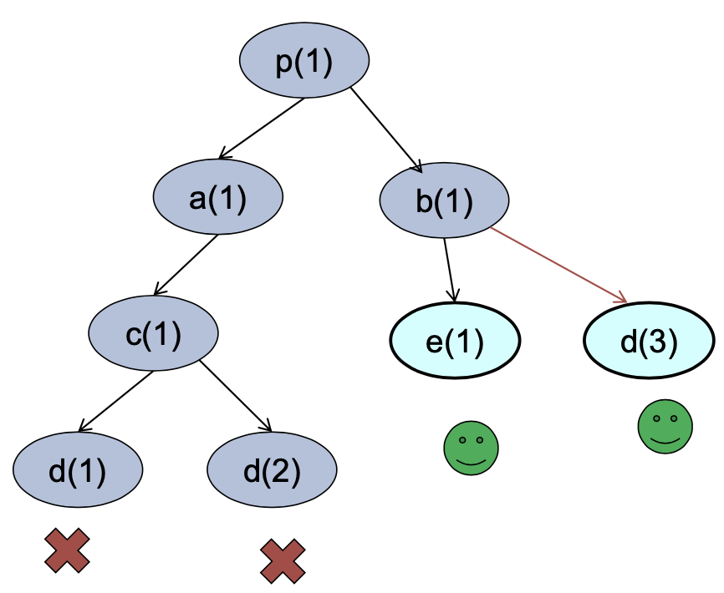
Operation
Backtracking can occur at every stage as the query is processed.
p(1) :- a(1).
p(1) :- b(1).
a(1) :- c(1).
c(1) :- d(1).
c(1) :- d(2).
b(1) :- e(1).
b(1) :- d(3).
e(1).
d(3).
Query: p(1)

Slide 24
Variables and Matching
Variables allow us to
Compute more than yes/no answers
Compress the program.
elephant(fred).
elephant(mary).
elephant(joe).
animal(fred) :- elephant(fred).
animal(mary) :- elephant(mary).
animal(joe) :- elephant(joe).
The three rules can be replaced by the single rule animal(X) :- elephant(X).
When matching queries against rule heads (of facts) variables allow many additional matches.

Slide 25
Example
elephant(fred).
elephant(mary).
elephant(joe).
animal(X) :- elephant(X).
QUERY
animal(fred), animal(mary), animal(joe)
X=fred, elephant(X), animal(mary), animal(joe) 2. animal(mary),animal(joe)
X = mary, elephant(X), animal(joe)
animal(joe)
X= joe, elephant(X)
EMPTY QUERY

Slide 26
Operations with Variables
Queries are processed as before (via rule and fact matching and backtracking), but now we can use variables to help us match rule heads or facts.
A query predicate matches a rule head or fact (either one with variables) if
  The predicate name much match. So elephant(X) can match elephant(fred), but can never match ant_eater(fred).
  Once the predicates names the arity of the predicates much match (number of terms). So foo(X,Y) can match foo(ann,mary), but cannot match foo(ann) or foo(ann,mary,fred).

Slide 27
Operation
A query predicate matches a rule head or fact (either one with variables) if
  If the predicate names and arities match then each of the k-terms much match. So for foo(t1, t2, t3) to match foo(s1, s2, s3) we must have that t1 matches s1, t2 matches s2, and t3 matches t3.
  During this matching process we might have to “bind” some of the variables to make the terms match.
  These bindings are then passed on into the new query (consisting of the rule body and the left over query predicates).

Slide 28
Variable Matching (Unification)
Two terms (with variables match if):
  If both are constants (identifiers, numbers, or strings)
  and are identical.
  If one or both are bound variables then they match if what the variables are bound to match.
    X and mary where X is bound to the value mary will match.
    X and Y where X is bound to mary and Y is bound to mary
    will match,
    X and ann where X is bound to mary will not match.

Slide 29
Variable Matching (Unification)
If one of the terms is an unbound variable then they match AND we bind the variable to the term.
  X and mary where X is unbound match and make X bound to mary.
  X and Y where X is unbound and Y is bound to mary match and make X bound to mary.
  X and Y where both X and Y are unbound match and make X bound to Y (or vice versa).

Slide 30
Variable Matching (Unification)
If the two terms are structures
t = f(t1, t2, ..., tk)
s = g(s1, s2, ..., sn)
Then these two terms match if
  the identifiers “f” and “g” are identical.
  They both have identical arity (k=n)
  Each of the terms ti, si match (recursively).
E.g.
  date(X, may, 1900) and date(3, may, Y) match and make X bound
  Note we can bind a variable to a term containing another variable!
The predicate “=” shows what Prolog unifies!

Slide 31
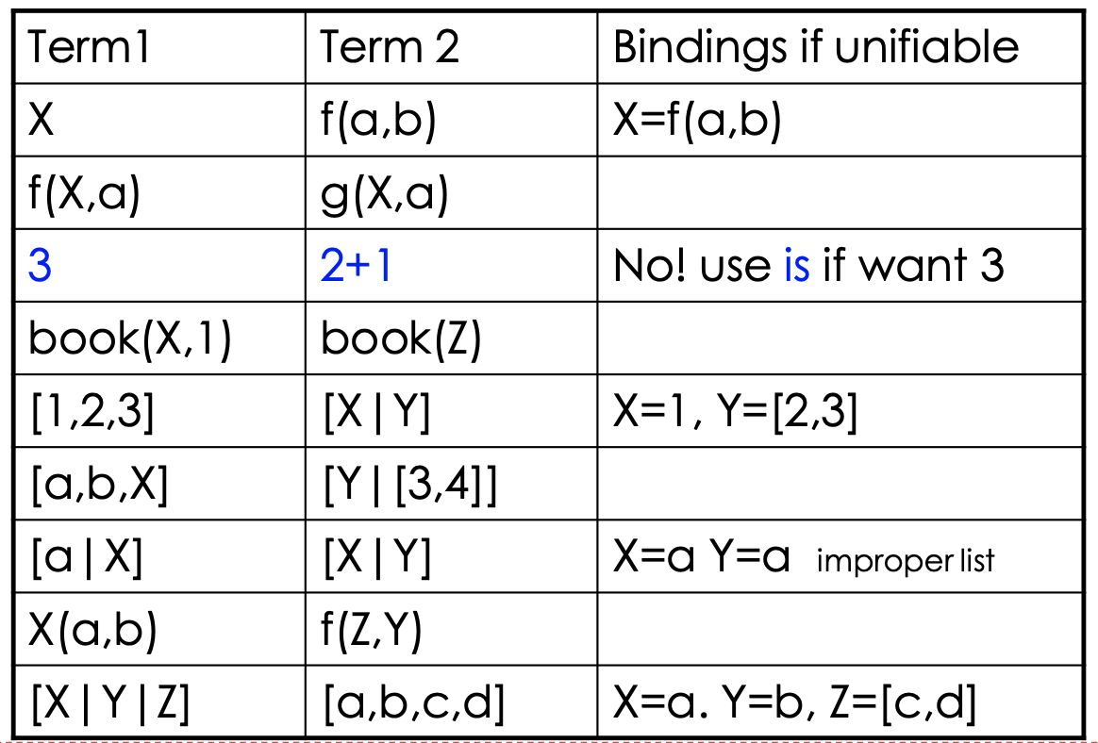
Unification Examples
Which of the following are unifiable?

Slide 32
Solving Queries
How Prolog works:
  Unification
  Goal-Directed Reasoning
  Rule-Ordering
  DFS and backtracking
When given a query Q = q1, q2, ..., qn Prolog performs a search in an attempt to solve this query. The search can be specified as follow

Slide 33
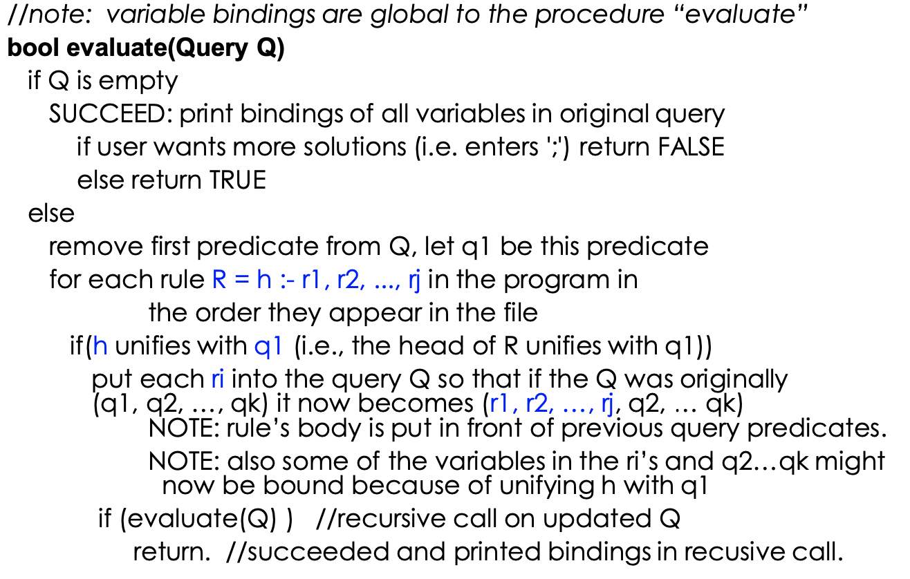
Details of Solving Queries by Prolog

Slide 34
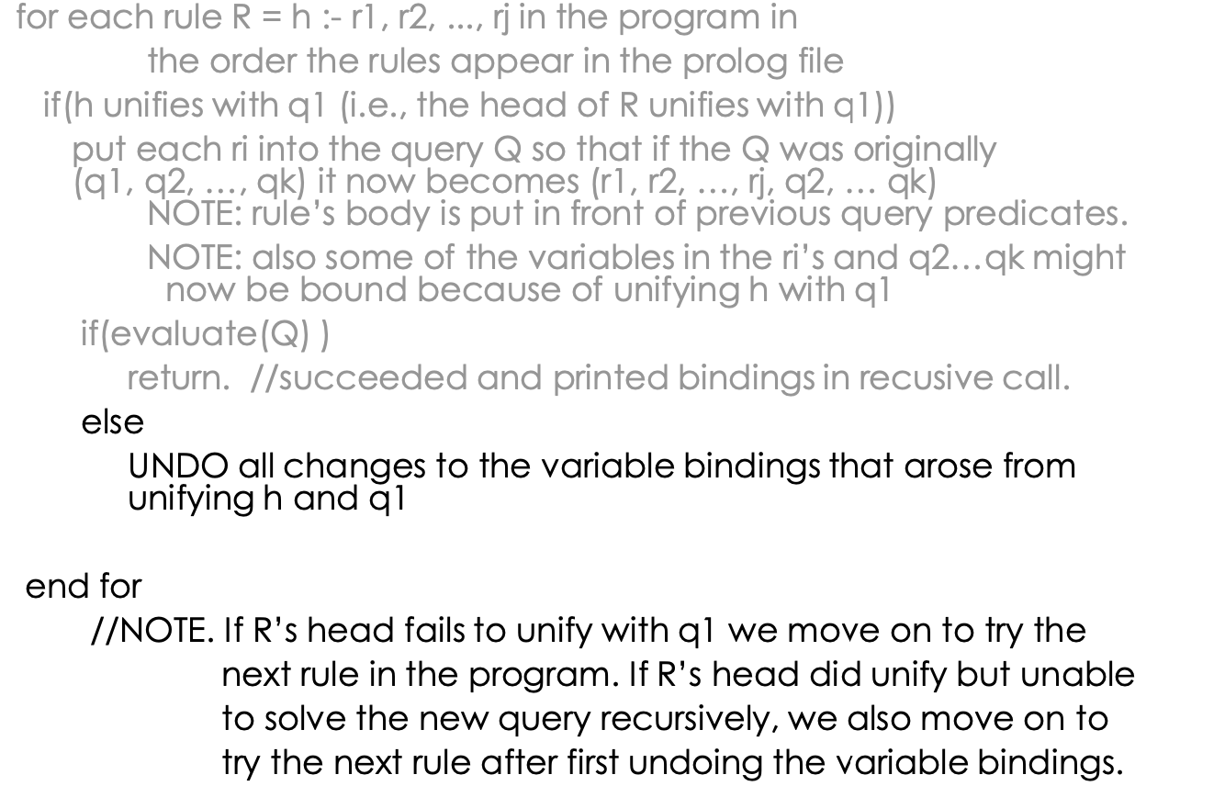
Computing with Queries

Slide 35
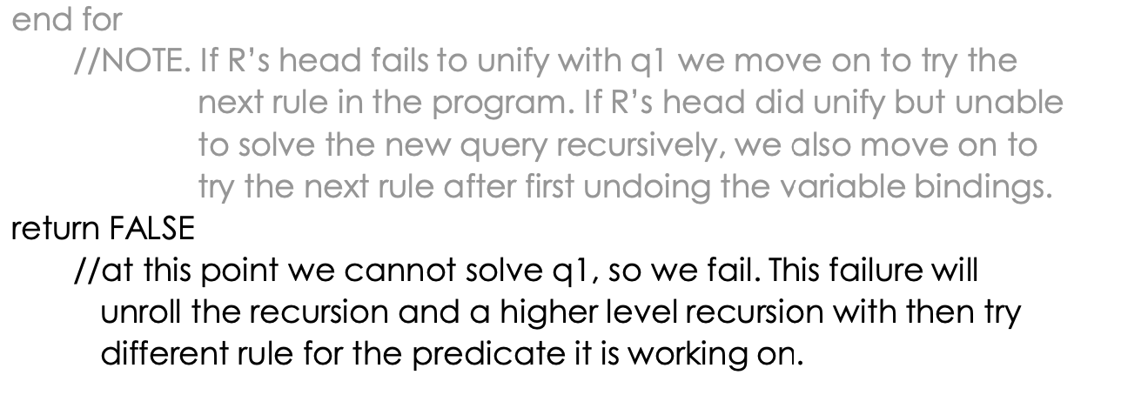
Computing with Queries

Slide 36
Query Answering is Depth First Search
This procedure operates like a depth-first search, where the order of the search depends on the order of the rules and predicates in the rule bodies.
When Prolog backtracks, it undoes the bindings it did before.
Exercise: try the following queries on family.pl:
parent(P,C)
father(F,C).
[if you can, use the interactive SWI with graphical debugger]

Slide 37
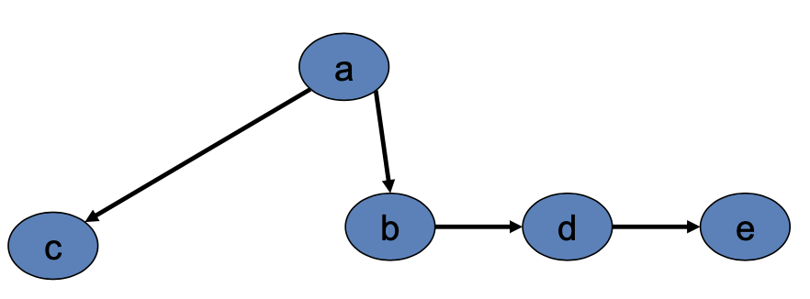
Another Example of Query Answering
Route finding in in a directed acyclic graph:
edge(a,b).
edge(a,c).
edge(b,d).
edge(d,e).
path(X,Y) :- path(X,Z), edge(Z,Y).
path(X,Y) :- edge(X,Y).
The above is problematic. Why?
Here is the correct solution:
path(X,Y) :- edge(X,Y).
path(X,Y) :- edge(X,Z), path(Z,Y).

Slide 38
Search Tree for Path Predicate
Here is the program:
  edge(a,b).
  edge(a,c).
  edge(b,d).
  edge(d,e).
path(X,Y) :- edge(X,Y).
path(X,Y) :- edge(X,Z), path(Z,Y).
Queries:
    path(a,e). [run SWI interactively to see this in action.]
    path(c,R).
    path(S,c).
What if the graph is undirected? Simple:
    undirEdge(X,Y):- edge(X,Y).
    undirEdge(X,Y):- edge(Y,X).
then replace edge predicate by undirEdge in the definition of path.

Slide 39
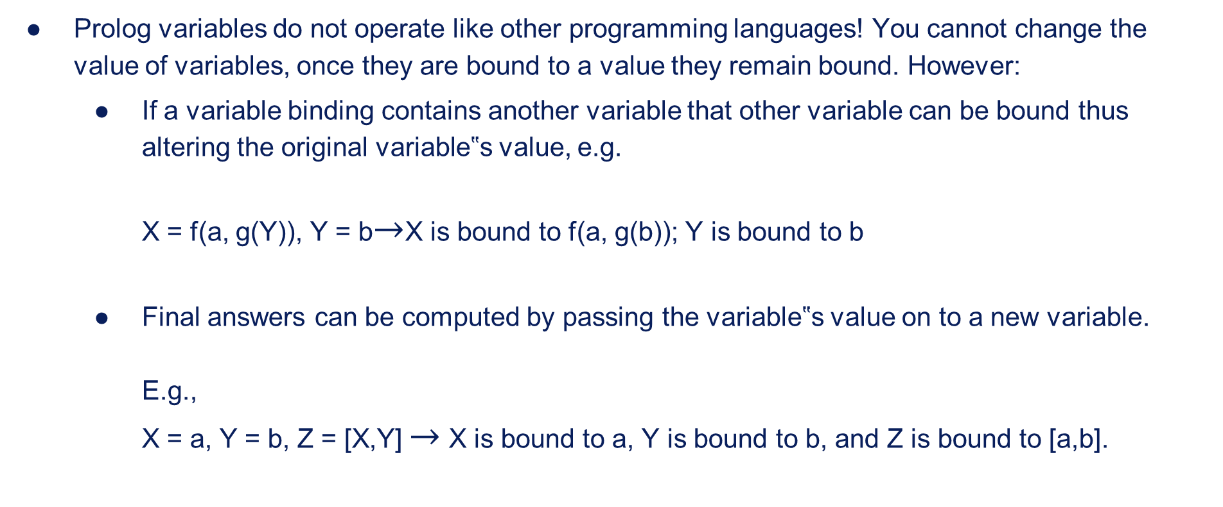
Notes on Prolog Variables
Prolog variables do not operate like other programming languages! You cannot change the value of variables, once they are bound to a value they remain bound. However:
  If a variable binding contains another variable that other variable can be bound thus altering the original variable‟s value, e.g.
  X = f(a, g(Y)), Y = b$→$X is bound to f(a, g(b)); Y is bound to b
  Final answers can be computed by passing the variable‟s value on to a new variable.
  E.g.,
  X = a, Y = b, Z = [X,Y] $→$ X is bound to a, Y is bound to b, and Z is bound to [a,b].

Slide 40
List Processing in Prolog
Much of prolog‟s computation is organized around lists. Two key things we do with a list is iterate over them and build new ones.
E.g. checking membership: member(X,Y) X is a member of list Y.
member(X,[X|_]).
member(X,[_|T]):- member(X,T).
What if we define member like this:
member(X,[X|_]).
member(X,[Y|T]):- X \= Y, member(X,T).
what is the result of member(X,[a,b,c,d])?
E.g. building a list of integers in range [i, j]. build(from, to, NewList)
        build (I,J,[ ]) :- I > J.
        build (I,J,[I | Rest]) :- I =< J, N is I + 1, build(N,J,Rest).

Slide 41
List Processing in Prolog continue...
Computing the size of a list: size(List, ListSize) size([],0).
size([ _|T],N) :- size(T,N1), N is N1+1.
Computing the sum of a list of nums: sumlist(List, Sum) sumlist([],0)
sumlist([H|T],N) :- sumlist(T,N1), N is N1+H.
Exercise: implement append(L1,L2, L3) which holds if L3 is the result of appending list L1 and L2. For example,
append([a,b,c],[1,2,3,4],[a,b,c,1,2,3,4]).

Slide 42
Next Tutorial (Part 2)
More advanced material in the next tutorial:
  Efficient lists processing using accumulators
  Constructing predicates dynamically (on-the-fly)
  Cut (controlling how Prolog does the search)
  Negation as failure (NAF)
  if-then-else
  Debugging Prolog programs

