Slide 1
A Brief Introduction to Prolog
Lesson 12

Slide 2
Overlay
Debugging Prolog programs
Passingpredicatesasargumentsandconstructing predicates dynamically (on-the-fly).
Efficient lists processing using accumulators
Negation as failure(NAF)
Cut (controlling how Prolog does the search)
if-then-else

Slide 3
Debugging Prolog Programs
Graphical Debugger (gtrace):
On CDF: run“xpce” instead of “prolog”. Then, to debug:  ?-gtrace, father(X, john).
Very easy to use. see “http://www.swi-prolog.org/gtrace.html”
Text-based debugger:
You can put or remove a breakpoint on a predicate:
?- spy(female).
?- nospy(female).
To start debugging use “trace” before the query:
?- trace, male(X).

Slide 4
Debugging Prolog Programs
While tracing you can do the following:
creap: step inside the current goal (press c/enter/or space)
leap: run up to the next spypoint (press l )
skip: step over the current goal without debugging (press s)
abort: abort debugging (press a)
And much more... press h for help

Slide 5
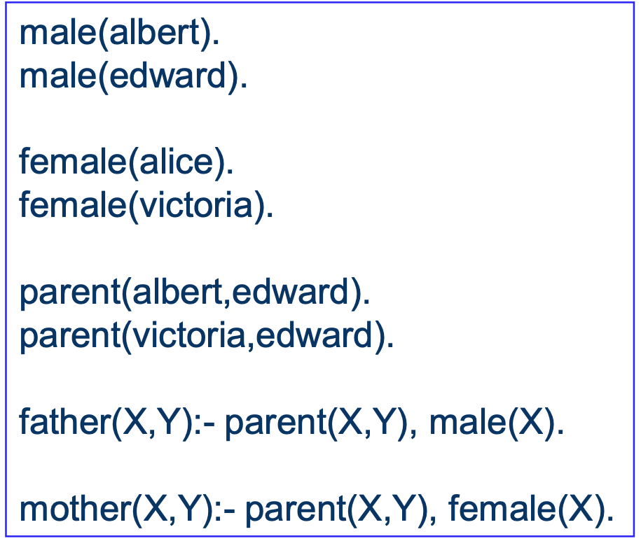
Text Debugger Example
?-spy(female/1). Yes
?-mother(X,Y). %starts debugging! Call: (9) female(albert) ?
?-nospy(female/1). % Spy point removed from female/1
trace, father(X,Y). %let’s debug! Call: (9) father(_G305, _G306) ?
Simple Exercise: debug this program both in the text and graphical debugger.

Slide 6
Passing Predicates as Argument
We can pass a predicate as an argument to a rule: test(X) :- X. ?- test(male(john)). %succeeds if male(john) holds. ?- test(parent(carrot,4)). %fails .
What if we want to pass arguments of the predicate separately? test(X,Y) :- X(Y). % this is syntax error! ?- test(male, john).
Unfortunately the above does not work, we cannot write X(Y) !!

Slide 7
Passing Predicates as Argument
=.. is used to build predicates on the fly: test(X,Y) :- G =.. [X,Y], G. %builds predicate X(Y) dynamically and calls it ?- test(male, john).
In general, G =.. [P,X1,X2,...,Xn] creates P(X1,X2,...,Xn). E.g: ?- G =.. [parent, john, X]. G = parent(john, X)

Slide 8
Adding/Deleting Rules/Facts Dynamically
A program can add or delete facts/rules dynamically:
assert(term) %adds the given rule or fact
assert(male(john)).
assert((animal(X) :- dog(X))).
retract(term) %deletes the first fact/rule that unifies with the given term
retract(animal(_)).
died(X), retract(parent(john,X)).
retractrtall(term) %deletes ALL facts/rules that unify
retractall(parent(_,_)).
There is also assertz(term) that adds the fact/rule to the end rather than beginning

Slide 9
More Lists Processing in Prolog
Much of Prolog’s computation is organized around lists.
Many built-in predicates: member, append ,length, reverse.
List of lists:
[[1,2], [a, b, c(d), 4], [] ]
Can define a matrix, e.g. 3x2 M=[[1,2], [-1,4], [5,5]]
Elements can be structures: M2= [[(1.5,a), (3.2,b)], [(0,c), (7.2,d)]] is a 2x2 matrix. Then if write M2=[H|_], H=[_,(Cost, Name)]. It succeeds and we get Cost=3.2 and Name=b.
Exercise: write a predicate getElm(M,R,C,E) which holds if element E is at M[R][C]. Assume the matrix is KxL and I,J>=0 and in range. Note that M[0][0] is the element at 1st row 1st column

Slide 10
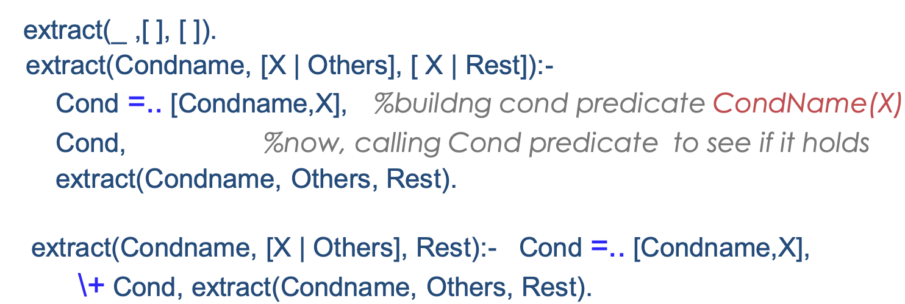
Lists: Extracting Desired Elements
Extracting all elements satisfying a condition: e.g. extract(male, [john, alice, 2, sam], Males)
Generally: extract(+Cond, +List, ?Newlist) %Note: +, -, ? are not actual Prolog symbols, just used as convention!
\+ is negation as failure. We can also simplify the above using if- then-else. We will get back to these in a couple of slides.

Slide 11
List: append
Appending two lists (challenge: no assumption on args): append(?X, ?Y, ?Z)
Holds iff Z is the result of appending lists X and Y.
Examples:
append([a,b,c],[1,2,3,4],[a,b,c,1,2,3,4])
Extracting the third element of L: append([_,_,X],_,L) Extracting the last element of L: axppend(_,[X],L)
Finding two consecutive elements X&Y in L:
append(_,[X,Y|_],L)

Slide 12
Implementing append
definition: append(?X, ?Y, ?Z)
append([ ],L,L).
append([H|T],L,[H|L2]):-
append(T,L,L2).
What are all the answers to append(_,[X,Y],[1,2,3,4,5]) ?
What are all the answers to append(X,[a],Y) ?
What is the answer to append(X,Y,Z)? How many answers?

Slide 13

Lists: reversing
Reversing a list: [1,2,[a,b],3] -> [3,[a,b],2,1]
reverse(?L,?RevL)
reverse([ ], [ ]).
reverse([H|T],RevL):-
reverse(T,RevT),append(RevT,[H],RevL).
This is not efficient! Why? O($N^{2}$)

Slide 14
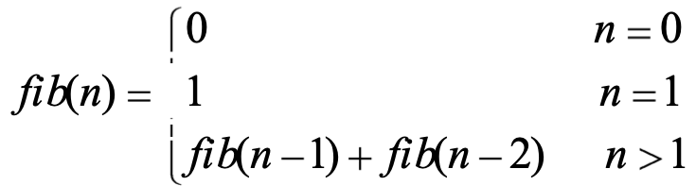
Efficiency issues: Fibonacci
Fibonacci numbers:
Consider the following implementation: fib(0,0) fib(1,1) fib(N,F):- N>1,
N1 is N-1, fib(N1,F1), N2 is N-2, fib(N2, F2), F is F1+F2.
This is very inefficient (exponential time)! Why?
Solution: use accumulator!

Slide 15
Fibonacci using accumulators
Definition: fibacc(+N,+Counter,+FibNminus1,+FibNminus2,-F) We start at counter=2, and continue to reach N. FibNminus1 and FibNminus2 are accumulators and will be update in each recursive call accordingly.
fibacc(N,N,F1,F2,F):- %basecase: the counter reached N, we are done!
F is F1+F2.
fibacc(N,I,F1,F2,F):- I<N, %the counter < N, so updating F1&F2
Ipls1 is I +1, F1New is F1+F2, F2New is F1,
fibacc(N,Ipls1,F1New,F2New,F).
This is O(N).
Now we define fib(N,F) for N>1 to be fibacc(N,2,1,0,F).

Slide 16
Accumulators: reverse
Efficient List reversal using accumulators: O(n)
reverse(L,RevL):-
revAcc(L,[ ], RevL).
revAcc([ ],RevSoFar, RevSoFar).
revAcc([H|T],RevSoFar, RevL):-
revAcc(T,[H|RevSoFar], RevL).

Slide 17
Negation As Failure
Prolog cannot assert something is false.
Anything that cannot be proved from rules and facts is considered to be false (hence the name Negation as Failure)
Note that this is different than logical negation!
In SWI it is represented by symbols \+
\+ member(X,L) %this holds if it cannot prove X is a member of L
\+(A<B) %this holds if it cannot prove A is less than B
X \= Y is shorthand for \+ (X=Y)

Slide 18
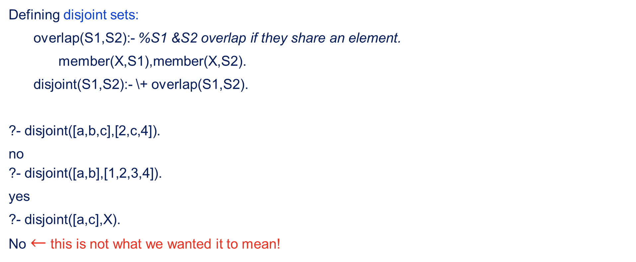
NAF examples
Defining disjoint sets:
overlap(S1,S2):- %S1 &S2 overlap if they share an element.
member(X,S1),member(X,S2).
disjoint(S1,S2):- \+ overlap(S1,S2).
?- disjoint([a,b,c],[2,c,4]).
no ?- disjoint([a,b],[1,2,3,4]).
yes
?- disjoint([a,c],X). No $←$ this is not what we wanted it to mean!

Slide 19
Proper use of NAF
\+ G works properly only in the following two cases:
When G is fully instantiated at the time of processing \+. In this case, the meaning is straightforward.
When there are uninstantiated variables in G but they do not appear elsewhere in the same clause. In this case, it mean there are no instantiations for those variable that makes the goal true. e.g. \+G(X) means there is no X such that G(X) succeeds.

Slide 20
If-then-else
Let’s implement max(X,Y,Z) which holds if Z is maximum of X and Y. using NAF: max(X,Y,Z) :- X =< Y , Z = Y. max(X,Y,Z) :- \+(X =< Y) , Z = X.
This is a simple example. But shows a general pattern: we want the second rule be used only if the condition of the 1st rule fails.: it’s basically an if-then-else: p :-A, B. p:- \+ A , C.
SWI has a built-in structure that simplifies this and is much more efficient: ->

Slide 21
If-then-else
InProlog,“ifAthenBelseC”iswrittenas(A->B;C).
To Prolog this means:
tryA.Ifyoucanproveit,goontoproveBand ignore C. If A fails, however, go on to prove C ignoring B.
Let’s write max using -> max(X,Y,Z) :-
(X =< Y -> Z = Y ;
Z=X
).
Note that you may need to add parenthesis around A, B, or C themselves if they are not simple predicates.

Slide 22
Guiding the Search Using Cut
The goal “!”, pronounced cut, always succeeds immediately but just once
It has an important side-effect: once it is satisfied, it disallows (just for the current call to predicate containing the cut):
backtracking before the cut in that clause
Using next rules of this predicate
So, below, before reaching cut, there might be backtracking on b1 and b2 and even trying other rules for p if b1&b2 cannot be satisfied.
p:- b1,b2,!,a1,a2,a3. %however, after reaching !, no backtracking on b1&b2
p:- r1,...,rn. %also this rule won’t be searched p:- more rules. %this one too!
See the following link for more details and examples: http://cs.union.edu/~striegnk/learn-prolog-now/html/node88.html#sec.l10.cut

Slide 23
Implementing \+ and -> using cut
fail is a special symbol that will immediately fail when Prolog encounters it.
We can implement NAF using cut and fail as follows:
neg(Goal) :- Goal, !, fail.
neg(Goal).
neg will act similarly to \+. Why? We can implement “p :- A -> B ; C” using cut:
p :- A,!,B. p :- C.
If A can be proved, we reach the cut and the 2nd rule will not be tried.
If A cannot be proved we don’t reach cut and the 2nd rule is tried.

