Slide 1
Uncertainty
Lesson 13

Slide 2
Outline
Uncertainty
Probability
Syntax and Semantics
Inference
Independence and Bayes' Rule

Slide 3
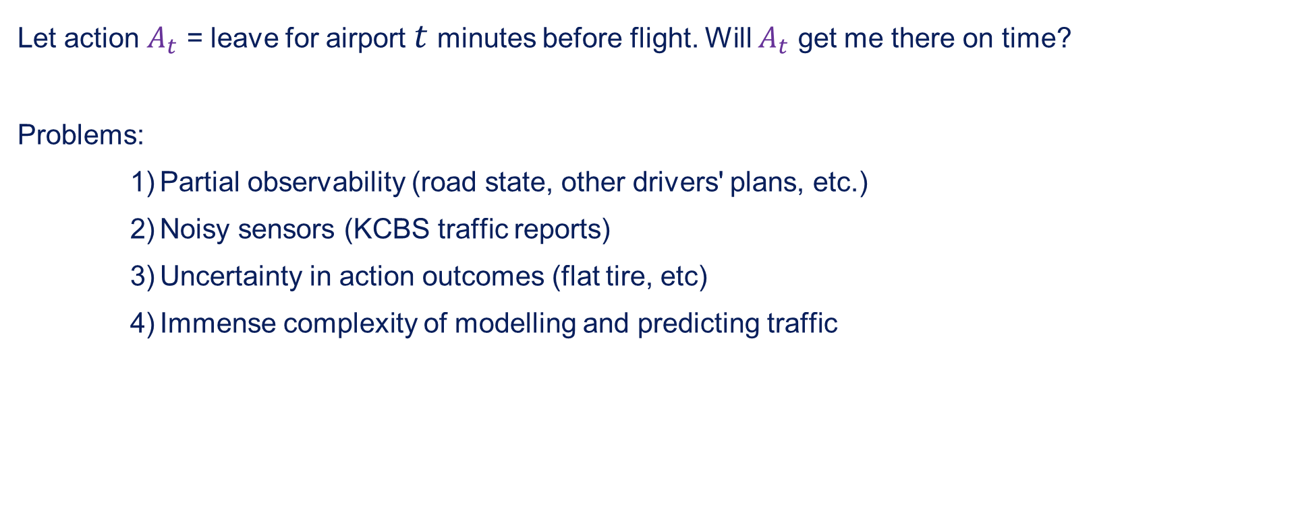
Uncertainty
Let action $A_{t}$ = leave for airport $t$ minutes before flight. Will $A_{t}$ get me there on time?
Problems:
Partial observability (road state, other drivers' plans, etc.)
Noisy sensors (KCBS traffic reports)
Uncertainty in action outcomes (flat tire, etc)
Immense complexity of modelling and predicting traffic

Slide 4
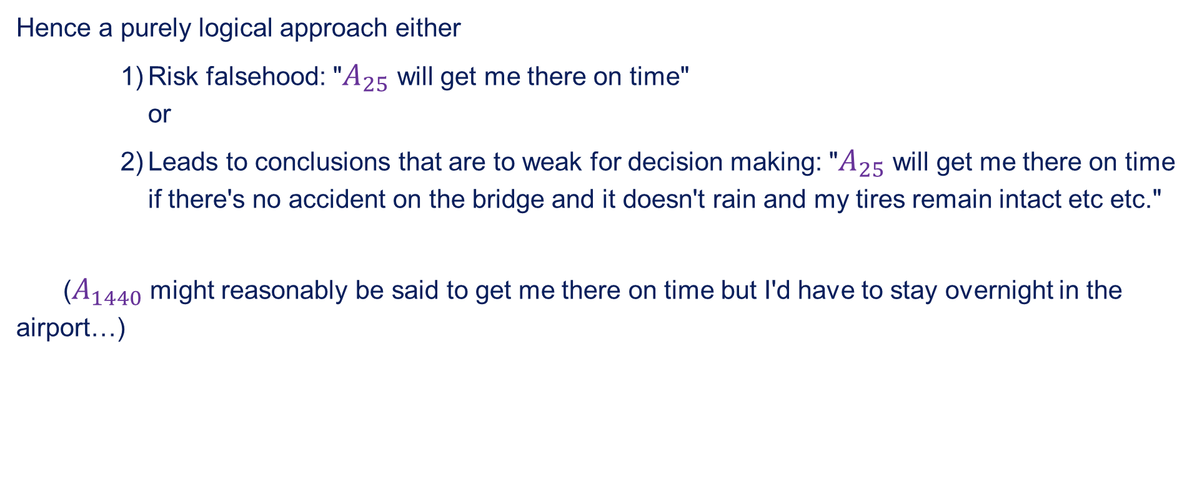
Uncertainty contd.
Hence a purely logical approach either
Risk falsehood: "$A_{25}$ will get me there on time" or
Leads to conclusions that are to weak for decision making: "$A_{25}$ will get me there on time if there's no accident on the bridge and it doesn't rain and my tires remain intact etc etc."
($A_{1440}$ might reasonably be said to get me there on time but I'd have to stay overnight in the airport…)

Slide 5
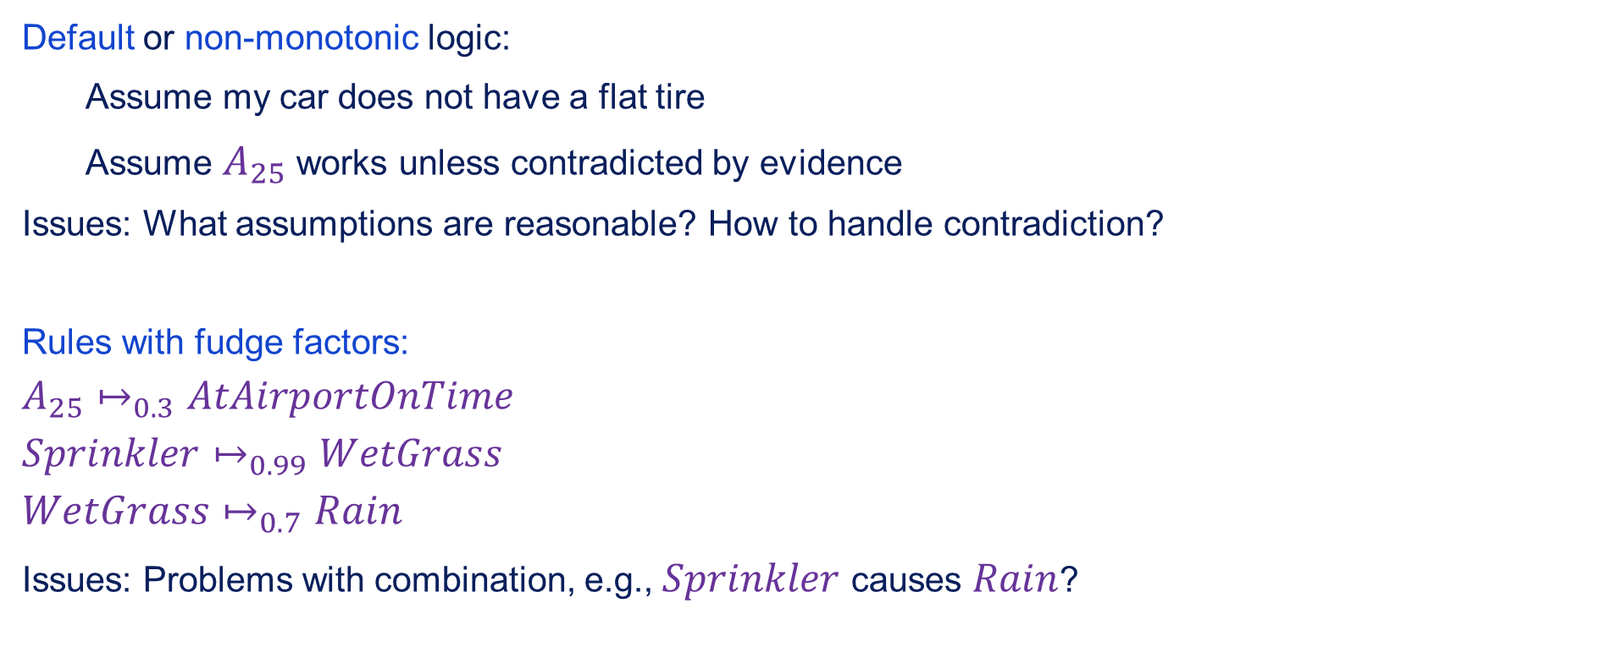
Methods for handling uncertainty
Default or non-monotonic logic:
Assume my car does not have a flat tire
Assume $A_{25}$ works unless contradicted by evidence
Issues: What assumptions are reasonable? How to handle contradiction?
Rules with fudge factors:
$$A_{25}↦_{0.3}AtAirportOnTime$$
$$Sprinkler↦_{0.99}WetGrass$$
$$WetGrass↦_{0.7}Rain$$
Issues: Problems with combination, e.g., $Sprinkler$ causes $Rain$?

Slide 6
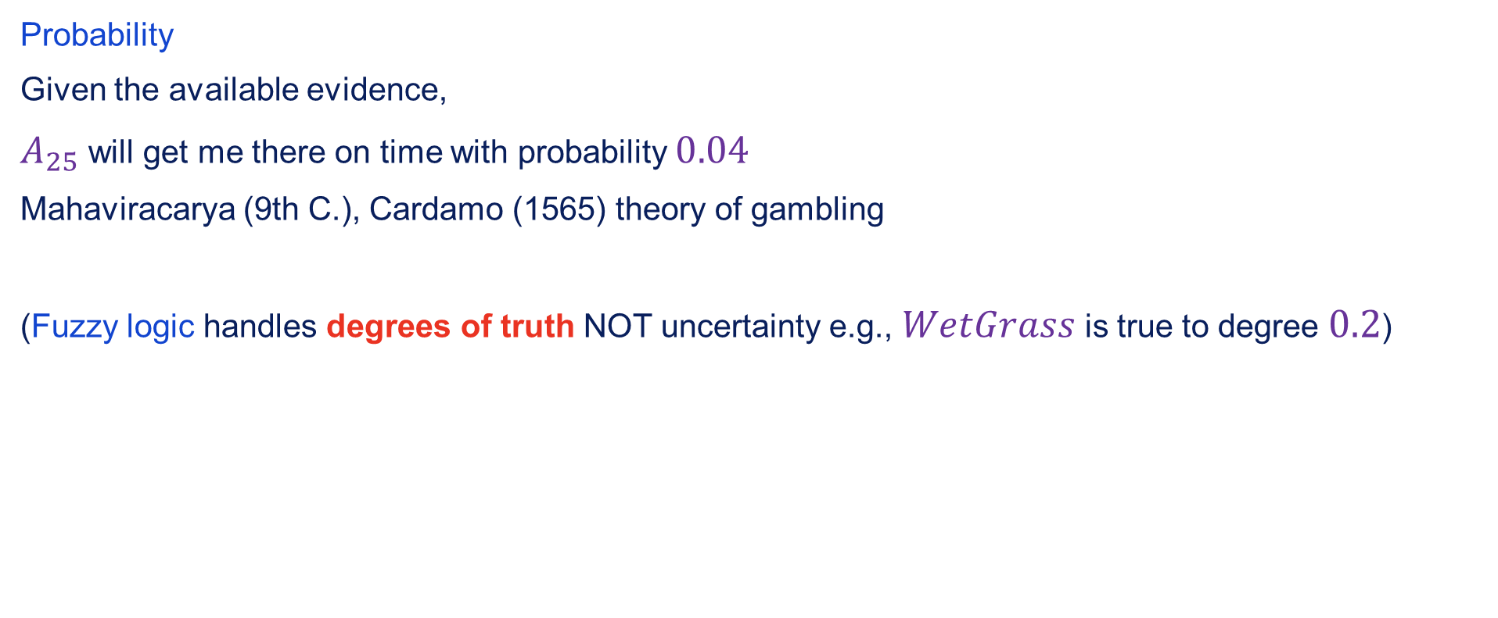
Methods for handling uncertainty contd.
Probability
Given the available evidence,
$A_{25}$ will get me there on time with probability $0.04$
Mahaviracarya (9th C.), Cardamo (1565) theory of gambling
(Fuzzy logic handles degrees of truth NOT uncertainty e.g., $WetGrass$ is true to degree $0.2$)

Slide 7
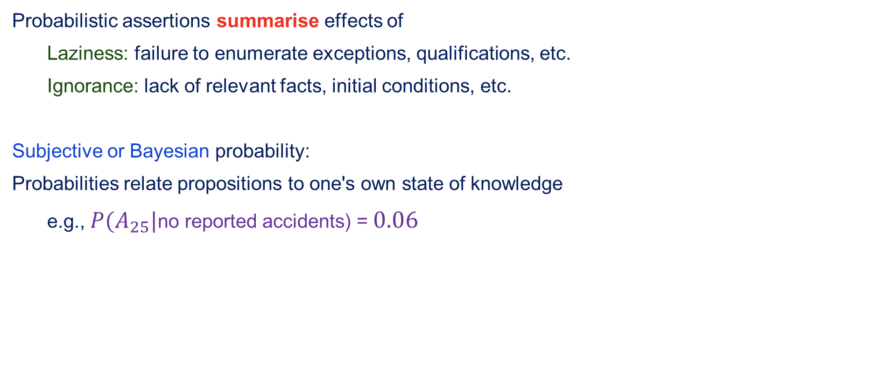
Probability
Probabilistic assertions summarise effects of
Laziness: failure to enumerate exceptions, qualifications, etc.
Ignorance: lack of relevant facts, initial conditions, etc.
Subjective or Bayesian probability:
Probabilities relate propositions to one's own state of knowledge
e.g., $P(A_{25}|$no reported accidents) = $0.06$

Slide 8
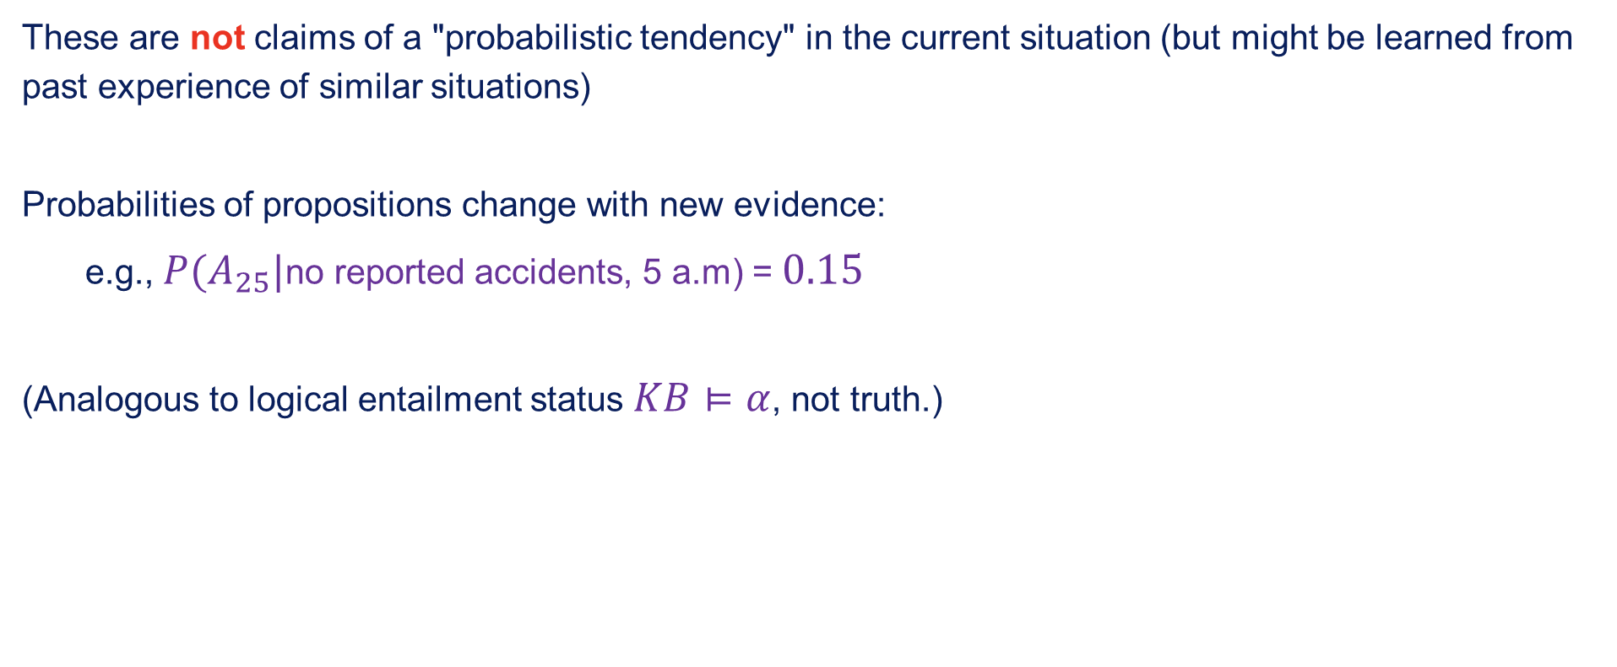
Probability contd.
These are not claims of a "probabilistic tendency" in the current situation (but might be learned from past experience of similar situations)
Probabilities of propositions change with new evidence:
e.g., $P(A_{25}|$no reported accidents, 5 a.m) = $0.15$
(Analogous to logical entailment status $KB⊨α$, not truth.)

Slide 9
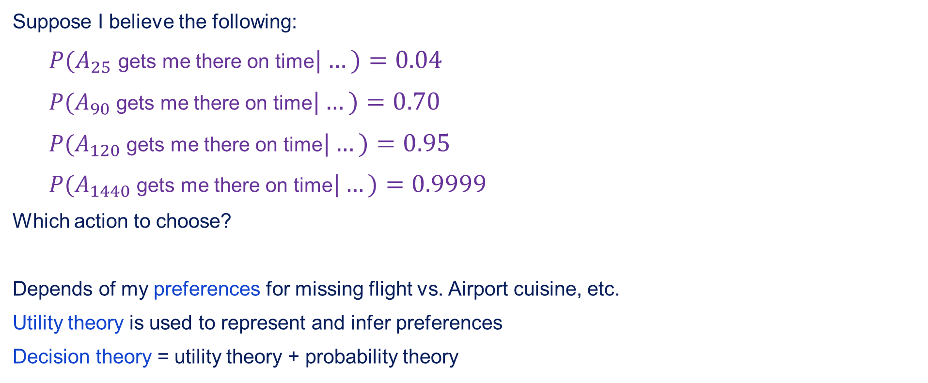
Making decisions under uncertainty
Suppose I believe the following:
$P(A_{25}$ gets me there on time$|…)=0.04$
$P(A_{90}$ gets me there on time$|…)=0.70$
$P(A_{120}$ gets me there on time$|…)=0.95$
$P(A_{1440}$ gets me there on time$|…)=0.9999$
Which action to choose?
Depends of my preferences for missing flight vs. Airport cuisine, etc.
Utility theory is used to represent and infer preferences
Decision theory = utility theory + probability theory

Slide 10
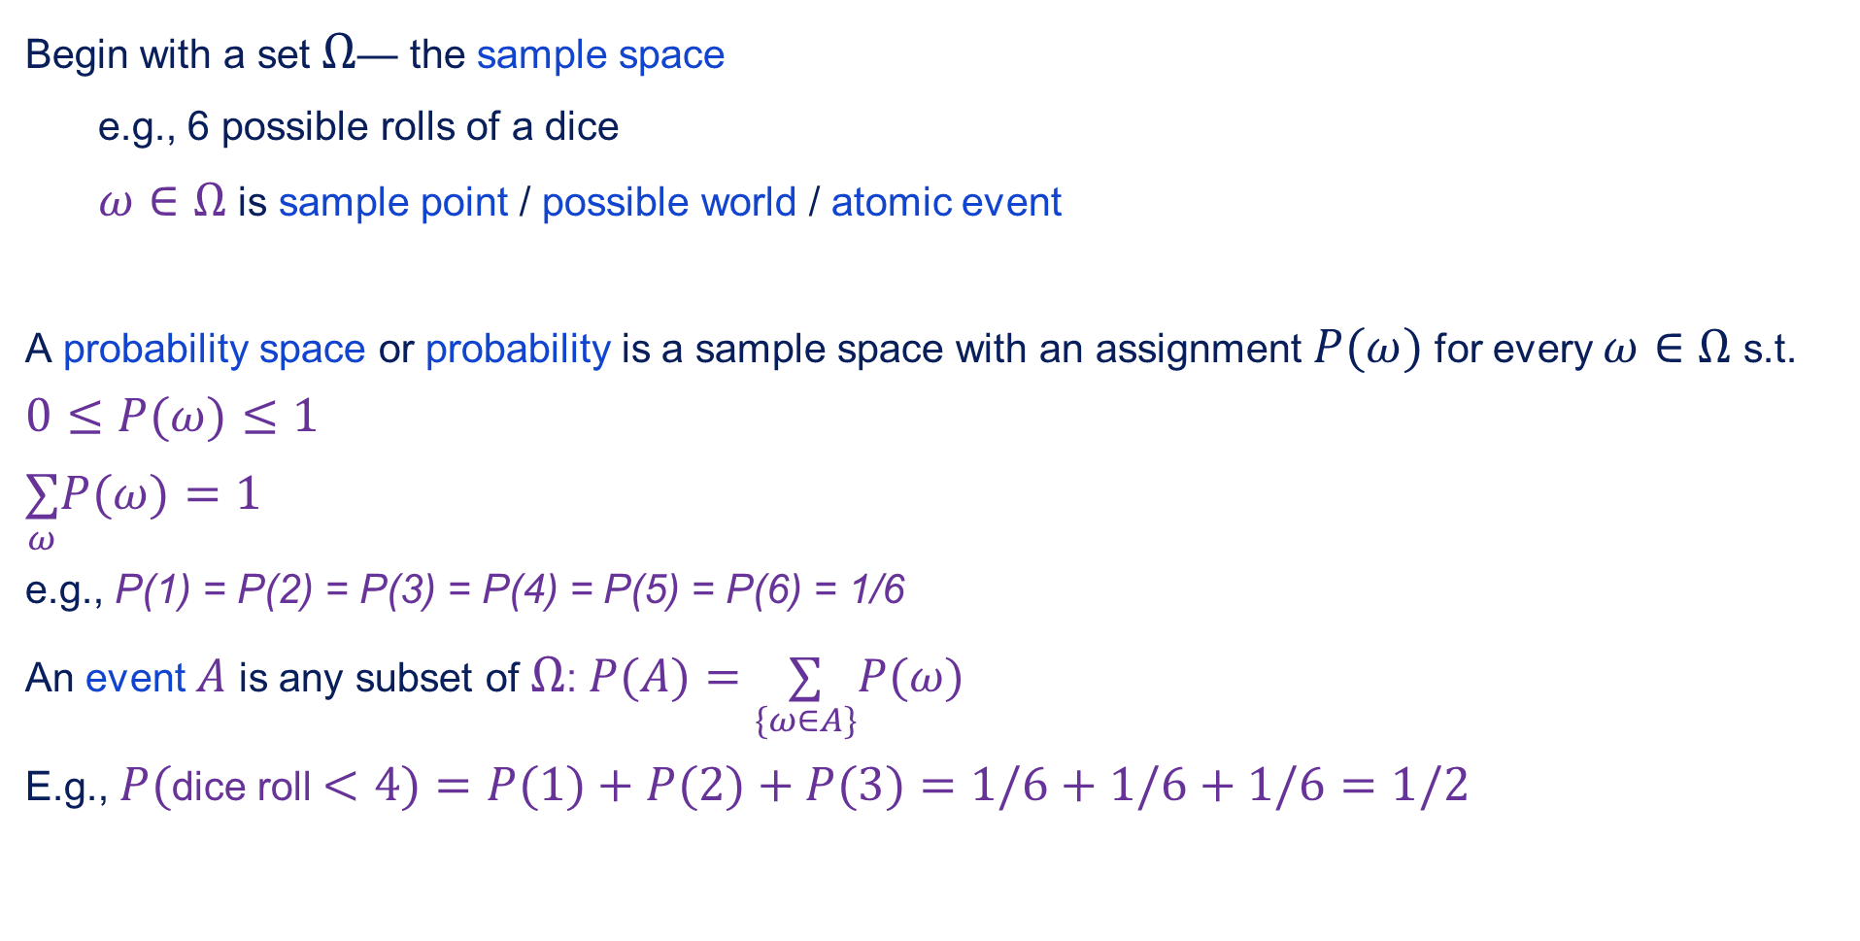
Probability basics
Begin with a set $Ω$— the sample space
e.g., 6 possible rolls of a dice
$ω∈Ω$ is sample point / possible world / atomic event
A probability space or probability is a sample space with an assignment $P(ω)$ for every $ω∈Ω$ s.t.
$$0≤P(ω)≤1$$
$$\underset{ω}{∑}P(ω)=1$$
e.g., P(1) = P(2) = P(3) = P(4) = P(5) = P(6) = 1/6
An event $A$ is any subset of $Ω$: $P(A)=\underset{\{ω∈A\}}{∑}P(ω)$
E.g., $P($dice roll $<4)=P(1)+P(2)+P(3)=1/6+1/6+1/6=1/2$

Slide 11
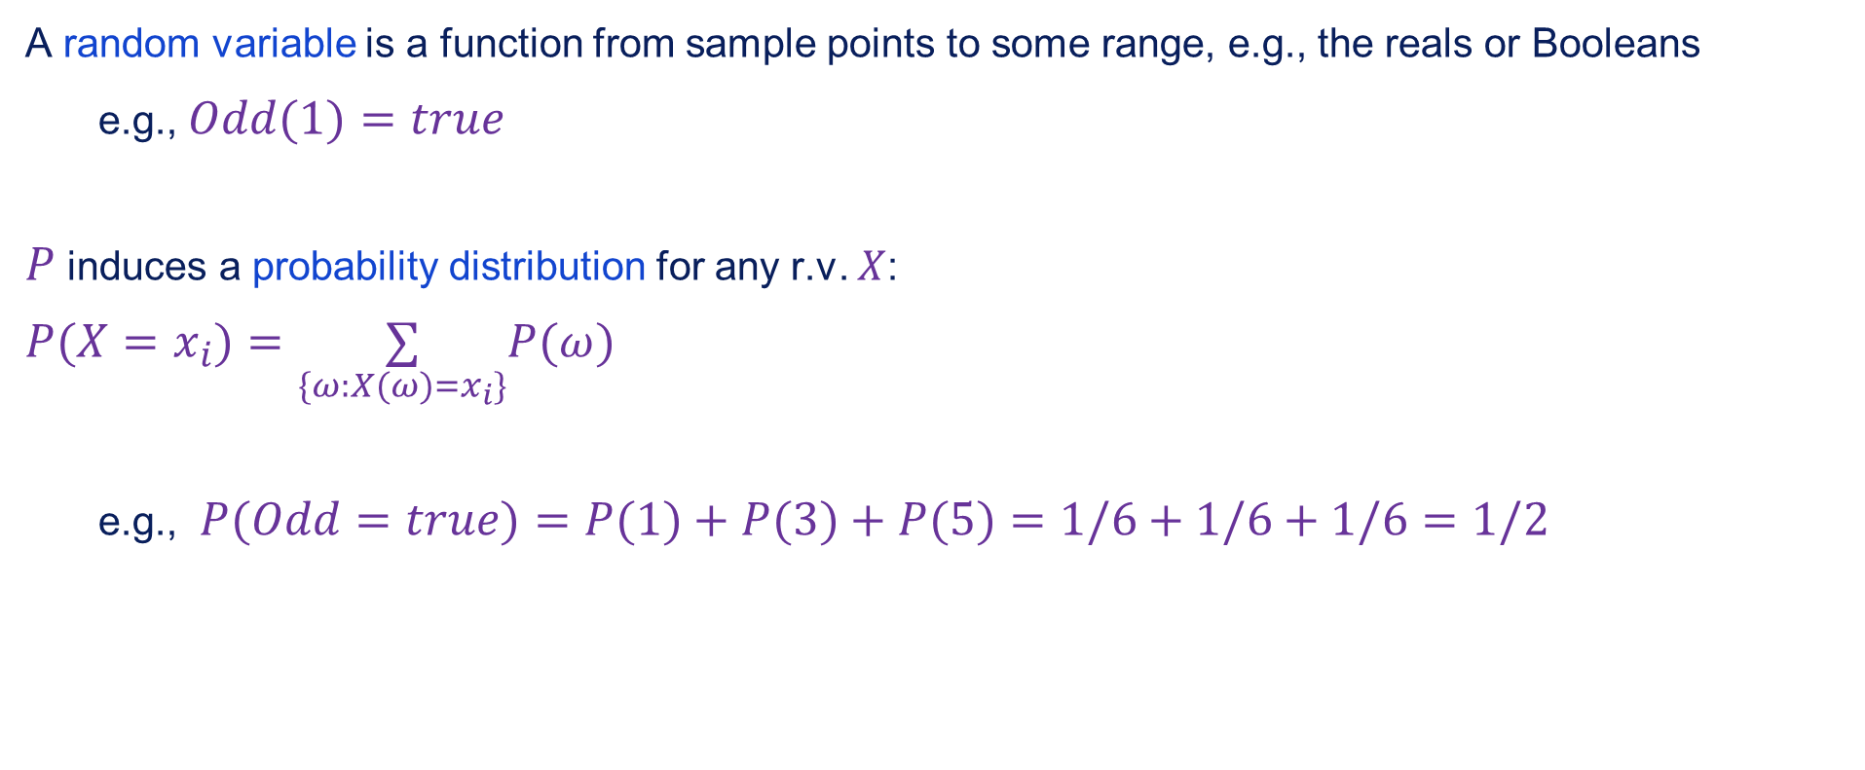
Random variables
A random variable is a function from sample points to some range, e.g., the reals or Booleans
e.g., $Odd(1)=true$
$P$ induces a probability distribution for any r.v. $X$:
$$P(X=x_{i})=\underset{\{ω:X(ω)=x_{i}\}}{∑}P(ω)$$
e.g., $P(Odd=true)=P(1)+P(3)+P(5)=1/6+1/6+1/6=1/2$

Slide 12
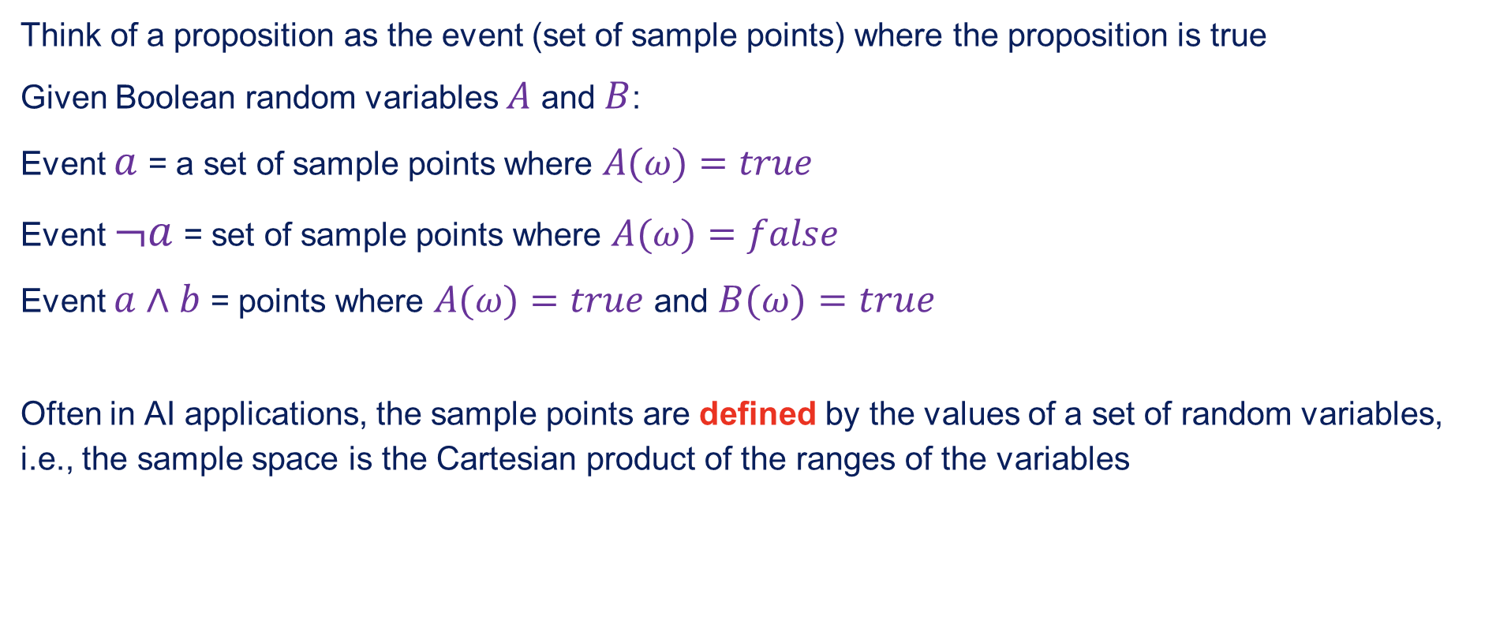
Propositions
Think of a proposition as the event (set of sample points) where the proposition is true
Given Boolean random variables $A$ and $B$:
Event $a$ = a set of sample points where $A(ω)=true$
Event $¬a$ = set of sample points where $A(ω)=false$
Event $a∧b$ = points where $A(ω)=true$ and $B(ω)=true$
Often in AI applications, the sample points are defined by the values of a set of random variables, i.e., the sample space is the Cartesian product of the ranges of the variables

Slide 13
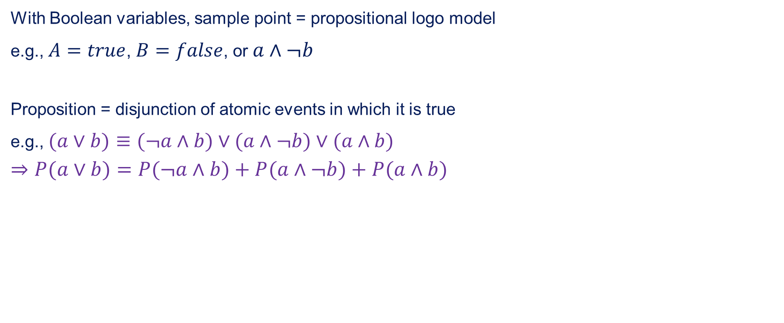
Propositions contd.
With Boolean variables, sample point = propositional logo model
e.g., $A=true$, $B=false$, or $a∧¬b$
Proposition = disjunction of atomic events in which it is true
e.g., $(a∨b)≡(¬a∧b)∨(a∧¬b)∨(a∧b)$
$$⇒P(a∨b)=P(¬a∧b)+P(a∧¬b)+P(a∧b)$$

Slide 14
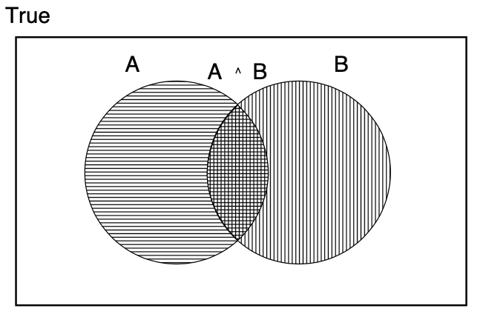

Why use probability?
The definitions imply that certain logically related events must have related probabilities
e.g., $P(a∨b)=P(a)+P(b)−P(a∧b)$
De Finetti (1931): an agent who bets accordingly to probabilities that violate these axioms can be forced to bet so as to lose money regardless of the outcome

Slide 15
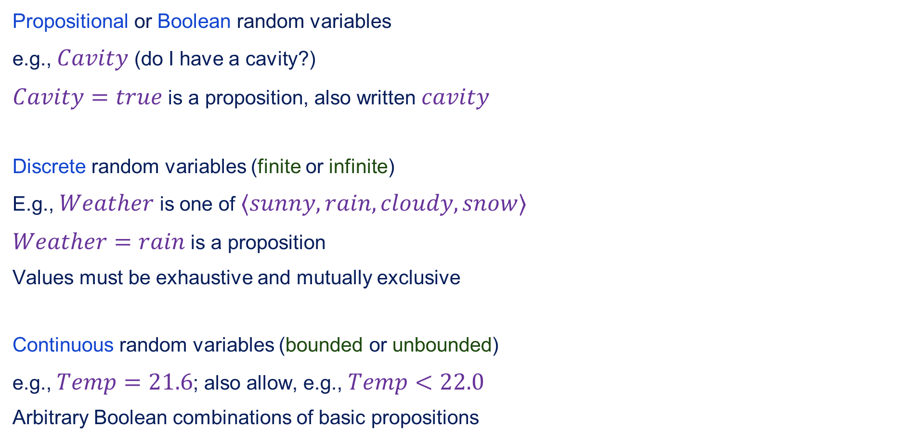
Syntax for propositions
Propositional or Boolean random variables
e.g., $Cavity$ (do I have a cavity?)
$Cavity=true$ is a proposition, also written $cavity$
Discrete random variables (finite or infinite)
E.g., $Weather$ is one of $⟨sunny,rain,cloudy,snow⟩$
$Weather=rain$ is a proposition
Values must be exhaustive and mutually exclusive
Continuous random variables (bounded or unbounded)
e.g., $Temp=21.6$; also allow, e.g., $Temp<22.0$
Arbitrary Boolean combinations of basic propositions

Slide 16
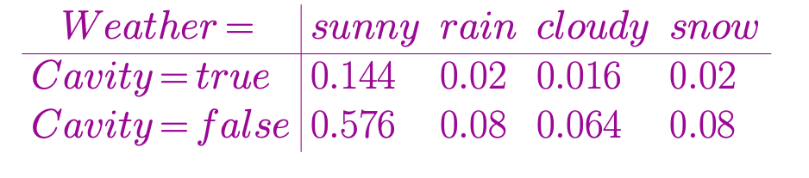
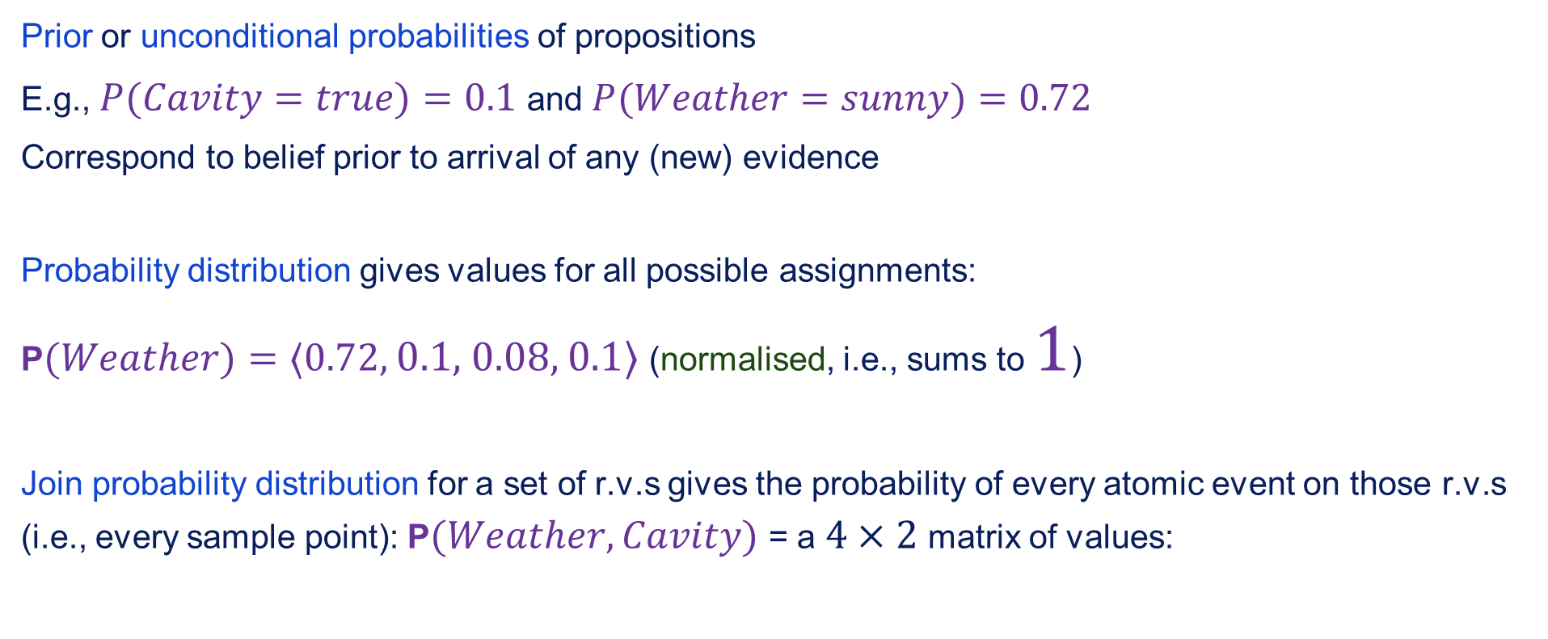
Prior probability
Prior or unconditional probabilities of propositions
E.g., $P(Cavity=true)=0.1$ and $P(Weather=sunny)=0.72$
Correspond to belief prior to arrival of any (new) evidence
Probability distribution gives values for all possible assignments:
P$(Weather)=⟨0.72,$ $0.1,$ $0.08,$ $0.1⟩$ (normalised, i.e., sums to $1$)
Join probability distribution for a set of r.v.s gives the probability of every atomic event on those r.v.s (i.e., every sample point): P$(Weather,Cavity)$ = a $4×2$ matrix of values:

Slide 17
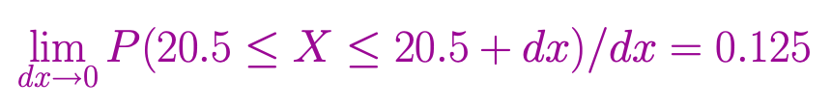

Probability for continuous variables
Express distribution as a parameterised function of value:
$P(X=x)=U[18,26](x)$ = uniform density between $18$ and $26$
Here $P$ is a density; integrates to 1.
$P(X=20.5)=0.125$ really means

Slide 18
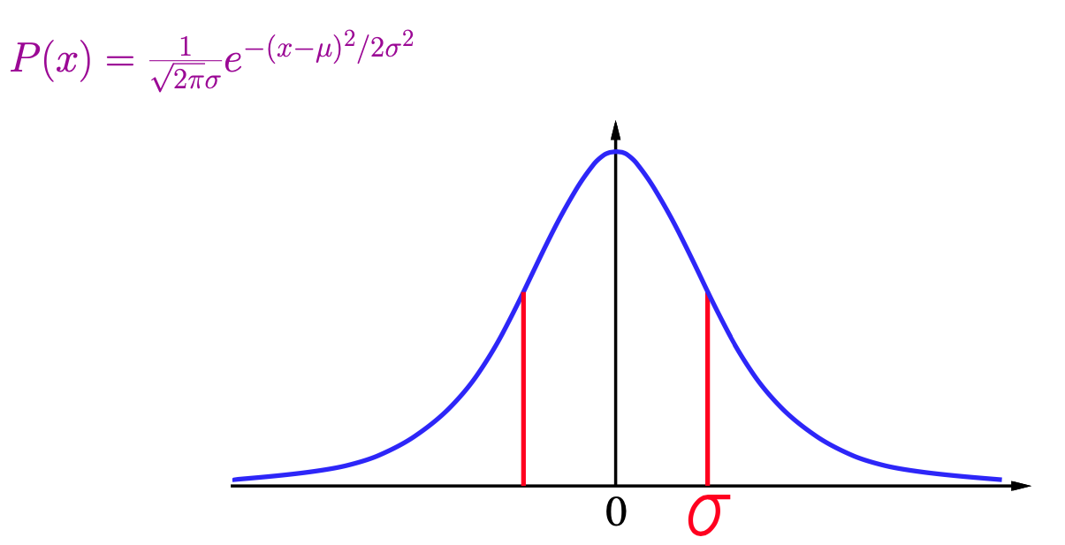
Gaussian density

Slide 19
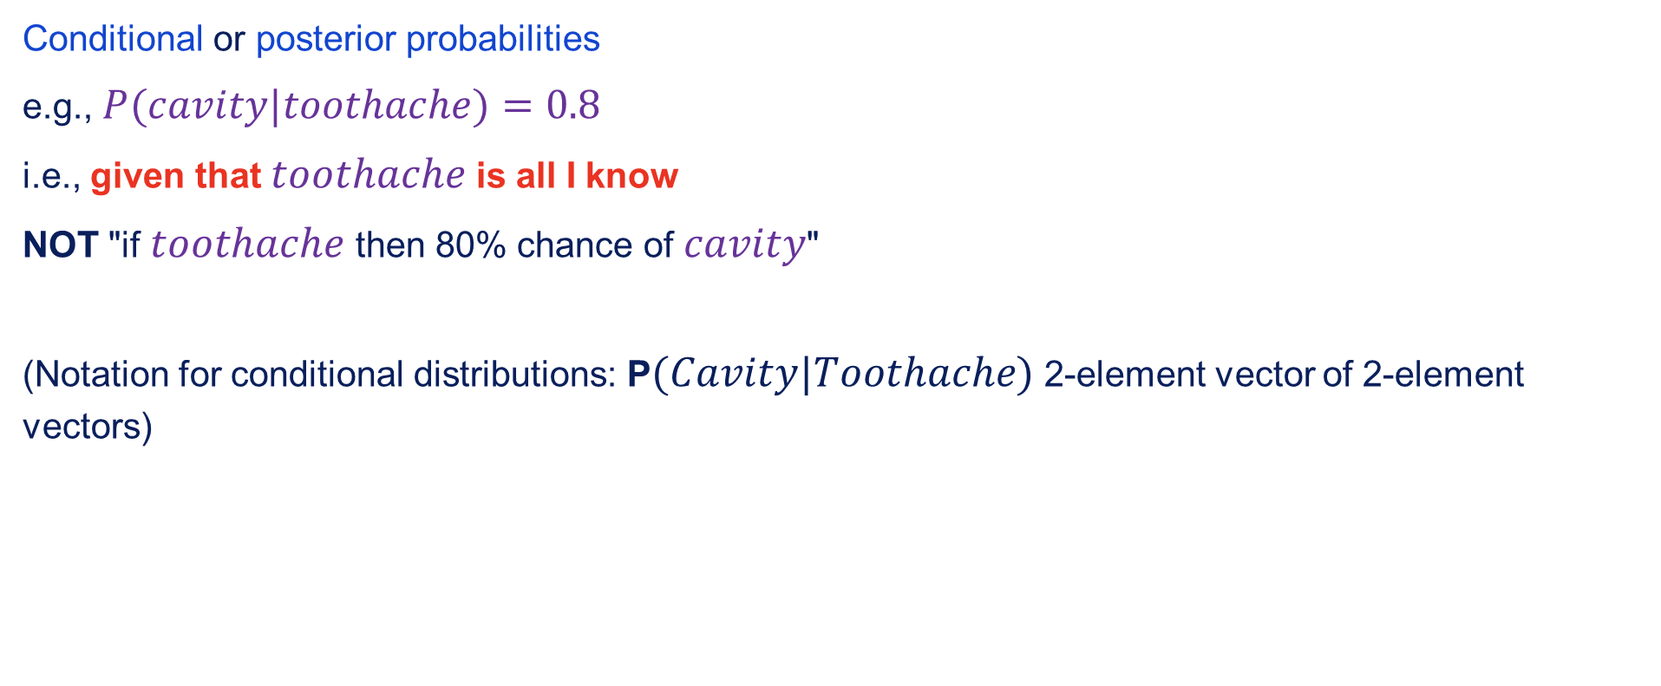
Conditional probability
Conditional or posterior probabilities
e.g., $P(cavity|toothache)=0.8$
i.e., given that $toothache$ is all I know
NOT "if $toothache$ then 80% chance of $cavity$"
(Notation for conditional distributions: P$(Cavity|Toothache)$ 2-element vector of 2-element vectors)

Slide 20
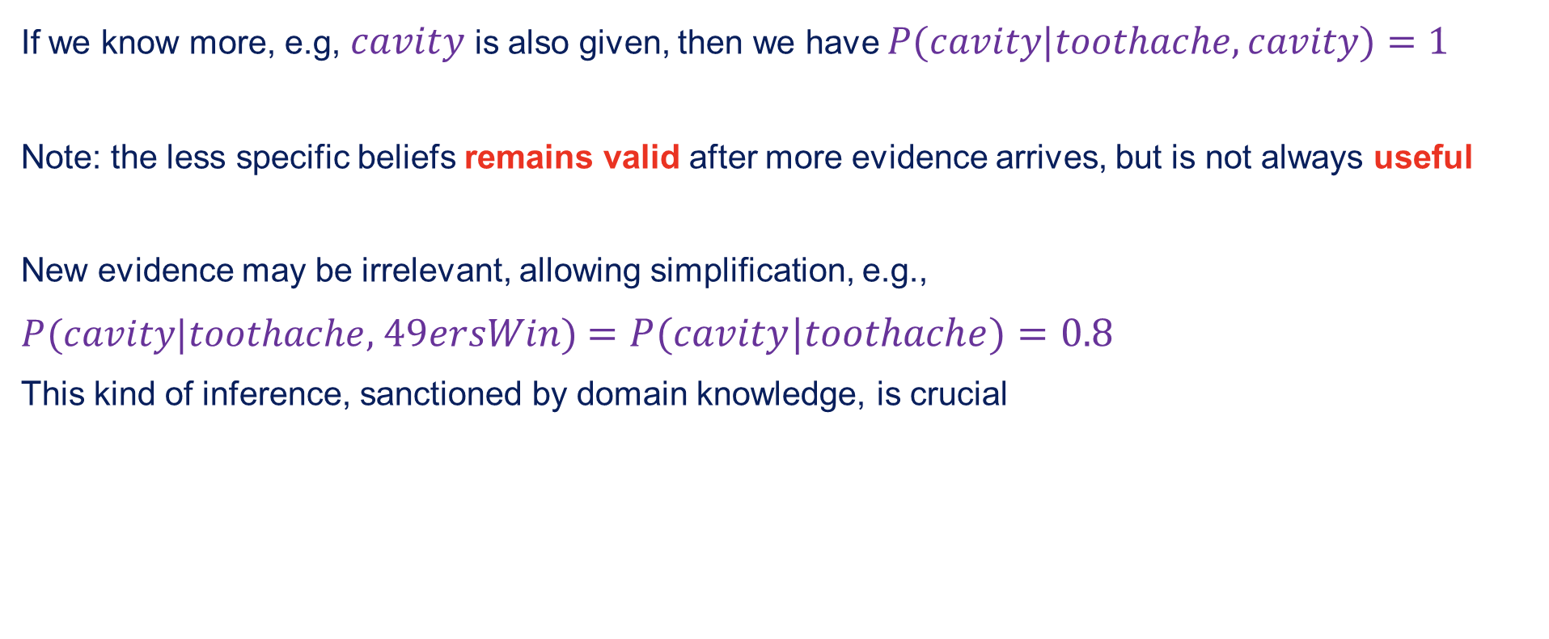
Conditional probability contd.
If we know more, e.g, $cavity$ is also given, then we have $P(cavity|toothache,cavity)=1$
Note: the less specific beliefs remains valid after more evidence arrives, but is not always useful
New evidence may be irrelevant, allowing simplification, e.g.,
$P(cavity|toothache,$ $49ersWin)$ $=P(cavity|toothache)=0.8$
This kind of inference, sanctioned by domain knowledge, is crucial

Slide 21

Conditional probability
Definition of conditional probability
$P(a|b)=\frac{P(a∧b)}{P(b)}$ if $P(b)≠0$
Product rule gives an alternative formulation:
$$P(a∧b)=P(a|b)P(b)=P(a|b)P(a)$$

Slide 22

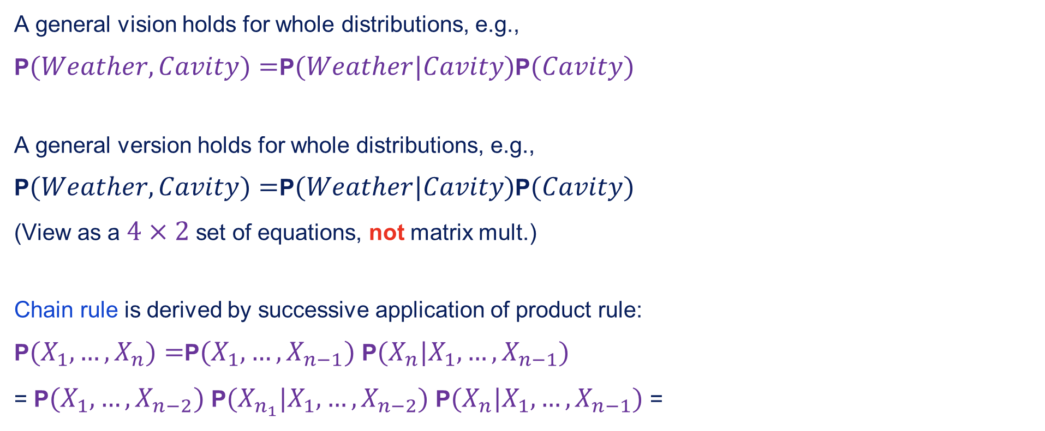
Conditional probability contd.
A general vision holds for whole distributions, e.g.,
P$(Weather,Cavity)=$P$(Weather|Cavity)$P$(Cavity)$
A general version holds for whole distributions, e.g.,
P$(Weather,Cavity)=$P$(Weather|Cavity)$P$(Cavity)$
(View as a $4×2$ set of equations, not matrix mult.)
Chain rule is derived by successive application of product rule:
P$(X_{1},…,X_{n})=$P$(X_{1},…,X_{n−1})$ P$(X_{n}|X_{1},…,X_{n−1})$
= P$(X_{1},…,X_{n−2})$ P$(X_{n_{1}}|X_{1},…,X_{n−2})$ P$(X_{n}|X_{1},…,X_{n−1})$ =

Slide 23
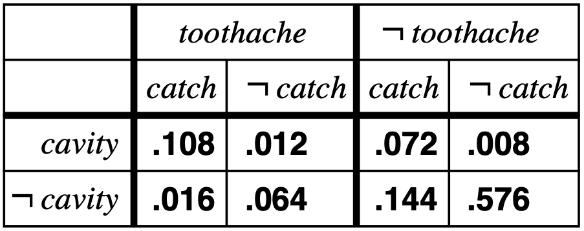

Interference by enumeration
Start with the joint distribution:
For any propositions $φ$, sum the atomic events where it is true:
$$P(φ)=\underset{ω:ω⊨φ}{∑}P(ω)$$

Slide 24
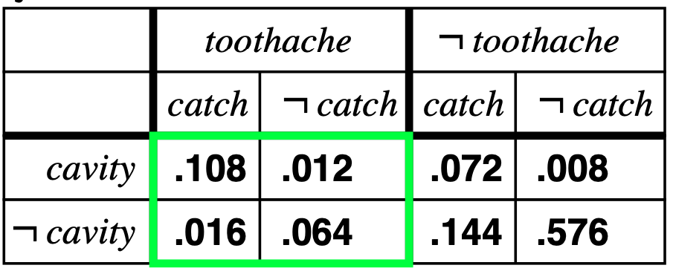

Interference by enumeration
Start with the joint distribution:
For any propositions $φ$, sum the atomic events where it is true:
$$P(φ)=\underset{ω:ω⊨φ}{∑}P(ω)$$
$$P(toothache)=0.108+0.012+0.016+0.064=0.2$$

Slide 25
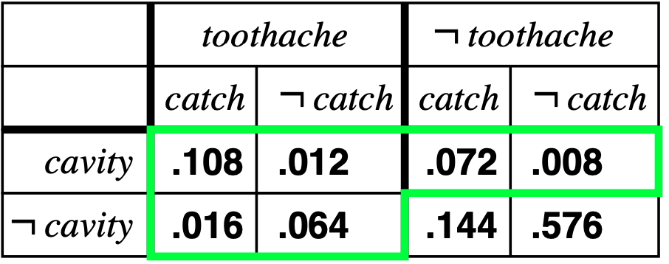

Interference by enumeration
Start with the joint distribution:
For any propositions $φ$, sum the atomic events where it is true:
$$P(φ)=\underset{ω:ω⊨φ}{∑}P(ω)$$
$$P(cavity∨toothache)=0.108+0.012+0.072+0.008+0.016+0.064=0.28$$

Slide 26
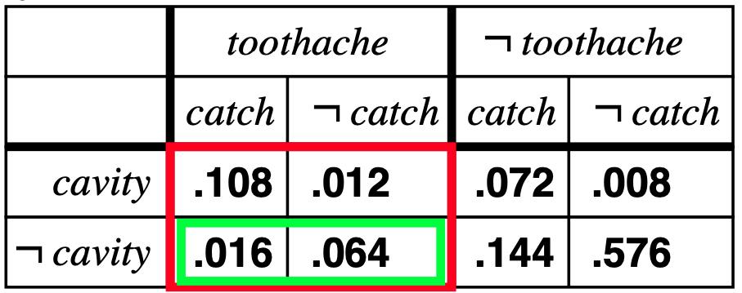
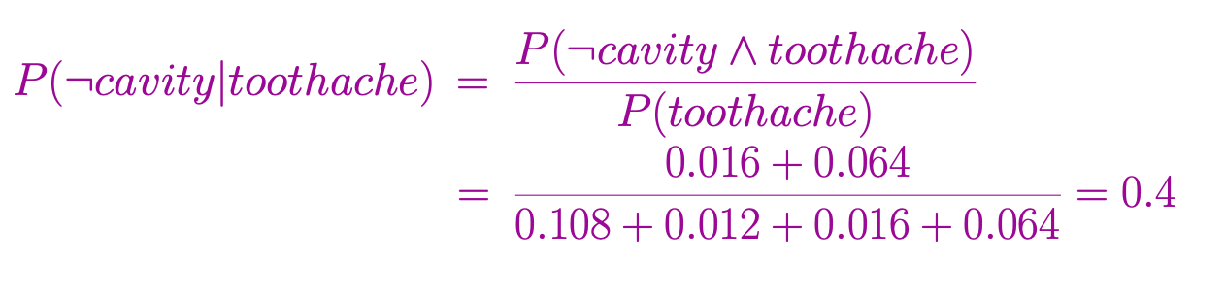
Inference by enumeration
Start with the joint distribution:
Can also compute conditional probabilities:

Slide 27
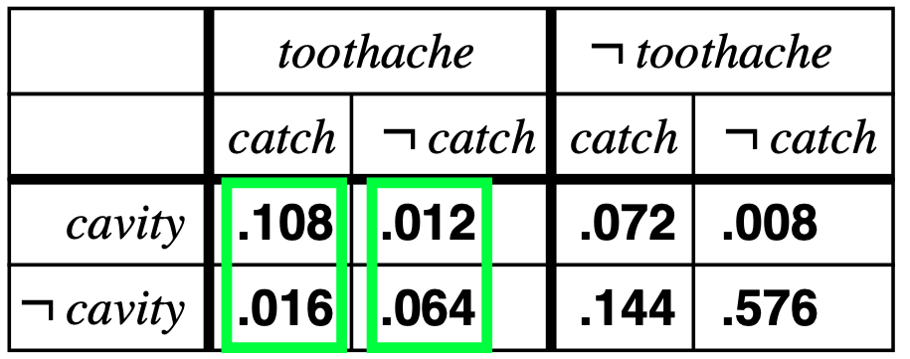
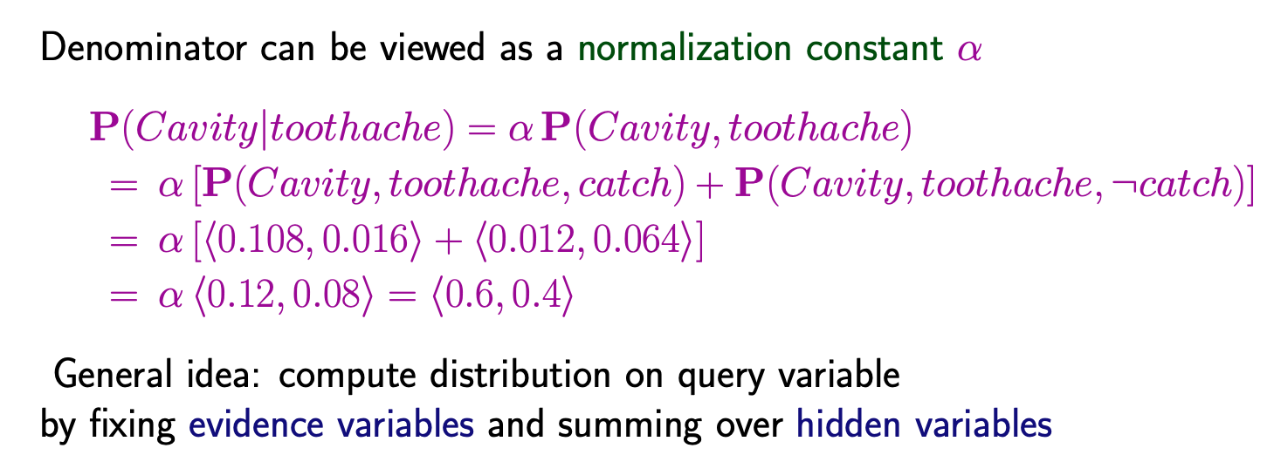
Normalisation

Slide 28
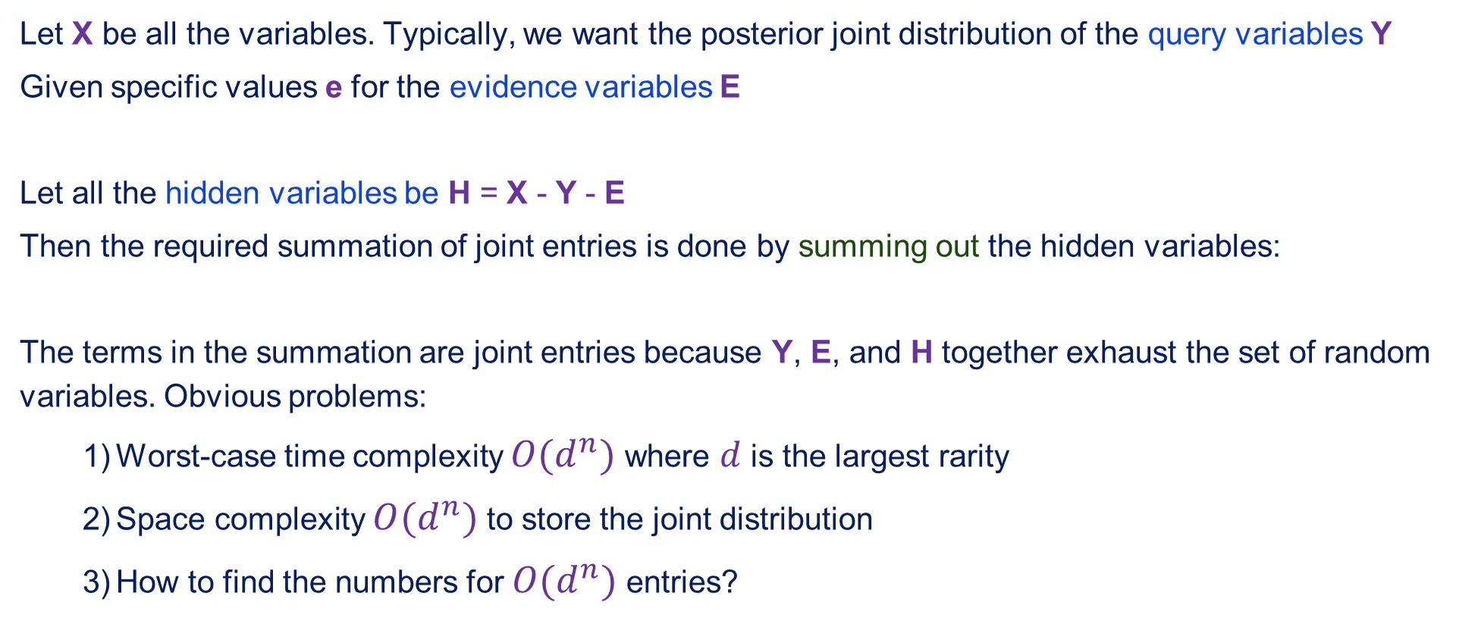
Inference by enumeration, contd.
Let X be all the variables. Typically, we want the posterior joint distribution of the query variables Y
Given specific values e for the evidence variables E
Let all the hidden variables be H = X - Y - E
Then the required summation of joint entries is done by summing out the hidden variables:
The terms in the summation are joint entries because Y, E, and H together exhaust the set of random variables. Obvious problems:
Worst-case time complexity $O(d^{n})$ where $d$ is the largest rarity
Space complexity $O(d^{n})$ to store the joint distribution
How to find the numbers for $O(d^{n})$ entries?

Slide 29
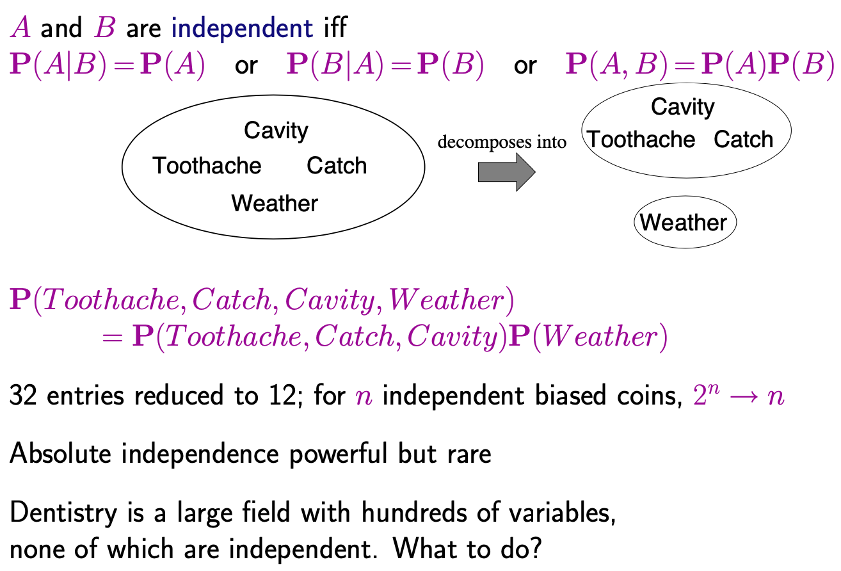
Independence

Slide 30
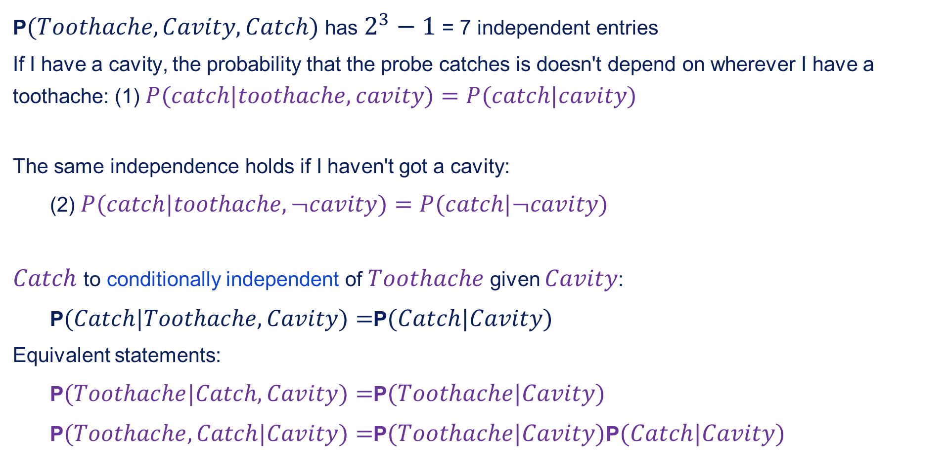
Conditional independence
P$(Toothache,Cavity,Catch)$ has $2^{3}−1$ = 7 independent entries
If I have a cavity, the probability that the probe catches is doesn't depend on wherever I have a toothache: (1) $P(catch|toothache,cavity)=P(catch|cavity)$
The same independence holds if I haven't got a cavity:
(2) $P(catch|toothache,¬cavity)=P(catch|¬cavity)$
$Catch$ to conditionally independent of $Toothache$ given $Cavity$:
P$(Catch|Toothache,Cavity)=$P$(Catch|Cavity)$
Equivalent statements:
P$(Toothache|Catch,Cavity)=$P$(Toothache|Cavity)$
P$(Toothache,Catch|Cavity)=$P$(Toothache|Cavity)$P$(Catch|Cavity)$

Slide 31
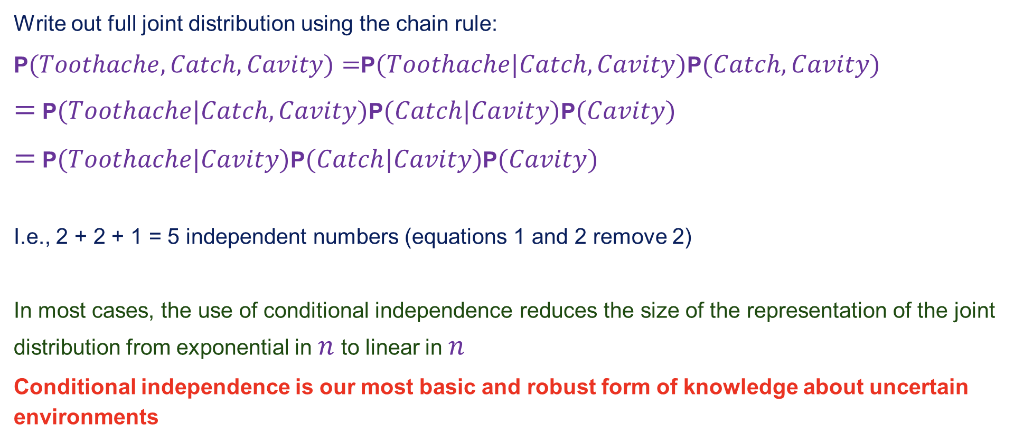
Conditional independence contd.
Write out full joint distribution using the chain rule:
P$(Toothache,Catch,Cavity)=$P$(Toothache|Catch,Cavity)$P$(Catch,Cavity)$
$=$ P$(Toothache|Catch,Cavity)$P$(Catch|Cavity)$P$(Cavity)$
$=$ P$(Toothache|Cavity)$P$(Catch|Cavity)$P$(Cavity)$
I.e., 2 + 2 + 1 = 5 independent numbers (equations 1 and 2 remove 2)
In most cases, the use of conditional independence reduces the size of the representation of the joint distribution from exponential in $n$ to linear in $n$
Conditional independence is our most basic and robust form of knowledge about uncertain environments

Slide 32
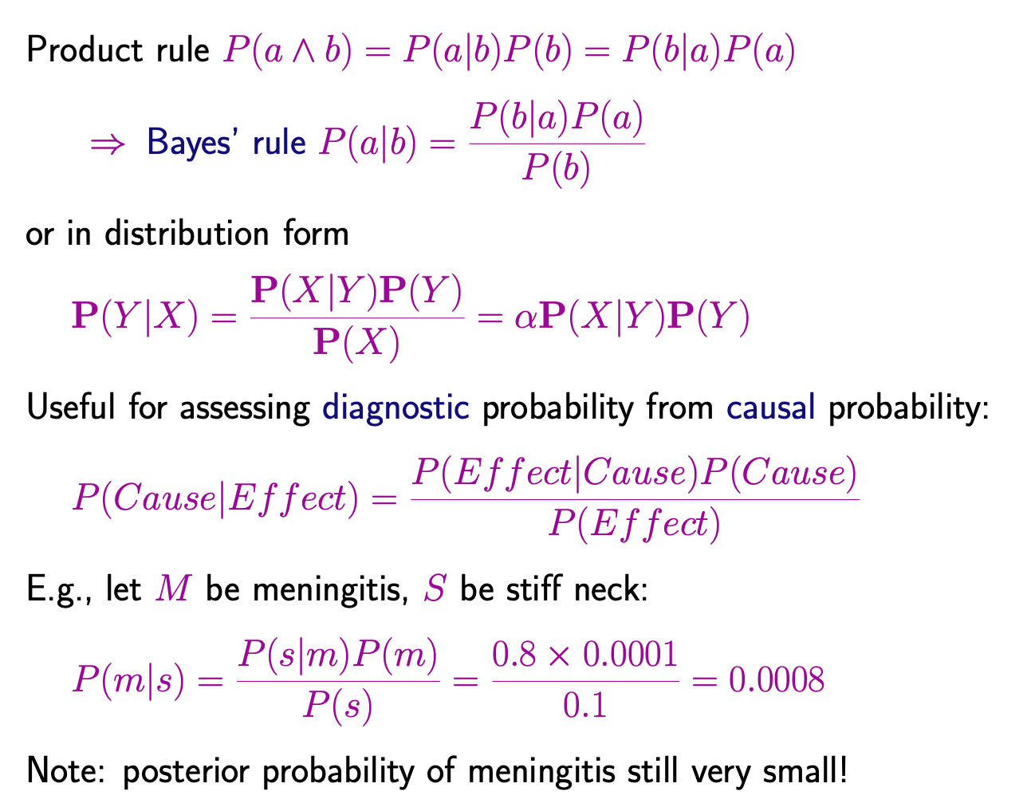
Bayes' Rule

Slide 33
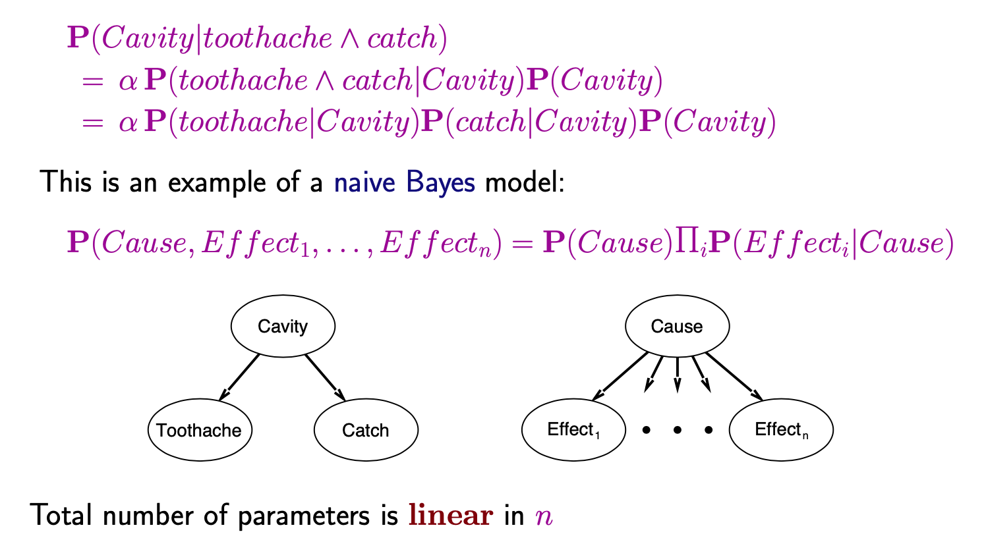
Bayes' Rule and conditional independence

Slide 34
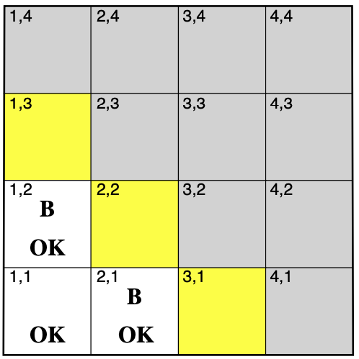
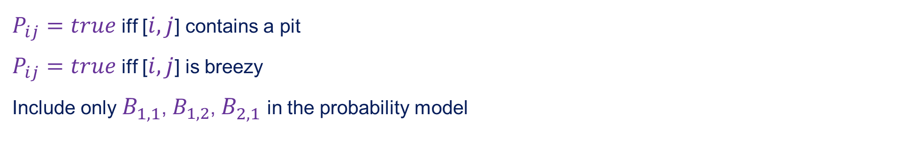
Wumpus World
$P_{ij}=true$ iff [$i,j$] contains a pit
$P_{ij}=true$ iff [$i,j$] is breezy
Include only $B_{1,1}$, $B_{1,2}$, $B_{2,1}$ in the probability model

Slide 35
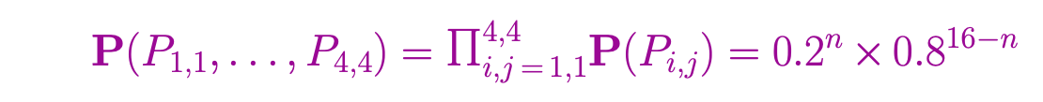
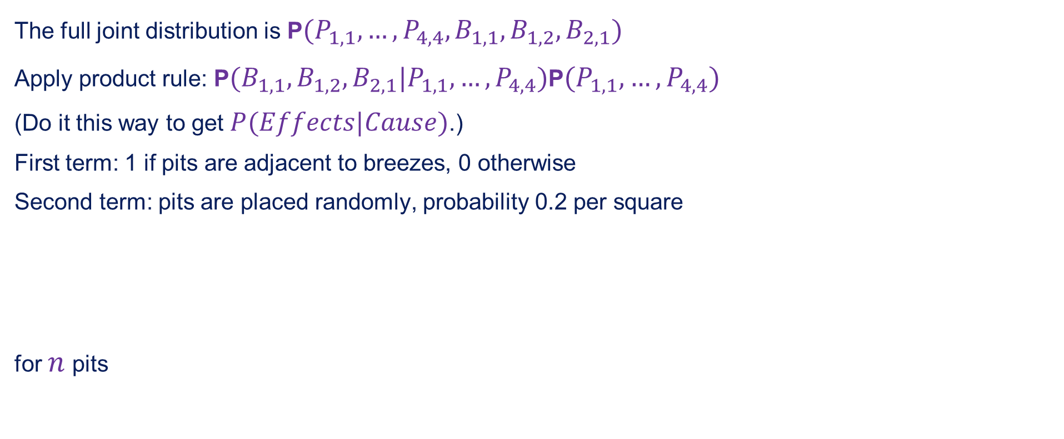
Specifying the probability model
The full joint distribution is P$(P_{1,1},…,P_{4,4},B_{1,1},B_{1,2},B_{2,1})$
Apply product rule: P$(B_{1,1},B_{1,2},B_{2,1}|P_{1,1},…,P_{4,4})$P$(P_{1,1},…,P_{4,4})$
(Do it this way to get $P(Effects|Cause)$.)
First term: 1 if pits are adjacent to breezes, 0 otherwise
Second term: pits are placed randomly, probability 0.2 per square
for $n$ pits

Slide 36
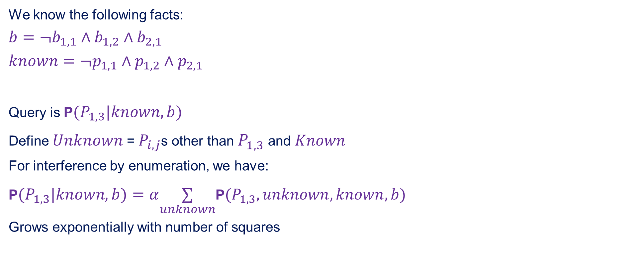
Observation and query
We know the following facts:
$$b=¬b_{1,1}∧b_{1,2}∧b_{2,1}$$
$$known=¬p_{1,1}∧p_{1,2}∧p_{2,1}$$
Query is P$(P_{1,3}|known,b)$
Define $Unknown$ = $P_{i,j}$s other than $P_{1,3}$ and $Known$
For interference by enumeration, we have:
P$(P_{1,3}|known,b)=α\underset{unknown}{∑}$P$(P_{1,3},unknown,known,b)$
Grows exponentially with number of squares

Slide 37
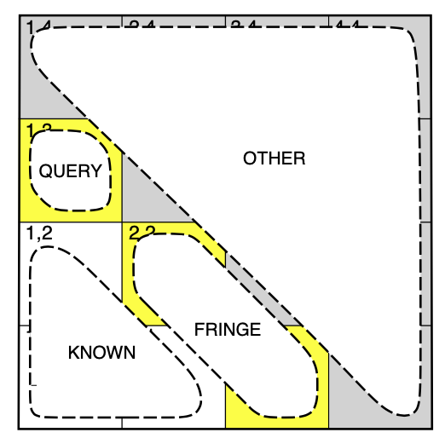

Using conditional independence
Basic insight: observations are conditionally independent of other hidden squares given neighbouring hidden squares
Define $Unknown=Fringe∪Other$
P$(b|P_{1,3},Known,Unknown)=$P$(b|P_{1,3},Known,Fringe)$
Manipulate query into a form where we can use this!

Slide 38
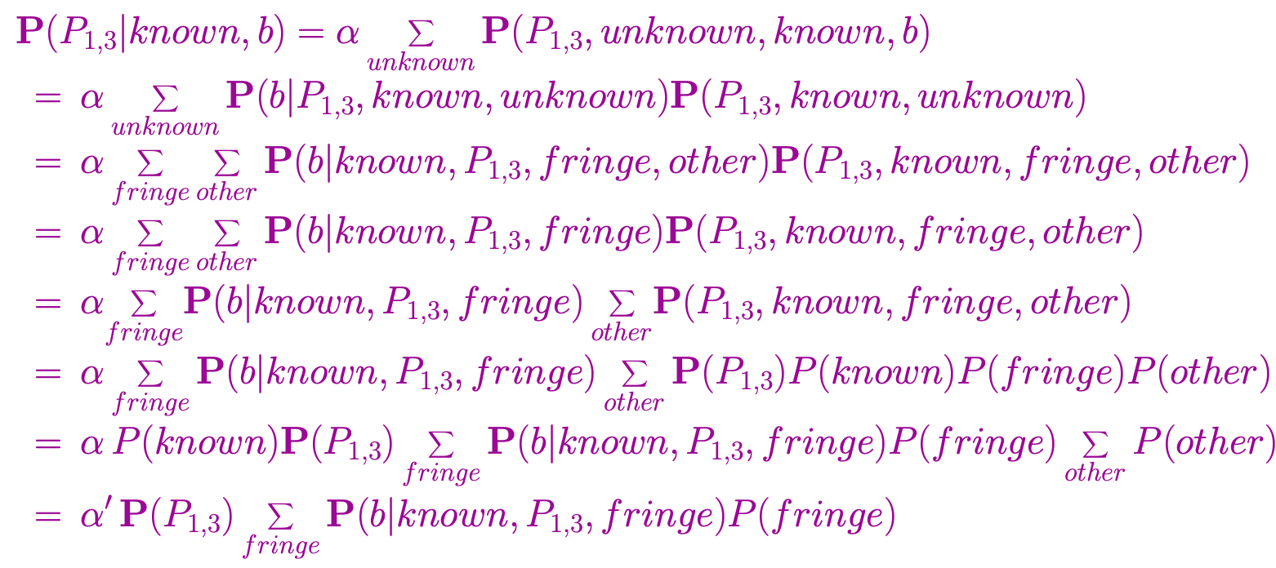
Using conditional independence contd.

Slide 39
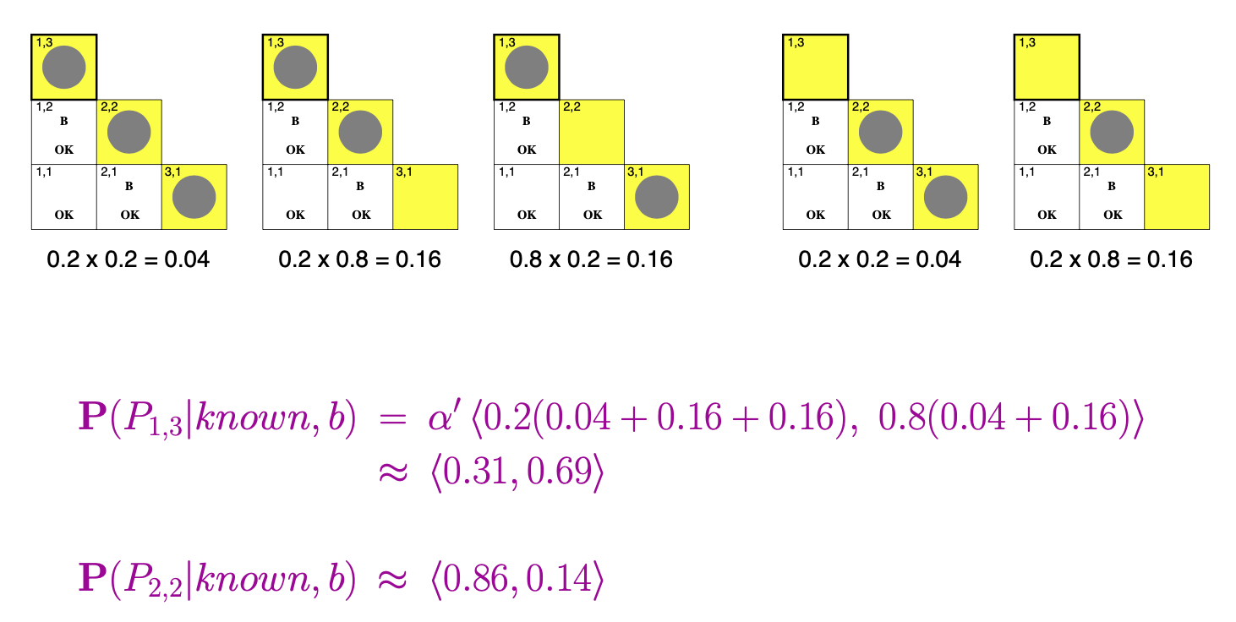
Using conditional independence contd.

Slide 40
Summary
Probability is a rigorous formalism for uncertain knowledge
Joint probability distribution specifies probability of every atomic event
Queries can be answered by summing over atomic events
For nontrivial domains, we must find a way to reduce the joint size
Independence and conditional independence provide the tools

