Slide 1
Bayesian Networks
Lesson 14

Slide 2
Outline
Syntax
Semantics
Parameterised distributions

Slide 3
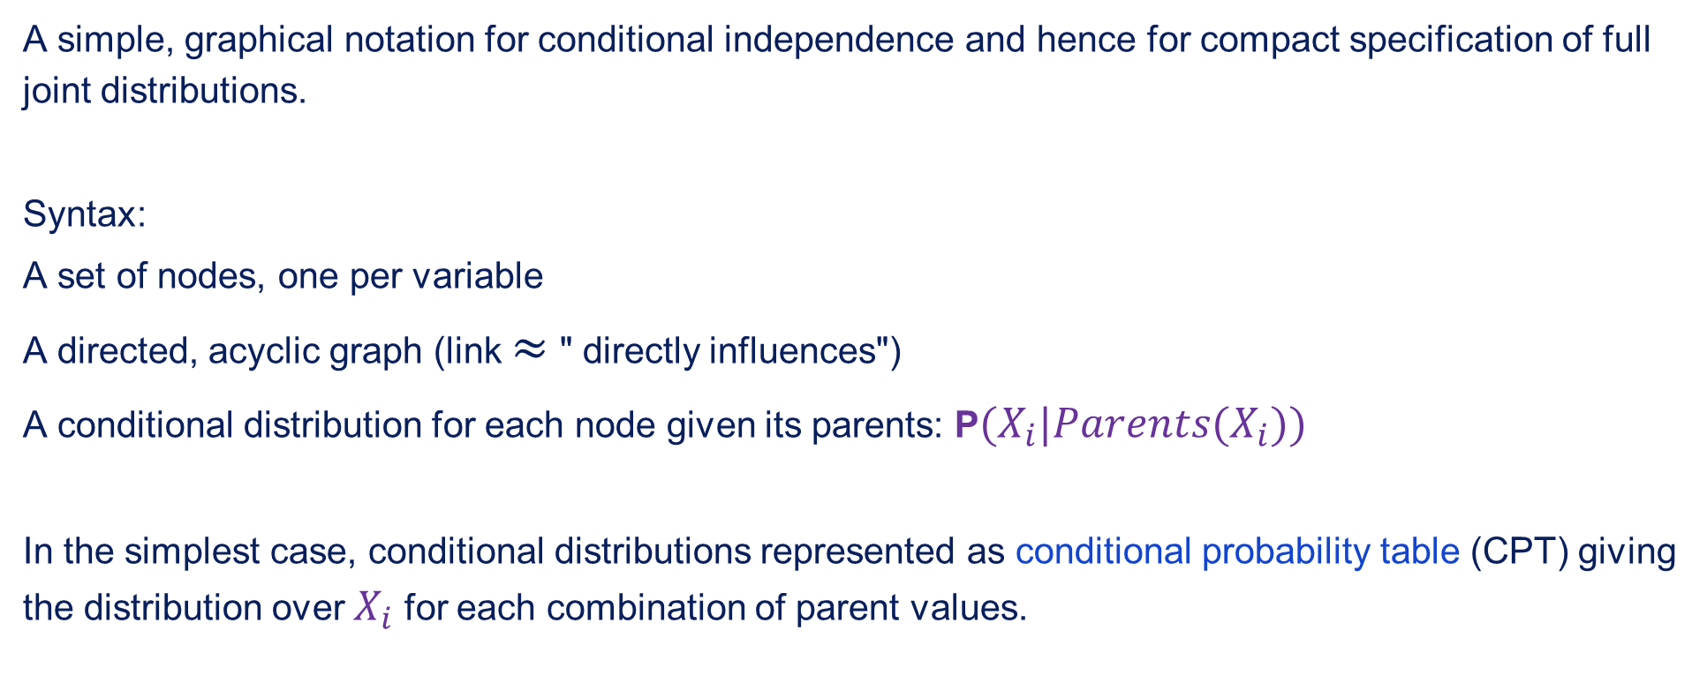
Bayesian networks
A simple, graphical notation for conditional independence and hence for compact specification of full joint distributions.
Syntax:
A set of nodes, one per variable
A directed, acyclic graph (link $≈$ " directly influences")
A conditional distribution for each node given its parents: P$(X_{i}|Parents(X_{i}))$
In the simplest case, conditional distributions represented as conditional probability table (CPT) giving the distribution over $X_{i}$ for each combination of parent values.

Slide 4
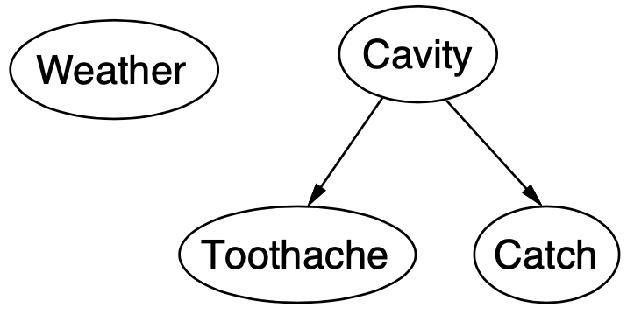

Example
Topology of network encodes conditional independence assertions:
$Weather$ is independent of the other variables
$Toothache$ and $Catch$ are conditionally independent given $Cavity$

Slide 5
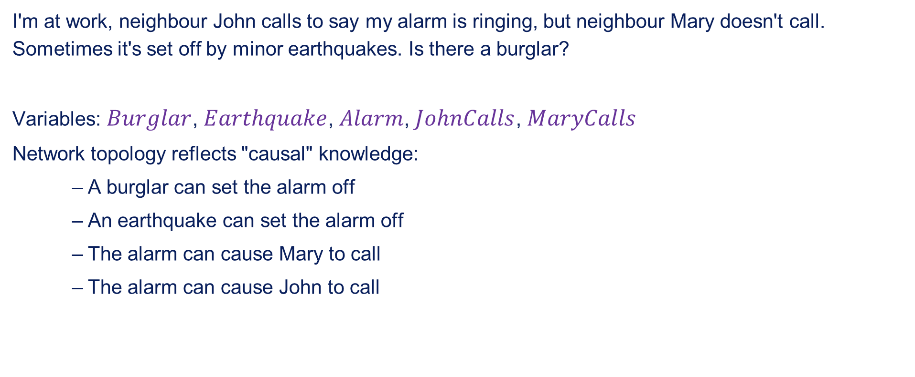
Example
I'm at work, neighbour John calls to say my alarm is ringing, but neighbour Mary doesn't call. Sometimes it's set off by minor earthquakes. Is there a burglar?
Variables: $Burglar$, $Earthquake$, $Alarm$, $JohnCalls$, $MaryCalls$
Network topology reflects "causal" knowledge:
A burglar can set the alarm off
An earthquake can set the alarm off
The alarm can cause Mary to call
The alarm can cause John to call

Slide 6
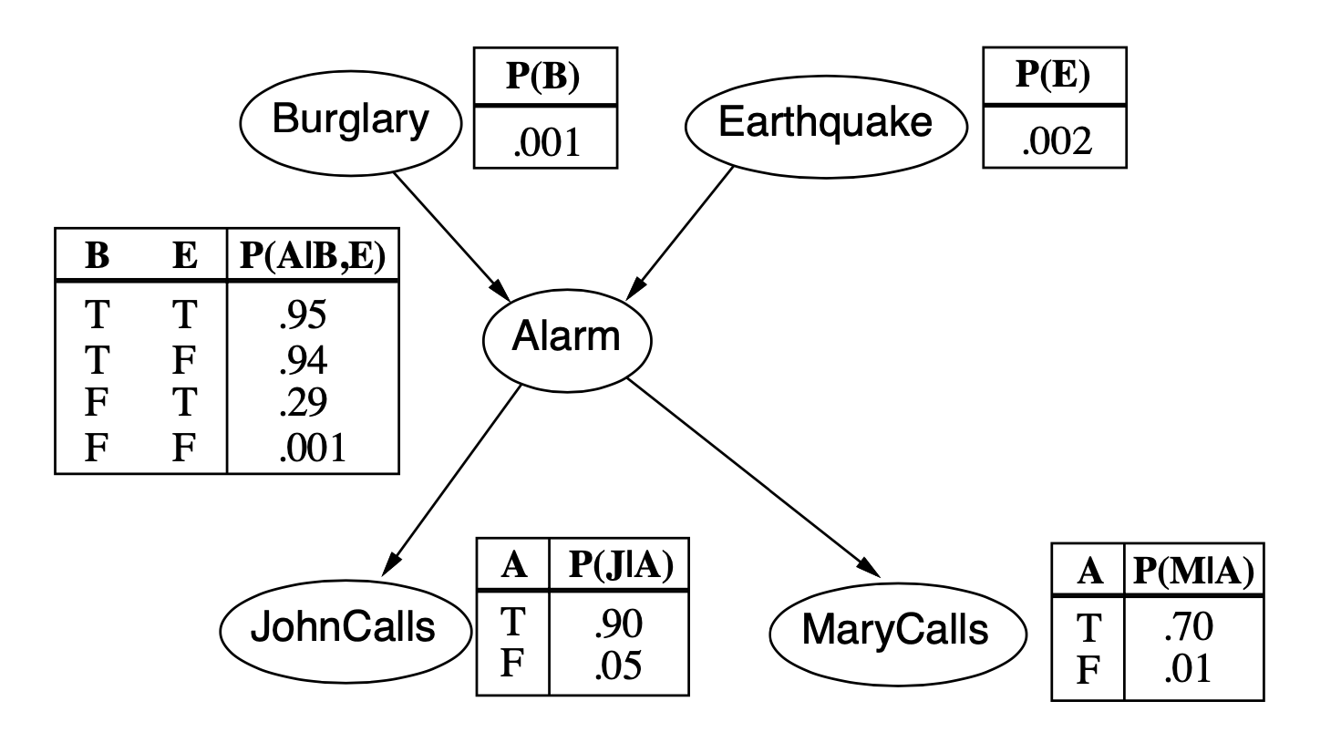
Example contd.

Slide 7
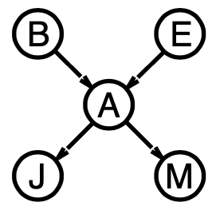
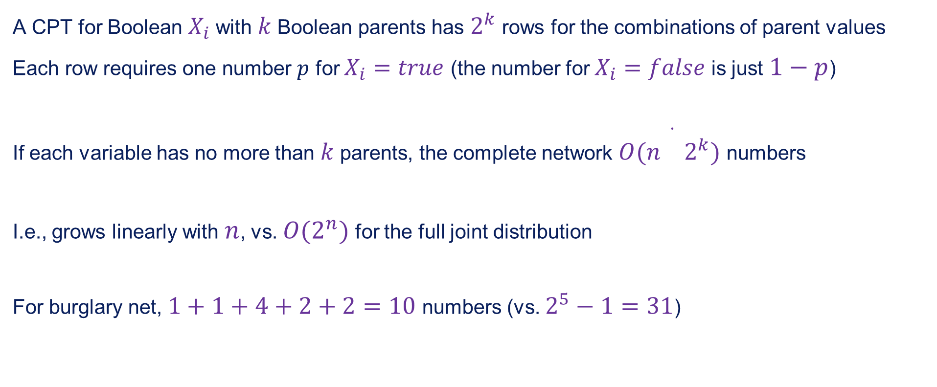
Compactness
A CPT for Boolean $X_{i}$ with $k$ Boolean parents has $2^{k}$ rows for the combinations of parent values
Each row requires one number $p$ for $X_{i}=true$ (the number for $X_{i}=false$ is just $1−p$)
If each variable has no more than $k$ parents, the complete network $O(n\overset{·}{}2^{k})$ numbers
I.e., grows linearly with $n$, vs. $O(2^{n})$ for the full joint distribution
For burglary net, $1+1+4+2+2=10$ numbers (vs. $2^{5}−1=31$)

Slide 8
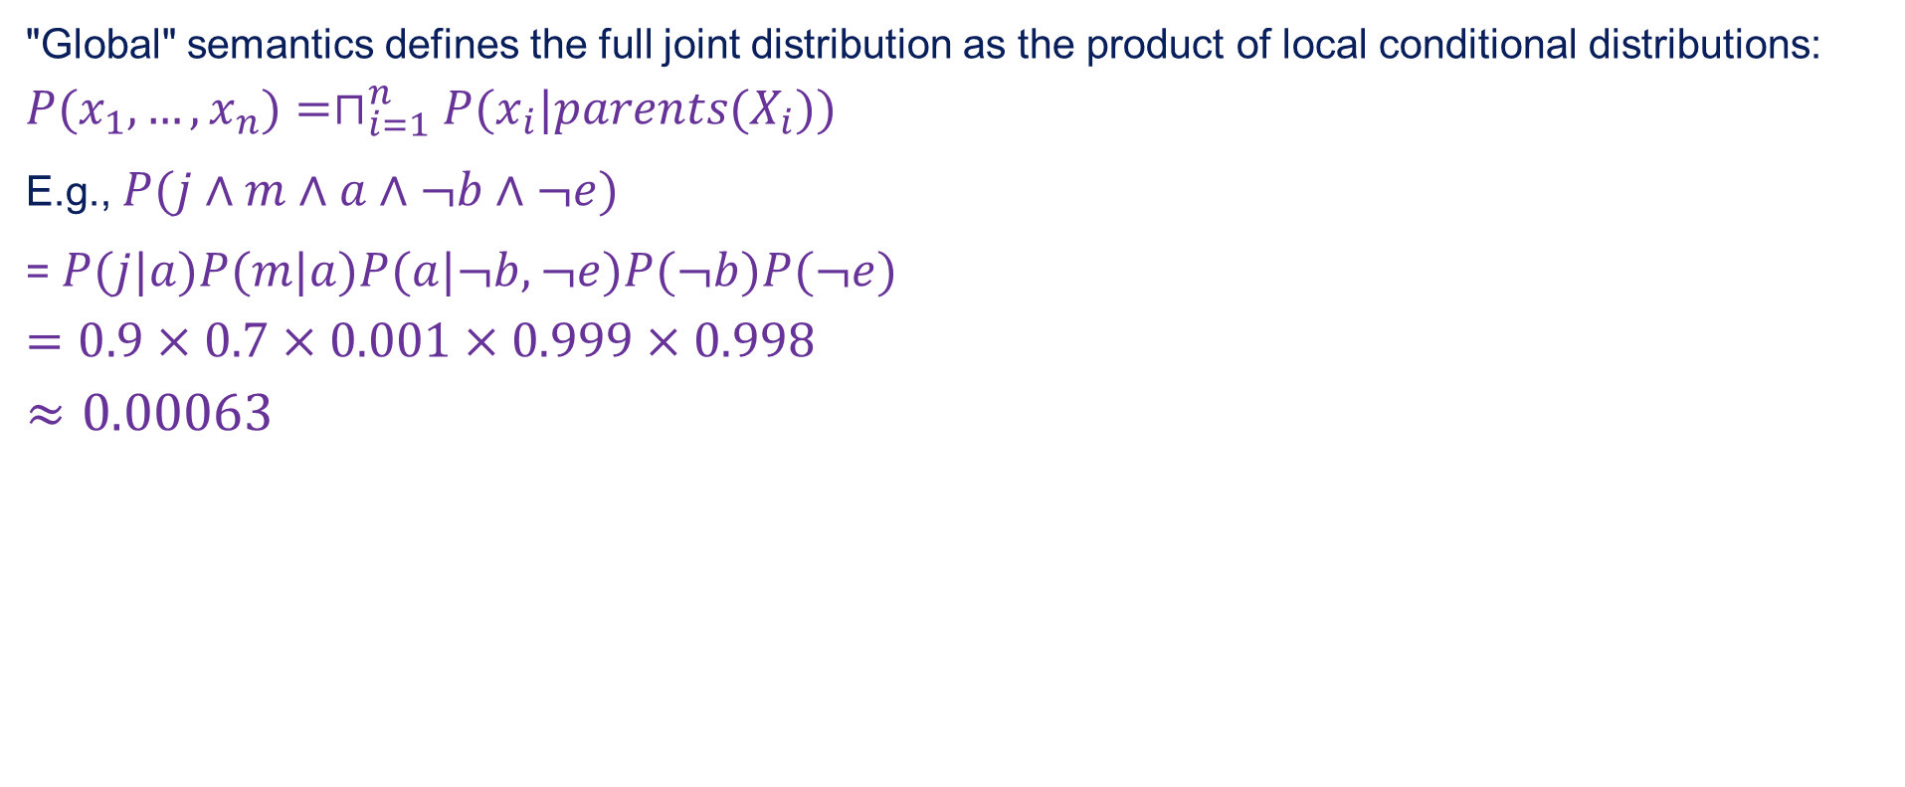
Global semantics
"Global" semantics defines the full joint distribution as the product of local conditional distributions:
$$P(x_{1},…,x_{n})=⊓_{i=1}^{n}P(x_{i}|parents(X_{i}))$$
E.g., $P(j∧m∧a∧¬b∧¬e)$
= $P(j|a)P(m|a)P(a|¬b,¬e)P(¬b)P(¬e)$
$$=0.9×0.7×0.001×0.999×0.998$$
$$≈0.00063$$

Slide 9
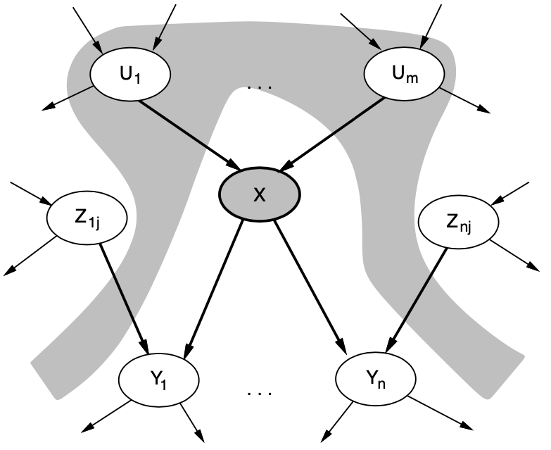

Local semantics
Local semantics: each node is conditionally independent of its nondecendants given its parents
Theorem: Local semantics $⇔$ global semantics

Slide 10
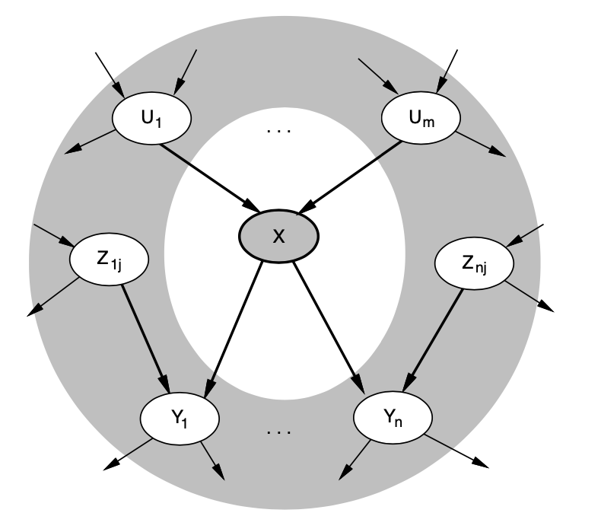
Markov blanket
Each node is conditionally independent of all others given its
Markov blanket: parents + children + children's parents

Slide 11
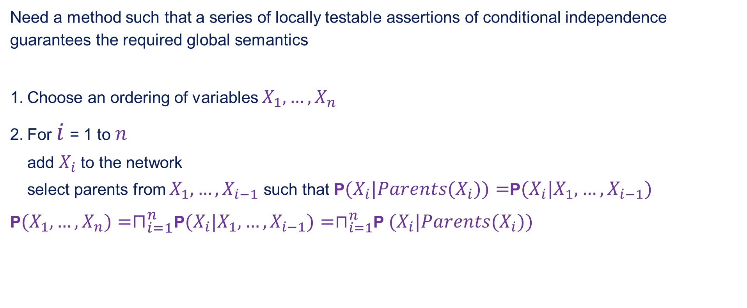
Constructive Bayesian networks
Need a method such that a series of locally testable assertions of conditional independence guarantees the required global semantics
Choose an ordering of variables $X_{1},…,X_{n}$
For $i$ = 1 to $n$ add $X_{i}$ to the network select parents from $X_{1},…,X_{i−1}$ such that P$(X_{i}|Parents(X_{i}))=$P$(X_{i}|X_{1},…,X_{i−1})$
P$(X_{1},…,X_{n})=⊓_{i=1}^{n}$P$(X_{i}|X_{1},…,X_{i−1})=⊓_{i=1}^{n}$P $(X_{i}|Parents(X_{i}))$

Slide 12
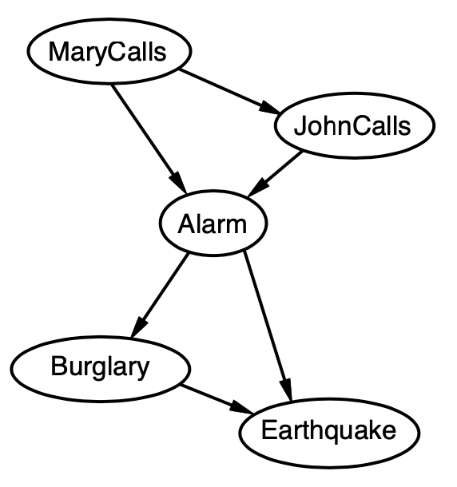
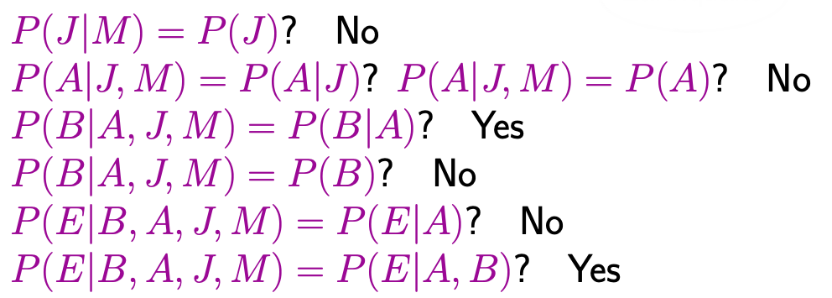

Example
Suppose we choose the ordering $M$, $J$, $A$, $B$, $E$

Slide 13

Example contd.
Deciding conditional independence is hard in noncausal directions
(Causal models and conditional independence seem hardwired for humans!)
Assessing conditional probabilities is hard in non causal directions.
Network is less compact: $1+2+4+2+4=13$ numbers needed.

Slide 14
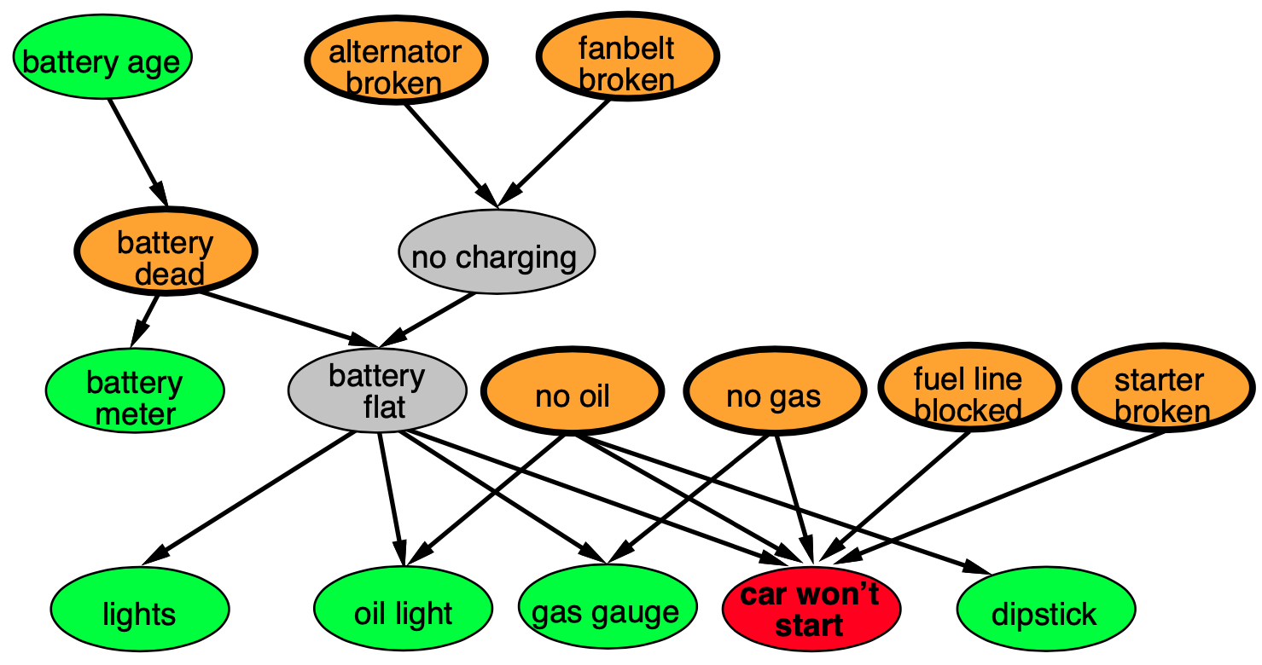
Example: Car diagnosis
Initial evidence: car won't start
Testable variables (green), "broken, so fix it" variables (orange)
Hidden variables (gray) ensure sparse structure, reduce parameters

Slide 15
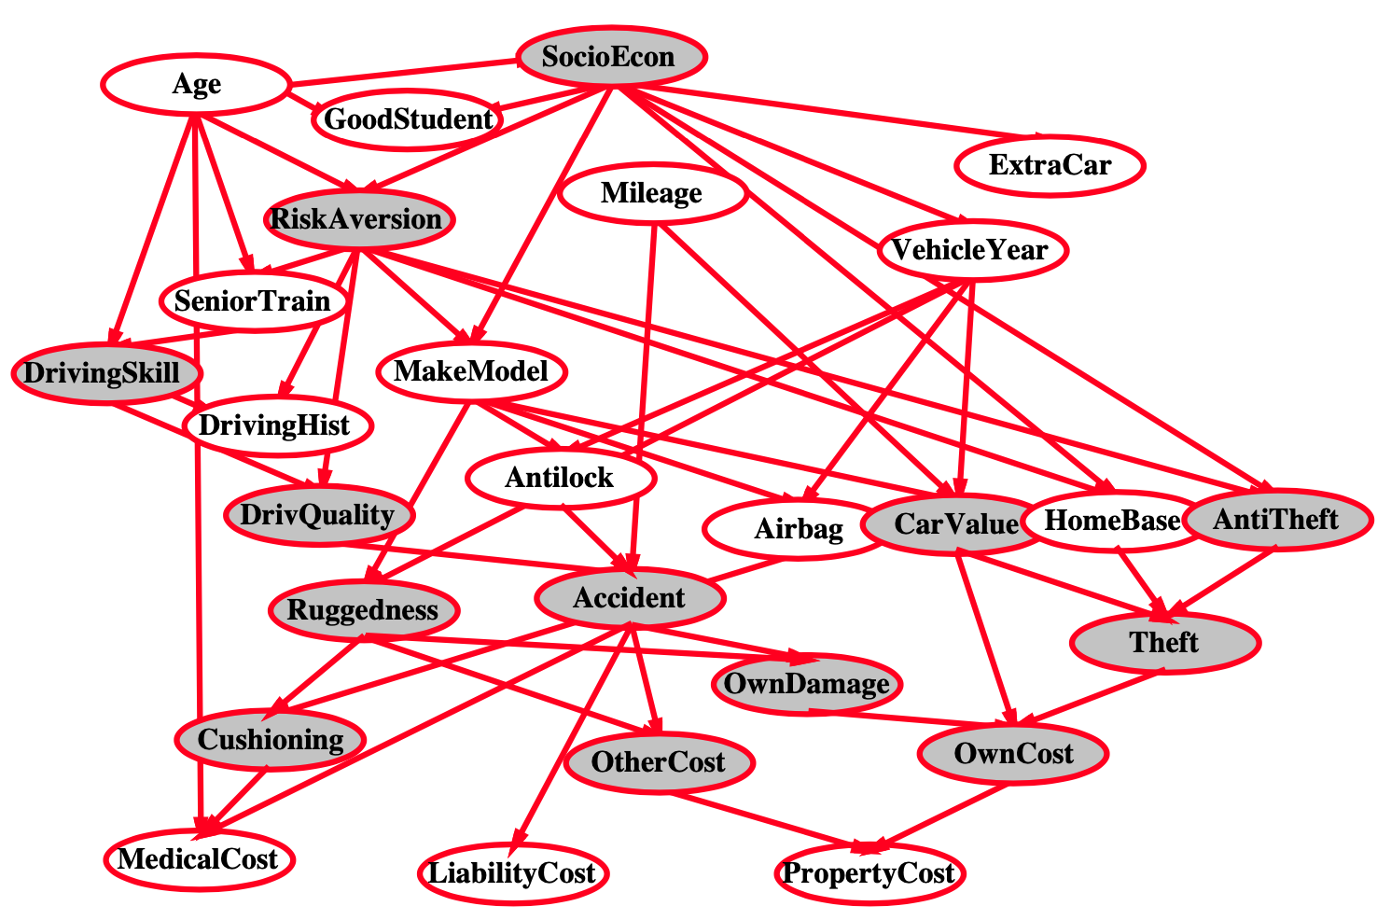
Example: Car insurance

Slide 16
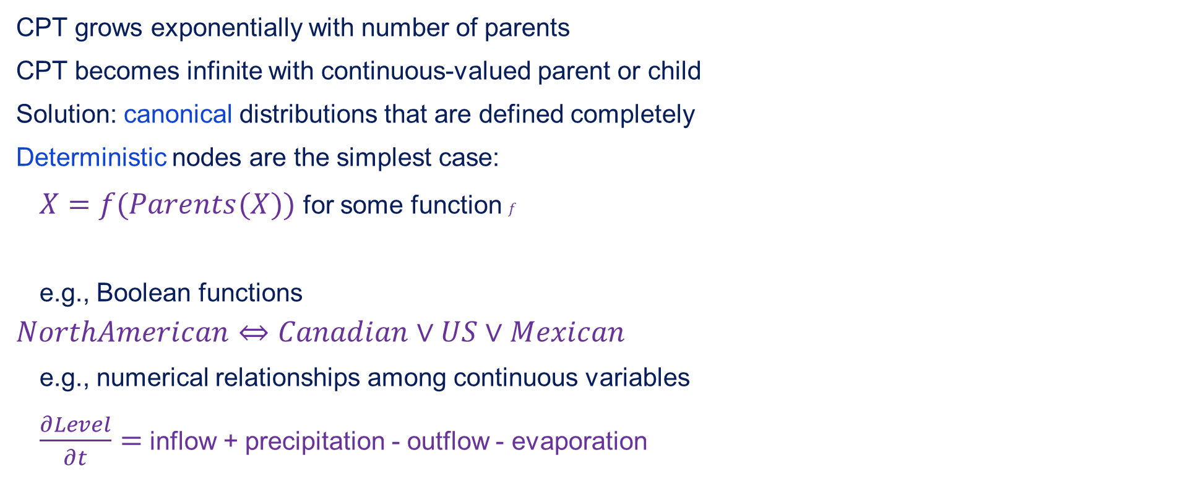
Compact conditional distributions
CPT grows exponentially with number of parents
CPT becomes infinite with continuous-valued parent or child
Solution: canonical distributions that are defined completely
Deterministic nodes are the simplest case:
$X=f(Parents(X))$ for some function $f$
e.g., Boolean functions
$$NorthAmerican⇔Canadian∨US∨Mexican$$
e.g., numerical relationships among continuous variables
$\frac{∂Level}{∂t}=$ inflow + precipitation - outflow - evaporation

Slide 17
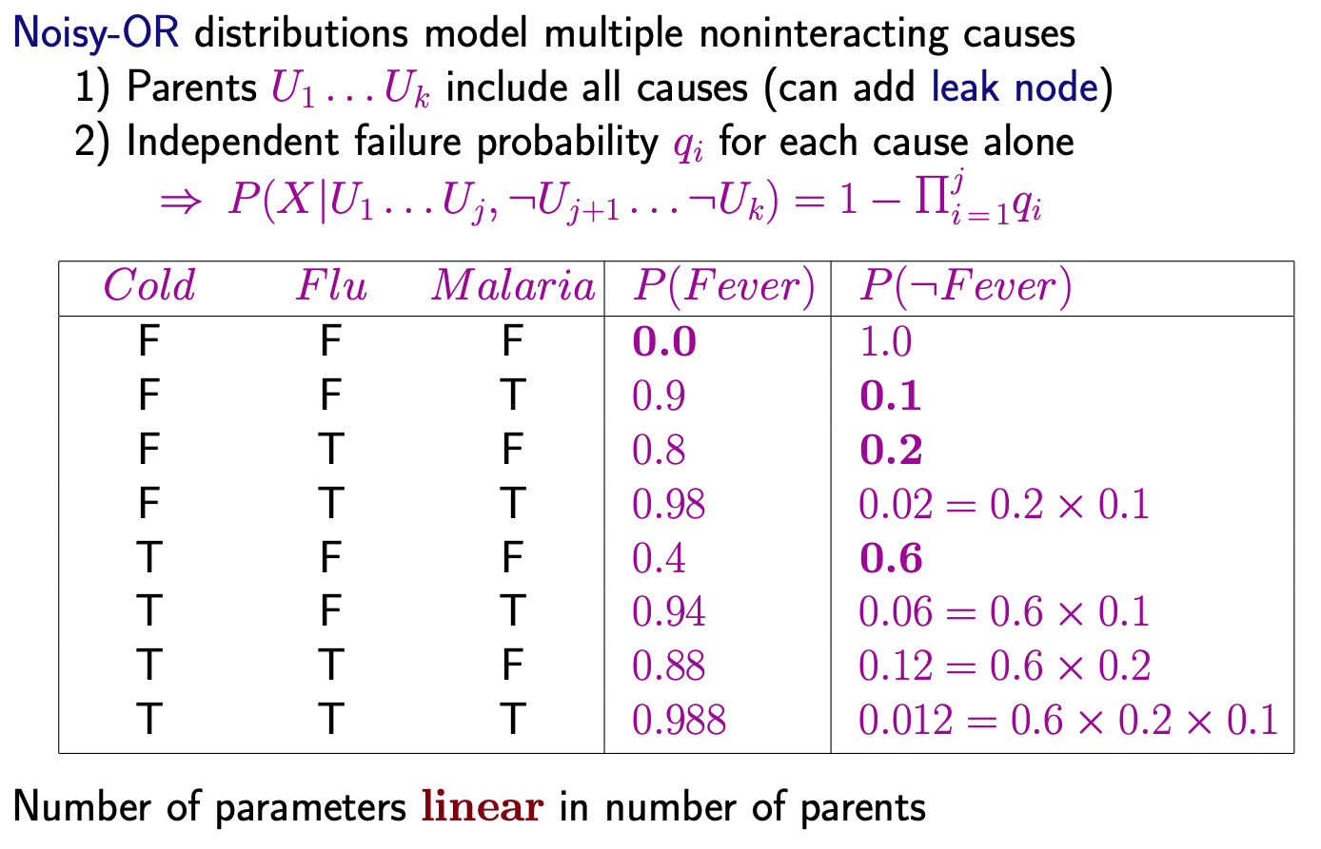
Compact conditional distributions contd.

Slide 18
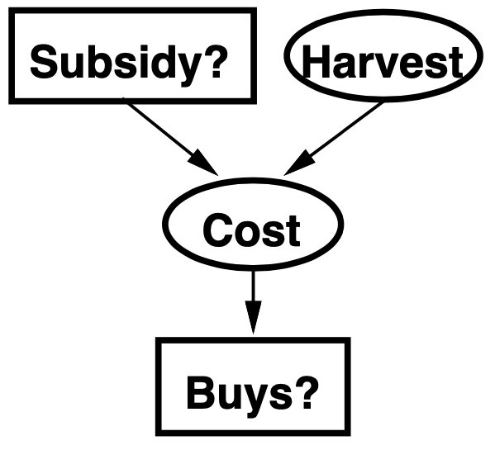
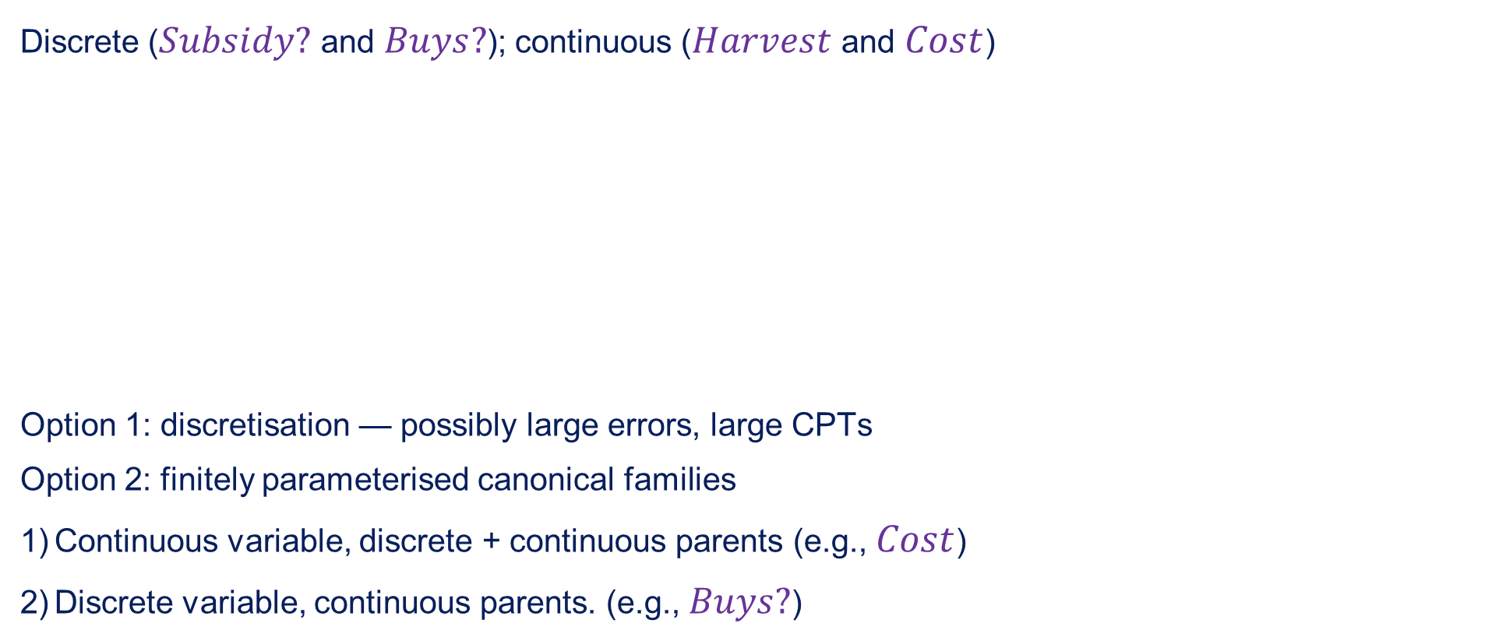
Hybrid (discrete+continuous) networks
Discrete ($Subsidy?$ and $Buys?$); continuous ($Harvest$ and $Cost$)
Option 1: discretisation — possibly large errors, large CPTs
Option 2: finitely parameterised canonical families
Continuous variable, discrete + continuous parents (e.g., $Cost$)
Discrete variable, continuous parents. (e.g., $Buys?$)

Slide 19
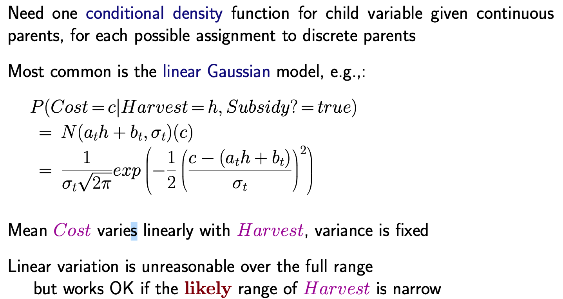
Continuous child variables

Slide 20
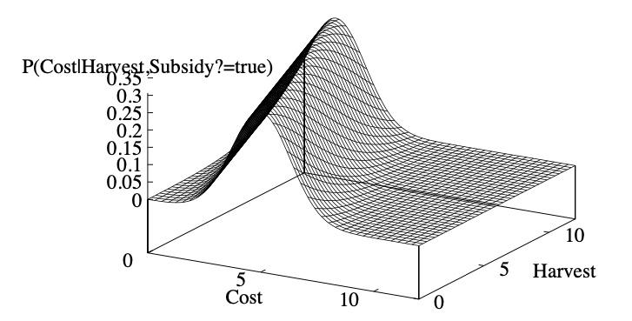

Continuous child variables
All-continuous network with LG distributions $⇒$ full joint distribution is a multivariate Gaussian
Discrete+continuous LG network is a conditional Gaussian network i.e., a multivariate Gaussian over all continuous variables for each combination of discrete variable values

Slide 21
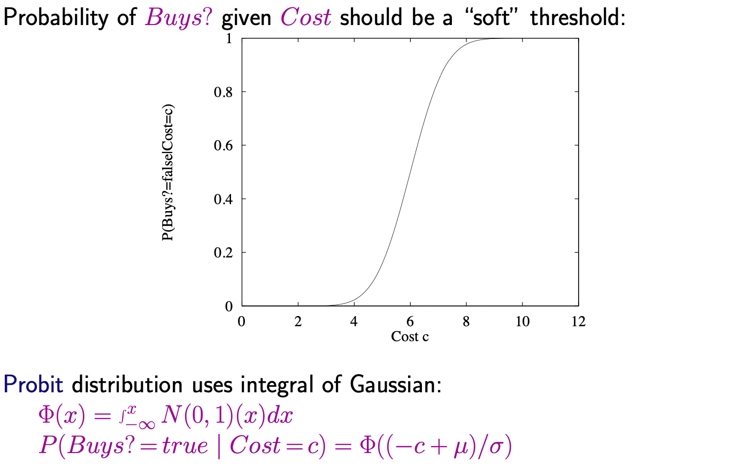
Discrete variable w/ continuous parents

Slide 22
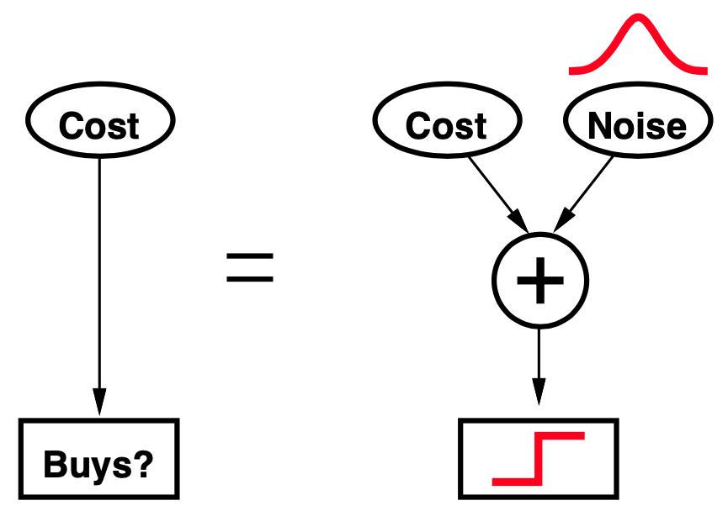
Why the profit
It's sort of the right shape
Can view as hard threshold whose location is subject to noise

Slide 23
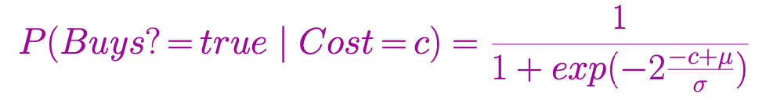
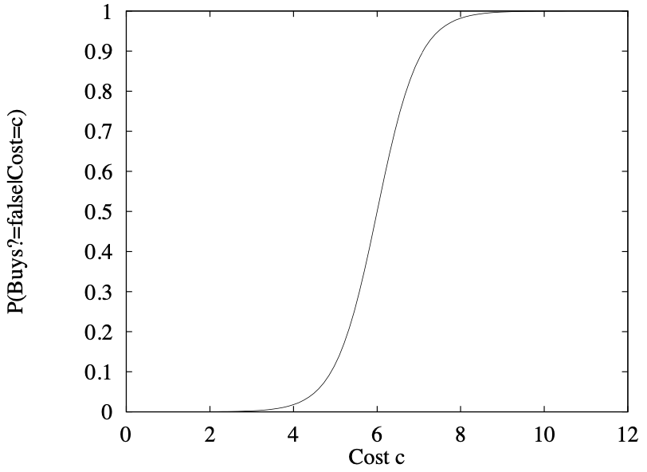
Discrete variable contd.
Sigmoid (or logit) distribution also used in neural networks
Sigmoid has similar shape to profit but much longer tails:

Slide 24
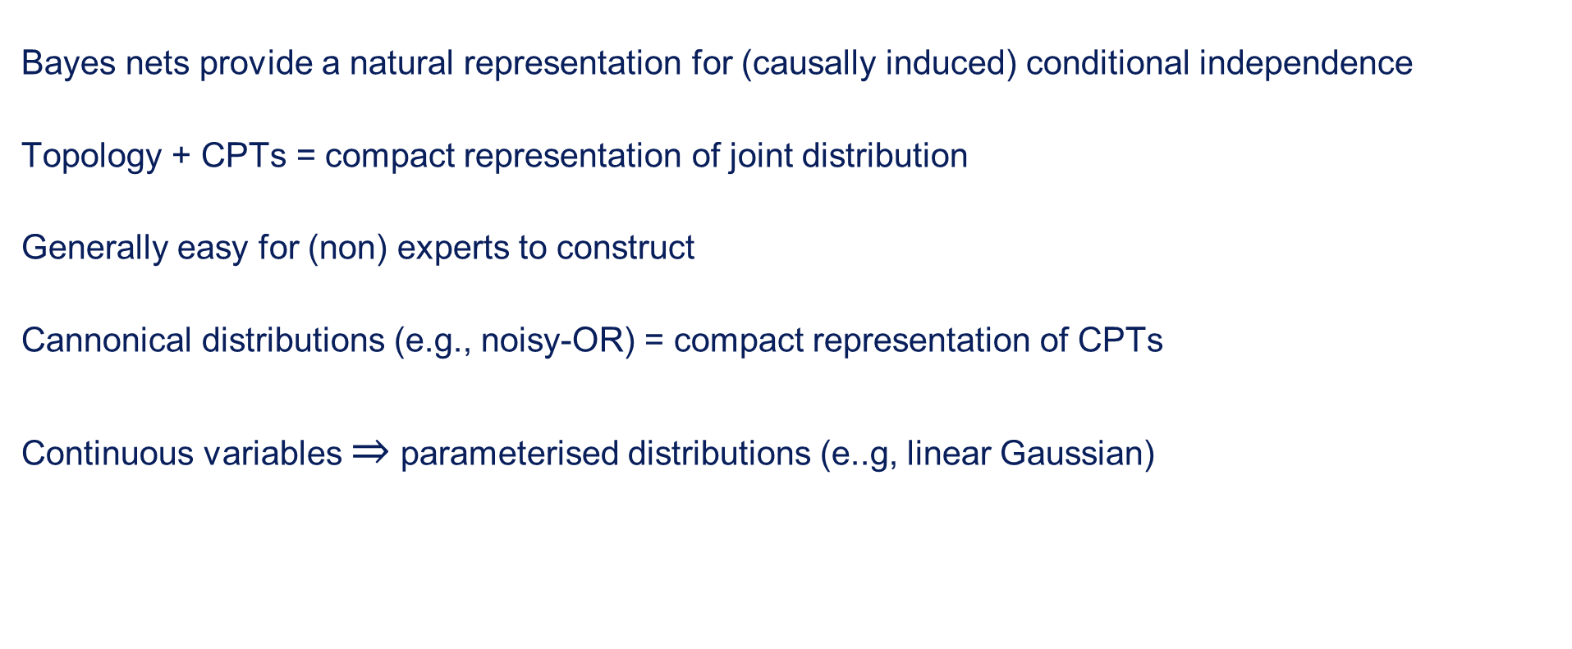
Summaray
Bayes nets provide a natural representation for (causally induced) conditional independence
Topology + CPTs = compact representation of joint distribution
Generally easy for (non) experts to construct
Cannonical distributions (e.g., noisy-OR) = compact representation of CPTs
Continuous variables $⇒$ parameterised distributions (e..g, linear Gaussian)

