Slide 1
Temporal Probability Models
Lessons 17 and 18

Slide 2
Outline
Time and uncertainty
Inference: filtering, prediction, smoothing
Hidden Markov models
Kalman filters (a brief mention)
Dynamic Bayesian networks
Particle filtering

Slide 3
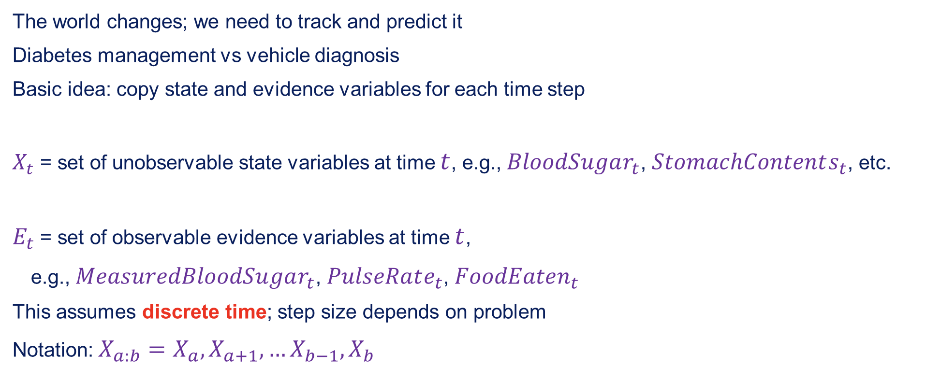
Time and uncertainty
The world changes; we need to track and predict it
Diabetes management vs vehicle diagnosis
Basic idea: copy state and evidence variables for each time step
$X_{t}$ = set of unobservable state variables at time $t$, e.g., $BloodSugar_{t}$, $StomachContents_{t}$, etc.
$E_{t}$ = set of observable evidence variables at time $t$,
e.g., $MeasuredBloodSugar_{t}$, $PulseRate_{t}$, $FoodEaten_{t}$
This assumes discrete time; step size depends on problem
Notation: $X_{a:b}=X_{a},X_{a+1},…X_{b−1},X_{b}$

Slide 4
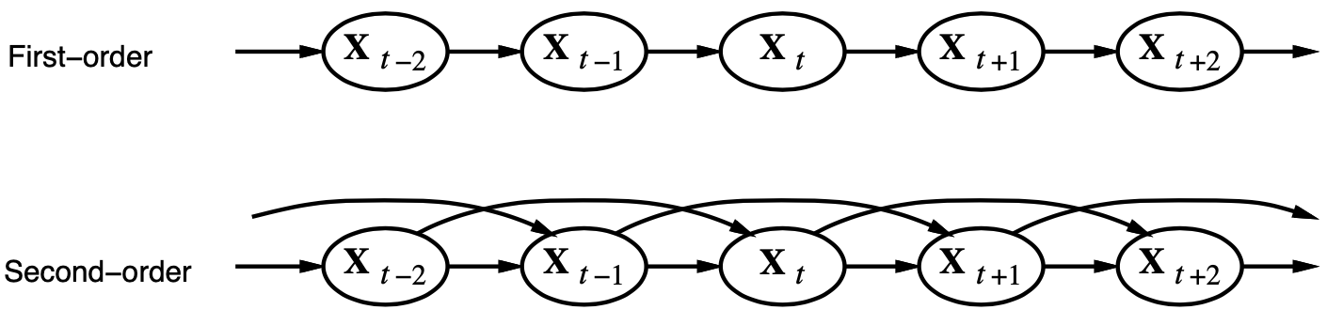

Markov processes (Markov chains)
Construct a Bayes net from these variables: parents?
Markov assumption: $X_{t}$ depends on bounded subset of $X_{0:t−1}$
First-order Markov process: $P(X_{t}|X_{0:t−1})=P(X_{t}|X_{t−1})$
Second-order Markov process: $P(X_{t}|X_{0:t−1})=P(X_{t}|X_{t−2},X_{t−1})$

Slide 5

Markov processes (Markov chains)
Sensor Markov assumption: $P(E_{t}|X_{0:t},E_{0:t−1})=P(E_{t}|X_{t})$
Stationary process: transition model $P(X_{t}|X_{t−1})$ and sensor model $P(E_{t}|X_{t})$ fixed for all $t$

Slide 6
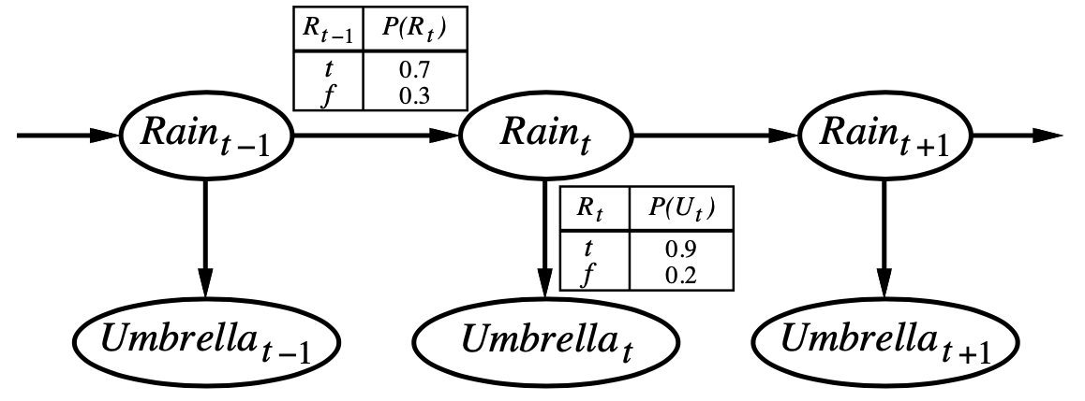

Example
First-order Markov assumption not exactly true in real world!
Possible fixes:
Increase order of Markov process
Augment state, e.g., add $Temp_{t}$, $Pressure_{t}$
Example: robot motion
Augment position and velocity with $Battery_{t}$

Slide 7
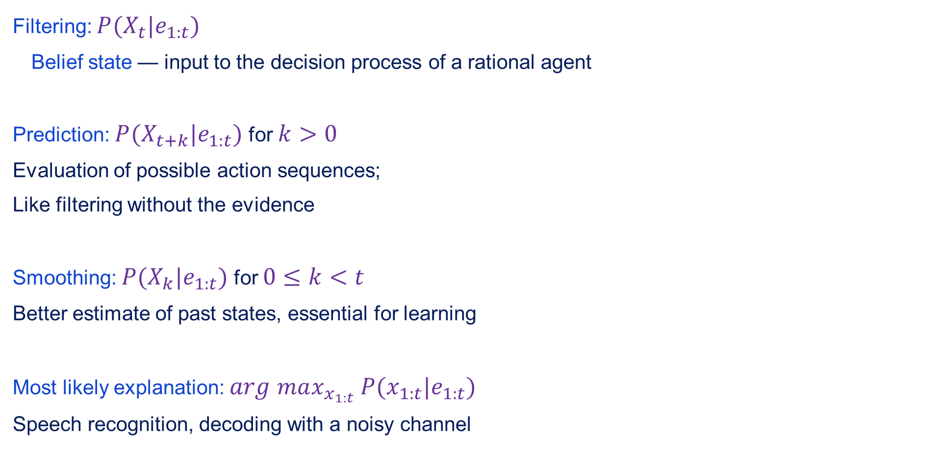
Inference tasks
Filtering: $P(X_{t}|e_{1:t})$
Belief state — input to the decision process of a rational agent
Prediction: $P(X_{t+k}|e_{1:t})$ for $k>0$
Evaluation of possible action sequences;
Like filtering without the evidence
Smoothing: $P(X_{k}|e_{1:t})$ for $0≤k<t$
Better estimate of past states, essential for learning
Most likely explanation: $arg$ $max_{x_{1:t}}$ $P(x_{1:t}|e_{1:t})$
Speech recognition, decoding with a noisy channel

Slide 8
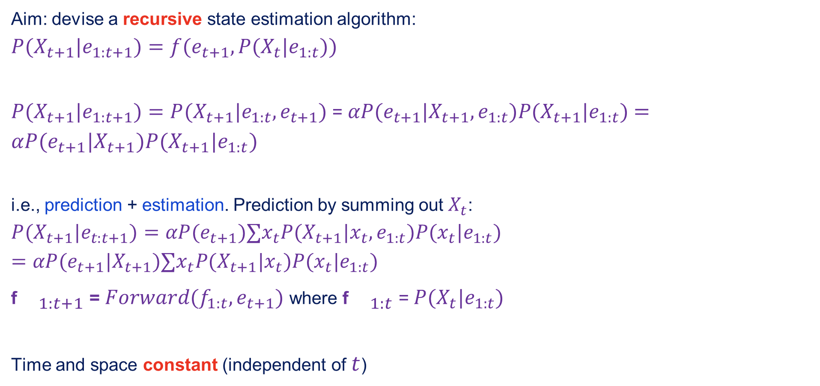
Filtering
Aim: devise a recursive state estimation algorithm:
$$P(X_{t+1}|e_{1:t+1})=f(e_{t+1},P(X_{t}|e_{1:t}))$$
$P(X_{t+1}|e_{1:t+1})=P(X_{t+1}|e_{1:t},e_{t+1})$ = $αP(e_{t+1}|X_{t+1},e_{1:t})P(X_{t+1}|e_{1:t})$ $=αP(e_{t+1}|X_{t+1})P(X_{t+1}|e_{1:t})$
i.e., prediction + estimation. Prediction by summing out $X_{t}$:
$$P(X_{t+1}|e_{t:t+1})=αP(e_{t+1})∑x_{t}P(X_{t+1}|x_{t},e_{1:t})P(x_{t}|e_{1:t})=αP(e_{t+1}|X_{t+1})∑x_{t}P(X_{t+1}|x_{t})P(x_{t}|e_{1:t})$$
f${}_{1:t+1}$ = $Forward(f_{1:t},e_{t+1})$ where f${}_{1:t}$ = $P(X_{t}|e_{1:t})$
Time and space constant (independent of $t$)

Slide 9
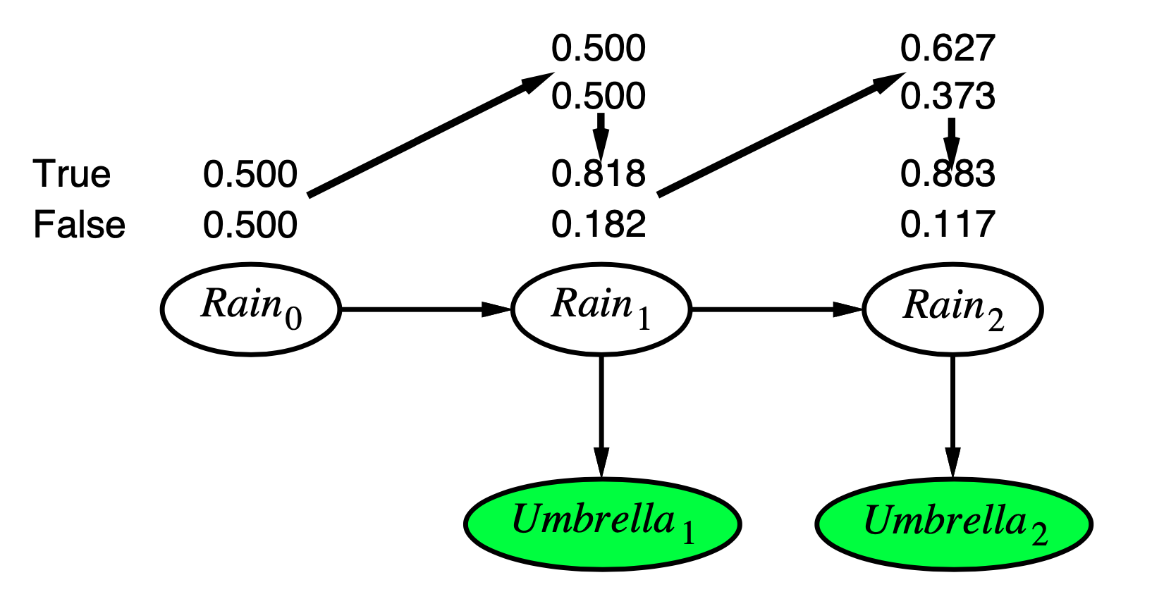
Filtering example

Slide 10
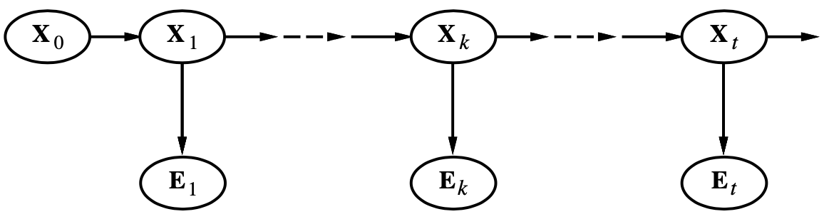
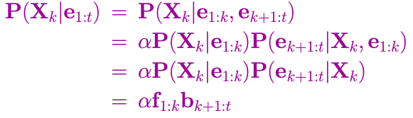
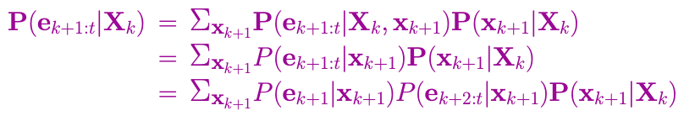

Smoothing
Divide evidence $e_{1:t}$ into $e_{1:k}$, $e_{k+1:t}$:
Backward message computer by a backwards recursion:

Slide 11
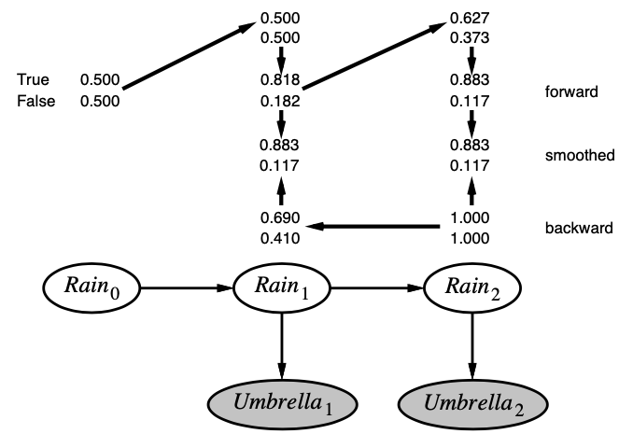

Smoothing example
Forwards-backward algorithm: cache forward messages along the way
Time linear in $t$ (polytree interference), space $O(t|$f$|)$

Slide 12
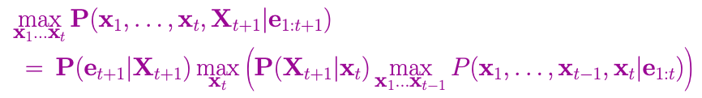

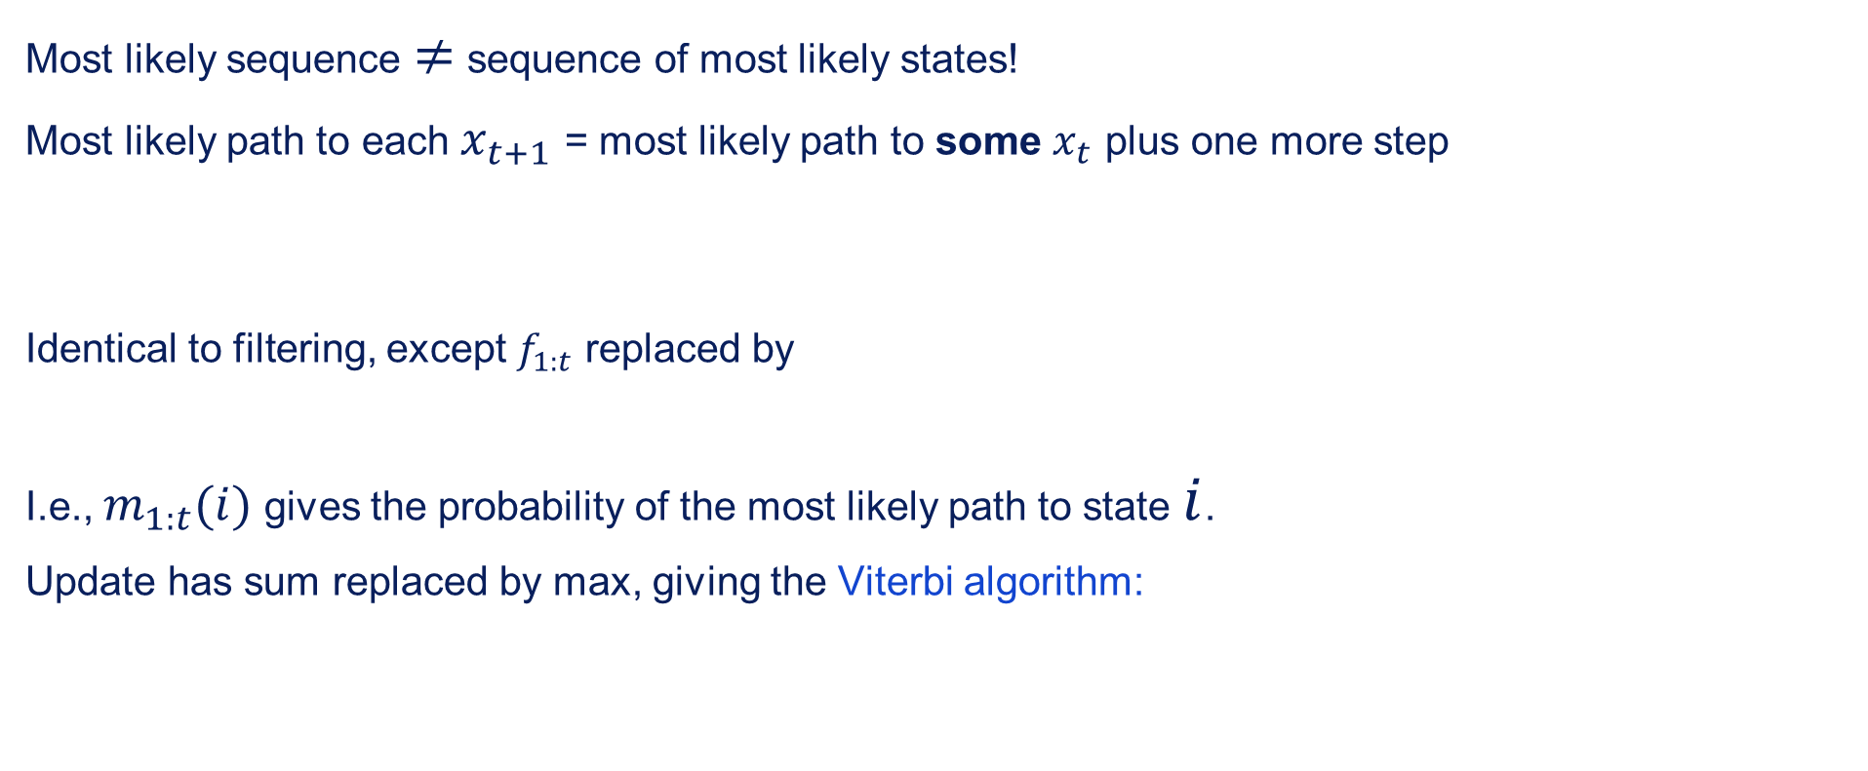
Most likely explanation
Most likely sequence $≠$ sequence of most likely states!
Most likely path to each $x_{t+1}$ = most likely path to some $x_{t}$ plus one more step
Identical to filtering, except $f_{1:t}$ replaced by
I.e., $m_{1:t}(i)$ gives the probability of the most likely path to state $i$.
Update has sum replaced by max, giving the Viterbi algorithm:

Slide 13
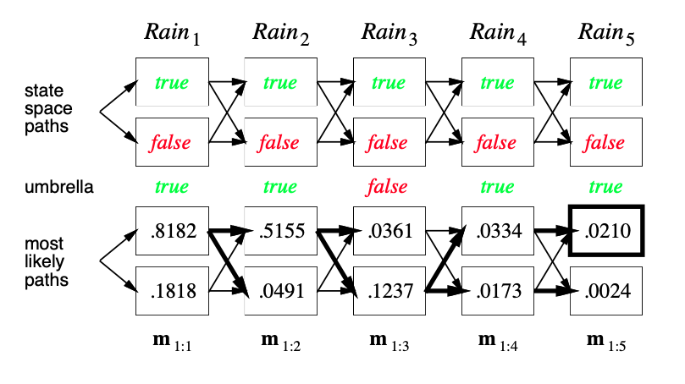
Viterbi example

Slide 14
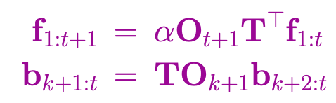
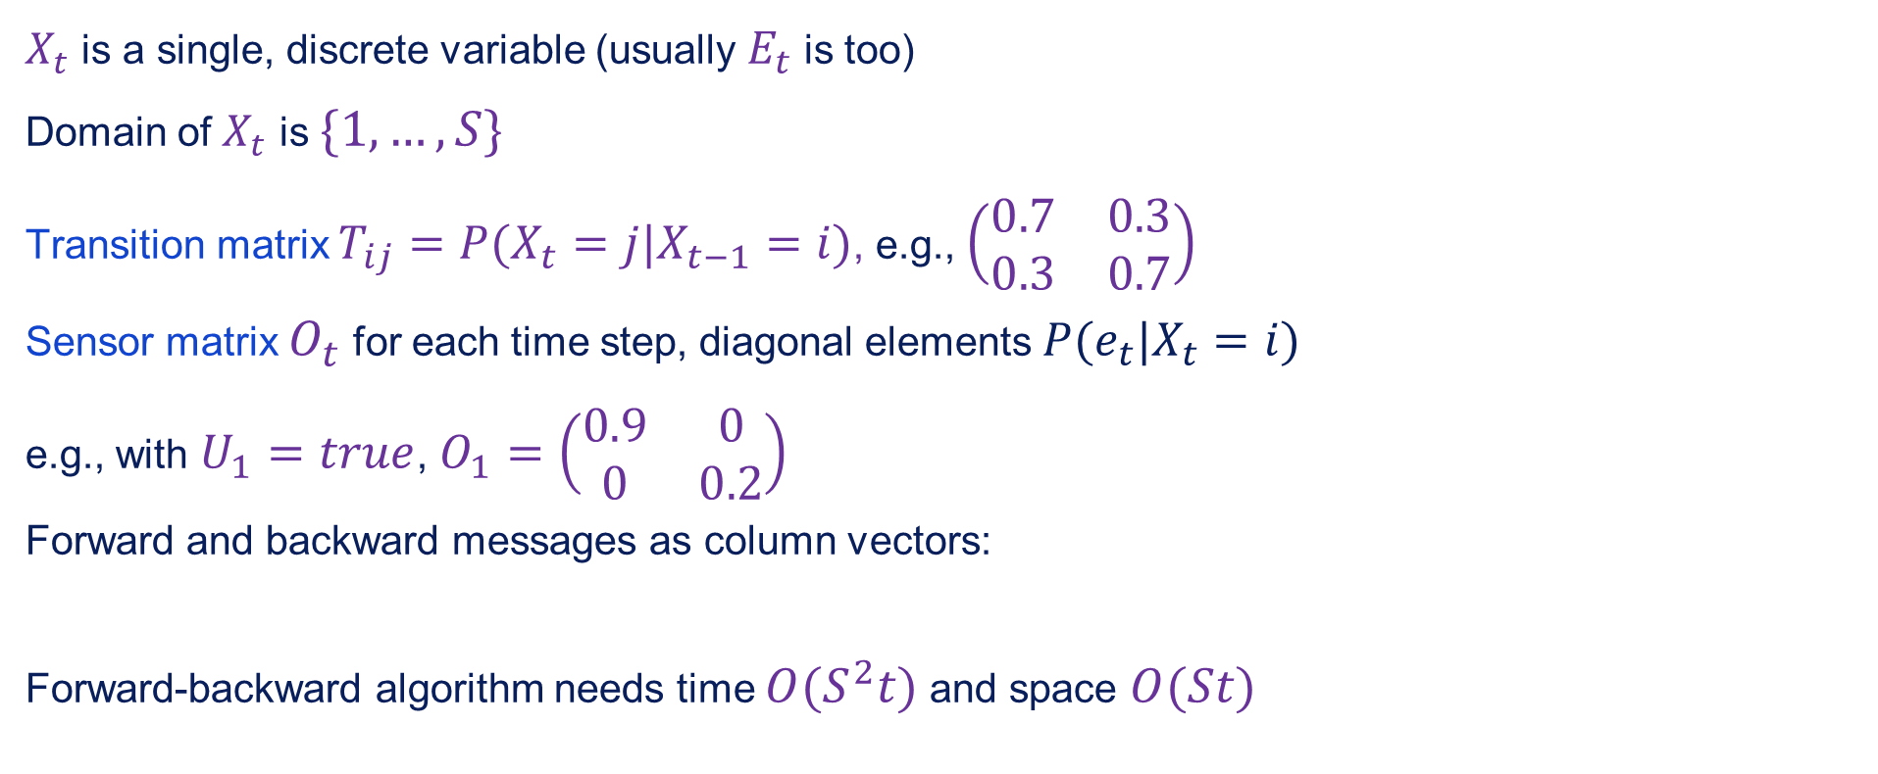
Hidden Markov models
$X_{t}$ is a single, discrete variable (usually $E_{t}$ is too)
Domain of $X_{t}$ is $\{1,…,S\}$
Transition matrix $T_{ij}=P(X_{t}=j|X_{t−1}=i)$, e.g., $\left(\begin{matrix}0.7 & 0.3 \\ 0.3 & 0.7\end{matrix}\right)$
Sensor matrix $O_{t}$ for each time step, diagonal elements $P(e_{t}|X_{t}=i)$
e.g., with $U_{1}=true$, $O_{1}=\left(\begin{matrix}0.9 & 0 \\ 0 & 0.2\end{matrix}\right)$
Forward and backward messages as column vectors:
Forward-backward algorithm needs time $O(S^{2}t)$ and space $O(St)$

Slide 15
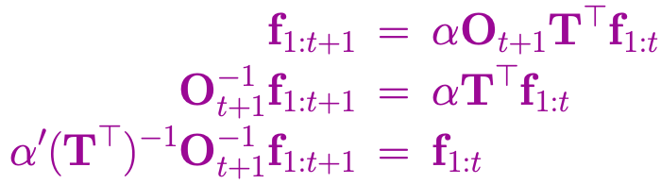
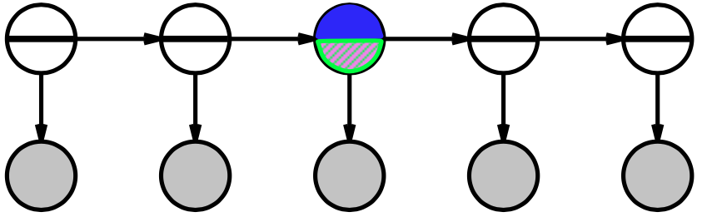
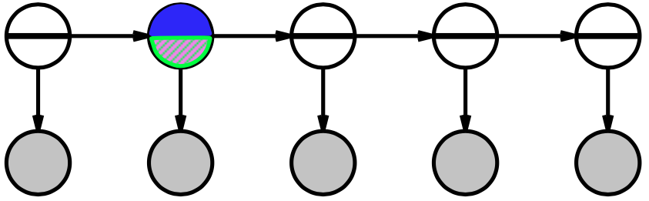
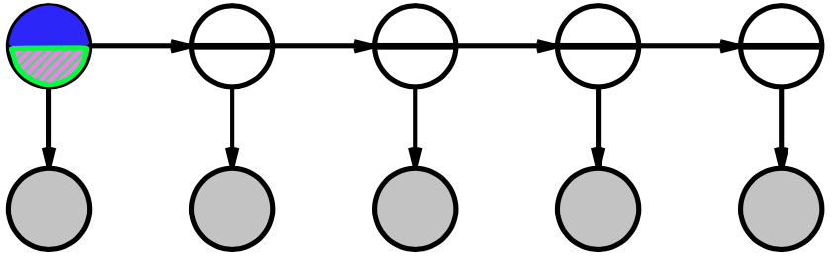
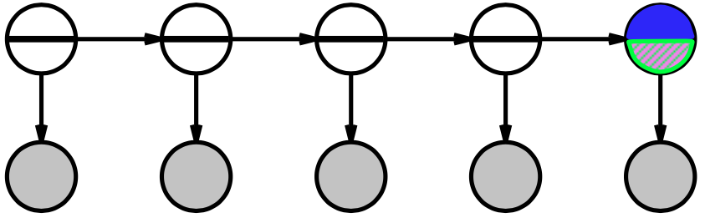
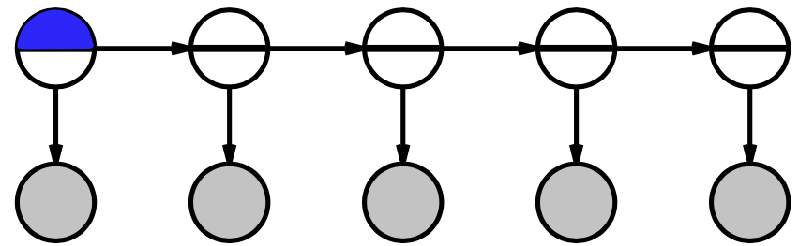
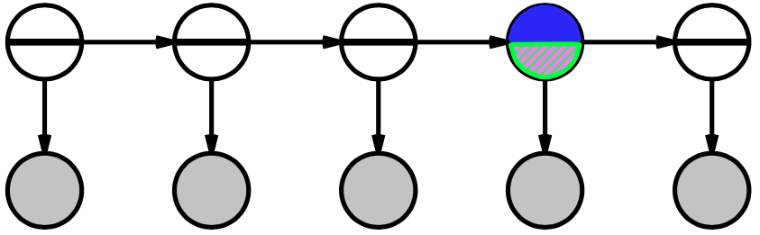
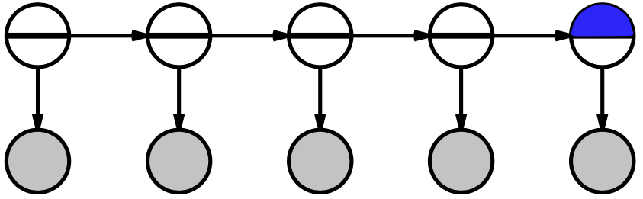
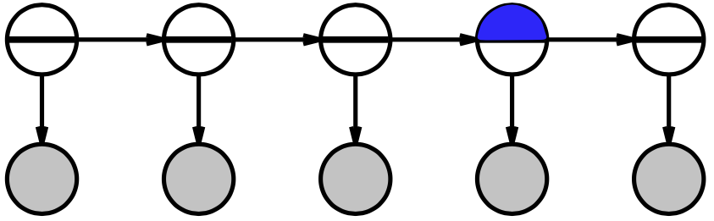
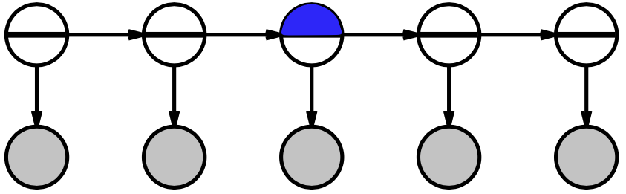
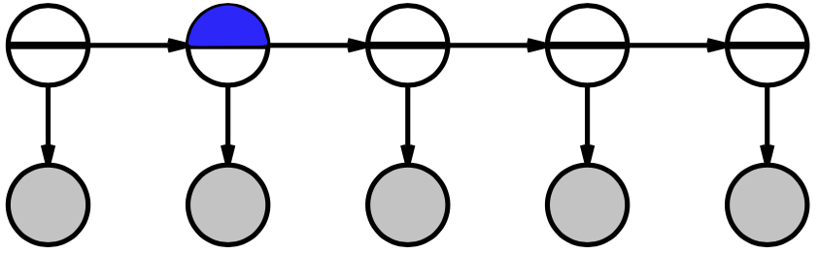

Country dance algorithm
Can avoid storing all forward messages in smoothing by running forward algorithm backwards:
Algorithm: forward pass computes $f_{t}$, backward pass does $f_{i}$, $b_{i}$

Slide 16
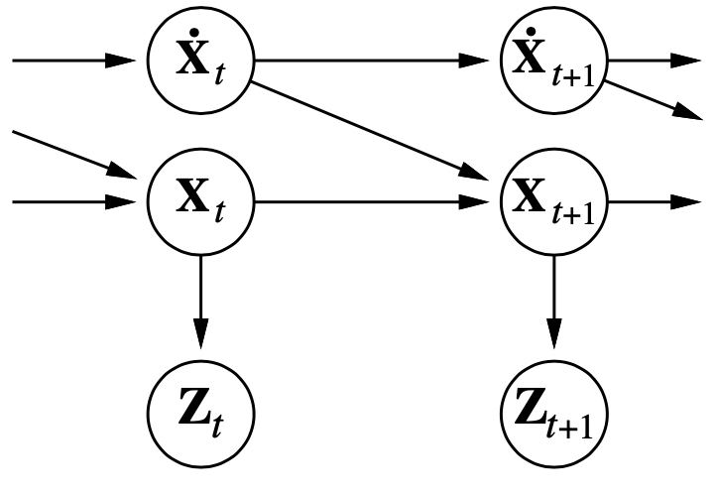
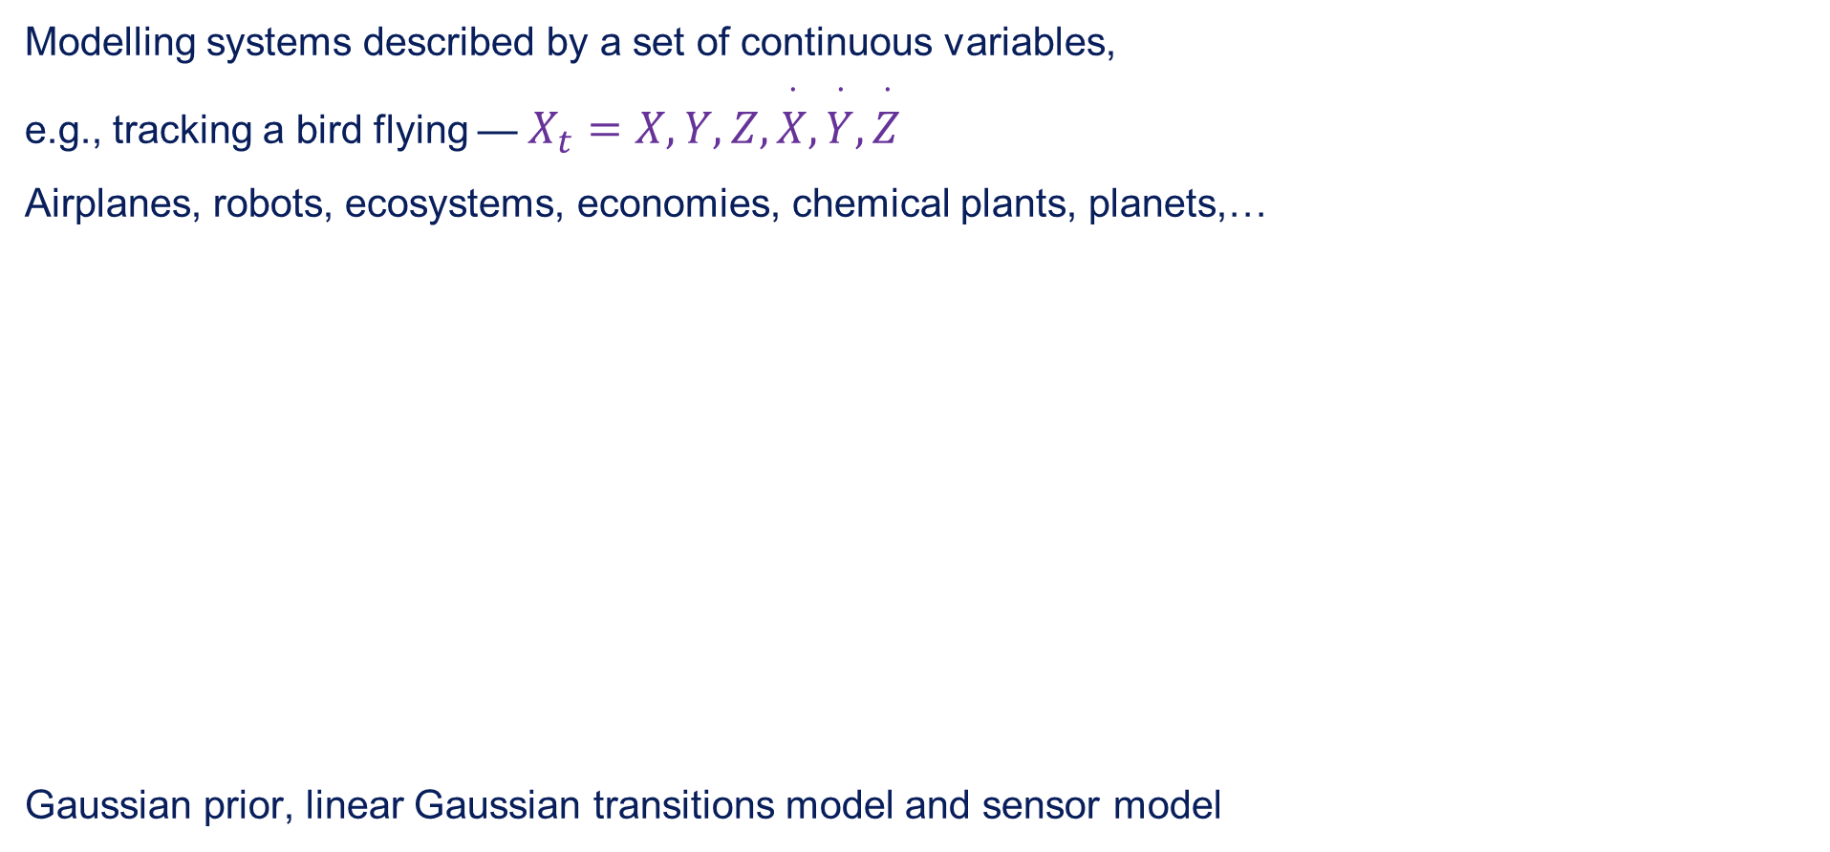
Kalman filters
Modelling systems described by a set of continuous variables,
e.g., tracking a bird flying — $X_{t}=X,Y,Z,\overset{·}{X},\overset{·}{Y},\overset{·}{Z}$
Airplanes, robots, ecosystems, economies, chemical plants, planets,…
Gaussian prior, linear Gaussian transitions model and sensor model

Slide 17
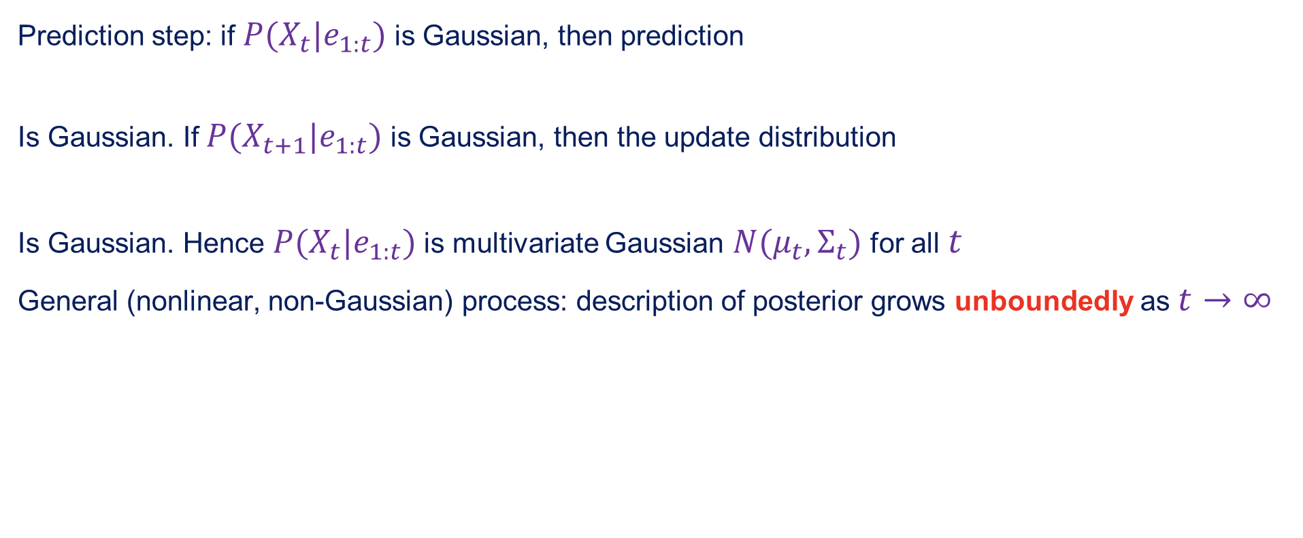
Update Gaussian distributions
Prediction step: if $P(X_{t}|e_{1:t})$ is Gaussian, then prediction
Is Gaussian. If $P(X_{t+1}|e_{1:t})$ is Gaussian, then the update distribution
Is Gaussian. Hence $P(X_{t}|e_{1:t})$ is multivariate Gaussian $N(μ_{t},Σ_{t})$ for all $t$
General (nonlinear, non-Gaussian) process: description of posterior grows unboundedly as $t→∞$

Slide 18
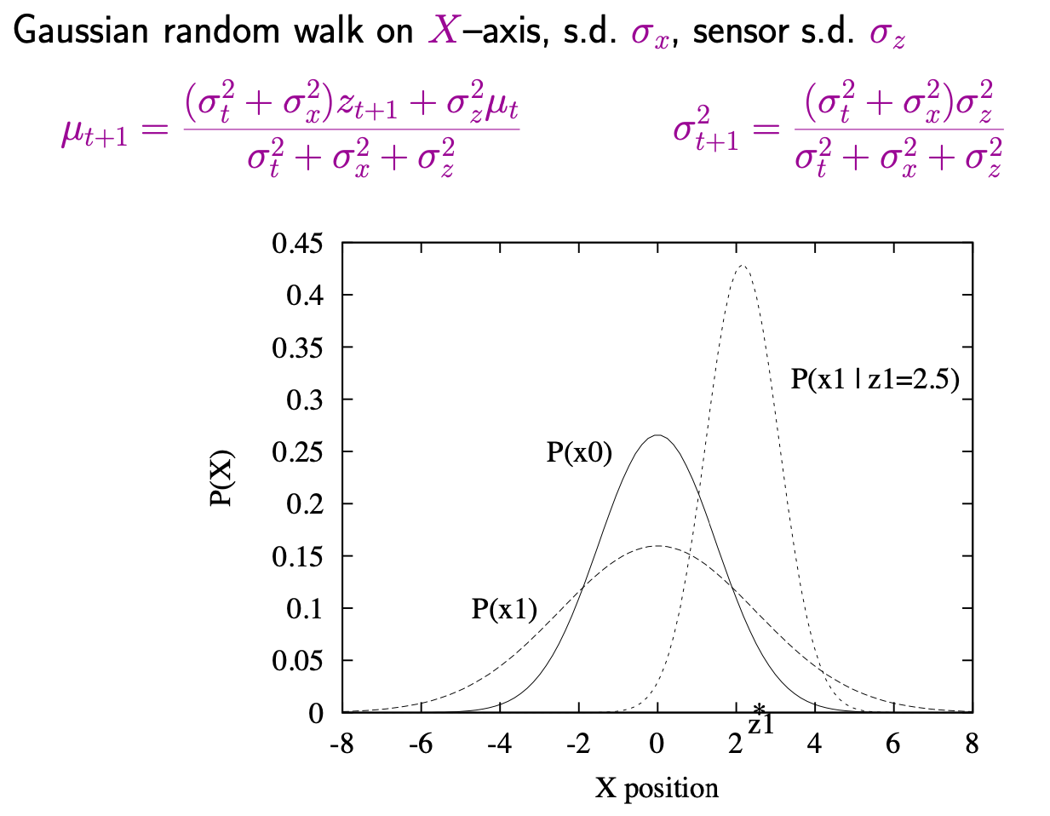
Simple 1-D example

Slide 19
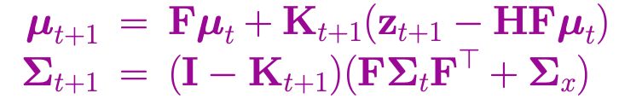
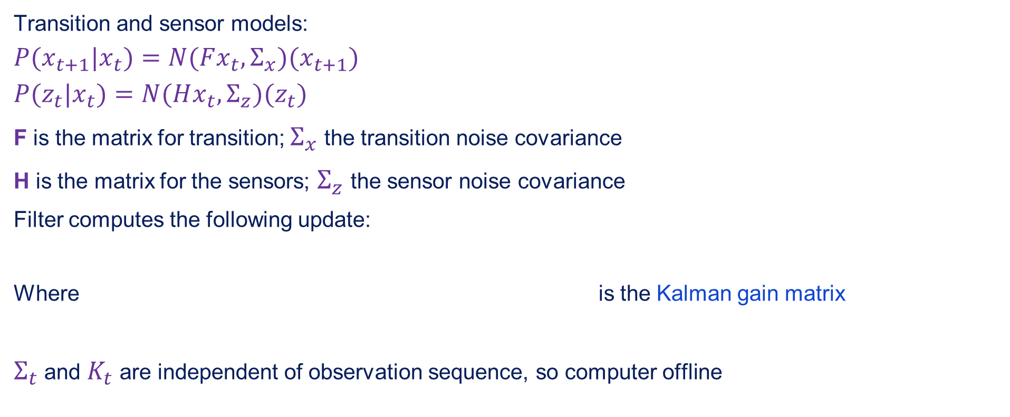
General Kalman update
Transition and sensor models:
$$P(x_{t+1}|x_{t})=N(Fx_{t},Σ_{x})(x_{t+1})$$
$$P(z_{t}|x_{t})=N(Hx_{t},Σ_{z})(z_{t})$$
F is the matrix for transition; $Σ_{x}$ the transition noise covariance
H is the matrix for the sensors; $Σ_{z}$ the sensor noise covariance
Filter computes the following update:
Where is the Kalman gain matrix
$Σ_{t}$ and $K_{t}$ are independent of observation sequence, so computer offline

Slide 20
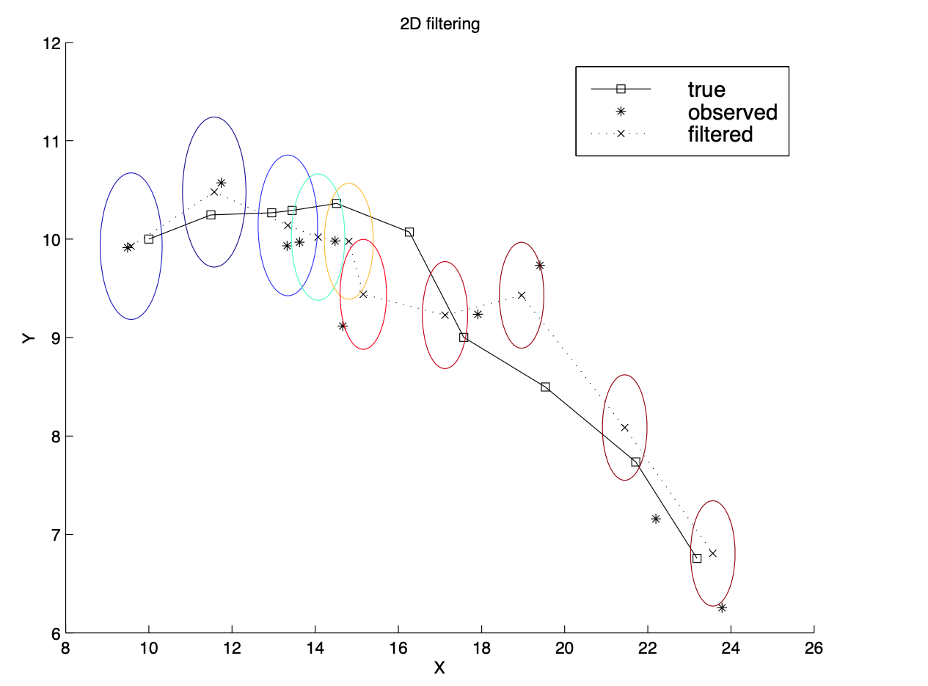
2-D tracking example: filtering

Slide 21
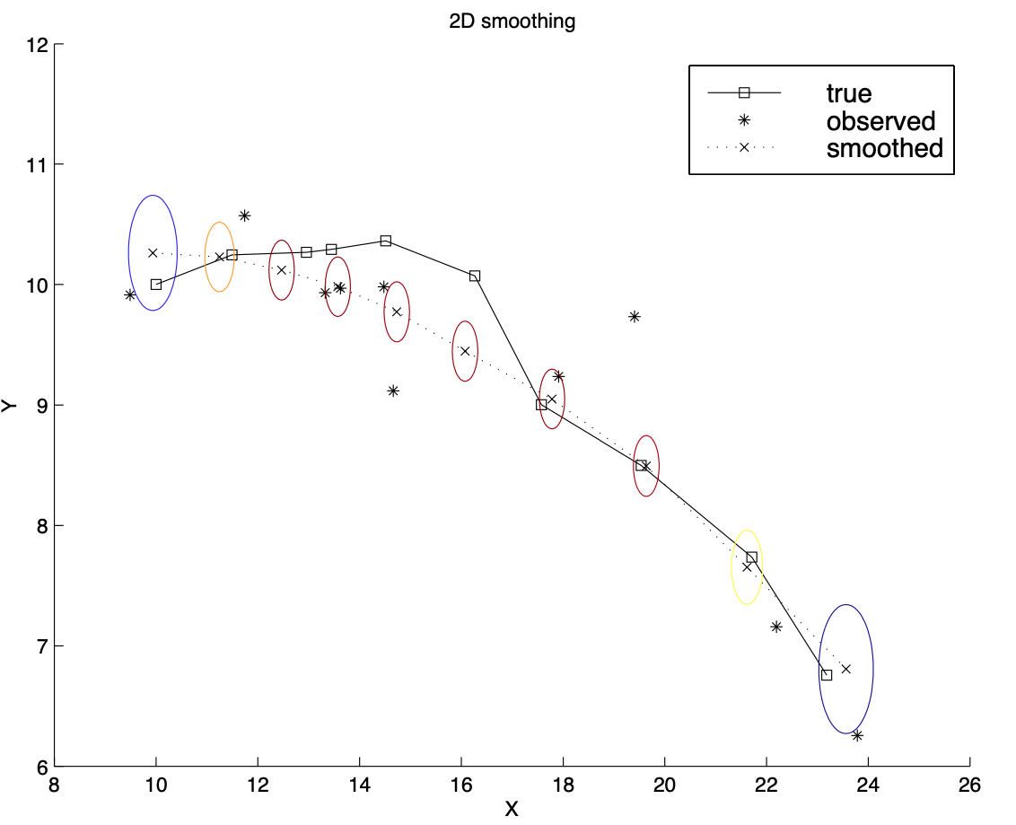
2-D tracking example: smoothing

Slide 22
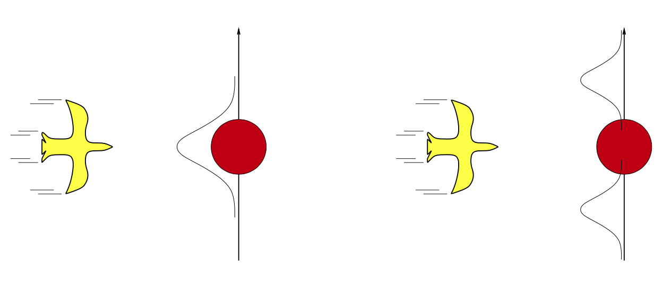

Where it breaks
Cannot be applied if the transition model is non-linear
Extended Kalman Filter models transition as locally linear around $x_{t}=μ_{t}$
Fails if system is locally unsmooth

Slide 23
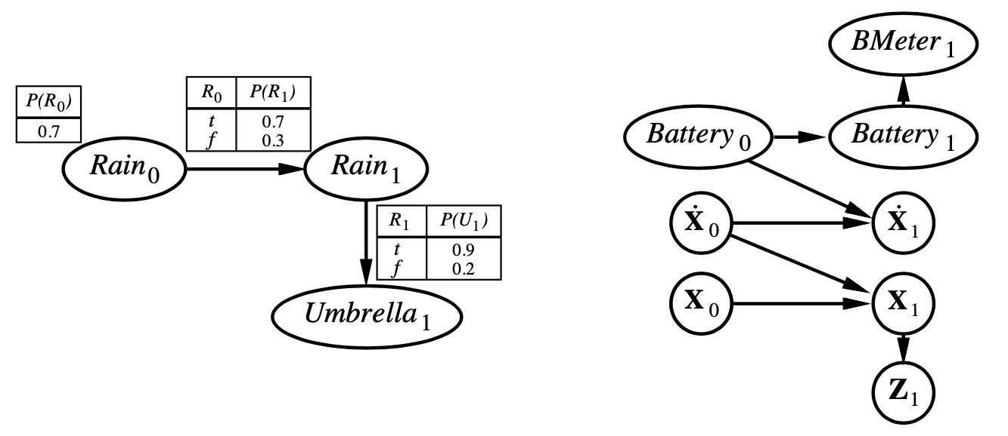

Dynamic Bayesian networks
$X_{t}$, $E_{t}$ contain arbitrarily many variables in a replicated Bayes net

Slide 24
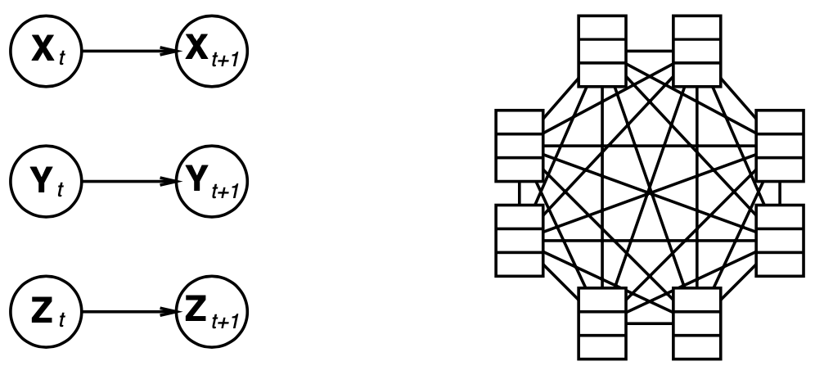
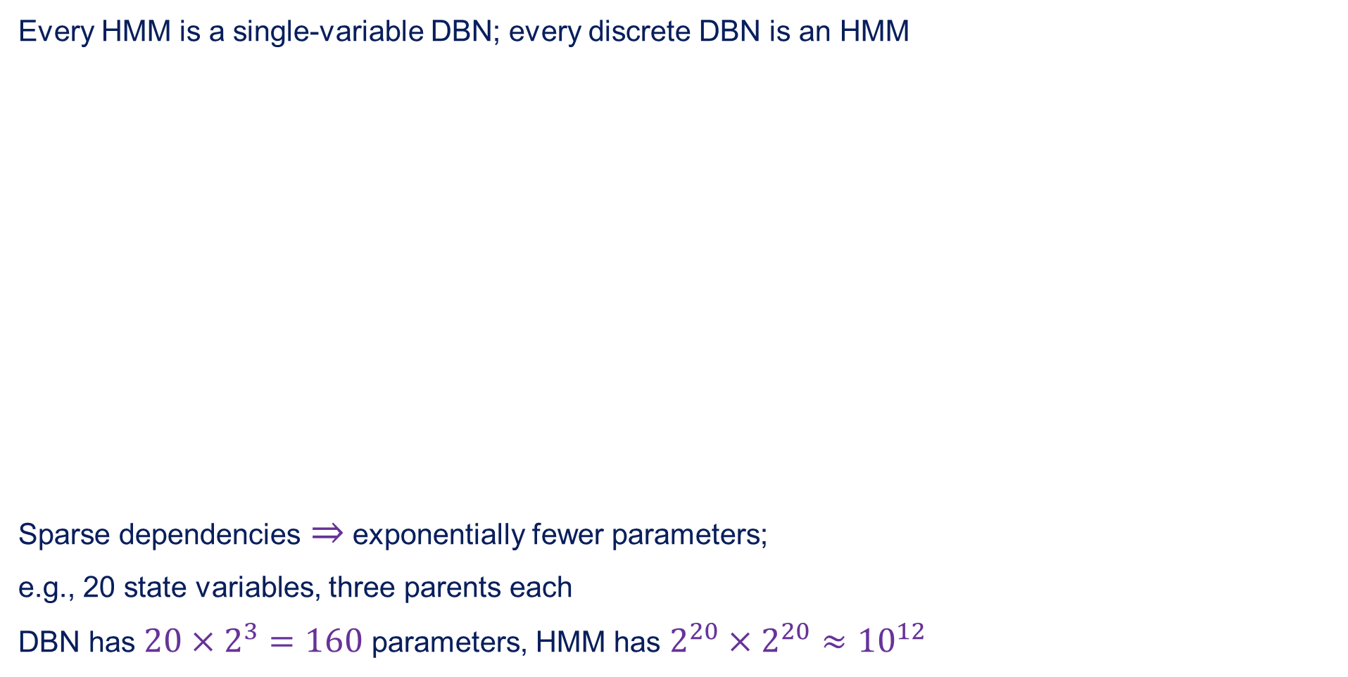
DBNs vs. HMMs
Every HMM is a single-variable DBN; every discrete DBN is an HMM
Sparse dependencies $⇒$ exponentially fewer parameters;
e.g., 20 state variables, three parents each
DBN has $20×2^{3}=160$ parameters, HMM has $2^{20}×2^{20}≈{10}^{12}$

Slide 25
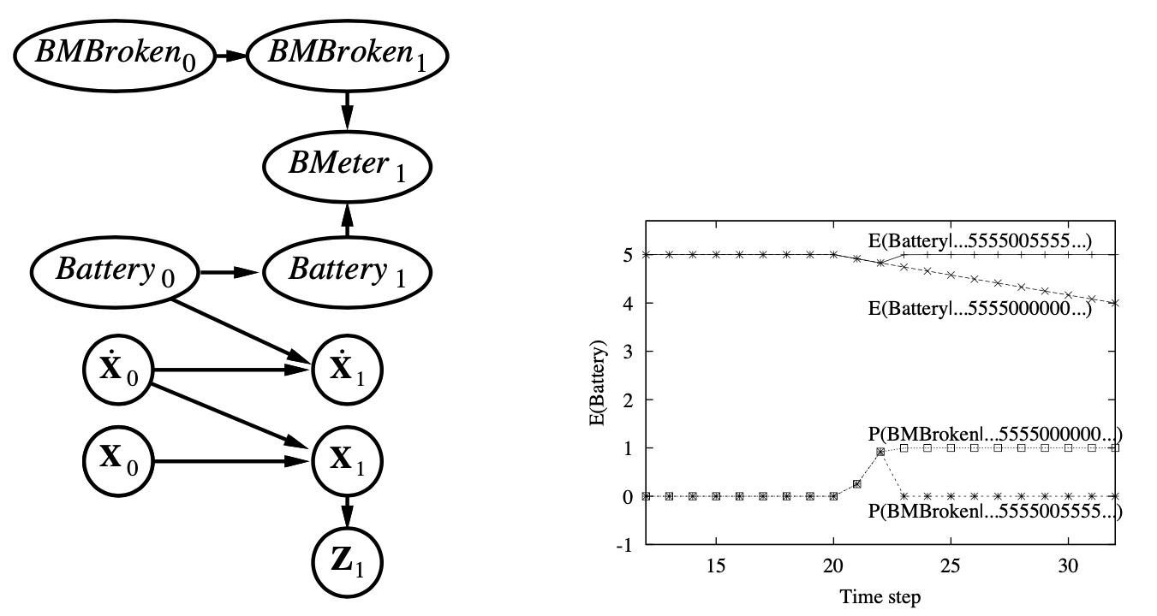
DBNs vs Kalman filters
Every Kalman filter model is a DBN, but few DBNs are KFs; real world requires non-Gaussian posteriors
e.g., where are bin Laden and my keys? What's the battery charge?

Slide 26
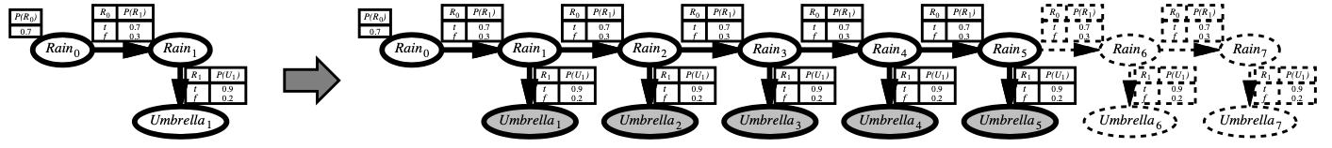
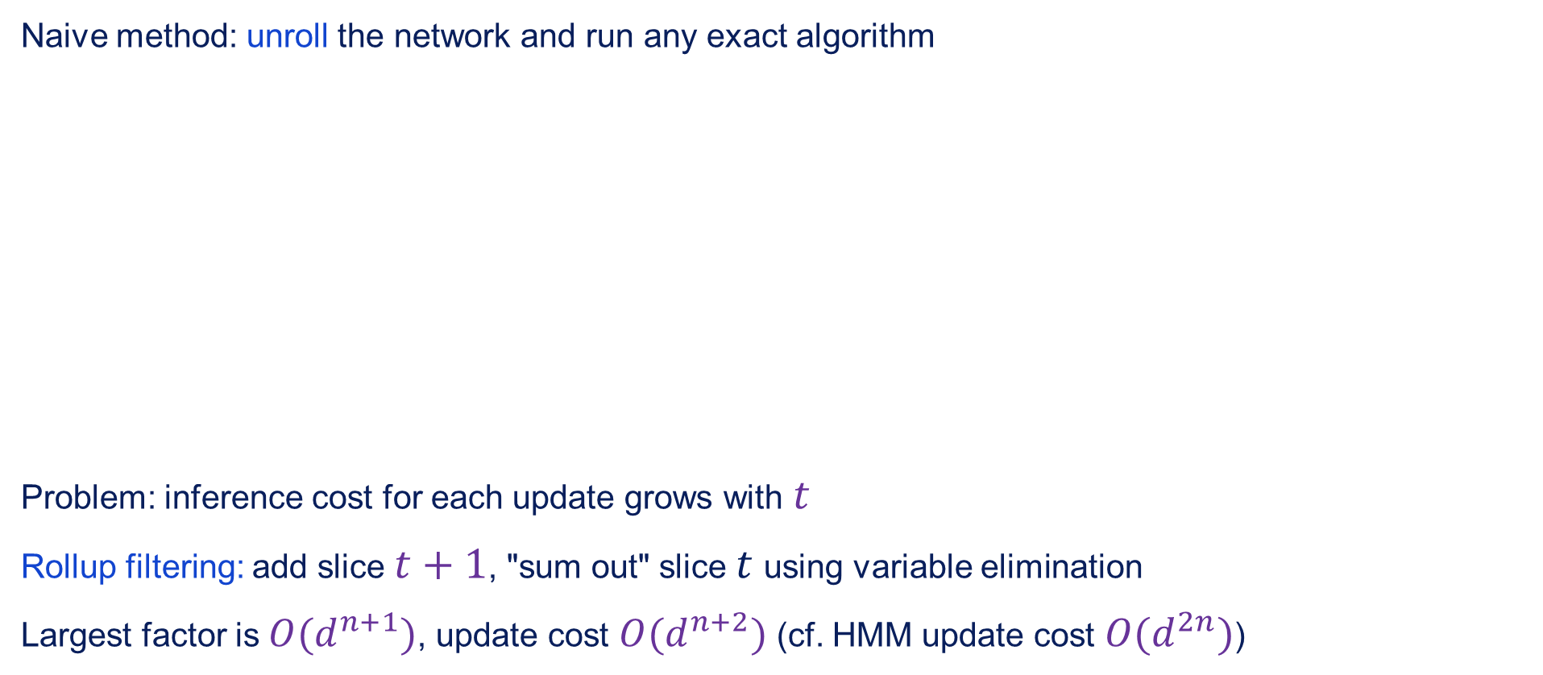
Exact inference in DBNs
Naive method: unroll the network and run any exact algorithm
Problem: inference cost for each update grows with $t$
Rollup filtering: add slice $t+1$, "sum out" slice $t$ using variable elimination
Largest factor is $O(d^{n+1})$, update cost $O(d^{n+2})$ (cf. HMM update cost $O(d^{2n})$)

Slide 27
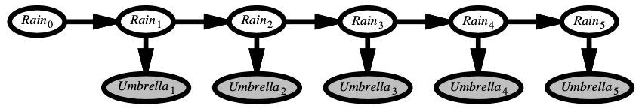


Likelihood weighting for DBNs
Set of weighted samples approximates the belief state
LW samples pay no attention to the evidence!
$⇒$ fraction "agreeing" falls exponentially with $t$
$⇒$ number of samples required grows exponentially with $t$

Slide 28


Particle filtering
Basic idea: ensure that the population of samples ("particles") tracks the high-likelihood regions of the state-space
Replicant particles proportional to likelihood for $e_{t}$
Widely used for tracking non-linear systems, esp. in vision
Also used fir simultaneous localisation and mapping in mobile robots ${10}^{5}$- dimensional state space

Slide 29


Particle filtering contd.
Assume consistent at time $t$: $N(x_{t}|e_{1:t})/N=P(x_{t}|e_{1:t})$
Propagate forward: populations of $x_{t+1}$ are
Weight samples by their likelihood for $e_{t+1}$:
Resample to obtain populations proportional to $W$:

Slide 30

Particle filtering performance
Approximation error of particle filtering remains bounded over time, at least empirically — theoretical analysis is difficult

Slide 31

Summary
Temporal models use state and sensor variables replicated over time
Markov assumptions and stationary assumption, so we need
Transition model $P(X_{t}|X_{t−1})$
Sensor model $P(E_{t}|X_{t})$
Tasks are filters, predictions, smoothing, most likely sequence:
All done recursively with constant cost per time step
Hidden Markov models have a single discrete state variable; used for speech recognition
Kalman filters allow $n$ state variables, linear Gaussian, $O(n^{3})$ update
Dynamic Bayes nets subsume HMMs, Kalman filters; exact update intractable
Particle filtering is a good approximate filtering algorithm for DBNs

