Slide 1
Planning
Lesson 19

Slide 2
Outline
Search vs. Planning
STRIPS operators
Partial-order planning

Slide 3
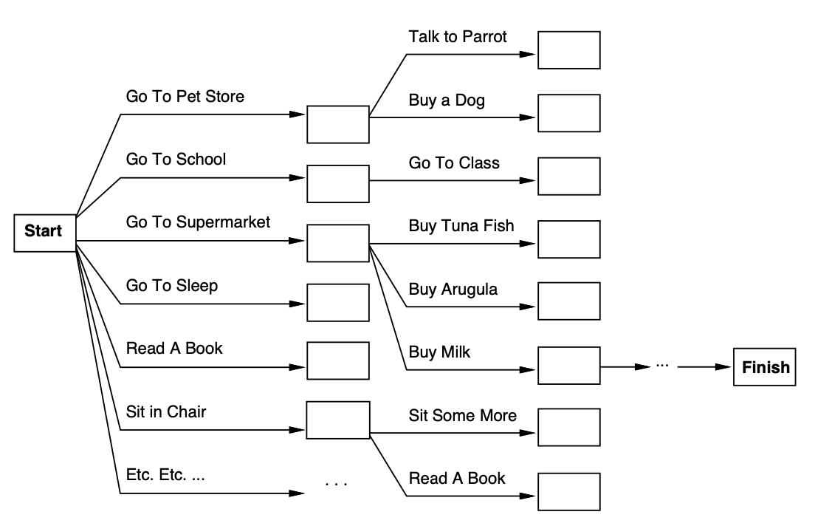
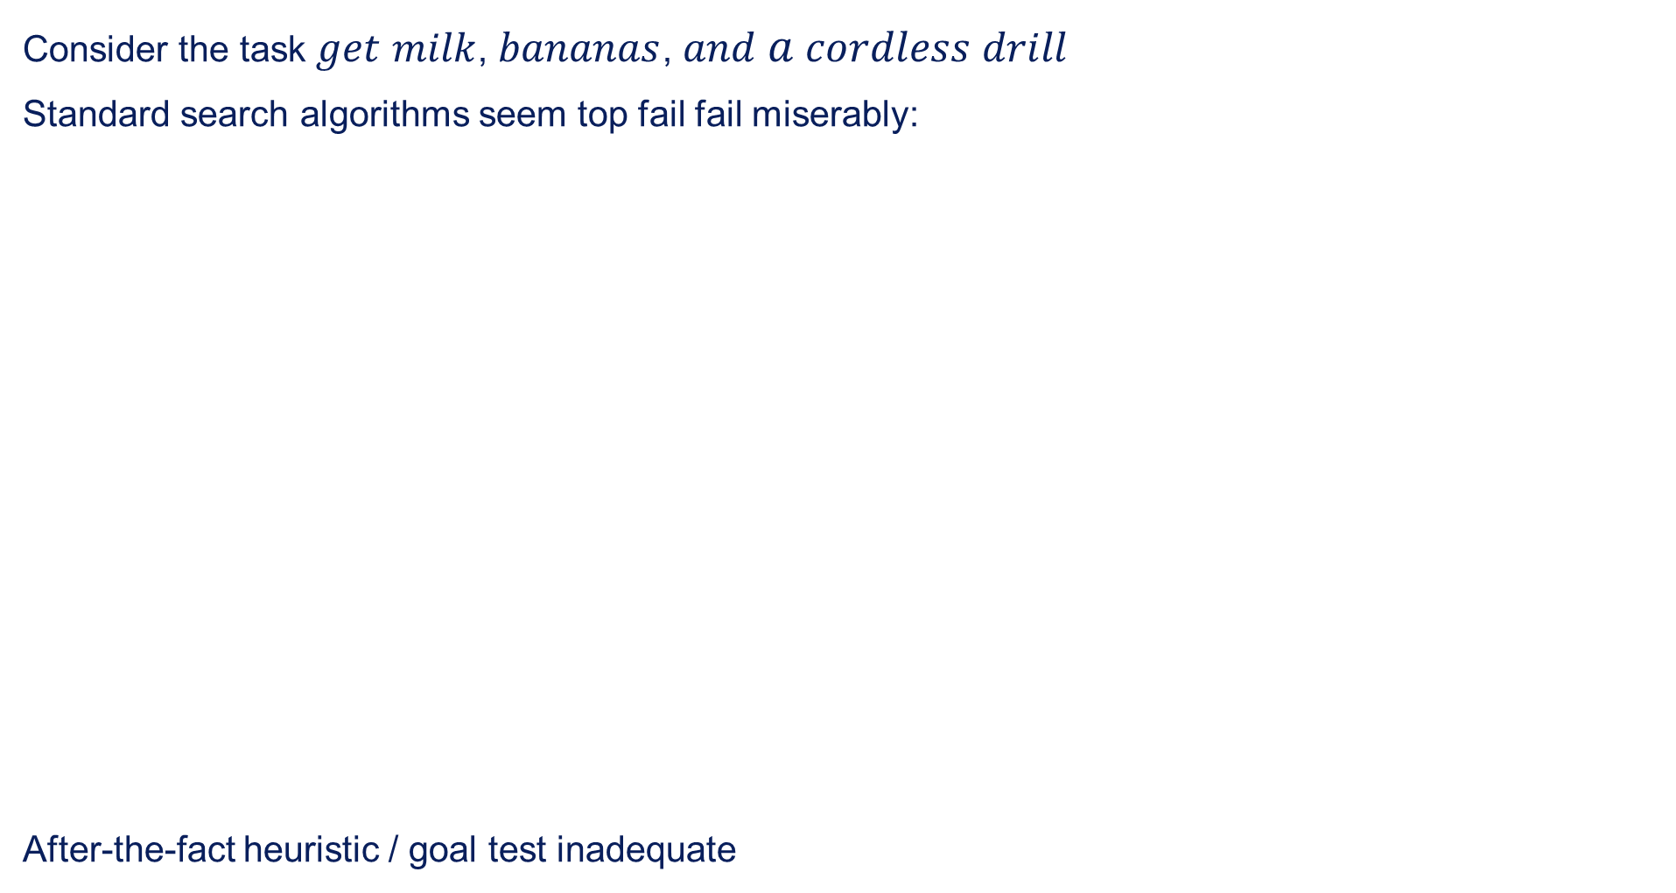
Search vs. Planning
Consider the task $get$ $milk$, $bananas$, $and$ $a$ $cordless$ $drill$
Standard search algorithms seem top fail fail miserably:
After-the-fact heuristic / goal test inadequate

Slide 4
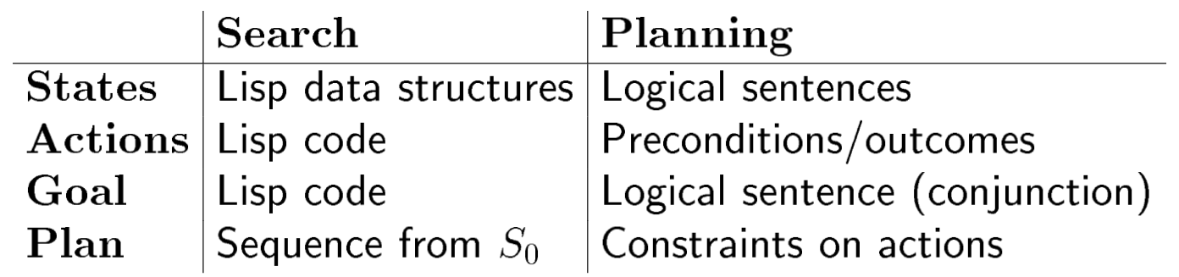
Search vs. Planning contd.
Planning systems do the following:
Open up action and goal representation to allow selection
Divide-and-conquer by subgoaling
Relax requirement for sequential construction of solutions

Slide 5
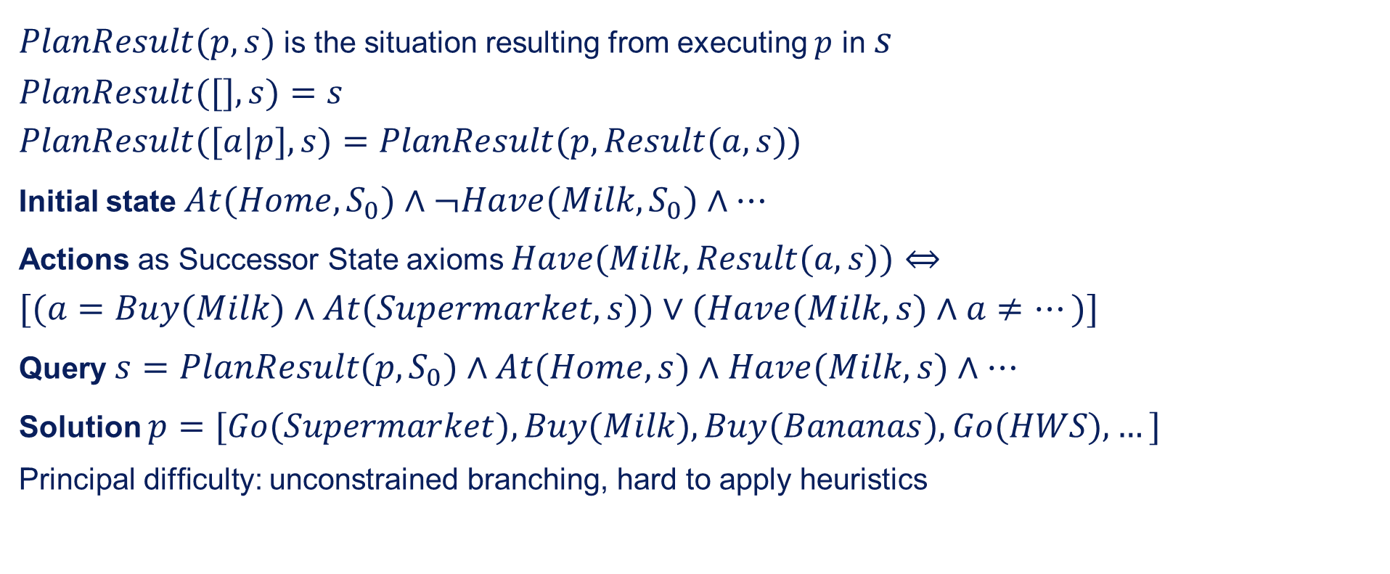
Planning in situation calculus
$PlanResult(p,s)$ is the situation resulting from executing $p$ in $s$
$$PlanResult([],s)=s$$
$$PlanResult([a|p],s)=PlanResult(p,Result(a,s))$$
Initial state $At(Home,S_{0})∧¬Have(Milk,S_{0})∧…$
Actions as Successor State axioms $Have(Milk,Result(a,s))⇔$
$$[(a=Buy(Milk)∧At(Supermarket,s))∨(Have(Milk,s)∧a≠…)]$$
Query $s=PlanResult(p,S_{0})∧At(Home,s)∧Have(Milk,s)∧…$
Solution $p=[Go(Supermarket),Buy(Milk),Buy(Bananas),Go(HWS),…]$
Principal difficulty: unconstrained branching, hard to apply heuristics

Slide 6
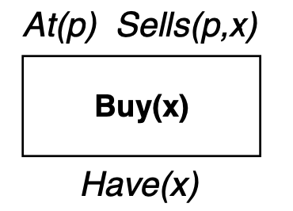
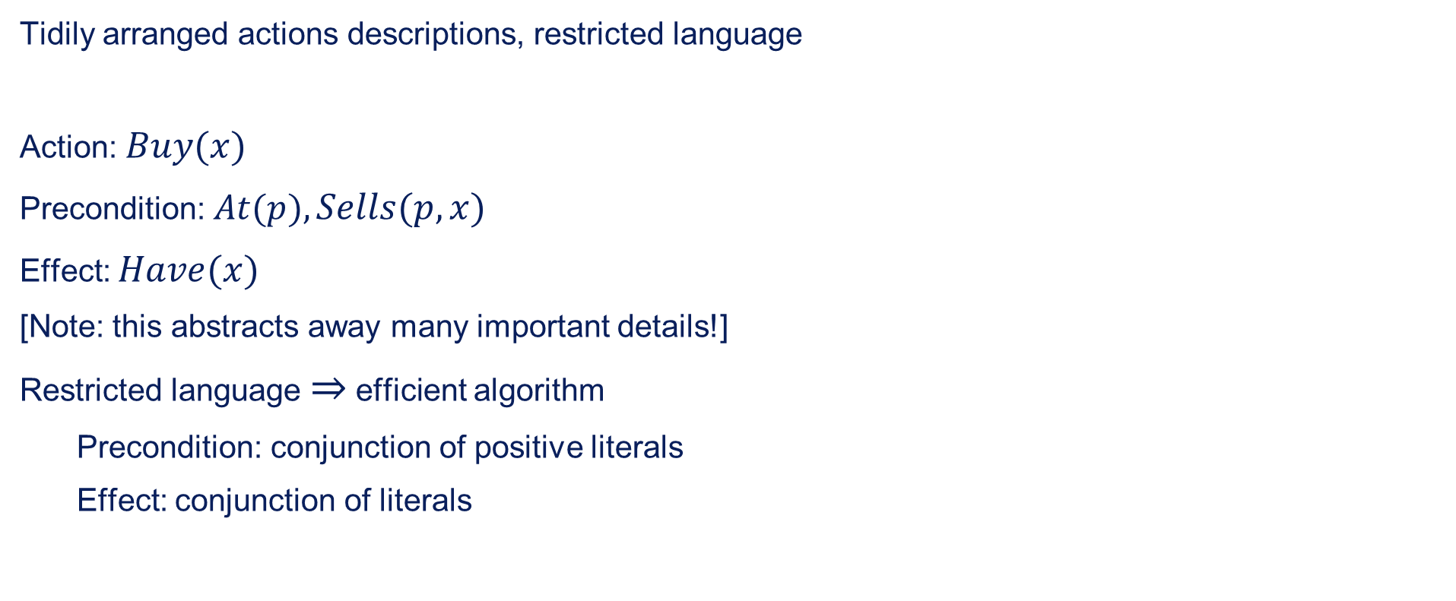
STRIPS operators
Tidily arranged actions descriptions, restricted language
Action: $Buy(x)$
Precondition: $At(p),Sells(p,x)$
Effect: $Have(x)$
[Note: this abstracts away many important details!]
Restricted language $⇒$ efficient algorithm
Precondition: conjunction of positive literals
Effect: conjunction of literals

Slide 7
State space vs. Plan space
Standard search: node = concrete world state
Planning search: node = partial plan
Defn: open condition is a precondition of a step not yet fulfilled
Operators on partial plans:
Add a link from an existing action to an open condition
Add a step to fulfil an open condition
Order one step wrt another
Gradually move from incomplete / vague plans to complete, correct plans

Slide 8
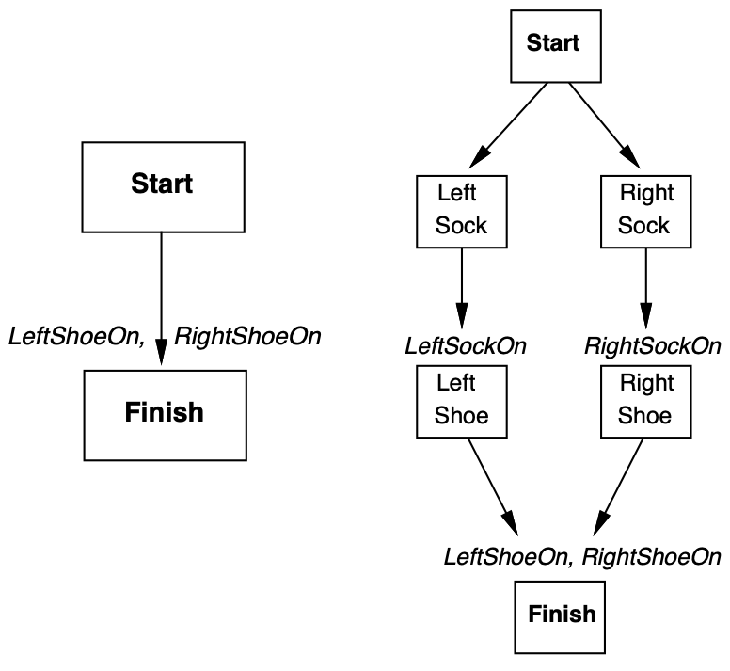
Partially ordered plans
A plan is complete iff every precondition is achieved
A precondition is achieved iff it is the effect of an earlier step and no possibly intervening step undoes it

Slide 9
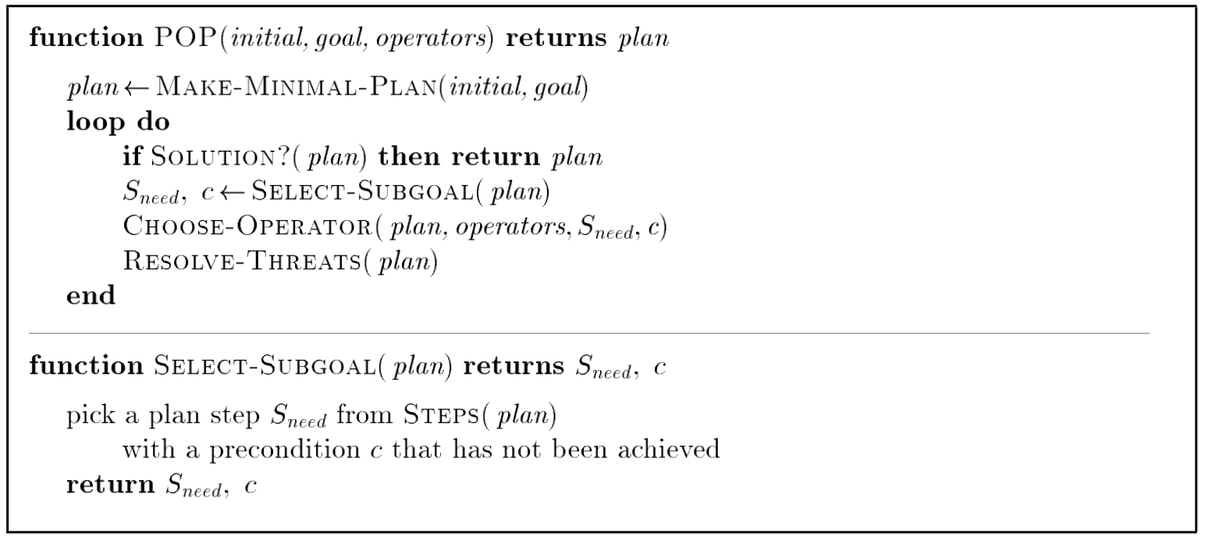
POP algorithm sketch

Slide 10
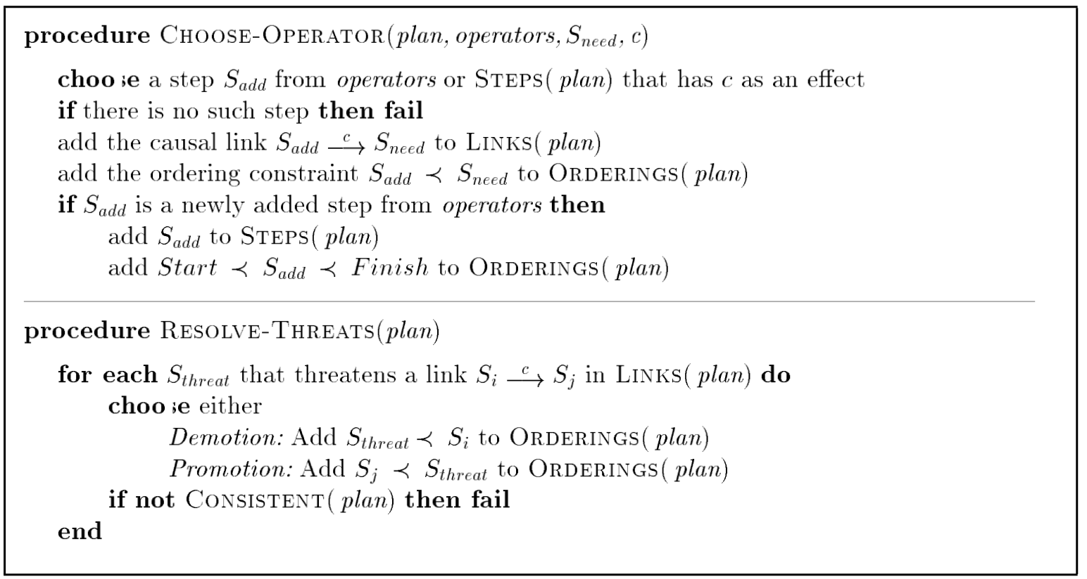
POP algorithm contd.
POP is sound, complete, and systematic (no repetition)
Extensions for disjunction, universals, negation, conditionals

Slide 11
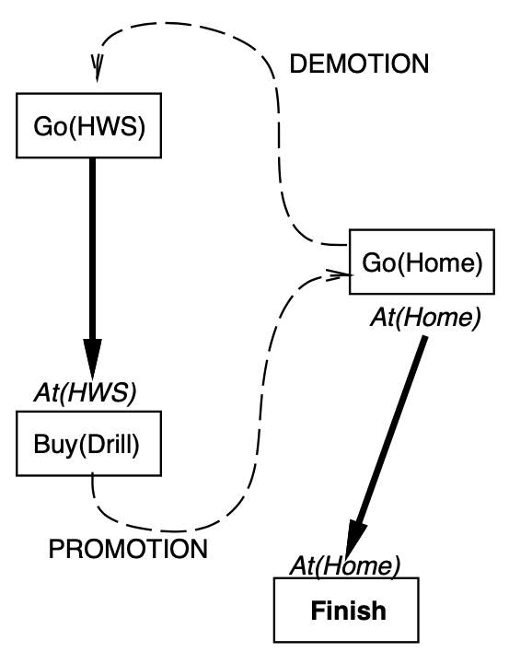

Clobbering and promotion / demotion
A clobberer is a potentially intervening step that destroys the condition achieved by a causal link.
E.g., $Go(Home)$ clobbers $At(HWS)$:
Demolition: put before $Go(HWS)$
Promotion: put after $Buy(Drill)$

Slide 12
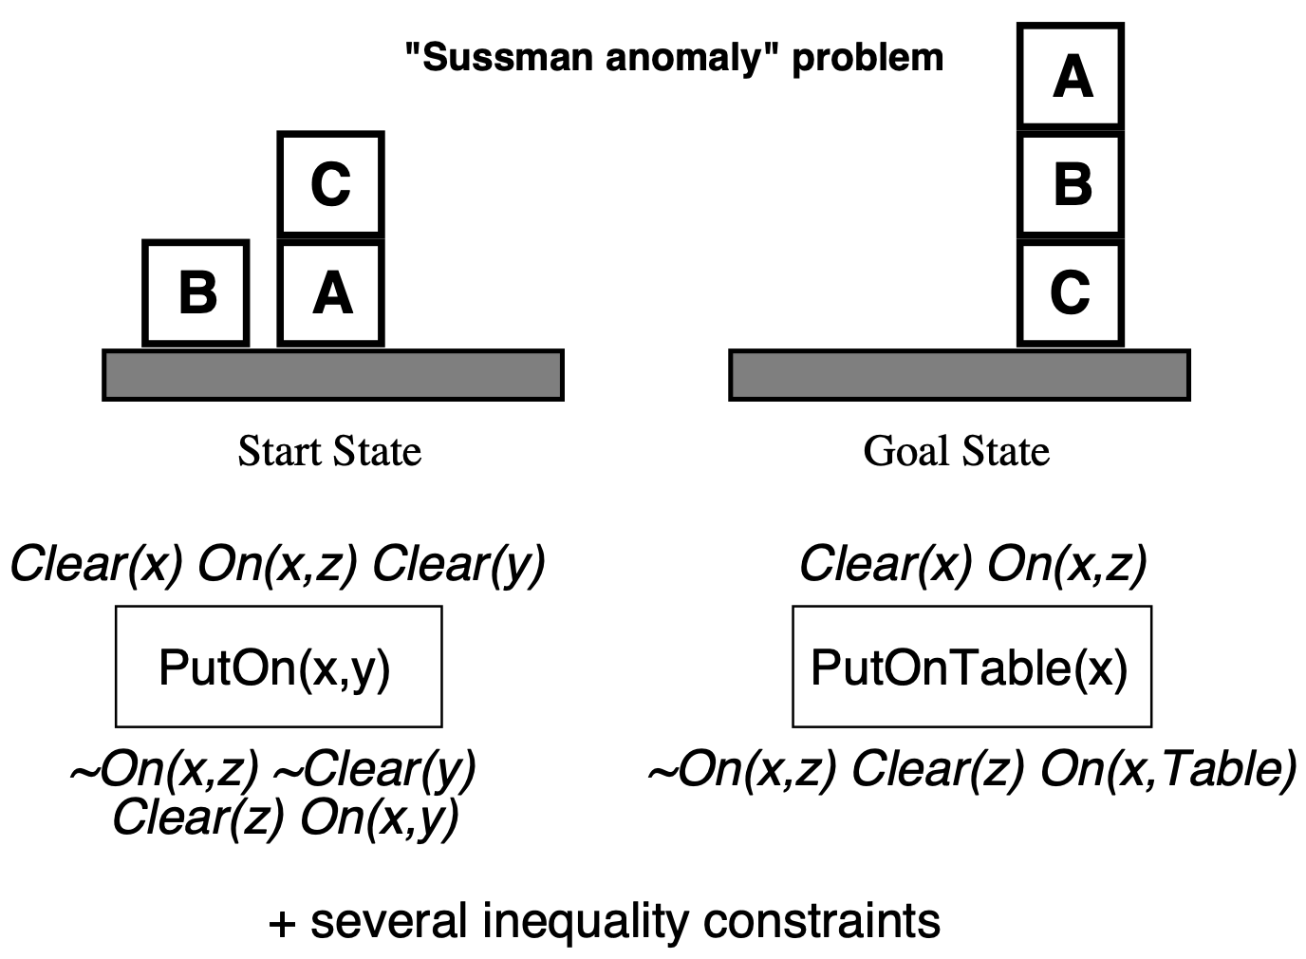
Example: Blocks world

Slide 13
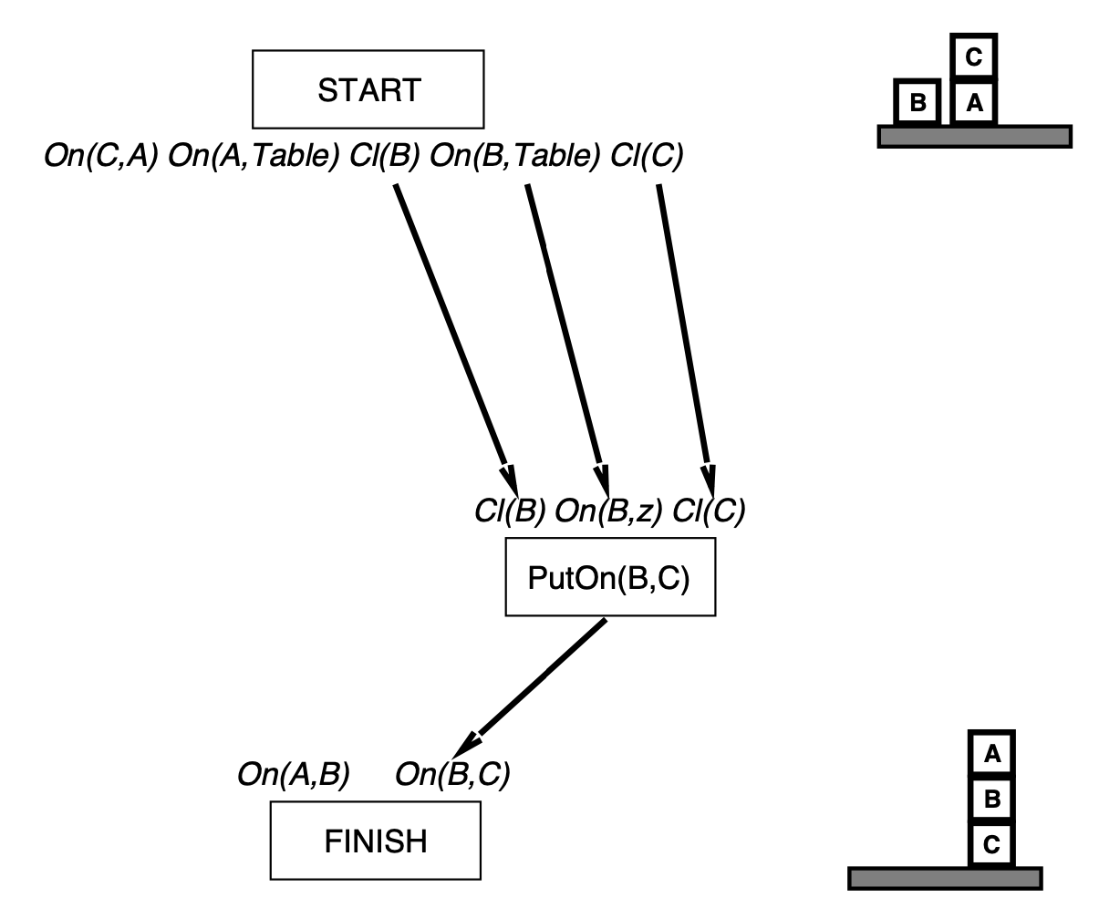
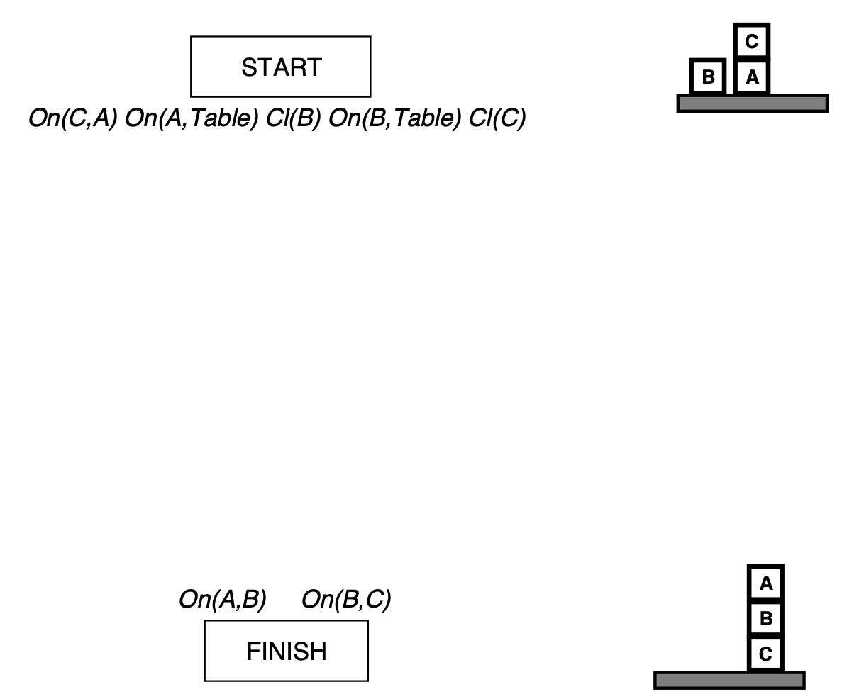
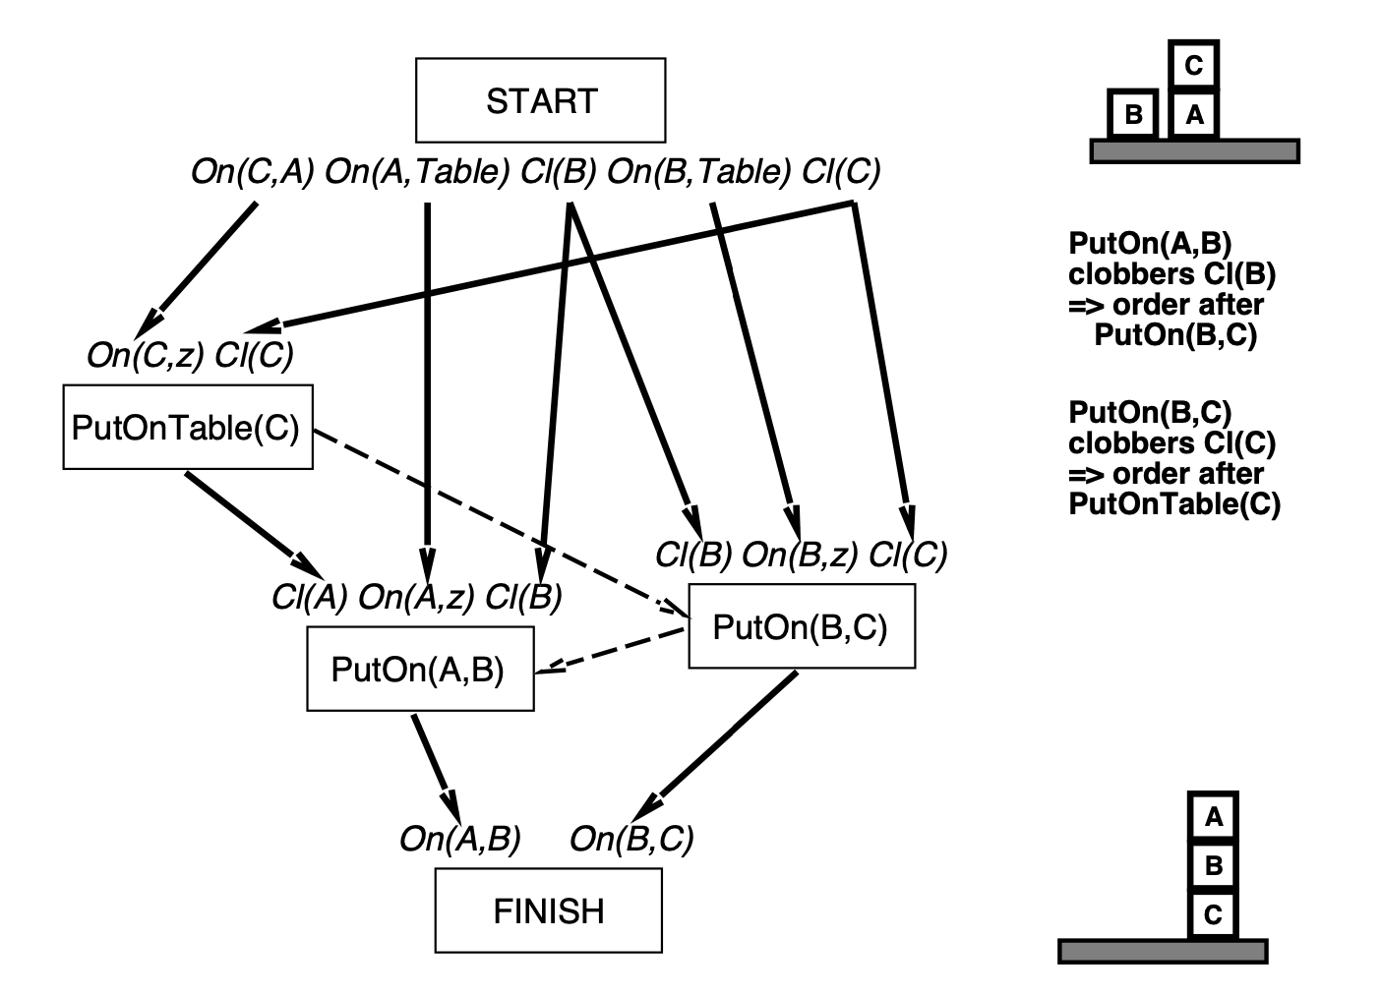
Example contd.

